Slide 1
Capstone Project 4
Customer Segmentation Team Member Suraj Kumar Shreya Ranjan

Slide 2
CUSTOMER SEGEMENTATION:
Customer segmentation is the practice of grouping the consumers of a firm into categories that represent the similarities among the customers in each category. In order to optimize each customer's value to the company, it is important to segment customers in order to determine how to interact with them.
Customer segmentation may enable marketers to reach out to each customer in the most efficient manner. A customer segmentation analysis enables marketers to accurately identify distinct groups of customers based on demographic, behavioral, and other factors by utilizing the vast amount of customer (and potential customer) data accessible.
Problem description:
In this project, your task is to identify major customer segments on a transnational data set which contains all the transactions occurring between 01/12/2010 and 09/12/2011 for a UK-based and registered non-store online retail. The company mainly sells unique all-occasion gifts. Many customers of the company are wholesalers.

Slide 3
Data Set:
1}Invoice No: Invoice number. Nominal, a six-digit integral number assigned to each transaction specifically. This code denotes a cancellation if it begins with the letter "c.".
2}Stock Code: Product (item) code. A 5-digit integral number known as the nominal is assigned to each unique product.
3}Description: Name of the Product (Item). Nominal.
4}Quantity: The number of each item (product) in each transaction. Numeric.
5}Invoice Date: Invoice Time and date. The day and time that each transaction was created, represented by a number.
6}Unit Price: Unit pricing. Numeric, Sterling unit price for the product.
7}CustomerID: Customer number. Nominal, a five-digit integral number assigned to every customer uniquely.
8}Country: Country name. Nominal, the name of the country in which each customer resides.

Slide 4
Data Pipeline
DATA PREPROCESSING
REMOVE DUPLICATE
EDA
FEATURE ENGENEERING
CORRELATION MATRIX
ANALYZINGNUMERICAL VALUES
UNSUPERVISED LEARNING MODEL
DATA SET INFORMATION
IMPORT DATASET

Slide 5



Libraries:
1}Pandas
2}Numpy
3}Seaborn
4}Matplotlib
5}Datetime
6}Sklearn
7}Scripy
8}Pretty table

Slide 6

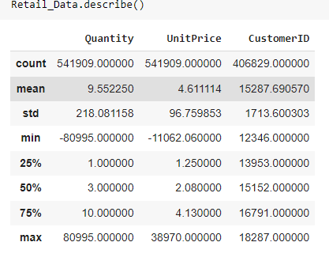
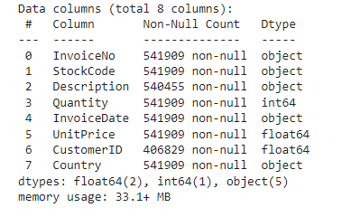
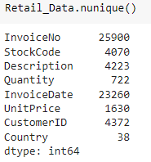
Data Wrangling:
Data Set Data Describe Data Info
Unique Data

Slide 7
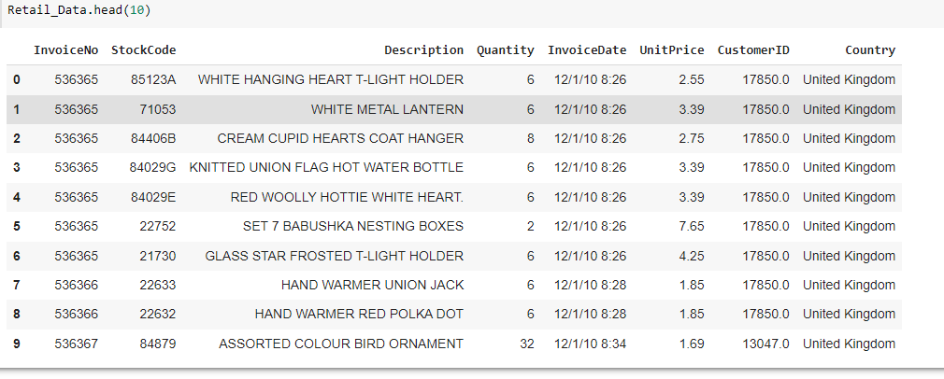
Data Wrangling(cont..)
Data Head

Slide 8
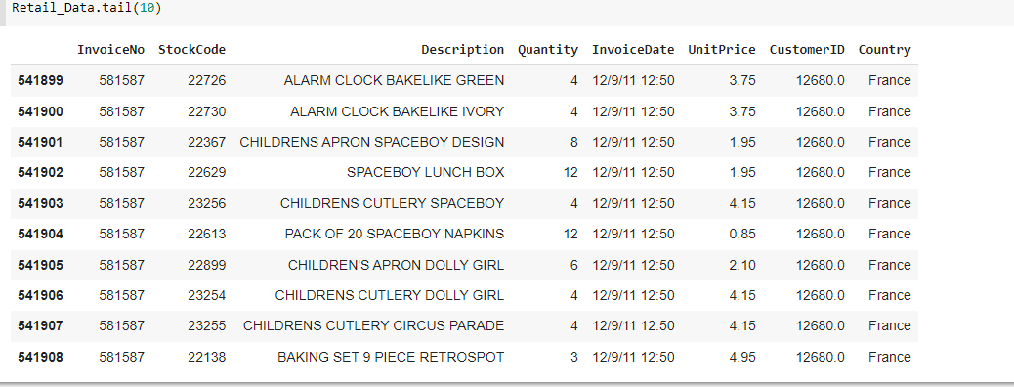
Data wrangling(cont..)
Data Tail

Slide 9
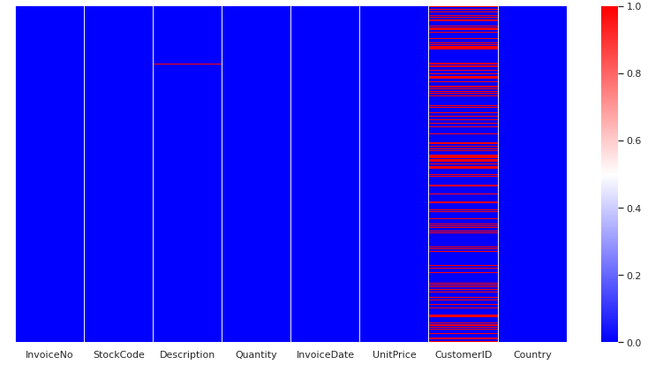
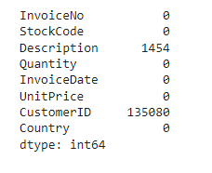
Data Pre-processing:
Null values Heat Map
Null values present in Description
and CustomerID column includes exactly
1454 and 135080 null values.
Shining red lines indicate null values.

Slide 10
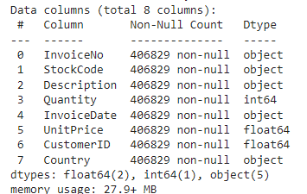
Data Pre-processing:
Data info after dropping null values.

Slide 11
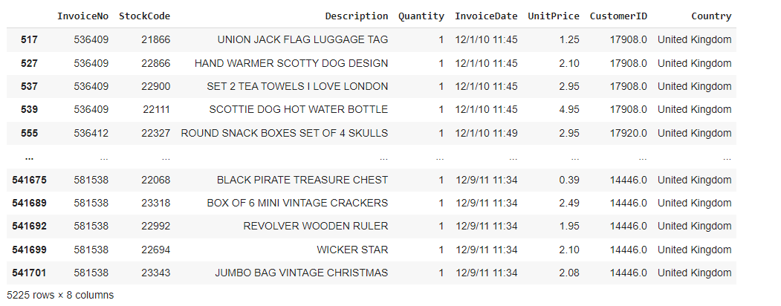
Duplicate data:

Slide 12
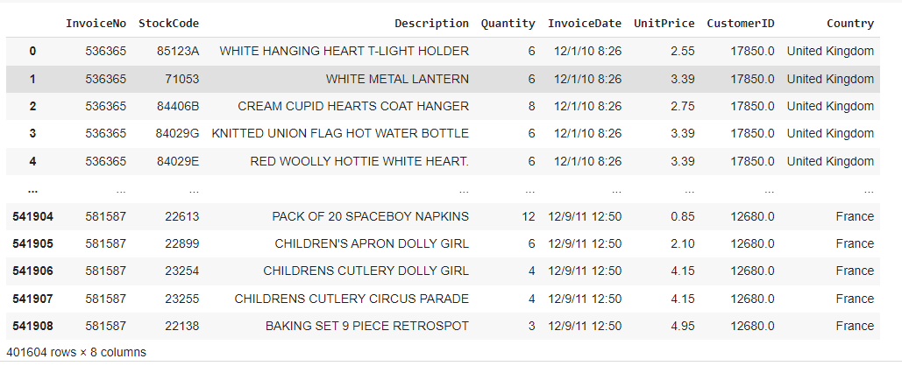
Dropping duplicate values:
After removing the duplicate values the shape of the dataset changes to(401604, 8)

Slide 13
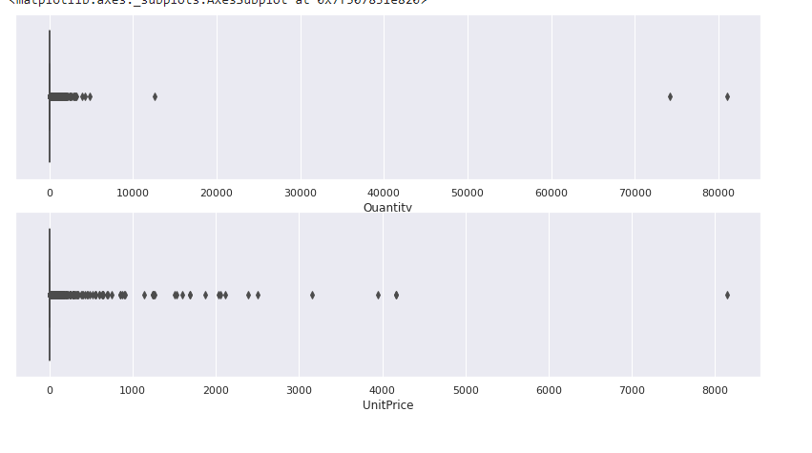
Outliners:

Slide 14
Exploratory data analysis(EDA):
Top 5 product based on maximum selling are :
WHITE HANGING HEART T-LIGHT HOLDER,
REGENCY CAKESTAND 3 TIER
JUMBO BAG RED RETROSPOT
PARTY BUNTING
LUNCH BAG RED RETROSPOT
Bottom 5 Product based on the selling are
RUBY GLASS CLUSTER EARRINGS
PINK CHRYSANTHEMUMS ART FLOWER
72 CAKE CASES VINTAGE CHRISTMAS
WALL ART , THE MAGIC FOREST
PAPER CRAFT , LITTLE BIRDIE

Slide 15
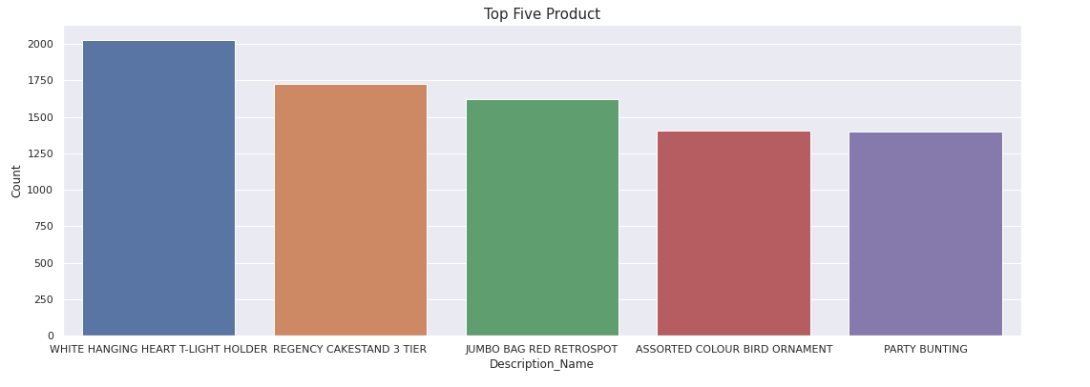
Visualization of Description:
Top 5 product:

Slide 16
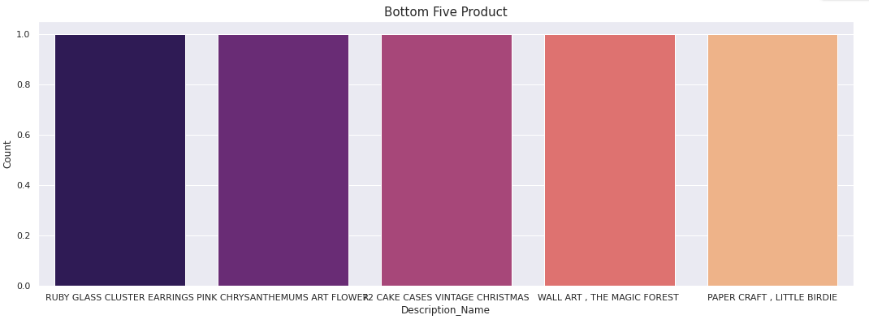
Bottom 5 product:

Slide 17
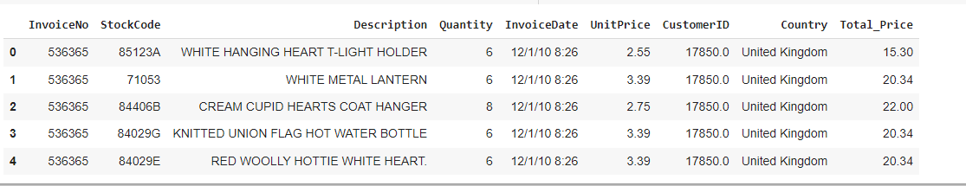
New column with the Total_Price paid by the customer:

Slide 18
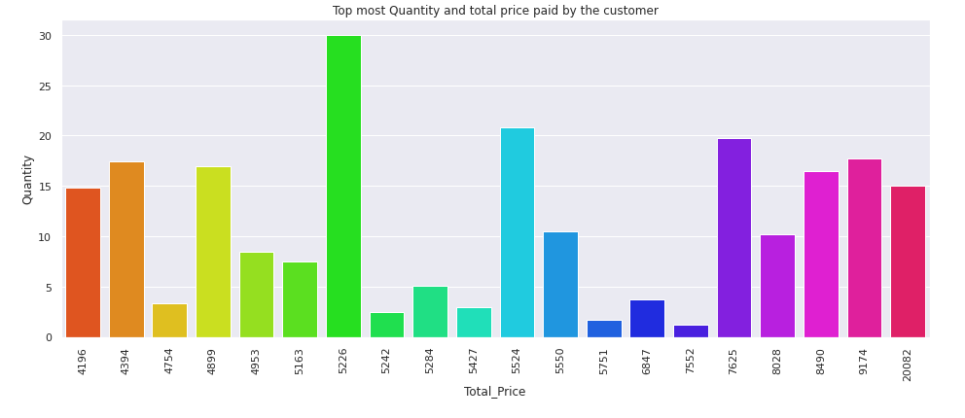
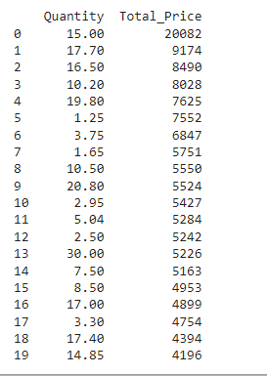
Top most Quantity and total price paid by the customer:

Slide 19
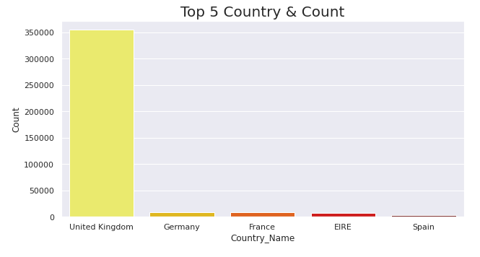
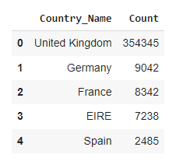
Country Analysis:
5 Highest transactions Countries:
From the above graph, it is clear that the United Kingdom has more transactions than other nations, indicating that it has a larger likelihood of making a purchase than Germany, France, Ireland, and Spain.

Slide 20
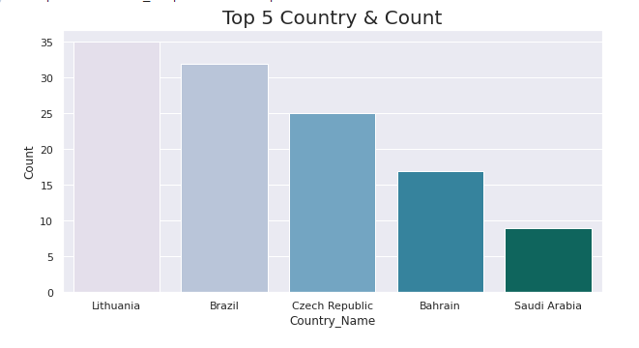
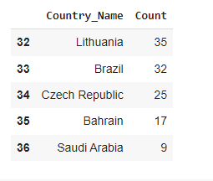
The Lowest 5 countries
The Saudi Arabia has the lowest purchasing history, so we won't concentrate more on these five nations while analyzing the consumer.

Slide 21
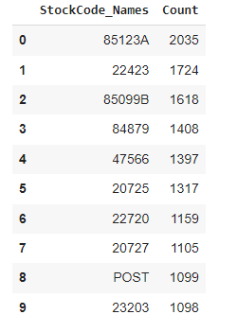
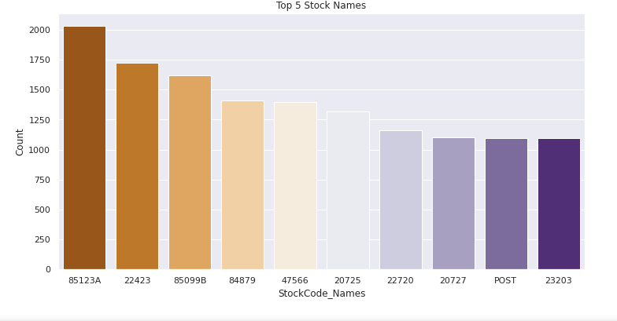
Stock Analysis:
StockCodes_Name with highest selling:
Top 10 Stock name based on selling

Slide 22
Feature engineering

Slide 23
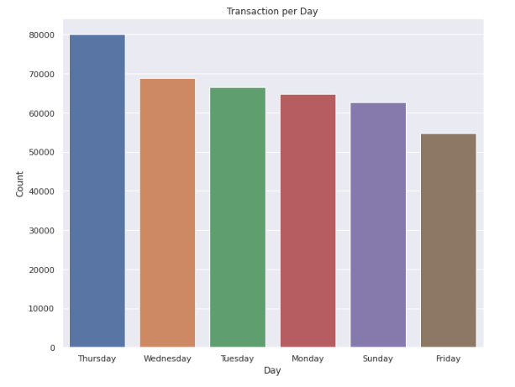
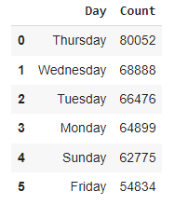
Transaction per day: From the above graph, it is clear that Thursday has higher transaction volume than the other days, possibly because clients are more available, and Friday has lower transaction volume.

Slide 24
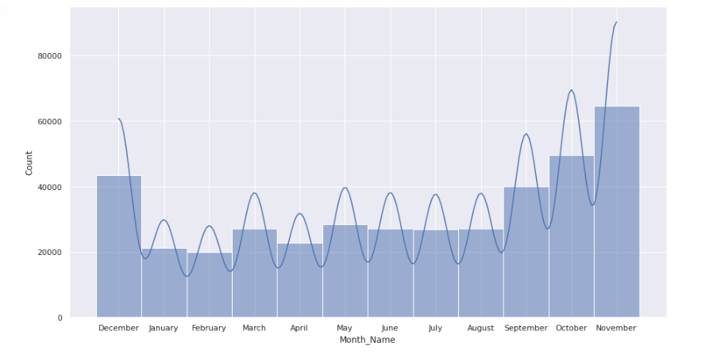
Purchasing Stats:
The above graph makes it clearly transparent that buyers are purchasing winter clothing and possibly even Diwali decorations in November, which is winter season.
Given that customers make fewer purchases in January and February and that the winter season is coming to an end, it is obvious that customers make more purchases during the winter.

Slide 25
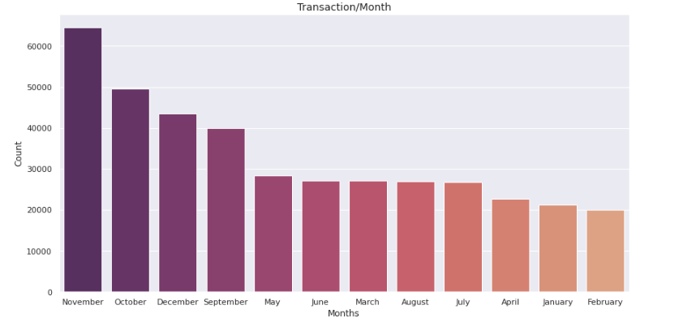
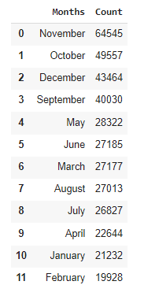
Transaction Per Month:

Slide 26
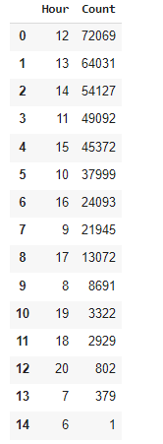
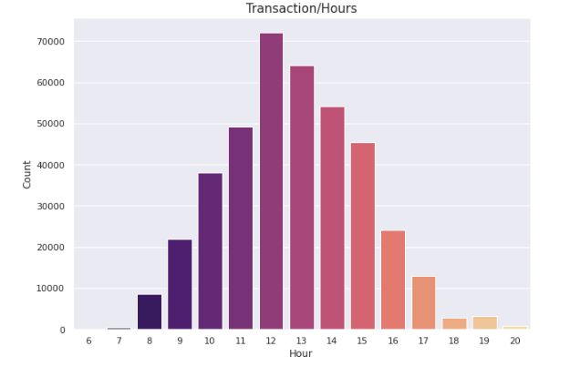
Transaction Per Hours:
According to hour, people do most of their shopping between the hours of 11 and 4, therefore practically all of them are free at this time.

Slide 27
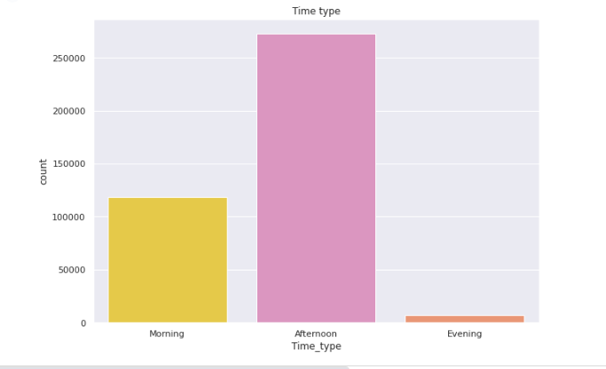
Distributing the day in Morning Afternoon and Evening
Most customers purchase things in the afternoon, followed by modest numbers of customers in the morning, and the smallest numbers of customers in the evening.

Slide 28
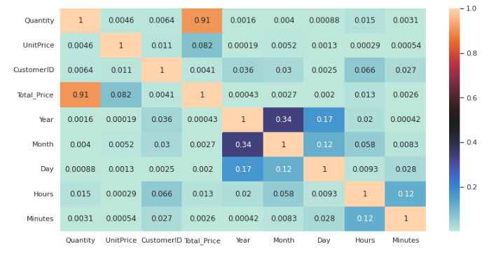
Correlation matrix:

Slide 29
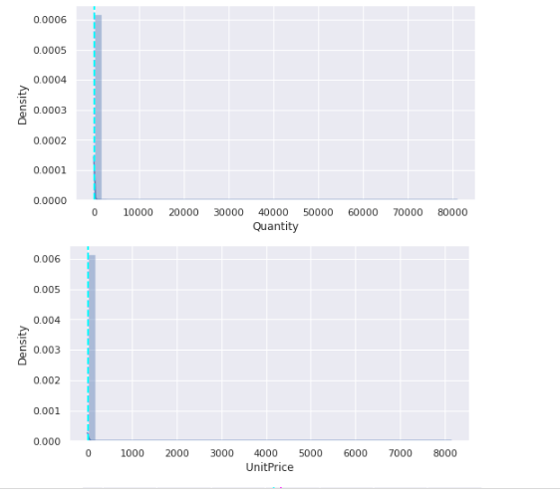
Numerical Features:
Distribution of all numerical variables:

Slide 30
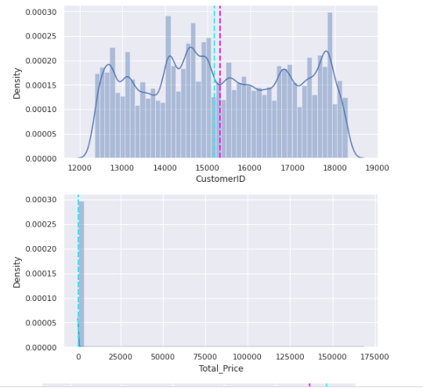

Slide 31
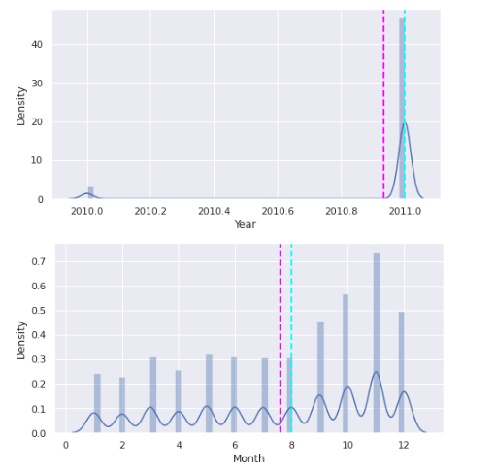

Slide 32
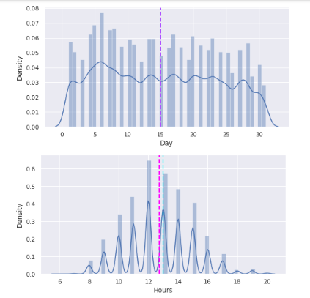
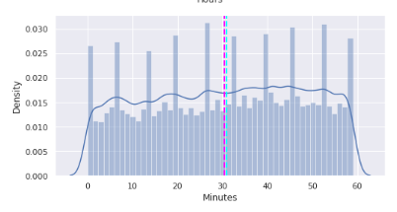

Slide 33
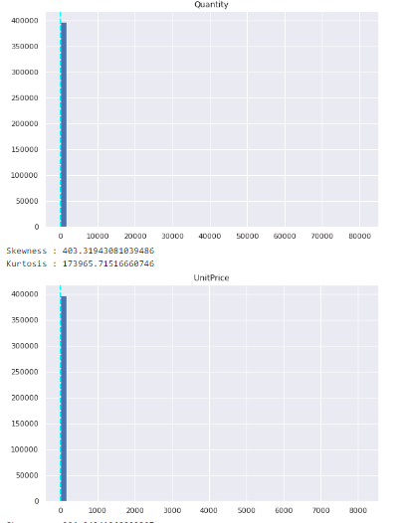
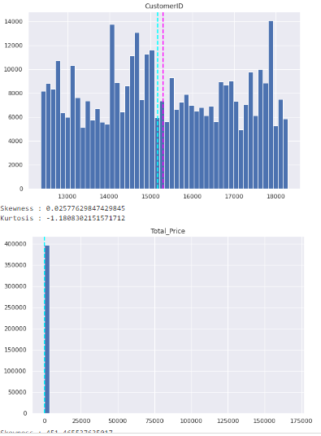
All numerical feature using histogram

Slide 34
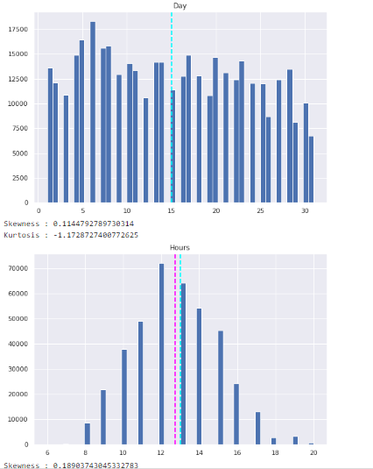
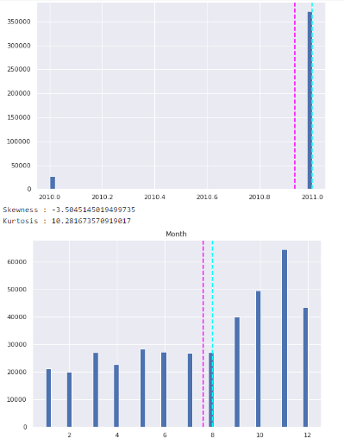

Slide 35
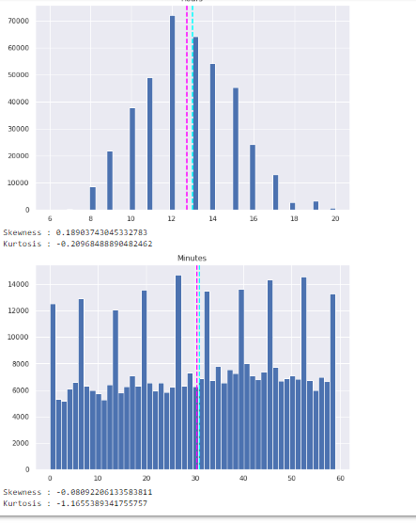

Slide 36
Recency, Frequency, Monetary (RFM) Model:
It is always required to establish several quantitative factors on which the algorithm will execute segmentation prior to using any clustering techniques. These include characteristics like the total amount spent, the customer's activity level, their most recent visit, etc.
One of the steps is the RFM model, which stands for Recency, Frequency, and Monetary. For each customer, we calculate the recency—the number of days since the customer's last visit—the frequency—how frequently they make repeat purchases—and the monetary—their overall spending.
There are other processes where we break each of these attributes into the appropriate groups and figure out a score for each client. However, since segmentation may be done manually, this strategy does not need machine learning algorithms. As a result, we will skip the second stage and use the rfm characteristics directly as input for clustering algorithms.
Recency :- Latest Date - Last Inovice Data
Frequency :-Count of Invoice No. of transactions
Monetary:- Sum of Total Amount for each customer

Slide 37
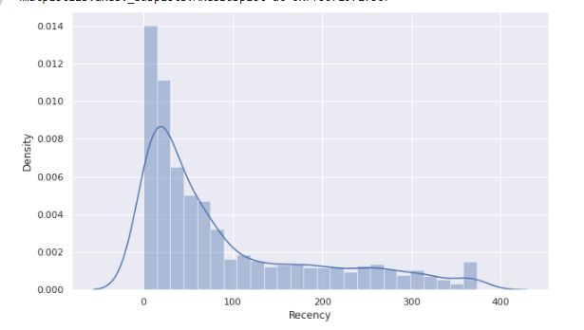
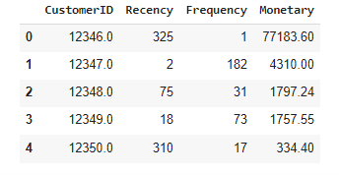
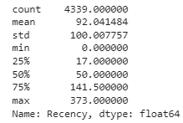
Descriptive Statistics:
Distribution Plot

Slide 38
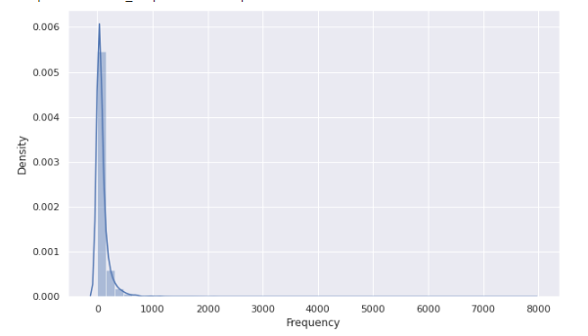
Descriptive Statistics (Frequency):

Slide 39
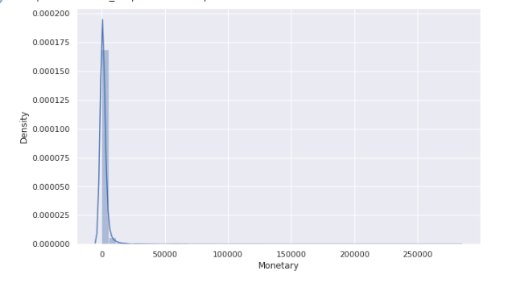
Descriptive Statistics (Monetary)

Slide 40
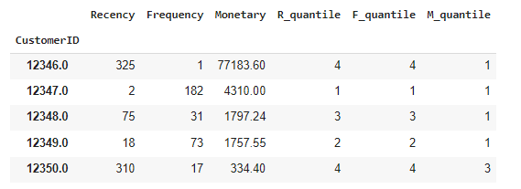
Computing Quantile of RFM values:
Customers are categorized as top customers based on their frequency, amount spent, and recency.
qcut() is a discretization function based on quantiles. Data is binned by qcut using sample quantiles. For instance, a categorical object representing quantile membership for each client would be produced from 1000 values for 4 quantiles.
Calculate & Add R, F and M segment value columns in the existing dataset to show R, F andM segment values:

Slide 41
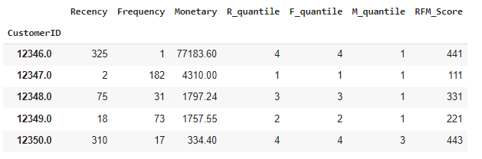
RFM Interpretation result:
Calculate and Add column showing total sum of RFMGroup values:

Slide 42
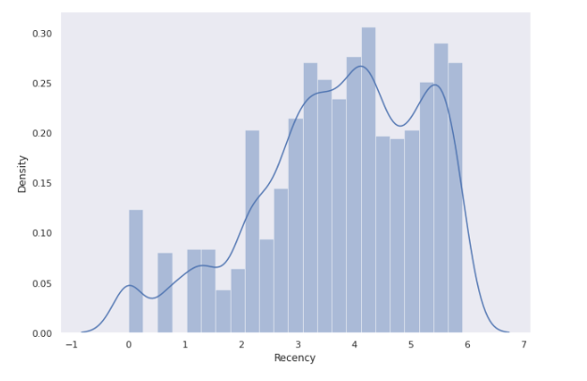
Log Transformation: Normalization for Recency, the distribution of data is as follows:

Slide 43
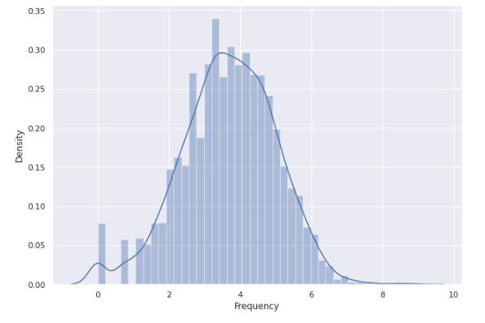
Normalization for Frequency, the distribution of data is as follows:

Slide 44

Normalization for Monetary, the distribution of data is as follows:

Slide 45
K- Means Clustering Implementation:
It can be summarized as the process of finding data subgroups where data points in the same subgroup (cluster) are extremely similar and other data points in other clusters are very different.
Finding Optimal Number of Clusters
There are two primary methods to define number of clusters:
Silhouette Score (math method)
Measures intra- and inter-cluster distance
Elbow criterion (visual method)
Plot number of clusters against within-cluster
sum-of- squared-errors (SSE) - sum of squared
distances from every data point to their cluster center

Slide 46

Silhouette Score:

Slide 47

Elbow Method on Recency and Monetary:
The graph for the sum of square distance values and Number of Clusters

Slide 48

Hyperparameter Tuning For the Best Value of K
Customer segmentation by taking k=2
When we separate customers by Recency and Monetary value, we can observe that they are well-separated.

Slide 49

Implementation of Density Based Spatial Clustering of Applications with Noise (DBSCAN):
DBSCAN on Recency and Monetary

Slide 50

Silhouette score method on Frequency and Monetary:
Silhouette score method on Frequency and Monetary

Slide 51

The graph for the sum of square distance values and Number of Clusters

Slide 52

Hyperparameter Tuning For Best Value of K

Slide 53

DBSCAN on Frequency and Monetary
DBSCAN method on Frequency and Monetary

Slide 54

Comparison between R vs M and F vs M
Plot R vs M and F vs M

Slide 55
Conclusion:
1}We performed consumer segmentation using a variety of steps throughout the analysis. Starting with data wrangling, we tried to deal with duplicates, null values, and feature updates. We then performed some exploratory data analysis in an effort to derive observations from the dataset's features.
2}Then, for each of the consumers, we developed some quantitative components, such as recency, frequency, and monetary data, known as the rfm model. On these features, we applied the KMeans clustering algorithm. To determine the ideal number of clusters, which was 2, we also performed silhouette and elbow method analyses.
3}Customers with low frequency and high value transactions were part of one cluster, while those with low frequency and high value transactions were part of another cluster.
4}There may be other adjustments made to this analysis, though. Depending on the goals and preferences of the firm, one may decide to cluster into a greater number. After clustering, the tagged feature can be put into supervised machine learning algorithms for classification that can forecast the classes for fresh sets of observations.
5}The clustering can also be done on a new set of features, such segmenting customers based on the times of their visits, determining customer lifetime value (CLV), and many more.

Slide 56
Thank you

