Slide 2

EXIT

Slide 3

EXIT

Slide 4

Customer Churn Prediction Using Machine Learning
This presentation explores the utilization of machine learning techniques to predict customer churn, emphasizing the methodology and its significance in identifying at-risk customers.
SHREYAS DASAN
Presenter

Slide 5



Understanding Customer Churn
Introduction
Customer Churn
Customer churn refers to the loss of clients or subscribers which negatively influences revenue generation.
Importance of Retention
In competitive business landscapes, retaining existing customers is essential for maintaining market position and profitability.
Key Points on Customer Retention
Machine Learning Benefits
Utilizing machine learning techniques can significantly enhance the accuracy of churn predictions and customer insights.

Slide 6
Objectives of Churn Prediction Model
Building a predictive model to mitigate churn costs using advanced machine learning techniques.
Importance of Churn Prediction
Churn leads to significant business losses; accurately predicting it helps businesses save costs and retain customers.
Model Aim and Development
The primary aim is to create a model that not only predicts churn but also supports proactive retention strategies for businesses.
Tools and Technologies Used
Key tools include Python, pandas for data manipulation, scikit-learn for building models, seaborn and matplotlib for visualization.

Slide 7
Description About the Data
Overview of Telecom Customer Churn Dataset
Source of the Data:
The dataset is sourced from Kaggle titled 'Telecom Customer Churn Insights'.

Slide 8
Description About the Data
Source of the Data:
The dataset is sourced from Kaggle titled 'Telecom Customer Churn Insights'.
Overview of Telecom Customer Churn Dataset
Dataset Size:
The dataset comprises 1,000 rows and 10 columns, providing a solid sample for analysis.

Slide 9
Description About the Data
Source of the Data:
The dataset is sourced from Kaggle titled 'Telecom Customer Churn Insights'.
Dataset Size:
The dataset comprises 1,000 rows and 10 columns, providing a solid sample for analysis.
Overview of Telecom Customer Churn Dataset
Types of Variables:
Contains both categorical and numerical variables, which are essential for churn prediction.

Slide 10
Description About the Data
Dataset Size:
The dataset comprises 1,000 rows and 10 columns, providing a solid sample for analysis.
Types of Variables:
Contains both categorical and numerical variables, which are essential for churn prediction.
Overview of Telecom Customer Churn Dataset
Key Columns:
Includes important columns like Age, Tenure, Gender, Contract Type, and Internet Service.

Slide 11
Description About the Data
Types of Variables:
Contains both categorical and numerical variables, which are essential for churn prediction.
Key Columns:
Includes important columns like Age, Tenure, Gender, Contract Type, and Internet Service.
Overview of Telecom Customer Churn Dataset
Dependent Variable:
The dependent variable in this analysis is 'Churn', which determines customer retention.

Slide 12
Description About the Data
Key Columns:
Includes important columns like Age, Tenure, Gender, Contract Type, and Internet Service.
Dependent Variable:
The dependent variable in this analysis is 'Churn', which determines customer retention.
Overview of Telecom Customer Churn Dataset
Independent Variables:
These variables include Age, Tenure, Gender, Contract Type, and Internet Service that influence Churn.

Slide 13
Description About the Data
Dependent Variable:
The dependent variable in this analysis is 'Churn', which determines customer retention.
Independent Variables:
These variables include Age, Tenure, Gender, Contract Type, and Internet Service that influence Churn.
Overview of Telecom Customer Churn Dataset

Slide 14
Key steps in preprocessing for Customer Churn Prediction
Data Cleaning
1
2
3
4
Missing Values
Filled 'InternetService' as Unknown
Duplicates
No duplicate records detected
Encoding
Converted categorical to numeric
Standardization
Applied StandardScaler to numerics (independent columns)

Slide 15

Model Optimization Techniques
Handling Class Imbalance
The dataset was skewed toward non-churners.
SMOTE was applied to balance the training data.
It generates synthetic examples
of the minority class.
Resulted in improved recall and
F1-score.

Slide 16

Model Optimization Techniques
Hyperparameter Tuning
Used GridSearchCV with cross-validation.
Tuned parameters like C, kernel, max_depth, n_neighbors, n_estimators.
Helped reduce overfitting and
improve accuracy.
Especially effective for SVM,
Random Forest, and KNN.
These optimization techniques helped improve model generalization, especially in identifying churners more accurately.

Slide 17




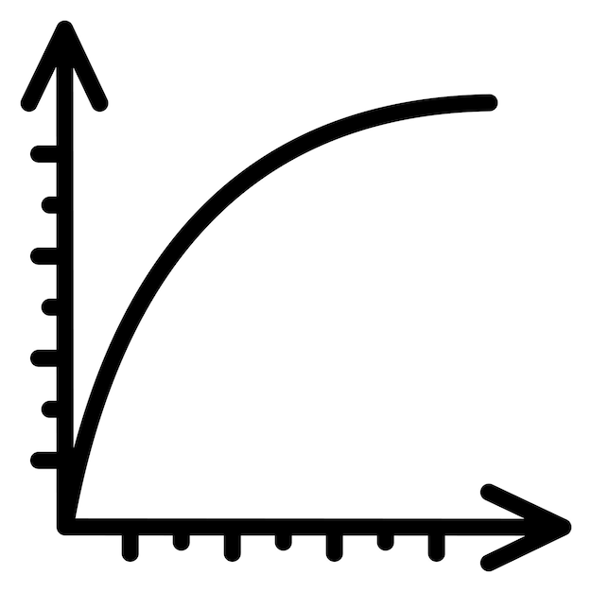
Model 1- LOGISTIC REGRESSION
90.50% Accuracy
99.37% Precision
89.77% Recall
0.9433 F-Score
0.9728 AUC-ROC
Observation: Reliable but outperformed by ensemble models.
Logistic Regression is a simple yet powerful linear model used for binary classification. It estimates the probability of churn by applying a sigmoid (S‑shaped) function to weighted input features.

Slide 18
Model 2- SUPPORT VECTOR MACHINE (SVM)
94.50% Accuracy
98.25% Precision
95.45% Recall
0.9683 F-Score
0.9804 AUC-ROC
Observation: Well-balanced model with strong generalization performance.
SVM finds the optimal boundary between churners and non-churners by maximizing the margin. Works well in high-dimensional and scaled data.

Slide 19
Model 3- DECISION TREE
97.50% Accuracy
98.86% Precision
98.30% Recall
0.9858 F-Score
0.9512 AUC-ROC
Observation: High-performing but prone to overfitting on training data.
Builds a flowchart-like structure to split data based on feature importance. Fast and interpretable but prone to overfitting without depth control.

Slide 20
Model 4- RANDOM FOREST
98.50% Accuracy
99.43% Precision
98.86% Recall
0.9915 F-Score
0.9949 AUC-ROC
Observation: Best overall performer with excellent accuracy and stability.
An ensemble of decision trees that reduces overfitting and increases accuracy. Aggregates predictions from multiple trees to improve reliability.

Slide 21
Model 5- K-NEAREST NEIGHBOUR (KNN)
91.00% Accuracy
98.77% Precision
90.91% Recall
0.9467 F-Score
0.9389 AUC-ROC
Observation: Consistent but slightly weaker in churn recall.
Classifies churn by looking at the 'k' most similar data points. Performance depends heavily on feature scaling and choice of 'k'.

Slide 22
Model 6- NAÏVE BAYES
81.00% Accuracy
100.0% Precision
78.41% Recall
0.8790 F-Score
0.9706 AUC-ROC
Observation: Fast but underperformed due to strong independence assumptions.
A probabilistic model assuming feature independence. Fast and simple, but less effective when features are correlated.

Slide 23

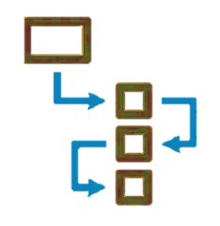


Key Takeaways from Churn Analysis
Summary of Findings and Insights
Churn Prediction System Built
Successfully developed a system leveraging various Machine Learning models for accurate churn predictions.
Best Model: Random Forest
Identified Random Forest as the most reliable and high-performing model in predicting customer churn.
Full Pipeline Learned
Acquired knowledge in essential processes: data cleaning, exploratory data analysis, modeling, SMOTE, and evaluation.
Business Insights Gained
Derived valuable business insights through the analysis of customer churn patterns and behaviors.

Slide 24


Slide 25
Consider implementing predictive analytics in your organization to proactively address customer churn and enhance retention strategies. This data-driven approach empowers teams to understand customer behavior, reduce losses, and drive informed decisions.
THANK YOU

