Slide 1
Q-learning

Slide 2
Q value
When an agent take action at in state st at time t,
the predicted future rewards is defined as Q(st,at).
Example)
a³t
Q³(st,at)=0
a²t
Q²(st,at)=1
…
…
rt
rt+1
rt+1
st
st+1
st+2
a¹t
at+1
at+2
Q¹(st,at)=2
Generally speaking, an agent should take action a¹_{t}
because the corresponding Q value Q¹(st,at) is max.

Slide 3
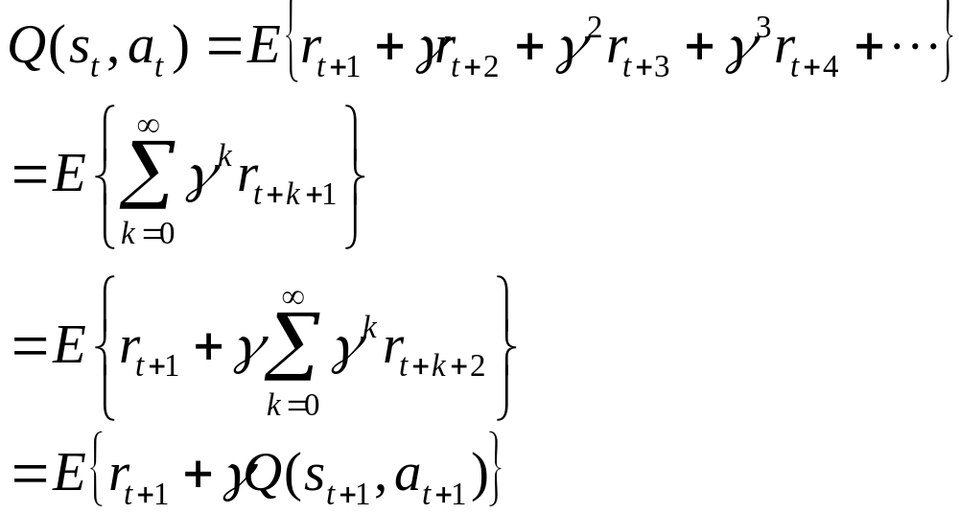

Q learning
First, Q value can be transformed as follows.
①
( ① )
As a result, the Q value at time t is easily calculated
by r_{t+1} and Q value of the next step.

Slide 4
Q learning
Q values is updated every step.
When an agent take action a_{t} in state s_{t},
and gets reward r, the Q value is updated as follows.
current value
target value
TD error
α: step size parameter (learning rate)

Slide 5
Q learning algorithm
Initialize Q(s,a) arbitrarily
Repeat (for each episode):
initialize s
Repeat (for each step of episode):
Choose a from s using policy derived from Q
(e.g., greedy, ε-greedy)
take action a, observe r, s’
s←s’;
until s is terminal

Slide 6


n- step return (reward)
1 step
(Q-learning)
2 step
n step
Monte Carlo
initial state
(time t)
…..
…..
Complete experience based method
Boot-strapping
...
…..
action
Terminal state
(time T)
state

Slide 7
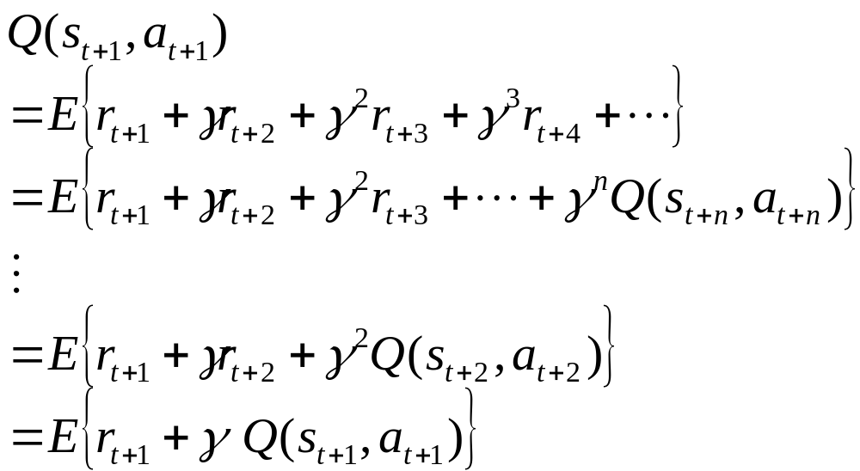
n- step return (reward)

Slide 8

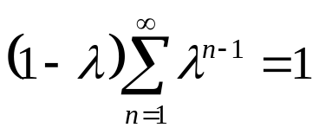


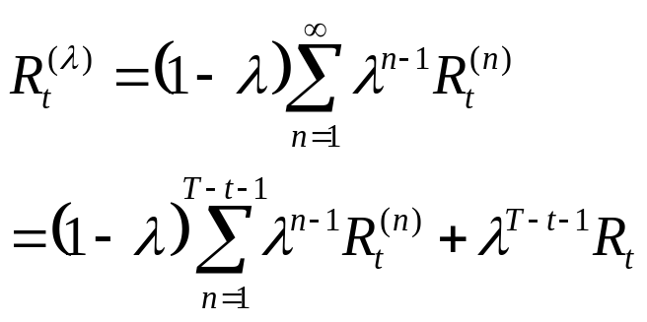


λ-return (trace-decay parameter)
1 step
2 step
3 step
n step
Monte Carlo
weight
…..
…..
...
…..
λ-return

Slide 9
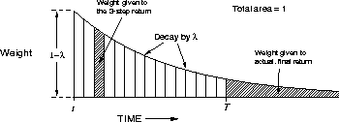
λ-return (trace-decay parameter)
3-step return

Slide 10
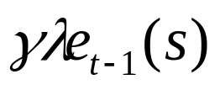
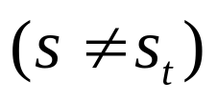
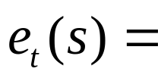
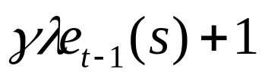
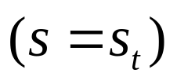

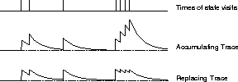
Eligibility trace and Replacing trace
Eligibility and Replacing traces is useful to calculate the n-step return
These traces show how often each state is visited.
Eligibility trace
replacing trace
Eligibility trace
Replacing trace

Slide 11

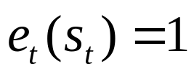

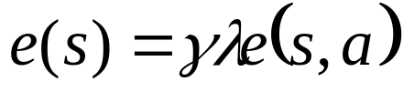
Q(λ) algorithm
Q-learning
Q(λ) with replacing trace
current value
target value
s_{t}
a_{t}
S_{t+1}
for all s,a
Q (s_{t} ,a_{t})

Slide 12
Q(λ) algorithm
Initialize Q(s,a) arbitrarily and e(s,a)=0, for all s, a
Repeat (for each episode):
Initialize s, a
Repeat (for each step):
take action a, observe r, s’
choose a’ from s’ using policy derived from Q (e.g., ε-greedy)
a*←arg max_{b} Q(s’,b) (if a’ ties for the max, then a*←a’)
δ←r+γQ(s’,a*)-Q(s,a)
e(s,a)←1
for all s, a:
Q(s,a)←Q(s,a)+αδe(s,a)
If a’=a*, then e(s,a)←γλe(s,a)
else e(s,a)← 0
s←s’; a←a’
until s is terminal

