Slide 1
Agenda
Decision Trees
What is ID3?
Entropy
Calculating Entropy with Code
Information Gain
Advantages and Disadvantages
Example

Slide 2
Decision Trees
Rules for classifying data using attributes.
The tree consists of decision nodes and leaf nodes.
A decision node has two or more branches, each representing values for the attribute tested.
A leaf node attribute produces a homogeneous result (all in one class), which does not require additional classification testing.

Slide 3



Decision Tree Example
Outlook
sunny
overcast
rain
Humidity
Yes
Windy
high
normal
true
false
No
Yes
No
Yes

Slide 4
What is ID3?
A mathematical algorithm for building the decision tree.
Invented by J. Ross Quinlan in 1979.
Uses Information Theory invented by Shannon in 1948.
Builds the tree from the top down, with no backtracking.
Information Gain is used to select the most useful attribute for classification.

Slide 5

Entropy
A formula to calculate the homogeneity of a sample.
A completely homogeneous sample has entropy of 0.
An equally divided sample has entropy of 1.
Entropy(s) = - p+log2 (p+) -p-log2 (p-) for a sample of negative and positive elements.
The formula for entropy is:

Slide 6
Entropy Example
Entropy(S) =
- (9/14) Log2 (9/14) - (5/14) Log2 (5/14)
= 0.940

Slide 7
Calculating Entropy with Code
Most programming languages and calculators do not have a log2 function.
Use a conversion factor
Take log function of 2, and divide by it.
Example: log10(2) = .301
Then divide to get log2(n):
log10(3/5) / .301 = log2(3/5)

Slide 8
Calculating Entropy with Code (cont’d)
Taking log10(0) produces an error.
Substitute 0 for (0/3)log10(0/3)
Do not try to calculate log10(0/3)

Slide 9
Information Gain (IG)
The information gain is based on the decrease in entropy after a dataset is split on an attribute.
Which attribute creates the most homogeneous branches?
First the entropy of the total dataset is calculated.
The dataset is then split on the different attributes.
The entropy for each branch is calculated. Then it is added proportionally, to get total entropy for the split.
The resulting entropy is subtracted from the entropy before the split.
The result is the Information Gain, or decrease in entropy.
The attribute that yields the largest IG is chosen for the decision node.

Slide 10
Information Gain (cont’d)
A branch set with entropy of 0 is a leaf node.
Otherwise, the branch needs further splitting to classify its dataset.
The ID3 algorithm is run recursively on the non-leaf branches, until all data is classified.

Slide 11
Advantages of using ID3
Understandable prediction rules are created from the training data.
Builds the fastest tree.
Builds a short tree.
Only need to test enough attributes until all data is classified.
Finding leaf nodes enables test data to be pruned, reducing number of tests.
Whole dataset is searched to create tree.

Slide 12
Disadvantages of using ID3
Data may be over-fitted or over-classified, if a small sample is tested.
Only one attribute at a time is tested for making a decision.
Classifying continuous data may be computationally expensive, as many trees must be generated to see where to break the continuum.

Slide 13
Example: The Simpsons

Slide 14










Person | Hair Length | Weight | Age | Class
Homer | 0” | 250 | 36 | M
Marge | 10” | 150 | 34 | F
Bart | 2” | 90 | 10 | M
Lisa | 6” | 78 | 8 | F
Maggie | 4” | 20 | 1 | F
Abe | 1” | 170 | 70 | M
Selma | 8” | 160 | 41 | F
Otto | 10” | 180 | 38 | M
Krusty | 6” | 200 | 45 | M
Comic | 8” | 290 | 38 | ?

Slide 15
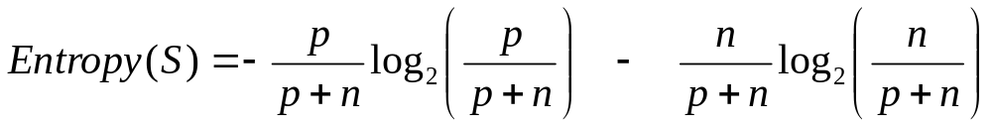
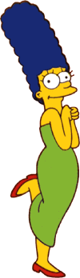


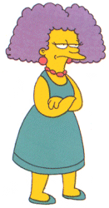
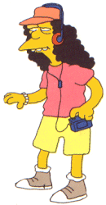
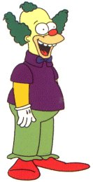
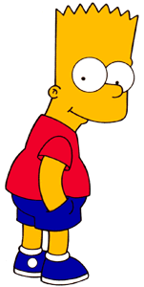

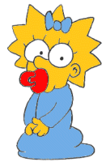
Entropy(4F,5M) = -(4/9)log₂(4/9) - (5/9)log₂(5/9)
= 0.9911
yes
no
Hair Length <= 5?
Let us try splitting on Hair length
Entropy(1F,3M) = -(1/4)log₂(1/4) - (3/4)log₂(3/4)
= 0.8113
Entropy(3F,2M) = -(3/5)log₂(3/5) - (2/5)log₂(2/5)
= 0.9710
Gain(Hair Length <= 5) = 0.9911 – (4/9 * 0.8113 + 5/9 * 0.9710 ) = 0.0911

Slide 16
Entropy(4F,5M) = -(4/9)log₂(4/9) - (5/9)log₂(5/9)
= 0.9911
yes
no
Weight <= 160?
Let us try splitting on Weight
Entropy(4F,1M) = -(4/5)log₂(4/5) - (1/5)log₂(1/5)
= 0.7219
Entropy(0F,4M) = -(0/4)log₂(0/4) - (4/4)log₂(4/4)
= 0
Gain(Weight <= 160) = 0.9911 – (5/9 * 0.7219 + 4/9 * 0 ) = 0.5900

Slide 17
Entropy(4F,5M) = -(4/9)log₂(4/9) - (5/9)log₂(5/9)
= 0.9911
yes
no
age <= 40?
Let us try splitting on Age
Entropy(3F,3M) = -(3/6)log₂(3/6) - (3/6)log₂(3/6)
= 1
Entropy(1F,2M) = -(1/3)log₂(1/3) - (2/3)log₂(2/3)
= 0.9183
Gain(Age <= 40) = 0.9911 – (6/9 * 1 + 3/9 * 0.9183 ) = 0.0183

Slide 18
Of the 3 features we had, Weight was best. But while people who weigh over 160 are perfectly classified (as males), the under 160 people are not perfectly classified… So we simply recurse!
yes
no
Weight <= 160?
This time we find that we can split on Hair length, and we are done!
yes
no
Hair Length <= 2?

Slide 19
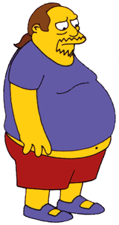
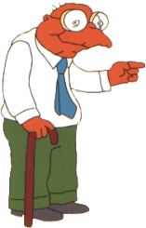

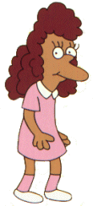
We need don’t need to keep the data around, just the test conditions.
Weight <= 160?
yes
no
How would these people be classified?
Hair Length <= 2?
Male
yes
no
Male
Female

Slide 20
It is trivial to convert Decision Trees to rules…
Weight <= 160?
yes
no
Hair Length <= 2?
Male
yes
no
Male
Female
Rules to Classify Males/Females
If Weight greater than 160, classify as Male
Elseif Hair Length less than or equal to 2, classify as Male
Else classify as Female

Slide 21
References
Quinlan, J.R. 1986, Machine Learning, 1, 81
http://dms.irb.hr/tutorial/tut_dtrees.php
http://www.dcs.napier.ac.uk/~peter/vldb/dm/node11.html
http://www2.cs.uregina.ca/~dbd/cs831/notes/ml/dtrees/4_dtrees2.html
Professor Sin-Min Lee, SJSU. http://cs.sjsu.edu/~lee/cs157b/cs157b.html

