Slide 1
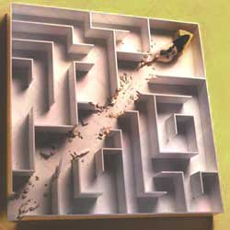
Reinforcement Learning
Source: T. Mitchell, Machine Learning, Chapter 13.

Slide 2
Overview
Supervised Learning: Immediate feedback (labels provided for every input).
Unsupervised Learning: No feedback (no labels provided).
Reinforcement Learning: Delayed scalar feedback (a number called reward).
RL deals with agents that must sense & act upon their environment.
This is combines classical AI and machine learning techniques.
It the most comprehensive problem setting.
Examples:
  A robot cleaning my room and recharging its battery
  Robot-soccer
  How to invest in shares
  Modeling the economy through rational agents
  Learning how to fly a helicopter
  Scheduling planes to their destinations
  and so on

Slide 3
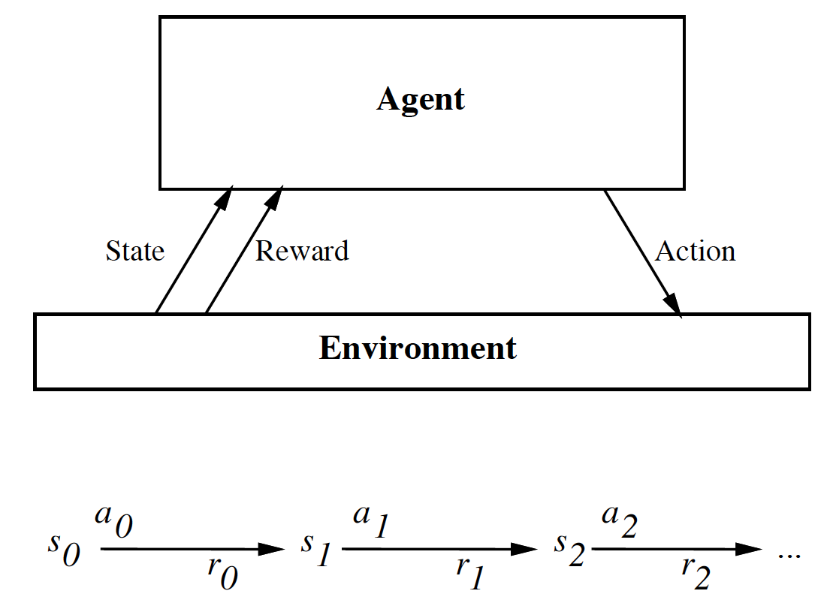
The Big Picture
Your action influences the state of the world which determines its reward

Slide 4
Complications
The outcome of your actions may be uncertain
You may not be able to perfectly sense the state of the world
The reward may be stochastic.
Reward is delayed (i.e. finding food in a maze)
You may have no clue (model) about how the world responds to your actions.
You may have no clue (model) of how rewards are being paid off.
The world may change while you try to learn it
How much time do you need to explore uncharted territory before you
exploit what you have learned?

Slide 5

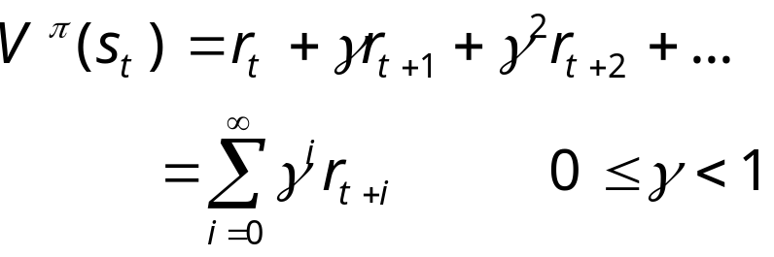
The Task
To learn an optimal policy that maps states of the world to actions of the agent.
I.e., if this patch of room is dirty, I clean it. If my battery is empty, I recharge it.
What is it that the agent tries to optimize?
Answer: the total future discounted reward:
Note: immediate reward is worth more than future reward.
What would happen to mouse in a maze with gamma = 0 ?

Slide 6


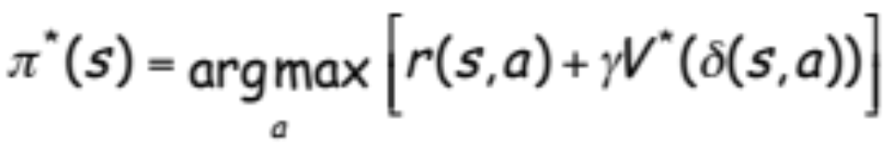


Value Function
Let’s say we have access to the optimal value function that computes the
total future discounted reward
What would be the optimal policy ?
Answer: we choose the action that maximizes:
We assume that we know what the reward will be if we perform action “a” in
state “s”:
We also assume we know what the next state of the world will be if we perform
action “a” in state “s”:

Slide 7
Example I
Consider some complicated graph, and we would like to find the shortest
path from a node Si to a goal node G.
Traversing an edge will cost you “length edge” dollars.
The value function encodes the total remaining
distance to the goal node from any node s, i.e.
V(s) = “1 / distance” to goal from s.
If you know V(s), the problem is trivial. You simply
choose the node that has highest V(s).
S_{i}
G

Slide 8
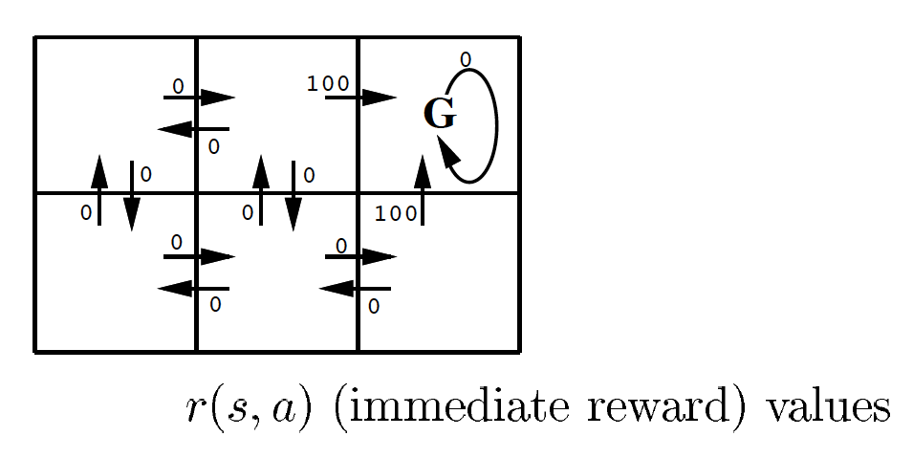
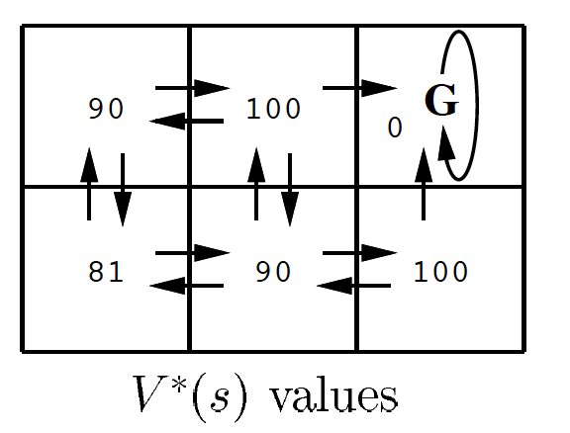
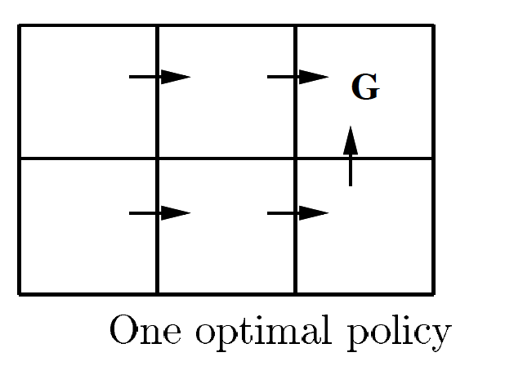
Example II
Find your way to the goal.

Slide 9

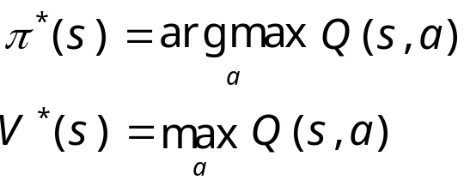
Q-Function
Bellman Equation:
One approach to RL is then to try to estimate V*(s).
However, this approach requires you to know r(s,a) and delta(s,a).
This is unrealistic in many real problems. What is the reward if a robot
is exploring mars and decides to take a right turn?
Fortunately we can circumvent this problem by exploring and experiencing
how the world reacts to our actions. We need to learn r & delta.
We want a function that directly learns good state-action pairs, i.e.
what action should I take in this state. We call this Q(s,a).
Given Q(s,a) it is now trivial to execute the optimal policy, without knowing
r(s,a) and delta(s,a). We have:

Slide 10
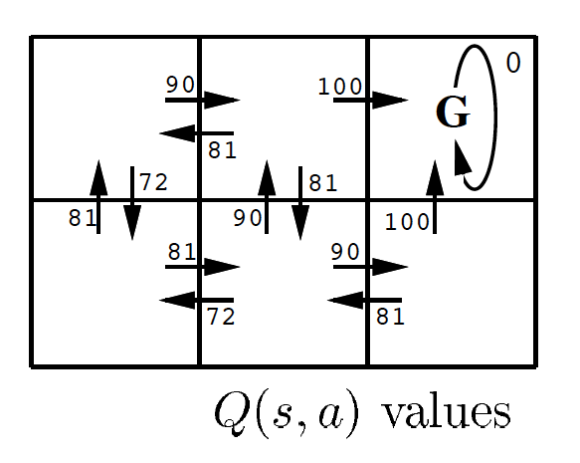
Example II
Check that

Slide 11
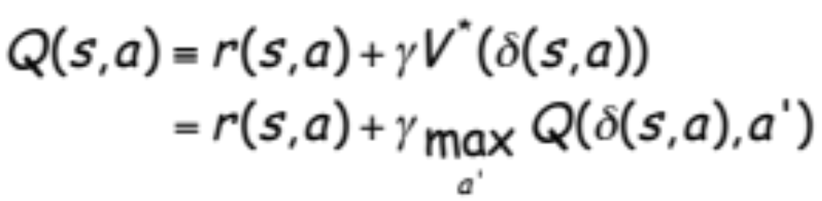
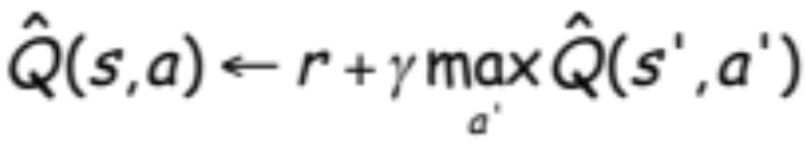
Q-Learning
This still depends on r(s,a) and delta(s,a).
However, imagine the robot is exploring its environment, trying new actions
as it goes.
At every step it receives some reward “r”, and it observes the environment
change into a new state s’ for action a.
How can we use these observations, (s,a,s’,r) to learn a model?
s’=s_{t+1}

Slide 12
Q-Learning
s’=s_{t+1}
This equation continually estimates Q at state s consistent with an estimate
of Q at state s’, one step in the future: temporal difference (TD) learning.
Note that s’ is closer to goal, and hence more “reliable”, but still an estimate itself.
Updating estimates based on other estimates is called bootstrapping.
We do an update after each state-action pair. I.e., we are learning online!
We are learning useful things about explored state-action pairs. These are typically
most useful because they are likely to be encountered again.
Under suitable conditions, these updates can actually be proved to converge to the
real answer.

Slide 13
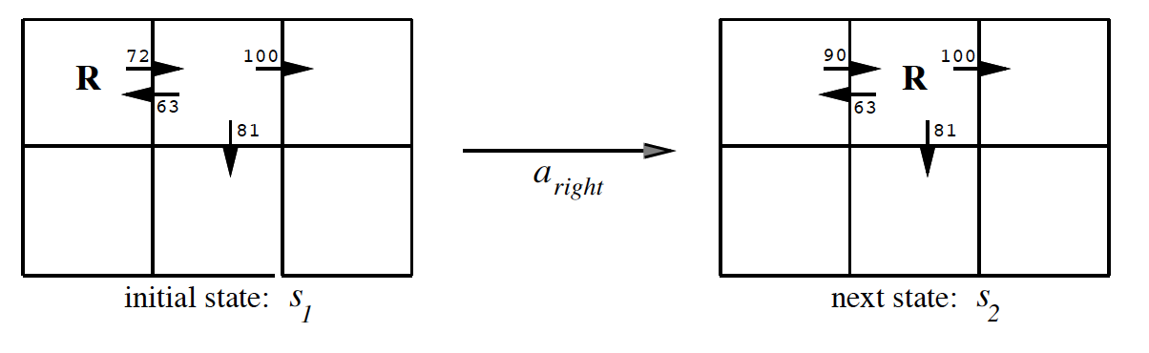
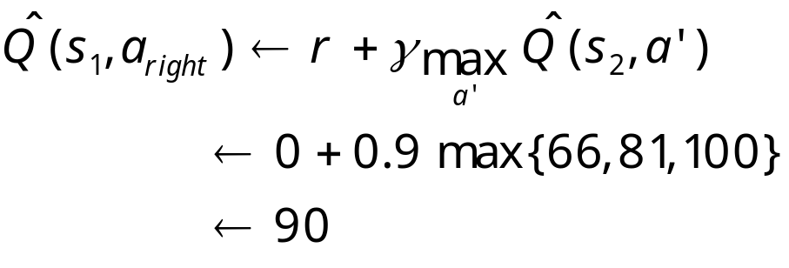
Example Q-Learning
Q-learning propagates Q-estimates 1-step backwards

Slide 14

Exploration / Exploitation
It is very important that the agent does not simply follow the current policy
when learning Q. (off-policy learning).The reason is that you may get stuck
in a suboptimal solution. I.e. there may be other solutions out there that you
have never seen.
Hence it is good to try new things so now and then, e.g.
If T large lots of exploring, if T small follow current policy.
One can decrease T over time.

Slide 15


Improvements
One can trade-off memory and computation by cashing (s,s’,r) for observed
transitions. After a while, as Q(s’,a’) has changed, you can “replay” the update:
One can actively search for state-action pairs for which Q(s,a) is
expected to change a lot (prioritized sweeping).
One can do updates along the sampled path much further back than just
one step ( learning).

Slide 16
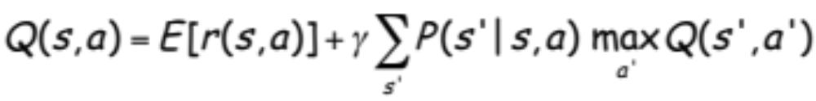

Extensions
To deal with stochastic environments, we need to maximize
expected future discounted reward:
Often the state space is too large to deal with all states. In this case we
need to learn a function:
Neural network with back-propagation have been quite successful.
For instance, TD-Gammon is a back-gammon program that plays at expert level.
state-space very large, trained by playing against itself, uses NN to approximate
value function, uses TD(lambda) for learning.

Slide 17
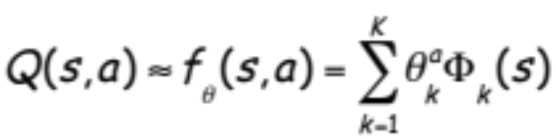
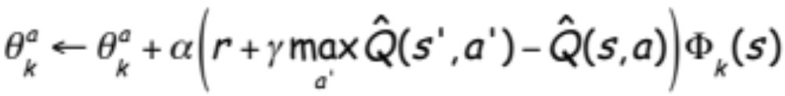
More on Function Approximation
For instance: linear function:
The features Phi are fixed measurements of the state (e.g. # stones on the board).
We only learn the parameters theta.
Update rule: (start in state s, take action a, observe reward r and end up in state s’)
change in Q

Slide 18
Conclusion
Reinforcement learning addresses a very broad and relevant question:
How can we learn to survive in our environment?
We have looked at Q-learning, which simply learns from experience.
No model of the world is needed.
We made simplifying assumptions: e.g. state of the world only depends on
last state and action. This is the Markov assumption. The model is called
a Markov Decision Process (MDP).
We assumed deterministic dynamics, reward function, but the world really is
stochastic.
There are many extensions to speed up learning.
There have been many successful real world applications.
http://elsy.gdan.pl/index.php?option=com_content&task=view&id=20&Itemid=39

