Slide 1
Reinforcement Learning

Slide 2
What is learning?
Learning takes place as a result of interaction between an agent and the world, the idea behind learning is that
  Percepts received by an agent should be used not only for acting, but also for improving the agent’s ability to behave optimally in the future to achieve the goal.

Slide 3
Learning types
Learning types
  Supervised learning:
    a situation in which sample (input, output) pairs of the function to be learned can be perceived or are given
    You can think it as if there is a kind teacher
  Reinforcement learning:
    in the case of the agent acts on its environment, it receives some evaluation of its action (reinforcement), but is not told of which action is the correct one to achieve its goal

Slide 4
Reinforcement learning
Task
  Learn how to behave successfully to achieve a goal while interacting with an external environment
  Learn via experiences!
Examples
  Game playing: player knows whether it win or lose, but not know how to move at each step
  Control: a traffic system can measure the delay of cars, but not know how to decrease it.

Slide 5
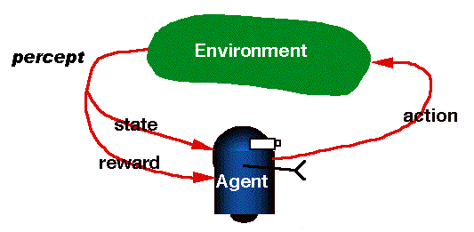
RL is learning from interaction

Slide 6
RL model
  Each percept(e) is enough to determine the State(the state is accessible)
  The agent can decompose the Reward component from a percept.
  The agent task: to find a optimal policy, mapping states to actions, that maximize long-run measure of the reinforcement
  Think of reinforcement as reward
  Can be modeled as MDP model!

Slide 7
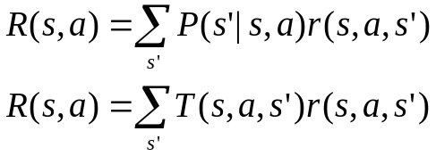
Review of MDP model
MDP model <S,T,A,R>
S– set of states
A– set of actions
T(s,a,s’) = P(s’|s,a)– the probability of transition from s to s’ given action a
R(s,a)– the expected reward for taking action a in state s
Agent
State
Action
Reward
Environment
a₀
a1
a2
s₀
s₁
s2
s3
r₀
r1
r2

Slide 8
Model based v.s.Model free approaches
But, we don’t know anything about the environment model—the transition function T(s,a,s’)
Here comes two approaches
  Model based approach RL:
  learn the model, and use it to derive the optimal policy.
    e.g Adaptive dynamic learning(ADP) approach
  Model free approach RL:
  derive the optimal policy without learning the model.
    e.g LMS and Temporal difference approach
Which one is better?

Slide 9
Passive learning v.s. Active learning
Passive learning
  The agent imply watches the world going by and tries to learn the utilities of being in various states
Active learning
  The agent not simply watches, but also acts

Slide 10
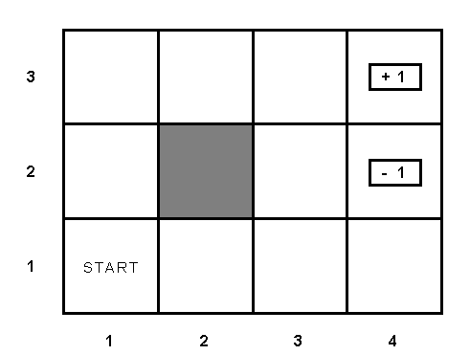
Example environment

Slide 11
Passive learning scenario
The agent see the the sequences of state transitions and associate rewards
  The environment generates state transitions and the agent perceive them
    e.g (1,1) →(1,2) →(1,3) →(2,3) →(3,3) →(4,3)[+1]
      (1,1)→(1,2) →(1,3) →(1,2) →(1,3) →(1,2) →(1,1) →(2,1) →(3,1) →(4,1) →(4,2)[-1]
Key idea: updating the utility value using the given training sequences.

Slide 12
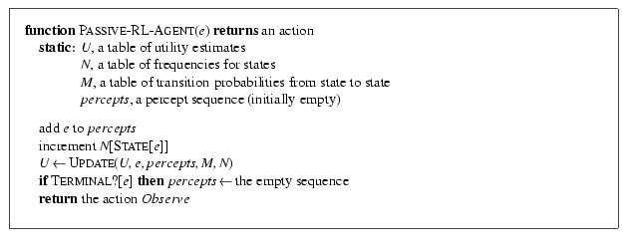
Passive leaning scenario

Slide 13
LMS updating
Reward to go of a state
the sum of the rewards from that state until a terminal state is reached
Key: use observed reward to go of the state as the direct evidence of the actual expected utility of that state
Learning utility function directly from sequence example

Slide 14
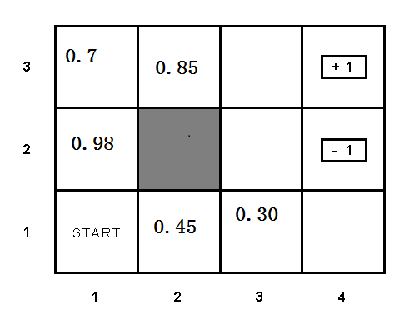
updating the utility value using the given training sequences.

Slide 15
LMS updating
  function LMS-UPDATE (U, e, percepts, M, N ) return an updated U
  if TERMINAL?[e] then
  { reward-to-go ← 0
  for each ei in percepts (starting from end) do
  s = STATE[ei]
  reward-to-go ← reward-to-go + REWARS[ei]
  U[s] = RUNNING-AVERAGE (U[s], reward-to-go, N[s])
  end
  }
  function RUNNING-AVERAGE (U[s], reward-to-go, N[s] )
  U[s] = [ U[s] * (N[s] – 1) + reward-to-go ] / N[s]

Slide 16
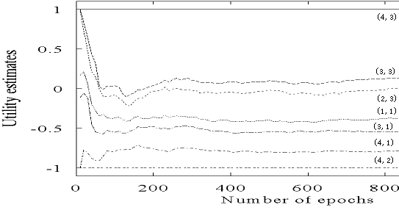
LMS updating algorithm in passive learning
Drawback:
  The actual utility of a state is constrained to be probability- weighted average of its successor’s utilities.
  Converge very slowly to correct utilities values (requires a lot of sequences)
    for our example, >1000!

Slide 17

Temporal difference method in passive learning
TD(0) key idea:
  adjust the estimated utility value of the current state based on its immediately reward and the estimated value of the next state.
The updating rule
  is the learning rate parameter
  Only when is a function that decreases as the number of times a state has been visited increased, then can U(s)converge to the correct value.

Slide 18

TD learning
U(s)
U(s’)
R(s)
S
S’

Slide 19
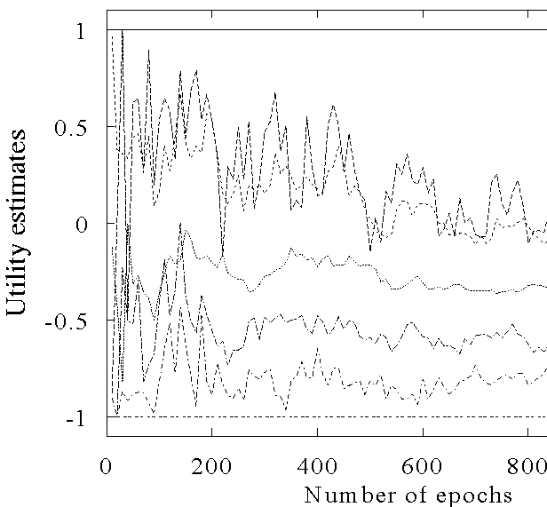
The TD learning curve
(4,3)
(2,3)
(2,2)
(1,1)
(3,1)
(4,1)
(4,2)

Slide 20
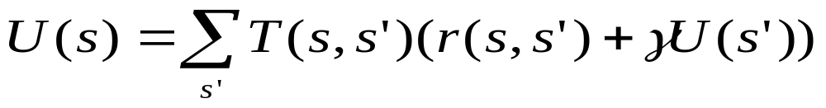
Adaptive dynamic programming(ADP) in passive learning
Different with LMS and TD method(model free approaches)
ADP is a model based approach!
The updating rule for passive learning
However, in an unknown environment, T is not given, the agent must learn T itself by experiences with the environment.
How to learn T?

Slide 21
ADP learning
U(s)
U(s’)
T(s,s’)
r(s,s’)
S
S’
R(s,s’’)
U(s’’)
S’’

Slide 22
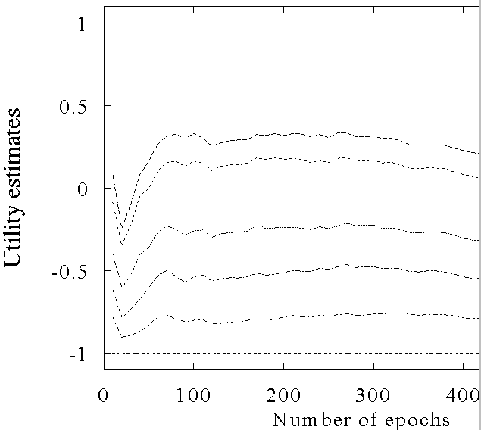
ADP learning curves
(4,3)
(3,3)
(2,3)
(1,1)
(3,1)
(4,1)
(4,2)

Slide 23
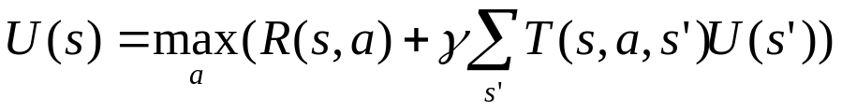
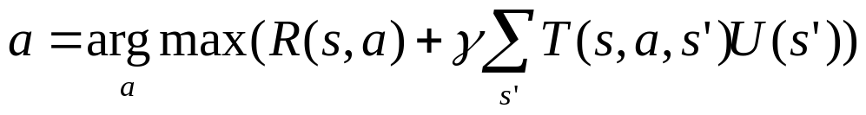
Active learning
An active agent must consider
  what actions to take?
  what their outcomes maybe(both on learning and receiving the rewards in the long run)?
Update utility equation
Rule to chose action

Slide 24
Active learning: choose action a
U(s)
U(s’)
T(s,a, s’)
R(s,a)
S
S’
R(s,a)
U(s’’)
S’’

Slide 25


Active ADP algorithm
For each s, initialize U(s) , T(s,a,s’) and R(s,a)
Initialize s to current state that is perceived
Loop forever
{
  Select an action a and execute it (using current model R and T) using
  Receive immediate reward r and observe the new state s’
  Using the transition tuple <s,a,s’,r> to update model R and T (see further)
  For all the sate s, update U(s) using the updating rule
  s = s’
}

Slide 26
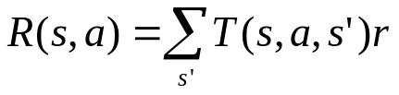
How to learn model?
Use the transition tuple <s, a, s’, r> to learn T(s,a,s’) and R(s,a). That’s supervised learning!
  Since the agent can get every transition (s, a, s’,r) directly, so take (s,a)/s’ as an input/output example of the transition probability function T.
  Different techniques in the supervised learning(see further reading for detail)
  Use r and T(s,a,s’) to learn R(s,a)

Slide 27
ADP approach pros and cons
Pros:
  ADP algorithm converges far faster than LMS and Temporal learning. That is because it use the information from the the model of the environment.
Cons:
  Intractable for large state space
  In each step, update U for all states
  Improve this by prioritized-sweeping (see further reading for detail)

Slide 28

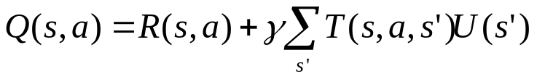
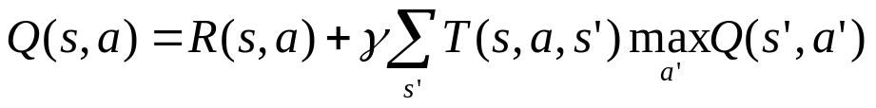
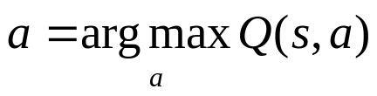
Another model free method– TD-Q learning
a’
a
S’
Define Q-value function
Q-value function updating rule
  <*>
Key idea of TD-Q learning
  Combined with temporal difference approach
  The updating rule
Rule to chose the action to take
S
S”
S’”

Slide 29
TD-Q learning agent algorithm
For each pair (s, a), initialize Q(s,a)
Observe the current state s
Loop forever
{
  Select an action a and execute it
  Receive immediate reward r and observe the new state s’
  Update Q(s,a)
  s=s’
}

Slide 30
Exploration problem in Active learning
An action has two kinds of outcome
  Gain rewards on the current experience tuple (s,a,s’)
  Affect the percepts received, and hence the ability of the agent to learn

Slide 31
Exploration problem in Active learning
A trade off when choosing action between
  its immediately good(reflected in its current utility estimates using what we have learned)
  its long term good(exploring more about the environment help it to behave optimally in the long run)
Two extreme approaches
  “wacky”approach: acts randomly, in the hope that it will eventually explore the entire environment.
  “greedy”approach: acts to maximize its utility using current model estimate
Just like human in the real world! People need to decide between
  Continuing in a comfortable existence
  Or striking out into the unknown in the hopes of discovering a new and better life

Slide 32
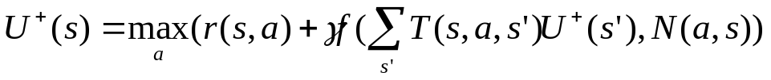
Exploration problem in Active learning
One kind of solution: the agent should be more wacky when it has little idea of the environment, and more greedy when it has a model that is close to being correct
  In a given state, the agent should give some weight to actions that it has not tried very often.
  While tend to avoid actions that are believed to be of low utility
Implemented by exploration function f(u,n):
  assigning a higher utility estimate to relatively unexplored action state pairs
  Chang the updating rule of value function to
  U+ denote the optimistic estimate of the utility

Slide 33



Exploration problem in Active learning
One kind of definition of f(u,n)
  if n< Ne
  u otherwise
  is an optimistic estimate of the best possible reward obtainable in any state
  The agent will try each action-state pair(s,a) at least Ne times
  The agent will behave initially as if there were wonderful rewards scattered all over around– optimistic .

Slide 34
Generalization in Reinforcement Learning
So far we assumed that all the functions learned by the agent are (U, T, R,Q) are tabular forms—
i.e.. It is possible to enumerate state and action spaces.
Use generalization techniques to deal with large state or action space.
  Function approximation techniques

Slide 35
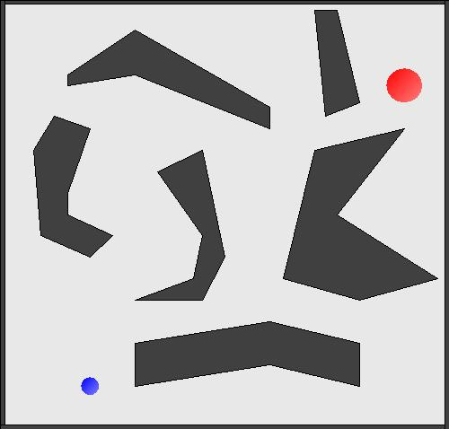

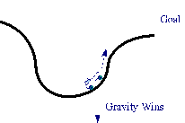
RL resources
Umass Repository
  http://www-anw.cs.umass.edu/rlr/domains.html

Slide 36
Thank you!

