Slide 1


MULTILEVEL TICTACTOE GAME
Team members:
1) SHREYAS R (PES2UG21CS507)
2) PRANAY H (PES2UG21CS389)
3) NITHIN K (PES2UG21EC063)

Slide 2
ABSTRACT
Tic-tac-toe also known as noughts and crosses or X’s and O’s is a two players game who take turns marking the spaces in a three-by-three grid with ”X” or ”O”. The player who succeeds in placing three of their marks in a horizontal, vertical, or diagonal row is the winner. If the board is filled and no one wins, it is a draw.
In our version of the tic-tac-toe game, there is no need for the user to type in the row and column number in the console. Rather the user has to just click the pygame window with the mouse.
To start with, the user has the option to view the command list in the starting window, through which the user will get an idea on how to toggle between the ‘player vs player’ game mode and ‘player vs computer’ game mode (easy + hard levels).

Slide 3

SUMMARY OF THE PROJECT WITH SNAPSHOTS

Slide 4
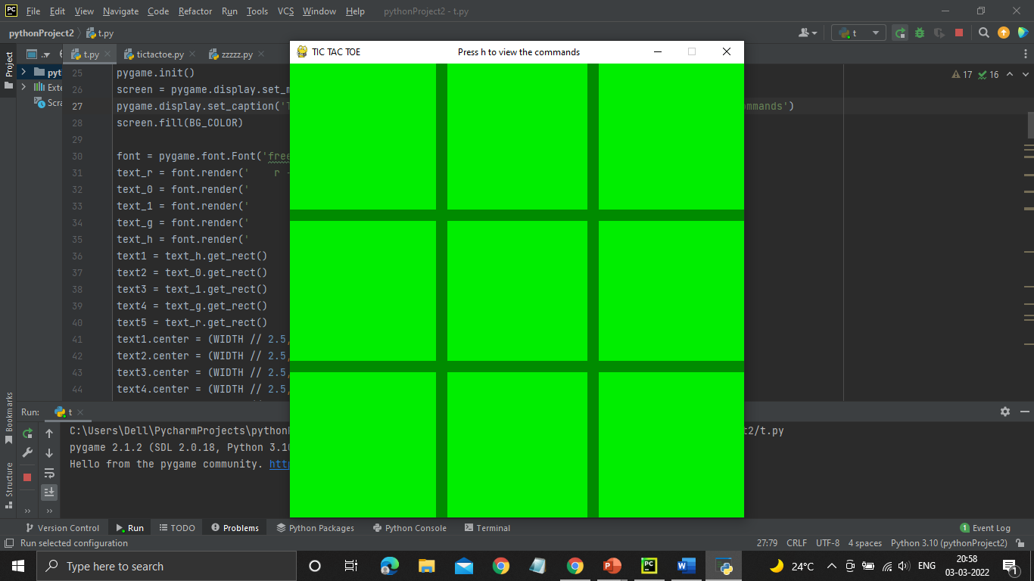
The opening view of the board:
Instruction for the user to view the commands

Slide 5
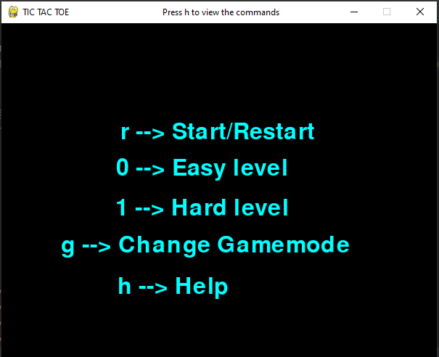
The command list:
The user should first click the ‘r’ key to start the game.
The user can then choose the game mode he/she wants to play in by clicking the required keys in the keyboard as mentioned in the command list.

Slide 6
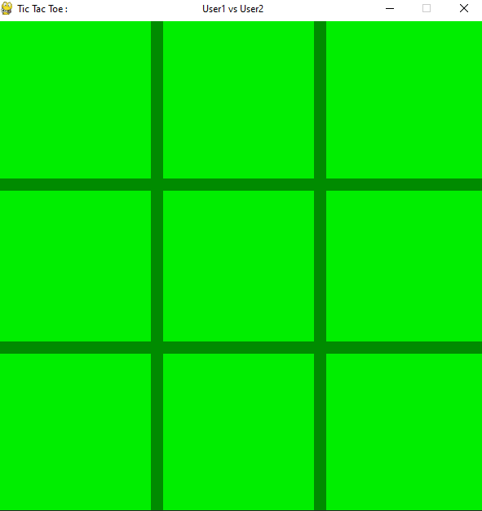
There are three game modes available:
1) Player1 vs Player2 mode.

Slide 7
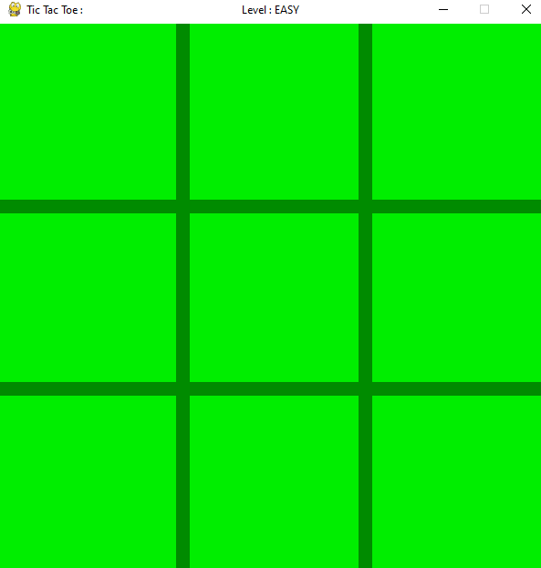
2) Easy level
In this mode, the computer randomly chooses a square from the available squares and marks it.

Slide 8
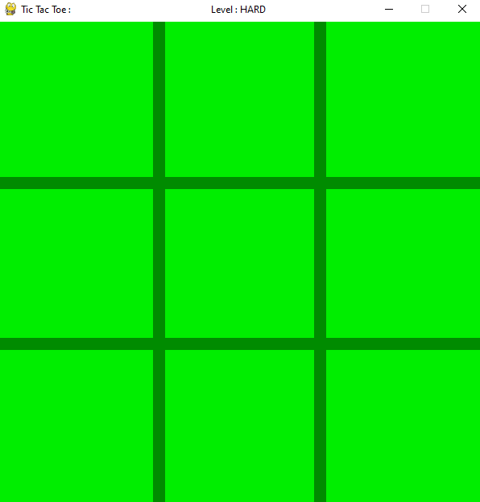
3) Hard level
The computer in this case uses the ‘minimax algorithm’ and plays the best possible move in that situation.

Slide 9
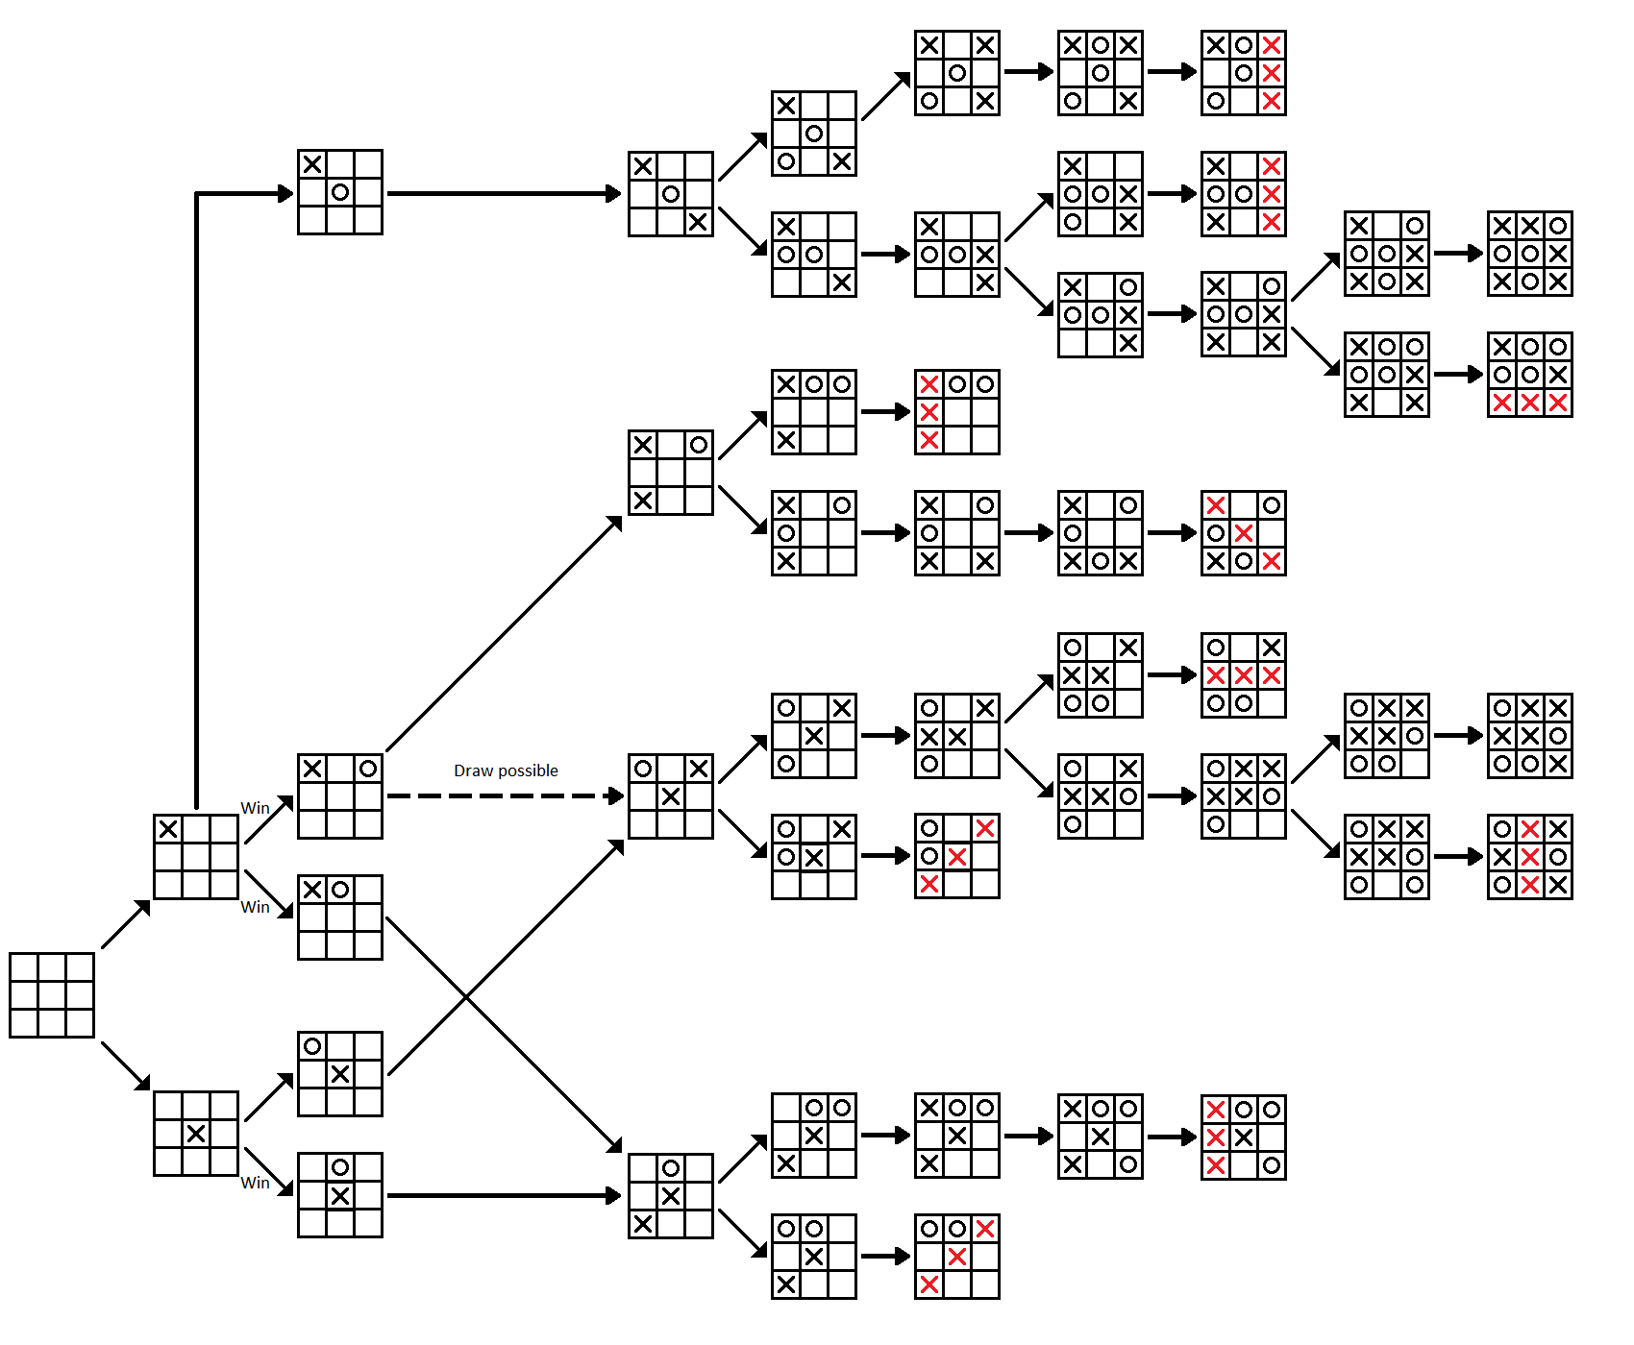
The Minimax Algorithm :
Best move strategy algorithm.
It makes use of recursion.
Considers 2 players: Max and Min.
Problem is solved as a tree diagram.

Slide 10
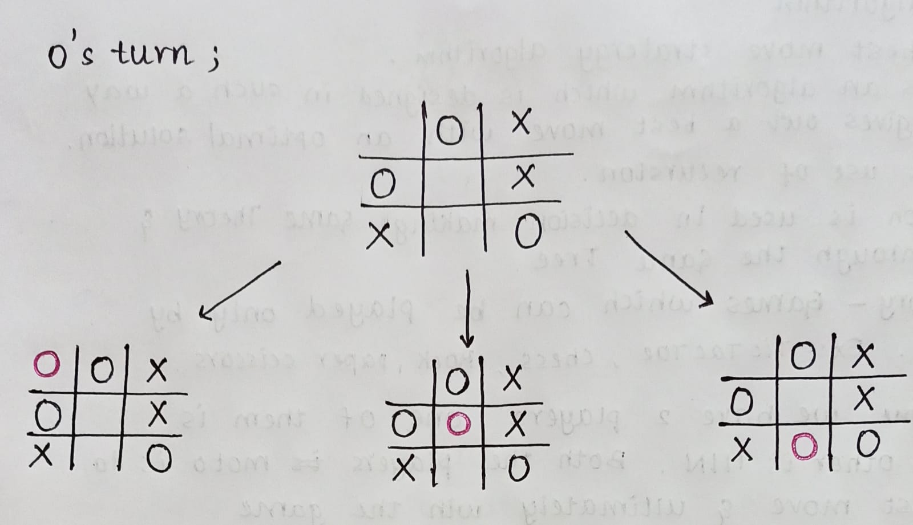
IMPLEMENTATION OF THE MINIMAX ALGORITHM

Slide 11
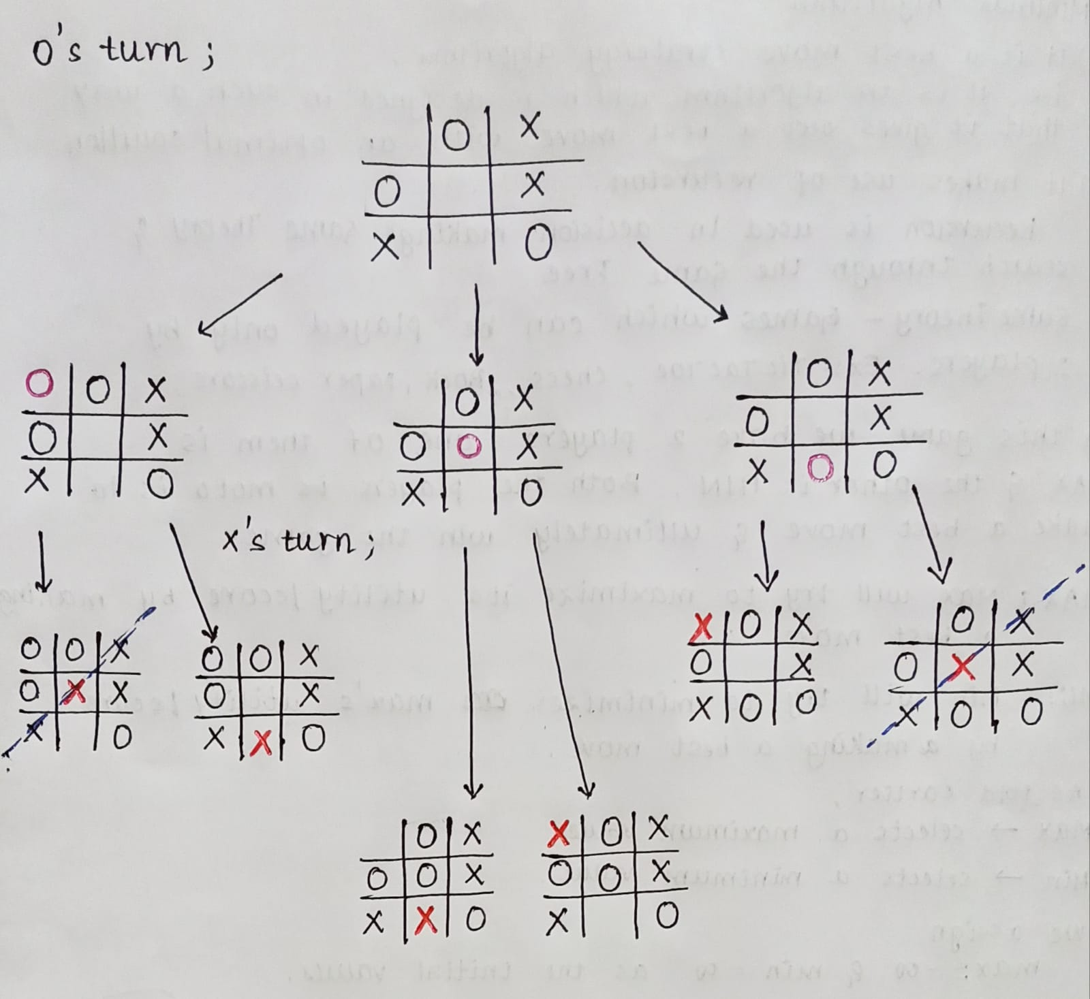

Slide 12
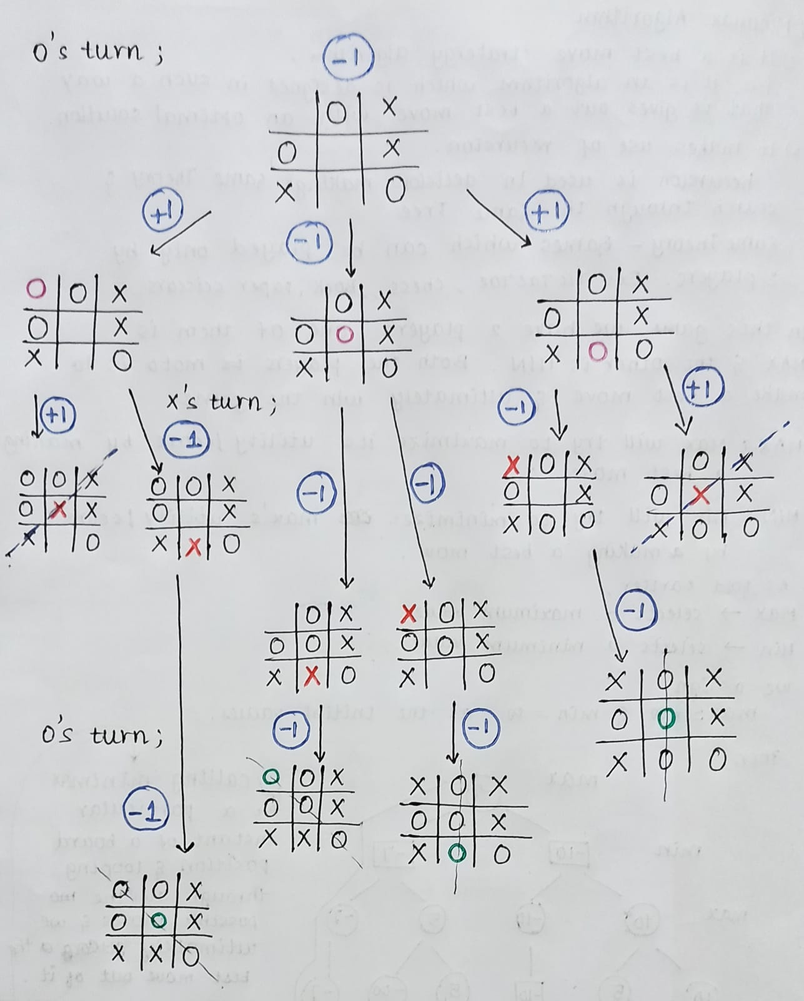

Slide 13
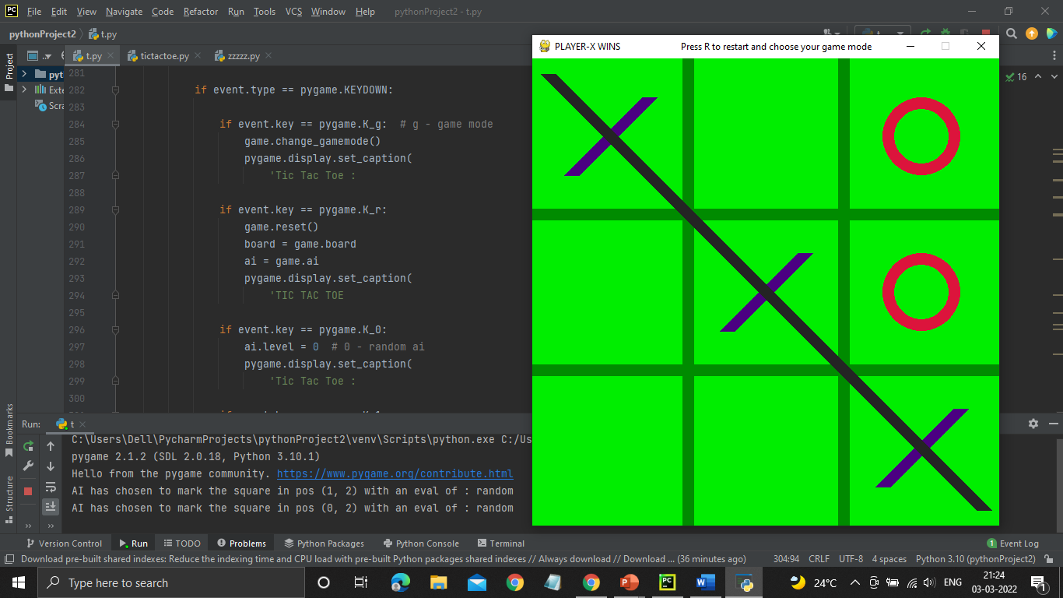
A special feature is included which, at every move, will print the type of move played by the computer on the terminal window.
In case of the easy(random) level:

Slide 14
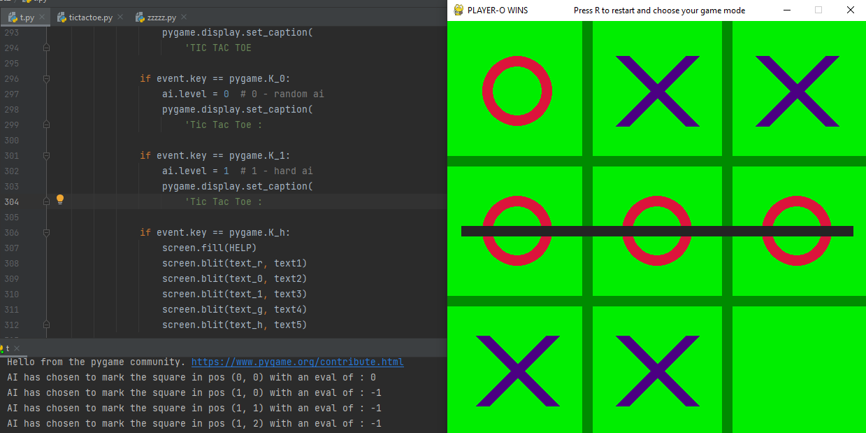
In case of the hard level:-
If the value of the ‘eval’ is 0:
User has a chance of drawing the game.
If the eval is ‘-1’:
User is going to lose

Slide 15
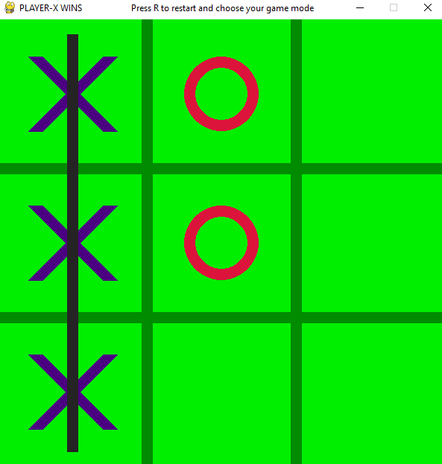
When the game is finished, the result of the game is displayed on the top left of the board.
Also, the restart message is displayed.

Slide 16
CONCLUSION
This project helped us understand the working and implementation of various programming concepts, and also helped us understand the importance of an user friendly interface.
The learning in this project was immense and we thank PESU for giving us an opportunity to expand our knowledge on the same.

Slide 17
