Slide 1
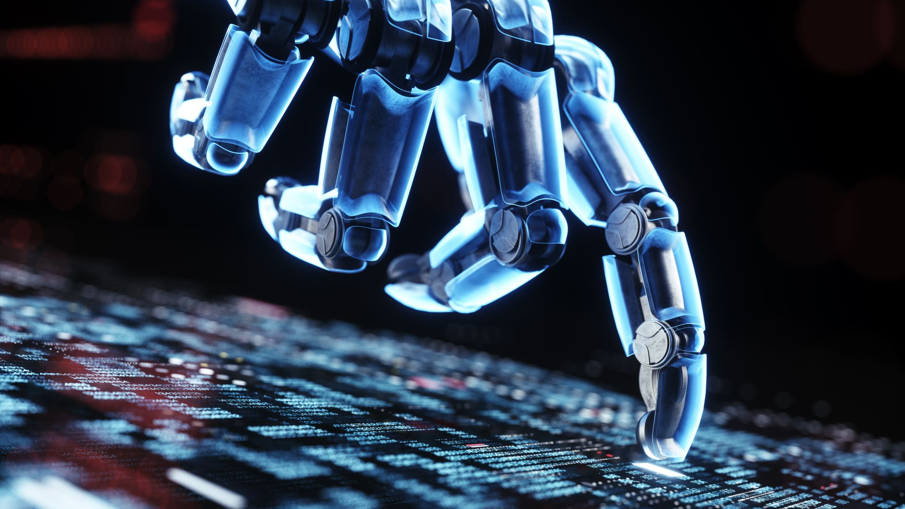
AI Assistant Development
A Project for Prompt Engineering

Slide 2
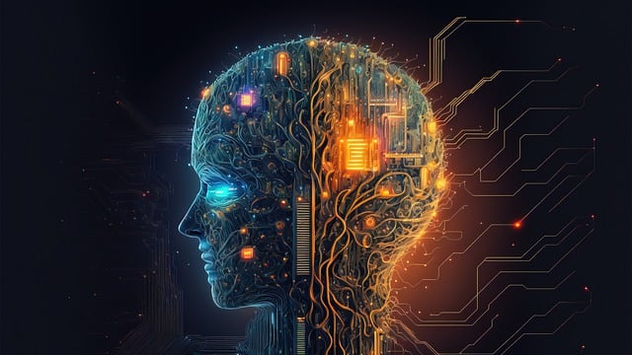
Project Overview
This project involves the design and implementation of a basic AI Assistant capable of performing various tasks based on user prompts.

Slide 3

Objectives
Develop an AI Assistant to answer factual questions, summarize text, and generate creative content.
Design effective prompts to guide AI responses.
Create a user-friendly interface for interaction.
Implement a feedback mechanism for response improvement.

Slide 4

Key Functions
Answering Factual Questions: Provides answers from Wikipedia.
Summarizing Text: Summarizes provided text or articles.
Generating Creative Content: Creates stories, poems, or other content.

Slide 5

Prompt Design
Prompts are crafted to effectively guide the AI:
Varying length and specificity.
Adjusting tone and style.
Considering complexity and context.

Slide 6

User Interaction
Users can input queries and select functions.
Responses are displayed clearly for user understanding.

Slide 7

Feedback Mechanism
Users can provide feedback on responses (e.g., helpful or not).
Feedback is used to refine prompts and improve AI responses.

Slide 8

Implementation Steps
Set up the development environment.
Define the key functionalities of the AI Assistant.
Design effective prompts for each functionality.
Build the user interface (CLI).
Implement the feedback mechanism.

Slide 9

Technologies Used
Python: Programming language for development.
spaCy : Natural Language Processing library for keyword extraction.
Wikipedia API: To fetch information from Wikipedia.
Flask (optional): For web-based implementation.

Slide 10

Testing and Validation
Thorough testing of each function to ensure accuracy.
Refinement of prompts based on user feedback.
Validation of user interactions for a smooth experience.

Slide 11

Conclusion
The AI Assistant Project demonstrates effective prompt engineering, user interaction, and feedback implementation to enhance AI capabilities.

