Slide 1

Project Title – Keystroke Logging Demonstration
Shreyas Hiru Vanage

Slide 2

PROBLEM STATEMENT
Keystroke logging is a common cyber security threat used to capture sensitive user input such as passwords and personal data. Understanding how this attack works is important for improving security awareness and defense mechanisms. However, implementing such techniques without proper control can raise ethical and legal concerns. This project addresses the need for a consent-based, controlled keystroke logging system that allows users to explicitly start and stop logging within an isolated environment, while securely storing data in text and JSON formats for educational analysis.

Slide 3
Project Description
This project implements a GUI-based, consent-driven keystroke logging demonstration for cyber security education. The system allows users to manually start and stop keystroke logging within a secure virtual environment, ensuring full transparency and ethical usage. Captured keystrokes are recorded only during authorized sessions and stored in text and JSON formats for analysis, helping users understand keystroke logging threats and related prevention techniques without performing any illegal or covert activities.

Slide 4

WHO ARE THE END USERS?
Cyber security students
Ethical hacking learners
Educational institutions and faculty
Beginner-level security researchers

Slide 5

Technology Used
Python – Core programming language
Tkinter – GUI development
pynput – Keyboard event handling
Virtual Environment (venv) – Dependency isolation
JSON & Text Files – Data storage formats

Slide 6
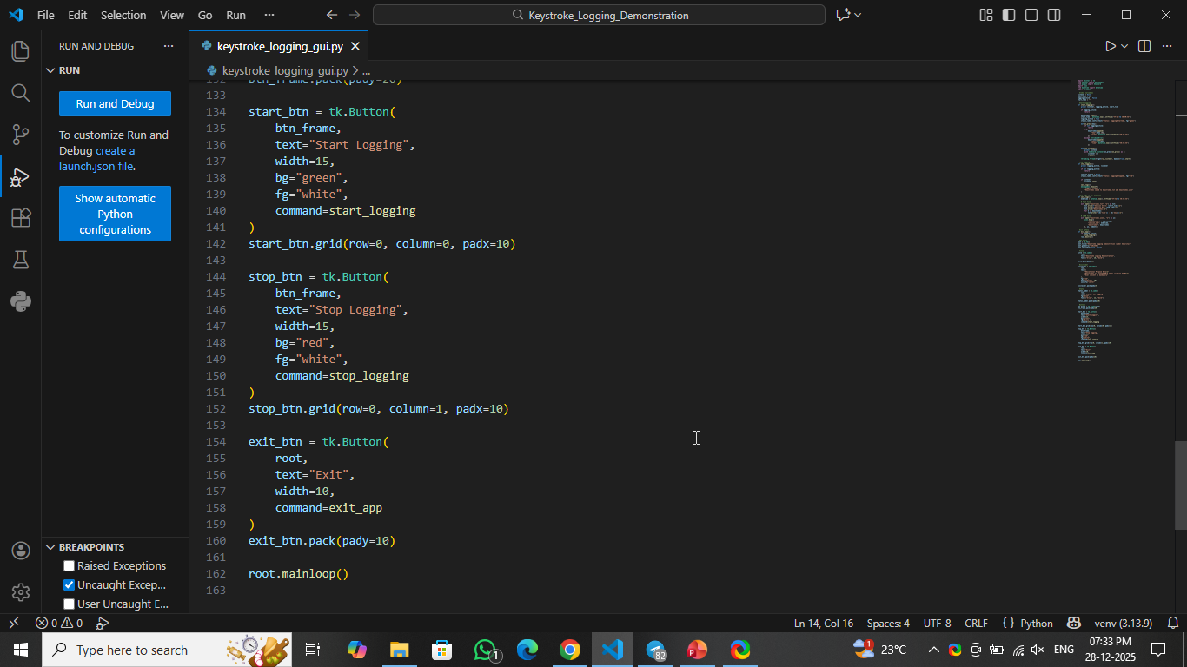
RESULTS
Demo Link

Slide 7
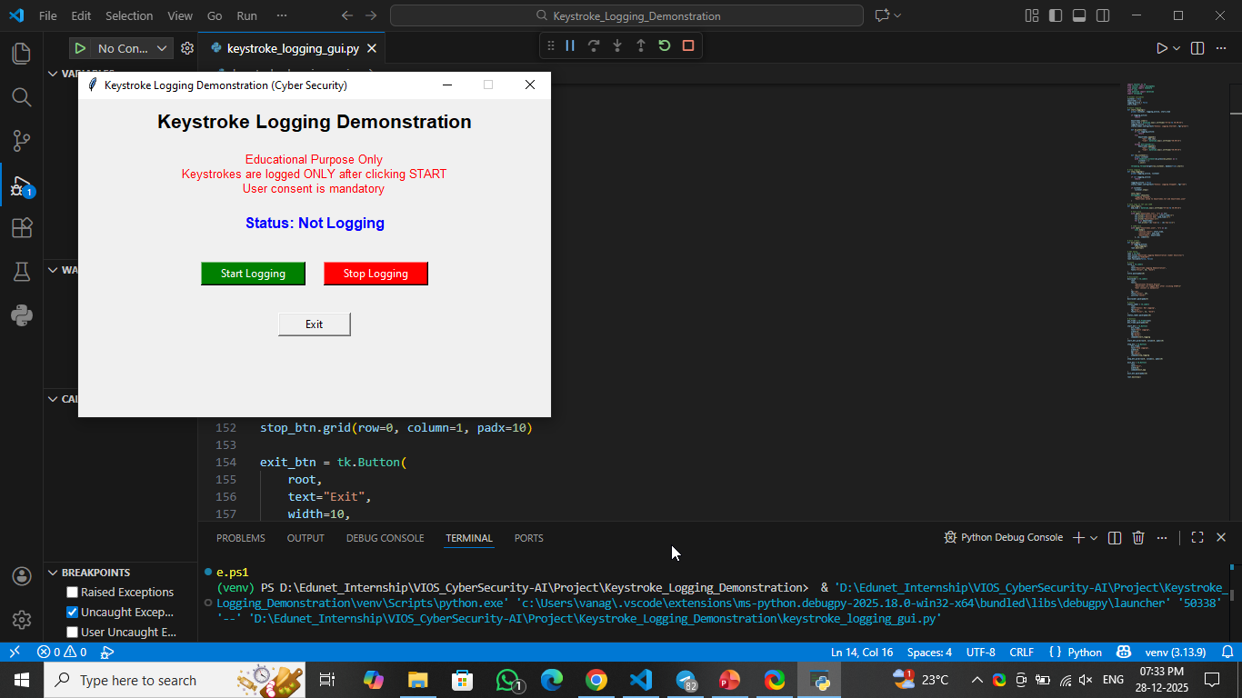

Slide 8
Thank you
.
.

