Slide 1
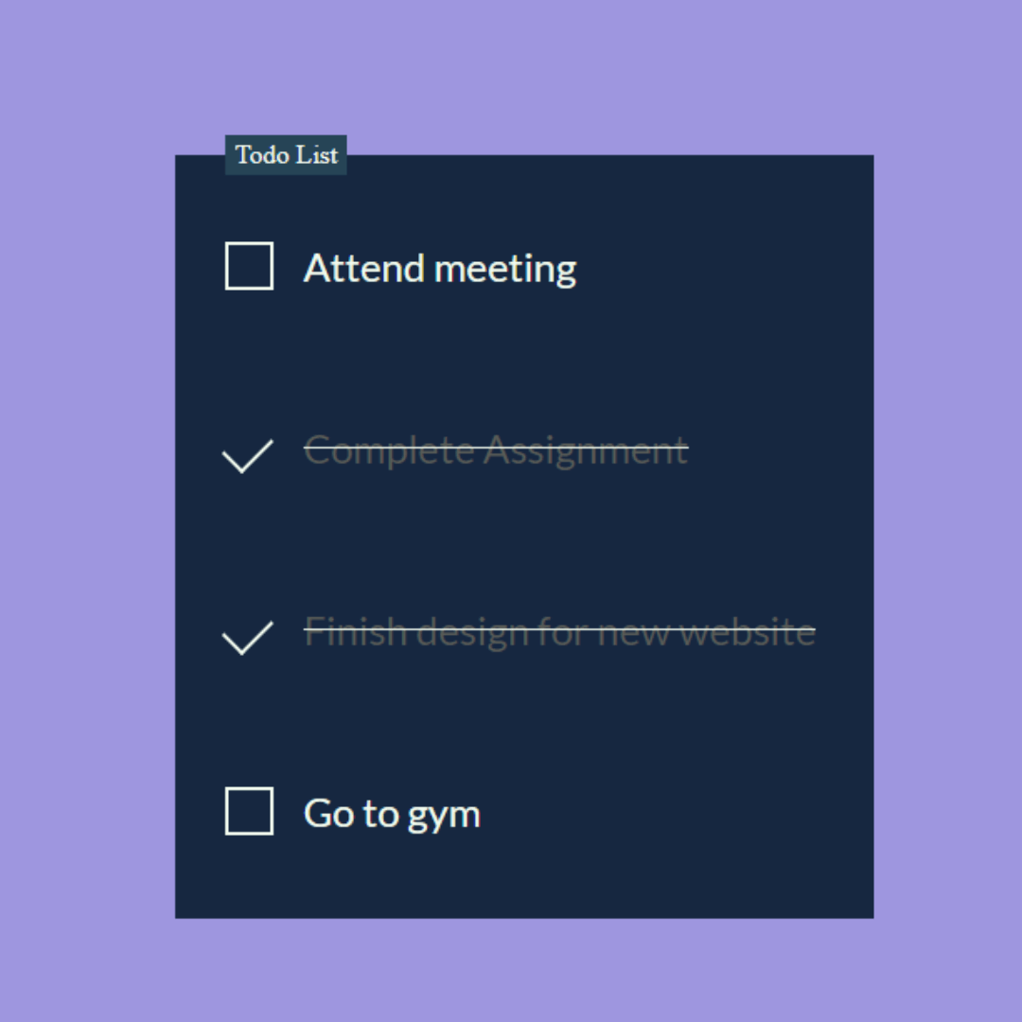
Personal To-Do List Application
A Simple Python Project for Task Management

Slide 2
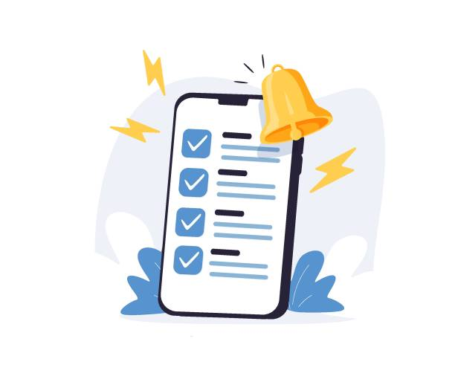
Objective Create, view, edit, delete tasks.
User Interaction Simple and intuitive.
File Handling
Saves and loads tasks.
No Database
Focus on the basics

Slide 3
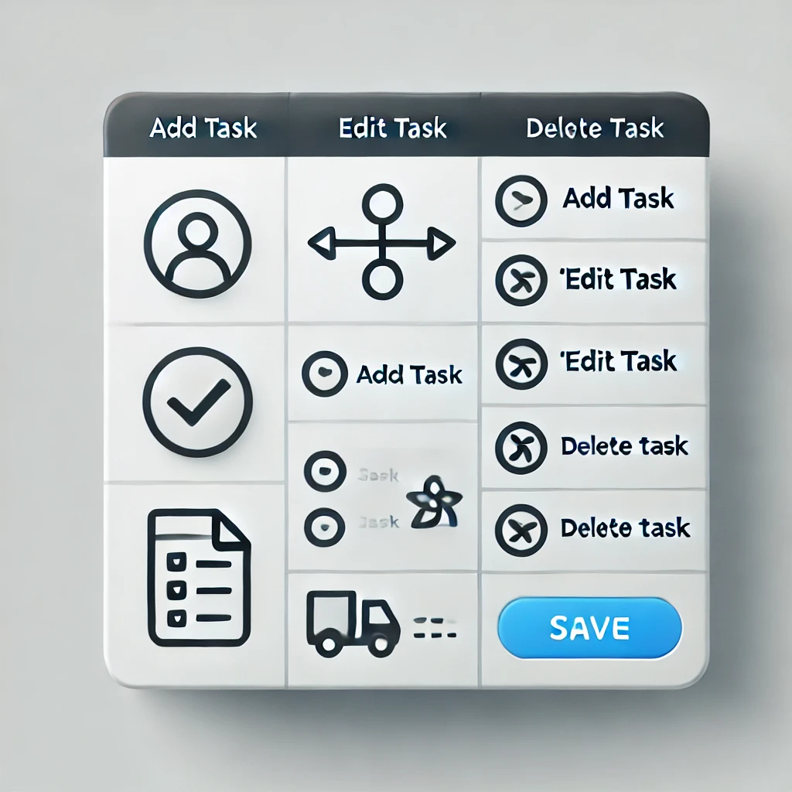
Functionality Basic task management
Task Management
Add, edit, delete tasks.
Categorization
Organize tasks by category.
Persistence
Save progress using JSON or CSV.

Slide 4
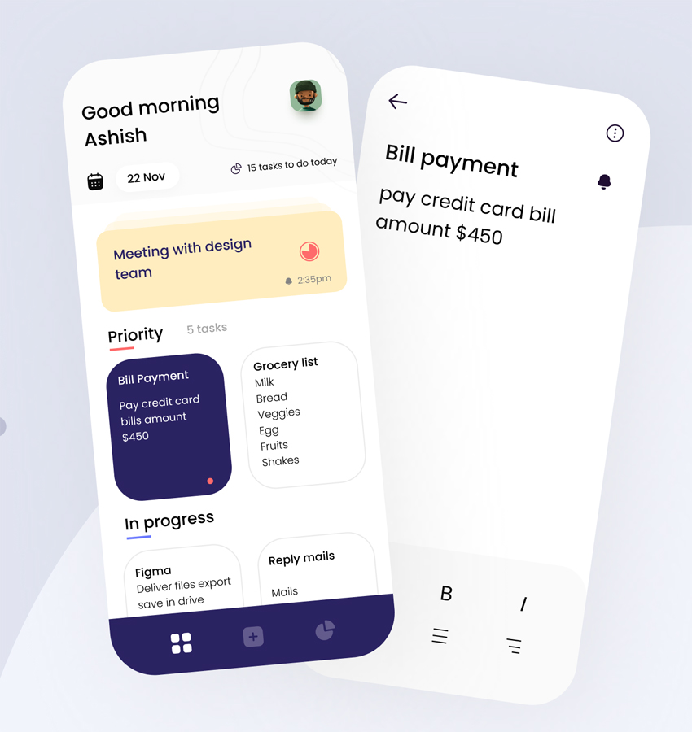
User Interface
Command-line or simple graphical interface.
Prompts and Feedback Clear communication for actions.
Easy Navigation Intuitive for users to follow.
User-Friendly Design
Simple and understandable

Slide 5

Deployment
Local execution on user's machine.
No External Dependencies
Self-contained and easy to run.

Slide 6
Core Features
Task Class ,File Handling ,User Interaction
Task Class | Represents tasks with attributes.
File Handling | Saves and loads using JSON or CSV.
User Interaction | Simple commands for adding, viewing, etc

Slide 7
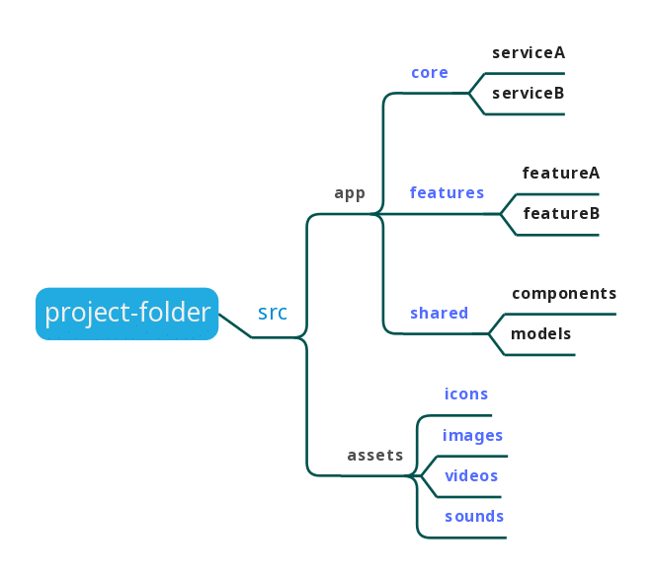
Project Structure
Organized project files for clarity.
todo.py Main application logic.
tasks.json Storage for tasks.
README.md Project documentation

Slide 8
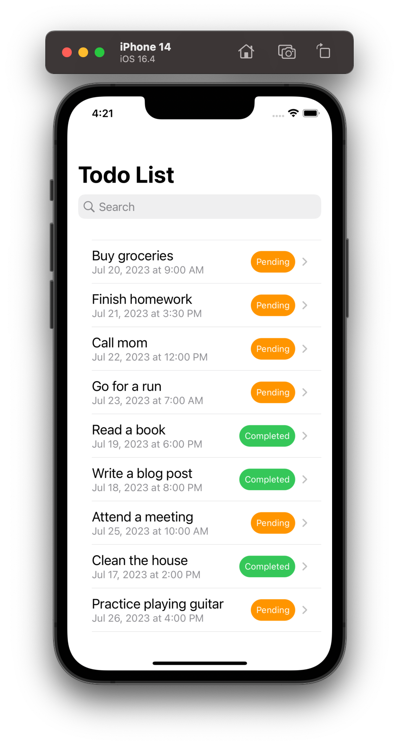
User Interaction
Simple command-line interface for user interaction.
Add Task : Create a new task.
View Tasks : Display the list of tasks.
Mark Task Completed : Mark a task as finished.
Delete Task : Remove a task from the list.
Exit : Close the application

Slide 9
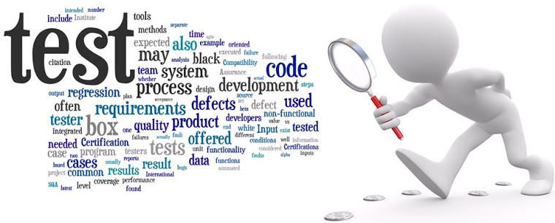
Testing & Documentatio
Ensure functionality and clarity.
Testing : Verify features work correctly.
Documentation : Provide clear README file.
PowerPoint : Explain core features.

Slide 10

Conclusion
A simple but useful tool.
Personal Productivity : Manage your daily tasks.
Beginner Project : Learn Python and build something practical.
Expand and Customize : Add more features as you learn

