Slide 1






VISVESVARAYA TECHNOLOGICAL UNIVERSITY JNANASANGAMA,BELAGAVI
CAUVERY INSTITUTE OF TECHNOLOGY MANDYA
“FAKE PRODUCT REVIEW MONITORING"
PRESENTED BY 1.SHREYAS K R 2.VARINI P
UNDER THE GUIDANCE OF Prof. AKSHATHA T M
(4CA22CS096)
(4CA22CS112)
(HOD of computer science and engineering)
3.VARSHITHA H B (4CA22CS115) (4CA22CS123)
4YASHAS M

Slide 2
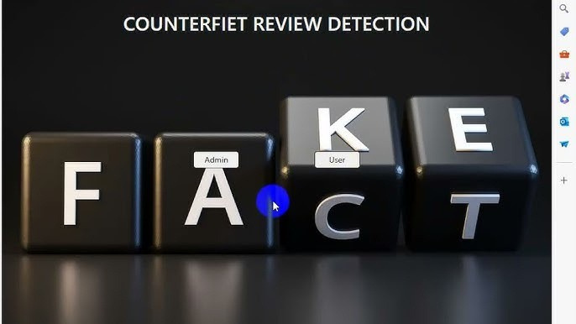
Fake Product Review Monitoring and Removal of Non- Genuine Ratings

Slide 3






In the digital age, online shopping has become an integral part of consumer behavior.
Many products receive fake or
biased reviews, affecting customer trust. Fake product reviews and non- genuine ratings, which are often manipulated by sellers to boost visibility and sales or to harm competitors. These deceptive practices not only mislead consumers but also undermine the trustworthiness and integrity of e-commerce platforms.

Slide 4






Customers are misled by fake reviews. Companies may manipulate ratings for better visibility. Need for a system to monitor, detect, and remove such reviews automatically.
OBJECTIVES
Monitor Reviews Regularly Ensure Authenticity of User Feedback Develop an Automated Detection System Maintain Brand Trust and Credibility Follow Ethical and Legal Guidelines
Identify FakeReviews and Ratings
www.reallygreatsite.com

Slide 5
Literature Survey
Paper N0. | Title | Authors | Year | Methodology | Merits | Limitations
1 | Spam Review Detection Using Deep Learning | G. M. Shahariar, Swapnil Biswas, Faiza Omar, Faisal Muhammad Shah, Samiha Binte Hassan. | 2019 | Various ML (Naive Bayes, KNN, SVM) and deep learning models (MLP, CNN, LSTM) were implemented and evaluated using accuracy, precision, recall, and F1-score. | The study offers a practical comparison of ML and DL methods, showcasing scalability for real-world e-commerce applications. | The study's limitations include lack of real-time evaluation and restricted focus on English-language reviews, limiting broader applicability
2 | Fake Reviews Detection through Analysis of Linguistic Features | : Faranak Abri, Luis Felipe Gutierrez, Akbar Siami Namin, Keith S. Jones, David R. W. Sears | 2020 | These features were used to train machine learning models (SVM, Random Forest, Naïve Bayes) for classifying fake vs. genuine reviews. | The method is interpretable and lightweight, relying solely on linguistic features without complex infrastructure | The model may struggle with domain transferability and unseen writing styles. It ignores contextual, behavioural , and metadata cues that could enhance detection accuracy.

Slide 6
Literature Survey
3 | Automated Crowdturfing Attacks and Defences in Online Review Systems | Yuanshun Yao, Bimal Viswanath, Jenna Cryan, Haitao Zheng, Ben Y. Zhao | 2017 | The authors used deep learning language models (e.g., GPT-based) to generate fake reviews simulating crowdturfing attacks. | The study addresses a modern and realistic threat using advanced generative models | Real-world deployment of defences may face challenges across diverse platforms and languages.
4 | Review Classification and False Feedback Detection using Machine Learning | Dr. Balika J. Chelliah, T. C. A. Ananthajith, Anoushka Dutta, Aditya Sugandhi | 2020 | The study involved data preprocessing, feature extraction, model training, and performance evaluation using standard classification metrics | Applies well-known and interpretable machine learning models for effective review classification. | Relies heavily on the quality and representativeness of training data. May not handle subtle or highly realistic fake reviews generated by advanced AI models.

Slide 7

Existing System
Limitations
Time-consuming: Manual checking is slow and not scalable.
Low Accuracy: Rule-based systems fail when spammers adapt.
Easily Manipulated: Fake reviewers can bypass keyword filters.
Scalability Issues: Cannot handle millions of reviews on big platforms (Amazon, Flipkart, etc.).
Reactive, not Proactive: Works after fake reviews are posted, not before.
Methods Used
Manual Moderation: Human moderators check reviews and flag suspicious ones.
Rule-based Filtering: Simple filters (e.g., detecting duplicate reviews, excessive keywords like “best product,” “cheap,” etc.).
IP/Account Tracking: Blocking multiple reviews from same IP or fake accounts.
Benefits
Simple to implement.
Low cost for small platforms.
Human intuition sometimes catches subtle fake reviews better than machines.

Slide 8
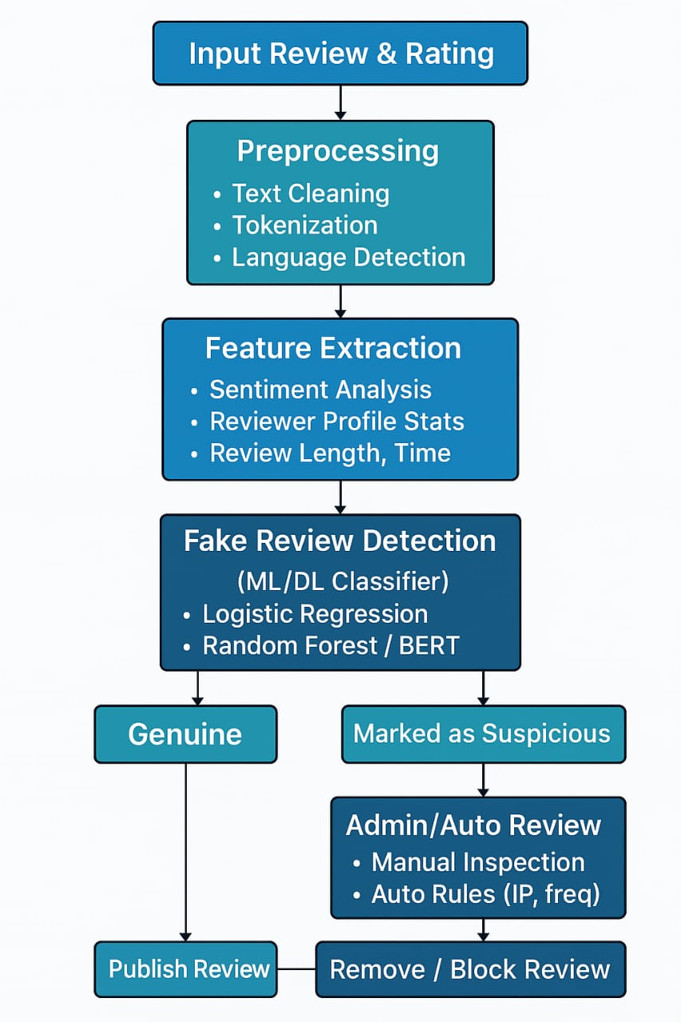
Proposed System

Slide 9



Hardware Requirements
Processor: Intel Core i5 or higher
RAM: 8 GB minimum
Storage: 250 GB HDD/SSD
Internet Connectivity: Required for deployment and testing
Software Requirements
Operating System: Windows/Linux Programming Language: Python
Web Framework: Flask
Frontend: HTML, CSS, JavaScript Libraries/Tools: scikit-learn, NLTK, spaCy, pandas, NumPy Database: MySQL / MongoDB IDE: VS Code / PyCharm Browser: Chrome/Firefox

Slide 10


Improves user trust in e-commerce platforms. Enhances shopping experience. Helps businesses maintain fair competition. Reduces reputation damage from fake reviews. Useful for product comparison and decision-making.
Usage of the Website
Login/Sign-up for users and admins. Browse Products and post reviews. View verified reviews only. Admin Panel to monitor flagged or suspicious reviews. Real-time feedback on review authenticity.

Slide 11





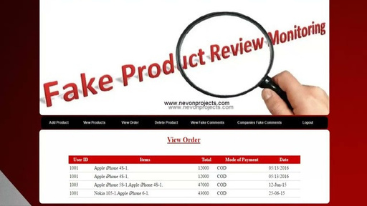

1.False Positives
2.High Operational Costs
3.Privacy Concerns
4.Algorithm Limitations
5.Delay in Review Publishing
6.Scalability Challenges

Slide 12
Phase-02

Slide 13
System Architecture

Slide 14
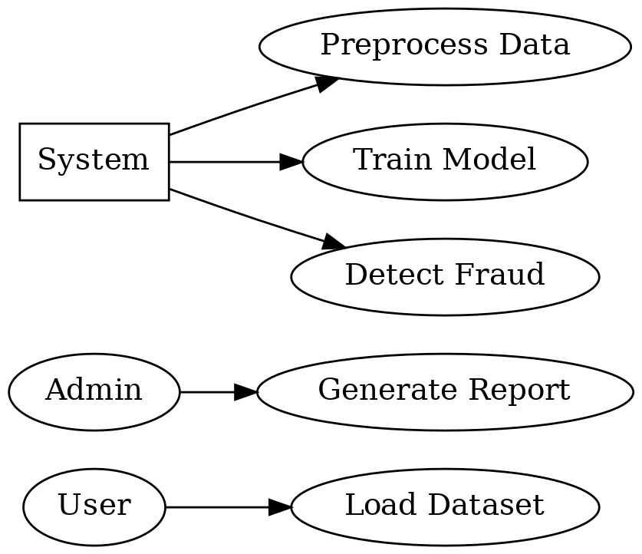
Use Case Diagram

Slide 15
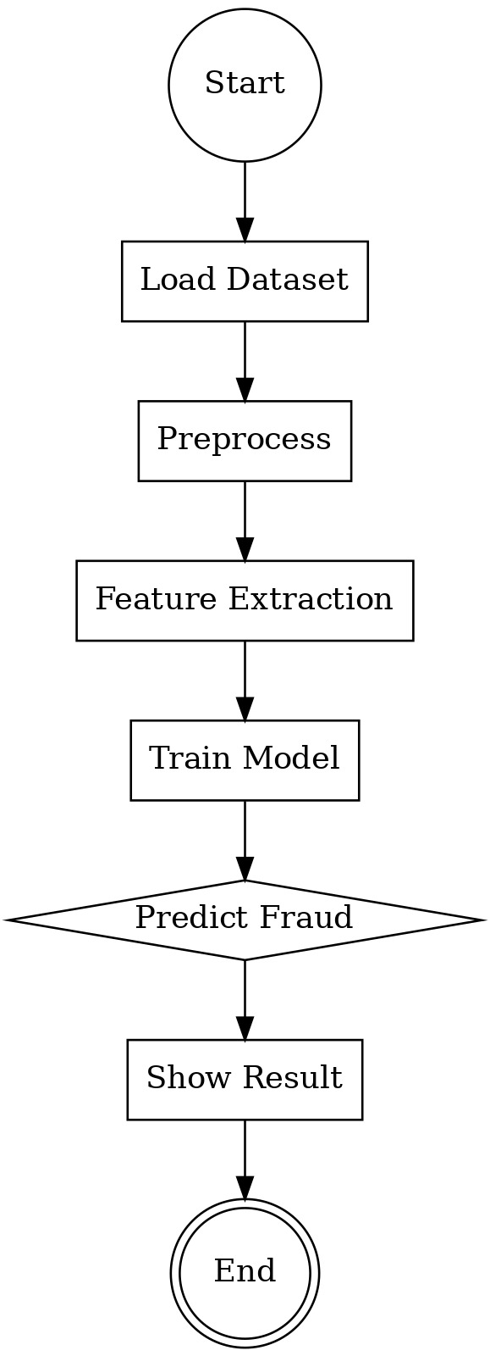
Activity Diagram

Slide 16
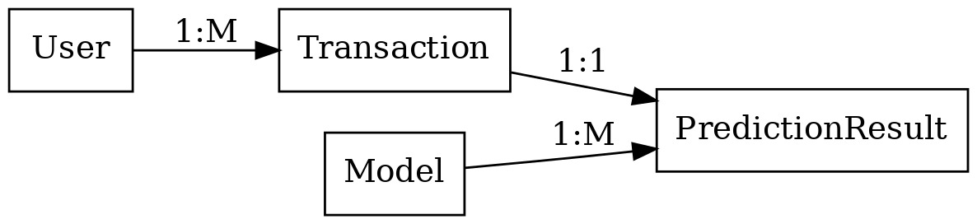
ER Diagram

Slide 17
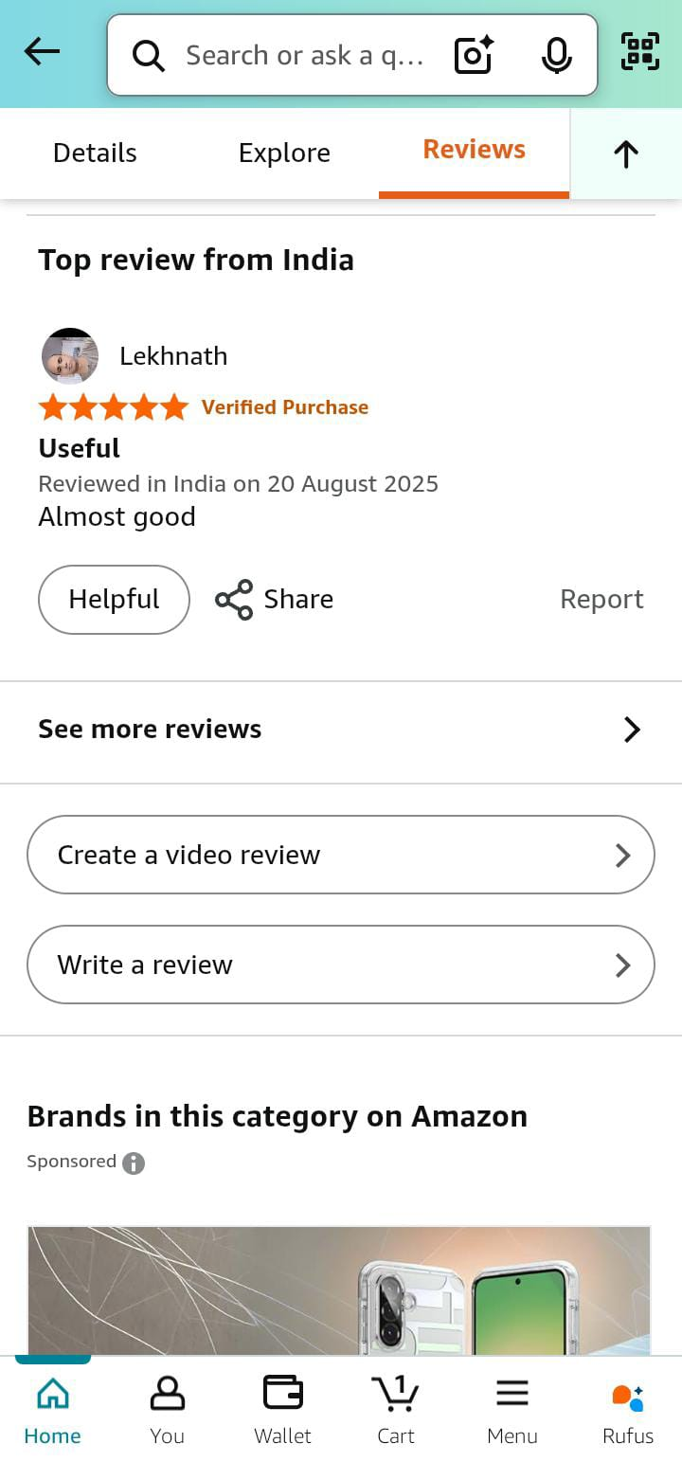
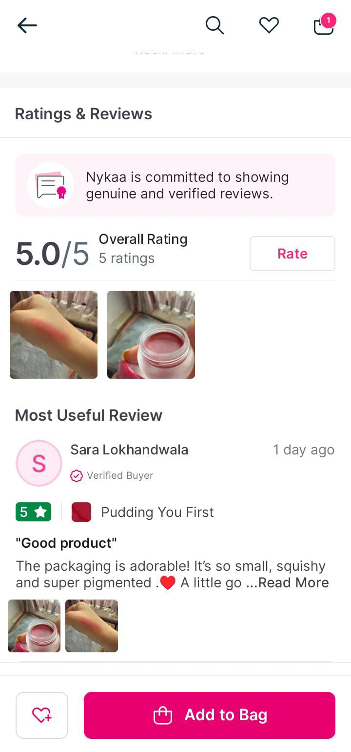
Real Time Examples

Slide 18
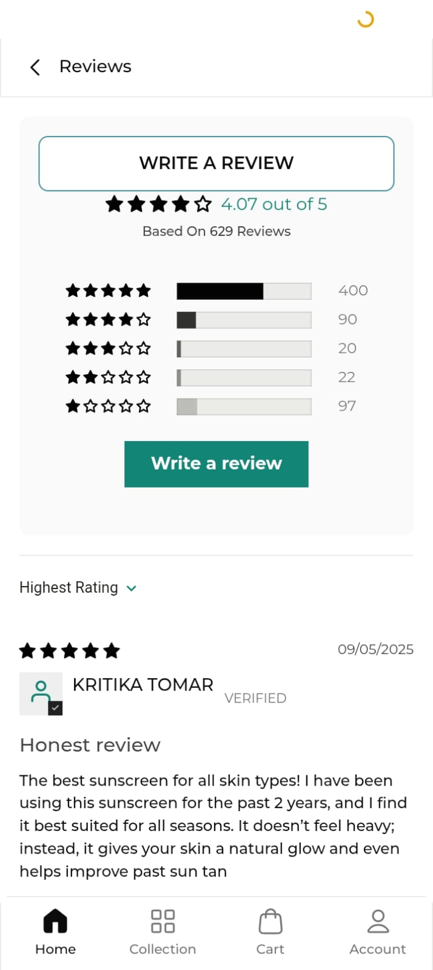
Real Time Example

Slide 19

As we look to the future, these technologies will play a crucial role in shaping a better world for generations to come.

