Slide 1
SNMIMT ENGINEERING COLLEGE
Maliankara p.o, Moothakunnam, Ernakulam Dt, Kerala - 683 516
Website : www.snmimt.edu.in
IEDC SNMIMT
Kerala Startup Mission
INNOVATION AND ENTREPRENEURSHIP DEVELOPMENT CENTRE
ed
club
BMC
B U S I N E S S M O D E L C A N V A S
HANDLED BY -
SHREYAS K P
IPR & RESEARCH LEAD
16-09-2026
2:00 PM - 4:00 PM
IEDC SNMIMT

Slide 2
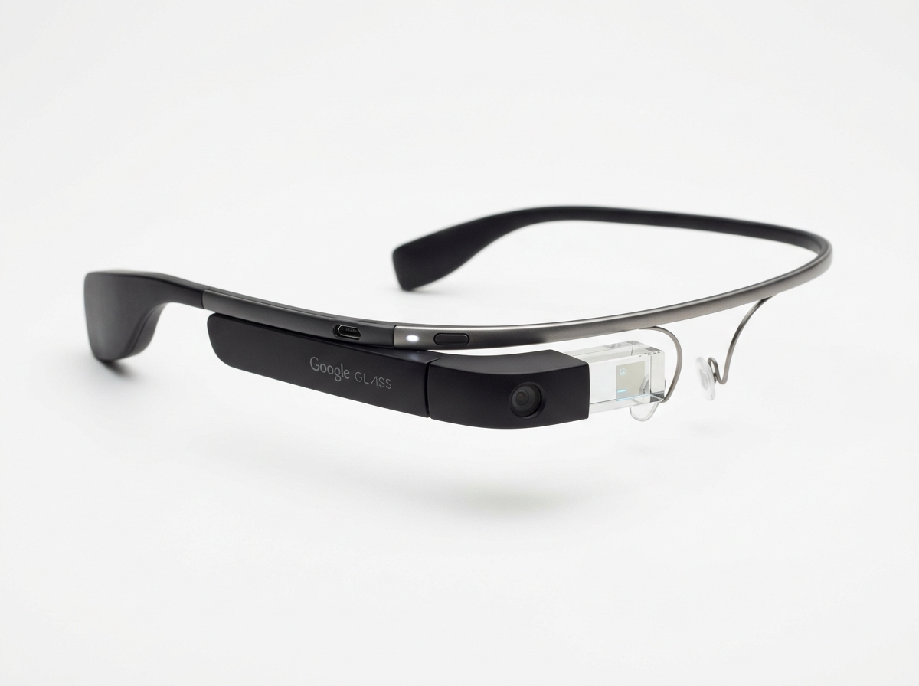


WHY DO GOOD PRODUCTS FAIL?
Some products have:
✓ Great Technology
✓ Innovative Features
✓ Excellent Engineering
✓ Strong Marketing
BUT STILL FAIL.
💡 A GREAT PRODUCT DOESN'T GUARANTEE A GREAT BUSINESS.

Slide 3
BUSINESS MODEL CANVAS
It breaks a business idea into 9 building blocks (like puzzle pieces) so that anyone can easily understand the whole business in a simple way.
KEY PARTNERS
KEY ACTIVITIES
VALUE PROPOSITION
CUSTOMER RELATIONSHIPS
CUSTOMER SEGMENTS
7
4
8
KEY RESOURCES
2
CHANNELS
1
6
3
COST STRUCTURE
REVENUE STREAMS
9
5

Slide 4
SO HOW IS BMC DIFFERENT
FROM LEAN CANVA?
🤔 Thinking about when to use which framework...

Slide 5
LEAN CANVAS
PROBLEM
List your top 1-3 problems.
SOLUTION
Outline a possible solution for each problem.
UNIQUE VALUE PROPOSITION
Single, clear, compelling message that states why you are different.
UNFAIR ADVANTAGE
Something that cannot easily be bought or copied.
CUSTOMER SEGMENTS
List your target customers and users.
EXISTING ALTERNATIVES
List how these problems are solved today.
KEY METRICS
List key numbers that tell you how business is doing.
HIGH-LEVEL CONCEPT
List your X for Y analogy e.g. YouTube = Flickr for videos.
CHANNELS
List your path to customers (inbound or outbound).
EARLY ADOPTERS
List characteristics of your ideal customers.
COST STRUCTURE
List your fixed and variable costs.
REVENUE STREAMS
List your sources of revenue.

Slide 6
BMC IS USED TO:
◦ UNDERSTAND HOW A BUSINESS WORKS.
◦ SHOW INVESTORS OR TEAM MEMBERS YOUR BUSINESS MODEL.
◦ ANALYZE SUCCESSFUL COMPANIES.
LEAN CANVAS IS USED TO:
◦ QUICKLY TEST IF YOUR STARTUP IDEA MAKES SENSE.
◦ FOCUS ON CUSTOMER PROBLEMS FIRST.
◦ AVOID WASTING TIME BUILDING SOMETHING NOBODY WANTS.

Slide 7
Group Activity

