Slide 1

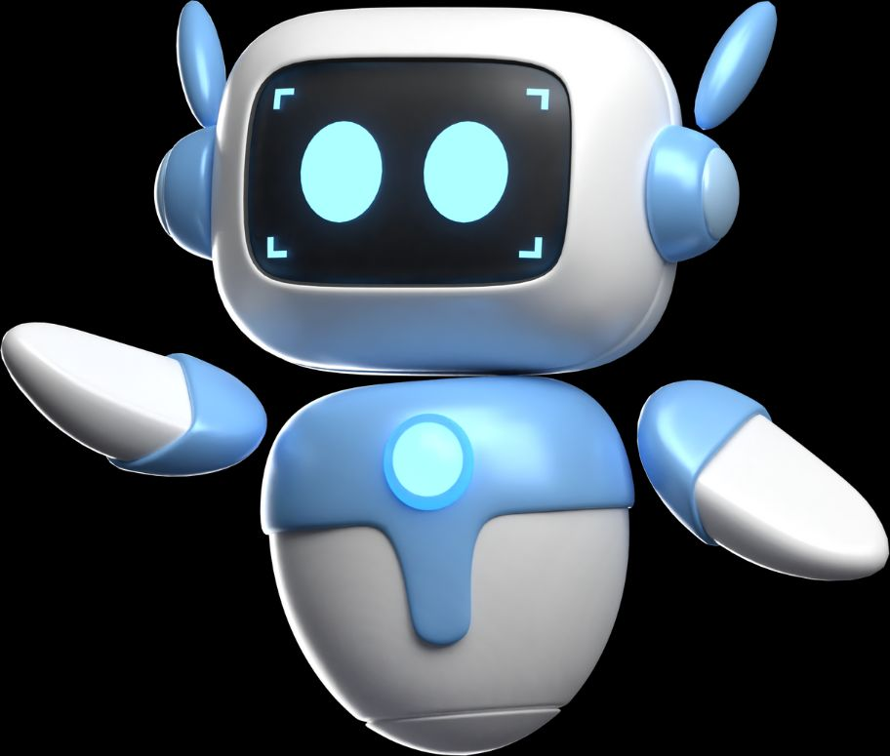

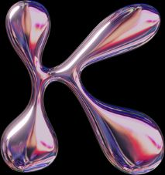
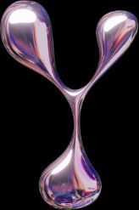
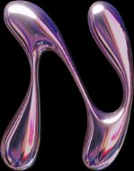

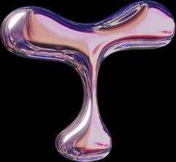


TO UNFOLD FUTURE
Giving Robots the Power to Feel
By Shreyas K P & Amrithraj

Slide 2



Introduction to Skynetic
Skynetic is a system designed to equip robots with a sense of touch, allowing them to detect and interpret physical contact
We aimed to bridge the gap between human intuition and robotic response, paving the way for more natural interactions.
Skynetic explores a new frontier in robotics: giving machines the ability to feel. We built this project to enhance human-robot interaction, making robots more intuitive and responsive to physical cues.

Slide 3


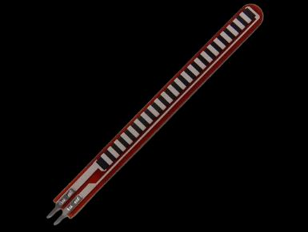
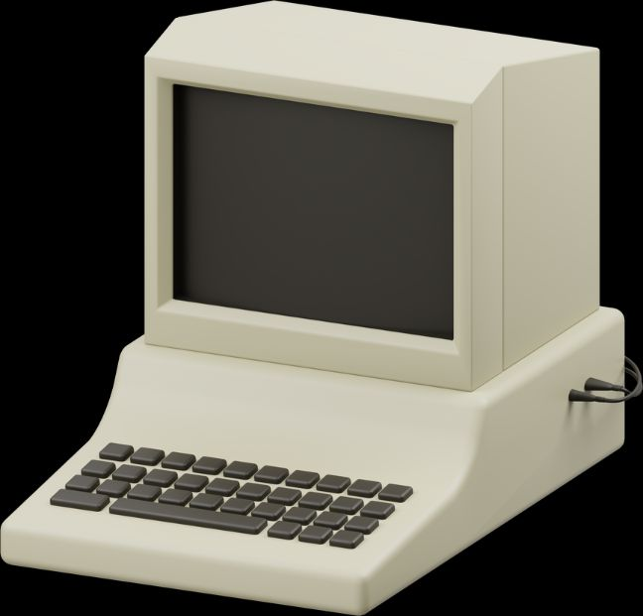
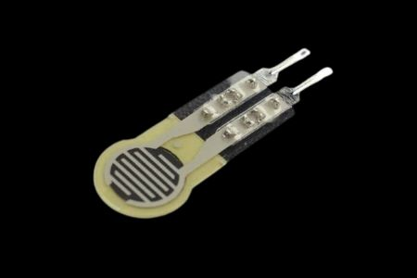
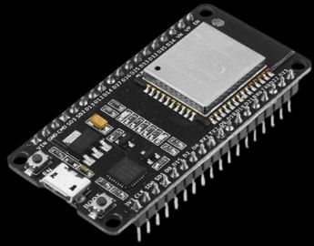
Core Components
Our Skynetic system is built upon a selection of key electronic components
ESP32-S2-WROVER74HC4051
MUX
Flex Sensor
LEDs
MS5837 Pressure Sensor

Slide 4




Working Principle
Skynetic's touch sensing capabilities are driven by a precise step-by-step process, allowing the system to interpret physical interactions and respond dynamically.
Touch Input
A touch or slap is applied to the sensor array
Sensor Data
Flex and pressure sensors convert physical contact into electrical signals.
ESP32 Processing
The ESP32 reads and analyzes sensor data against predefined thresholds.
LED Output
Based on intensity: Soft touch = Green LED Hard slap = Red LED

Slide 5

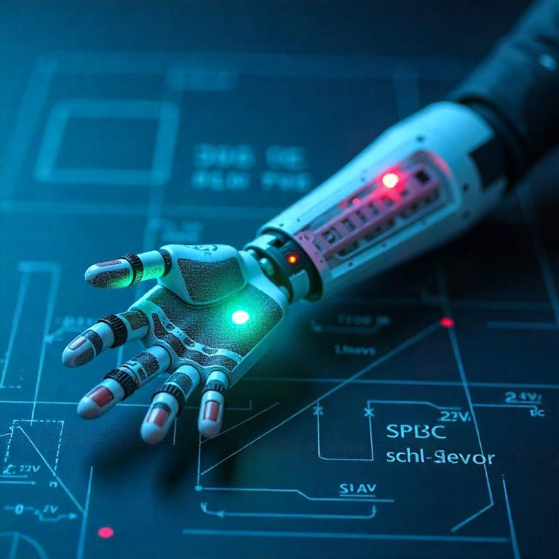
Travelling to the Future!
What do you think the world will look like in 15 years?

Slide 6


How do you imagine technology?
Computer

Slide 7


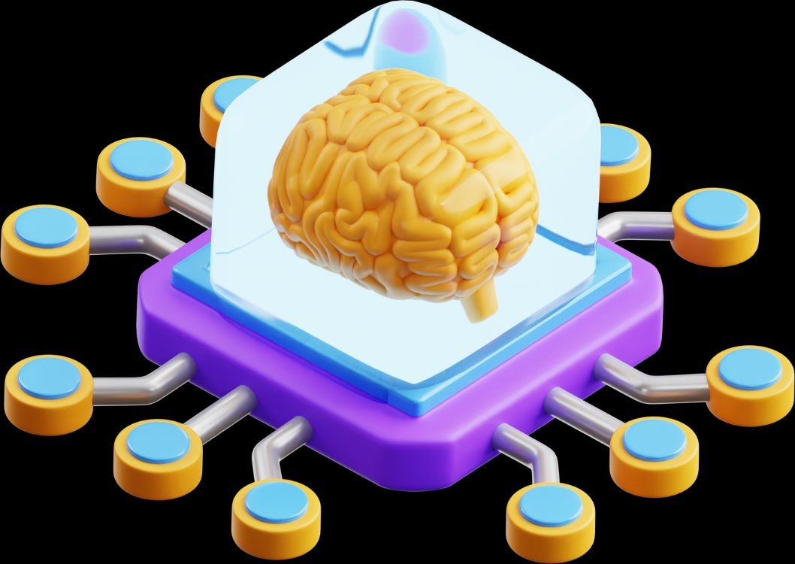
Circuit Overview
SKYNETIC

Slide 8
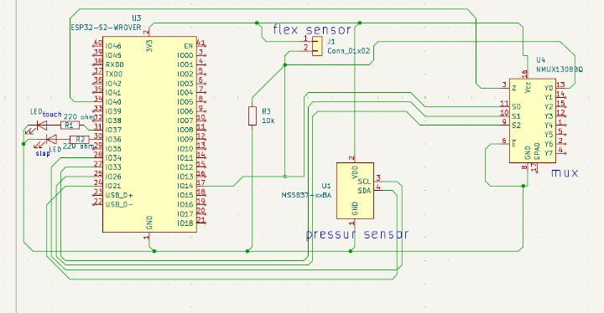

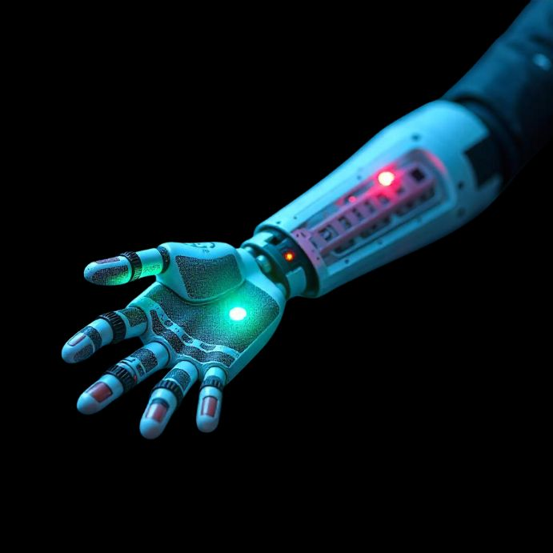
Circuit Overview

Slide 9

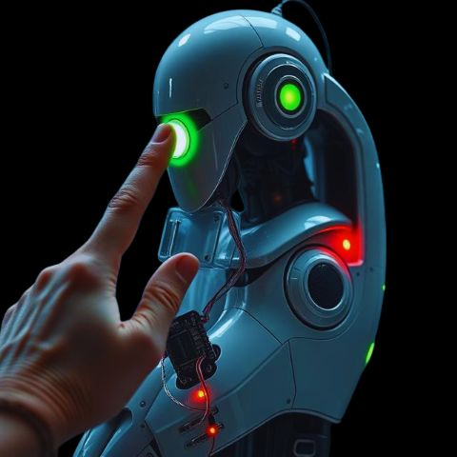
Applications
Enabling artificial limbs to feel and react to pressure.
Human-Robot Interaction
Smart Toys
Medical Robotics
More projects

Slide 10


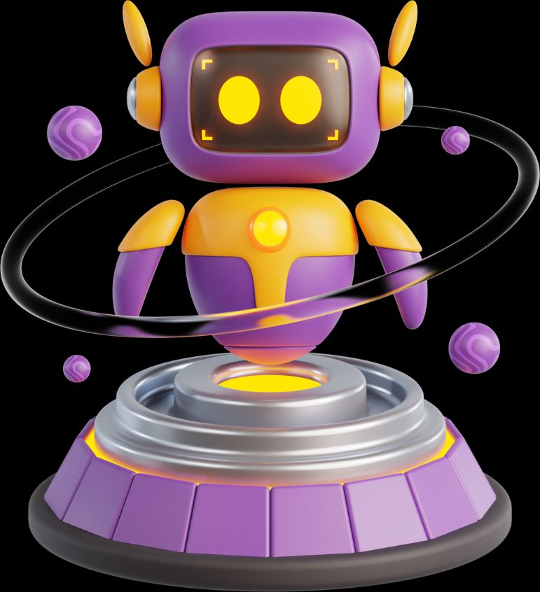
Do you know...?
Advantages
Robots

Slide 11

Advantages
Detects both touch and slap using pressure & flex sensors
Uses low-cost, easily available components
Modular design – more sensors can be added using a multiplexer
Provides real-time feedback with LED indicators
Enhances Human-Robot Interaction (HRI) and safety
Fully compatible with Arduino IDE and ESP32
Simple logic makes it easy to understand and modify
Compact and lightweight – ideal for wearable or robotic use
Great for educational and research purposes
A future-ready base for advanced haptics and AI integration

Slide 12


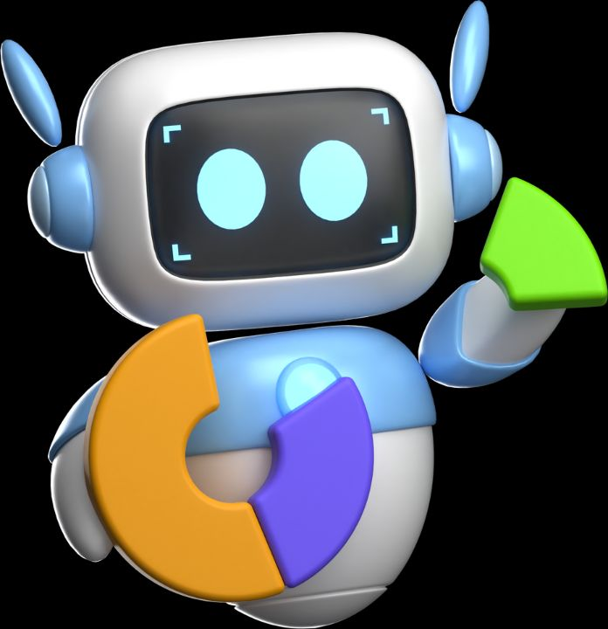

Do you know...?
Limitations

Slide 13
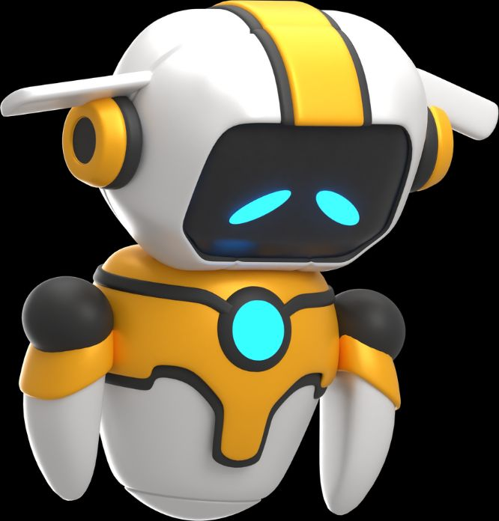
Limitations
Requires manual calibration for accurate detection
Flex sensors may degrade over time with frequent use
Limited pressure range
Only provides LED feedback
Not ideal for industrial environments without rugged redesign

Slide 14

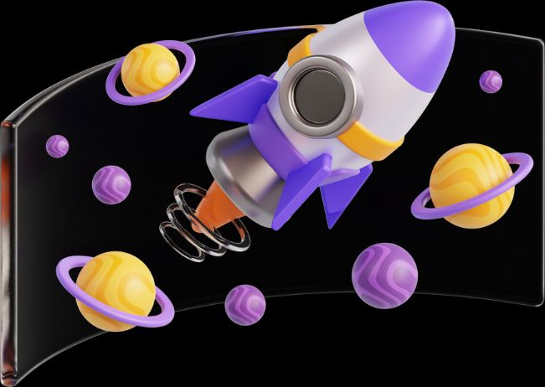
Conclusion
Skynetic gives robots the ability to feel and respond to human touch. Using simple sensors and smart logic, it can tell the difference between a soft touch and a slap. This project is a step toward more human-aware, emotionally intelligent machines.

Slide 15

“SKYNETIC IS WHERE TECHNOLOGY STARTS TO FEEL.”

