Slide 1
Olist A Brazilian E-commerce Company
Olist Project Group 1
Shreyash Khote Akash Dandu Sreenija Pottladurthi Akshay Buktare Mayank Rai

Slide 2
Agenda
Client Scenario & Data Overview
Database Normalization
KPI’S
Analytics Insights Automation - Benefits & Procedure
Dashboard

Slide 3
Client Scenario: Empowering Business Intelligence At Olist
Existing Points
Data stored in disparate locations across numerous flat files.
Ineffective retrieval process for information.
Insufficient analytical insights hindering strategic decision-making.
Create a normalized relational database as a central data repository to collect data.
Perform data manipulation and cleansing using tools such as Excel.
Produce actionable insights using an interactive dashboard created with Meta base.
Future implications
Reduce data storage redundancy.
Develop streamlined processes for data querying and analytics.
Enhance the capacity for data-driven decision-making.

Slide 4

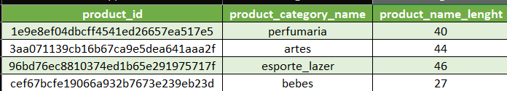
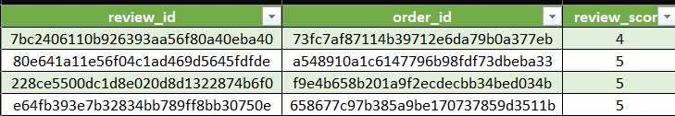
Original Data Sample – Data Overview
The Data encompasses 100,000 orders placed by Olist customers between 2016 and 2018, originating from multiple sellers located across Brazil.
9 Flat CSV Files: Customers, Geolocation, Order Items, Order Payments, Order Reviews, Orders, Products, Sellers, and Categories.
Combined size: 123.4 MB.
Combining the geolocation dataset (61.3MB) with the customer dataset (9MB) to establish linkage would result in the customer dataset exceeding 150MB.
Consequently, we choose to sample both datasets for subsequent utilization.
In the reviews dataset, one review_id would link to different order_id with different information in other columns. (composite primary key: review_id, order_id)
Information about orders, delivery, product ordered is stored in separate files.

Slide 5
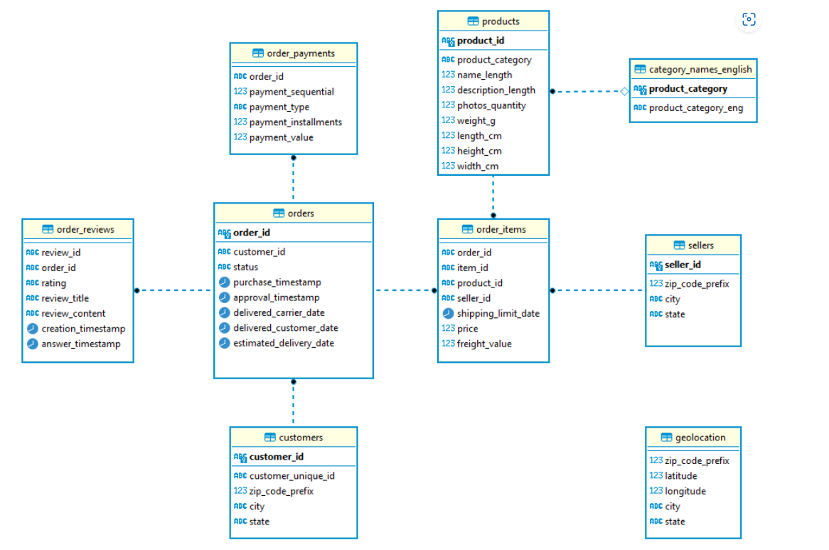
Normalization Plan: Creating an Optimized Data Schema :
1st Normal Form
Added primary keys such as geolocation_id to Address table
Added foreign keys such as product_category_id to Product Category table
Dropped duplicated data such as address data from Customers/Sellers tables
2nd Normal Form
No changes on the tables as all non-key attributes were fully dependent
3rd Normal Form
The Orders table was split into Orders and Delivery tables

Slide 6
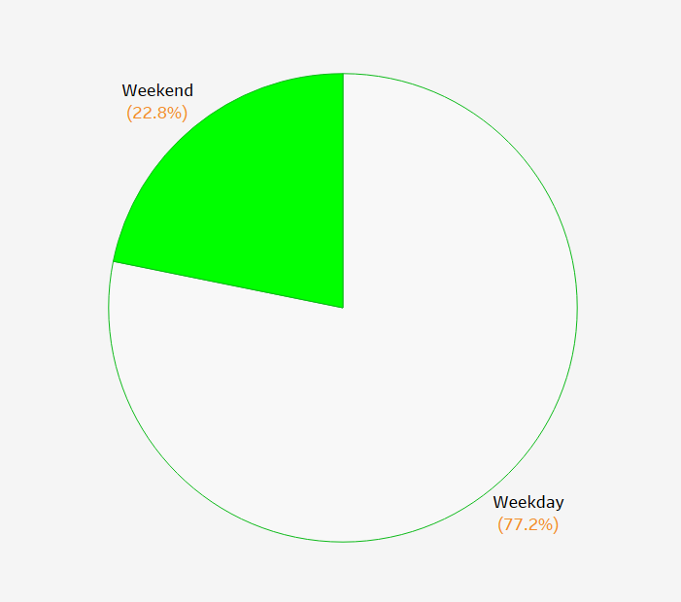
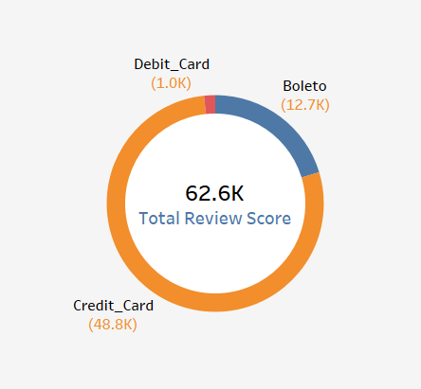
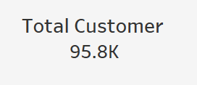
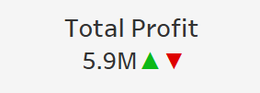

KPI’S :-
KPI stands for Key Performance Indicator. It is a measurable value that demonstrates how effectively a company is achieving key business objectives. KPIs are used to evaluate the success of an organization or a particular activity in relation to its strategic goals.
Weekday Vs Weekend (order_purchase_timestamp) Payment Statistics
Number of Orders with review score 5 and payment type as credit card.
Average number of days taken for order_delivered_customer_date for pet_shop
Average price and payment values from customers of sao Paulo city
Relationship between shipping days (order_delivered_customer_date -order_purchase_timestamp) Vs review scores.

Slide 7
The Advantages of Analytical Procedures (Why) :
Customer Insights
CMO: The CMO seeks to grasp customer demographics, shopping behaviors, and product preferences for targeted marketing. This includes analyzing city distribution, customer lifetime value, top categories, peak purchase times, and customer numbers monthly and annually.
Seller Insights
The Client Account Executive aims to grasp sellers' demographic information, sales performance, and product rankings to help them enhance their performance. This includes identifying top sellers and categories with the highest growth.
Provide C-level Executives And Analysts With A Holistic Perspective On Business Performance.
Financials Insights
The CFO is responsible for analysing real-time platform revenue and costs to facilitate quick decision-making and identify potential performance issues. Furthermore, they aim to understand order values and monitor monthly and annual sales for continuous improvement.
Operations Insights
The COO Supervise logistics operations, promptly addressing significant shipment delays, and monitor monthly performance of on-time delivery rates.
Post-Purchase Support Insights
The Customer Service Executive evaluates customer review metrics to uphold high-quality closed-loop service, examining order review scores and addressing customer complaints.

Slide 8
Analytical Methodology Guidelines (How) :
Vision
C-suite executives convey essential metrics utilized for assessing departmental performance to analysts.
Creation
Analysts build customized metrics for the dashboard by writing queries using both Excel and SQL on the Metabases platform.
Action
C-level executives regularly monitor the dashboard daily to supervise business performance. Upon identifying issues like a decline in sales, they should promptly notify analysts to conduct deeper analysis and guide data-driven decision-making.
Implementation
Analysts are encouraged to gather feedback from executives to enhance the analytical process through metric revisions.

Slide 9
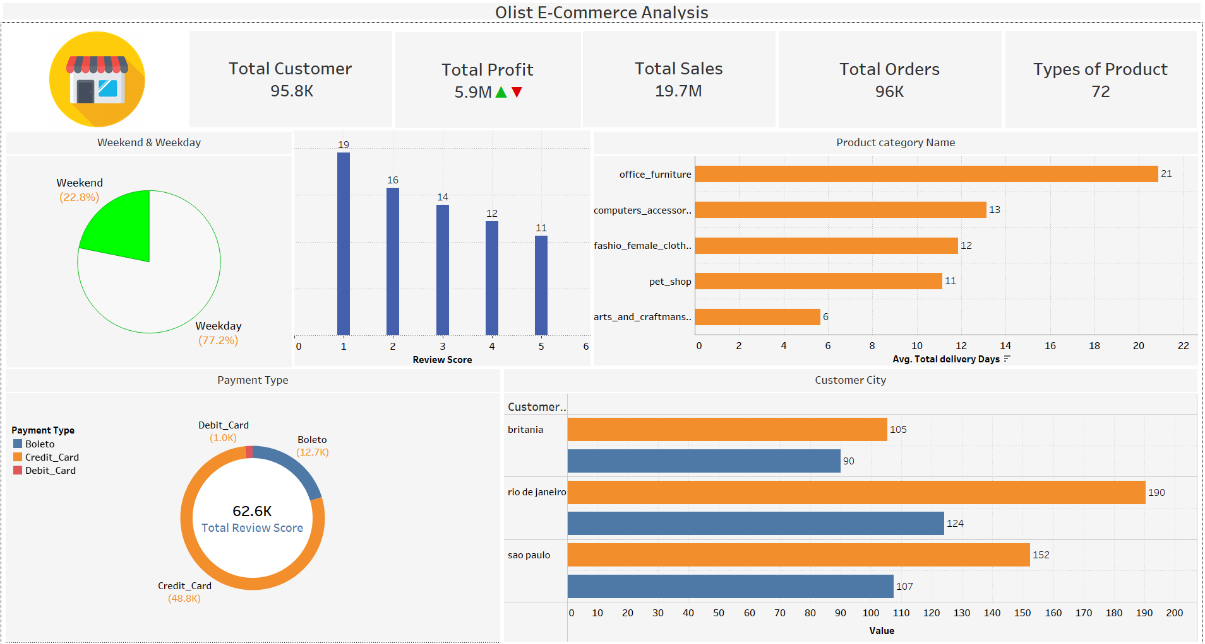
Dashboard Interaction Demo

Slide 10
Thank You

