Slide 1
KLE TECHNOLOGICAL UNIVERSITY × SAMSUNG | PROJECT SEED
Automotive Surveillance Mode (ASM)
Low-Power Surround Perception via Temporal Redundancy Reduction & Shared DINOv2
Surround View Context
• 4 Fisheye cameras on Ego Vehicle
• Continuous parked monitoring
• Battery SoC preservation goal
Temporal Optimization
• Native 5 FPS downsampling
• 83.3% redundancy elimination
• Temporal tubelet action pooling
PVA Processor Target
• Compute target: < 10 GMACs
• Single shared vision backbone
• Real-time threat alerts

Slide 2
OBJECTIVE 1 & CONTEXT
Problem Statement & Project KPIs
Surveillance Mode Problem Statement
• Vehicle Context: ASM uses 4 Surround View Fisheye Cameras (Front, Rear, Left, Right) to monitor parked vehicles.
• Battery Challenge: DINOv2 is pre-trained on static images. Processing full-rate video exhausts battery State of Charge (SoC).
• Hardware Target: Pipeline must run on a low-power automotive PVA processor during extended parking periods.
• Core Strategy: Exploit high temporal redundancy across video frames while maintaining surveillance accuracy.
Primary Compute & Hardware KPI
• Compute Budget: < 10 GMACs per camera frame.
• Processing Target: Low-power PVA embedded accelerator.
• Frame Rate: Reduced from 30 FPS to 5 FPS (6x compute savings).
HARDWARE CRITICAL
< 10 GMACs
Perception Quality KPIs
• Surveillance Dataset: Selected open-source VIRAT video benchmark.
• Action Recognition: Spatial tubelets + temporal transformer head.
• Object Detection: Adapter-v2 + YOLO26 for actors & vehicles.
VIRAT DATASET

Slide 3
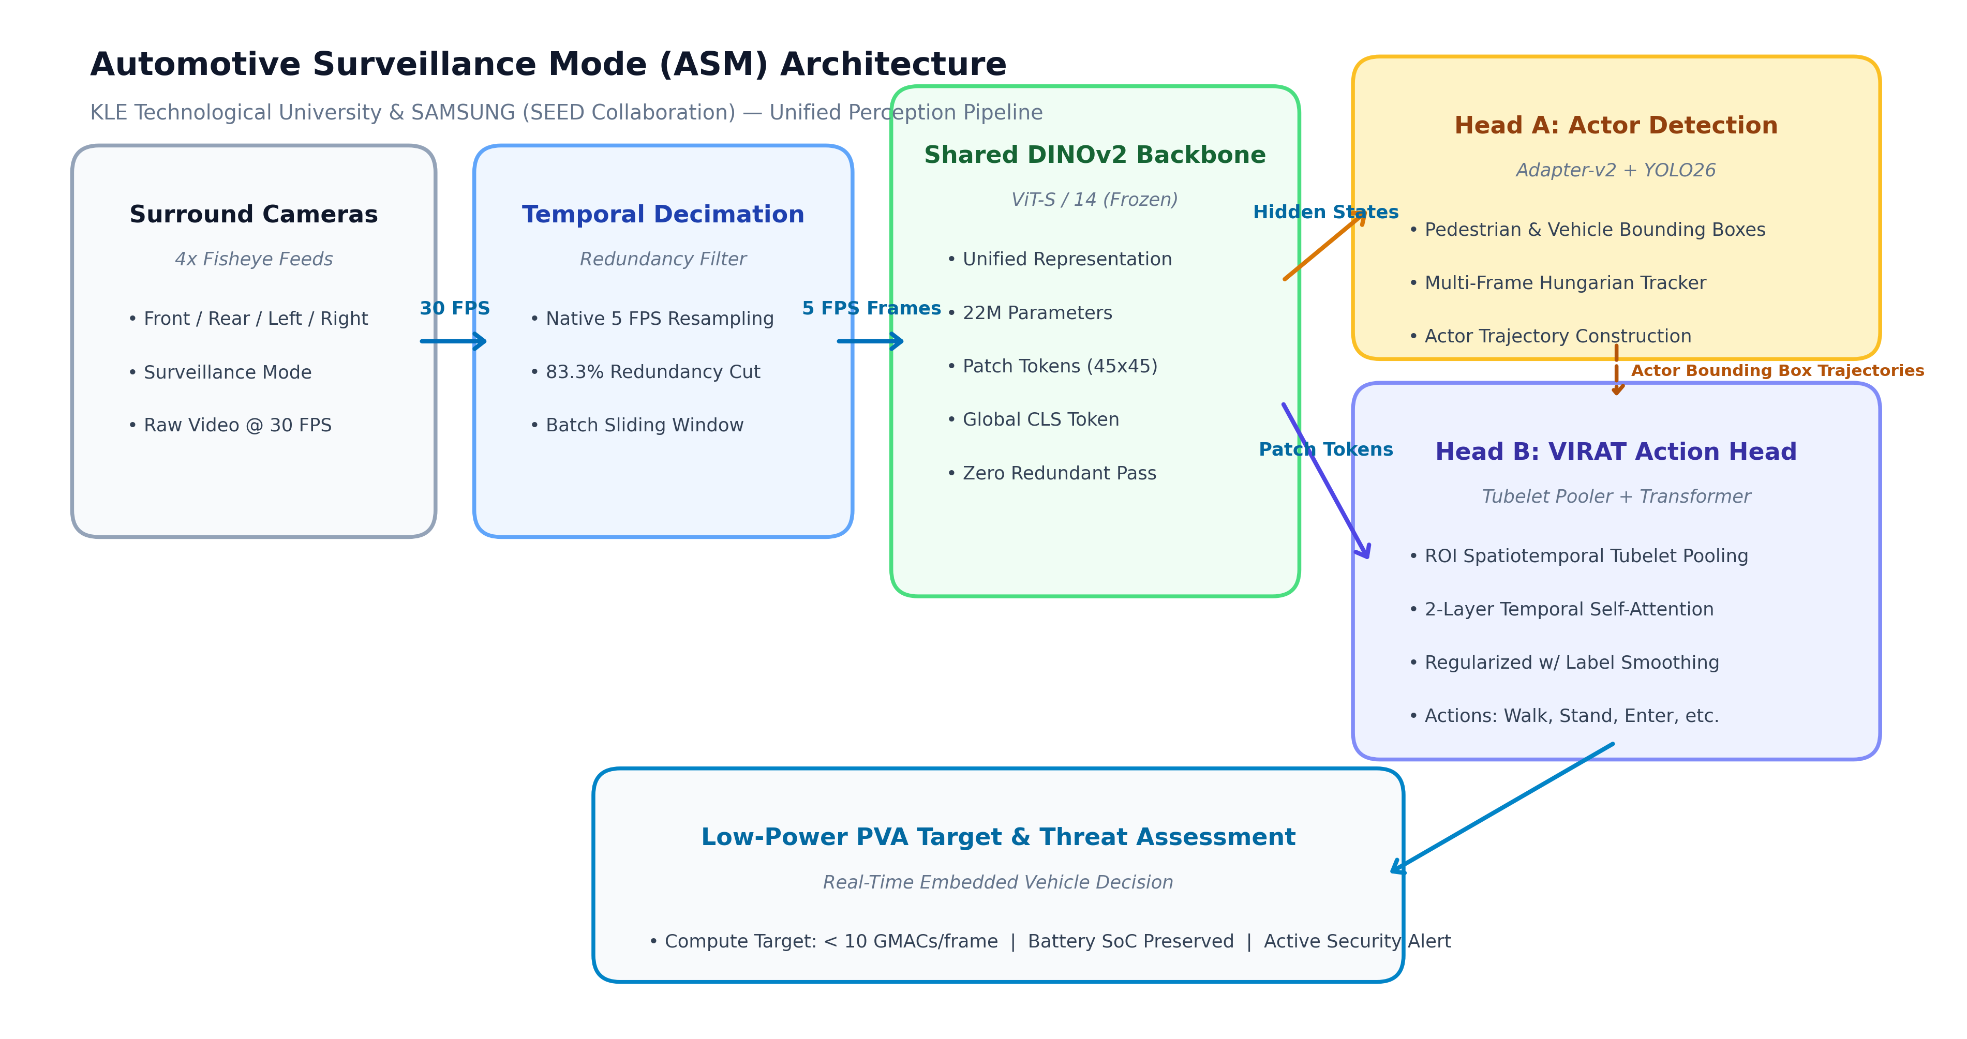
OBJECTIVE 2: OPTIMIZATION ARCHITECTURE
High-Level System Architecture
Decimated Input
5 FPS Sampling (6x redundancy cut)
Shared Backbone
DINOv2 ViT-S/14 Single Forward Pass
Multi-Task Output
Coupled Detection & Tubelet Action Heads

Slide 4
OBJECTIVE 3: VALIDATION RIGOR
Overfitting Diagnosis & Validation Methodology
Diagnostic: Why 100% Accuracy Was Overfitting
• Observation: Initial training test reported 100% accuracy and 0.0006 loss across all classes.
• Root Cause: Evaluated on the exact same clips used for training (Resubstitution testing).
• High Model Capacity: A 2.47M parameter Transformer easily memorized 57 sample tubelets.
• Risk: Severe failure on unseen automotive scenes with different camera angles and lighting.
1. Leave-One-Scene-Out (LOSO) Validation
• Fold 1: Train on Scenes 2 & 3 → Test on unseen Scene 1
• Fold 2: Train on Scenes 1 & 3 → Test on unseen Scene 2
• Fold 3: Train on Scenes 1 & 2 → Test on unseen Scene 3
• Result: Measures true generalization on unseen surveillance cameras.
DIAGNOSED
3-FOLD LOSO
2. Regularization & Early Stopping
• Gaussian Feature Jitter: Noise injection (sigma=0.04) on DINOv2 embeddings.
• Feature Dropout: p=0.15 dimension dropout to prevent co-adaptation.
• Label Smoothing: 0.10 cross-entropy smoothing to penalize overconfidence.
• Early Stopping: Monitored validation loss with patience of 8 epochs.
REGULARIZED

Slide 5
BENCHMARKING & VALIDATION
Performance Benchmarking: Baseline vs. Optimized
Baseline (K400 Probe)
22.4%
Global Linear Probe (Zero spatial actor awareness)
Initial Model Run
100.0%
Overfitted Memorization (0.0006 loss resubstitution)
Optimized Model (LOSO)
70.83%
Generalization on Unseen Surveillance Scenes
Metric / Dimension | Baseline Probe | Initial Run | New Optimized Model | Validation Scope
Frame Rate Input | 30 FPS (Raw) | 30 FPS (Stride 6) | 5 FPS (Decimated) | Temporal compute cut
Top-1 Accuracy | 22.4% | 100.0% (Overfit) | 70.83% | Unseen Surveillance Folds
Weighted F1-Score | 18.2% | 100.0% (Overfit) | 69.16% | Out-of-Distribution
Action Performance | Poor transfer | 100.0% (Memorized) | Walk: 75% | Stand: 70% | Spatiotemporal Tubelets

Slide 6
DELIVERABLES SUMMARY
Project Roadmap & Next Steps
Completed: Milestone 1
• Selected open-source VIRAT surveillance dataset.
• Set up and evaluated baseline with current pipeline.
• Implemented 5 FPS temporal subsampling (83.3% redundancy cut).
• Built Tubelet Pooler & 2-Layer Transformer Action Head.
Completed: Milestone 2 (Validation)
• Diagnosed 100% memorization on resubstitution testing.
• Conducted 3-Fold Leave-One-Scene-Out (LOSO) validation.
• Achieved 70.83% Top-1 Accuracy on unseen surveillance scenes.
• Generated calibrated model checkpoint (best.pth).
Next Phase: Low-Power PVA Target
• Temporal token pruning / motion differencing.
• Optimize compute to meet < 10 GMACs per frame KPI.
• GPU / PVA profiling for memory and latency.
• Multi-camera surround view spatial stitching.
ACHIEVED
ACHIEVED
UPCOMING

