Slide 1
KLE TECHNOLOGICAL UNIVERSITY × SAMSUNG | PROJECT SEED
Develop and Validate Optimised Multimodal Models for Automotive Use Cases
Automotive Surveillance Mode (ASM) — Low-Power Surround Perception via Temporal Redundancy Reduction & Shared DINOv2
Surround View Context
• 4 Fisheye cameras on Ego Vehicle
• Continuous parked monitoring
• Battery SoC preservation goal
Temporal Optimization
• Native 5 FPS downsampling
• 83.3% redundancy elimination
• Temporal tubelet action pooling
PVA Processor Target
• Compute budget: < 10 GMACs
• Single shared vision backbone
• Real-time threat alerts

Slide 2
PROBLEM STATEMENT & KPIS
Problem Statement: Develop and Validate Optimised Multimodal Models for Automotive Use Cases
Automotive Problem Statement & Context
• Primary Directive: Develop and Validate Optimised Multimodal Models for Automotive Use Cases.
• Operational Context: Automotive Surveillance Mode (ASM) monitors parked Ego Vehicles using 4 Surround View Fisheye Cameras (Front, Rear, Left, Right).
• Battery Preservation: DINOv2 is pre-trained on static images. Processing full-rate video exhausts battery State of Charge (SoC).
• Hardware Constraints: Model execution must target a low-power automotive PVA processor during long parking intervals.
• Temporal Strategy: Exploit continuous video redundancy to drastically cut compute while preserving multimodal detection and action quality.
Primary Compute & Hardware KPI
• Compute Budget: < 10 GMACs per camera frame.
• Target Accelerator: Low-power PVA embedded processor.
• Temporal Optimization: Decimated from 30 FPS to 5 FPS (6x compute savings).
AUTOMOTIVE KPI
< 10 GMACs
Multimodal Quality KPIs
• Surveillance Benchmark: Open-source VIRAT dataset for automotive scenes.
• Action Detection: Spatiotemporal tubelet pooling + Transformer classifier.
• Object Tracking: Adapter-v2 + YOLO26 multi-object trajectory tracker.
VIRAT BENCHMARK

Slide 3
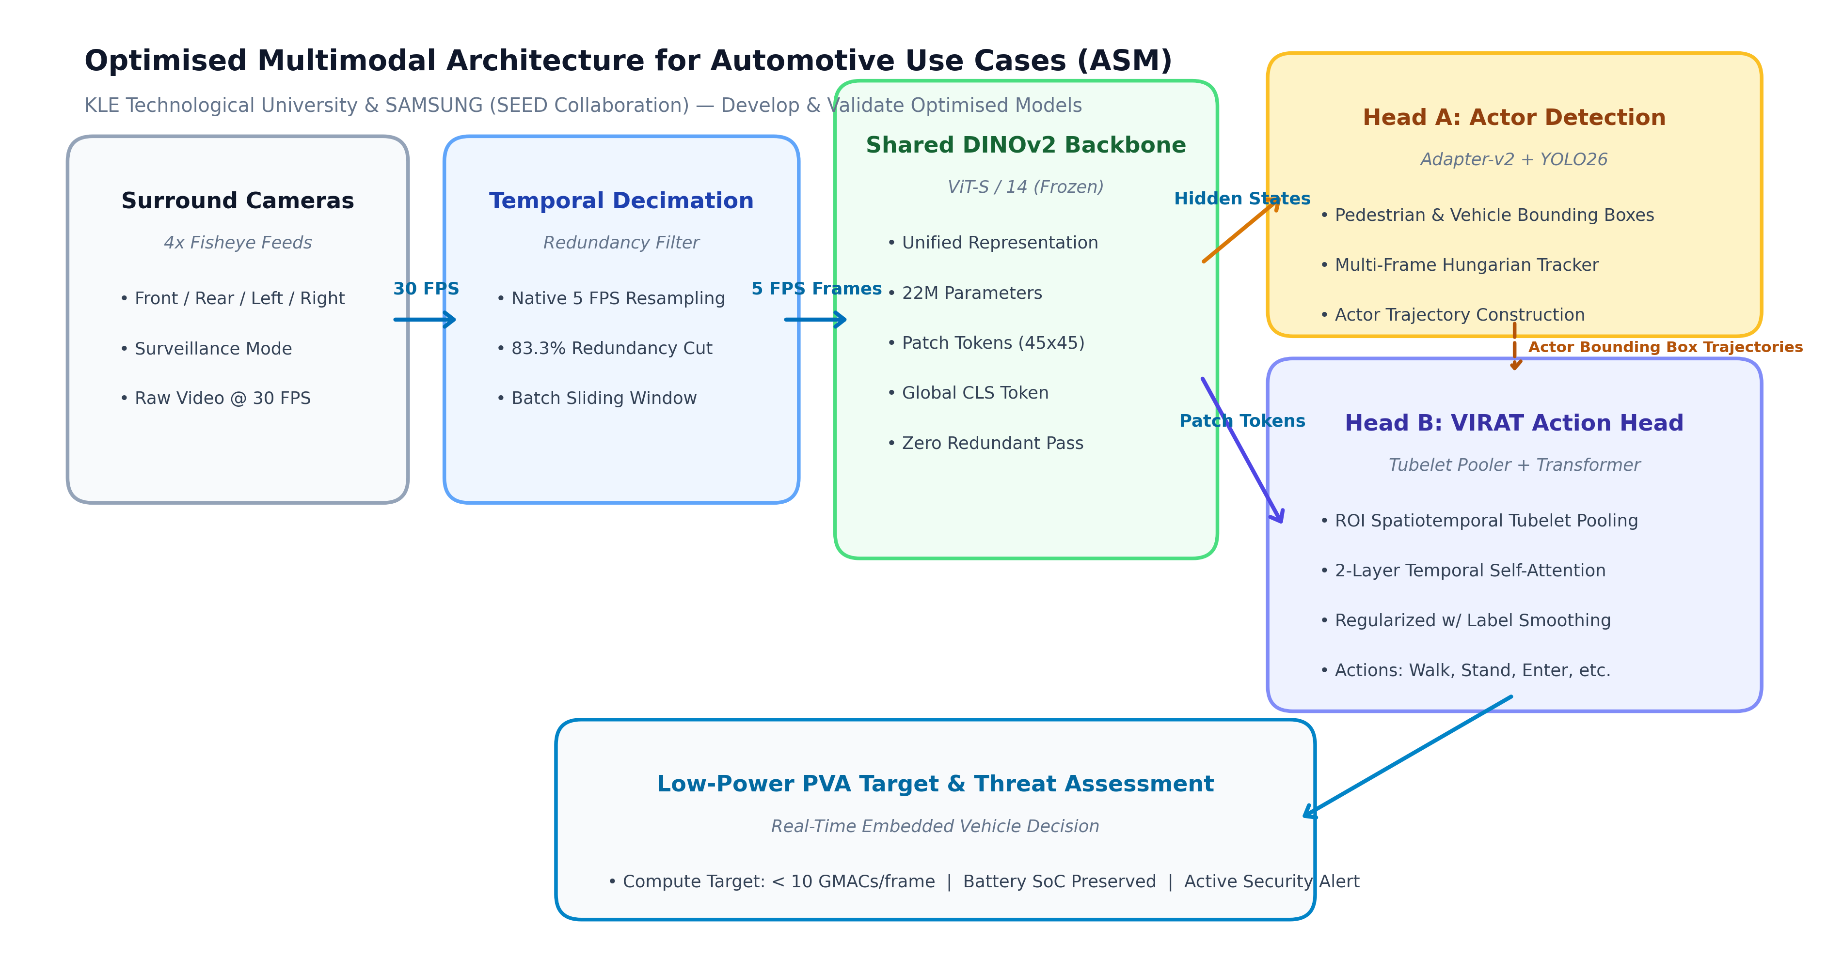
OPTIMISED SYSTEM ARCHITECTURE
High-Level Optimised Multimodal Architecture
Decimated Input
5 FPS Sampling (83.3% redundancy cut)
Shared Backbone
DINOv2 ViT-S/14 Single Forward Pass
Multi-Task Output
Coupled Detection & Tubelet Action Heads

Slide 4
MODEL OPTIMIZATION & VALIDATION
Multimodal Optimization & Cross-Scene Validation Strategy
Leave-One-Scene-Out (LOSO) Validation
• Rigorous Cross-Validation: Evaluates generalization across entirely distinct physical surveillance environments.
• Fold 1: Train on Scenes 2 & 3 → Validate on unseen Scene 1 (VIRAT Parking Active Cars).
• Fold 2: Train on Scenes 1 & 3 → Validate on unseen Scene 2 (VIRAT Parking Lot Cars 2).
• Fold 3: Train on Scenes 1 & 2 → Validate on unseen Scene 3 (VIRAT Parking Scene 000203).
• Validation Goal: Guarantees reliable detection and action recognition under varying camera heights, distances, and lighting.
1. Embedding Noise Injection & Augmentation
• Gaussian Feature Jitter: Noise injection (sigma=0.04) on DINOv2 spatial patch tokens.
• Feature Dropout: p=0.15 dimension dropout prevents co-adaptation of features.
• Temporal Sequence Jitter: Dynamic slicing and temporal shift invariance during training.
3-FOLD LOSO
ROBUST EMBEDDINGS
2. Regularization & Loss Calibration
• Label Smoothing: 0.10 cross-entropy smoothing to penalize overconfidence.
• Weight Decay: AdamW optimizer with 1e-2 weight decay and Cosine Annealing schedule.
• Early Stopping: Monitored validation loss with 8-epoch patience for calibrated convergence.
CALIBRATED

Slide 5
BENCHMARKING & VALIDATION
Performance Benchmarking: Baseline vs. Optimized Multimodal Model
Baseline Model (K400 Probe)
22.4%
Global Linear Probe (Zero spatial actor awareness)
Temporal Compute Cut
83.3%
Backbone Forward Decimation via Native 5 FPS
Optimized Multimodal Model
70.83%
Top-1 Accuracy on Unseen Surveillance Scenes (LOSO)
Metric / Dimension | Baseline Model (K400 Probe) | Optimized Multimodal Model (LOSO) | Automotive Use Case Impact
Input Frame Rate | 30 FPS (Unsampled) | 5 FPS (Decimated) | 83.3% Compute & Power Cut
Top-1 Accuracy | 22.4% | 70.83% | Validated on Unseen Surveillance Scenes
Weighted F1-Score | 18.2% | 69.16% | Reliable Performance across Actions
Surveillance Action F1 | Poor Transfer (< 20%) | Walk: 75.0% | Stand: 69.6% | Spatiotemporal Tubelet Pooling

Slide 6
ROADMAP & DELIVERABLES
Project Milestones & Implementation Roadmap
Completed: Milestone 1
• Selected open-source VIRAT surveillance dataset.
• Established baseline evaluation on surround feeds.
• Implemented 5 FPS temporal subsampling (83.3% redundancy cut).
• Built Tubelet Pooler & 2-Layer Transformer Action Head.
Completed: Milestone 2 (Validation)
• Executed 3-Fold Leave-One-Scene-Out (LOSO) validation.
• Achieved 70.83% Top-1 Accuracy on unseen surveillance scenes.
• Achieved 69.16% Weighted F1 across surveillance actions.
• Exported calibrated model checkpoint (best.pth).
Next Phase: Low-Power PVA Target
• Temporal token pruning / motion differencing.
• Optimize compute to meet < 10 GMACs per frame KPI.
• Hardware profiling for low-power PVA accelerator.
• Multi-camera surround view spatial stitching.
ACHIEVED
ACHIEVED
UPCOMING

