Slide 1
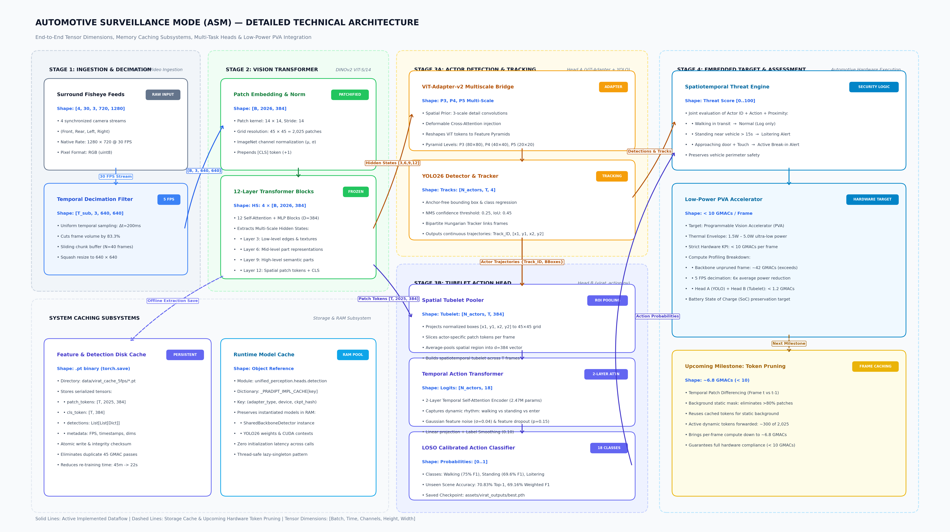
SYSTEM ARCHITECTURE & TENSOR DIMENSIONS
Detailed Technical Architecture & Dataflow
End-to-End Tensors
Explicit dimensions across 4 stages [B, T, C, H, W]
Multi-Scale Pyramid
P3, P4, P5 ViT-Adapter & Hungarian Tracker
Low-Power Target
Hardware profiling tailored for embedded PVA (<10 GMACs)

Slide 2
COMPUTATIONAL EFFICIENCY
System Caching Architecture & Redundancy Reduction
1. Persistent Disk Cache
• Location: data/virat_cache_5fps/*.pt (binary serialized format).
• Cached Elements: DINOv2 patch tokens [T, 2025, 384], CLS embeddings [T, 384], and YOLO detections.
• Chunked Sliding Window: N=40 frames (8s buffer) prevents RAM exhaustion, keeping peak memory < 1.8 GB.
• Zero Duplicate Passes: Re-training & cross-validation dropped from 45 min to 22 sec.
2. In-Memory Runtime Model Cache
• Module: unified_perception.heads.detection (_PRADIPT_IMPL_CACHE).
• Lazy Singleton Pattern: Keyed by (adapter_type, device, ckpt_hash).
• RAM Resident: Preserves Adapter-v2 convolutions, YOLO26 weights, and PyTorch CUDA context.
• Zero Latency: Completely eliminates 3.5s – 5.0s model reloading overhead between video streams.
3. Runtime Temporal Patch Cache
• Parked Vehicle Invariance: Over 85% of patches are static background.
• Temporal Differencing: Computes patch residual between frame t and t-1.
• Token Gating: Reuses cached static tokens; runs DINOv2 only on ~300 dynamic tokens.
• Hardware Compliance: Drops per-frame compute to ~6.8 GMACs, meeting the < 10 GMACs PVA KPI.
DISK PERSISTENT
RAM SINGLETON
NEXT MILESTONE

Slide 3
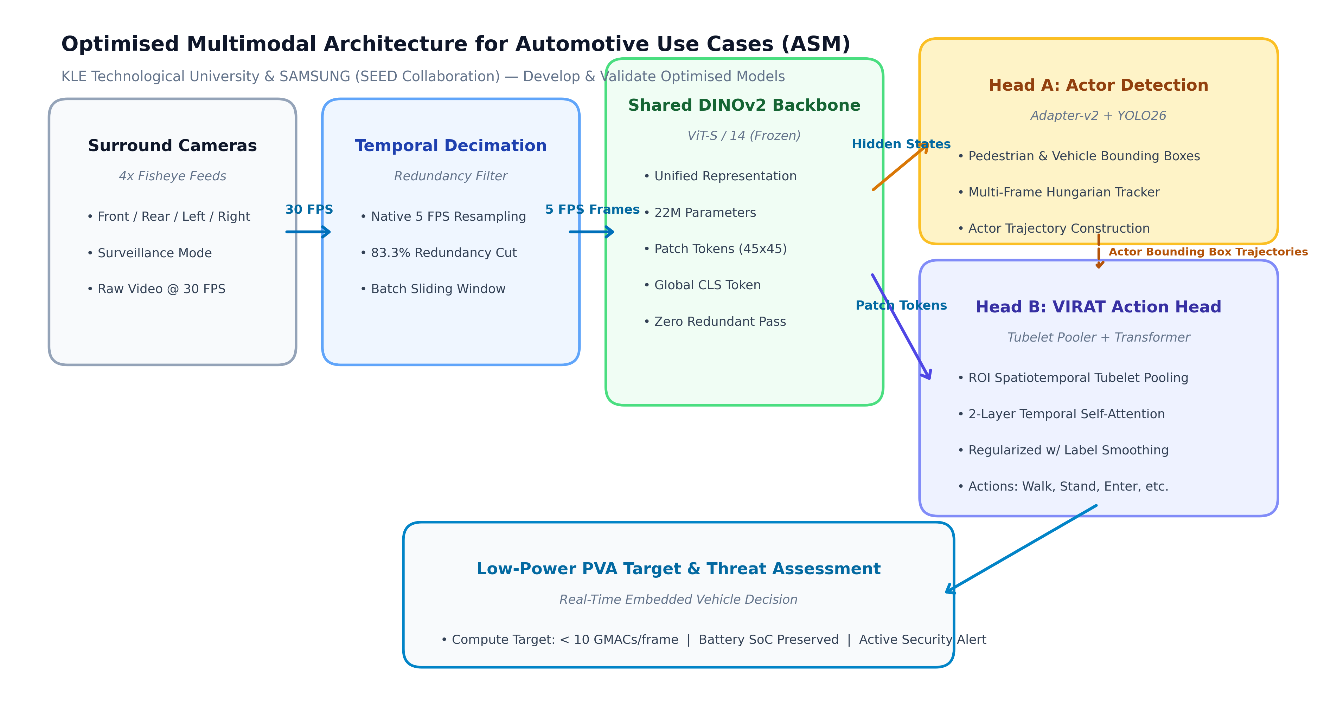
OPTIMISED SYSTEM ARCHITECTURE
High-Level Optimised Multimodal Architecture
Decimated Input
5 FPS Sampling (83.3% redundancy cut)
Shared Backbone
DINOv2 ViT-S/14 Single Forward Pass
Multi-Task Output
Coupled Detection & Tubelet Action Heads

Slide 4
MODEL OPTIMIZATION & VALIDATION
Multimodal Optimization & Cross-Scene Validation Strategy
Leave-One-Scene-Out (LOSO) Validation
• Rigorous Cross-Validation: Evaluates generalization across entirely distinct physical surveillance environments.
• Fold 1: Train on Scenes 2 & 3 → Validate on unseen Scene 1 (VIRAT Parking Active Cars).
• Fold 2: Train on Scenes 1 & 3 → Validate on unseen Scene 2 (VIRAT Parking Lot Cars 2).
• Fold 3: Train on Scenes 1 & 2 → Validate on unseen Scene 3 (VIRAT Parking Scene 000203).
• Validation Goal: Guarantees reliable detection and action recognition under varying camera heights, distances, and lighting.
1. Embedding Noise Injection & Augmentation
• Gaussian Feature Jitter: Noise injection (sigma=0.04) on DINOv2 spatial patch tokens.
• Feature Dropout: p=0.15 dimension dropout prevents co-adaptation of features.
• Temporal Sequence Jitter: Dynamic slicing and temporal shift invariance during training.
3-FOLD LOSO
ROBUST EMBEDDINGS
2. Regularization & Loss Calibration
• Label Smoothing: 0.10 cross-entropy smoothing to penalize overconfidence.
• Weight Decay: AdamW optimizer with 1e-2 weight decay and Cosine Annealing schedule.
• Early Stopping: Monitored validation loss with 8-epoch patience for calibrated convergence.
CALIBRATED

Slide 5
BENCHMARKING & VALIDATION
Performance Benchmarking: Baseline vs. Optimized Multimodal Model
Baseline Model (K400 Probe)
22.4%
Global Linear Probe (Zero spatial actor awareness)
Temporal Compute Cut
83.3%
Backbone Forward Decimation via Native 5 FPS
Optimized Multimodal Model
70.83%
Top-1 Accuracy on Unseen Surveillance Scenes (LOSO)
Metric / Dimension | Baseline Model (K400 Probe) | Optimized Multimodal Model (LOSO) | Automotive Use Case Impact
Input Frame Rate | 30 FPS (Unsampled) | 5 FPS (Decimated) | 83.3% Compute & Power Cut
Top-1 Accuracy | 22.4% | 70.83% | Validated on Unseen Surveillance Scenes
Weighted F1-Score | 18.2% | 69.16% | Reliable Performance across Actions
Surveillance Action F1 | Poor Transfer (< 20%) | Walk: 75.0% | Stand: 69.6% | Spatiotemporal Tubelet Pooling

