Slide 1

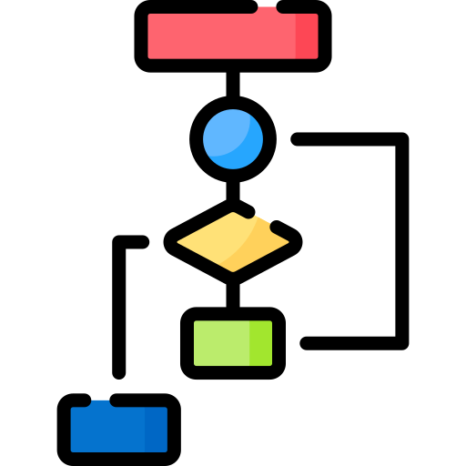
Algorithm Visualizer
By –
36 Shreyas Sawant
37 Vikas Patil
38 Rupam Jadhav
39 Harshvardhan Solankure

Slide 2


01
INTRODUCTION
02
GOALS
03
OVERVIEW
04
FEATURERS & WORKING
05
FUTURE SCOPE
06
TOOLS USED

Slide 3

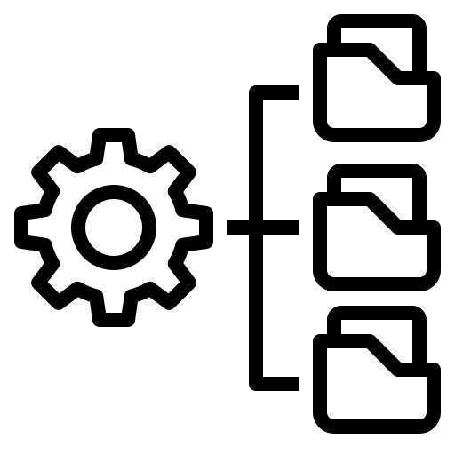
INTRODUCTION
This project focuses on visualizing the data structures by the help of computer software and equipment.
2. The user can provide their custom values and perform preferred technique and see live result.
3. We can see searching and sorting techniques visually using graphical user interface.
4.This webapp provides Tutorials | Documents | Source Code to User.

Slide 4

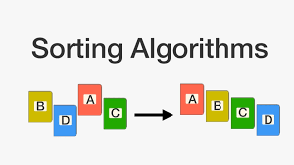
GOALS
1. TREES AND GRAPH TRAVERSAL
TECHNIQUES
2. STACK,QUEUE AND OTHER
DATA STURCTURE VSIUALS
3. EDITABLE VISUALS
4. EASY IMPLEMENTATION

Slide 5
FEATURES
Attractive UI
For Better Understanding
01
02
Responsive code IDE
Platform Independant
03
04
Understandable concepts
through Videos | Documents!

Slide 6
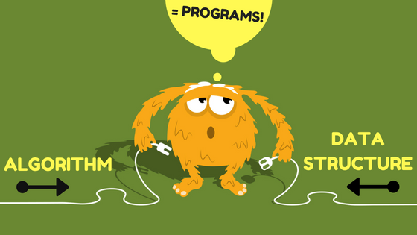
WORKING
Basically we have named the project after the actual function and combined it with our UI theme we going for i.e a bit neonish. The basic job of the webapp is the simplify the working of various DS algorithms with the help of the visuals where we will try to give the code at below of the output and user can map the visuals with the code. About the home page - We kept it simple and just gave a toolbar with 4 options and a main button which will direct to search and sort pages. Also tried some new with the ALGORITHM label there. Sort - We have given 4 choices to user to choose between i.e bubble, selection, quick and merge. In the toolbar at left side provided size and speed drag bar where he can choose. At the right side GENERATE NEW ARRAY for randomizing the array elements in sort of bars, RESET for reseting the page, or stopping the visuals, and Home for redirecting to the home page. This was just overall working and explanation, Now we will try to deep it.

Slide 7
FUTURE SCOPE
There are many sorting and searching algorithms and techniques we are using in day-to-day
life. There are many applications where searching and sorting algorithms are used like phone
directory, databases, any web engine searches, tv channel list but we usually don’t know about
how it works at the backend side .so this analyzer can show us how searching and sorting works
in real time with the help of graphical user interface. It will help students to get better
understanding about these algorithms.

Slide 8
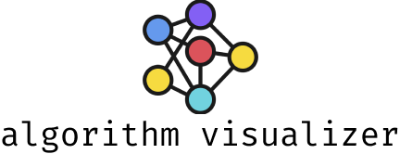
TOOLS USED
Hardware Requirements Laptop/PC with minimum 2GB RAM I3 processor 3.4 Ghz
Software Requirements IDE Browser Operating system
Technologies Html Css JavaScript
Operating Sytem
Windows
Linux

Slide 9
Advantages
Easy to understand the data structures
In-browser no need to do anything
Good for beginners or refreshers
Responsive & user friendly

Slide 10

THANK YOU

