Slide 1



AMC ENGINEERING COLLEGE
Department of Information Science and Engineering
AMC
AMC ENGINEERING COLLEGE
ISE
Department of Information Science and Engineering
AI-POWERED SMART COMMUNITY
PROBLEM DETECTION
Presented By:
H RAGHAVENDRA SHETTY (1AM23IS061)
ROHAN P (1AM23IS130)
SHREYAS SHASHIDHAR (1AM23IS159)
SRUJAN S GOWDA (1AM23IS164)
Guided By:
Ms. Maria Sneha
Assistant Professor
Dept. of ISE, AMCEC

Slide 2
AMC ENGINEERING COLLEGE
Department of Information Science and Engineering
AMC
AMC ENGINEERING COLLEGE
ISE
Department of Information Science and Engineering
INTRODUCTION
Urban Pulse AI is an evidence-aware civic reporting and response platform built for Bengaluru.
Multi-format evidence: accepts text, voice transcript, image and location evidence.
Visual understanding: uses Florence-2 for structured visual observations and uncertainty signals.
Combined reasoning: fuses text, image, location and prior-report context for civic decision-making.
Smart routing: supports category, priority, threat assessment, ward/department routing and human review.
Accountability: preserves decision audits and supports authority and community workflows.
1

Slide 3
AMC ENGINEERING COLLEGE
Department of Information Science and Engineering
AMC
AMC ENGINEERING COLLEGE
ISE
Department of Information Science and Engineering
LITERATURE SURVEY
Sl. No. | Title | Author | Methodology | Findings | Gaps
1 | Florence-2: Advancing a Unified Representation for a Variety of Vision Tasks | Xiao et al. (2024) | Prompt-based vision foundation model; multi-task seq2seq | Unified captioning, detection, grounding and segmentation | General vision model; civic decision rules remain application-specific
2 | Sentence-BERT: Sentence Embeddings using Siamese BERT-Networks | Reimers & Gurevych (2019) | Siamese/triplet sentence embeddings + cosine similarity | Efficient semantic similarity search | Not designed for multimodal civic routing
3 | UrBench: A Comprehensive Benchmark for Evaluating Large Multimodal Models in Multi-View Urban Scenarios | Zhou et al. (2025) | Urban multimodal benchmark across 14 task types | Shows LMM gaps in complex urban reasoning | Benchmarking does not provide an end-to-end civic workflow
4 | AI Based Smart Civic Complaint Management System | Suganthi et al. (2026) | AI/ML, NLP and image processing for complaint management | Targets automated civic complaint handling | Limited evidence-aware multimodal safety/decision boundaries
5 | Robust Speech Recognition via Large-Scale Weak Supervision | Radford et al. (2023) | Large-scale weakly supervised speech recognition | Strong multilingual speech recognition foundation | Speech transcription alone does not solve civic reasoning/routing
2

Slide 4
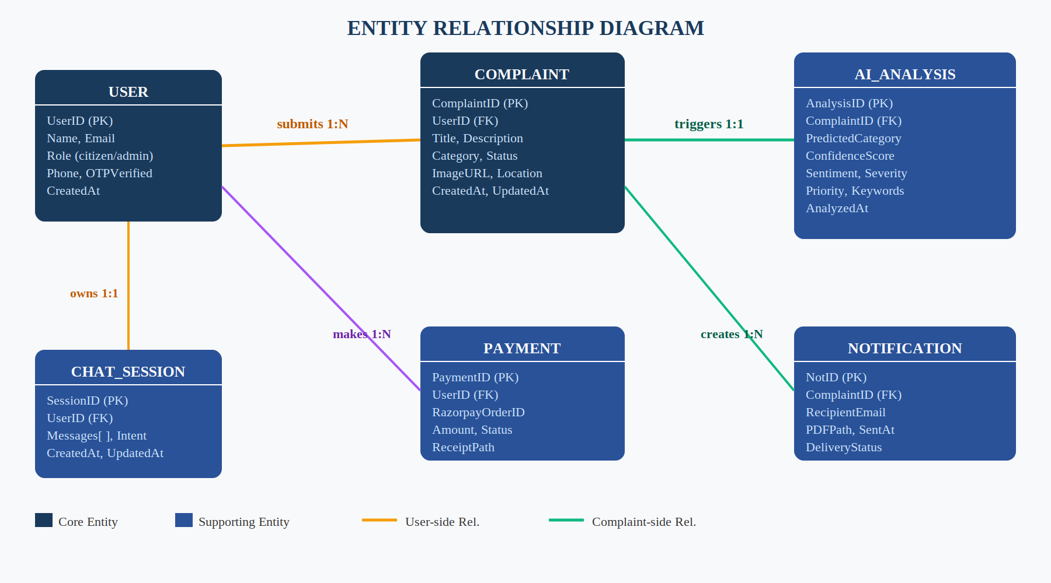
AMC ENGINEERING COLLEGE
Department of Information Science and Engineering
AMC
AMC ENGINEERING COLLEGE
ISE
Department of Information Science and Engineering
MOTIVATION
• Urban complaints often arrive as incomplete or single-format evidence.
• Manual classification can delay routing and response.
• Images can reveal hazards and infrastructure evidence that text may miss.
• Risk and uncertainty should influence whether a case is automated or reviewed.
• Bengaluru-specific ward and department routing can reduce operational ambiguity.
• A transparent audit trail supports accountable AI-assisted civic response.
3

Slide 5
AMC ENGINEERING COLLEGE
Department of Information Science and Engineering
AMC
AMC ENGINEERING COLLEGE
ISE
Department of Information Science and Engineering
PROBLEM STATEMENT
Urban civic reporting often lacks an evidence-aware mechanism that can combine multimodal citizen inputs with risk assessment, location-based routing and human-review safeguards for timely and accountable response.
4

Slide 6
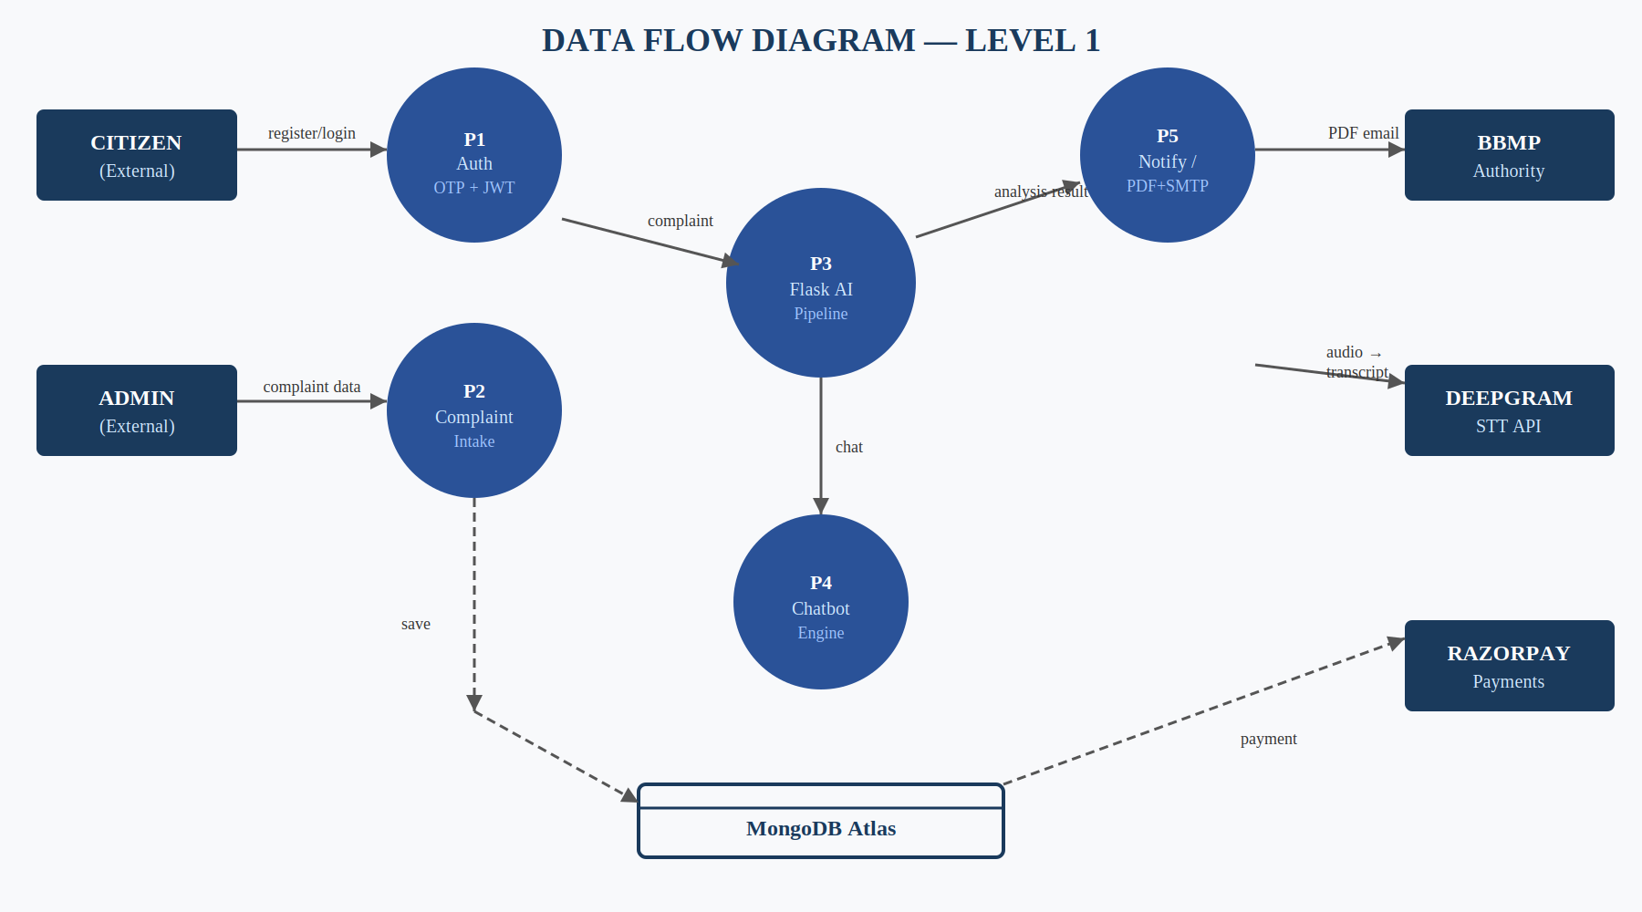
AMC ENGINEERING COLLEGE
Department of Information Science and Engineering
AMC
AMC ENGINEERING COLLEGE
ISE
Department of Information Science and Engineering
OBJECTIVES
• Build a multimodal civic reporting platform for text, voice, image and Bengaluru location evidence.
• Extract structured visual observations from submitted images using Florence-2.
• Combine semantic text evidence, visual evidence and prior-report context for civic classification.
• Estimate confidence, severity, threat evidence and review requirements safely.
• Resolve Bengaluru ward and department routing using configurable civic rules.
• Support duplicate/incident intelligence, community verification and authority handoff.
• Preserve human corrections and important decisions through an append-only audit history.
5

Slide 7
AMC ENGINEERING COLLEGE
Department of Information Science and Engineering
AMC
AMC ENGINEERING COLLEGE
ISE
Department of Information Science and Engineering
SYSTEM ARCHITECTURE
SYSTEM ARCHITECTURE
Citizen / Admin
uses web application
CITIZEN / ADMIN
Browser Client
HTML / CSS / JavaScript UI
BROWSER CLIENT
(React / HTML5 UI)
Express API
auth, complaints, routing, reports
EXPRESS API
(Node.js)
MongoDB Atlas
(data store)
Flask AI Service
(complaint analysis)
MongoDB Atlas
users, complaints, audits
Flask AI Service
category, severity, threat score
External Context
weather + civic search quotas
FLORENCE-2 VISUAL SERVICE
(AWS EC2)
URBAN PULSE DECISION ENGINE
Florence-2 Vision Service
AWS EC2 image observations
Routing
Authority
Community
SMTP / ALERTS / REPORTS
Email / Reports
OTP, alerts, authority PDFs
Dashboards
citizen + admin views
Routing + Community
ward, department, verification
External context: Weatherstack + civic search — optional providers, quota-guarded and failure-isolated.
Image analysis supports visual understanding only; Urban Pulse AI makes the final civic decision and safely falls back if providers fail.
6

Slide 8
AMC ENGINEERING COLLEGE
Department of Information Science and Engineering
AMC
AMC ENGINEERING COLLEGE
ISE
Department of Information Science and Engineering
ALGORITHMS USED — SEMANTIC CLASSIFICATION
1. Preparing the Complaint Text
• The text is cleaned up — converted to lowercase and split into words and short word-pairs so it can be compared easily.
2. Understanding Meaning, Not Just Keywords
• Each complaint and each civic category (e.g. pothole, garbage) is converted into a numeric ‘meaning’ representation.
• A standard similarity technique checks how closely they match in meaning, not just in wording.
3. Scoring Confidence
• Meaning-based similarity is combined with keyword and phrase matches into one confidence score, from 0 to 1.
• Only categories that cross a minimum confidence level are shortlisted as candidates.
Project use: combining meaning-based and keyword-based evidence lets the system classify complaints correctly, even when the wording differs from the training examples.
7

Slide 9
AMC ENGINEERING COLLEGE
Department of Information Science and Engineering
AMC
AMC ENGINEERING COLLEGE
ISE
Department of Information Science and Engineering
ALGORITHMS USED — MULTIMODAL FUSION & CONFIDENCE
1. Combining Text and Image Evidence
• The system compares what the complaint text says with what Florence-2 detects in the photo.
• If both point to the same category, confidence goes up; if they disagree, confidence goes down.
2. Adjusting Confidence
• The confidence score is nudged up or down based on how well the text and image evidence agree, always staying between 0 and 1.
3. Human Review Gate
• A report is sent for human review whenever evidence is incomplete, contradictory, or confidence is too low.
• This keeps uncertain or conflicting cases from being auto-approved.
Project use: this prevents low-quality or conflicting evidence from being forced into a confident civic decision.
8

Slide 10
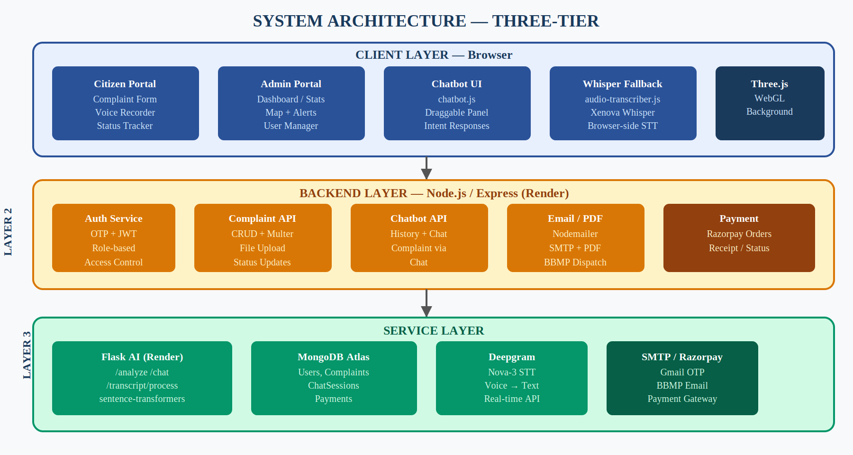
AMC ENGINEERING COLLEGE
Department of Information Science and Engineering
AMC
AMC ENGINEERING COLLEGE
ISE
Department of Information Science and Engineering
ALGORITHMS USED — SEVERITY, THREAT & EVIDENCE SAFETY
1. Estimating Severity
• The complaint text is scanned for negative, positive, and critical/urgent words.
• Based on how many critical or negative words appear, the case is graded High, Medium, or Low severity.
2. Checking Evidence Quality
• Every uploaded image gets a unique digital fingerprint (SHA-256 hash) so it can be tracked and verified.
• Brightness and contrast are checked to flag blurry, dark, or low-quality photos.
• Poor-quality, contradictory, or unclear evidence automatically triggers a review-safe state.
3. Threat Assessment
• Rule- and evidence-based safety checks flag potentially dangerous situations for priority handling.
Project use: severity and evidence-quality checks together decide how urgently a case is escalated and whether a human should review it.
9

Slide 11
AMC ENGINEERING COLLEGE
Department of Information Science and Engineering
AMC
AMC ENGINEERING COLLEGE
ISE
Department of Information Science and Engineering
RESULTS
Parameter | Observed / Verified in Repository | Status
Multimodal reporting | Text, voice transcript, image and Bengaluru location | Implemented
Visual perception | Florence-2 remote service with structured observations | Implemented
Semantic classification | Sentence embeddings + cosine similarity + keyword evidence | Implemented
Confidence / review safety | Conflict, uncertainty and evidence-quality gates | Implemented
Bengaluru routing | Ward + category + severity + workload + versioned registry | Implemented
Community / incident intelligence | Verification, duplicate clusters, alerts and incident commands | Implemented
Evaluation | Dataset validation + benchmark-readiness + AI evaluation commands | Available
Numeric benchmark results | Not published in current README/source snapshot | Not available
10

Slide 12
AMC ENGINEERING COLLEGE
Department of Information Science and Engineering
AMC
AMC ENGINEERING COLLEGE
ISE
Department of Information Science and Engineering
COMPARISON OF PARAMETERS
Parameter | Urban Pulse AI | Keyword-only | Image-only
Text evidence | Yes | Yes | No
Image evidence | Yes | No | Yes
Multimodal fusion | Yes | No | No
Semantic similarity | Yes | No | No
Uncertainty / review gate | Yes | Limited | Model-dependent
Location-aware routing | Yes | No | No
Duplicate/community intelligence | Yes | No | No
Comparison type | Implemented system | Conceptual baseline | Conceptual baseline
11

Slide 13
AMC ENGINEERING COLLEGE
Department of Information Science and Engineering
AMC ENGINEERING COLLEGE
Department of Information Science and Engineering
CONCLUSION & FUTURE STUDIES
CONCLUSION
• Urban Pulse AI converts multimodal citizen evidence into structured civic decision support.
• Florence-2 provides visual observations while the Urban Pulse layer controls category, priority, threat, routing and review decisions.
• Semantic text classification, evidence fusion and safety gates improve robustness against weak or contradictory evidence.
• Bengaluru-specific routing, community verification, authority workflows and audit trails support accountable response.
FUTURE STUDIES
• Integrate authorized government APIs and official ward-boundary datasets.
• Add multilingual reporting and mobile push notifications.
• Expand field-officer workflows with signed resolution evidence.
• Strengthen benchmark coverage, calibration and production HTTPS/security.
12

Slide 14
AMC ENGINEERING COLLEGE
Department of Information Science and Engineering
AMC ENGINEERING COLLEGE
Department of Information Science and Engineering
REFERENCES
[1] B. Xiao, H. Wu, W. Xu, X. Dai, H. Hu, Y. Lu, M. Zeng, C. Liu, and L. Yuan, “Florence-2: Advancing a unified representation for a variety of vision tasks,” in Proc. IEEE/CVF Conf. Comput. Vis. Pattern Recognit. (CVPR), 2024, pp. 4818–4829.
[2] N. Reimers and I. Gurevych, “Sentence-BERT: Sentence embeddings using Siamese BERT-networks,” in Proc. Conf. Empirical Methods Natural Lang. Process. (EMNLP-IJCNLP), 2019, pp. 3982–3992.
[3] B. Zhou, H. Yang, D. Chen, J. Ye, T. Bai, J. Yu, S. Zhang, D. Lin, C. He, and W. Li, “UrBench: A comprehensive benchmark for evaluating large multimodal models in multi-view urban scenarios,” in Proc. AAAI Conf. Artif. Intell., 2025, pp. 10707–10715.
[4] S. C. Suganthi, A. S., D. V., and J. M., “AI based smart civic complaint management system,” Int. J. Eng. Emerg. Technol. Res. (IJEETR), 2026.
[5] A. Radford et al., “Robust speech recognition via large-scale weak supervision,” in Proc. Int. Conf. Mach. Learn. (ICML), 2023.
[6] Shreyas0047, “Urban Pulse AI,” GitHub repository, current implementation and documentation.
13

Slide 15
AMC ENGINEERING COLLEGE
Department of Information Science and Engineering
AMC ENGINEERING COLLEGE
Department of Information Science and Engineering
THANK YOU
QUESTIONS & ANSWERS
Urban Pulse AI
Major Project Review

