Slide 1
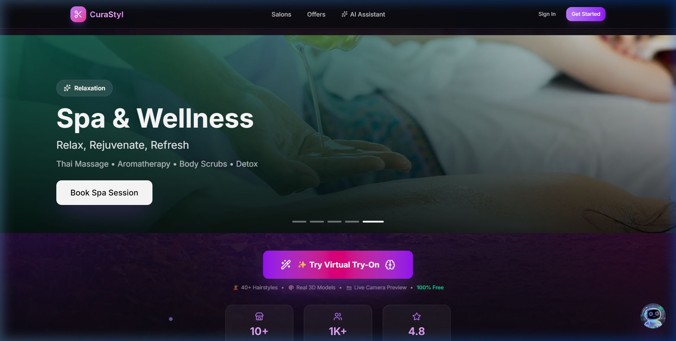
🏆 PITCHX 2026 | JIO WORLD CENTRE, BKC MUMBAI
CuraStyl ✨
India’s 1st AI-Enabled Hyperlocal Salon Marketplace & 3D WebAR Virtual Try-On Super-App
Solving post-haircut regret and salon idle capacity for Men & Women using real-time browser 3D camera try-on, Gemini 1.5 multimodal AI consultation, instant slot booking, and salon SaaS.
Presented by Team AgniDev’s (FRCRCE):
👨‍💻 Shreyas Mahajan (Tech Lead & WebAR 3D) | 🧠 Arnav Brahmane (AI & Gemini Architect) | 📈 Akshat Churi (Product & Growth)
🌐 Live Deployed Platform: https://curastyl.agnidev.me (100% Functional MVP Ready for Demo)

Slide 2
THE PROBLEM
The Three Major Breakdowns in India’s Salon & Grooming Industry
Customers face blind styling anxiety, while neighborhood salons suffer from idle chairs and zero digital tools.
1. Post-Haircut Regret (82% Anxiety)
• 82% of young Indians experience anxiety before visiting a salon.
• No tool exists to pre-visualize hairstyles on their actual 3D face structure & skin tone.
• Customer references (Pinterest/Celebrities) fail in execution, causing disappointment.
2. 42% Salon Idle Capacity & No-Shows
• Local salons run at only 58% average chair occupancy on weekdays.
• 18% to 25% appointment no-shows because bookings are unconfirmed over phone.
• High-skill neighborhood barbers have zero digital reach and struggle to compete with luxury chains.
3. Disjointed & Inefficient Booking
• Listing platforms (Google Maps/JustDial) only provide static phone numbers with zero live scheduling.
• Salon owners manage operations on paper diaries and WhatsApp messages.
• No unified loyalty rewards or personalized AI consultation for customers.

Slide 3
THE SOLUTION
CuraStyl’s Triple-Engine Beauty-Tech Ecosystem
A synchronized double-sided platform connecting smart visual discovery with instant booking & salon SaaS.
✨ Engine 1: AuraAI Consultation
• Powered by Google Gemini 1.5 with 10-key automatic rotation.
• Analyzes facial structure, skin tone, hair texture, and style vibe.
• Fetches live visual inspiration carousels via Pexels & Google CSE.
• Contextual deep-linking directly into Try-On & appointment booking.
👓 Engine 2: 3D WebAR Virtual Try-On
• Real-time webcam face mapping via MediaPipe 468 3D landmarks.
• Three.js & React Three Fiber dynamic 3D hairstyle projection (.glb).
• Zero app installation required—runs smoothly inside any mobile browser.
• Separate, highly curated catalogs for Men & Women.
🏪 Engine 3: Hyperlocal Booking & SaaS
• Geolocation discovery covering Bandra, BKC, Andheri, Powai, Juhu.
• Real-time slot reservation preventing double-bookings with QR check-in.
• GlamPoints gamified loyalty economy (earn on visit, burn at checkout).
• Salon Owner ERP: live scheduler, staff assignment, revenue & reviews.

Slide 4
TECHNICAL ARCHITECTURE
Enterprise-Grade Full-Stack & Browser AI/AR Stack
Lightweight client-side processing, high security, and high reliability built by student engineers.
Client & WebAR 3D Engine
• Next.js 15 & React 19 for server rendering & instantaneous transitions.
• MediaPipe FaceMesh: 468 3D landmarks at 60 FPS in browser.
• Three.js / React Three Fiber: Dynamic mesh scaling, lighting & .glb models.
• Tailwind CSS & Framer Motion for responsive glassmorphism UI.
Multimodal AI Core
• Google Gemini 1.5 Pro & Flash multimodal intelligence.
• 10-Key Auto-Rotation failover system ensuring 99.99% uptime.
• Style DNA Profiling with facial mood & feature extraction.
• Visual Search Integration with Pexels API & Google CSE.
Backend, Database & Security
• Supabase PostgreSQL with strict Row-Level Security (RLS).
• Role-Based Middleware protecting customer vs salon-owner paths.
• Unified Payments: Direct UPI simulator & Razorpay integration.
• QR Verification Engine & Automated booking reminder cron jobs.

Slide 5
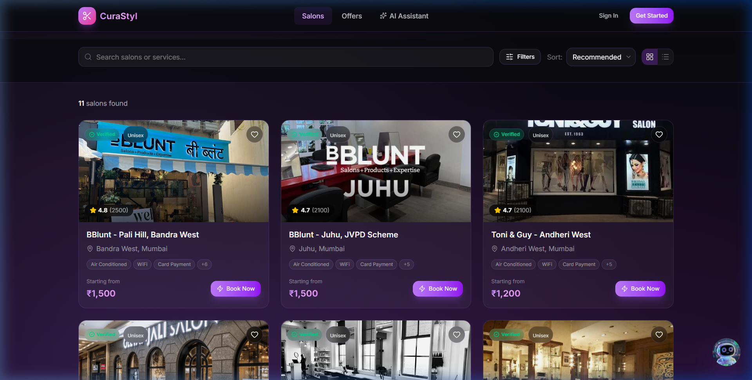
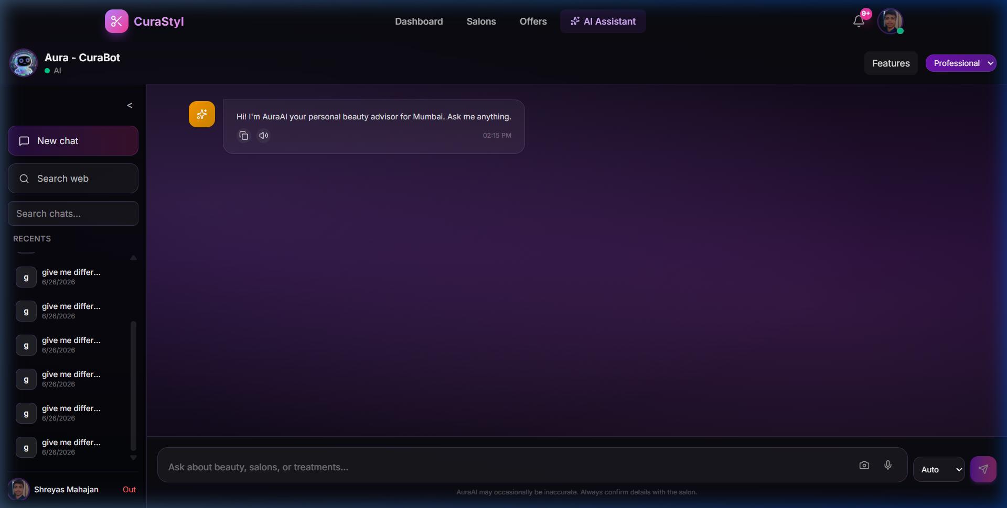
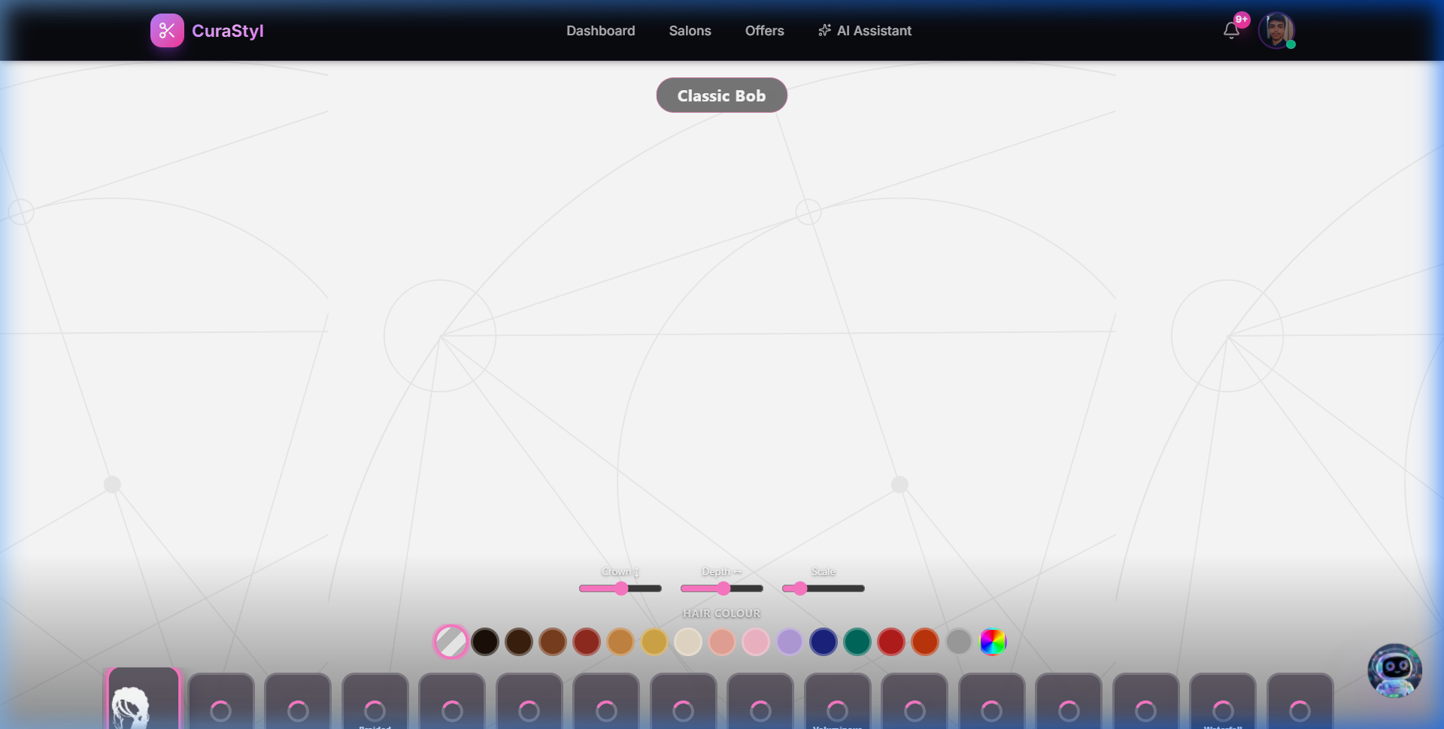
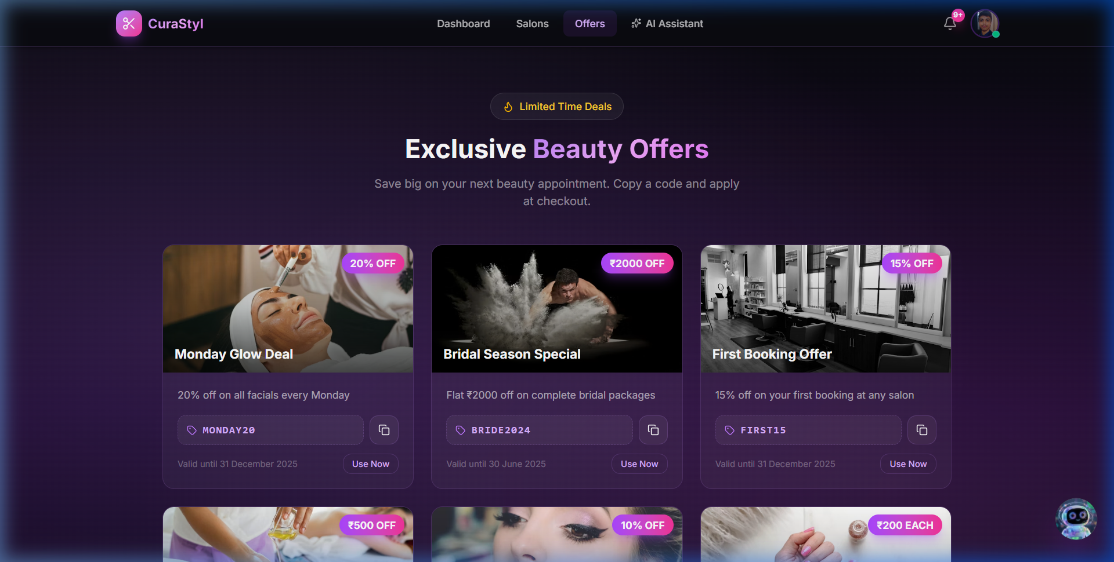
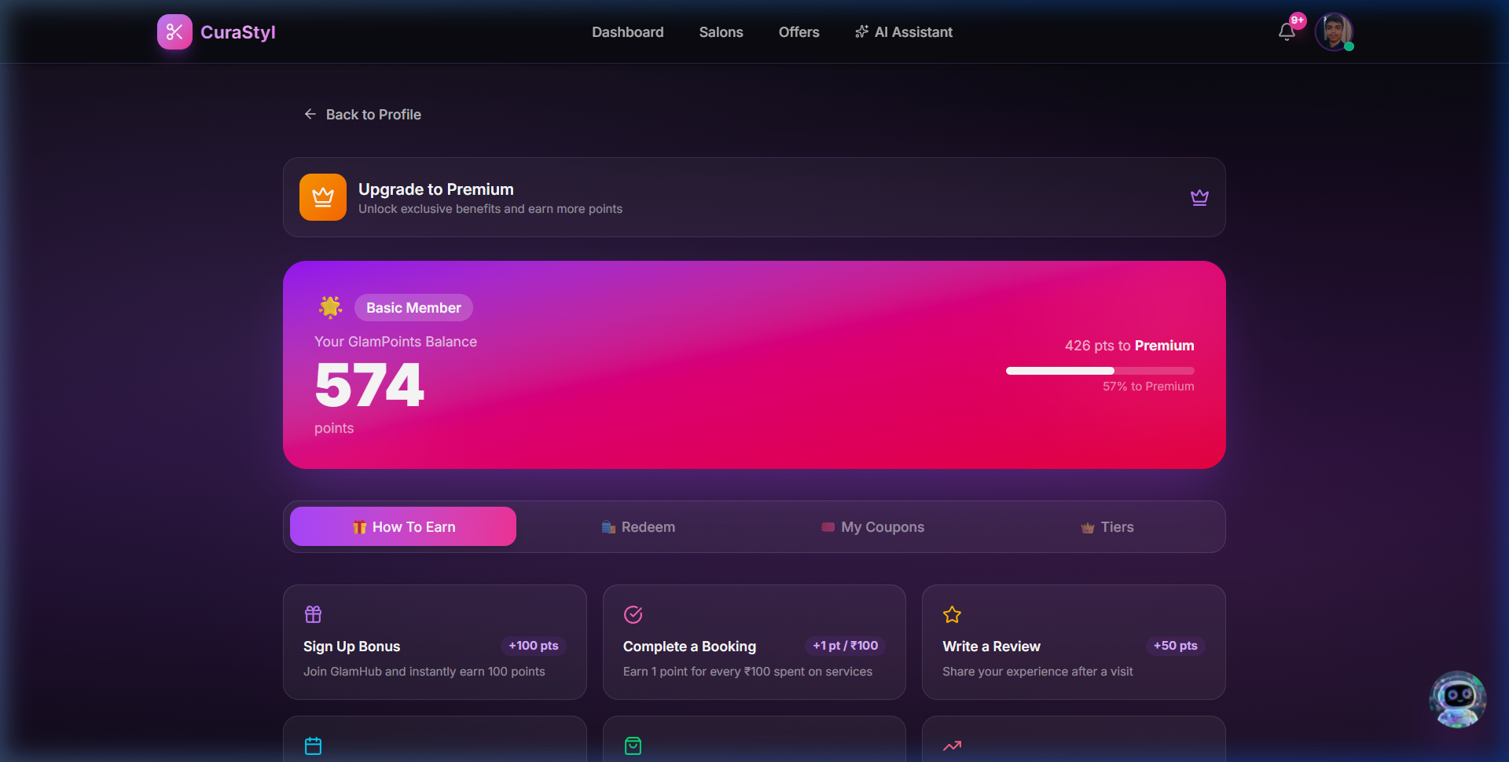
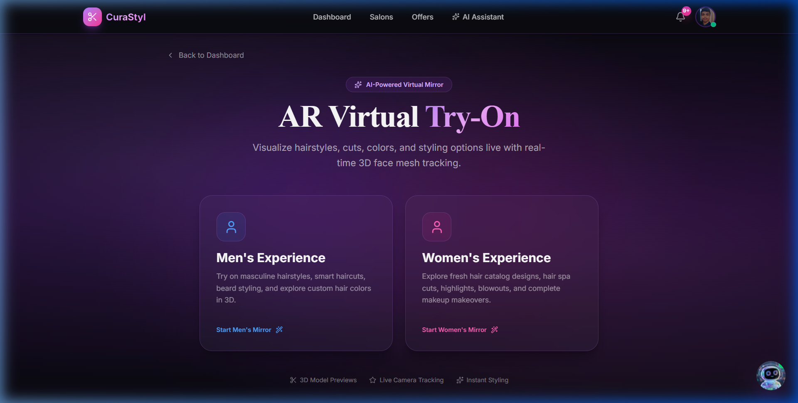
PRODUCT DEMO & SCREENSHOTS
100% Built & Live Production Features (Men & Women)
Live platform accessible on mobile & desktop: https://curastyl.agnidev.me
1. Hyperlocal Discovery & Filters
2. AuraAI Chat & Visual Carousels
3. Real-Time 3D WebAR Mirror
4. Offers, Deals & Promotions
5. Salon SaaS & Customer Plans
6. Gender Selection Hub (Men/Women)

Slide 6
TARGET AUDIENCE
Serving Both Men & Women with Tailored User Journeys
Unlocking India’s fast-growing male grooming market and high-ticket women’s beauty services.
👨 Men’s Grooming Journey (Booming 22% CAGR)
• High Visit Frequency: Men visit salons every 2-3 weeks (18-24 visits per year).
• Expanding Basket Size: Beard styling, fades, scalp care, detan & men’s facials.
• Virtual Try-On: 21+ real-time 3D male hairstyles & beard styles via browser webcam.
• Frictionless UPI Booking: Instant 30-second slot lock with zero waiting time.
• AuraAI Barber Consultation: Recommends cuts based on jawline, face shape & workplace style.
👩 Women’s Beauty & Styling (High-AOV Luxury)
• High Average Order Value: Hair spas, balayage, smoothening, bridal styling (₹1,500 - ₹8,000 AOV).
• Visual Criticality: 16+ curated female 3D hair models (.glb) eliminate post-cut regret.
• AuraAI Style DNA: Skin tone & mood analysis suggesting complementary color tones & highlights.
• Verified Reviews & Portfolios: Real stylist ratings, photo showcases & hygiene verification.
• GlamPoints Rewards: Earn significant reward points on high-value treatments for future discounts.

Slide 7
MARKET OPPORTUNITY
Tapping India’s ₹1.65 Lakh Cr ($20B) Beauty & Wellness Boom
Massive unorganized market rapidly digitizing with 18.2% annual growth in salon bookings.
₹1,65,000 Cr ($20B)
TAM: Total Addressable Market
Overall Indian Beauty, Grooming & Personal Care Market by 2028 (18.2% CAGR)
Key Growth Drivers in India
• Gen Z & Millennial Grooming Surge: 65% of salon spend driven by 18–35 age cohort seeking trendy styles.
• Male Grooming Explosion: Men’s grooming in India growing at 22%+ CAGR, demanding specialized beard and hair styling.
• Shift from Walk-Ins to Instant Booking: 74% of smartphone users prefer online slot locking over waiting in lines.
• SaaS Adoption by Local Salons: Salon owners eager for tools to reduce no-shows and increase weekday table turnover.
• AI/AR Personalization as Conversion Driver: 3D Try-On increases service booking conversion by +38%.
₹65,000 Cr ($7.8B)
SAM: Serviceable Addressable Market
Organized and Semi-Organized Salon & Parlor Services across Urban India
₹3,250 Cr ($390M)
SOM: Serviceable Obtainable Market
Target 5% market share in Top 8 Metros (Mumbai, Delhi-NCR, Bengaluru, etc.) within 4 years

Slide 8
COMPETITIVE LANDSCAPE
Why CuraStyl Dominates Generic Competitors
Competitors only offer home visits or static phone directories; CuraStyl owns the visual-to-chair workflow.
Feature / Capability | CuraStyl ✨ | Urban Company | Fresha | Nykaa / Purplle | JustDial / G-Maps
Real-Time 3D WebAR Try-On | ✅ Live 3D FaceMesh | ❌ None | ❌ None | ⚠️ 2D Makeup only | ❌ None
Gemini Multimodal AI Stylist | ✅ AuraAI (Voice/Img) | ❌ Basic FAQ bot | ❌ None | ❌ Basic search | ❌ None
Hyperlocal Physical Salon Booking | ✅ Real-time Slot Lock | ❌ At-home only | ⚠️ Limited in India | ❌ E-commerce focus | ❌ Unverified phone
Salon B2B ERP & Live Calendar | ✅ Built-in SaaS | ❌ Closed gig model | ⚠️ Expensive SaaS | ❌ None | ❌ None
Loyalty Economy (GlamPoints) | ✅ Integrated Checkout | ⚠️ UC Plus pass | ❌ None | ⚠️ E-com points only | ❌ None

Slide 9
BUSINESS MODEL
5 High-Margin, Diversified Revenue Streams
Multiple synergistic monetization levers creating robust unit economics and high recurring revenue.
1. Marketplace Commission (8% - 12%)
• Charged per confirmed booking facilitated through CuraStyl.
• Zero commission on initial 20 bookings to drive frictionless onboarding.
• Predictable recurring take-rate scaling directly with platform GMV.
2. Salon B2B SaaS Subscriptions
• Starter Tier: Free (up to 50 bookings/month).
• Pro Plan (₹999/mo): Live calendar, staff management & analytics.
• Enterprise Plan (₹2,499/mo): Multi-branch ERP, SMS reminders, CRM.
3. Featured Listings & Sponsored Salons
• Hyperlocal ad placement for top-of-search in Bandra, BKC, Andheri.
• Flash deals & seasonal banner promotions for beauty festivals.
• High-margin advertising engine (₹1,500 - ₹5,000 per salon/month).
4. AI Style DNA & Customer Pro Pass
• Freemium AI consultations & virtual try-ons.
• Pro Customer Pass (₹199/mo): Unlimited HD AR exports, premium salon discounts, 2x GlamPoints booster.
5. GlamPoints Loyalty Economy
• Commission arbitrage on point redemption partnerships.
• Brand-sponsored vouchers and beauty sample product promotions.

Slide 10
FINANCIAL PROJECTIONS
Realistic Growth Forecast & Unit Economics (FY26–FY30)
Grounded student-founder roadmap: starting lean in Mumbai, scaling to ₹61.5 Cr revenue with 78% Gross Margin.
Healthy Unit Economics (Per Customer)
• Average Order Value (AOV): ₹850 (Blended Men & Women).
• Customer Acquisition Cost (CAC): ₹180 (Organic AR virality & campus loops).
• Average Visits per Year: 8.5 visits.
• Annual Customer GMV: ₹7,225.
• Platform Net Take Rate: 10% = ₹722.50 / year.
• Customer Lifetime Value (LTV, 3 Yrs): ₹2,167.
• LTV / CAC Ratio: 12.0x (Outstanding SaaS/Marketplace benchmark).
• CAC Payback Period: 2.8 months.
• Gross Margin: 78% (Cloud-native Next.js & Supabase architecture).
Metric / Year | FY26 (Y1) | FY27 (Y2) | FY28 (Y3) | FY30 (Y5)
Onboarded Salons | 350 | 1,800 | 6,500 | 25,000
Active Customers | 45,000 | 280,000 | 1,100,000 | 4,800,000
Total Bookings | 180,000 | 1,400,000 | 6,200,000 | 32,000,000
Gross Platform GMV | ₹15.3 Cr | ₹119.0 Cr | ₹527.0 Cr | ₹2,720 Cr
Net Revenue (CuraStyl) | ₹1.53 Cr | ₹13.1 Cr | ₹61.5 Cr | ₹142.0 Cr

Slide 11
GO-TO-MARKET STRATEGY
3-Phase High-Velocity Execution Roadmap
Hyperlocal cluster strategy ensuring dense salon supply, instant booking reliability, and viral organic growth.
Phase 1: Mumbai Beachhead (Months 1–6)
• Target Hubs: BKC, Bandra West, Andheri, Powai, Juhu.
• Supply Onboarding: 200 premium & neighborhood unisex salons with 0% commission launch.
• Demand Engine: College campus ambassadors (FRCRCE, NMIMS, Mithibai) & localized Instagram AR filter challenges.
• Milestone: 30,000 completed bookings & ₹2.5 Cr GMV.
Phase 2: Tier 1 Metros (Months 7–18)
• Expansion Hubs: Bengaluru (Koramangala, Indiranagar), Delhi-NCR (Gurgaon, South Delhi), Pune, Hyderabad.
• B2B SaaS Monetization: Roll out Pro & Enterprise tiers (₹999 - ₹2,499/mo).
• Influencer Partnerships: 50+ beauty creators showcasing AuraAI Before & After WebAR transformations.
• Milestone: 1,500 active salons & ₹40 Cr GMV.
Phase 3: Pan-India Dominance (Months 19–36)
• Expansion: Tier 2 cities (Chandigarh, Ahmedabad, Jaipur, Kochi, Indore).
• Product Expansion: AI Skin Analysis, Dynamic Peak Pricing, Salon Inventory E-commerce.
• Enterprise Salon Chains: Integration with national salon franchises.
• Milestone: 10,000+ salons, ₹250+ Cr GMV, clear #1 market leadership.

Slide 12
THE ASK & VISION
Backing India’s Next Beauty-Tech Breakthrough
Seeking ₹25–50 Lakhs Seed Support / PitchX 2026 Champion Grant to scale Mumbai and launch in Bengaluru.
Funding & Resource Deployment (18 Months)
• 40% — Salon Merchant Acquisition & On-Ground BD in Mumbai & Bengaluru.
• 30% — AI & 3D Engineering: Expanded 3D hairstyle asset library & multi-angle try-on.
• 20% — Hyperlocal Campus Marketing & Instagram AR Viral Challenges.
• 10% — Cloud Infrastructure (Supabase, Vercel) & Operational Reserve.
• Target 18-Month Output: 1,000 onboarded salons, 350,000 bookings, and ₹25 Cr GMV.
Team AgniDev’s (FRCRCE) — Built for Speed
• 👨‍💻 Shreyas Mahajan: Full-Stack & 3D WebAR Lead (Three.js, MediaPipe).
• 🧠 Arnav Brahmane: AI Architect & Multimodal LLM Lead (Gemini 1.5).
• 📈 Akshat Churi: Product Management, Growth & Business Ops Lead.
• Proven Execution: 100% functional live app deployed with zero external capital.
• 🚀 Live Demo: https://curastyl.agnidev.me
• 📧 Contact: founders@curastyl.agnidev.me | BKC, Mumbai
• 🏆 PitchX 2026 Winner Contender

