Slide 1
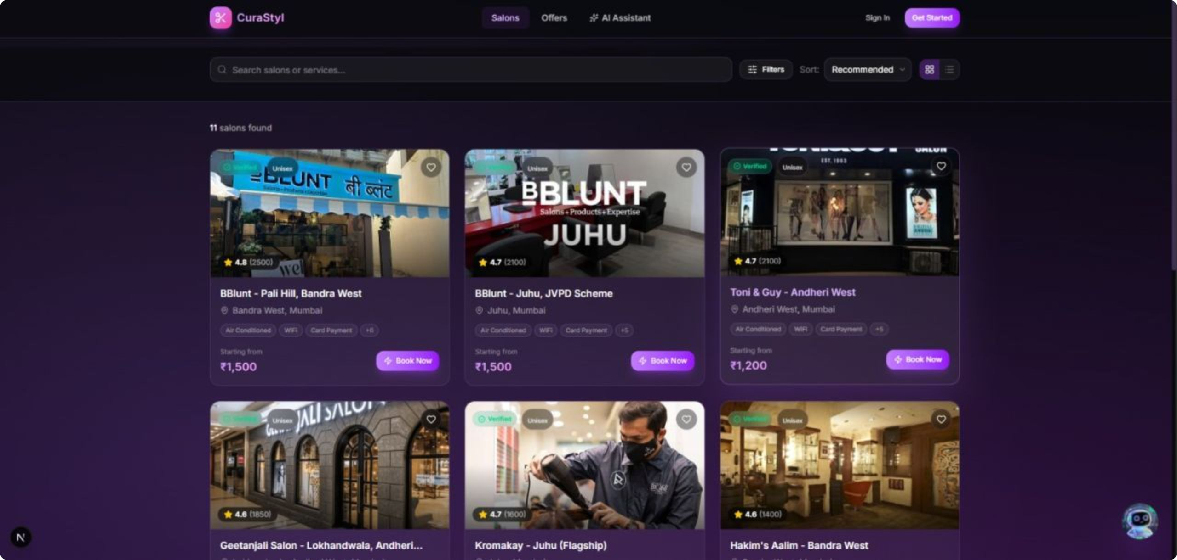
CuraStyl
India's 1st AI-Enabled Hyperlocal Salon Marketplace & 3D WebAR Virtual Try-On Super-App
🏆 PITCHX 2026 | JIO WORLD CENTRE, BKC MUMBAI
Team AgniDev's — FRCRCE, Mumbai | Shreyas • Arnav • Akshat
🌐 Live: https://curastyl.agnidev.me ⚡ Tech: Next.js 15, MediaPipe WebAR, Gemini 1.5, Supabase RLS

Slide 2
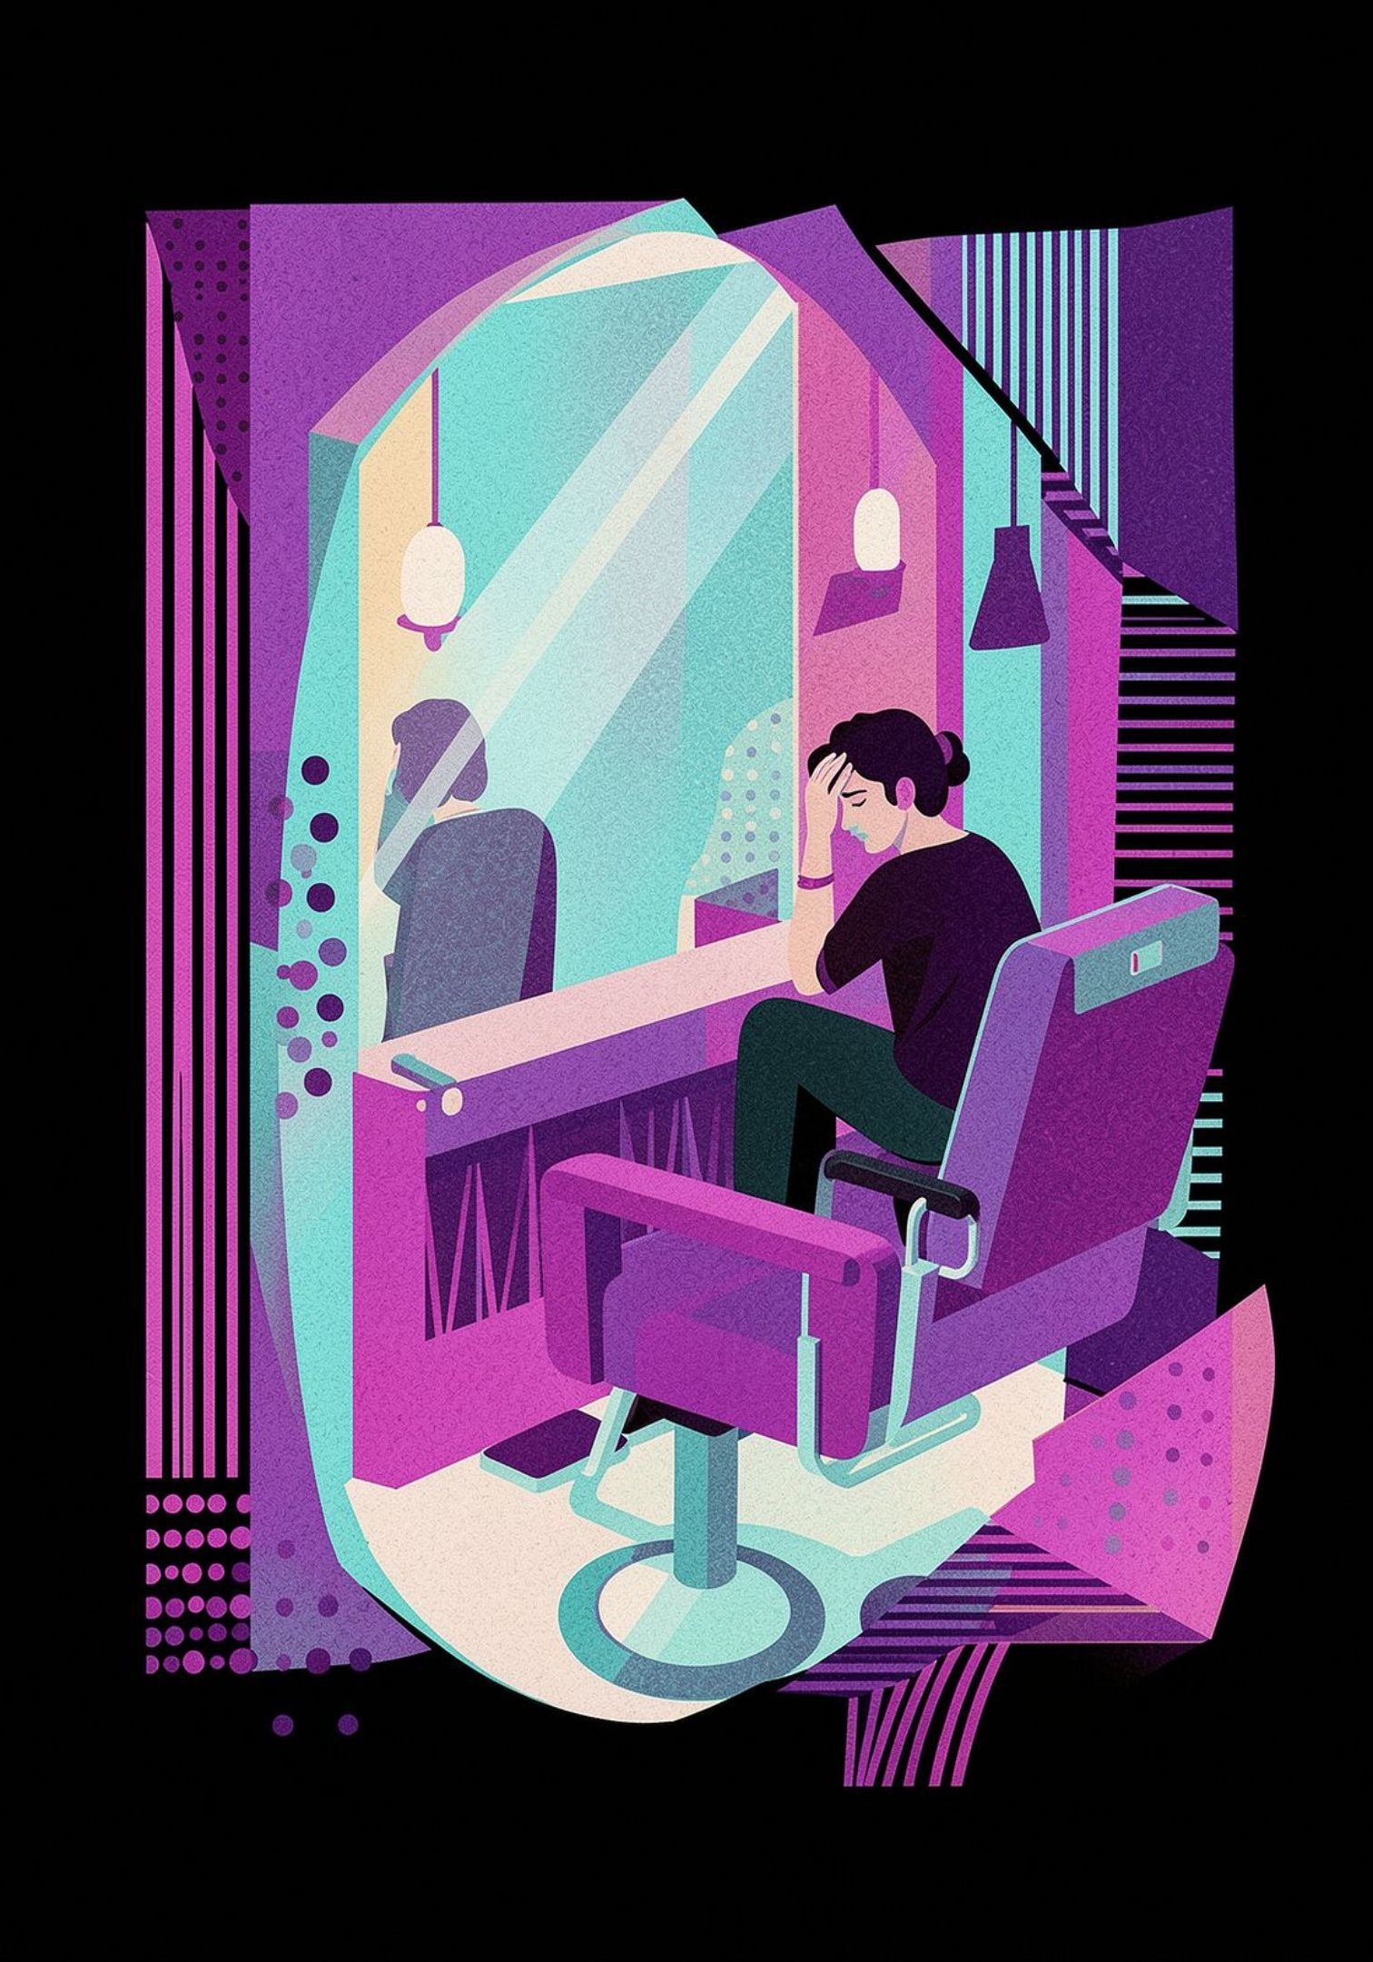
The Problem: ₹65,000 Cr Market Broken Into 3 Pillars
👥 Consumer Side
💼 Salon Side
82% Post-Haircut Regret
42% Idle Capacity & 20%+ No-Shows
Cannot visualize hairstyles on unique face structure & skin tone
Miscommunication between reference images and stylist execution
Empty chair time destroys profitability on weekdays
Unconfirmed phone bookings lead to costly no-shows
🔍 Industry Side
Fragmented & Manual
Google Maps & JustDial: static directories, zero live scheduling
90% of salons manage business on paper & WhatsApp

Slide 3


The Solution: Triple-Engine Ecosystem
Competitive Advantage Matrix
🤖 AuraAI: Gemini 1.5 Styling Assistant
Capability
CuraStyl
Urban Co.
Fresha
Nykaa
JustDial
Multimodal AI analyzes facial anatomy, skin tone, hair texture. Real-time visual inspiration + direct salon booking links.
3D WebAR Try-On
✅
❌
❌
⚠️
❌
🎥 3D WebAR Virtual Try-On
Gemini AI Stylist
✅
❌
❌
❌
❌
MediaPipe Face Mesh (468 3D landmarks @ 60 FPS). Dynamic 3D hairstyle overlays—zero app installation required.
Hyperlocal Booking
✅
❌
⚠️
❌
❌
Salon B2B ERP
✅
❌
⚠️
❌
❌
📍 Hyperlocal Marketplace & B2B SaaS
Gamified Loyalty
✅
⚠️
❌
⚠️
❌
Real-time slot locking, instant UPI payments, QR check-in, GlamPoints rewards + Comprehensive Salon Owner ERP.

Slide 4
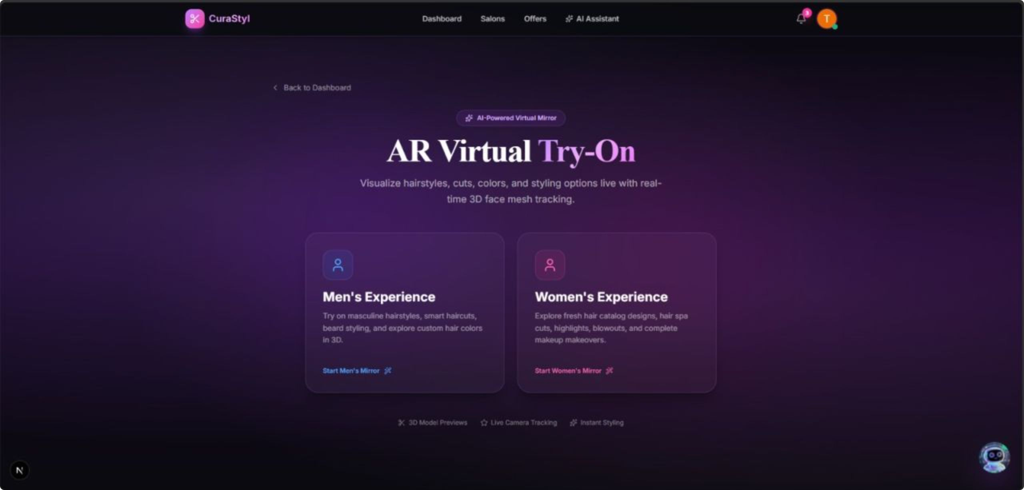
Live Product & Market Opportunity
Dual Market: Men & Women
Segment
Men's Grooming (22% CAGR)
Women's Styling (High-AOV)
Frequency
18–24 visits/year
₹1,500–₹8,000 AOV
Categories
Beard sculpting, fades, scalp treatments
Hair spas, balayage, bridal styling
CuraStyl
21+ 3D male hairstyles
16+ female 3D models, skin tone matching
Market Size
₹1.65L Cr
₹65K Cr
₹3,250 Cr
TAM
SAM
SOM
Total Indian Beauty Market by 2028 (18.2% CAGR)
Organized Salon & Parlor Services
5% share in Top 8 Metros within 4 years

Slide 5

Business Model & Unit Economics
5 Revenue Streams
Exceptional Unit Economics
Marketplace Commission (8–12%)
Metric
Value
Per confirmed booking — 0% on first 20 for onboarding incentive
Average Order Value (AOV)
₹850
Customer Acquisition Cost (CAC)
₹180
B2B SaaS
Free (50 bookings/mo) | Pro ₹999/mo | Enterprise ₹2,499/mo
Annual Customer GMV
₹7,225
3-Year LTV
₹2,167
Featured Listings
LTV/CAC Ratio
12.0x
₹1,500–₹5,000/month per salon
CAC Payback Period
2.8 months
Customer Pro Pass
Gross Margin
78%
₹199/month — unlimited AR exports, 2x GlamPoints
GlamPoints & Brand Partnerships
Point arbitrage + beauty sample distributions

Slide 6



5-Year Growth & Go-To-Market
Financial Projections (FY26–FY30)
Metric
FY26
FY27
FY28
FY30
Onboarded Salons
350
1,800
6,500
25,000
Active Customers
45K
280K
1.1M
4.8M
Gross Platform GMV
₹15.3 Cr
₹119 Cr
₹527 Cr
₹2,720 Cr
Net Revenue
₹1.53 Cr
₹13.1 Cr
₹61.5 Cr
₹142 Cr
3-Phase GTM Strategy
Phase 1 — Months 1–6
Phase 2 — Months 7–18
Phase 3 — Months 19–36
Mumbai beachhead
200 salons · 30K bookings · ₹2.5 Cr GMV
Tier 1 metros: Bengaluru, Delhi-NCR
1,500 salons · ₹40 Cr GMV
Pan-India scale
10,000+ salons · ₹250+ Cr GMV

Slide 7
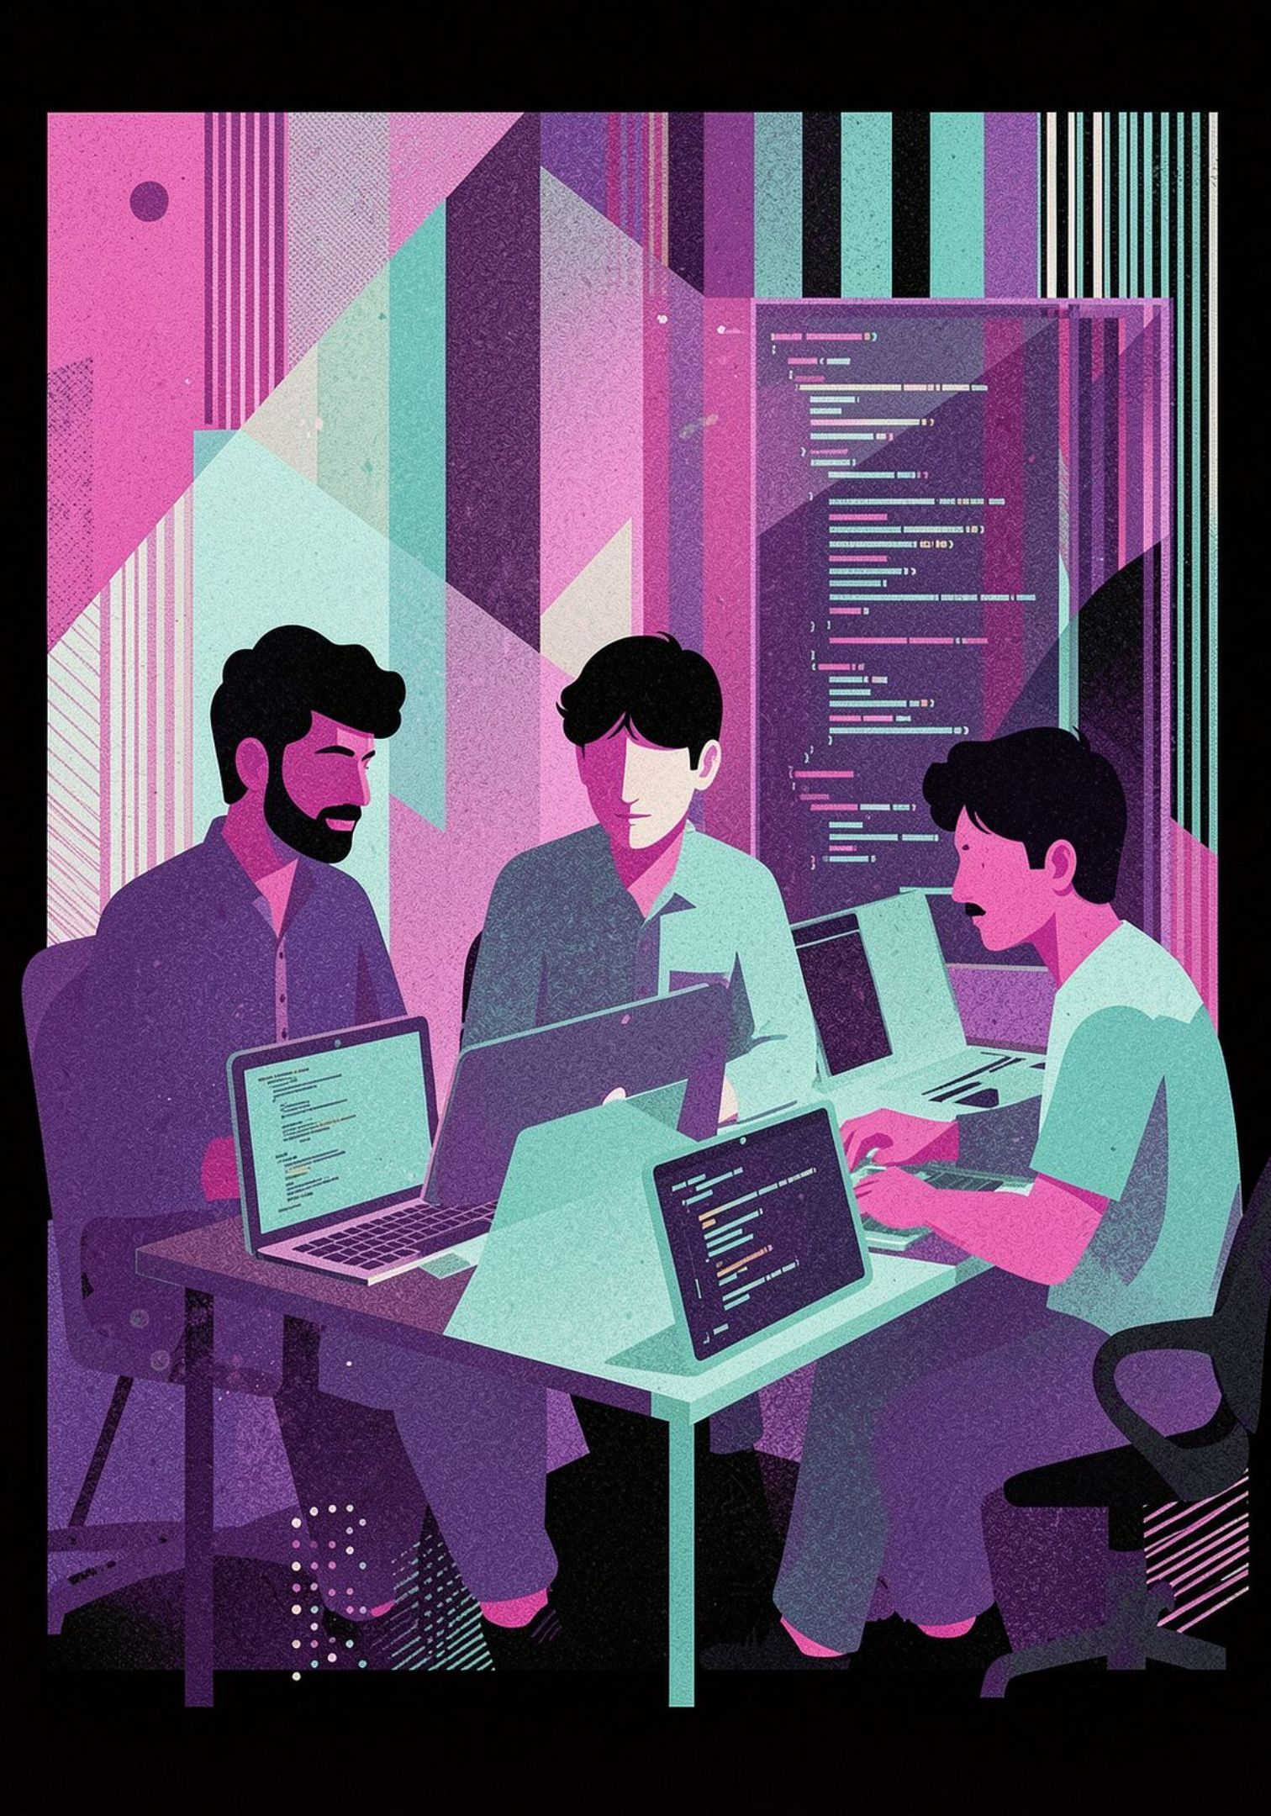

Technology & Team
Full-Stack Architecture
Team AgniDev's — FRCRCE, Mumbai
Frontend & WebAR
Shreyas Mahajan
Next.js 15, React 19, Three.js, MediaPipe FaceMesh, Tailwind CSS
Full-Stack & 3D WebAR Lead — Three.js, MediaPipe, React 19
AI Core
Arnav Brahmane
Gemini 1.5 Pro/Flash, 10-key failover (99.99% uptime), Style DNA profiler
AI Architect & Multimodal LLM Lead — Gemini 1.5, Style DNA
Akshat Churi
Backend & Security
Product, Growth & Business Operations — GTM, unit economics
Supabase PostgreSQL, Row-Level Security, Role-Based Middleware, Razorpay gateway
Execution Velocity: Built and deployed entire platform with zero external funding.

Slide 8
The Ask & Why CuraStyl Wins
Seeking: ₹50 Lakhs
Competitive Moat — Why CuraStyl Wins
18-Month Runway
✅ Only platform with complete visual-to-chair workflow (AI → 3D try-on → booking → salon SaaS)
✅ Proprietary 3D WebAR with 468-point facial tracking @ 60 FPS — zero competitors in India
✅ Dual-sided network: Solves customer anxiety AND salon profitability simultaneously
✅ Proven execution: Live product with real users, real bookings, real revenue
✅ Exceptional unit economics: 12x LTV/CAC, 2.8-month payback, 78% gross margin
✅ Massive TAM: ₹1.65 Lakh Crore market with only 5% digital penetration
01
40% — ₹20L
Salon Merchant Acquisition & On-ground BD
02
30% — ₹15L
AI & 3D Engineering (hairstyle library expansion)
03
🌐 Live Demo: https://curastyl.agnidev.me
📧 Contact: founders@curastyl.agnidev.me
📍 BKC, Mumbai
20% — ₹10L
Campus Marketing & Instagram AR Campaigns
04
10% — ₹5L
Cloud Infrastructure & Operations

