Slide 1
MEAM 5200 Final Project: Pick and Place Challenge
Group 17
Kabir Puri, Shreyas Raorane, Dhyey Shah, Chris Spletzer

Slide 2
High Level Architecture
Moving to POIs
Grabbing the block
Stacking the block
Detection
Detecting Blocks using get_detections (block to camera)
Inputting q to move from stationary to Static Block View position (SV)
Opening the gripper (0.09m) once it reaches SV
Computing q_stack from PV to SBV using IK
Getting transformation from Camera to End-effector
Closing the gripper with 52N at a width of 0.048m to grab the block
Computing q_block with IK to move to the block
Increment z for subsequent blocks to be stacked
Computing FK to get transformation of EE in world frame
Move to placement block view (PV) position with q
Opening the gripper once it reaches respective Stacking Block position (SBV)
Get feedback and validate gripper status using get_gripper_state

Slide 3
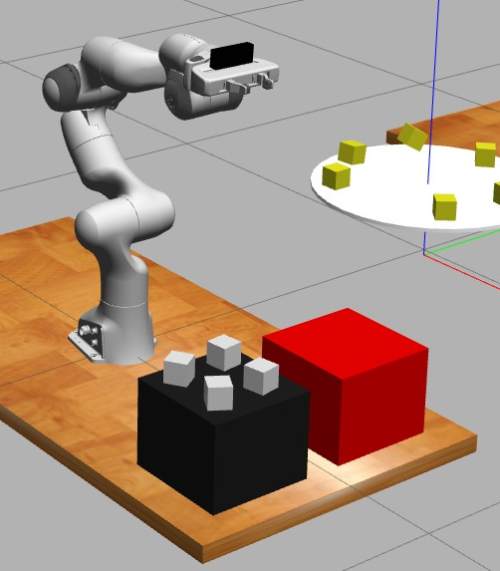
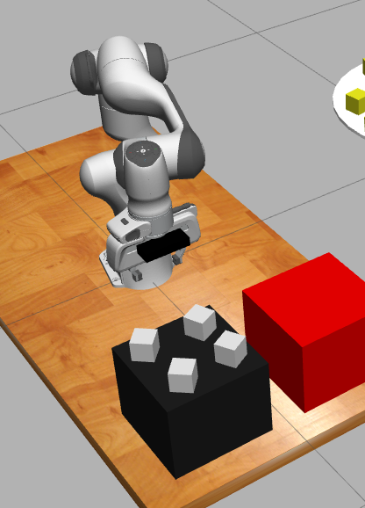
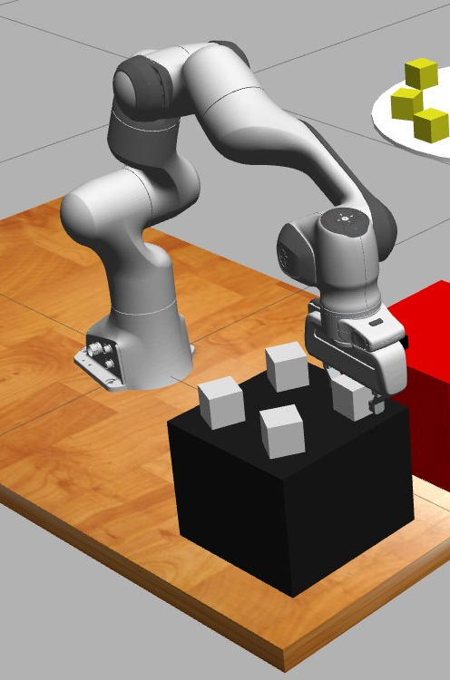
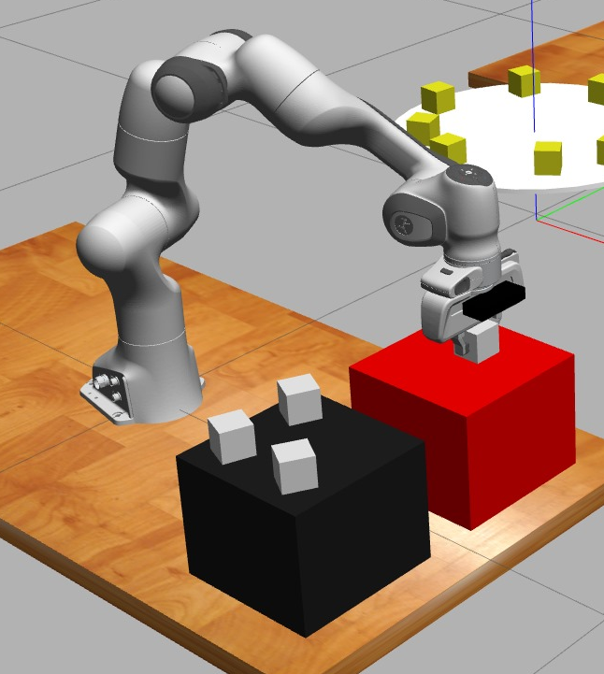
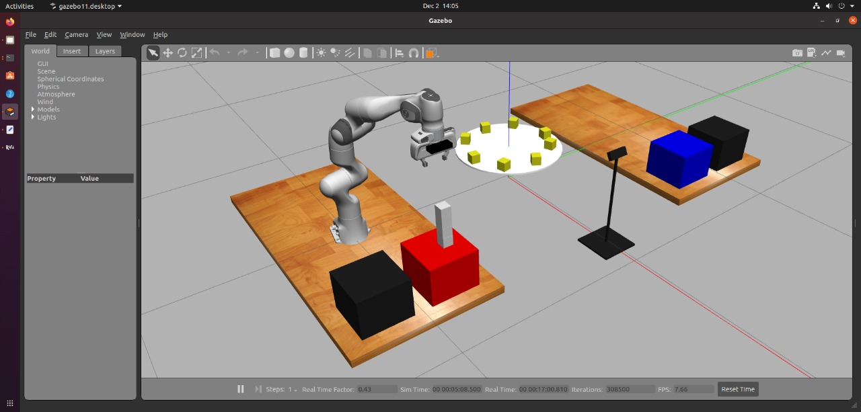
Approach -
Stationary Position
Static Block View (SV) Position for detecting
Grabbing Static block by computed IK
Placing the block at Stacking block position (SBV)
Dynamic Blocks Stacked (Robot at PV)

Slide 4
Dynamic Blocks
After running block detection, with the turntable center as the origin, converting the block’s cartesian coordinates (x,y) to polar coordinates (r,θ).
As the turntable rotates at a constant angular velocity(r=0.305m), we assume blocks move in a uniform circular motion to on the predict the block’s future angular position θ(t) = θ(0) + ωt
tune ωt and catch the block in place.

Slide 5
Results
We could properly stack the 4 static blocks

Slide 6
Results
We evaluated our approach with the inverse kinematics method to calculate the runtimes and the paths generated by the approach.
~ 2 minutes
Run Times
Run | IK Method
1 | 122.392
2 | 119.698
3 | 130.122
4 | 127.641

Slide 7

Results
A few other results we obtained by gruelling trial and errors were:
Computation Times Over Multiple Iterations for both blue and red teams
Paths Obtained
Probabilities of us stacking successfully (still under review)
Knowledge and Wisdom

Slide 8
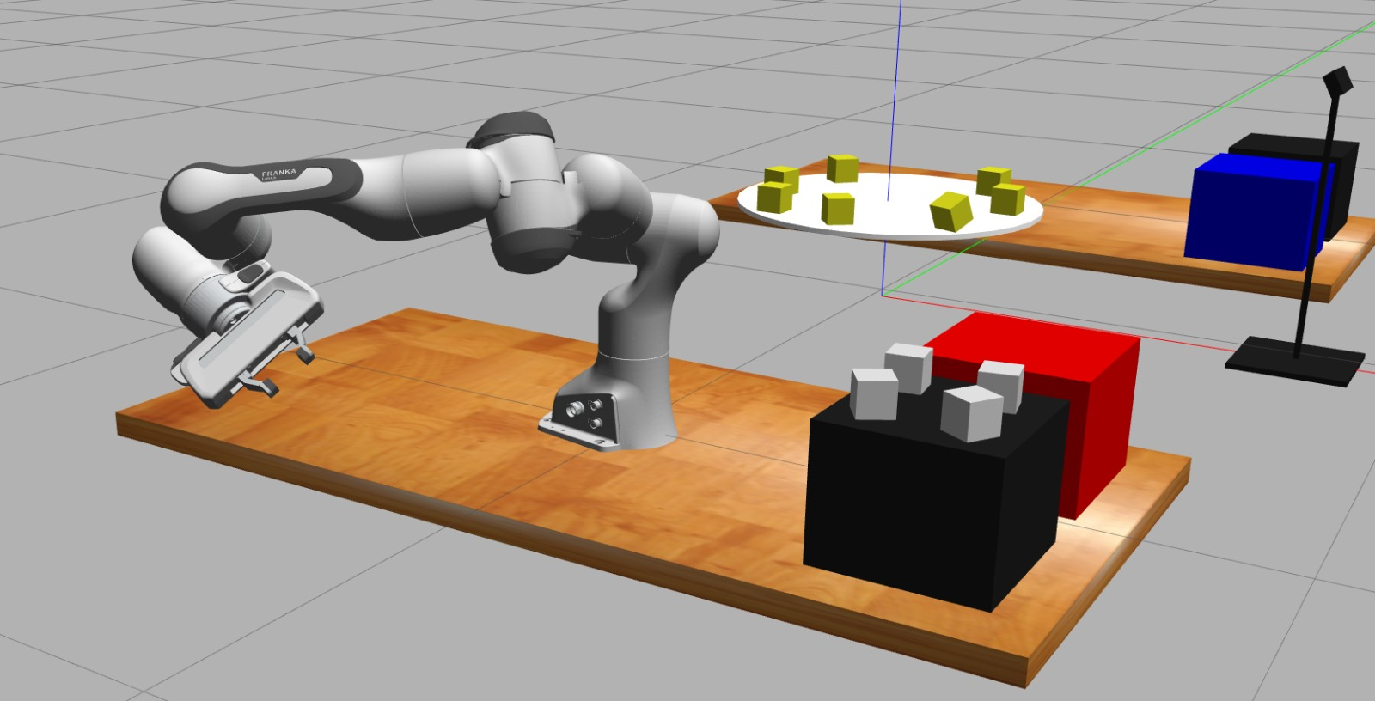
Problems and Challenges
IK converging issues (pre-defined q’s)

Slide 9
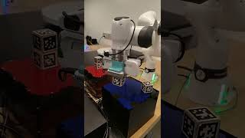
Problems and Challenges
software vs hardware gap, led to challenges like noise in the april tag pose detection (averaging over readings)

Slide 10
Lessons Learned
Need to reduce the amount of computation for IK
(Using previously computed q’s for predetermined positions)
Static Block View (SV) Position for detecting

Slide 11
Lessons Learned
Using a planner did not give much advantage (IK resulted in smoother trajectories compared to RRT, also for paths without obstacles, RRT added to the computation cost with no added benefits)

Slide 12
Thank You !

