Slide 1
Individual Project BUAN 6342 NLP 40 points

Slide 2
Importance and role of preprocessing steps
Explain why these steps are crucial and how they contribute to the summarization process.
Text Cleaning: Removing whitespace and special characters eliminates unnecessary noise and distractions, allowing summarization algorithms to focus on the meaningful content of the text.
Stemming and Lemmatization: This help normalize the text by reducing words to their root forms. Different variations of the same word are treated as the same, enhancing the efficiency and effectiveness of summarization algorithms.
Part-of-Speech (POS): This helps identify grammatical structure of sentences enhancing semantic understanding between words and phrases, which in turn facilitates more accurate summarization.
Named Entity Recognition (NER): Identifies key terms and entities within the text and can help prioritize relevant information for inclusion in the summary

Slide 3
Summarization Process
NLTK summarization Steps
spaCy summarization Steps
Preprocessing
Filtering Data
Count
Visualization
Word Cloud
Remove Special Character
Normalization
Tagging
TF-IDF
Text Rank
Cosine Similarity
Bar Chart
Line Chart
Remove whitespace
POS
NER
Stemming
Lemmatization
Feature Extraction
Preprocessing
Filtering Data
Modeling
Text Rank
Visualization
Bar Chart
Line Chart
Remove Special Character
Normalization
Tagging
NER
TF-IDF
Cosine Similarity
Word Cloud
Remove Whitespace
Stemming
Lemmatization
POS
Sentiment Analysis
Target Variable Identification
Linear SVC
*You may insert the step or function name only. Change / add / modify as needed.

Slide 4
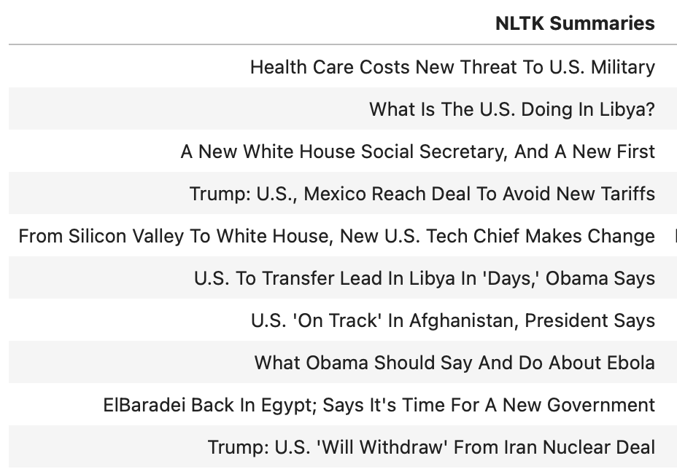
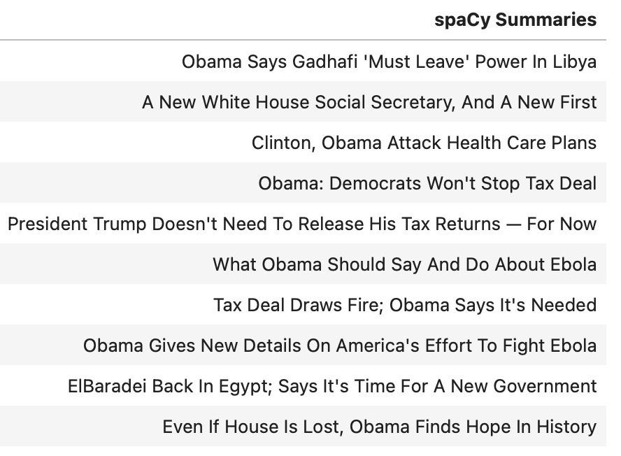
Summarization results ( side by side comparison)
NLTK top 10 headlines news
spaCy top 10 headlines news

Slide 5
Conclusion
As a conclusion, which of the following is the best practice for summarization and why?
Both libraries (spaCy & NLTK) are effective for text summarization, with NLTK being slightly more efficient.
Both are effective, but spaCy outperforms NLTK.
Both libraries successfully generate summaries that meet the committee's needs, and the summaries highlight the top 10 most important stories of the day's news. Therefore, depending on the specific project needs, either NLTK or spaCy could be chosen for text summarization.
Insert your choice here and provide a couple or three sentences as a rationale for your conclusion:
Conclusion: Both libraries successfully generate summaries that meet the committee's needs, and the summaries highlight the top 10 most important stories of the day's news. Therefore, depending on the specific project needs, either NLTK or spaCy could be chosen for text summarization.
Rationale: Both the techniques have its strengths and weaknesses. SpaCy is latest and offers more advanced features like pipelines. NLTK is older but also capable of generating high-quality summaries. The choice between NLTK and spaCy ultimately depends on specific project requirements, such as the need for advanced linguistic analysis or ease of use. Therefore, either library could be chosen based on the project goals.

