Slide 1
BANK LOAN STATUS PREDICTION TEAM 6
Analyzed By:
Srivats S Ramanujam, 120003312
Srivathsan G, 120003311
Arvind V, 120003036
Shreyas N, 120003292
Venkatraman M, 120003353
Srivattsan G, 120003313
Visnukanth P, 120003368

Slide 2
OBJECTIVES
Predicting the loan status of individuals based on their credit parameters such as Credit Score, Annual Income, etc. .
Comparing the efficiency of three standard Machine Learning models on a Banking Dataset.

Slide 3
BASIC CONCEPTS
Gradient Boosting: It is a ML technique for regression and classification problem, which produces a prediction model in the form of an ensemble of weak prediction model, typically decision trees.
Logistic Regression: It is a regression analysis to conduct when the dependent variable is binary. Logistic Regression is a predictive analysis used to describe and to explain the relationship between one dependent binary variable and one or more independent variable.
Random Forest: It is an ensemble learning method for classification, regression and other task that operates by constructing a multitude of decision trees of training time and outputting the class.

Slide 4
PROPOSED SYSTEM
Cleaned and preprocessed dataset used for building the models.
Three different models are built and efficiency of each model is compared.
Specific features were selected based on their collinearity using a threshold determined by experimenting.
The system will finally predict who can pay their loans and who cannot.

Slide 5
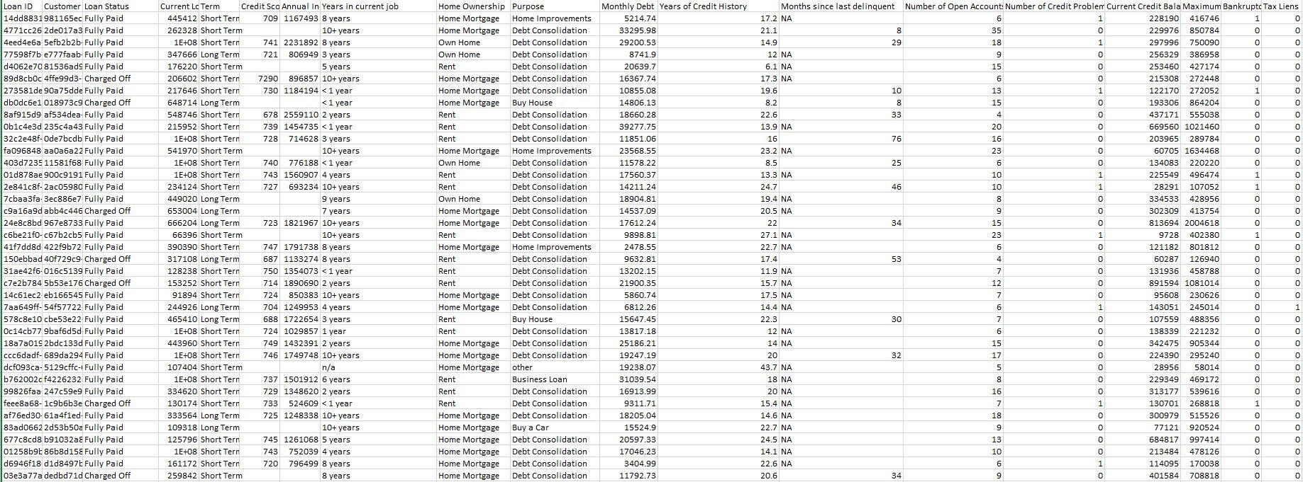
DATASET

Slide 6
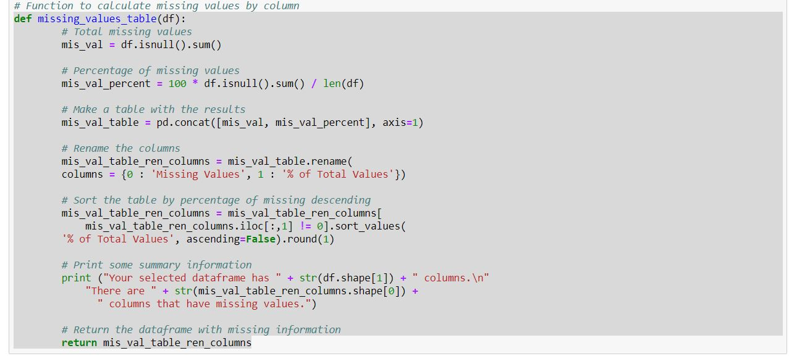
PREPROCESSING

Slide 7
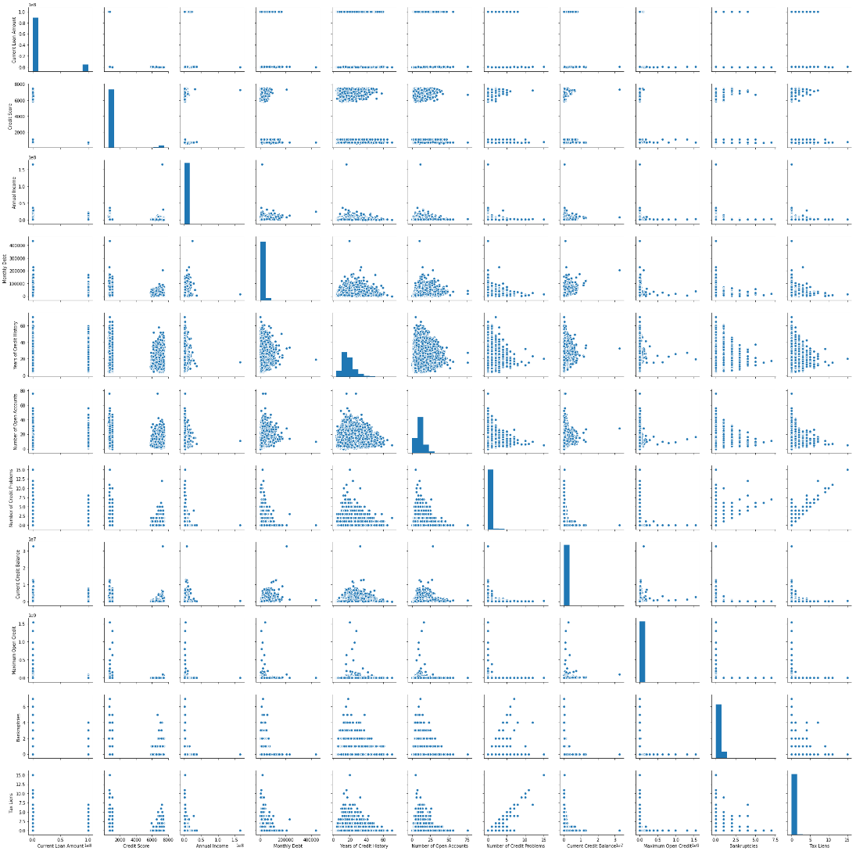
CORRELATION BETWEEN COLUMNS

Slide 8
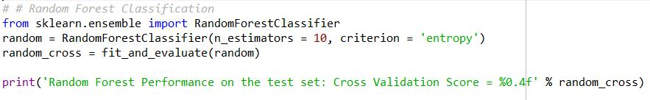
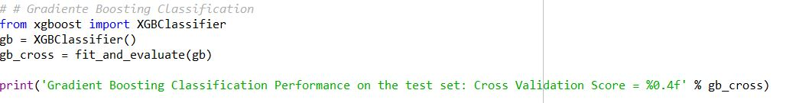
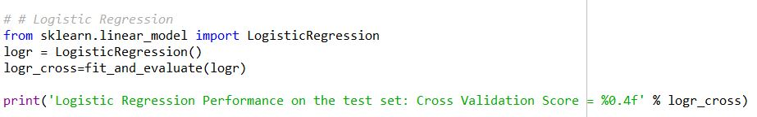
ALGORITHMS

Slide 9
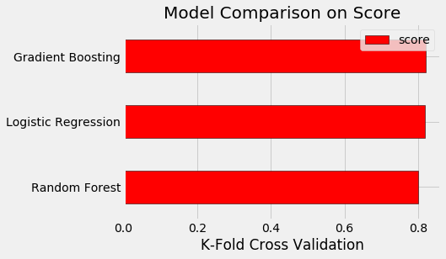
COMPARISON

Slide 10
OUTPUT AND FUTURE WORK
The model predicts the loan status of individuals whether fully paid or charged off.
Also, accuracy of various models are analyzed.
Future Work:
More Models should be analyzed and should be checked for accuracy.
Higher true negative data’s can be used for better analysis.

Slide 11
THANK YOU

