Slide 1



Crowd-Counting and Management

Slide 2

Learning Objectives
Understand how object detection algorithms (such as YOLO, SSD, Faster R-CNN) can be applied to images or video for real-time counting and tracking of people within crowds.
Develop skills in configuring, training, and deploying deep learning models to detect multiple objects in complex scenes.
Gain practical experience with data annotation, collecting ground truth data for object locations, and evaluating detection performance (using metrics such as Precision, Recall, IoU, and mAP).
Implement video analytics pipelines, including frame acquisition (using OpenCV), object localization, and result visualization.​
Learn to integrate crowd counting analytics with real-time alerting and reporting systems for crowd management and risk mitigation.
Track crowd density and distribution to find overcrowding.

Slide 3
Tools and Technology used
YOLOv8 (Ultralytics): State-of-the-art deep learning model for real-time object detection and tracking, providing fast, accurate detection of people in images and videos.
OpenCV: Widely used computer vision library for image/video processing, visualization, and annotation of detection results.
Python Libraries: Essential modules like NumPy for numerical processing, argparse for command-line control, glob for batch file handling, and csv for export of results.
Tracking & Counting Logic: Uses centroid-based tracking to monitor objects crossing a virtual line for counting entries and exits.
Optional GUI: tkinter for file selection dialogs to improve usability.
Command line interface: For flexible usage with single images, videos, or batch processing.

Slide 4
Methodology
Preprocessing video frames or images for consistent input.
Using YOLOv8 to detect people with bounding boxes and confidence scores.
Applying simple tracking by monitoring centroid movements relative to a virtual line or region.
Counting people crossing this line in/out to measure crowd flow.
Annotating frames for visualization and optionally saving/logging the counts.
Supporting batch processing for multiple files and enabling configurable detection thresholds.

Slide 5
Problem Statement:
"To develop an automated, real-time system capable of accurately detecting and counting the number of people in images and video streams from public and private environments. The system aims to monitor crowd size, flow, and density to enhance safety, optimize resource allocation, and provide actionable alerts during overcrowding or unusual movement patterns. The core challenge is achieving reliable detection and counting despite variations in crowd density, occlusions, and environmental conditions, using efficient detection models and simple tracking techniques."

Slide 6
Solution:
The solution is to implement a real-time, automated crowd counting system using the YOLOv8 object detection model integrated with video processing tools like OpenCV. The system detects and localizes people in images and video streams with high accuracy, then tracks their movement relative to a virtual line or region to count entries and exits.
Key components include:
Pretrained YOLOv8 for fast, reliable person detection.
Centroid-based tracking to associate detections frame-by-frame.
Counting logic to monitor crossing events for crowd flow measurement.
Visualization overlays for bounding boxes, counts, and tracking.
Batch processing capabilities for large-scale image analysis.
Optional GUI for easy file selection and user interaction.

Slide 7
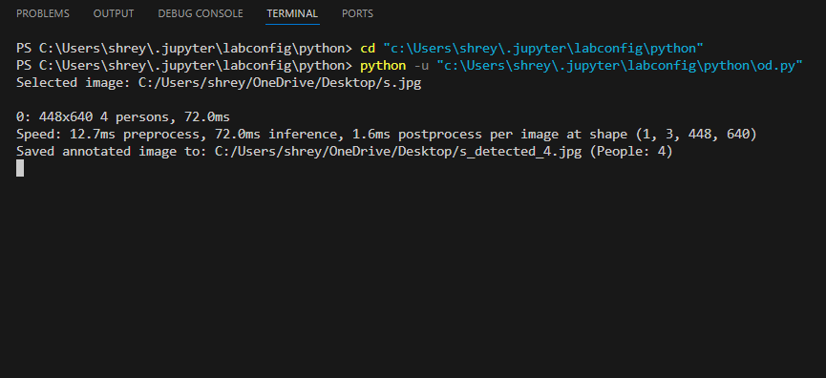
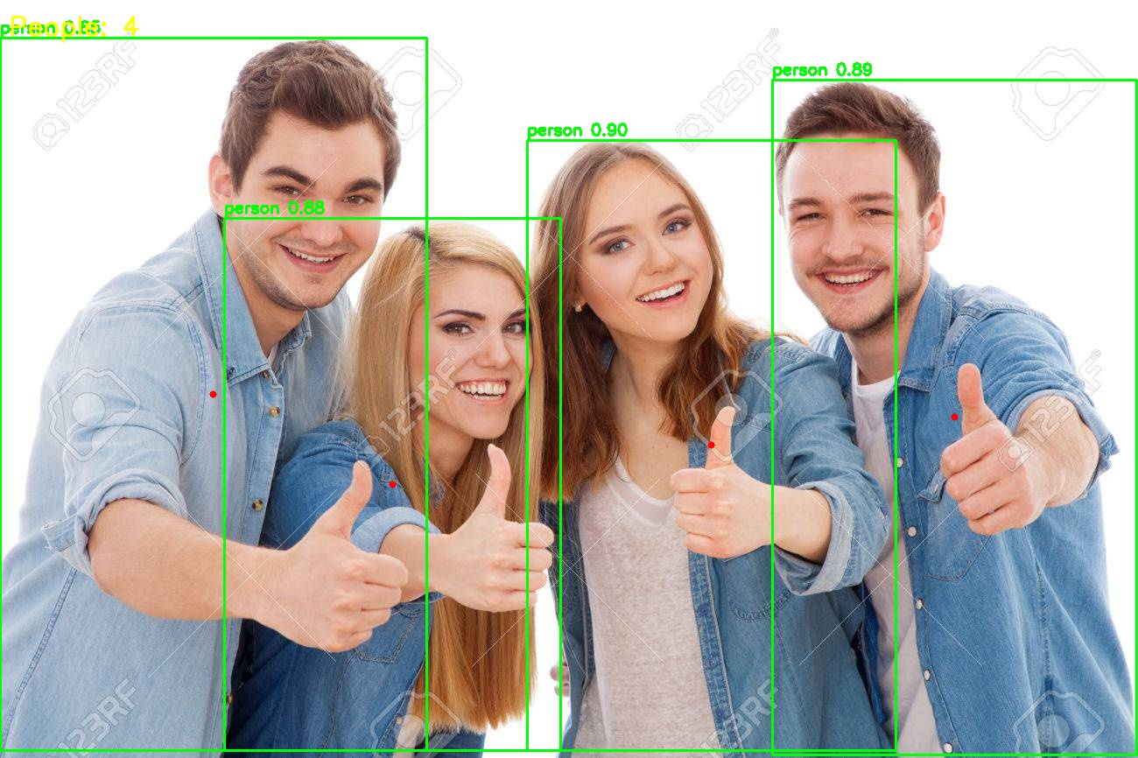
Screenshot of Output:

Slide 8
Conclusion:
The YOLOv8-based crowd counting and management system represents a powerful and efficient application of modern computer vision techniques. By leveraging YOLOv8’s real-time accurate detection capabilities combined with simple but effective tracking and counting logic, the system provides valuable insights into crowd size, flow, and density. This enables improved safety monitoring, event management, and resource optimization across various public and private environments.
The integration of visualization, batch processing, and optional alerting mechanisms further enhances its practicality for real-world deployments. While challenges such as occlusion and complex backgrounds exist, ongoing advances in deep learning continue to improve robustness and accuracy.
Overall, this system offers a scalable, automated solution to replace manual crowd monitoring, supporting proactive crowd control measures and informed decision-making to prevent accidents and optimize operations in crowded spaces

