Slide 1
LEARNMATE FOR PERSONALIZED COURSE PATHWAY
CAPSTONE PROJECT
Presented By:
1. Shreyas Bibhuty-MIT, Manipal-Computer and Communication Engineering

Slide 2
OUTLINE
Problem Statement (Should not include solution)
Proposed System/Solution
System Development Approach (Technology Used)
Algorithm & Deployment
Result (Output Image)
Conclusion
Future Scope
References

Slide 3
Problem Statement
Students often struggle to identify the right learning path that aligns with their interests and long-term goals due to the overwhelming number of online courses and a lack of personalized guidance. LearnMate aims to solve this by acting as an Agentic AI coach that interacts with students, understands their interests (like Frontend Development, Cybersecurity, UI/UX Design, etc.), assesses their current skill level, and dynamically builds a personalized course roadmap that adapts over time based on progress and preferences

Slide 4
Proposed Solution
Collect user profile data, including academic background, skill level, and interests (e.g., Frontend Development, Cybersecurity, UI/UX Design).
The proposed system aims to address the challenge of guiding students toward personalized learning pathways that align with their interests and career goals. This involves leveraging Agentic AI capabilities using IBM Cloud Lite services and IBM Granite foundation models to interact with students, assess their skills, and dynamically create adaptive course roadmaps. The solution consists of the following components:
Data Collection & Interaction:
Collect user profile data: academic background, skill level, interests (e.g., AI, Cybersecurity, UI/UX).
Interact through AI agent prompts using Watsonx Agent Lab interface.
Use external tools (Google/Wikipedia search, WebCrawler) for real-time information retrieval.
Preprocessing & Instruction Design:
Instructions framed using LangGraph architecture (e.g., ReAct-based prompt planning).
Skill and interest extraction from user messages for intent classification.
Agentic AI Modelling:
Foundation Model: llama-3-3-70b-instruct.
Incorporates interactive question-answering loop to refine learner intent.
Incorporates interactive question-answering loop to refine learner intent.
Deployment:
Project deployed via Watsonx.ai Sandbox.
Uses Watsonx.ai Runtime service and Deployment Space for production preview.
Evaluation:
Real-time response quality checked via agent preview.
Manual testing of conversation flow with beginner-level learner queries (e.g., "I want to learn AI in 2 days").

Slide 5
System Approach
The "System Approach" section outlines the overall strategy and tools used to build and deploy the LearnMate agent for guiding students in selecting personalized learning pathways using Agentic AI on IBM Cloud.
System requirements:
IBM Cloud account with access to Watsonx services.
Web browser for accessing the Agent Lab interface
Stable Internet connection
Libraries and tools Used:
Model:llama-3-3-70b-instruct
Framework:LangGraph
Architecture:ReAct
Tool Integrations
Watsonx Services
Watsonx.ai Runtime
Agent Lab
Deployment Space
Additional Platform Tools:
Prompt Interface(instruction tuning)
Agent preview panel for real-time testing

Slide 6
Algorithm & Deployment
Algorithm Selection:
The system uses LLM-based prompting with the llama-3-3-70b-instruct model deployed via Watsonxx.ai.
The ReAct architecture allows the agent to iteratively reason and take actions like web searches or API calls.
LangGraph framework orchestrates the flow between prompts,tools, and user responses.
Data Input:
User inputs include:
Interests(e.g.,AI,UI/UX,Cybersecurity
Skill levels(Beginner/Intermediate/Advanced)
Career goals and time constraints
Training Process:
No traditional model training is performed.Instead:
The LLM is pretrained and used in a zero-shot/few-shot prompting fashion.
Skill extraction and course matching are done through intelligent prompt design and tool interaction.
User feedback in Agent Preview helps fine-tune instructions manually.
Prediction Process:
The agents suggests personalized course roadmaps by combining:
Detected interests and skills
Web-searched certified course availability
Response patterns evaluated in real-time

Slide 7
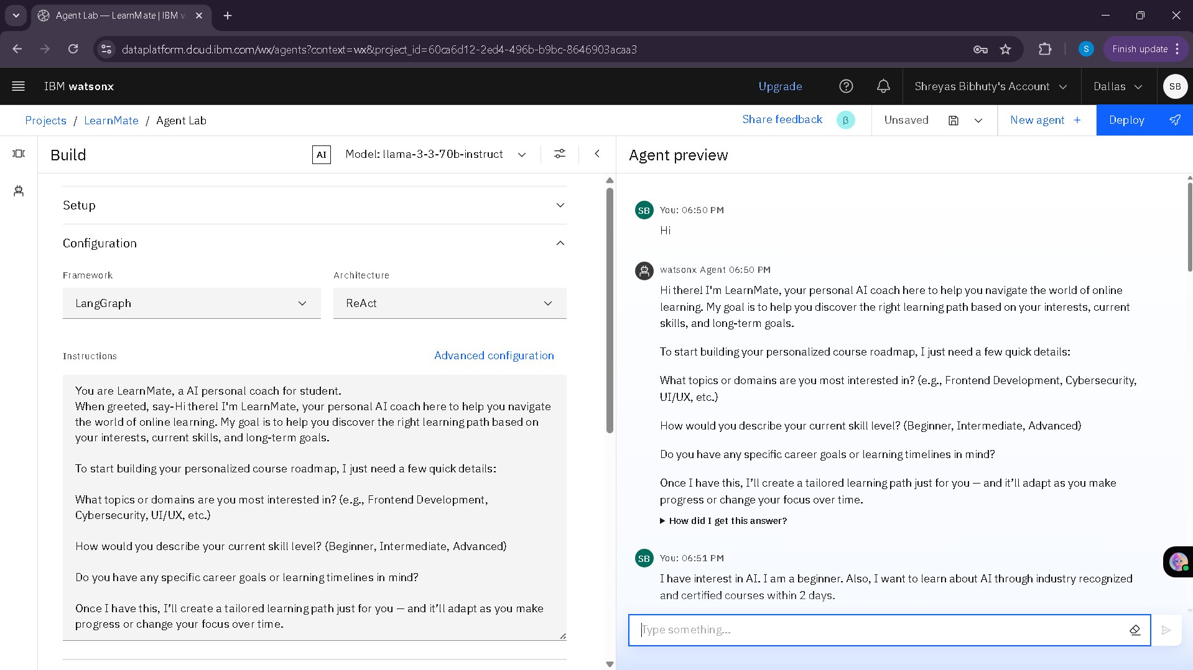
Result

Slide 8
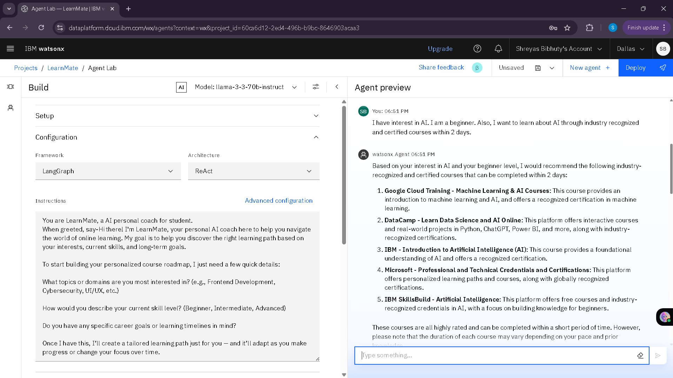

Slide 9
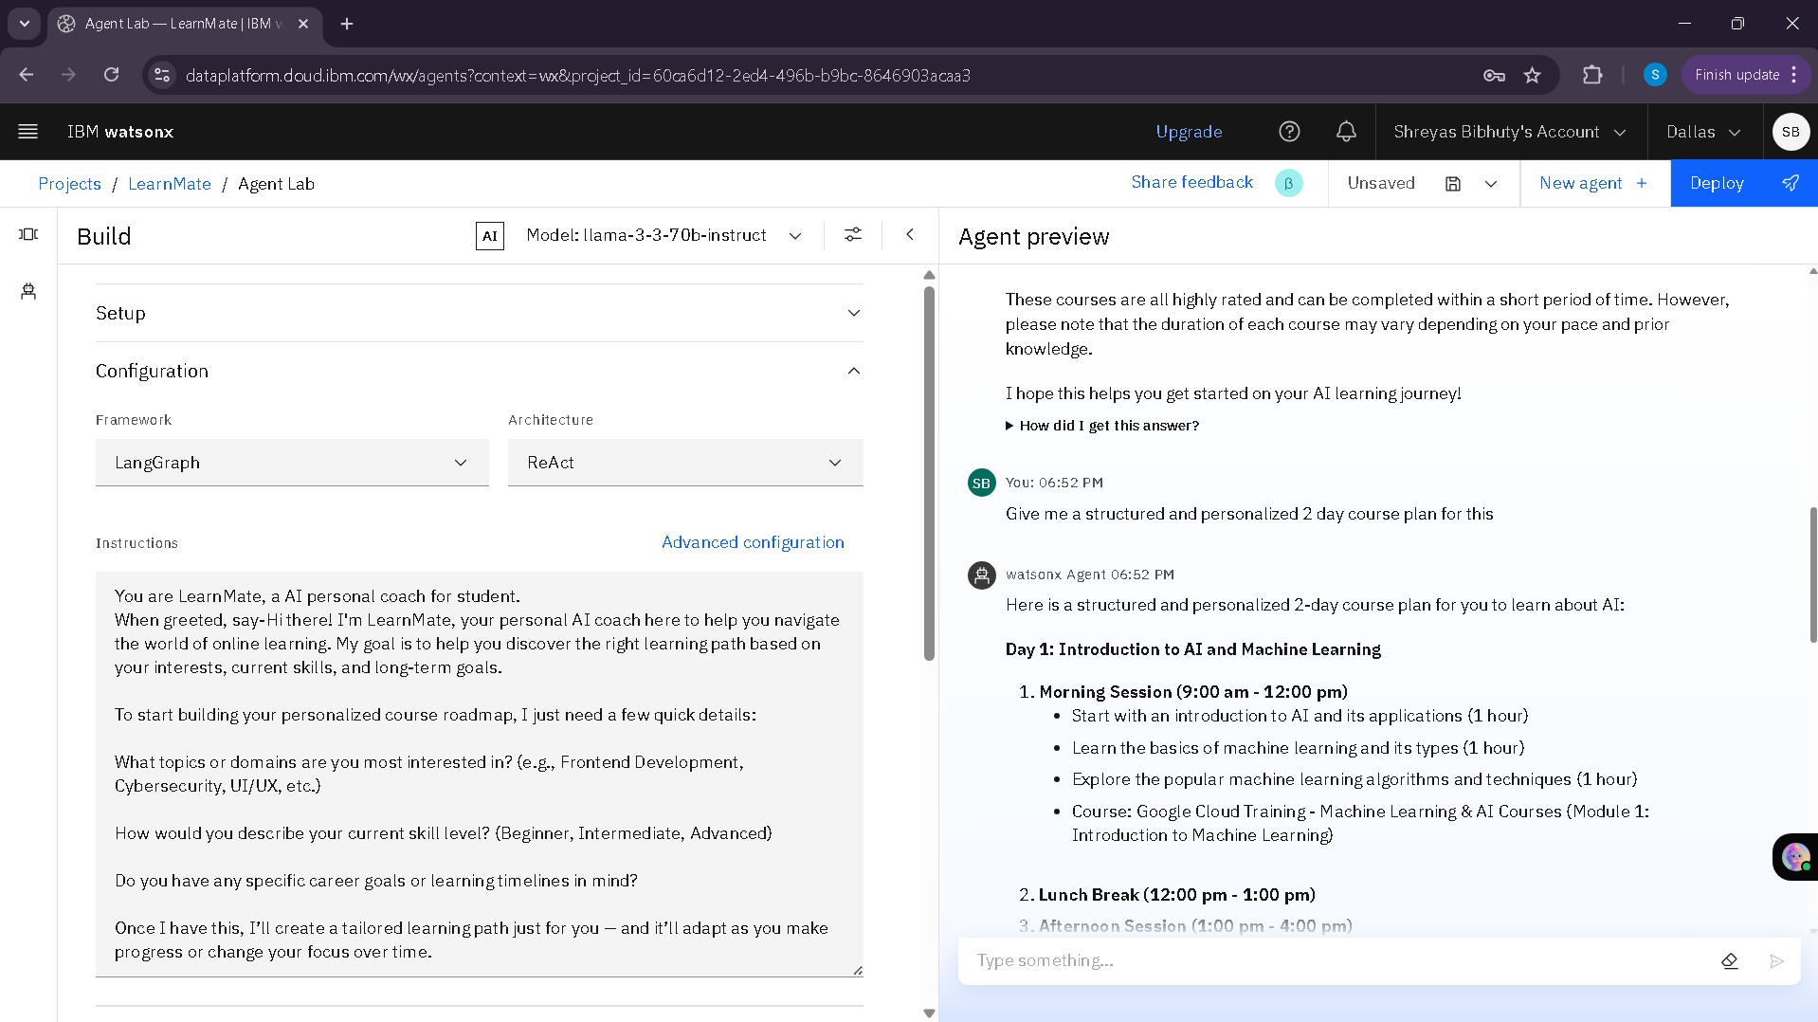

Slide 10
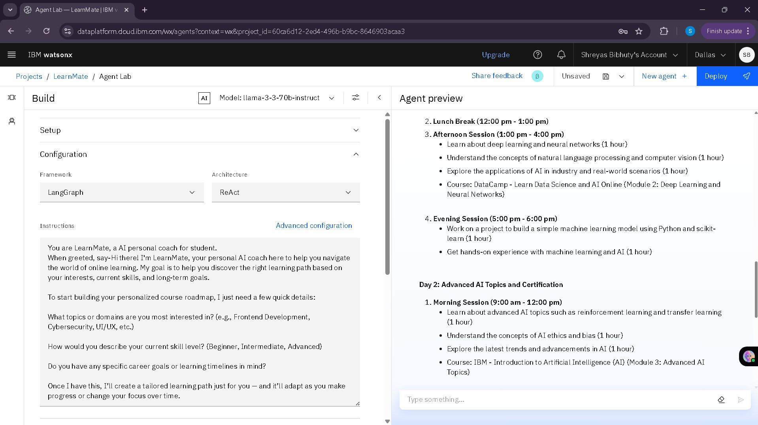

Slide 11
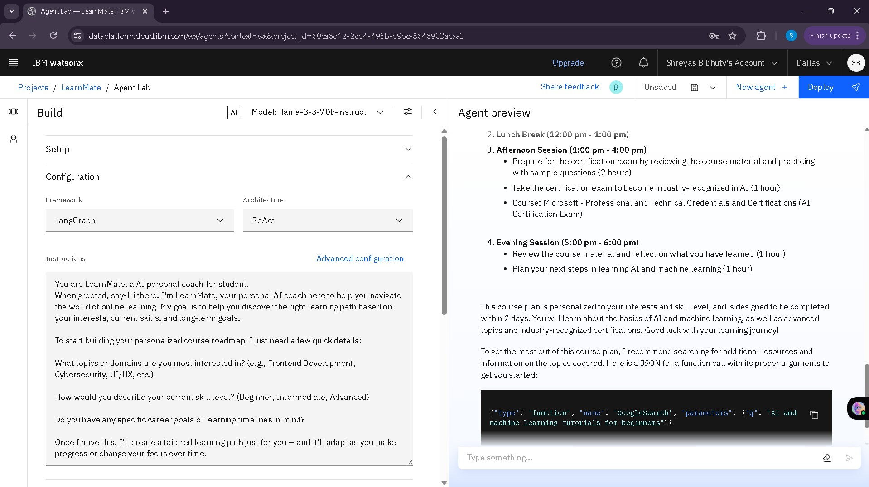

Slide 12
Conclusion
The LearnMate AI agent successfully demonstrates the potential of Agentic AI in guiding students through personalized learning paths based on their interests, skill levels, and goals.
By leveraging IBM Watsonx.ai, LangGraph framework, and tools like Google Search and Wikipedia, the system dynamically tailors course suggestions in real-time.
Challenges faced during implementation included managing model-tool interactions, handling ambiguous inputs, and fine-tuning prompts for improved personalization.
Moving forward, the system can be enhanced with more advanced recommendation algorithms, integration with verified course APIs (e.g., Coursera, edX), and feedback-driven learning loops for improved suggestions.
Key achievements include:
Seamless user-agent interaction via Watsonx Agent Preview
Integration of real-time search tools for relevant course recommendations
Accurate interpretation of learner goals and timelines

Slide 13
Future scope
Adaptive Learning with Feedback Loops
Introduce feedback-based tuning where the agent learns from user ratings, course completions, and satisfaction to improve future recommendations.
Multi-language and Regional Expansion Extend the system’s reach by supporting multiple languages and customizing recommendations based on regional education preferences and market needs.
Scalability Enhancements Deploy LearnMate across institutions, universities, or training centers as a plug-and-play AI academic assistant.

Slide 14
References
https://dataplatform.cloud.ibm.com/docs/content/wsj/analyze-data/fm-agent-lab.html?context=wx&audience=wdp

Slide 15
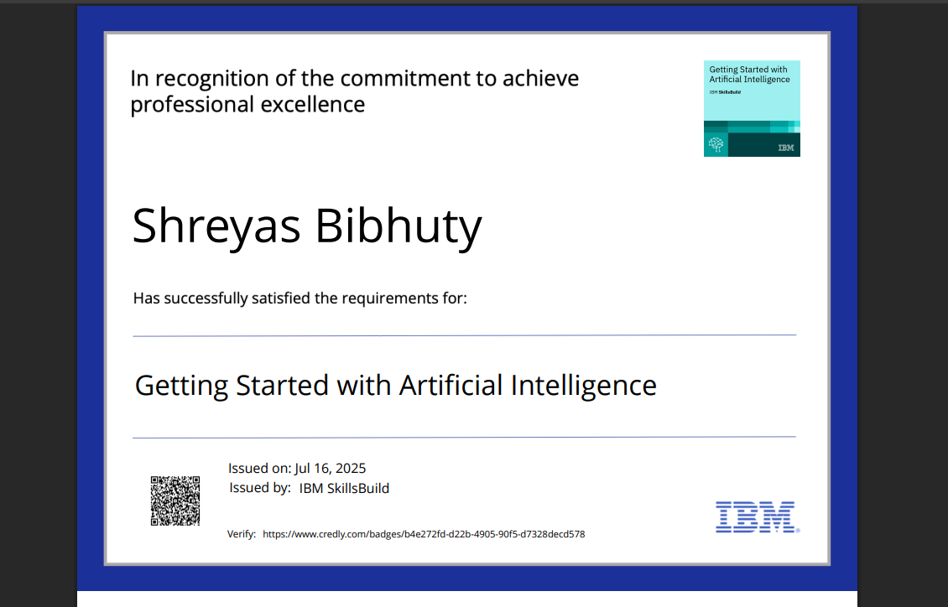
IBM Certifications

Slide 16
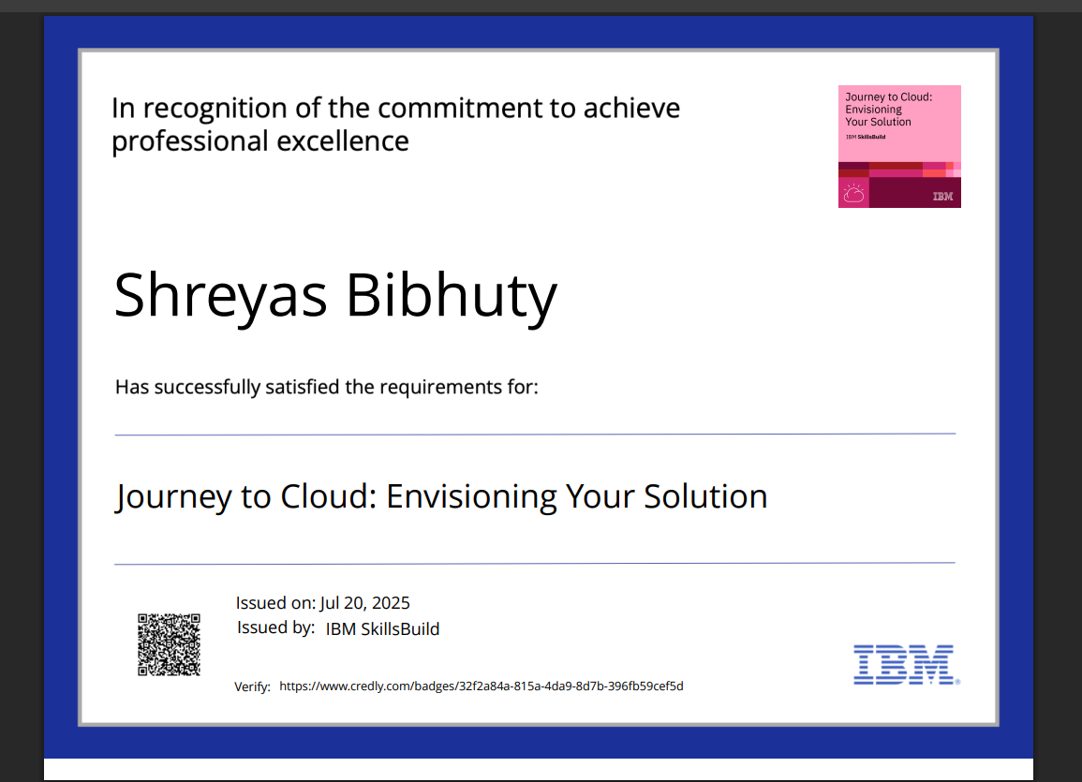
IBM Certifications

Slide 17
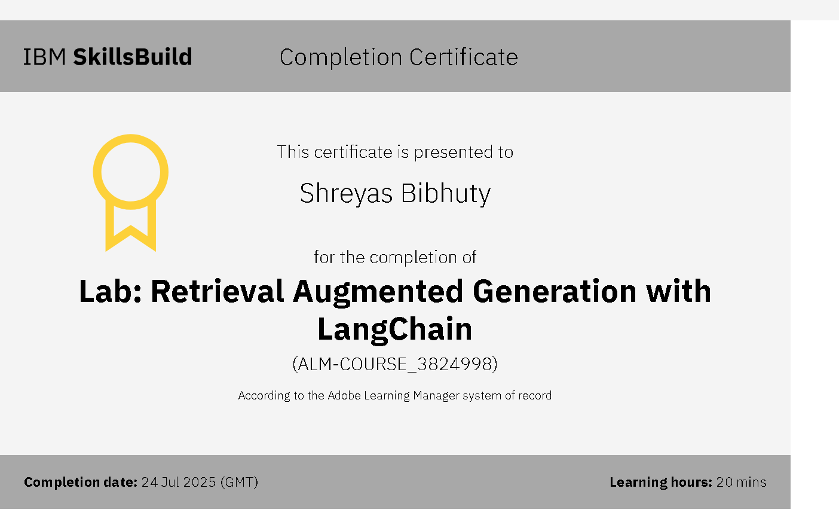
IBM Certifications

Slide 18
THANK YOU

