Slide 1

Why are suicide rates so high for men worldwide?
Team Details:
TEAM -3
Aayushi Gupta-01fe20bcs207(423)
Darshan Dixit-01fe20bcs215(431)
Shreyas Jakati-01fe20bcs216(432)
Shashank M Hosapeti-01fe20bcs197(413)

Slide 2
CONTENTS:
Problem Statement
Domain Understanding
Dataset Understanding
Dataset Description
Preprocessing
Data Analysis & Questions
Prediction Model
Conclusion
References

Slide 3
PROBLEM STATEMENT:
Analyzing the crude marriage rate , average male suicide rate and various disorders that contributes in the suicide rate. To find the relationship between various attributes given in our datasets(4).
And to conclude when and why suicide rate are high in men.
Source of our dataset:
https://www.kaggle.com/datasets/chimavogu/why-are-suicide-rates-so-high-for-men-worldwide
DOMAIN UNDERSTANDING :
Suicide is a hugely sensitive, complex issue with a tangled multitude of causes.
Male suicide methods are often more violent, making them more likely to be completed before anyone can intervene.
Men are nearly twice as likely as women to meet criteria for alcohol dependence.
Drinking can deepen the depression.
Men generally seek help with mental health problems less often.

Slide 4
Dataset understanding
ATTRIBUTE | DESCRIPTION
Row Labels | Year for which the average suicide rate is given.
Average of Male suicide rate (age-standardized) | Average male suicide rate per 100,000 for the given year.
Average of Female suicide rate (age-standardized) | Average female suicide rate per 100,000 for the given year.
Row Labels/Year | Year of the data
Average of depression prevalance in males | Average of depression prevalance in males
Entity | Name of the country.
Code | Three Alphabet code for the country.
Schizophrenia | Prevalance of Schizophrenia in a year of that country
anxiety_disorders | Prevalance of anxiety disorders in a year of that country
ATTRIBUTE | DESCRIPTION
bipolar_disorder | Prevalance of bipolar_disorder in a year of that country.
eating_disorders | Prevalance of eating_disorders in a year of that country.
Crude marriage rate (per 1,000 inhabitants) | Number of marriage by the total average population .
drug_use_disorders | Prevalance of drug_use_disorders in a year of that country
Depression | Prevalance of Depressionin a year of that country
alcohol_use_disorders | Prevalance of alcohol_use_disorders in a year of that country

Slide 5
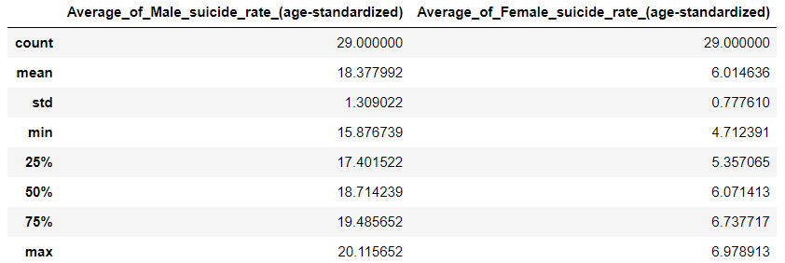
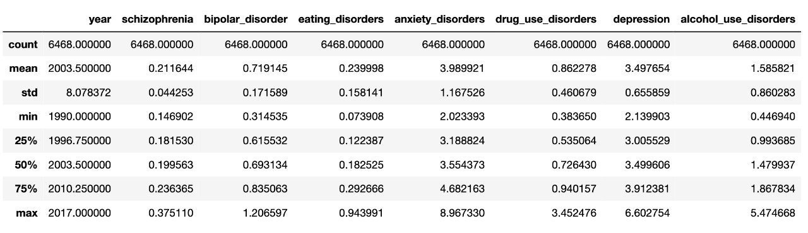
DATASET DESCRIPTION
male-vs-female-suicide:
Number of tuples:29
Total number of attributes: 3
prevalence_by_mental_and_substa description:
Number of tuples:6468
Total number of attributes: 10

Slide 6
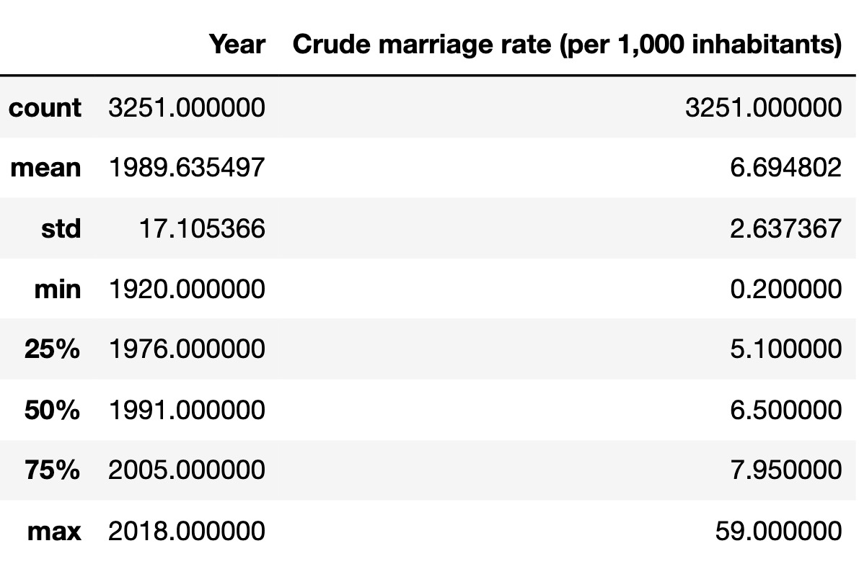
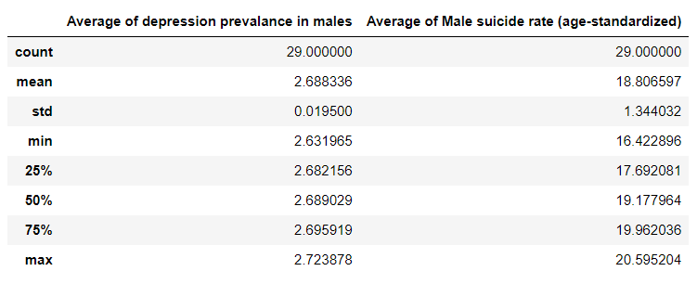
CONTINUED..
marriage-rate-per-1000-inhabitants description:
Number of tuples:3251
Total number of attributes: 4
male-suicide-with-depression-prevalance:
Number of tuples:29
Total number of attributes: 3

Slide 7
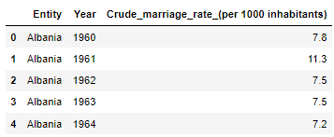

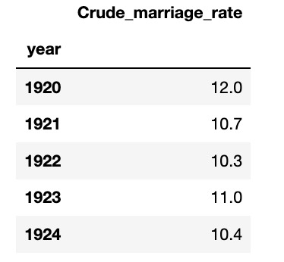
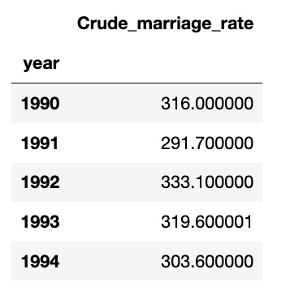
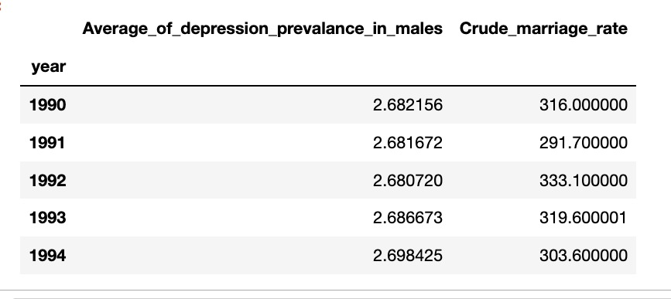
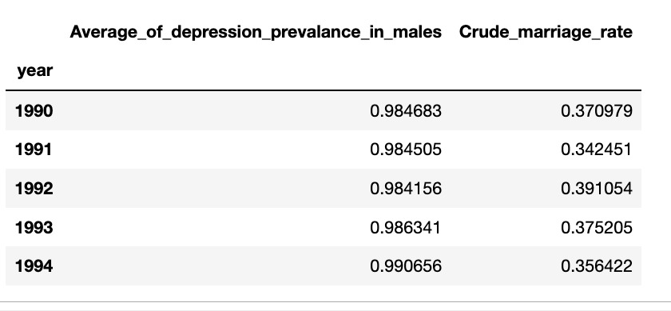
PREPROCESSING – AN OVERVIEW
Data Cleaning:
Data Selection:
Data Integration
Data Reduction
Data Transformation:
> There were total 103 and 980 null values in crude marriage dataset and prevalence_by_mental_and_substa description respectively.

Slide 8
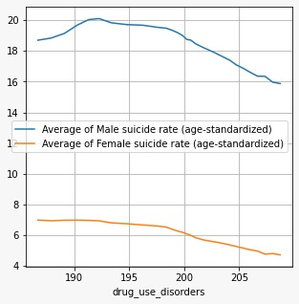
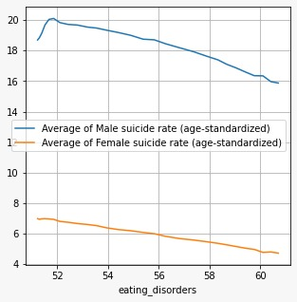
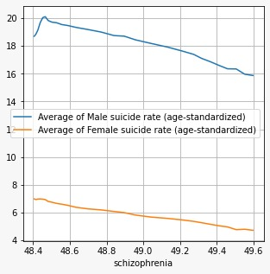
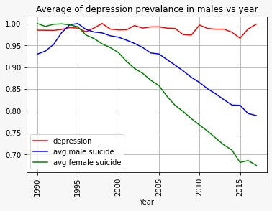
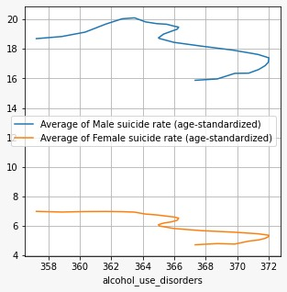
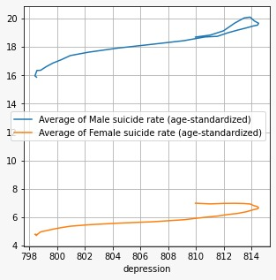
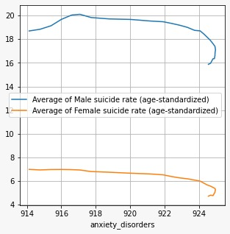
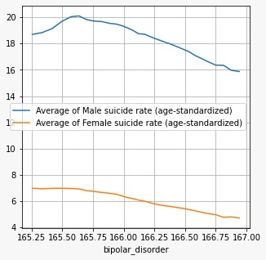
Q1. How avg. male and female suicide rates vary w.r.t mental disorders?
>Both male and female avg. suicide rates are decreasing as the disorders
are increasing except depression. As depression is increasing the avg. suicide
Rates of both male and female is also increasing.
>Depression prevalence is
approximately constant over the years.
>Depression and average male suicide
rate are strongly correlated(0.98)

Slide 9
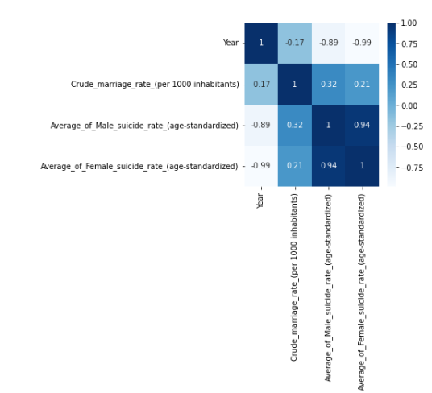
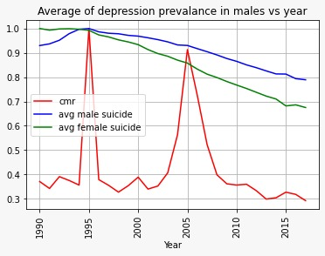
Q2. How suicide in males corelates with crude marriage?
>Crude marriage rate is decreasing gradually year by year , so is the average male suicide rate.
>1995 has the highest crude marriage rate, also in the year 1995 average male suicide rate was highest.
>Henceforth crude marriage rate and average male suicide rate are directly proportional to each other.
CRUDE MARRIAGE RATE AND SUICIDE RATE VS YEAR

Slide 10
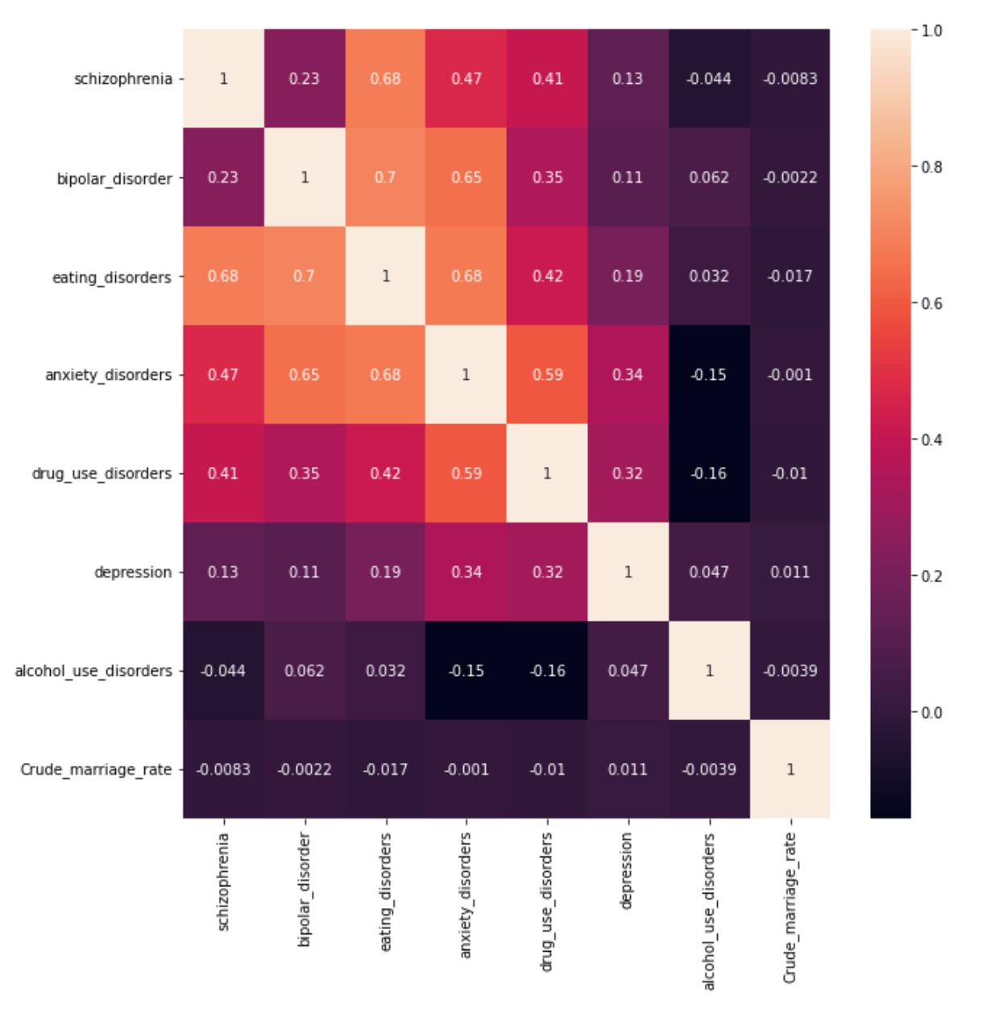
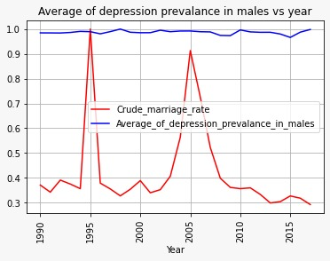
Q3. How depression in males and crude marriage rate correlates?
> Male suicide rate and depression are directly proportional to each other
> But crude marriage rate does not affect average of depression prevalence in males as as correlation between them is low i.e 0.011.
=>Although crude marriage rate is varying yearly avg. depression prevalence is nearly constant.

Slide 11
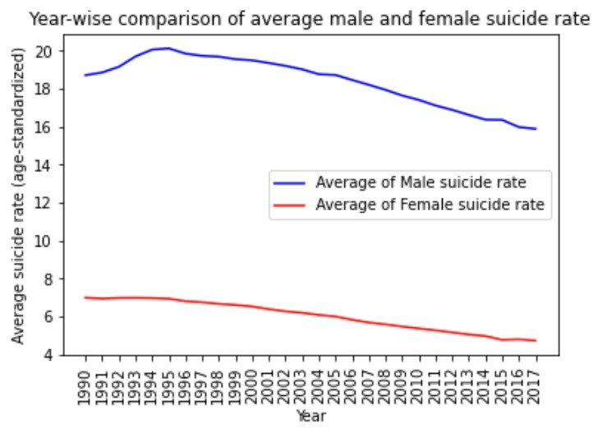
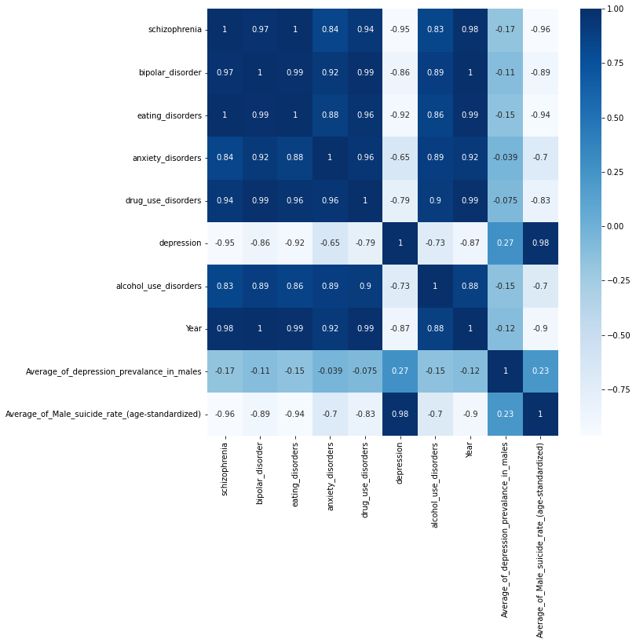
Q4. Why suicide rate are decreasing gradually?
>Depression and average male suicide rate are strongly correlated(0.98)
>As the years passes, depression is not the most common reason for males to commit suicide.
>Average male suicide rate and year are negatively corelated (-0.9), that’s is as the year is increasing male suicide rate is decreasing.
>The attribute year and depression are negatively corelated(-0.87).
>As the years are increasing the depression rate is decreasing as also the male suicide rate is decreasing.

Slide 12
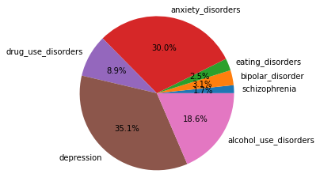
Q5.1 Which country has maximum suicide rate?
>Correlation between attributes we came to know that crude marriage rate and depression are positively correlated.
>We also know that avg. male suicide rate and depression are also highly correlated.
>In the year 1995 we have maximum average suicide rate and GREENLAND has maximum depression and crude marriage rate rate in the same year.
>So we can conclude that more the depression more is the crude marriage rate and avg male suicide rate and GREENLAND has maximum average male suicide rate.

Slide 13
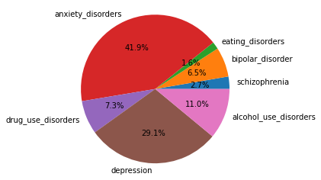
Q5.2 Which country has minimum suicide rate?
>We know that Crude marriage rate and suicide rate are directly proportional to each other.
>The minimum value of total disorder faced by people and minimum Crude marriage rate is found in the country MYANMAR.
>Hence the country with minimum suicide rates is MYANMAR.

Slide 14
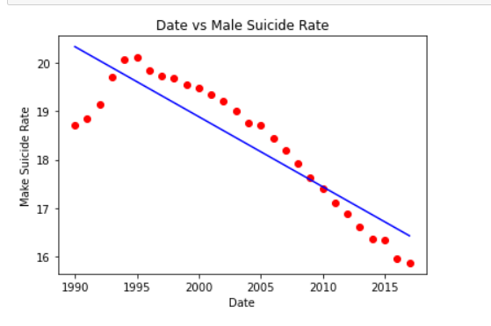
PREDICTION MODEL
>The red dot values represent the real dataset values and the blue line represents the prediction from the regression model.
Year VS male suicide rate
Male Suicide Rate
Year

Slide 15
CONCLUSION
>It is strongly evident from the analysis that factors such as crude marriage rate, depression rate, anxiety disorder, drug consumption disorder, bipolar disorder, eating disorders and schizophrenia, that affect average men suicide rate.
>Suicide rate of men are 3 times that of female.
>Crude marriage rate of a country and other major mental disorder such as depression play a vital role in male committing suicide as compared to females with correlation values 0.3, 0.98 respectively.
>Disorder like schizophrenia and drug use disorder are contributing to male committing suicide as the yar passes with the correlation value of 0.98 and 0.99 respectively.

Slide 16
REFERENCES:
https://onlinelibrary.wiley.com/doi/full/10.1111/dar.13032
https://pubmed.ncbi.nlm.nih.gov/26796925/
https://ourworldindata.org/drug-use
https://thecleverprogrammer.com/2020/05/31/suicides-in-india-data-analysis-with-python/
https://www.medscape.com/answers/286759-14675/what-is-the-suicide-rate-among-persons-with-depressive-disorder-clinical-depression#:~:text=Depression%20plays%20a%20role%20in,depressive%20disorder%20is%20nearly%2020%25
https://theprint.in/india/many-more-people-commit-suicide-due-to-bad-marriage-than-divorce-ncrb-data-shows/765923/

Slide 17
THANK YOU!

