Slide 1

CONSTRUCTION
Management System

Slide 2
Indala College of Engineering
ACADEMIC YEAR : 2022-23
Department of computer engineering
CONSTRUCTION
Management System
Sr.No | Name | Roll No.
1. | Shreyas Subodhkumar Baile | 04
2. | Suraj Anil Naik | 34
3. | Prajakta Pundalik Vishe | 67
Guided By: Monika Kedar

Slide 3
Index
Index
1
Introduction​
2
​Literature Survey
3
Proposed System​
4
System Design
5
Conclusion & Future Scope

Slide 4
INTRODUCITON
Construction management system is a software solution designed to help construction companies manage their projects more efficiently. It provides a centralized platform for all stakeholders to collaborate and communicate effectively, ensuring that projects are completed on time, within budget, and to the required quality standards.

Slide 5
Literature Survey
Construction management is a complex process that requires effective communication and collaboration among multiple parties involved in a project. In the past, construction management was a manual and tedious process, but with the advancement of technology, web-based applications have emerged to streamline and automate the construction management process. In this survey, we will discuss some of the existing web-based construction management systems that are currently available in the market.

Slide 6
Proposed System
The proposed construction management system is designed to streamline the process of managing borrowed equipment tools, transfer equipment, maintenance tools and equipment, employees, and locations. The system will be web-based and will utilize a database to store all relevant information.

Slide 7
Proposed System
The proposed construction management system is designed to streamline the process of managing borrowed equipment tools, transfer equipment, maintenance tools and equipment, employees, and locations. The system will be web-based and will utilize a database to store all relevant information.

Slide 8

The planning
1.2 Objectives
Methods of construction
Equipment and machinery planning
Material Purchases
Training Employees
Documentation and drawing requirements
Money Management

Slide 9
System Design
The project is designed to streamline construction project management. It includes an equipment module for tracking machinery, an employee module for managing labor, a site location module for mapping and location tracking, and a reporting module for data analysis. The system design aims to improve project efficiency, reduce costs, and increase productivity. With real-time monitoring and data analytics
The user-friendly interface and customizable features make it easy to navigate and adapt to individual project needs.

Slide 10
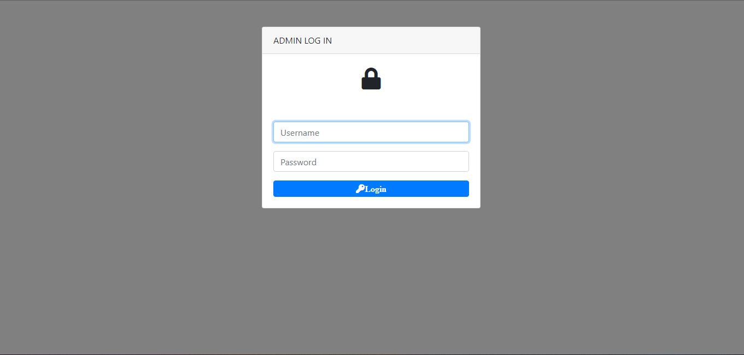
Login Page
The login page is the gateway for owners to access the construction management system.
Owners can input their credentials to access their project data and settings.
The login page may include additional security measures such as multi-factor authentication.
It ensures that only authorized personnel can view and modify project information.
It is an essential component of the construction management system, ensuring data privacy and protection.

Slide 11
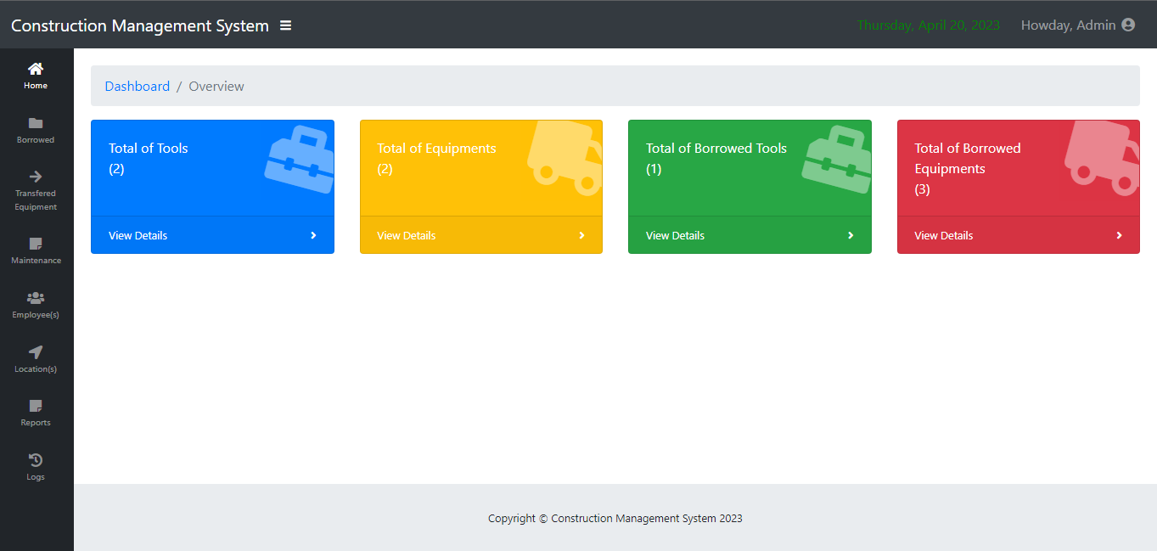
Dashboard
Dashboard page shows the total tools available, total equipment in use, total borrowed tools, and total borrowed equipment.
These metrics provide valuable insights into the status of the project's resources.
By tracking these numbers in real-time, stakeholders can make informed decisions and allocate resources effectively.
The dashboard page provides a quick and easy way to monitor these metrics, helping to improve project efficiency and reduce costs.

Slide 12
Reequipment Gathering
Hardware Interface:
Processor: Intel core i5
Processor Speed: 2.50 GHz
RAM: 8 GB
Software Interface:
Operating System: Windows 10
Database: MySQL
Front End: HTML, CSS, JavaScript, Php, Bootstrap
Browser: Preferable Google Chrome or Mozilla Firefox

Slide 13
Reequipment Gathering
Hardware Interface:
Processor: Intel core i5
Processor Speed: 2.50 GHz
RAM: 8 GB
Software Interface:
Operating System: Windows 10
Database: MySQL
Front End: HTML, CSS, JavaScript, Php, Bootstrap
Browser: Preferable Google Chrome or Mozilla Firefox

