Slide 1
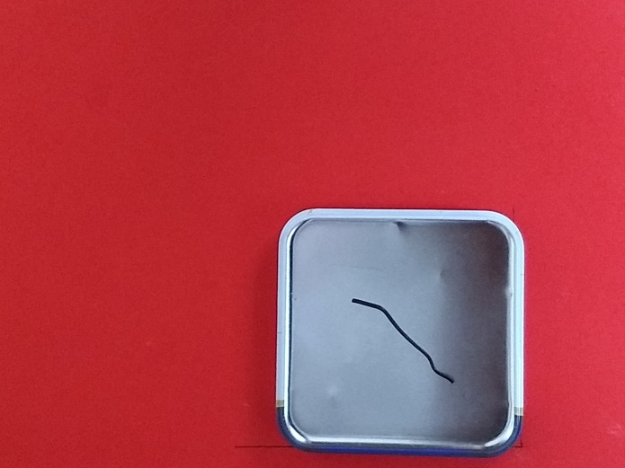
Task:
To identify crack on an object using Image processing.
Reference image chosen
Background
Metallic object
Crack to be identified

Slide 2
Process:
Read the image
OpenCV
Pre-processing
Resizing, Grayscale , Blurring
Extract the ROI(metallic object)
Canny edge detector, Morphological operations
and Contour functions
Processing ROI
Morphological operations
Extract interested
Objects(Cracks)
Canny edge detector and Contour functions

Slide 3
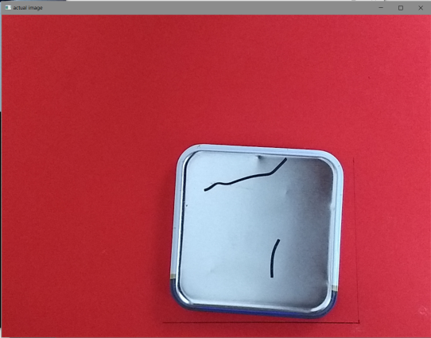
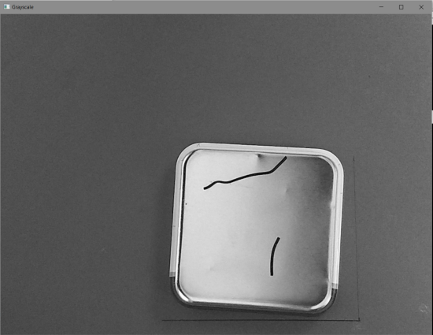
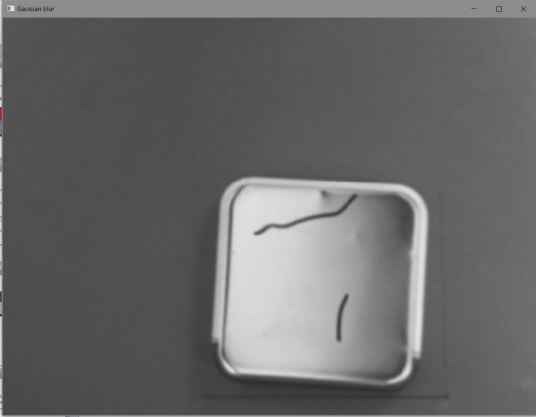
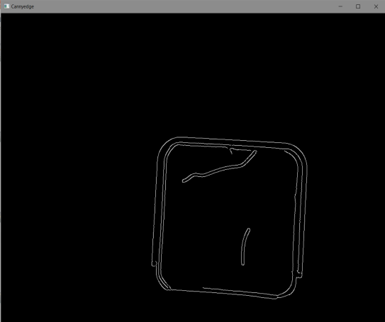
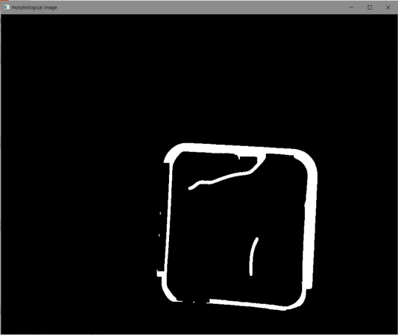

Image Snippets:
1. Actual Image
2. Grayscale Image
3. Gaussian blur Image
4. Canny edge detection
5. Morphological operations
6. Extracted ROI

Slide 4
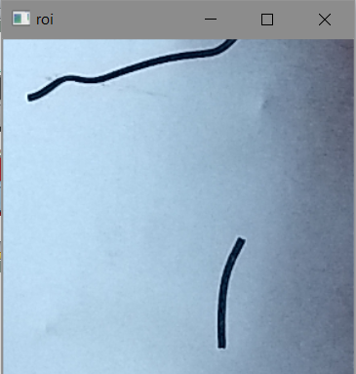
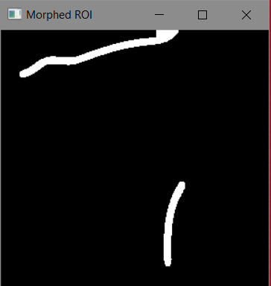
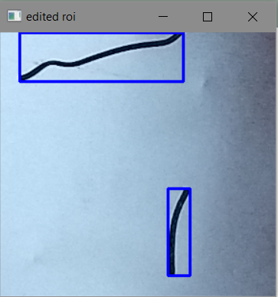
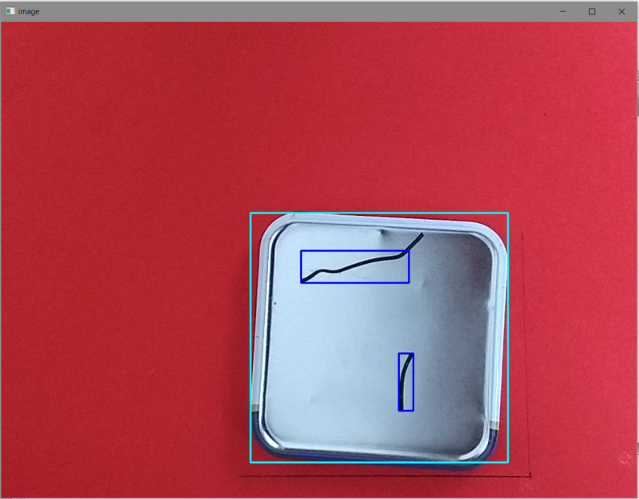
Image Snippets:
7. ROI
8. Morphed ROI
9.Contours detected
Actual output

Slide 5
Result:
Simple method to Identify Cracks on the metallic plate
Tested positive on image set with test-cases like:
When the position of the metallic object is changed in the image
When the Crack position moves in the image
When multiple cracks are found in the image
Can be easily extended to practical applications with minor changes
Better results when compared with template matching

Slide 6
Thank you!!

