Slide 1

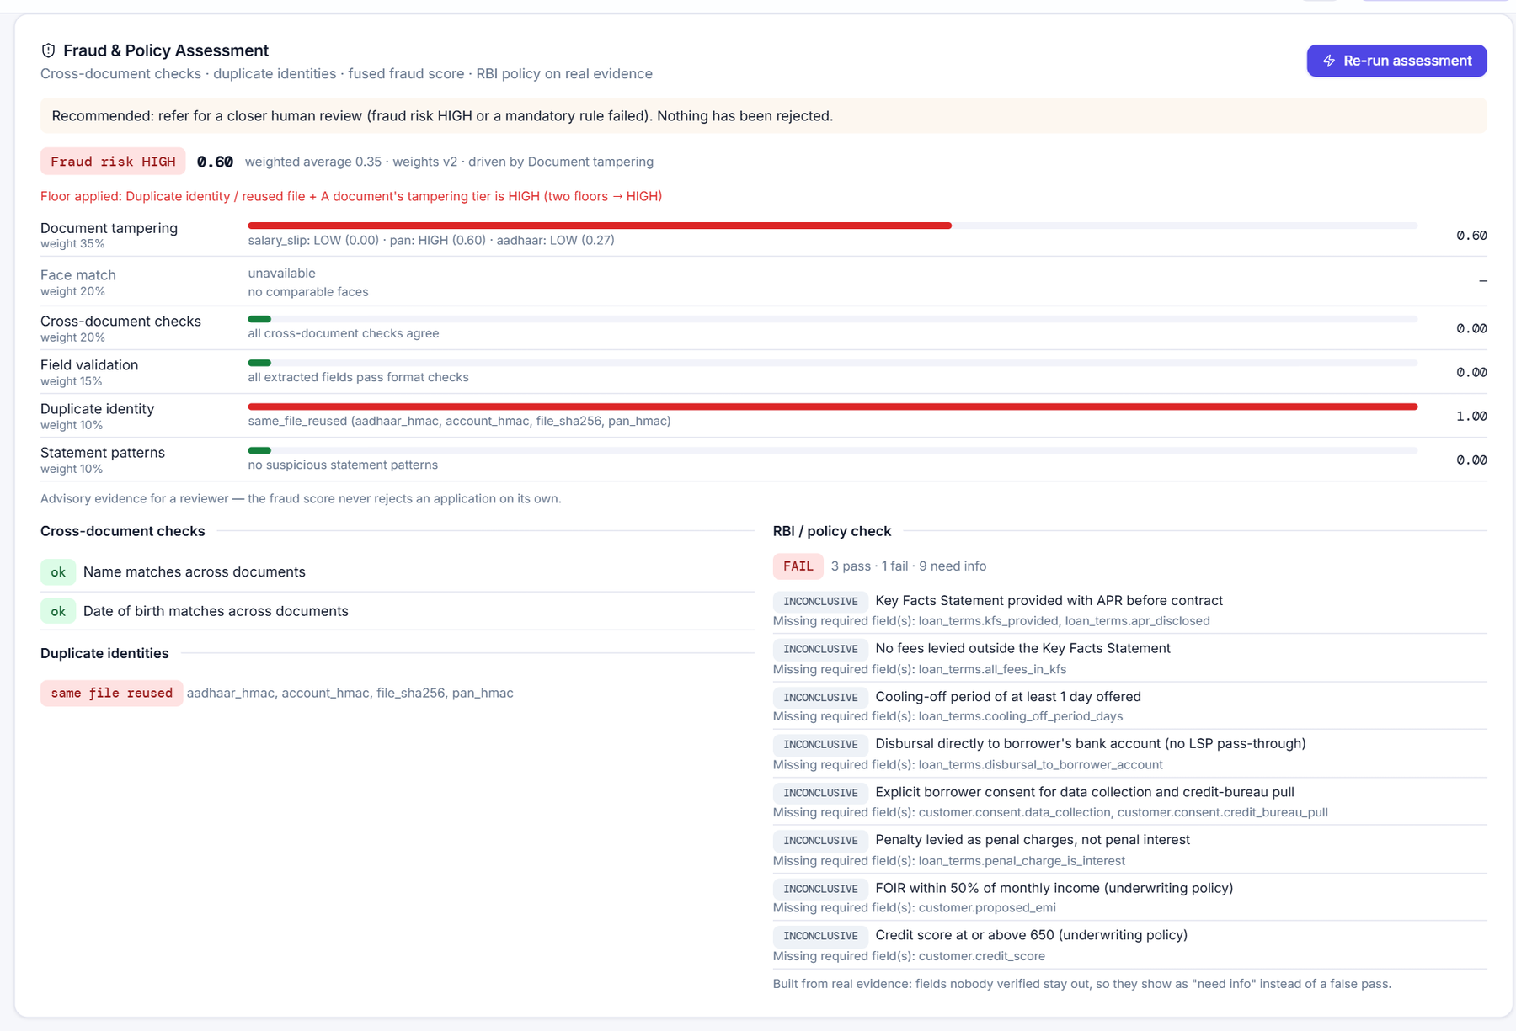
NBFC PLATFORM · PROJECT WALKTHROUGH
FinSight AI
Agentic loan underwriting for Indian NBFCs
29 CrewAI agents read the documents, check them for fraud and RBI policy, score the risk and draft the credit memo — on a local model, with a person making every decision.
29
6
12
61
agents
crews
loan products
automated tests
Shreyas Bile · 26 September 2026
Notes:
FinSight AI turns an NBFC's loan desk into a set of 29 specialised AI agents. This deck walks through the product, the architecture, every agent, the workflows, the controls that keep the AI honest, and how each agent was tested.

Slide 2







CONTENTS
What this deck covers
Six parts, from what the product does to how well each agent works.
00
01
02
The product
Architecture
The 29 agents
The problem, the three users, a tour of the app
Layers, tech stack, how one agent runs
Six crews, what each agent does and how it scored
03
04
05
Workflows
Trust & control
Evaluation
Loan lifecycle, the end-to-end journey, a real run
Model gateway, guardrails, tracing, the database
Method, scorecard, defects fixed, latency, limits
2
Notes:
Use this as the map for the talk. Each numbered part has its own divider slide.

Slide 3


00
The product
What FinSight does, who uses it, and what it looks like.
IN THIS SECTION
The problem
Three roles
Twelve loan products
App tour
3

Slide 4





THE PRODUCT
From a manual loan desk to agents that do the checking
Every NBFC loan file is a stack of Indian documents that someone has to read, verify and judge.
TODAY
WITH FINSIGHT
Manual document reading
Officers retype PAN, Aadhaar, payslip and statement fields by hand.
Reads each document into fields and validates them
Checks every document for tampering and fabrication
Forgeries are hard to see
An edited payslip or a pasted ID photo looks genuine to the eye.
Matches faces across documents, confirms a live selfie
Fuses all fraud evidence into one advisory score
Slow, uneven turnaround
In the seeded process data a file waits 77 h on average before its documents are read.
Tests the case against RBI and internal rules
Scores risk, drafts the credit memo, offer and next step
Rules keep changing
RBI Digital Lending Directions 2025, KFS and penal-charge rules apply to every loan.
People decide. Nothing is auto-rejected, and any loan above ₹5 lakh needs the Head Manager's approval.
4
Notes:
Left: the pain today. Right: what the agents take over. The key design choice is at the bottom — the agents produce evidence and drafts, people make the decisions.

Slide 5
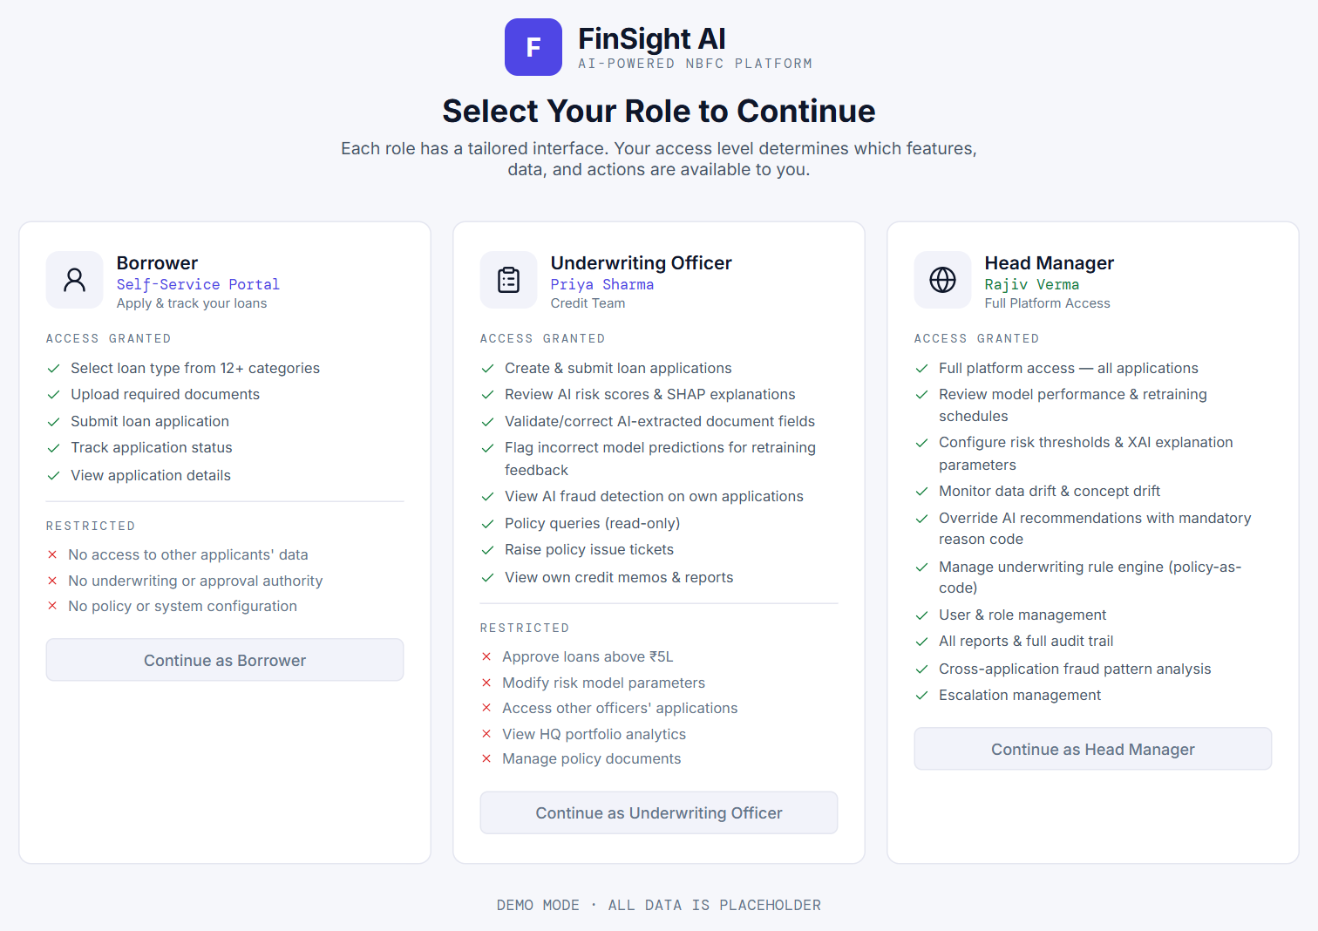



THE PRODUCT
Three roles, twelve loan products
One app, three views. Each product has its own document checklist and its own lifecycle branch.
Borrower
Applies, uploads documents, confirms what the agents read, takes a selfie and submits.
Underwriting Officer
Works the queue: evidence, fraud report, policy check, credit memo — then recommends.
Head Manager
Approves loans above ₹5 lakh, runs fraud triage, manages AI models and RBI rules.
12 LOAN PRODUCTS
Two Wheeler
Tractor
Gold
Personal
Home
MSME / Business
Car
Commercial Vehicle
Loan Against Property
Microfinance / Rural
Working Capital
Used Vehicle
5
Notes:
The role picker is the entry point. The borrower applies; the underwriting officer works the queue; the head manager approves large loans and controls the AI settings and RBI rules.

Slide 6
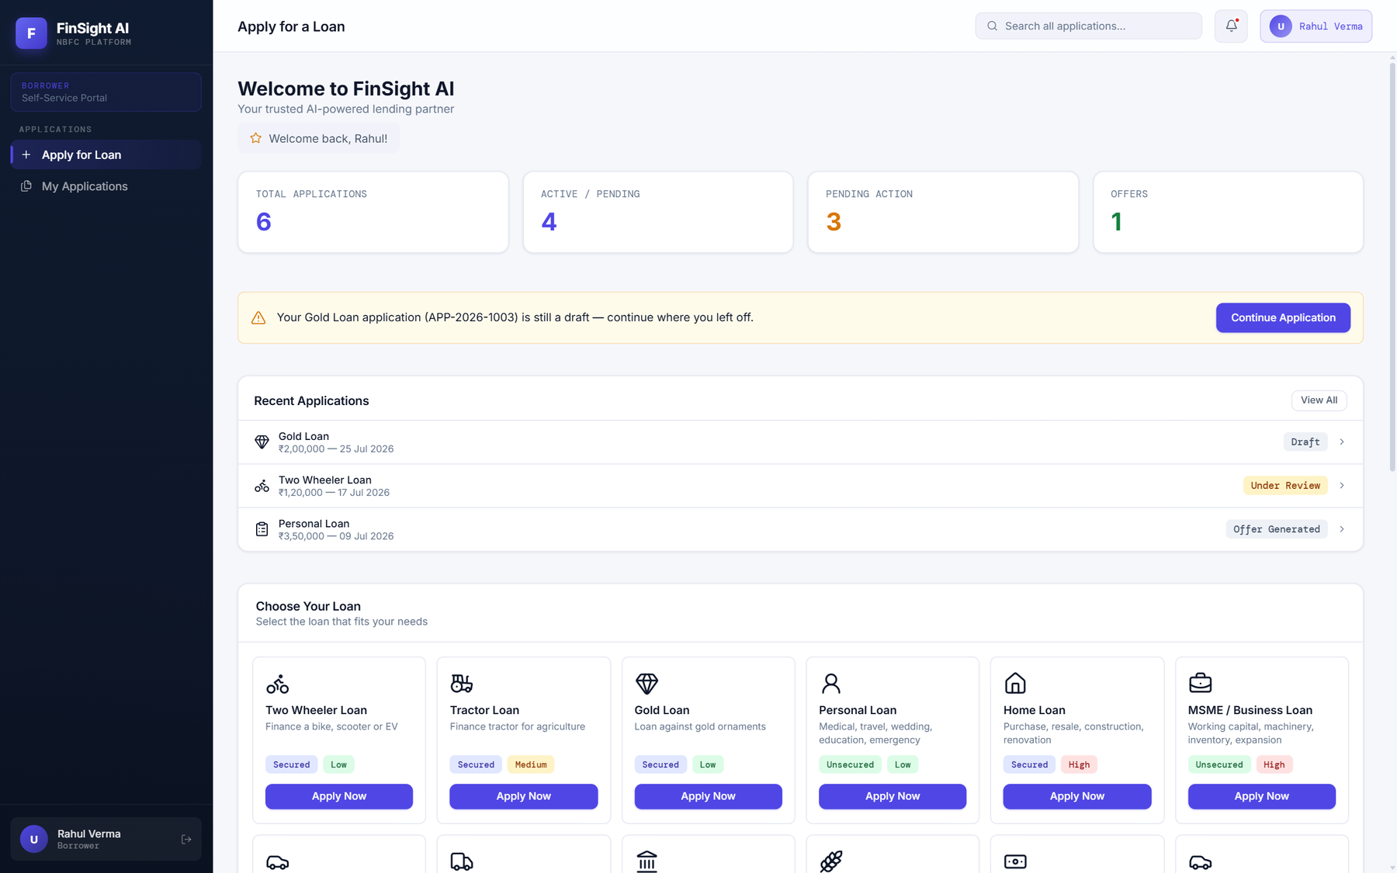
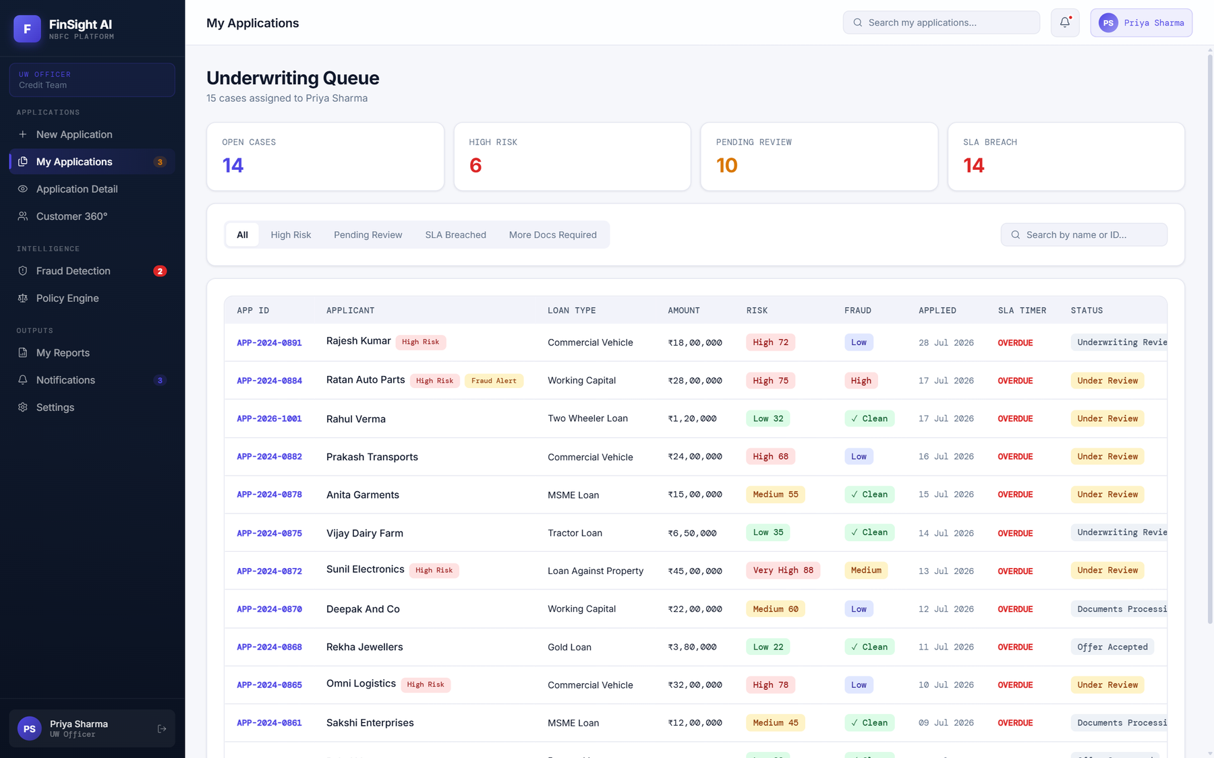
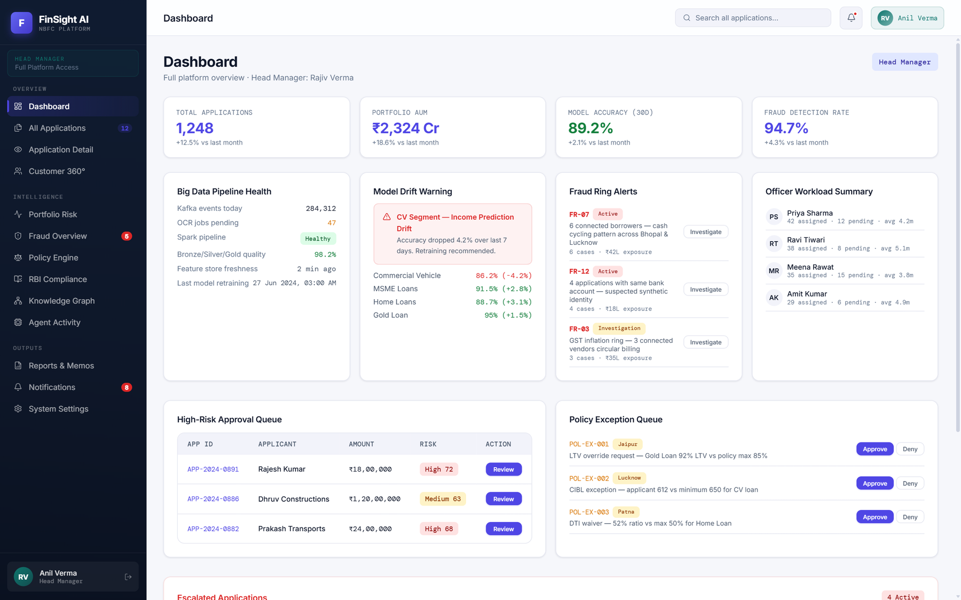
THE PRODUCT
A quick tour of the app
Screens captured from the running app (the application data shown is seeded demo data).
Borrower portal
Officer queue
Head dashboard
Status of every application and the 12 products to apply for.
Assigned cases with risk, fraud, SLA timer and next action.
Portfolio view: approvals waiting, fraud alerts, model health.
Apply for any of the 12 products
Upload, confirm fields, take a selfie
Track status and offers
Risk and fraud column for every case
SLA timer and the next action
Open a case: 8 tabs of evidence
Approvals waiting above ₹5 lakh
Fraud alerts and ring triage
AI model and RBI rule control
6
Notes:
Three views of the same platform. The borrower sees a simple portal; the officer sees a work queue with risk and fraud columns; the head sees the portfolio.

Slide 7

01
Architecture
Six layers, one gateway to the language model, and one rule for every agent: tools decide, the model only explains.
IN THIS SECTION
System layers
Tech stack
How one agent runs
7

Slide 8
ARCHITECTURE
System architecture
Users
3 roles
Borrower
Underwriting Officer
Head Manager
Frontend
React 18 · Vite 5
Loan wizard
Application detail (8 tabs)
Agent Activity
AI model settings
RBI compliance & policy
API
FastAPI · Uvicorn :8000
/extract
/document/integrity
/document/mask
/face/verify
/liveness/check
/agents/*
/settings/llm
Agent layer
CrewAI 1.15 flows
IntakeFlow
CaseAssessmentFlow
UnderwritingFlow + crew
Triage · process
29-agent registry
Grounding gate
Tracer
Engines & model
deterministic tools · one LLM gateway
OpenCV + RapidOCR
Tampering cascade (9 signals)
YuNet + SFace faces
LLM gateway
MiniFASNet liveness
Risk engine + XGBoost
Compliance RAG
Statement parser
Ollama · qwen2.5vl:7b
Claude (optional)
Data
SQL Server · files
SQL Server LocalDB 'FinSight' — 9 schemas · 82 tables · 17 views
Uploads & masked copies
Agent traces (JSON)
8
Notes:
Read top to bottom. Users work in a React single-page app. The FastAPI server keeps every pre-agent endpoint contract unchanged; behind each endpoint the work now runs as CrewAI flows over 29 registered agents. Agents call deterministic engines, and reach a language model only through one gateway. Everything lands in SQL Server and file storage.

Slide 9








ARCHITECTURE
Tech stack
Everything runs on one laptop — the local model uses an RTX 4060 (8 GB).
Frontend
React 18 · Vite 5 · lucide icons
Role-based single-page app
API
FastAPI 0.115 · Uvicorn · Pydantic 2
Python 3.13
Agents
CrewAI 1.15.22
Flows, crews and 29 registered agents
Language models
Ollama · qwen2.5vl:7b (default)
qwen3-vl:4b option · Claude optional
Vision & OCR
OpenCV 4.10 · RapidOCR (ONNX)
PDFium (pypdfium2) for PDFs
Face & liveness
YuNet · SFace · MiniFASNet
ONNX Runtime 1.27, all local
ML & scoring
XGBoost 3.3 · scikit-learn
Risk overlay trained on 50,000 NBFC loans
Data
SQL Server LocalDB · pyodbc
9 schemas · 82 tables · 17 views
Quality
pytest · evaluation harness
61 tests · 29 agent evaluations
9
Notes:
Versions are the pinned ones from package.json and api/requirements-agents.txt.

Slide 10
ARCHITECTURE
How one agent runs: tools decide, the model only explains
Every agent follows the same four steps. A score is fixed before any language model is involved.
Inputs
a document, or the case's evidence
1 · Deterministic tool
execute() sets the score, tier or verdict — locked
2 · One LLM call
optional · narrate or judge · JSON schema enforced
3 · Grounding gate
is every number ≥ 10 in the evidence?
4 · Result + trace
model text shown · run, step and tool call recorded
yes
no
Keep the tool's own text
THREE KINDS OF AGENT
18
Deterministic
7
Hybrid
4
LLM
Tool only — no model at all.
Validation, masking, face match, tampering signals, fraud fusion, policy rules, risk, offer…
Tool decides, model narrates or judges within limits.
Authenticity, tamper explainer, fraud patterns, triage, rule authoring, income, process mining
The model does the core task inside a fenced call.
Extraction, regulatory Q&A, credit memo, underwriting supervisor
10
Notes:
The deterministic tool is the source of truth for every number. If an agent needs words (an explanation, a memo), it makes ONE structured call. The grounding gate then checks every number of 10 or more in that text exists in the evidence; if not, the deterministic text is shown instead. Every step is traced.

Slide 11

02
The 29 agents
Six crews. Each agent has one job, one set of tools and a pass mark fixed before it was tested.
IN THIS SECTION
Agent map
Intake
Privacy & identity
Tampering
Fraud fusion
Patterns & triage
Compliance
Underwriting
Risk
Operations
11

Slide 12






THE 29 AGENTS
The agent map: 29 agents in six crews
Intake
4 agents
#1 deterministic
Preprocessing
#2 LLM
Extraction
#3 deterministic
Validation
#4 deterministic
Document Identity
Privacy
1 agent
#5 deterministic
PII Masking
Identity & fraud evidence
11 agents
#6 deterministic
Face Verification
#7 deterministic
Tampering Forensics
#8 hybrid
Authenticity
#9 hybrid
Tamper Explainer
#10 deterministic
Tamper Locator
#11 deterministic
Cross-Doc Verification
#12 deterministic
Dedupe
#13 deterministic
Fraud Fusion
#14 hybrid
Fraud Patterns
#15 hybrid
Fraud Triage
#29 deterministic
Liveness
Compliance
4 agents
#16 deterministic
KB Ingestion
#17 hybrid
Rule Authoring
#18 LLM
Regulatory Q&A
#19 deterministic
Policy Check
Underwriting
6 agents
#20 hybrid
Income Analysis
#21 deterministic
Risk Scoring
#22 LLM
Credit Memo
#23 LLM
Underwriting Supervisor
#24 deterministic
Offer Generation
#25 deterministic
Workflow Router
Operations
3 agents
#26 deterministic
Notifier
#27 deterministic
Audit / Storage
#28 hybrid
Process-Mining Analyst
12
Notes:
Colour marks the crew throughout the deck. 'Hybrid' agents decide with a tool and use the model only to explain or judge; 'LLM' agents use the model for their core task inside a single fenced call. Liveness (29) was added last and sits with identity and fraud evidence.

Slide 13
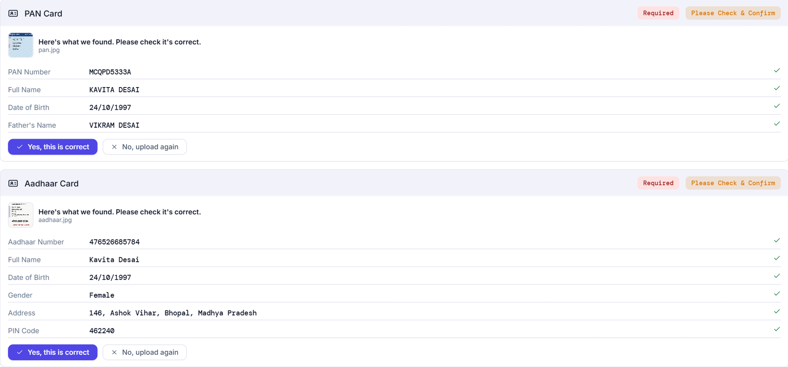
THE 29 AGENTS · INTAKE CREW
Intake: every upload becomes checked, structured fields
Four agents run on each document, in about 10 seconds on the local model.
Upload
photo or PDF
1 · Preprocessing
orient · crop · repair light · revert if worse
2 · Extraction
3 · Validation
Person confirms
"Please check & confirm"
page read (same OCR words)
4 · Document Identity
qwen2.5vl reads every requested field into JSON, inventing nothing · Verhoeff, PAN, IFSC, GSTIN formats · the page's own phrases must match the requested type
99.6%
Preprocessing
field text readable on 60 degraded cards
97.2%
Extraction
field accuracy · 48 docs, 318 fields · 9.1 s
100%
Validation
1,487 generated IDs flagged correctly
100%
Document Identity
wrong uploads caught (was 54%)
13
Notes:
Preprocessing repairs the photo (orientation, crop, lighting) but reverts if it made the page less readable. Extraction is the only model call on the upload path. In parallel the page's own words are read, which Document Identity uses to catch a payslip uploaded as a PAN. Validation checks formats and checksums, e.g. Aadhaar's Verhoeff digit.

Slide 14


THE 29 AGENTS · PRIVACY · IDENTITY
Privacy & identity: mask the numbers, match the faces
PII Masking protects the officer's view; Face Verification and Liveness make sure one real person is applying.
PII Masking #5
Face Verification #6
Liveness #29
PAN
MCQPD5333A → XXXXXX333A
YuNet
SFace
≥ 0.363
Selfie
MiniFASNet
ID match
AADHAAR
XXXX XXXX 5784
OCR finds the PAN / Aadhaar number and masks all but the last four
Reads the card upright first, so sideways photos can't leak
Officers and the audit view only ever see the masked copy
YuNet finds each face, SFace turns it into an embedding
Cosine similarity ≥ 0.363 → same person
A blurry or tiny face can only be 'uncertain', never 'mismatch'
Selfie checked by MiniFASNet for print / screen attacks
Then matched to the ID photo on the case
The picture is checked and discarded
0 leaks
48 test cards + 4 real scans · last four kept 93.8%
99.4%
correct verdicts on 160 LFW pairs · 0.3 s
22.2%
ACER (target ≤ 10%) — Weak; needs real selfies
14
Notes:
Masking finds the rotation where the ID number reads upright before splitting it — the fix for a real sideways PAN that leaked in testing. Face verification uses YuNet to find faces and SFace to compare them (cosine threshold 0.363). A low-quality face can only say 'uncertain', never 'mismatch'. Liveness is the weakest agent: it was only tested on public photos and simulated attacks.

Slide 15
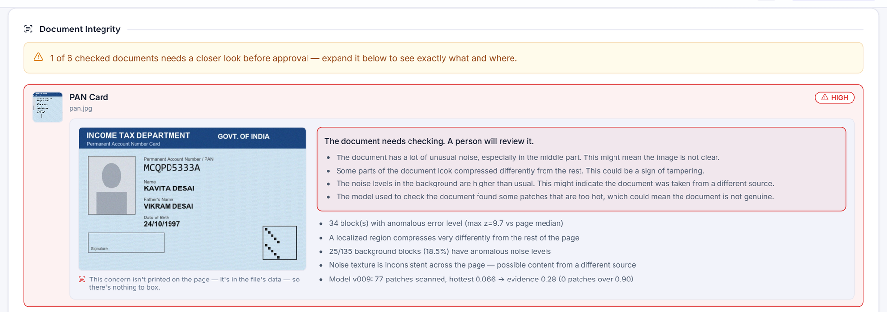
THE 29 AGENTS · IDENTITY & FRAUD EVIDENCE
Tampering: a nine-signal cascade, fused into one honest tier
Cheap checks first; pixel forensics only when needed (ID cards always get them). Two helper agents explain and locate.
Document
image or PDF
Stage 1 · fast
metadata · business rules · copy-move · PDF forensics · authenticity (VLM, capped 0.60)
Gate
all < 0.25?
Stage 2 · pixels
ELA · noise · CNN · photo-region
Fusion
max(weighted avg, strongest × confidence)
Tier
LOW · MEDIUM ≥ 0.30 · HIGH ≥ 0.60
yes → LOW, fast-tracked (never for ID cards)
#9 Tamper Explainer
plain words, grounded
#10 Tamper Locator
boxes the figure
100%
Forgeries flagged
72 forgeries, 7 attack types
16.7%
Genuine photos HIGH
known over-flag on camera photos
89.5%
Authenticity · Explainer
fabrications caught · explainer 90% grounded
Tamper Locator boxes only edited figures: 33% (Weak).
15
Notes:
Stage 1 runs fast checks. If they all score under 0.25 and business rules pass, the document is fast-tracked as LOW — except ID cards, which always get stage 2. Fusion takes the larger of the weighted average and the strongest single signal times its confidence, so one near-proof finding is not averaged away. The explainer rewrites findings in plain words (grounded); the locator draws a box around the figure a finding cites. The screenshot shows the synthetic PAN flagged HIGH — a known over-flag on camera-like images that a person reviews.

Slide 16
THE 29 AGENTS · IDENTITY & FRAUD EVIDENCE
Case assessment: all the evidence, one advisory route
Runs when the file is complete — no language model at all, about 100 ms.
Evidence bundle
extracted fields · tampering tiers · face result · statement rows
#11 Cross-Doc
names · DOB · gender
#12 Dedupe
HMAC keys · file hash · face
#14 Patterns
statement rows
#13 Fraud Fusion
one advisory score and tier (LOW · MEDIUM · HIGH)
#19 Policy Check
16 active RBI / internal rules → PASS · FAIL · NEED INFO
Advisory route
proceed · or refer for a closer human review — never reject
Real run, synthetic applicant submitted twice: Dedupe finds the same files → two floors → HIGH.
16
Notes:
The case-assessment flow runs three checks in parallel on the whole case, fuses them with the per-document tampering and face results into one fraud tier, then checks RBI policy. The result is only ever a recommendation: proceed, or refer for a closer human review. The screenshot is a real run on a synthetic applicant who was submitted twice — Dedupe found the same files, so two floors pushed the tier to HIGH.

Slide 17
THE 29 AGENTS · FRAUD FUSION
Fraud Fusion v2: how one score is built
A weighted average measures agreement; a dominant path and floors stop one strong red flag being averaged away.
Held-out tier accuracy · 400 labelled scenarios
1
Weighted average Each component scores 0–1; only components with evidence count.
2
Dominant path fused = max(average, strongest signal × its confidence) — plus 0.1 if another signal agrees.
93% meets the ≥ 90% target. In v2's errors, 17 of 35 HIGH cases were called MEDIUM — it leans cautious toward review, not toward rejection.
3
Floors Confident face mismatch · exact duplicate identity · tampering HIGH. One floor → at least MEDIUM; two → HIGH.
4
Tiers, advisory only MEDIUM ≥ 0.20 · HIGH ≥ 0.60. The score never rejects on its own.
17
Notes:
v1 was the weighted sum plus floors that was originally chosen; it scored 60% on 400 held-out labelled scenarios. Calibrating the weights reached 79%. v2 adds the same dominant-and-corroborated path the tampering fusion uses and scored 93%. Scores never fall when evidence gets worse. Weights are versioned and snapshotted on every assessment; v1 is a one-line switch.

Slide 18
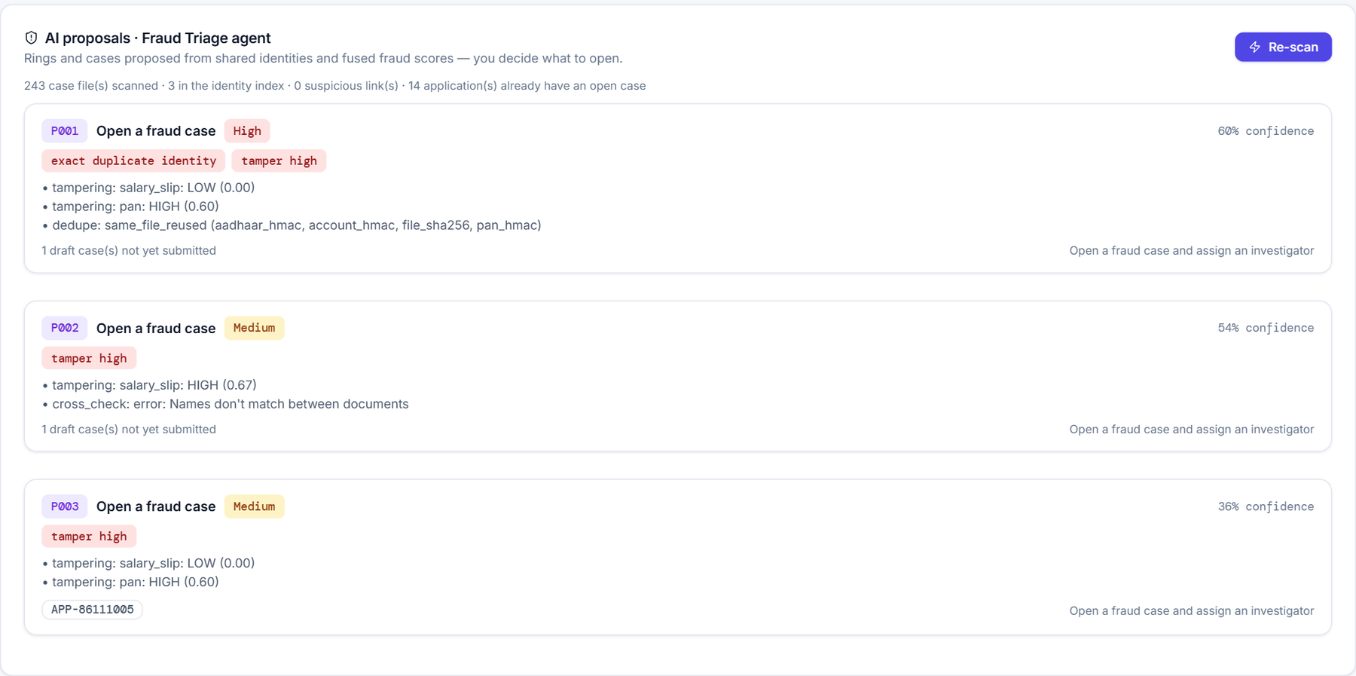
THE 29 AGENTS · IDENTITY & FRAUD EVIDENCE
Statement patterns and fraud triage
Patterns read the bank statement row by row; triage looks across all applications for rings.
#14 FRAUD PATTERNS
PDF text layer
or OCR words
Tilt-corrected rows
date + amounts
Reconcile
debit / credit by balance
FIVE PATTERNS
Cash cycling money in and straight back out
Sudden deposit a lump sum just before applying
Window dressing balance pumped near statement end
Income mismatch salary credits ≠ payslip net
#15 FRAUD TRIAGE
GST inflation credits far below declared turnover
Links applications that share one face under several PANs, one bank account, one PAN with two faces, or one file
Proposes cases only — a person decides what to open
9 of 9 planted rings and cases found, 0 false ones; repeat customers never flagged
F1 1.00
Pattern detection · 54 statements
photo statement rows parsed 99.5% (was 66%)
18
Notes:
The extraction prompt only returns a statement summary, so a separate parser recovers every row — from the PDF text layer, or from OCR on a photo with tilt correction — and decides debit vs credit from the balance movement. Rows that don't reconcile never raise a flag. Triage links applications through hashed identity keys and faces, and PROPOSES cases; a person decides what to open.

Slide 19
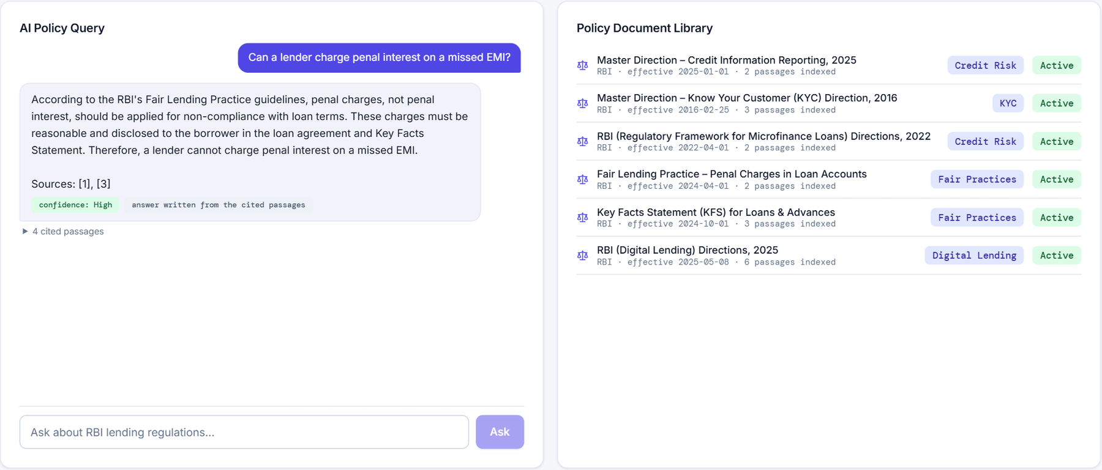
THE 29 AGENTS · COMPLIANCE CREW
Compliance: RBI rules as data, answers with citations
Regulations are indexed once; rules are drafted by an agent and approved by a person; every case is checked against them.
RBI & internal documents
6 seeded
#16 KB Ingestion
chunk & index
#17 Rule Authoring
drafts candidates
Human checker
review queue
Active rules
16 today
#19 Policy Check
PASS · FAIL · NEED INFO
#18 Regulatory Q&A
retrieves the top-5 passages, then writes a cited, grounded answer
91.7%
KB Ingestion
recall@5 on 12 gold questions
8 of 9
Rule Authoring
known rules recovered (88.9%)
100%
Regulatory Q&A
answering passage in top 5 · 5.1 s
100%
Policy Check
violations detected one at a time
19
Notes:
KB Ingestion chunks and indexes the regulations (6 documents seeded). Rule Authoring drafts machine-checkable rule candidates from a new regulation; they go to a human review queue before becoming active. Policy Check evaluates the 16 active rules against real evidence only: a field nobody verified shows as 'need info', never as a false pass. Regulatory Q&A answers only from retrieved passages and cites them.

Slide 20
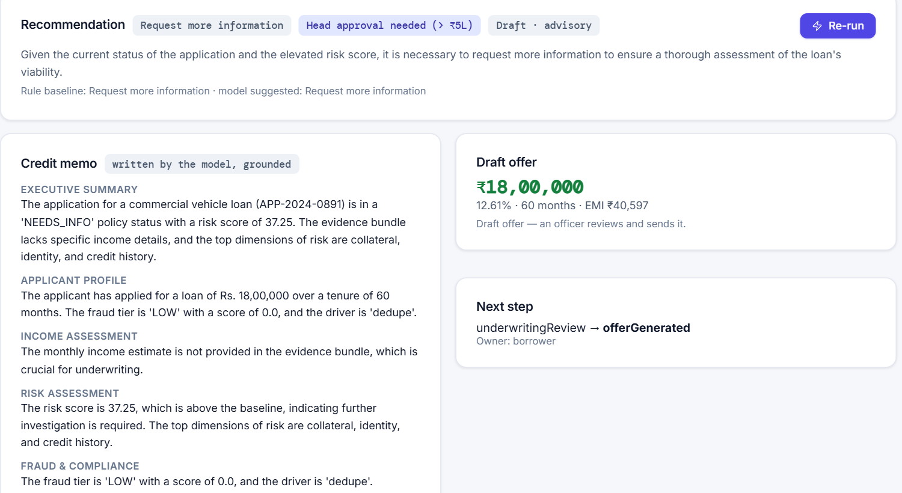
THE 29 AGENTS · UNDERWRITING CREW
Underwriting: from income to a drafted offer
One click runs the chain; the only model calls are the two agents inside the crew. About 20 seconds.
UNDERWRITING CREW · 2 LLM CALLS
#20 Income
payslip · ITR · bank · GST
#21 Risk
9 dimensions + XGBoost
#23 Supervisor
tighten-only
#22 Credit Memo
grounded
#24 Offer
rate · EMI
#25 Router
next step + owner
#26 Notifier
in-app
F1 1.00
Income Analysis
mismatch detection on 120 cases
100%
Credit Memo
memos citing only real figures · 19 s crew
100%
Supervisor
agrees with policy · 1 loosening blocked
100%
Offer · Router
EMI = formula (864) · next step (111)
20
Notes:
Income Analysis triangulates the monthly income across payslip, ITR/Form 16, bank credits and GST. Risk Scoring grades nine dimensions and adds an XGBoost default probability. The Underwriting Crew then runs two agents: the Supervisor recommends a next step but may only tighten the rule baseline, and the Credit Memo agent writes the memo citing only real figures. Offer Generation prices the loan and computes the EMI with the standard formula. The Workflow Router recommends the next lifecycle step and its owner; the Notifier drafts in-app messages.

Slide 21
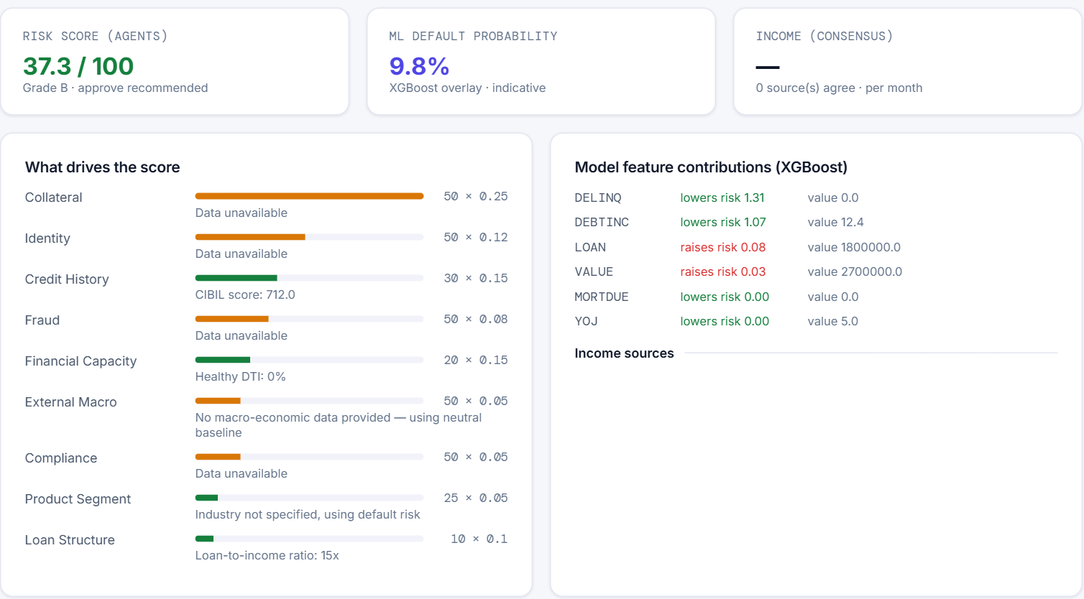
THE 29 AGENTS · UNDERWRITING CREW
Risk Scoring: nine dimensions plus a machine-learning check
A 12 × 9 weight matrix (one row per product) gives the grade; XGBoost adds an indicative default probability.
0.669 → 0.771
held-out ROC-AUC after the feature fix (target ≥ 0.75)
0 of 750
checks where a worse input lowered the risk score
Application › Risk Analysis: agent score, ML default probability and what drives each.
21
Notes:
The rule engine scores nine risk dimensions from 0 to 100 and weights them by product — the chart shows the commercial-vehicle row. The ML overlay is XGBoost trained on a 50,000-loan Indian NBFC book. Testing found the app was building its features differently from training: AUC 0.669. With the training feature builder reused, AUC is 0.771 on the 1,500 held-out loans. Across 750 checks, the score never fell when an input got worse.

Slide 22

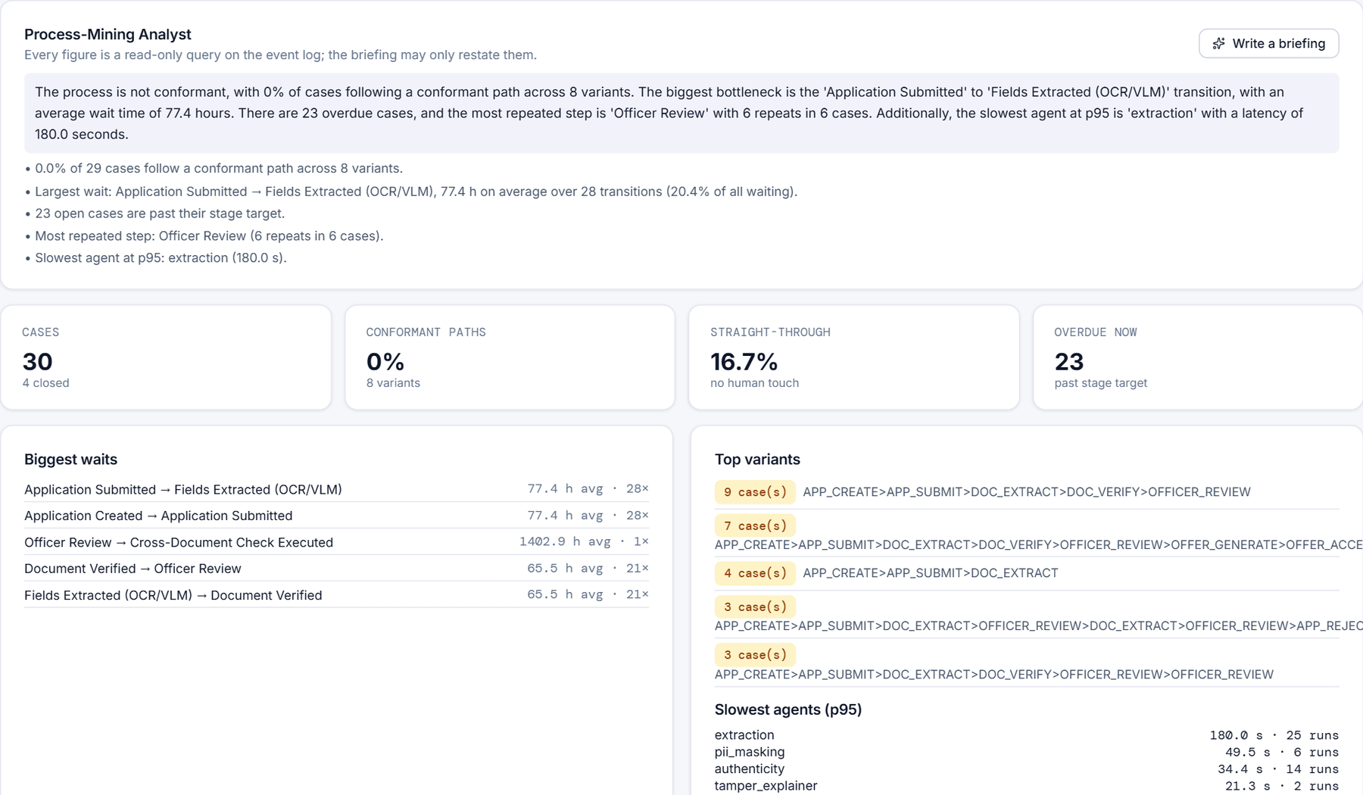


THE 29 AGENTS · OPERATIONS CREW
Operations: notify, keep the record, watch the process
Three back-office agents. None of them can send anything outside the app.
#26 Notifier
Drafts notification rows from templates for borrower, officer and head.
100% correct recipients · 0 outbound attempts
#27 Audit / Storage
Persists files and SQL rows; officers see a masked copy.
100% files and rows intact
#28 Process-Mining Analyst
Conformance, variants, waits and slow agents from pm.* views; optional grounded briefing.
100% of figures equal direct SQL · 129 ms
Agent Activity › Process Mining — seeded demo process data: 0% conformant paths, 23 cases overdue.
22
Notes:
The Notifier fills templates into in-app notification rows — during its evaluation every outbound connection was blocked and counted, and there were zero attempts. Audit/Storage writes the application, its files and a masked officer view to SQL Server. The Process-Mining Analyst reads the event log through SQL views: every figure is a query; the optional briefing may only restate those figures.

Slide 23

03
Workflows
How a loan moves through its lifecycle, who acts at each step, and what a real run looks like.
IN THIS SECTION
Loan lifecycle
End-to-end journey
A real run
23

Slide 24
WORKFLOWS
The loan lifecycle
One path for every product plus its own branch. The Workflow Router only recommends; a person moves the status.
Intake · Privacy
Case assessment
draft
borrower
submitted
system
documentsProcessing
agents: intake crew
documentsVerified
officer
product checks
branch · see below
disbursed
—
sanctioned
operations
accepted
officer / head
offerGenerated
borrower
underReview
officer · credit committee
Head approves > ₹5 lakh
Offer Generation
Underwriting crew · Router
PRODUCT BRANCHES (between documentsVerified and review)
Gold valuation scheduled → valued
Tractor · Microfinance field verification
Loan Against Property property valuation → legal
Home 6 checks: property, legal, income, docs, technical
MSME · Working capital bank & GST analysis → committee
Used vehicle vehicle inspection
24
Notes:
Read row one left to right, then row two right to left. Agents annotate the steps they support. Any state before a decision can end in rejected or cancelled — always by a person.

Slide 25



WORKFLOWS
End to end: who does what
Agents work between the human steps; every agent output is evidence for the next person.
Borrower
1
Picks a product, uploads documents
3
Confirms fields, takes a selfie, submits
9
Receives and accepts the offer
AI agents
2
Intake + masking read each file
4
Integrity, face, liveness, case assessment
6
Underwriting crew drafts memo & offer
Officer
5
Reviews fraud report and policy check
7
Recommends approve or reject
Head
8
Approves above ₹5 lakh
25
Notes:
Follow the numbers. Agents (red lane) do the reading, checking and drafting between the human steps. The officer triggers underwriting; the head only steps in above ₹5 lakh.

Slide 26
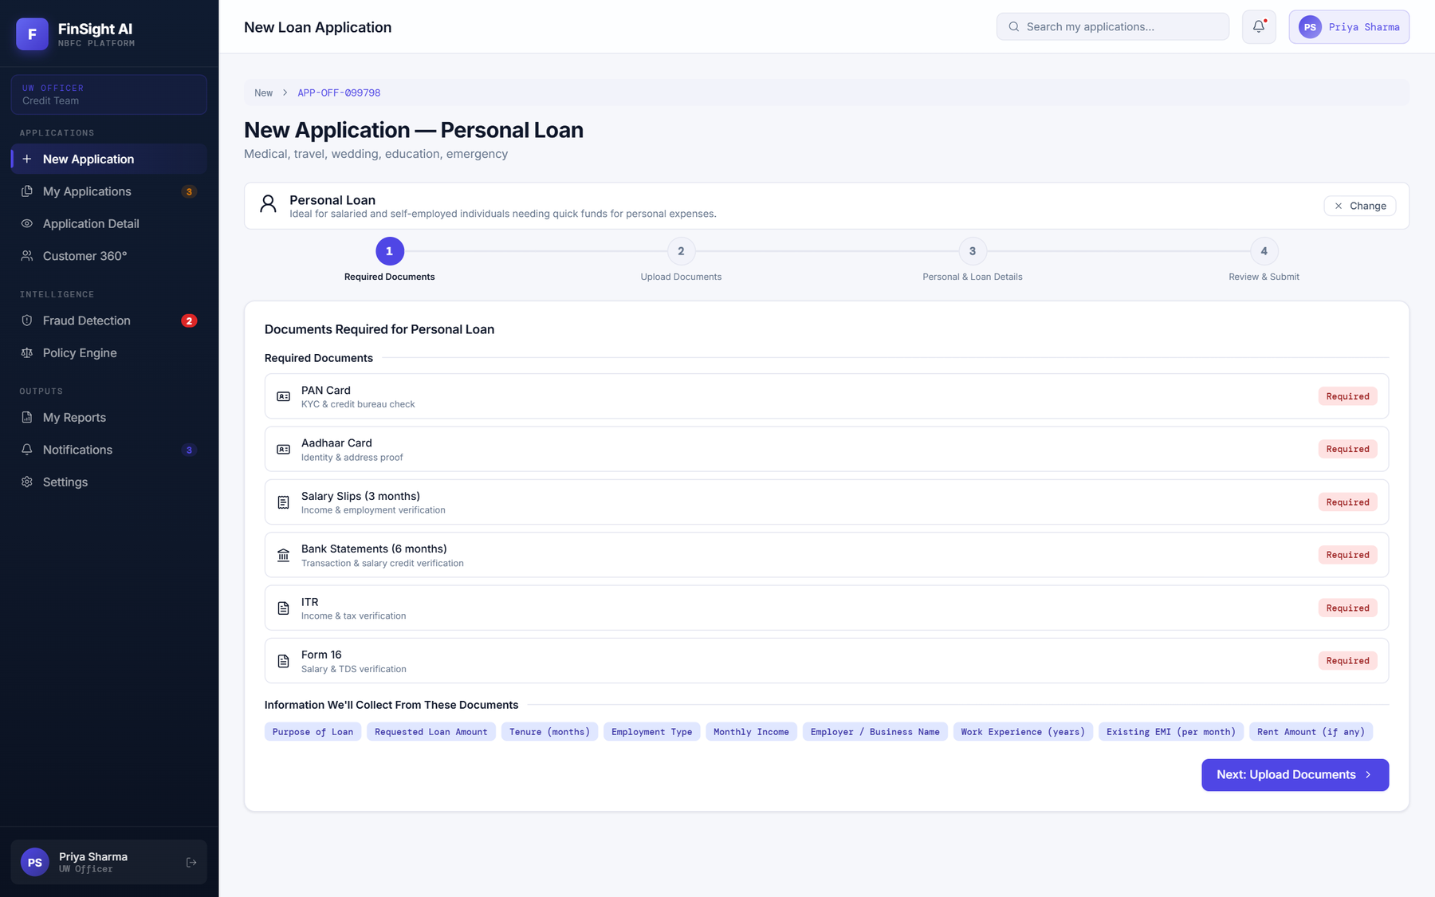
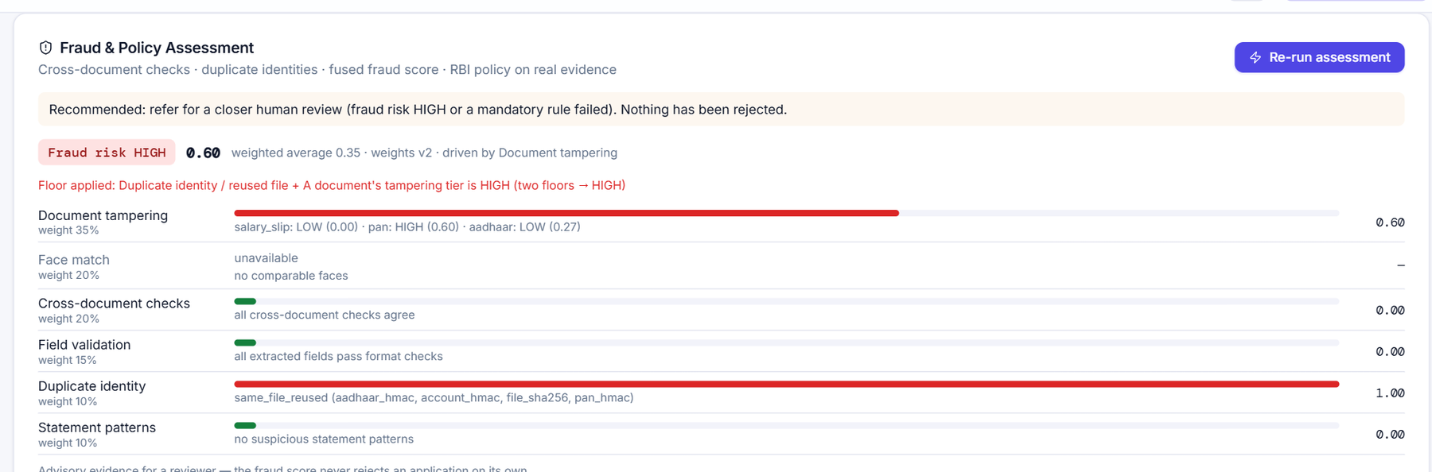
WORKFLOWS
A real run through the wizard
Captured from the app with a synthetic applicant (generated identity — no real personal data).
1
Product checklist
2
Fields read by the intake crew
3
Integrity: plain-language findings
4
Fraud & policy assessment
26
Notes:
1: the product decides the document checklist. 2: each upload is read by the intake crew and shown back for confirmation — here every field of the synthetic PAN and Aadhaar was read exactly. 3: on Review & Submit the tampering cascade explains why a document needs a closer look. 4: the case assessment fuses everything into an advisory tier and a policy result.

Slide 27

04
Trust & control
One gateway to every model, guardrails that are tested, and a trace of every step in SQL Server.
IN THIS SECTION
LLM gateway
Guardrails
Tracing
Data model
27

Slide 28
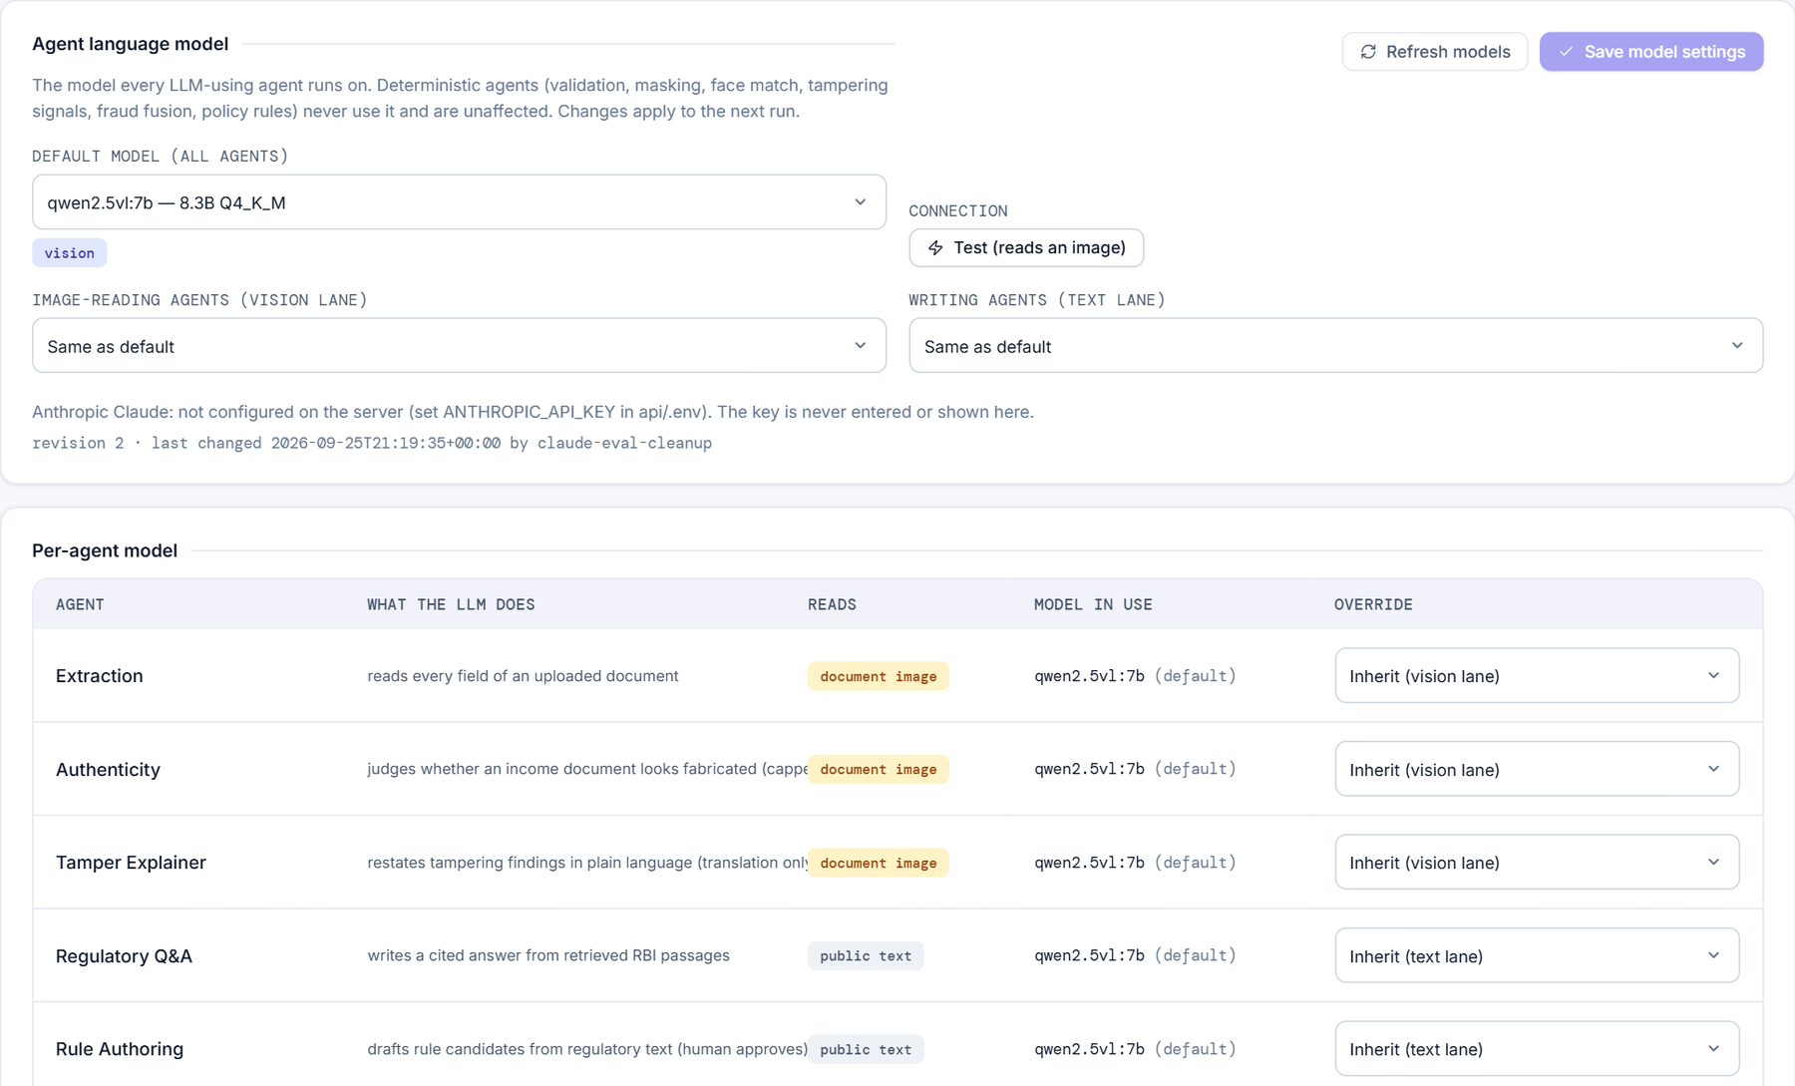
TRUST & CONTROL
One gateway for every model call
The Head Manager picks the model per agent, per lane or by default. The gateway enforces privacy and queues the calls.
Agent asks for a model
gateway.chat(agent_id, …)
1 · Resolve the model
agent override → vision / text lane → default · snapshot per run
2 · Privacy guard
FORBID_HOSTED switch · Head acknowledgement · pseudonymised text for hosted
3 · LLM gate
one slot per provider · priority queue · 180 s max wait
Ollama (local)
127.0.0.1 · pooled · images fitted to context
Anthropic Claude
optional · not configured today
System Settings › AI Models (Head only): default, lanes and a per-agent override table.
28
Notes:
Every model call goes through app/agents/llm/gateway.py. It resolves which model to use (agent override, then vision/text lane, then default) and snapshots the setting on every run. A hosted provider needs the Head's explicit acknowledgement, is refused outright when FINSIGHT_FORBID_HOSTED is set, and only receives pseudonymised text. One slot per provider with a priority queue protects the 8 GB GPU; a call that waits more than 180 s fails cleanly.

Slide 29









TRUST & CONTROL
Guardrails — each one pinned by a test
The promises the design makes, and how each was verified.
LLM never sets a score
Grounding gate
Tighten-only supervisor
Nothing auto-rejects
No side-effect tools
Scores, tiers and verdicts come from tools only.
Every number ≥ 10 in model text must be in the evidence.
May make the next step stricter, never looser.
Advisory routes only; above ₹5 lakh needs the Head.
No agent can approve, reject, file, accept or send.
tier unchanged 40 / 40
ungrounded text dropped
1 loosening attempt blocked
router guard test
checked on all 29
LLM budget per path
Authenticity capped
Hosted models gated
Identity keys hashed
Contracts unchanged
/extract ≤ 1 call; masking, face and assessment 0.
The fabrication signal is capped at 0.60, never alone.
Head acknowledgement, kill switch, pseudonymised text.
Dedupe stores HMAC digests, never raw PAN / Aadhaar.
Pre-agent endpoints answer exactly as before.
call-count test
0 lone decisions / 52
settings + gateway tests
holds
24 / 24 contract tests
29
Notes:
These are the rules that keep the agents advisory and the data private. Each is enforced in code and checked by an automated test or measured during the evaluation.

Slide 30
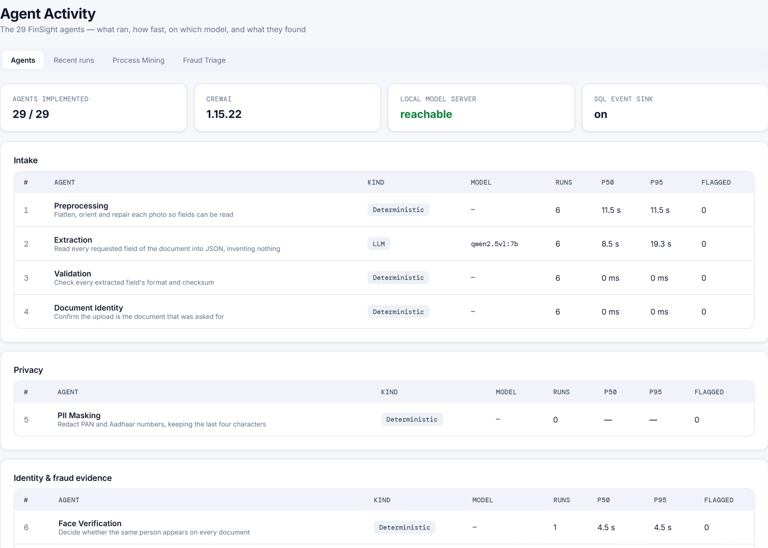
TRUST & CONTROL
Every step is traced — and becomes process-mining data
Runs and steps go to memory, JSON files and SQL Server. A database outage never fails a request.
In memory
/agents/stats → live p50 / p95
Agent step
run · step · tool call
Tracer
timing · model · outcome
JSON files
storage/agent_traces/
Kill switch: AGENTS_ENABLED=false runs the same tools directly, untraced.
SQL sink
agent.run · step · tool_call
pm.usp_log_event → pm.event_log
spool to disk + replay if SQL Server is down
pm.vw_* views
→ Process-Mining Analyst · Agent Activity page
Agent Activity › Agents: each agent's kind, model, runs, p50 / p95 and flags.
30
Notes:
The tracer records each agent run and step (inputs summary, timing, model, LLM calls, outcome). In memory it feeds the live p50/p95 on the Agent Activity page; as JSON it is kept under storage/agent_traces; with the SQL sink on it writes agent.run / step / tool_call and logs a business event through pm.usp_log_event into pm.event_log. If SQL Server is down, events are spooled to disk and replayed later.

Slide 31
TRUST & CONTROL
The database: SQL Server 'FinSight'
9 schemas · 82 tables · 17 views. Migrations live in docs/mssql/ — 08-agentic-layer.sql adds the agent tables.
core
9 tables
fraud
9 tables
comp
5 tables
customers · loan_applications · uploaded_documents · document_extraction_results · loan_offers
fraud_assessments · fraud_cases · fraud_rings · identity_keys · fraud_weight_sets
compliance_documents · document_chunks · rules · rule_candidates · check_results
risk
3 tables
agent
4 tables
pm
20 tables
risk_assessments · pricing_models · risk_thresholds
run · step · tool_call · llm_setting_audit
event_log · activity · case_metrics · case_variant · conformance_result · deviation
ops
8 tables
audit
3 tables
ref
21 tables
users · notifications · notification_templates · loan_products
audit_log · audit_log_details · business_events
application_status · lifecycle_transition · document_type · fraud_severity …
31
Notes:
core holds the business records; fraud, comp and risk hold each engine's results; agent holds traces and the audit of model-setting changes; pm is a full process-mining model (event log, variants, conformance); ops, audit and ref hold users, notifications, audit trails and reference codes.

Slide 32

05
Evaluation
Every agent was tested as soon as it was built, against a pass mark written down before the run.
IN THIS SECTION
Method
Scorecard
Defects fixed
Latency
Limits & next steps
32

Slide 33





EVALUATION
How every agent was tested
Build → fix the target → run → record → write it up → next agent. A weak result is reported as it is.
Build the agent
Fix its target
targets.yaml
Run the eval
run_eval --agent
Save results
results/<agent>.json
Write the section
report doc
EVERY RUN RECORDS
quality metric vs target
p50 / p95 latency
LLM calls made
degraded / fallback rate
failure examples, personal data removed
DATA USED
Synthetic generator
Ground-truth PAN, Aadhaar, payslips, statements, ITR, GST; forgeries; 54 fraud-pattern statements. The only data allowed to reach a hosted model.
16 real documents
Local model only; reported as aggregates. 9 genuine, 3 fabricated, 4 excluded.
45 public edited pairs
Original vs edited paystubs and statements — tampering on unfamiliar documents.
LFW public faces
Face verification, triage identities, liveness captures and simulated attacks.
50,000-loan NBFC book
Risk scoring on the held-out 20% only (anonymised).
RBI regulations + gold sets
40- and 12-question sets for knowledge base, rules, Q&A and policy.
33
Notes:
Targets are fixed in api/eval/targets.yaml before each run. Every run records the same things. Only synthetic identities may ever reach a hosted model; the 16 real documents stayed on the local model and are reported only as aggregates.

Slide 34
EVALUATION
Scorecard: 26 of 29 agents meet their target
1 Preprocessing
99.6%
target ≥ 85%
2 Extraction
97.2%
target ≥ 90%
3 Validation
100%
target 100%
4 Document Identity
100%
target ≥ 90%
5 PII Masking
100%
target 100%
6 Face Verification
99.4%
target ≥ 90%
7 Tampering Forensics
100%
target ≥ 85%
8 Authenticity
89.5%
target ≥ 70%
9 Tamper Explainer
90%
target ≥ 95%
10 Tamper Locator
33.3%
target ≥ 80%
29
agents
11 Cross-Doc Verification
100%
target 100%
12 Dedupe
100%
target ≥ 95%
13 Fraud Fusion
93%
target ≥ 90%
14 Fraud Patterns
F1 1.00
target ≥ 0.85
15 Fraud Triage
100%
target ≥ 80%
16 KB Ingestion
91.7%
target ≥ 85%
17 Rule Authoring
88.9%
target ≥ 70%
18 Regulatory Q&A
100%
target ≥ 85%
19 Policy Check
100%
target 100%
20 Income Analysis
F1 1.00
target ≥ 0.90
26
Strong
21 Risk Scoring
AUC 0.771
target ≥ 0.75
22 Credit Memo
100%
target ≥ 95%
23 UW Supervisor
100%
target ≥ 85%
24 Offer Generation
100%
target 100%
25 Workflow Router
100%
target 100%
1
Acceptable
2
Weak
26 Notifier
100%
target 100%
27 Audit / Storage
100%
target 100%
28 Process Mining
100%
target 100%
29 Liveness
ACER 22.2%
target ≤ 10%
34
Notes:
Strong means the agent meets the target set before its run; Acceptable is within 10%; Weak is below that. The two weak agents are the Tamper Locator (boxes only one kind of edit) and Liveness (no real selfies to calibrate on).

Slide 35
EVALUATION
Testing found — and fixed — 17 real defects
The eight that mattered most. Each was caught by an agent's evaluation or the latency benchmark, not by users.
PDF handling
PII Masking
Document Identity
LLM gateway
Two threads inside PDFium at once crashed the whole server — with no error logged.
Sideways cards split the wrong way; one real PAN photo leaked in full.
A payslip showing a PAN passed as a PAN — 54% of wrong uploads caught.
'localhost' tried IPv6 first on Windows: +2 s on every model call.
Fix One process-wide PDFium lock.
Fix Upright rotation first: 0 leaks.
Fix Also reads the page's own words: 100%.
Fix 127.0.0.1 and one pooled connection.
Risk Scoring
Policy Check
Structured LLM calls
Cross-Doc Verification
ML features built unlike training: held-out AUC 0.669.
Face rule used another model's 0.62 scale: every genuine match failed.
The model echoed the schema: 92% of written Q&A answers discarded.
A shared surname alone counted as a name match — family members looked like one person.
Fix Training feature builder reused: 0.771.
Fix SFace threshold 0.363.
Fix Schema-enforced JSON output.
Fix Fixed in the browser and Python logic.
+ 9 more: card rules applied to full pages · images overflowing the model context · regulation titles ignored by grounding · unreadable photo rows treated as real · SQL inserts refused on tables with triggers · a parser error result · review statuses in the router · a stale Agent Activity tab · PDFs rasterised needlessly
35
Notes:
The first two are the most serious: a whole-server crash from two threads inside PDFium at once, and a PII leak of a real PAN photographed sideways. Both are fixed and pinned by tests.

Slide 36
EVALUATION
Faster than before the agents
The two uploads that use the local model got 9–11% faster; everything else added at most 56 ms.
Endpoint (model mocked) | Before | After | Change
/extract · PAN photo | 4.33 s | 4.13 s | −202 ms
/extract · statement PDF | 11 ms | 33 ms | +22 ms
/document/integrity · PDF | 62 ms | 70 ms | +8 ms
/document/integrity · photo | 1.14 s | 1.19 s | +56 ms
/document/mask · PAN | 1.29 s | 0.85 s | −441 ms
/face/verify · two cards | 631 ms | 641 ms | +10 ms
2 s per model call
Windows tried IPv6 for 'localhost' first — now 127.0.0.1, pooled.
Photos 19% slower
A second OCR pass on ID cards — now reuses preprocessing's words.
Statement photos ~23 s
Their rows are now parsed in the background after the upload.
36
Notes:
Measured against the pre-agent commit in its own worktree, same script, same files, alternating builds. The speed-up came from three fixes found while benchmarking: the IPv6 localhost delay, a second OCR pass on ID cards, and parsing statement photos in the background.

Slide 37
EVALUATION
Known limits and what comes next
LIMIT
NEXT STEP
Tampering on genuine photos
17% of genuine camera-style photos score HIGH
Recalibrate ELA on real phone photos
NEEDS YOUR INPUT
1
Confirm Fraud Fusion v2
93% vs 60% for the original design; switching back is one line.
Tamper Locator · Weak 33%
Boxes only edited figures, not copy-move or photo swaps
Turn keypoint clusters and photo regions into boxes
Liveness · Weak ACER 22%
Only public photos and simulated attacks to test on
Collect real selfies and real print / screen attacks
2
Add an Anthropic key
Runs the Local-vs-Claude comparison on synthetic data only.
Tamper Explainer · 90%
4 of 40 explanations cited a figure not in the findings
Tighten the prompt (the gate already hides them)
Real-world data
No real fraud rings; income and patterns tested on synthetic data
Label a real production sample
3
Share real selfies
A small in-house set to calibrate the liveness threshold.
Timings
The 8 GB GPU was shared with other programs
Re-measure on a dedicated GPU
37
Notes:
The biggest open risk is tampering over-flagging genuine phone photos, which can push an honest applicant to a MEDIUM fraud tier — always reviewed by a person, but it costs time. Three items need input from you: confirm Fraud Fusion v2, add an Anthropic key for the Local-vs-Claude comparison, and supply real selfies for liveness.

Slide 38
GETTING STARTED
Run it yourself
Five steps on one Windows machine. Ports: frontend 5173, API 8000, Ollama 11434.
1 Database
2 Local model
3 API :8000
run docs/mssql/*.sql
on (localdb)\MSSQLLocalDB
ollama pull qwen2.5vl:7b
cd api
python -m venv .venv-agents
.venv-agents\Scripts\pip install -r requirements-agents.txt
run.bat
4 Frontend :5173
5 Tests & evaluation
npm install
npm run dev
pytest tests/unit tests/agents tests/contract
python -m eval.run_eval --all
WHERE THINGS LIVE
api/app/agents/ registry, agent implementations, flows, tools, llm/gateway.py
api/eval/ datasets, targets.yaml, run_eval.py, results/
docs/finsight-architecture.html 10 diagrams incl. the agent layer
docs/reports/06-…Evaluation-Report.docx the full per-agent report
38
Notes:
The database scripts create the FinSight database on SQL Server LocalDB. The API has its own virtual environment with CrewAI. Tests and the evaluation can be run from the api folder.

Slide 39
Agents read, check and draft.
People decide.
29
26
17
0
agents in 6 crews
meet their target
defects found & fixed
auto-rejections
Local model by default · every number grounded · every step traced · every decision human
Thank you · Questions?
Notes:
Close on the core idea: specialised agents take over the reading, checking and drafting; the person keeps every decision, with evidence they can trust.

