Slide 1






Interview Prep Crew
Pimpri Chinchwad College of Engineering, Pune
Department of Computer Science & Engineering (AI & ML)
Company Researcher
Role Analyst
A multi-agent AI system for interview preparation and resume ATS scoring
Question Generator
Answer Coach
Tejas Shidam · 123B1C037
Sandesh Phad · 123B1C033
Guided by Prof. Santwana Gudadhe · Academic Year 2026–2027
ATS Resume Reviewer
Notes:
Good morning. Our project is Interview Prep Crew: a multi-agent AI system that researches a company, analyses a role, predicts interview questions and coaches the answers, and that also scores a resume the way an applicant tracking system would. It is built with CrewAI and runs with Groq or a local model. Thank our guide, Prof. Santwana Gudadhe.

Slide 2




Problem Statement and Objectives
The problem
Objectives
Scattered preparation
Company facts, role needs and interview tips sit on many sites
Live view of every agent step
Sourced company and role research
Ten questions and coached answers, personalised from the resume
Resume ATS score out of 100 plus an AI review
Resumes never stored
Generic practice
One chatbot prompt ignores real facts and your projects
Opaque resume screening
You rarely learn why an ATS rejects a resume
Unverifiable AI output
Answers come with no sources to check
Notes:
Interview preparation is four jobs: researching the company, understanding the role, guessing questions and practising answers. Today that is scattered across many sites, a single chatbot prompt gives generic answers with no sources, and candidates never learn why their resume fails an ATS. Our objectives follow directly: a live view of every agent, sourced research, personalised questions, a resume score with an AI review, and privacy for the resume.

Slide 3



Literature Survey and Research Gap
Reasoning and acting
Tool use and grounding
Multi-agent frameworks
Resume screening
Chain-of-thought and ReAct mix thinking with search: the loop our research agents follow.
Toolformer and retrieval-augmented generation ground answers in retrieved text.
AutoGen, MetaGPT and CrewAI organise role-based agents; CrewAI fits our pipeline.
ATS vendors publish no rules and no public benchmark exists, so ours is a heuristic.
[1] [2]
[3] [4]
[5] [6] [7]
No benchmark
Research gap Each work solves one component. This project integrates them for interview preparation: sourced, personalised, with a deterministic resume score and a visible audit trail.
Notes:
The building blocks already exist. Chain-of-thought and ReAct show that models reason better when they interleave thinking with actions such as search. Toolformer and retrieval-augmented generation show how to ground answers in retrieved text. AutoGen, MetaGPT and CrewAI are frameworks for role-based agents; we chose CrewAI because its sequential process matches our pipeline. For resume screening there is no public benchmark, so we are clear that our scoring is a heuristic. The gap we fill is the integration for interview preparation. We do not claim any single technique is new.

Slide 4








System Architecture
Browser
REST +
SSE
API server
kickoff()
events
CrewAI crew
chat
API
LLM provider
Dashboard, prep, ATS, history
FastAPI: runs, history, ATS engine
5 agents, sequential
Groq, Claude or Ollama
Run history
JSON files, no resumes
Web tools
search, news, page reader
Code decides, the model writes
Every step shown live
Private by default
Notes:
The browser talks to a FastAPI server over REST and Server-Sent Events. The server starts a CrewAI crew in a background thread, and an event bridge subscribes to CrewAI's event bus and turns every agent, model and tool event into a small event for the browser. That is how the interface shows each step live. The crew calls a language model (Groq, Claude or a local Ollama model) and three web tools. Finished runs are saved as JSON without resume text. Three design rules: code decides and the model writes, every step is visible, and the resume is private by default.

Slide 5
The Agent Crew
1
2
3
4
Company Researcher
Role Analyst
Question Generator
Answer Coach
Company brief with sources
Skills, interview rounds, gaps
10 likely questions
Answers, tips, 5-day plan
web_search
web_search
reasoning only
reasoning only
news_search
read_webpage
Sequential process: every agent receives the earlier agents’ outputs as context
ATS Resume Reviewer
Starts from the rule-based score and rewrites only bullets that exist; unknown numbers become [add metric]
Notes:
Four agents run one after another. The Company Researcher searches the web and news and writes a brief with sources. The Role Analyst finds the skills and interview rounds and, if a resume is given, the gaps. The Question Generator writes ten likely questions, at least three of them from the candidate's own resume. The Answer Coach writes model answers, tips and a five-day plan. Each agent receives the earlier outputs as context, which is why later agents work from real research. A fifth agent, the ATS Resume Reviewer, belongs to the resume crew: it starts from the rule-based score and may only rewrite bullets that exist in the resume.

Slide 6


ATS Scoring and Privacy
ATS score areas (100 points)
Personalised
Upload a PDF, DOCX or TXT: questions marked “From your resume”
AI review
Fixes ranked by score area, bullets rewritten from your own text
Private by default
Never saved to disk and hidden from the activity log
No job description? The keyword area is skipped and the rest is rescaled to 100.
Notes:
The ATS score is computed by deterministic rules, so it is instant and repeatable: keyword match 35 points, sections 15, impact 15, formatting 15, contact information 10 and language 10. Without a job description the keyword area is skipped and the rest is rescaled to 100. The AI reviewer then turns the findings into fixes and rewrites. The resume is used to personalise questions, but it is never written to disk and is redacted from the activity log. A privacy test found that the resume had leaked into saved task prompts; we fixed it, and the test now guards against it.

Slide 7
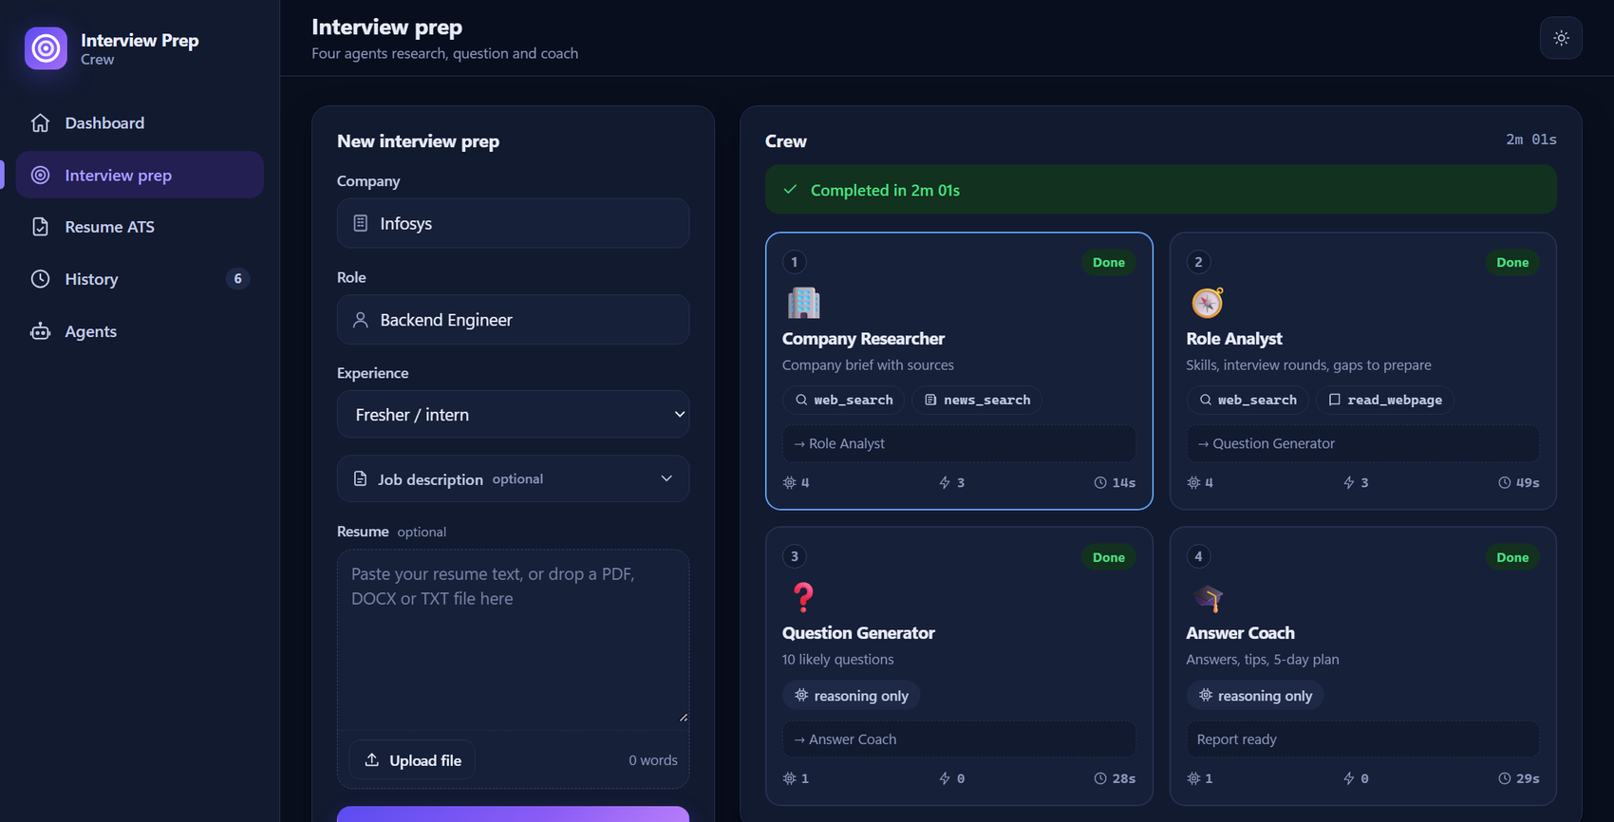
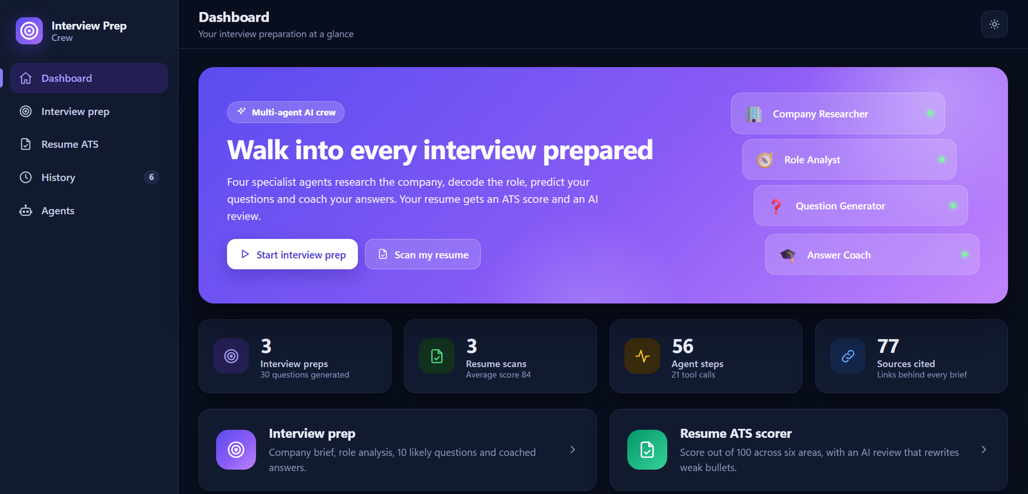
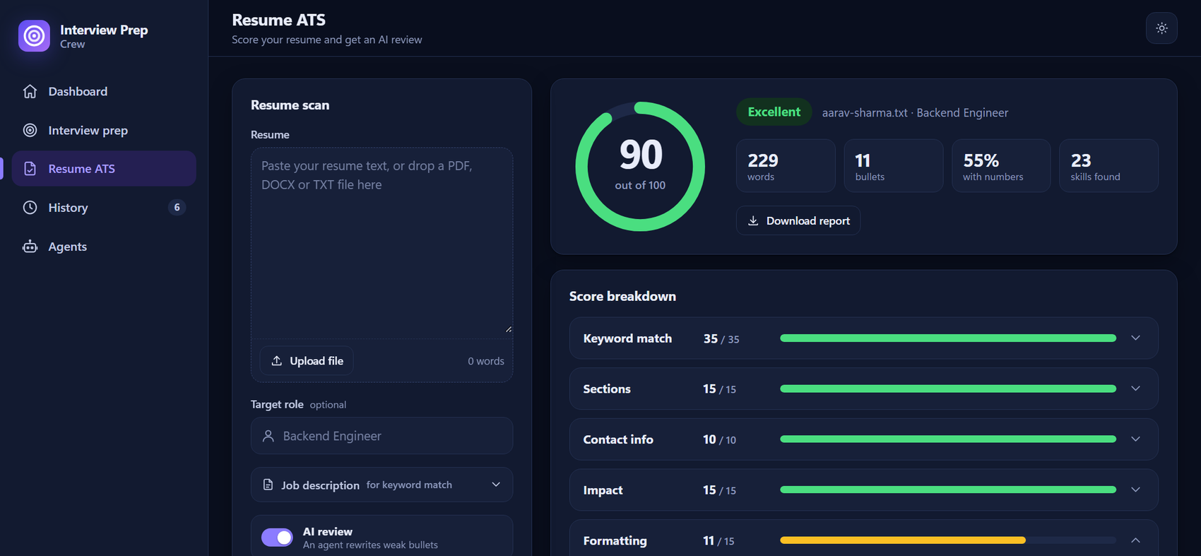
The Application
Dashboard: statistics, recent runs, ATS trend
Interview prep: the four agents, live and complete
Live agent cards
History and downloads
Light and dark themes
Resume ATS: score, breakdown, AI review
Notes:
This is the running application. On the left, the interview prep screen after a full run: four agent cards, each showing its tools, number of model and tool calls and time taken; below it are the Activity, Prep pack and Sources tabs. On the right, the dashboard with statistics and recent runs, and the resume ATS page with the score gauge and a six-area breakdown. If time allows, switch to the live application and run the crew for a company the audience suggests.

Slide 8
Results, Limitations and Future Scope
2m 14s
98 vs 4
155
four agents on Groq; about 6 min locally on a CPU
ATS score of a strong versus a weak sample resume
automated tests pass, using a scripted model
Limitations
Future scope
ATS rules are a heuristic, not checked against real ATS software
Results depend on web search and model quality
Not yet tried by real candidates
Mock interview that scores your spoken or typed answers
Model comparison and a user study
Fact-checker agent and Docker deployment
Thank you. Questions?
Notes:
Results: on Groq the four-agent crew finishes in 2 minutes 14 seconds, with all ten questions and ten answers; a 4B local model on a laptop CPU needs about six minutes. The ATS engine scored a strong sample resume 98 out of 100 and a weak one 4. All 155 automated tests pass. Limitations: the ATS score is a heuristic that we did not compare with commercial ATS software, results depend on web search and model quality, and no real candidates have used the system yet. Future scope: an interactive mock interview, a model comparison with a user study, a fact-checker agent and deployment. Thank the audience and invite questions.

