Slide 1

Predicting shopping trends from customer behaviors
SHREYAS MADHUSUDAN DASARI - 002743612
PO-WEI SUN - 002198884
YANBO LI - 002749858
ZEQUN CAO - 002747196

Slide 2
Contribution
Shreyas Madhusudan Dasari:
Po-Wei Sun:
Yanbo Li:
Zequn Cao:

Slide 3


Problem Statement
When visiting a large e-commerce website, which products would be pushed to us?
How are the products shown to us by the website after we search for keywords?
How is the order of arrangement determined?
The e-commerce website analyzes customers' shopping behaviors, then decide what products to recommend will make customers more likely to place an order.

Slide 4



Proposed Solution
In collecting data, the data may be inaccurate due to many conditions, so we will use enormous data and multi-faceted analysis.
Most of the contents in the shopping cart are discarded or placed directly. We want to used as a classification indicator to analyze the customer's website consumption habits. -Shopping cart data collection
There is a lot of analysis to categorize a consumer and then promote a valuable product. -Products categorize
Amount of time that customers spend on different product pages and the number of clicks on the products for analyzing the interests of types of products. -Time spending
In addition, the order, shopping cart and product information on the page can help us better analyze which types of products are more likely to be purchased after a customer views the page or adds it to their shopping cart. -Analyze the behavior
As data is accumulated, each customer's shopping habits show the types of products and specific products placed will better match the interests and tastes of the customer.

Slide 5
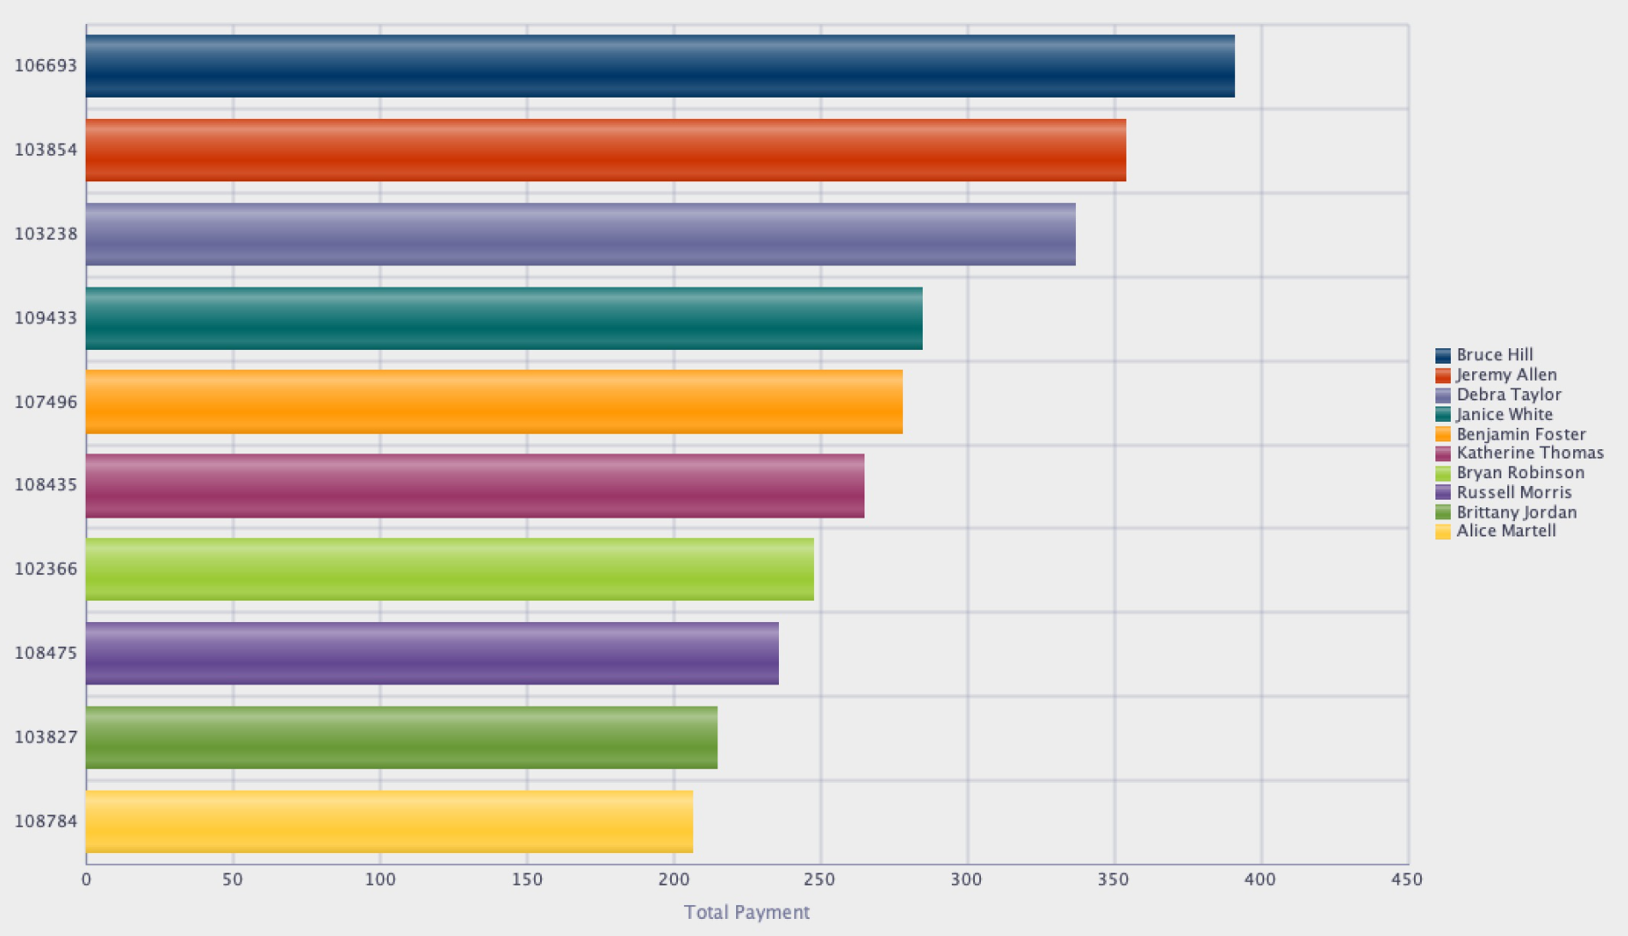
Top 10 amount for Payment
Display the highest total payment for 10 customers show with ID and names.

Slide 6
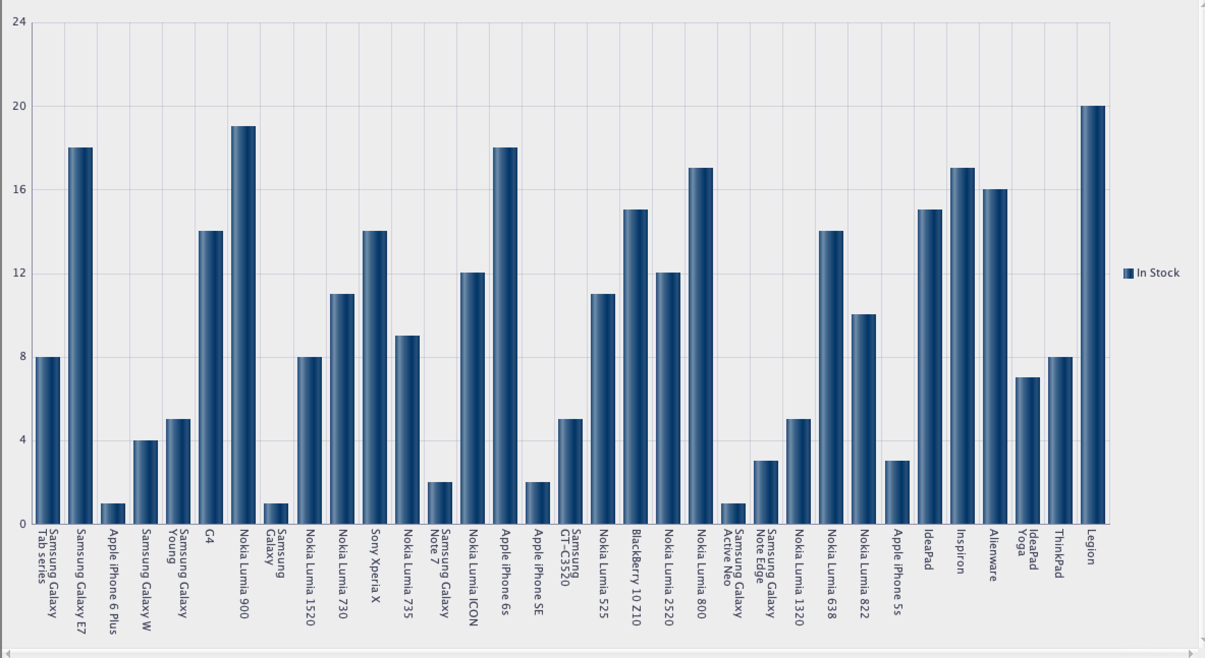
Products Stocking
Display all products stocking conditions and show product name.

Slide 7
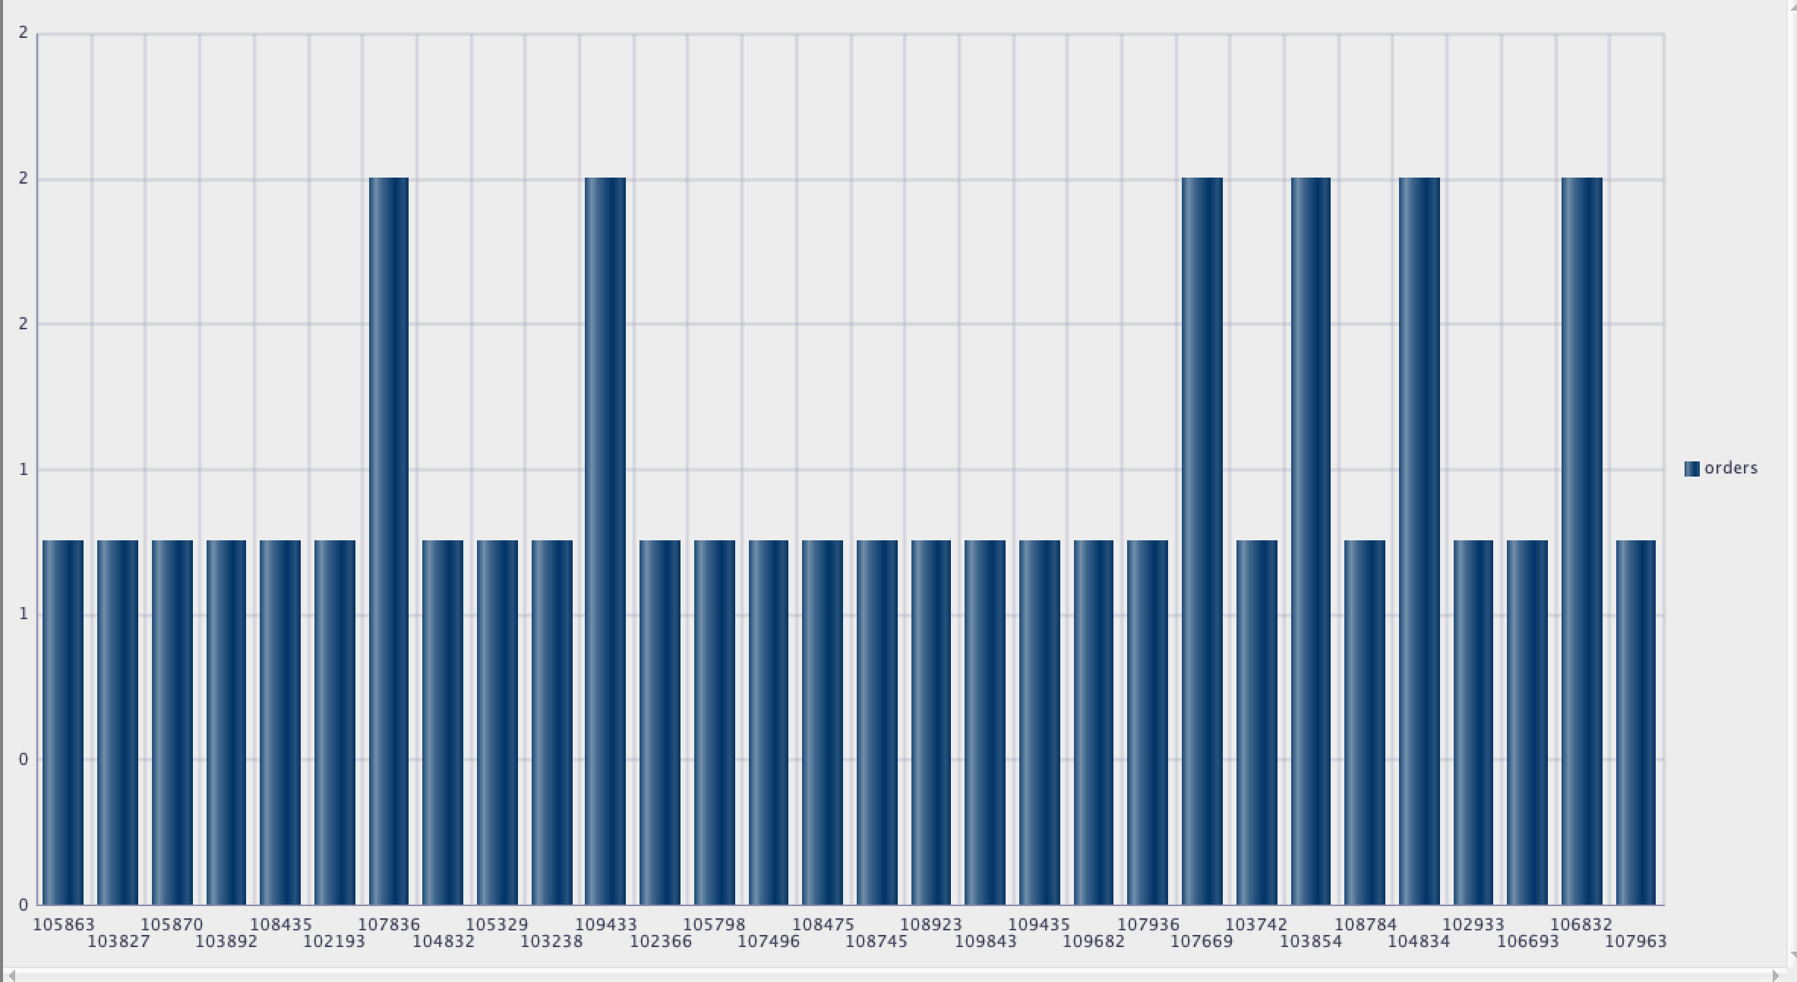
Customer Orders
Display all customers’ order amount, and show with customer ID.

Slide 8
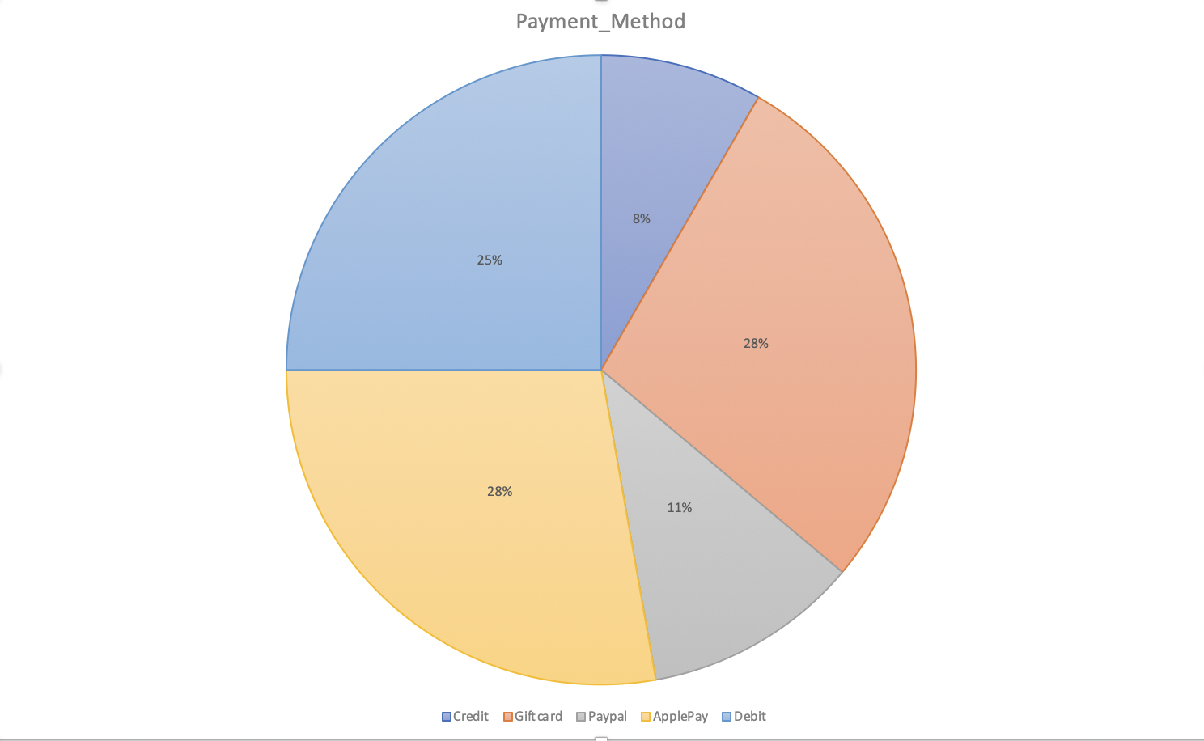
Proportion of Payment Method
Count all payment method using with all orders.
Credit: 8%
Gift Card: 28%
Paypal: 11%
Apple Pay:28%
Debit: 25%

Slide 9
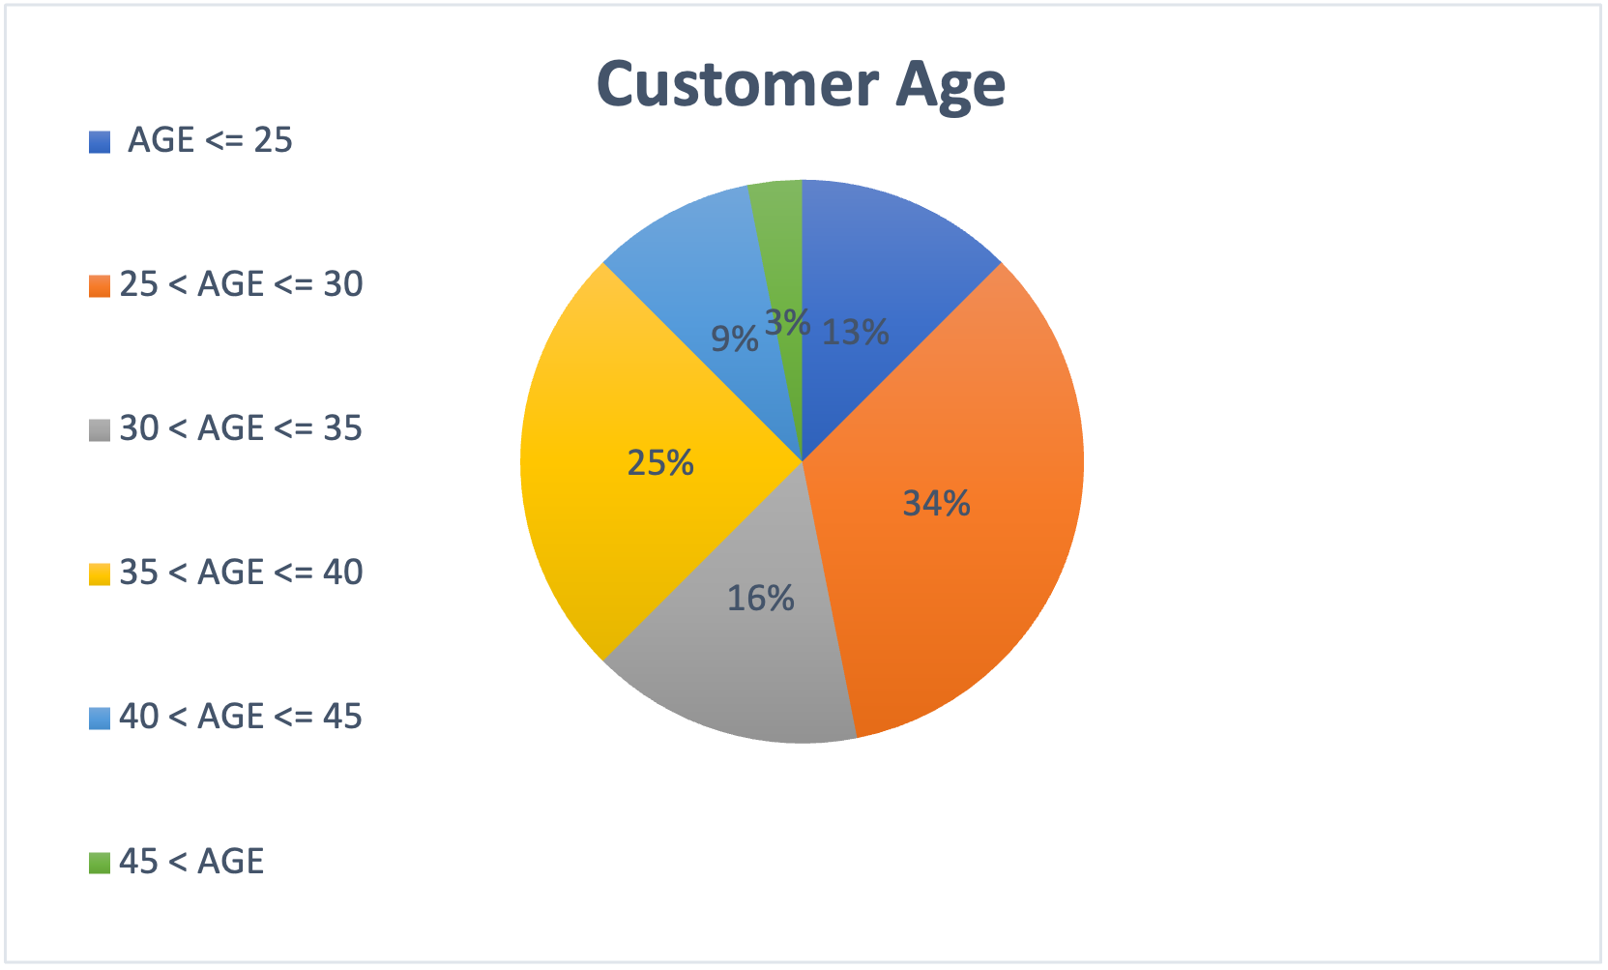
Customer Age
Divine all customers’ age into 5 years of scale for a pie chart.
25↓: 8%
25~30: 34%
30~35: 16%
35~40: 25%
40~45: 13%
45↑: 3%

Slide 10

Thank you !

