Slide 1
Pestana CR7: Stay with the best
Samiksha Mundas| Prathamesh Kulkarni| Shreyas Shetty| Ojasvi Patel| Shreyas Dasari

Slide 2

01
02
Design & Analysis
In depth design used and the analysis
Motivation
The reason behind choosing this topic
Pestana CR7
03
Implementation
How the project is implemented
04
Tech Used
Elaborating the functionality of the project

Slide 3
Motivation
Need for websites focused on helping the users ﬁnd places to stay.
Every stay-cation accommodation listed at one place.
Easier way to provide information for potential guests
Best deals on travel and hotels when planning a vacation.
Website to facilitate online bookings.
01

Slide 4
The Idea
The main aim behind this website is to provide a user-friendly and accessible interface for the users to plan their whole vacations from a single website.

Slide 5
Design & Analysis
Register and Login: First time users can directly register using their email, gmail, or social media apps. Login is for the returning customers.
Search: the search and ﬁlter functionality helps the users ﬁlter through the various options based on the dates, price, and ratings.
Instant payment and booking option for different hotels, ﬂight tickets, etc.
02

Slide 6
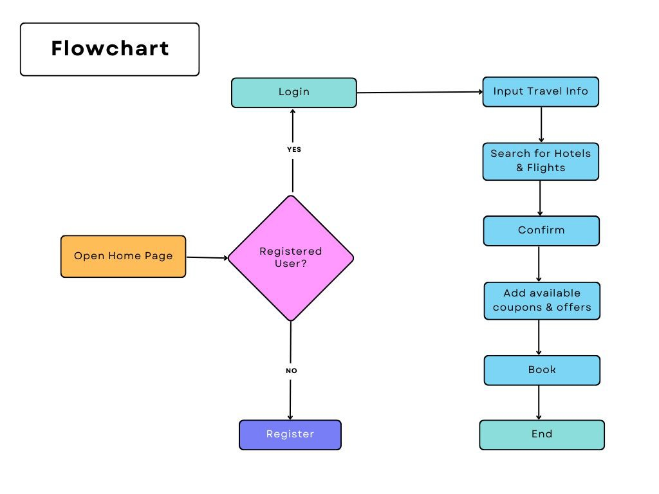
Implementation
03

Slide 7
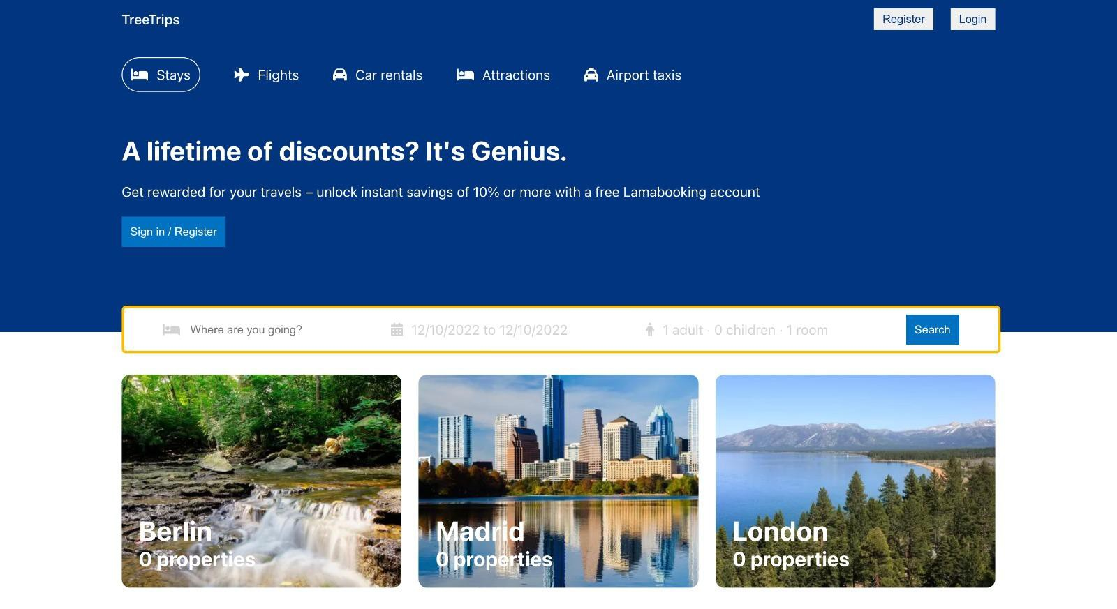
Responsive Design
The website is mobile-friendly and responsive. It can be viewed easily on different devices.

Slide 9
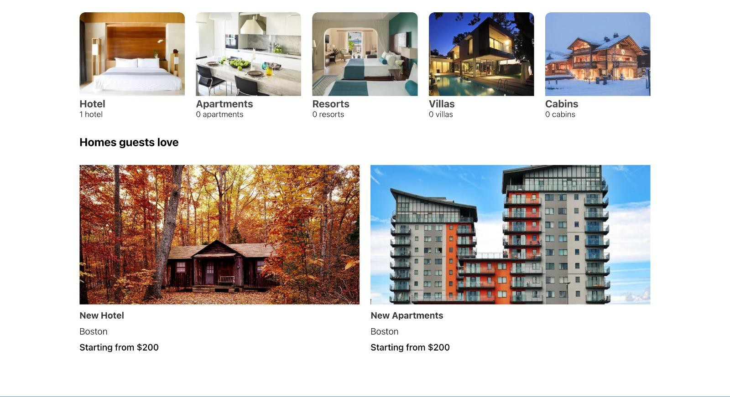

Slide 10
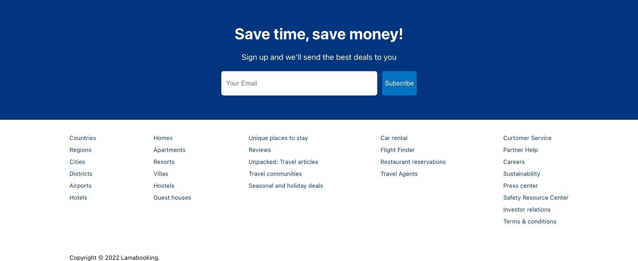

Slide 11
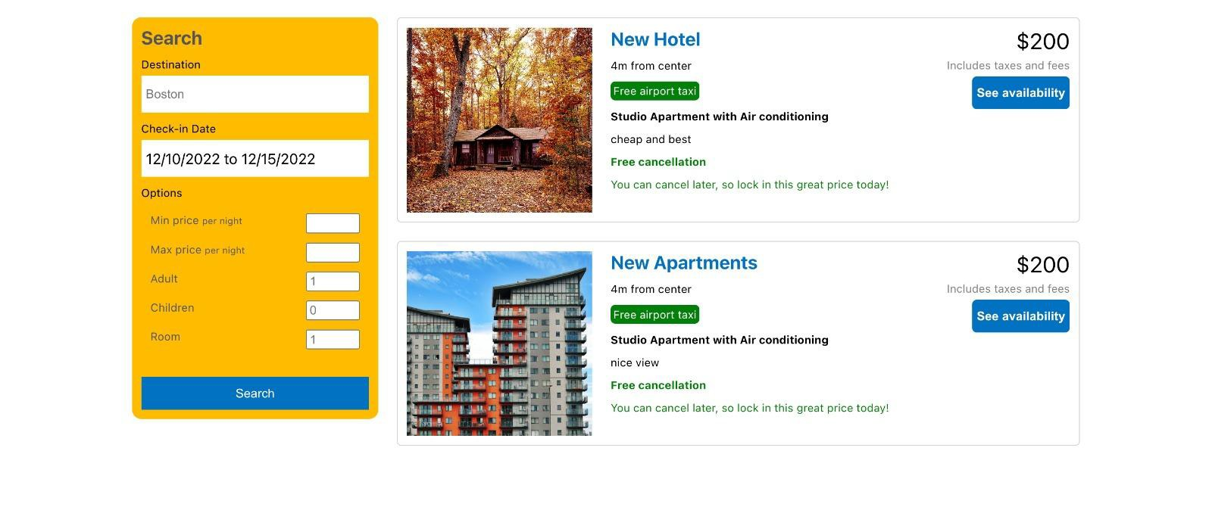

Slide 12
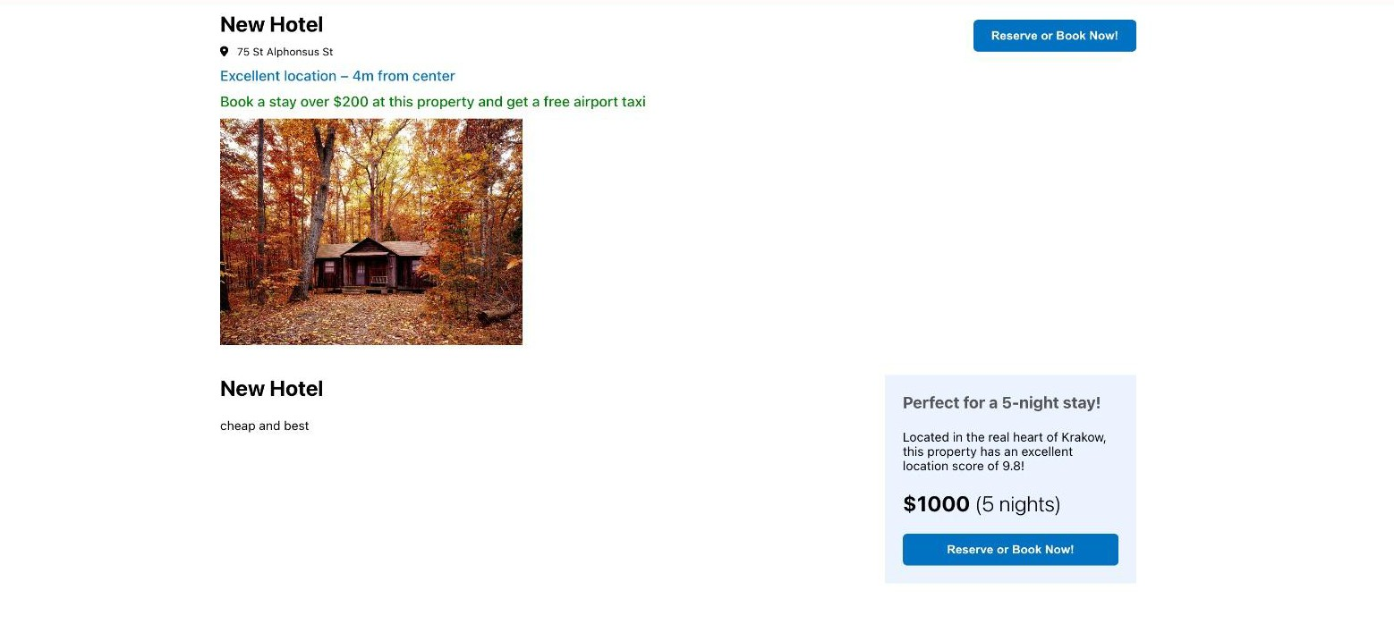

Slide 13
Tech Used
For the frontend we have used React.
React is preferred here because it helps to easily build testable and rich user interface.
Also, since React’s DOM is declarative, it is easy to follow and understand the code.
For the backend we have used NodeJS and MongoDB.
It was easier to use NodeJS as it helps to connect the site to the MongoDB database.
04

Slide 14
The End

