Slide 1
Pestana CR7
Group Members:
Prathamesh Kulkarni
Ojasvi Patel
Shreyas Shetty
Samiksha Mundas
Shreyas Dasari
Experience the luxury of football with Pestana Hotels & Resorts

Slide 2
Overview of Pestana CR7
• Pestana CR7 is a web application that offers a unique football-themed hotel experience
• It is a collaboration between Pestana Hotels & Resorts and Cristiano Ronaldo
• The web application offers a range of features including room bookings, restaurant reservations, and exclusive packages for football fans
• The application is available on both desktop and mobile platforms

Slide 3
Features of Pestana CR7
• Football-themed hotel rooms and suites
• Exclusive access to CR7 museum and events
• Dining options with a football twist
• Fitness center and rooftop infinity pool with views of the city
• Business center and meeting rooms
• Personalized services for football fans
• 24/7 customer support

Slide 4
Benefits of using Pestana CR7
• A unique and memorable hotel experience for football fans
• Access to exclusive CR7 events and museum
• Personalized services for football fans
• Convenient and easy-to-use web application for booking rooms, dining reservations, and more
• 24/7 customer support

Slide 5
Testimonials
• \I had the best football-themed hotel experience at Pestana CR7. The rooms were amazing and the service was exceptional.\ - John Smith
• \I'm a huge fan of Cristiano Ronaldo and Pestana CR7 exceeded my expectations. The museum and events were unforgettable. - Maria Garcia
• I highly recommend Pestana CR7 to any football fan. The hotel offers a unique and luxurious experience that is unmatched. - David Lee

Slide 6

Hotel Rooms and Suites

Slide 7
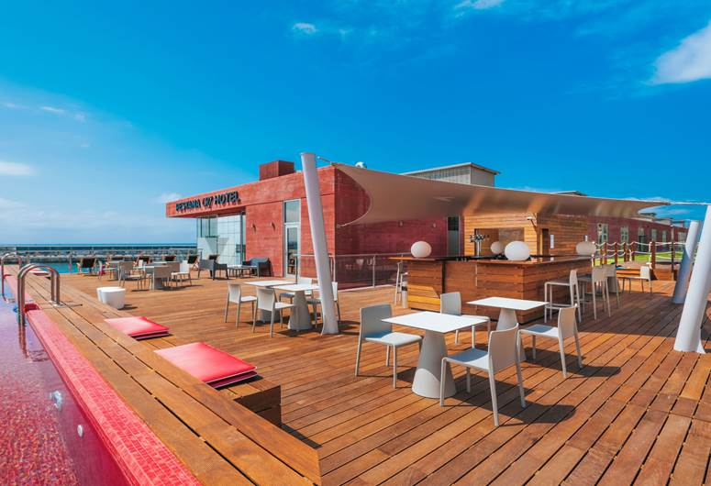
Dining Options

Slide 8
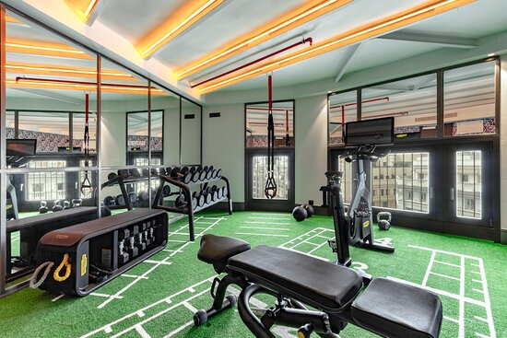
Fitness Center and Rooftop Infinity Pool

Slide 9
Booking and Reservations
• Pestana CR7 offers a convenient and easy-to-use web application for booking rooms, dining reservations, and more
• The application is available on both desktop and mobile platforms
• Customers can also book directly through the Pestana Hotels & Resorts website
• For any inquiries or issues, 24/7 customer support is available

Slide 10
Contact Us
Contact us for more information or to book your stay:
Email: info@pestanacr7.com
Phone: +1 (800) 555-5555
Follow us on social media:
Twitter: @PestanaCR7
Facebook: Pestana CR7
Instagram: @PestanaCR7

