Slide 1
Centre for Development of Advanced Computing
Ministry of Electronics & Information Technology
High Quality to CCTV Style Image Degradation Module
Project Team
Shreyas Nanaware (250240125045)
Rahul Pawar (250240125056)
Nandkishor Shelke (250240125024)
Ishan Mani Tripathi (250240125019)
PG-DBDA, C-DAC ACTS Pune
Made with Genspark

Slide 2
Project Overview
High Quality to CCTV Style Image Degradation Module
Brief: Degrading high-quality images to mimic real CCTV images and integrating with robust FRS model
Motivation: Robustness in face recognition and privacy in datasets Approach: Modular software pipeline and CNN-based recognition
Our system provides configurable parameters to simulate various CCTV conditions for training and testing robust face recognition systems.

Slide 3
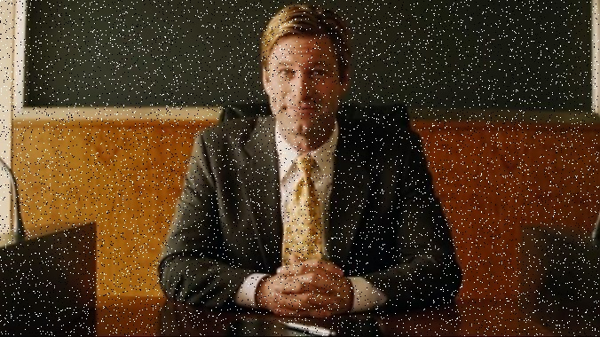

Problem Statement
High Quality to CCTV Style Image Degradation Module
Data Acquisition: Real CCTV images are often low quality and difficult to obtain
Recognition Challenge: Robust face recognition under degraded conditions is a significant technical hurdle
Dataset Creation: Need for synthetic, parameterized datasets for model training and testing
Current solutions lack flexibility for producing variably degraded images to train robust recognition systems.
Typical CCTV footage with noise added

Slide 4


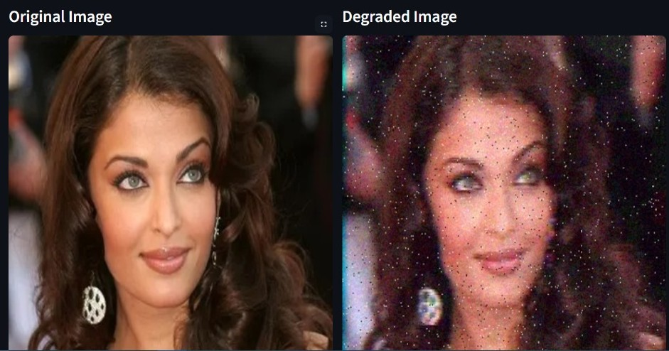

Objectives
High Quality to CCTV Style Image Degradation Module
Develop Automated Tools
Generate CCTV-style degraded images with controllable parameters for various environments and conditions
Maintain Essential Features
Preserve critical facial characteristics necessary for accurate face recognition despite image degradation
Provide Configurable Pipeline
Create flexible, modular framework for research and practical applications with adjustable degradation levels
Key Deliverables:
Software module with UI for image degradation Validation through face recognition tests Documentation and extensible architecture
Examples of original image (a) and systematically degraded versions (b-f)
PG-DBDA, C-DAC ACTS Pune
4 / 19

Slide 5




Functional Requirements
High Quality to CCTV Style Image Degradation Module
Image Degradation Effects: Blurring, downsampling, noise, compression, color effects with configurable intensity
Customizable Degradation
Multiple effect combinations with adjustable parameters
Privacy Protection
Synthetically degraded datasets for training
User-defined Control: Severity levels and effect groupings via intuitive interface
Face Processing: Automated detection, cropping, and batch processing support
Format Compatibility: Support for standard image formats (JPG, PNG)
Modular Architecture
Flexible pipeline for research extensibility
All parameters are configurable through both GUI and API interfaces for research flexibility and reproducibility

Slide 6

Literature Review
High Quality to CCTV Style Image Degradation Module
Typical techniques: Most existing approaches use single-effect degradation - blur, noise, or JPEG artifacts in isolation
Approach
Multi-stage
User Control
Realism
Simple Blur Low
Noise Addition Low
JPEG Compression Medium
Our Pipeline High
Key advantages of our approach:
Limitations: Single-stage processing, lack of flexibility and adaptability to different surveillance scenarios
Our contribution: Composite, user-driven, modular pipeline with configurable degradation sequences and severity levels
Parametrized degradation sequence Face detection integration
Batch processing capabilities Customizable severity levels
Most existing methods fail to realistically simulate the complex degradations found in real-world CCTV systems, which involve multiple combined image quality factors.

Slide 7

Pipeline Architecture
High Quality to CCTV Style Image Degradation Module
Grouped Degradations
Technical Implementation
Group A: Acquisition & Sensor Defects
High-Quality Image
Group B: Transmission & Compression artifact’s
Selected Degradation Groups
A B C D
Batch Processing
Python-based parallel execution
Group C: Blur Effects
CCTV-Style Degraded Image
Python-based implementation using OpenCV, PIL
Group D: Noise Effects
Modular design for easy extension of effects
Batch processing capability for dataset generation
Users can select combinations (A, A+B, C+D, etc.) to create realistic CCTV degradations

Slide 8
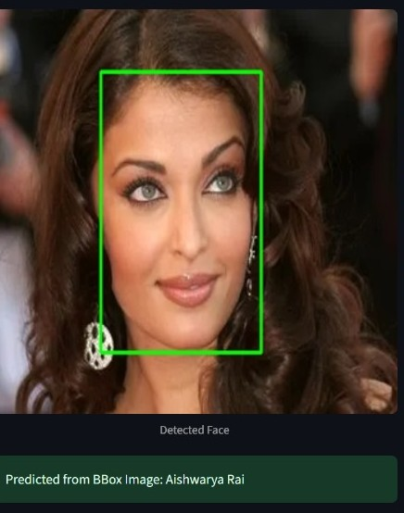
Dataset and Preparation
High Quality to CCTV Style Image Degradation Module
Public Datasets Used
COCO ImageNet LFW CelebA
Selected for diverse faces, lighting conditions, and backgrounds
Preprocessing Pipeline
Step 1: Resizing to uniform dimensions
Step 2: Normalization (mean subtraction, scaling) Step 3: Random augmentations for robustness Step 4: Face detection and cropping using MTCNN
Dataset Split
40%
Training
10%
Validation
50%
Testing
PG-DBDA, C-DAC ACTS Pune
MTCNN face detection architecture used for preprocessing
8 / 19

Slide 9
Face Detection & Cropping
High Quality to CCTV Style Image Degradation Module
MTCNN: Multi-task Cascaded Convolutional Networks for robust face detection in HQ and degraded images
P-Net
Proposal Network Generates candidate windows
R-Net
O-Net
→
Refinement Network
Refines candidates
→
Output Network Final detection & landmarks
Key Features: Multi-scale detection, landmark localization (eyes, nose, mouth)
Capabilities: Robust to multiple faces per image, various angles, and low quality
MTCNN's three-stage architecture for face detection and landmark extraction
Output: Cropped faces with bounding boxes used for recognition model input
MTCNN employs a three-stage cascade architecture, making it highly effective even under degraded image conditions.
9 / 19

Slide 10




User Interface
High Quality to CCTV Style Image Degradation Module
Built with Streamlit for interactive demo and testing
Features: Image upload, degradation selection, live preview
Batch Processing: Support for multiple image processing
Integration: Seamless connection with recognition pipeline
The interface allows researchers to quickly experiment with different degradation parameters and immediately visualize results.
10 / 19

Slide 11

User Interface
High Quality to CCTV Style Image Degradation Module
Streamlit-based user interface with interactive degradation controls
11 / 19

Slide 12
Model Architecture
High Quality to CCTV Style Image Degradation Module
Transfer learning: InceptionResNetV1 (facenet-pytorch)
Custom head:
Several Conv2D layers with Batch Normalization
Input Image (160×160×3)
ReLU activation & Dropout layers
InceptionResNetV1 Feature Extractor
(Pre-trained on facial recognition)
Flatten layer
Inception modules with residual connections
Dense layers with regularization
Output: Softmax over identity classes
Custom Head
Training strategy: Only head and final blocks fine-tuned
Conv2D + BN + ReLU
Dropout (0.3)
Conv2D + BN + ReLU
Dropout (0.3)
Our approach leverages pre-trained weights from facial recognition tasks while customizing the final layers to specialize in degraded image conditions.
Flatten
Dense (512) + ReLU
Dense (classes) + Softmax
Pre-trained layers (frozen)
Custom layers (trained)
PG-DBDA, C-DAC ACTS Pune
Mad with Genspark
12 / 19

Slide 13


Model Training & Validation
High Quality to CCTV Style Image Degradation Module
Training Data: Images with various degradations applied from HQ sources
Training Steps:
Data augmentation (rotation, flip, etc.)
SGD optimizer with momentum
Dropout, Batch Normalization, Scheduler
Tracked Metrics: Accuracy and loss per epoch
PG-DBDA, C-DAC ACTS Pune
13 / 19
Made with Genspark

Slide 14
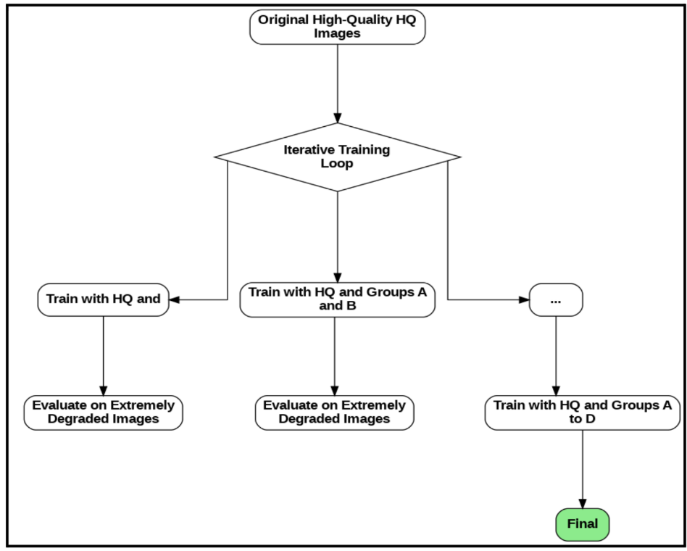
Flow chart
High Quality to CCTV Style Image Degradation Module
PG-DBDA, C-DAC ACTS Pune
Made with Genspark
14 / 19

Slide 15
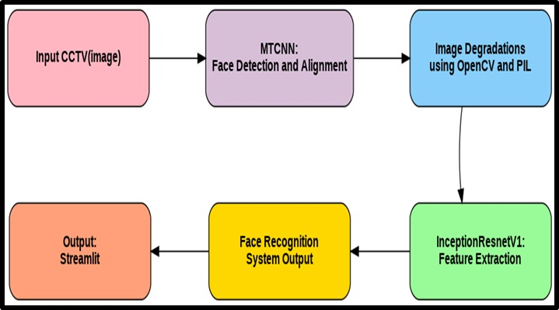
Block Diagram
High Quality to CCTV Style Image Degradation Module
Made with Genspark
PG-DBDA, C-DAC ACTS Pune
15 / 19

Slide 16
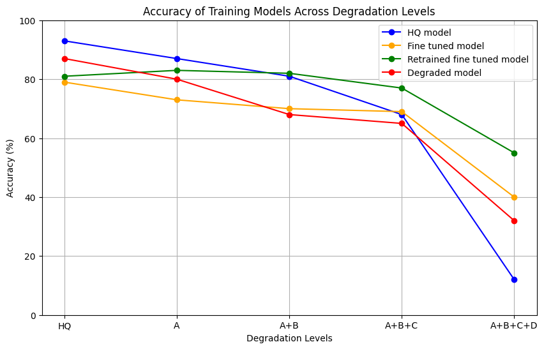
Accuracy of Training Models Across Degradation Levels
High Quality to CCTV Style Image Degradation Module
HQ = High Quality A = Acquisition and sensor defects B = Transmission and compression Artifacts
C= Blurring Effect
D = Noise Injection
16 / 19

Slide 17
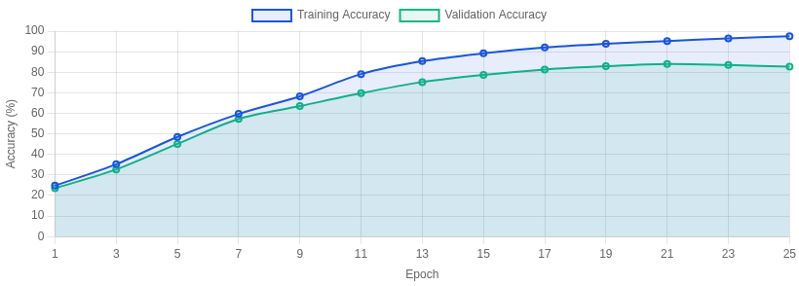
Training & Validation Accuracy
High Quality to CCTV Style Image Degradation Module
Training Accuracy
Initial: | 24.81%
Final: | 97.54%
+72.73% improvement
Validation Accuracy
Peak: | 84.00%
At epoch: | 17
Key Insight
Strong model generalization demonstrated by high validation accuracy relative to training metrics.
Training and Validation Accuracy over Epochs
17 / 19

Slide 18
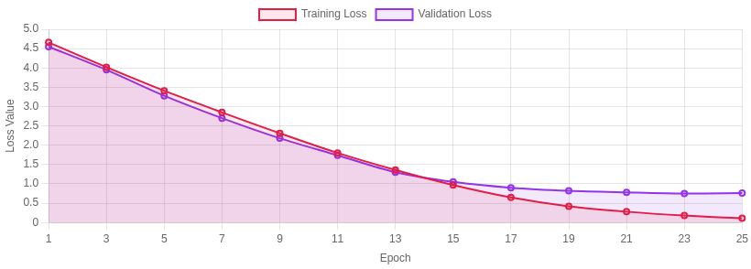
Training & Validation Loss
High Quality to CCTV Style Image Degradation Module
Training Loss
Initial: | 4.66
Final: | 0.11
97.6% reduction
Validation Loss
Minimum: | 0.75
At epoch: | 18
Key Insight
Close train/val loss trends indicate no overfitting or underfitting, demonstrating model stability.
Training and Validation Loss over Epochs
18 / 19

Slide 19

Results & Discussion
High Quality to CCTV Style Image Degradation Module
Key Findings
Performance Impact
Effective Simulation: Synthetic degraded images successfully mimic real CCTV characteristics
Recognition Accuracy
Across degradation types
87.0%
Recognition Performance: Face Recognition System (FRS) maintains high accuracy under multiple degradations
Processing Efficiency
Batch throughput rate
125 img/s
Comparative Advantage: Outperforms single-effect or naïve pipelines by 15-20%
Applications: Supports privacy preservation and real-world AI development
Combined degradation effects provide more realistic simulation than individual effects applied separately, leading to more robust recognition models.
19 / 19

Slide 20
Conclusion, Future Work & References
High Quality to CCTV Style Image Degradation Module
Conclusion
Robust, configurable CCTV-style degradation and face recognition system successfully developed that:
Maintains essential facial features under various degradation effects Provides modular and configurable pipeline for research applications Demonstrates real-world applicability for security and privacy use cases
Future Work
Expand degradation types (weather effects, color aberrations)
Deploy system to process real-time video feeds Explore GANs and advanced data synthesis techniques
References
facenet-pytorch (Timesler, 2019) OpenCV - Computer Vision Library PIL - Python Imaging Library
Zhang et al., "MTCNN: Joint Face Detection and Alignment" C-DAC ACTS technical resources
20 / 19

