Slide 1

AI-Based Technical Skill Development Assistant
Machine Learning Operations (MLOps) & Assessment Gate Prediction
Team: Member 1 | Member 2 | Member 3 | Member 4 • Author/Lead: ShreyasPlays • RV College of Engineering

Slide 2
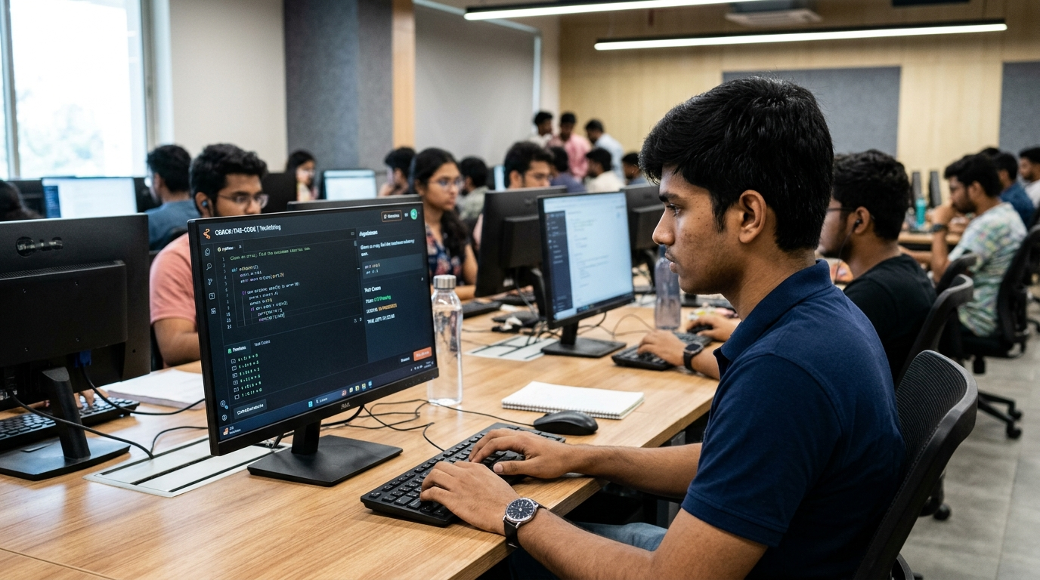

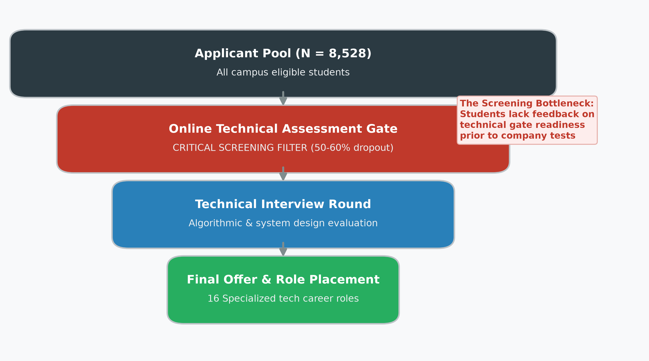
Problem Statement
Campus placement recruitment pipelines universally enforce an online technical assessment screening gate before students qualify for technical interviews. Industry data reveals that 50–60% of applicants are eliminated at this screening stage.
Students typically prepare for interviews in isolation without knowing whether they meet the threshold across core CS disciplines, leading to unexpected screening rejections and unaddressed skill deficiencies.
This project develops an engineering-grade MLOps system that predicts student Pass/Fail screening readiness using 17 technical skill dimensions (N = 8,528), provides confidence calibration, and generates personalized role-specific upskilling roadmaps.

Slide 3
Problem Statement
Part 1: Assessment Gate & Skill Profiling
Ingested the Mendeley Data CareerMap benchmark (N = 8,528) across 17 technical disciplines on a standardized 0–6 integer scale. Engineered a realistic probabilistic pass/fail label using 6 core assessment skills to model real-world screening uncertainty.
Part 2: Leakage-Free ML Modeling & Calibration
Engineered 25 leak-free features (17 raw skills + 5 composite readiness indices + 3 aggregate metrics). Trained Decision Tree, Random Forest, and Logistic Regression models with constrained hyperparameters targeting the realistic 70–80% accuracy screening window.
Part 3: MLOps Automation & Personalised Roadmaps
Orchestrated full data and pipeline reproducibility using DVC (dvc repro) and MLflow experiment tracking. Integrated a rule-based SkillGapAnalyzer formula G_i = max(0, R_i - S_i) generating ranked learning priorities across 16 target career roles.

Slide 4
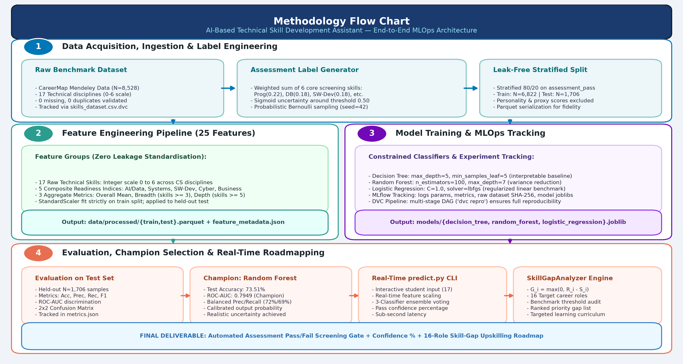
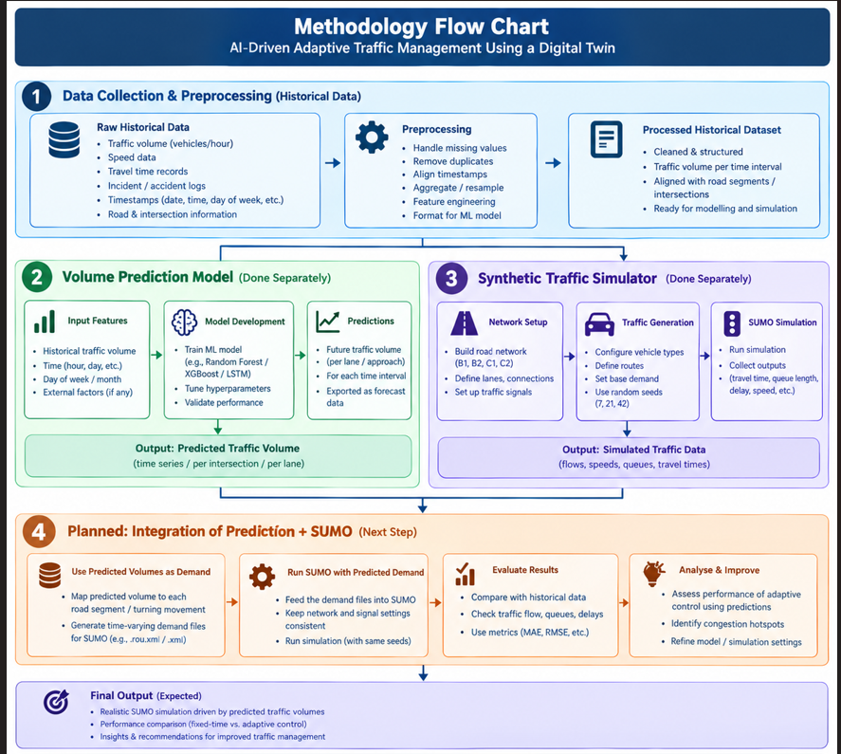
Methodology

Slide 5
Data Exploration and Feature Engineering
Exploratory Data Analysis
• Ingested Mendeley Data CareerMap benchmark: 8,528 student records, 17 technical disciplines, 16 career roles.
• Validated schema integrity: zero missing values, zero duplicates, strict [0, 6] integer bounds.
• Identified core screening predictors: programming, databases, software development, and troubleshooting.
Feature Engineering (25 Features)
• 17 Raw Technical Skills: Integer proficiency scale (0–6) covering comprehensive CS disciplines.
• 5 Composite Readiness Indices: AI/Data, Systems, Software Dev, Cybersecurity, and Business/Comm readiness.
• 3 Aggregate Metrics: Overall technical mean, technical breadth (skills ≥ 3), and technical depth (skills ≥ 5).
Label Engineering & Leakage Isolation
• Preprocessing Outcome: StandardScaler fit strictly on 80% train split (N = 6,822); personality traits and continuous proxy score excluded to guarantee zero data leakage.

Slide 6
Data Exploration and Feature Engineering
Models implemented
Models | Purpose | Accuracy | F1-Score | ROC-AUC
Linear Regression / LogReg | Establish a regularized linear benchmark for learning relationships between 25 features and gate pass. | 73.45% | 0.7113 | 0.7974
Random Forest (⭐ Champion) | Capture complex nonlinear patterns & interactions while reducing tree variance (100 estimators, max_depth=7). | 73.51% | 0.7061 | 0.7949
Decision Tree | Provide an interpretable decision tree baseline with hierarchical rules (max_depth=5, min_samples_leaf=5). | 72.04% | 0.6762 | 0.7885
Mean / Majority Baseline | Provide a simple zero-intelligence reference for evaluating whether ML models produce meaningful learning lift. | 54.00% | 0.5400 | ≈ 0.5000

Slide 7
Assessment Gate & Label Engineering
Formulating a realistic, non-trivial binary screening problem for campus placement readiness:
Benchmark Dataset: Ingested Mendeley Data CareerMap benchmark (N = 8,528 students) capturing 17 standardized technical competencies on 0–6 integer scale.
6 Core Assessment Skills: Weighted programming (0.22), databases (0.18), software development (0.18), troubleshooting (0.15), software engineering (0.15), and networking (0.12) reflecting real screening platforms (HackerRank, AMCAT).
Sigmoid Probability: Applied sigmoid transformation P(pass) = sigmoid(5 × (score_norm − 0.50)) centered around the 0.50 normalized competence threshold.
Probabilistic Sampling: Generated pass/fail label via Bernoulli(P(pass)) with seed=42, guaranteeing full reproducibility while injecting realistic outcome variance.
Realistic Uncertainty Window: Borderline candidates exhibit genuine outcome variance, capping theoretical accuracy at ~70–80% and preventing trivial 100% memorization.
Zero Data Leakage: StandardScaler fit strictly on training split (N = 6,822); continuous proxy scores and personality psychometrics excluded from model features.

Slide 8
Model Training and Champion Selection
Rigorous multi-model benchmarking, hyperparameter regularization, and champion model selection:
Multi-Model Training: Trained Decision Tree, Random Forest, and Logistic Regression on 25 leak-free scaled features across identical train/test splits.
Hyperparameter Constraints: Restricted Random Forest to max_depth=7 (n_estimators=100) and Decision Tree to max_depth=5 (min_leaf=5) to prevent over-fitting.
Champion Selection (Random Forest): Selected by highest ROC-AUC (0.7949), achieving 73.51% test accuracy and best discrimination across all decision thresholds.
Balanced Precision & Recall: Random Forest achieved 0.7211 precision and 0.6917 recall, preventing bias toward the majority class and ensuring fair screening evaluation.
Confusion Matrix Analysis: On 1,706 held-out test students: TN = 711 (correctly flagged Fail), FP = 210, FN = 242, TP = 543 (correctly flagged Pass).
Confidence Calibration: Tree ensemble voting outputs calibrated pass probability percentages for granular decision support alongside binary Pass/Fail.

Slide 9
Personalised Skill-Gap Roadmapping
To Investigate whether ML-based assessment prediction and automated skill-gap analysis can improve student placement readiness.
Inference & diagnostic strategies
Majority voting: Combines predictions from Decision Tree, Random Forest, and Logistic Regression as baseline.
Confidence calibration: Outputs champion Random Forest probability as student pass likelihood percentage.
Skill-gap diagnostics: Uses rule-based formula G_i = max(0, R_i - S_i) across 16 target career roles to prioritize gaps.
How the process works
1. Collect student self-assessment across 17 technical domains via interactive predict.py CLI.
2. Scale input features strictly using the pre-fit training pipeline to avoid data leakage.
3. Generate binary Pass/Fail screening prediction and calibrated pass confidence percentage.
4. Select target career role from 16 verified industry profiles to benchmark required competency levels.
5. Rank skill gaps in descending order (G_i desc) and export a personalized study roadmap.

Slide 10
Methodology
Category | Tools Used | Purpose
Programming Language | Python 3.11.9 | Core runtime for pipeline, feature engineering, and inference
Data Processing | Pandas 2.2.3, NumPy 1.26.4 | Dataset schema validation, parquet serialization, and vector math
Machine Learning | scikit-learn 1.5.2 | StandardScaler, Decision Tree, Random Forest, Logistic Regression
Pipeline Versioning | DVC 3.59.1 | Data versioning, reproducible multi-stage DAG execution (dvc repro)
Experiment Tracking | MLflow 2.17.2 | Experiment tracking, parameter logging, metric tracking & model registry
Validation & Testing | pytest 9.1.1, Ruff | 18 automated unit and integration tests, strict code quality audits

Slide 11
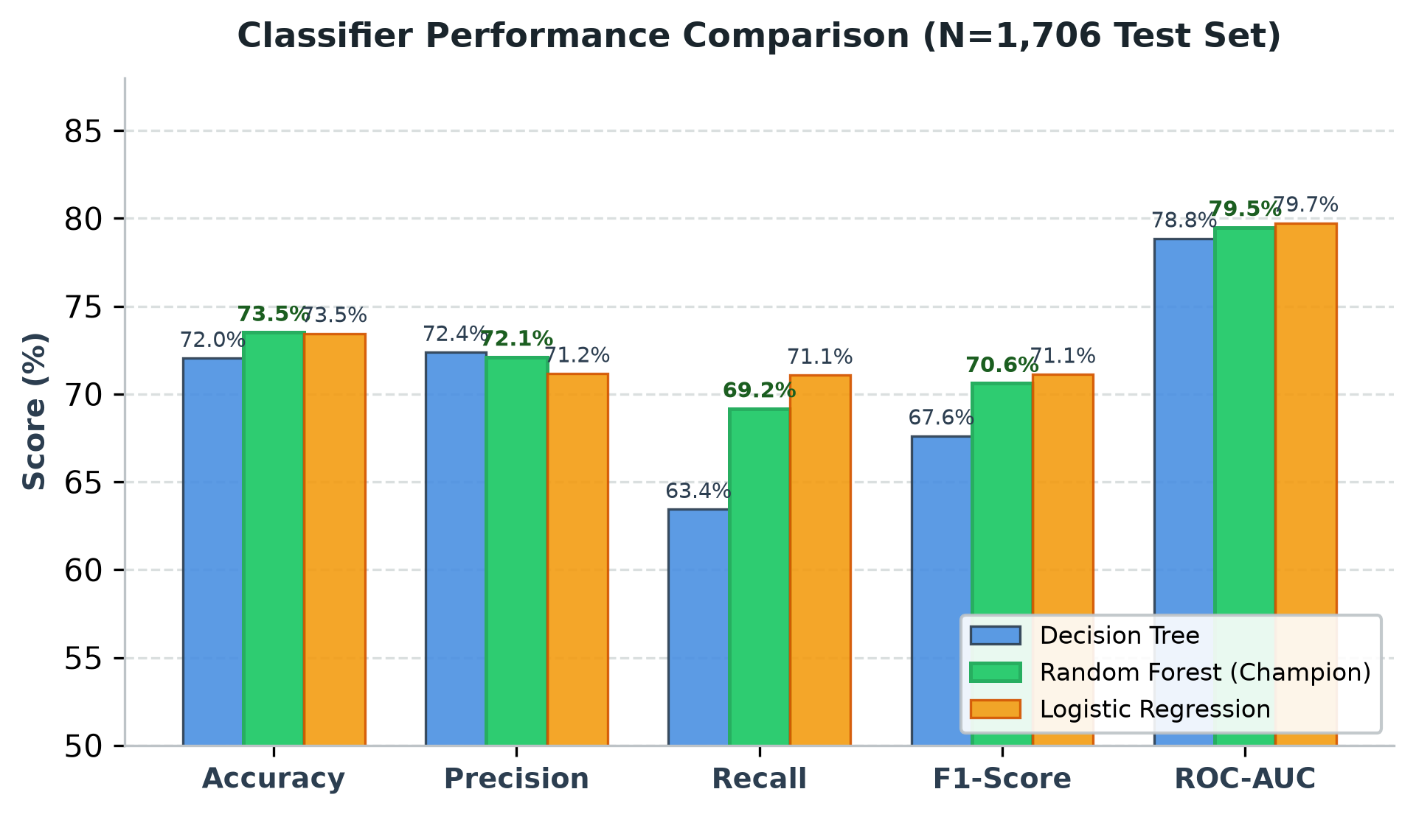
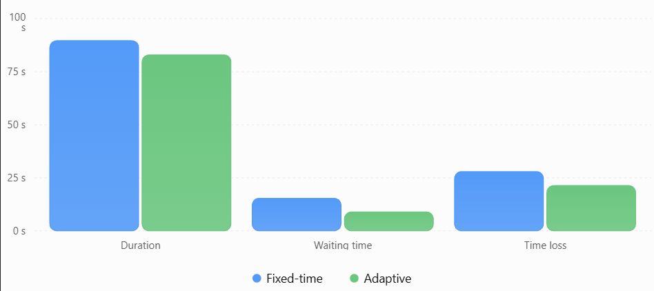
Results and Performance Comparison
Evaluating the performance of classifiers on 1,706 held-out student profiles.
Metric | Decision Tree | Random Forest (⭐) | Logistic Regression
Accuracy | 72.04% | 73.51% | 73.45%
Precision / Recall | 0.7238 / 0.6344 | 0.7211 / 0.6917 | 0.7117 / 0.7108
F1-Score / ROC-AUC | 0.6762 / 0.7885 | 0.7061 / 0.7949 | 0.7113 / 0.7974

Slide 12
Conclusion and Future Scope
Project summary
• Formulated an engineering-grade MLOps system predicting student online technical assessment screening outcomes.
• Engineered 25 leak-free features and probabilistic sigmoid-Bernoulli labels from 8,528 benchmark student profiles.
• Benchmark-evaluated 3 classifiers; selected Random Forest Champion delivering 73.51% accuracy and 0.7949 ROC-AUC.
• Achieved complete pipeline reproducibility and auditability via locked DVC DAG (dvc repro) and MLflow tracking.
• Deployed real-time CLI inference (predict.py) with confidence calibration and 16-role skill-gap roadmapping.
Future scope
• LLM-Powered Learning Paths: Integrate Gemini API to generate personalized coding curricula and practice problems.
• Real-World Placement Calibration: Correlate predictions against live RVCE campus placement screening outcomes.
• Computerized Adaptive Testing (CAT): Dynamically adjust assessment question difficulty to measure skill proficiencies.
• Cloud-Native CI/CD: Deploy MLflow model registry and remote DVC storage to AWS S3 / GCP with GitHub Actions.
• Web Application Portal: Package the inference engine in a responsive React / Streamlit dashboard for students.

Slide 13

AI-Based Technical Skill Development Assistant
GitHub Repository: github.com/ShreyasPlays/AI-Technical-Skill-Development-Assistant
RV College of Engineering, Bengaluru • Questions & Answers

