Slide 1

BITS, PILANI – K. K. BIRLA GOA CAMPUS
Time Series Forecasting of COVID-19 Using Multivariate Data
-Shreyas Sinha
Notes:
1

Slide 2
Motivation
Performance of Traditional Models and their comparison
Real-world problem of such importance
BITS, PILANI – K. K. BIRLA GOA CAMPUS
2

Slide 3
Initial Analysis
▶Data Cleaning and Imputation
▶ Exploratory Data Analysis (EDA)
▶ Stationarity Testing
▶ Visualization and Insights
BITS, PILANI – K. K. BIRLA GOA CAMPUS
3

Slide 4
Initial Analysis
Notes:
4

Slide 5
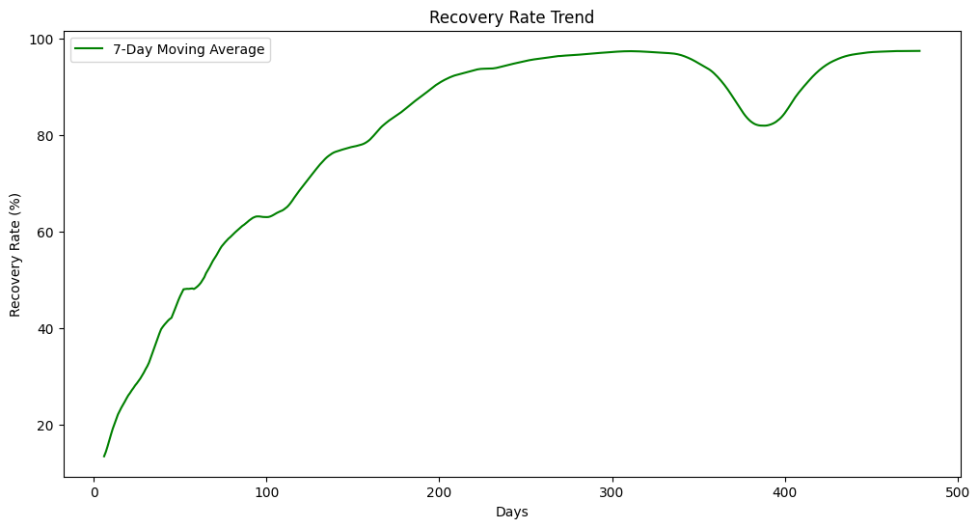
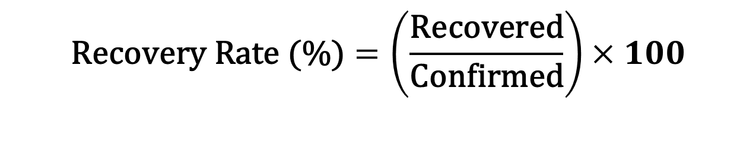
$$\text{Recovery} \text{Rate}\text{ (\%)}=\left(\frac{\text{Recovered}}{\text{Confirmed}}\right)×100$$
BITS, PILANI – K. K. BIRLA GOA CAMPUS
5

Slide 6
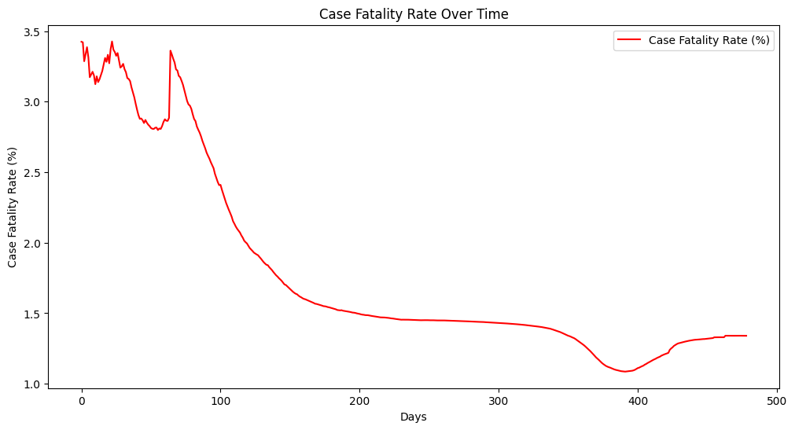
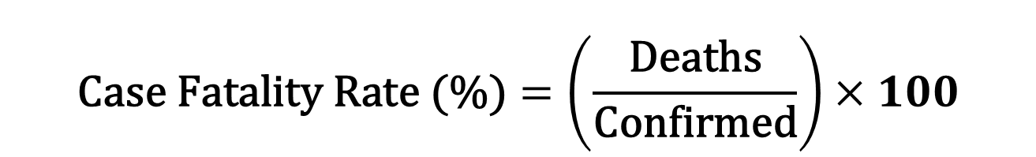
$$\text{Case} \text{Fatality} \text{Rate}\text{ (\%)}=\left(\frac{\text{Deaths}}{\text{Confirmed}}\right)×100$$

Slide 7
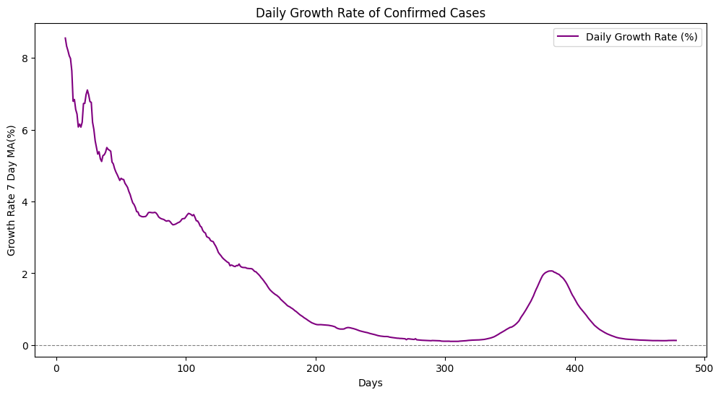
$$\text{Daily} \text{Growth} \text{Rate}\text{ (\%)}=\text{pct}\text{_}\text{change}\text{(}\text{Confirmed}\text{)}×100$$
The peak in growth rate at 30 days from start which is around 11th May
Phase 3 would be final but it peaked again
Phase 4 had to be introduced
7
BITS, PILANI – K. K. BIRLA GOA CAMPUS

Slide 8
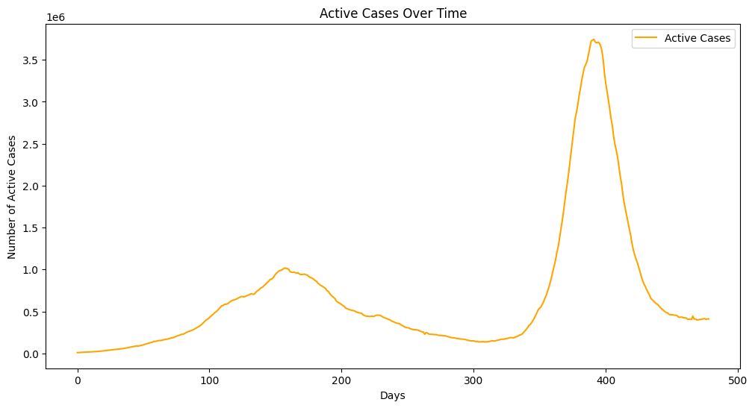
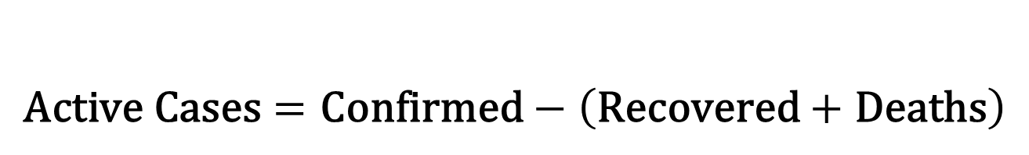
$$\text{Active} \text{Cases}=\text{Confirmed}−\left(\text{Recovered}+\text{Deaths}\right)$$
BITS, PILANI – K. K. BIRLA GOA CAMPUS
8

Slide 9
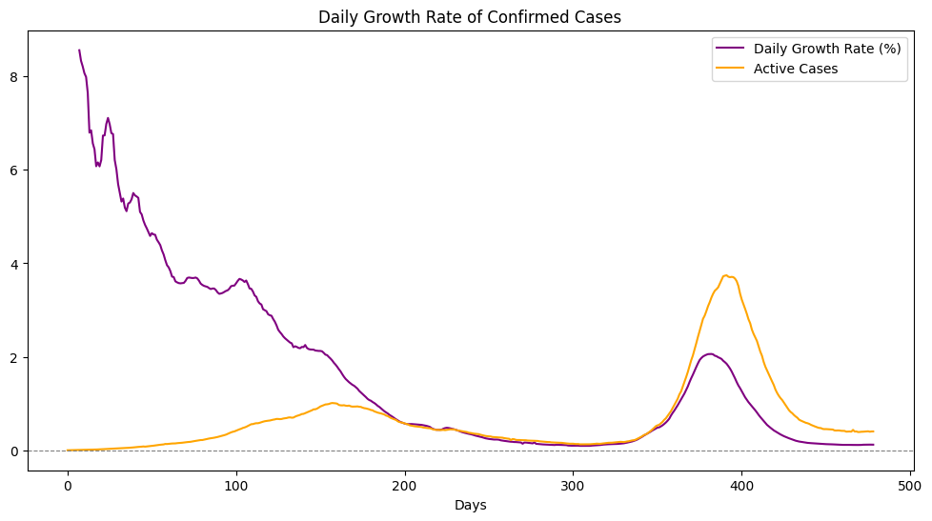
March 2021 Wave

Slide 10
Forecasting
Notes:
10

Slide 11
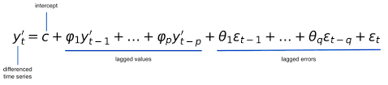
ARIMA Models
Grid Search For Optimal p q r
AIC Score and RMSE Error
BITS, PILANI – K. K. BIRLA GOA CAMPUS
11

Slide 12
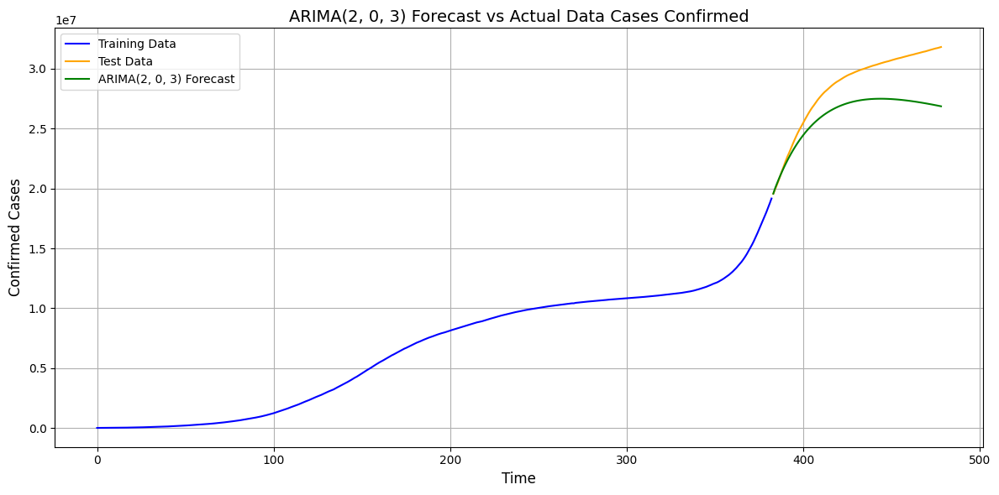
Confirmed Cases: ARIMA (2,0,3)
BITS, PILANI – K. K. BIRLA GOA CAMPUS
12

Slide 13
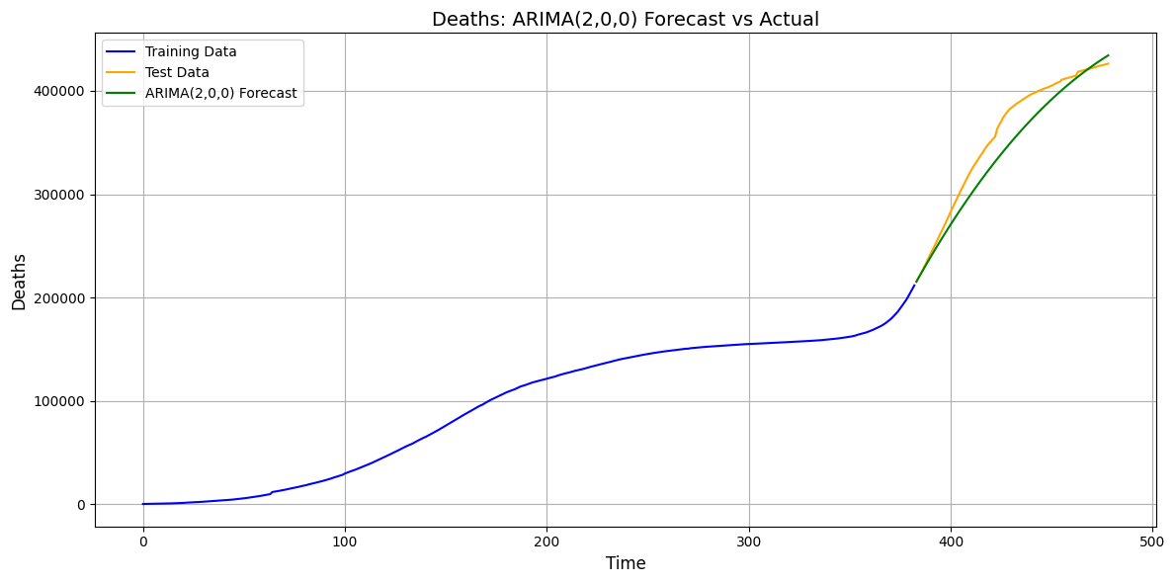
Deaths : ARIMA (2,0,0)
BITS, PILANI – K. K. BIRLA GOA CAMPUS
13

Slide 14
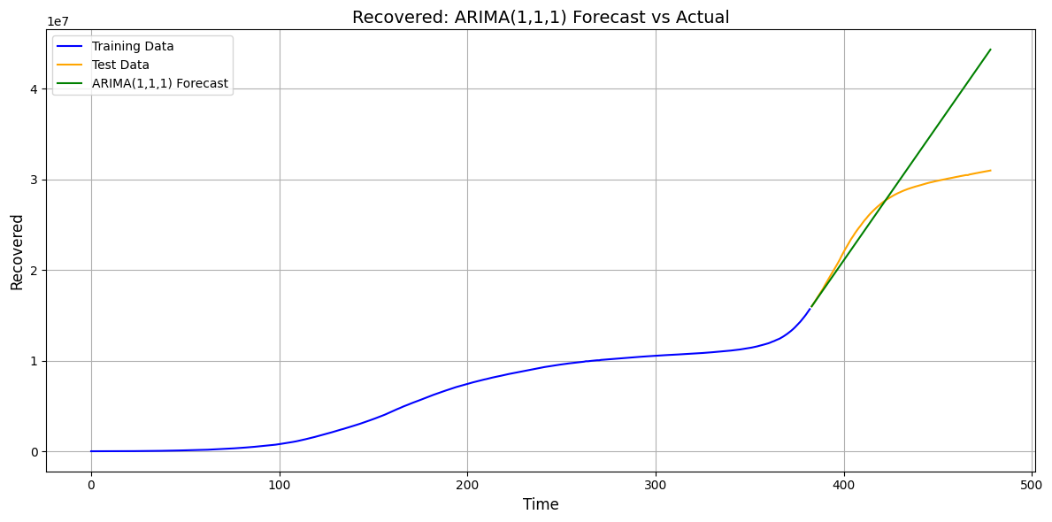
Recovered : ARIMA (1,1,1)
BITS, PILANI – K. K. BIRLA GOA CAMPUS
14

Slide 15
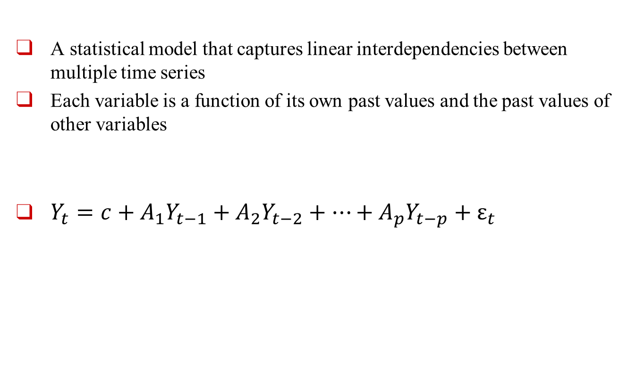
Vector Auto Regression
A statistical model that captures linear interdependencies between multiple time series
Each variable is a function of its own past values and the past values of other variables
$Y_{t}=c+A_{1}Y_{t−1}+A_{2}Y_{t−2}+⋯+A_{p}Y_{t−p}+ε_{t}$
BITS, PILANI – K. K. BIRLA GOA CAMPUS
15

Slide 16
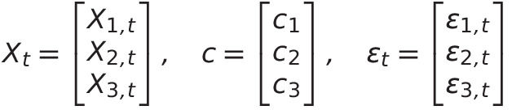
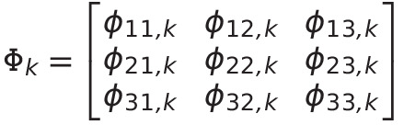

Vector Auto Regression
$$X_{t}=c+Φ_{1}X_{t−1}+Φ_{2}X_{t−2}+⋯+Φ_{p}X_{t−p}+ε_{t}$$
BITS, PILANI – K. K. BIRLA GOA CAMPUS
16

Slide 17
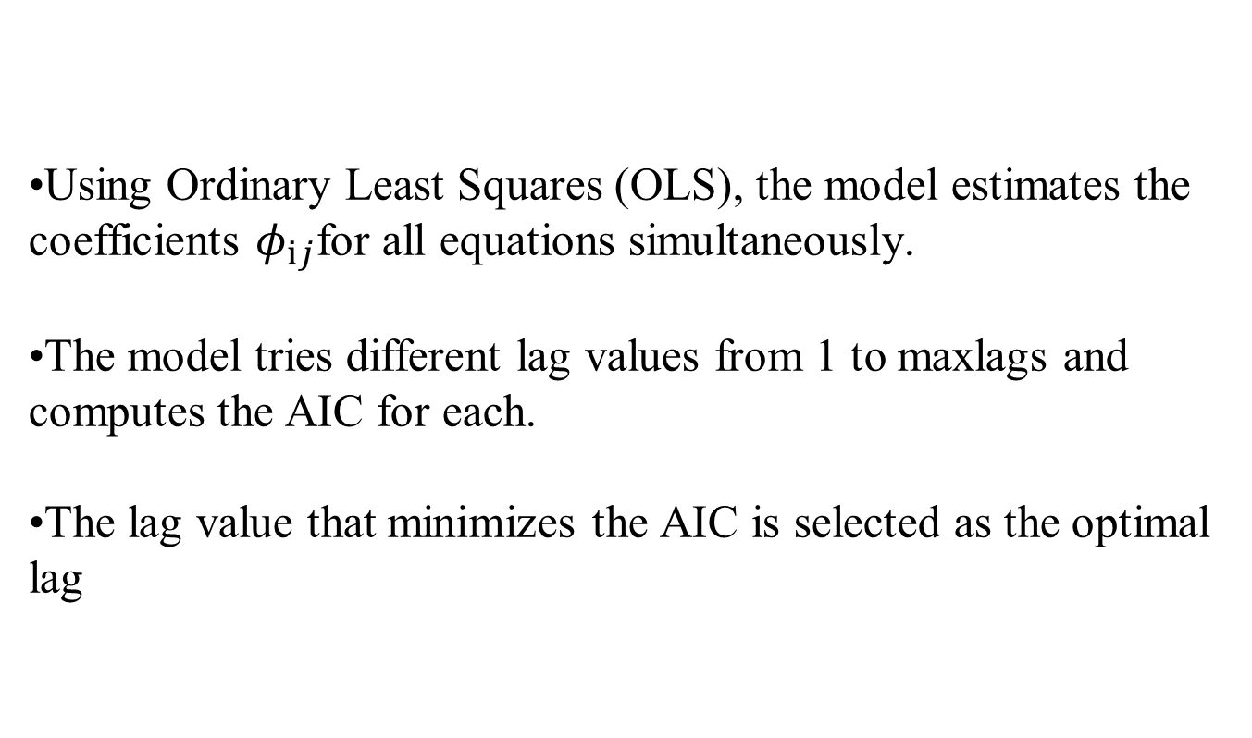
Parameter Estimation
Using Ordinary Least Squares (OLS), the model estimates the coefficients $φ_{ij}$for all equations simultaneously.
The model tries different lag values from 1 to maxlags and computes the AIC for each.
The lag value that minimizes the AIC is selected as the optimal lag
BITS, PILANI – K. K. BIRLA GOA CAMPUS
17

Slide 18
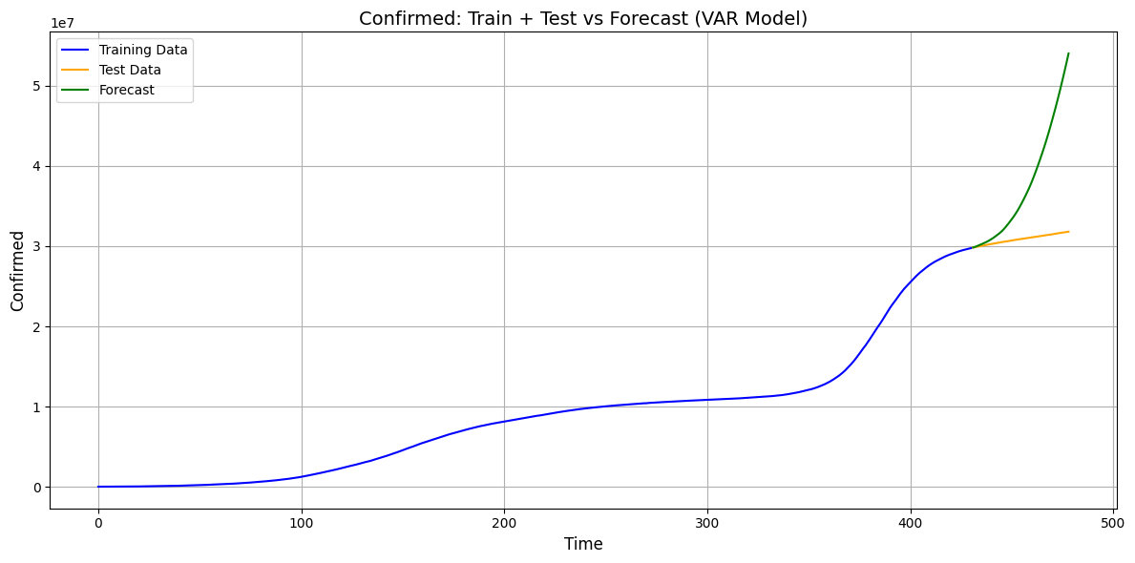
Confirmed Cases: VAR
BITS, PILANI – K. K. BIRLA GOA CAMPUS
18

Slide 19
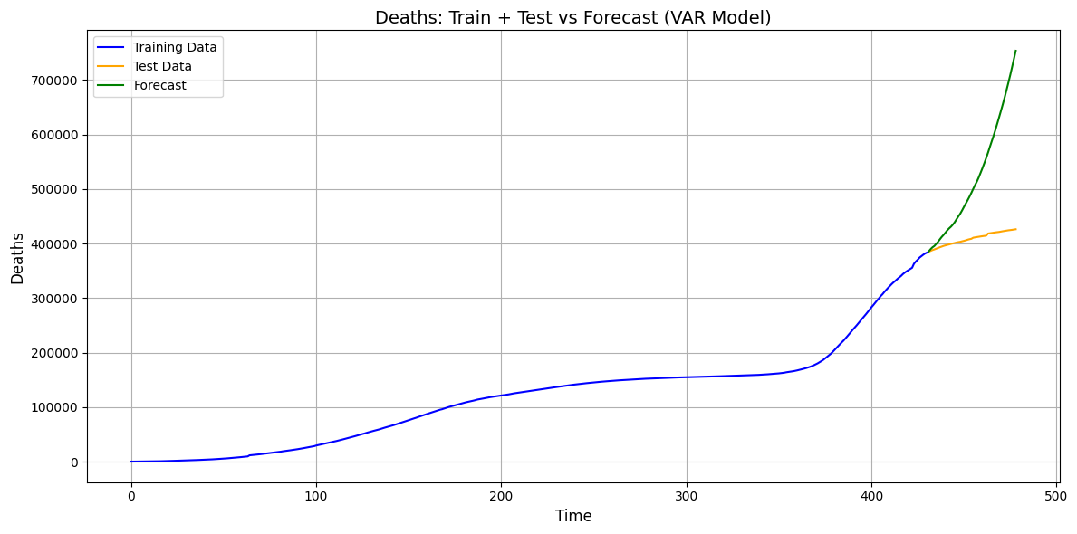
Deaths: VAR
BITS, PILANI – K. K. BIRLA GOA CAMPUS
19

Slide 20
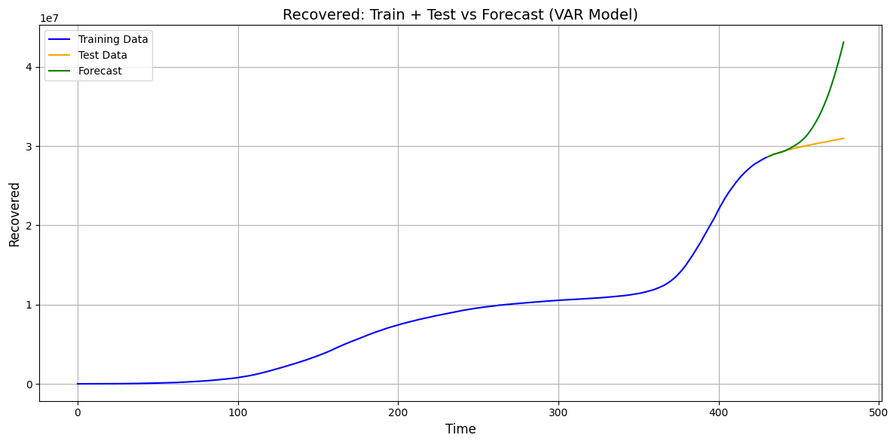
Recovered : VAR
BITS, PILANI – K. K. BIRLA GOA CAMPUS
20

Slide 21
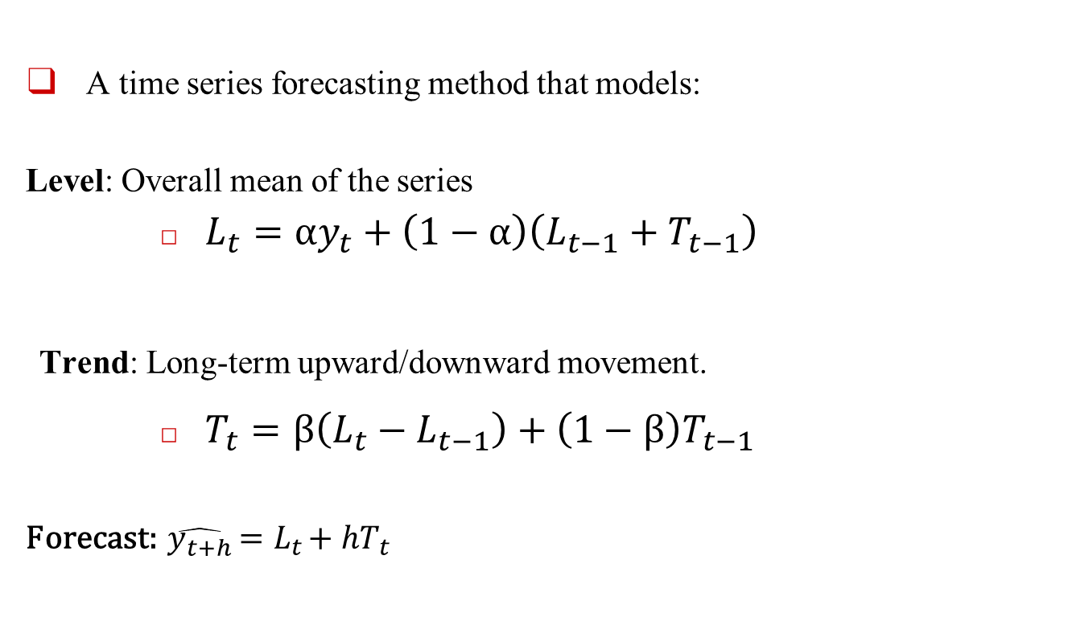
Holt-Winters Method
A time series forecasting method that models:
Level: Overall mean of the series
$L_{t}=αy_{t}+\left(1−α\right)\left(L_{t−1}+T_{t−1}\right)$
Trend: Long-term upward/downward movement.
$T_{t}=β\left(L_{t}−L_{t−1}\right)+\left(1−β\right)T_{t−1}$
Forecast: $\hat{y_{t+h}}=L_{t}+hT_{t}$
BITS, PILANI – K. K. BIRLA GOA CAMPUS
21

Slide 22
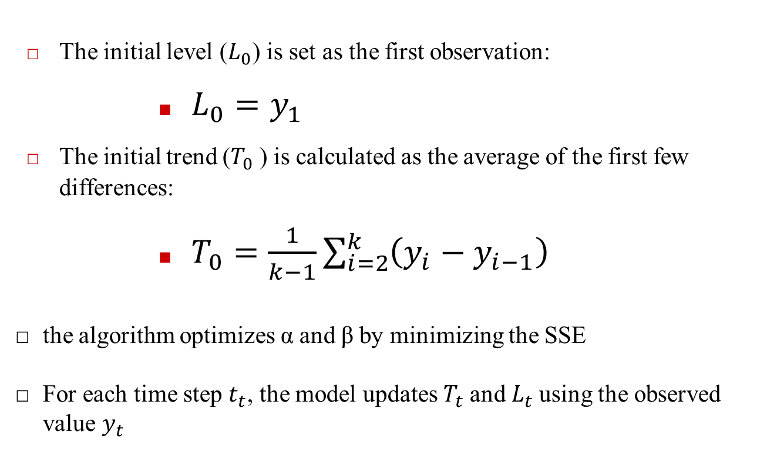
Parameter Estimation
The initial level ($L_{0}$) is set as the first observation:
$L_{0}=y_{1}$
The initial trend ($T_{0}$​) is calculated as the average of the first few differences:
$T_{0}=\frac{1}{k−1}\sum_{i=2}^{k}{\left(y_{i}−y_{i−1}\right)}$
the algorithm optimizes α and β by minimizing the SSE
For each time step $t_{t}$, the model updates $T_{t}$and $L_{t}$using the observed value $y_{t}$
BITS, PILANI – K. K. BIRLA GOA CAMPUS
22

Slide 23
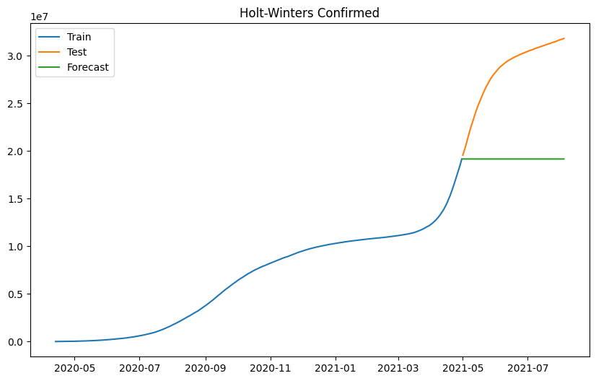
Confirmed Cases: Holt Winters
BITS, PILANI – K. K. BIRLA GOA CAMPUS
23

Slide 24
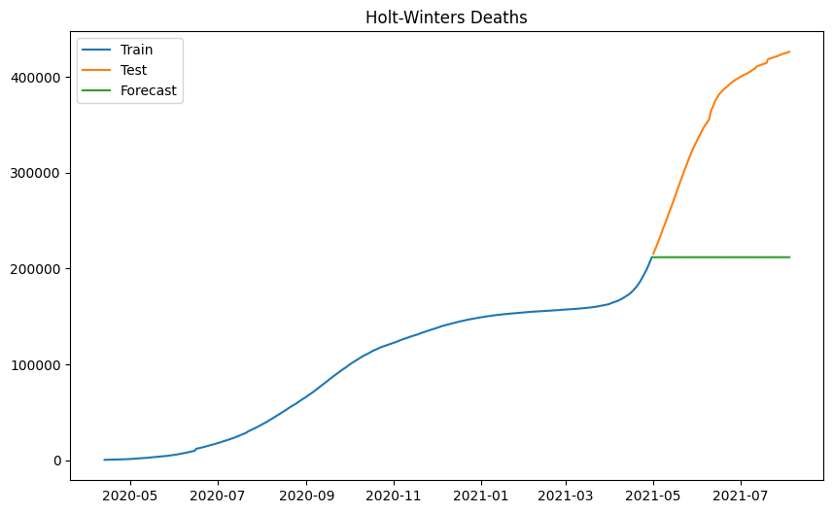
Deaths : Holt Winters
BITS, PILANI – K. K. BIRLA GOA CAMPUS
24

Slide 25
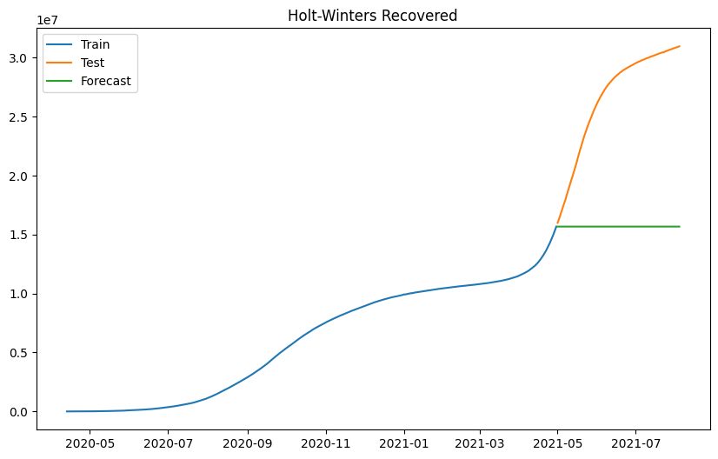
Recovered : Holt Winters
BITS, PILANI – K. K. BIRLA GOA CAMPUS
25

Slide 26
Comparative Analysis
Notes:
26

Slide 27
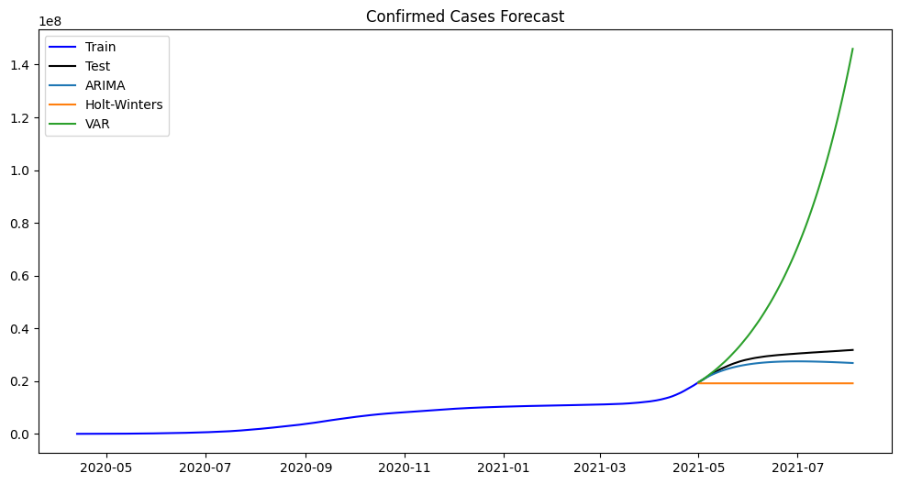
RMSE Scores for 80-20 split
ARIMA: 2,804,695
Holt-Winters: 9,892,410
VAR: 47,816,210
BITS, PILANI – K. K. BIRLA GOA CAMPUS
27

Slide 28
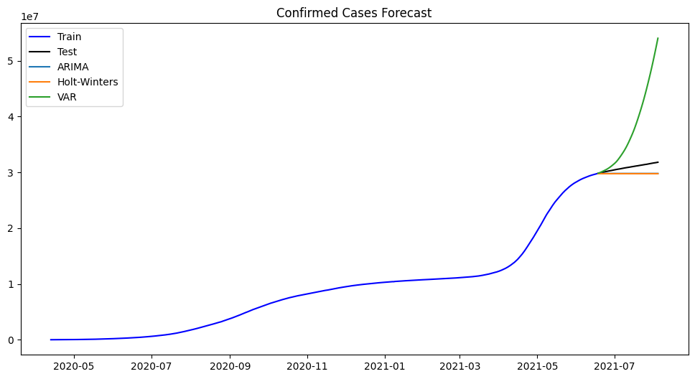
RMSE Scores for 90-10 split
ARIMA: 1,213,329
Holt-Winters: 1,242,686
VAR: 9,462,370
BITS, PILANI – K. K. BIRLA GOA CAMPUS
28

Slide 29
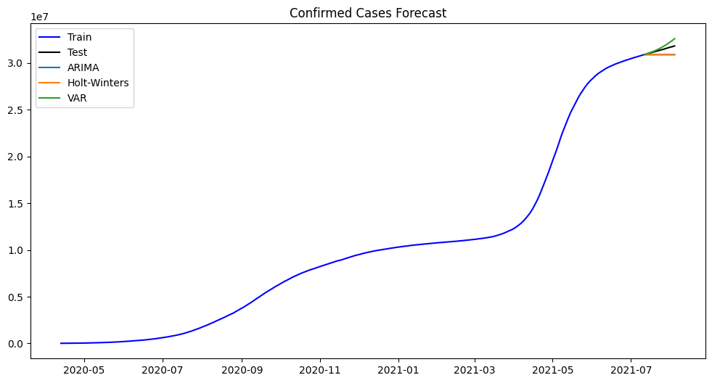
RMSE Scores for 95-5 split
VAR: 358,768.36
ARIMA: 542,999.42
Holt-Winters: 552,524.65
BITS, PILANI – K. K. BIRLA GOA CAMPUS
29

Slide 30
For long-term forecasts (0.2 test split), ARIMA is the most reliable model due to its ability to generalize over longer horizons.
For medium-term forecasts (0.1 test split), ARIMA and Holt-Winters are both strong choices, with ARIMA having a slight edge.
For short-term forecasts (0.05 test split), VAR is the best model, as its ability to model multivariate relationships makes it highly effective for short-range predictions.
BITS, PILANI – K. K. BIRLA GOA CAMPUS
30

Slide 31
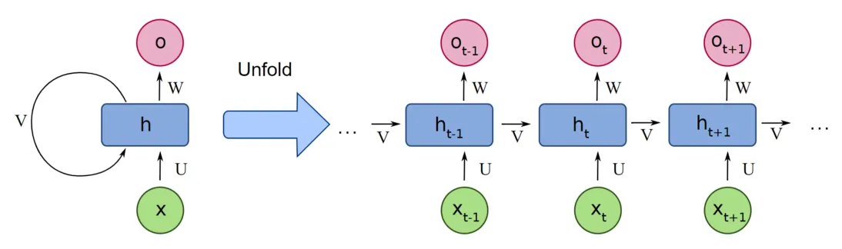
Recurrent Neural Network
Deep Learning Model
Retains information from previous steps
BITS, PILANI – K. K. BIRLA GOA CAMPUS
31

Slide 32
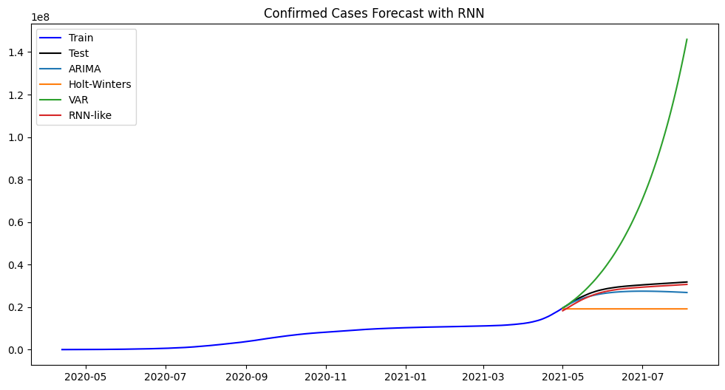
RNN Model Comparison (50 epochs)
RMSE Scores for 80-20 split
RNN: 1,193,589
ARIMA: 2,804,695
Holt-Winters: 9,892,410
VAR: 47,816,210

Slide 33
Increasing Dataset Complexity
Notes:
33

Slide 34
France Dataset
New Cases
New Deaths
ICU patients
Hospital patients
New Vaccinations
BITS, PILANI – K. K. BIRLA GOA CAMPUS
34

Slide 35
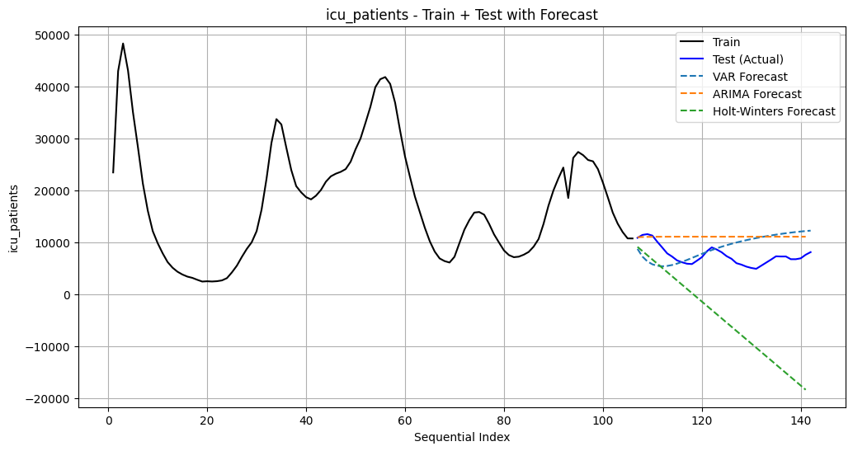
RMSE
VAR: 3,797.2714
ARIMA: 4,046.7979
Holt-Winters: 14,064.9299
BITS, PILANI – K. K. BIRLA GOA CAMPUS
35

Slide 36
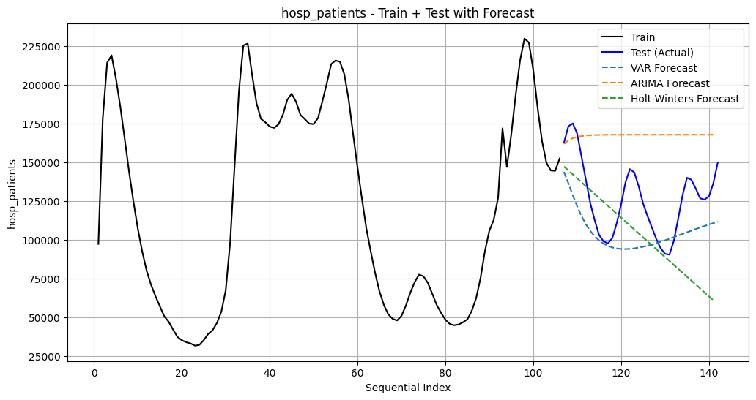
RMSE
VAR: 27,187.2009
Holt-Winters: 35,337.8513
ARIMA: 48,010.6162
BITS, PILANI – K. K. BIRLA GOA CAMPUS
36

Slide 37
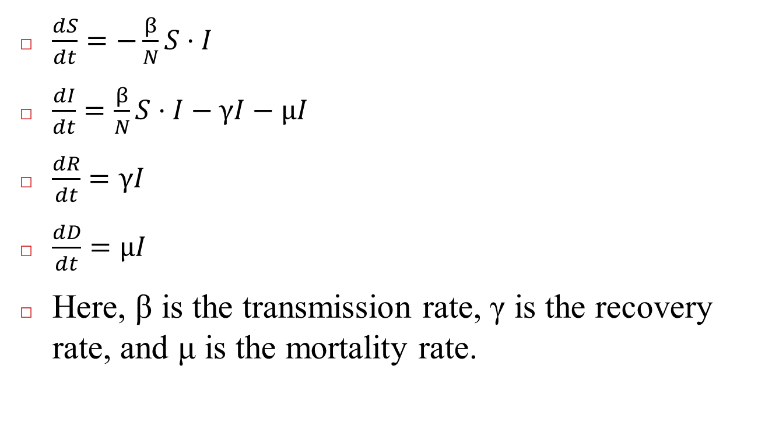
SIRD Model
$\frac{dS}{dt}=−\frac{β}{N}S⋅I$
$\frac{dI}{dt}=\frac{β}{N}S⋅I−γI−μI$
$\frac{dR}{dt}=γI$
$\frac{dD}{dt}=μI$
Here, β is the transmission rate, γ is the recovery rate, and μ is the mortality rate.
BITS, PILANI – K. K. BIRLA GOA CAMPUS
37

Slide 38
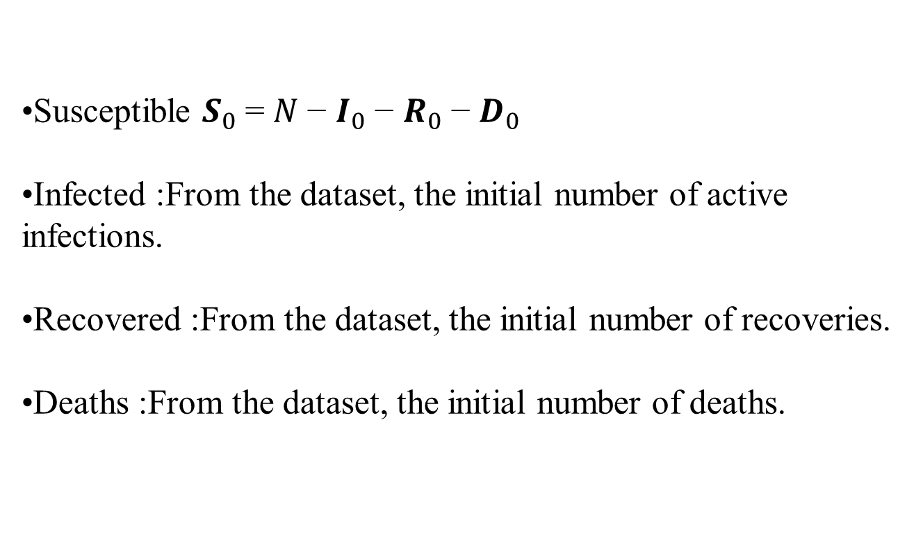
Initial Conditions:
Susceptible $S_{0}$= $N$− $I_{0}$− $R_{0}$− $D_{0}$
Infected :From the dataset, the initial number of active infections.
Recovered :From the dataset, the initial number of recoveries.
Deaths :From the dataset, the initial number of deaths.
BITS, PILANI – K. K. BIRLA GOA CAMPUS
38

Slide 39
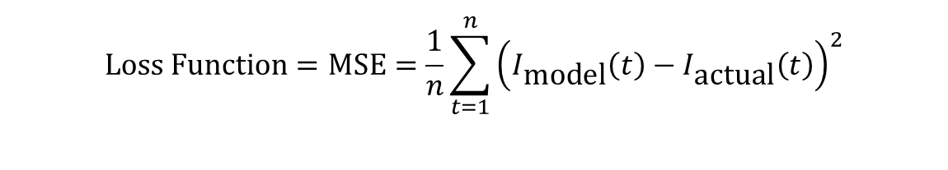
Solving for Model
The odeint method from scipy.integrate solves the SIRD differential equations using:
Iterative adjustment of parameters to minimize the loss.
$$\text{Loss} \text{Function}=\text{MSE}=\frac{1}{n}\sum_{t=1}^{n}{{\left(I_{\text{model}}\left(t\right)−I_{\text{actual}}\left(t\right)\right)}^{2}}$$
Notes:
39

Slide 40
Results
Optimal beta: 0.3587 (0.240961)
Optimal gamma(recovery rate): 0.03408(0.0263881)
Optimal mu (mortality rate): 0.0016
BITS, PILANI – K. K. BIRLA GOA CAMPUS
40

Slide 41
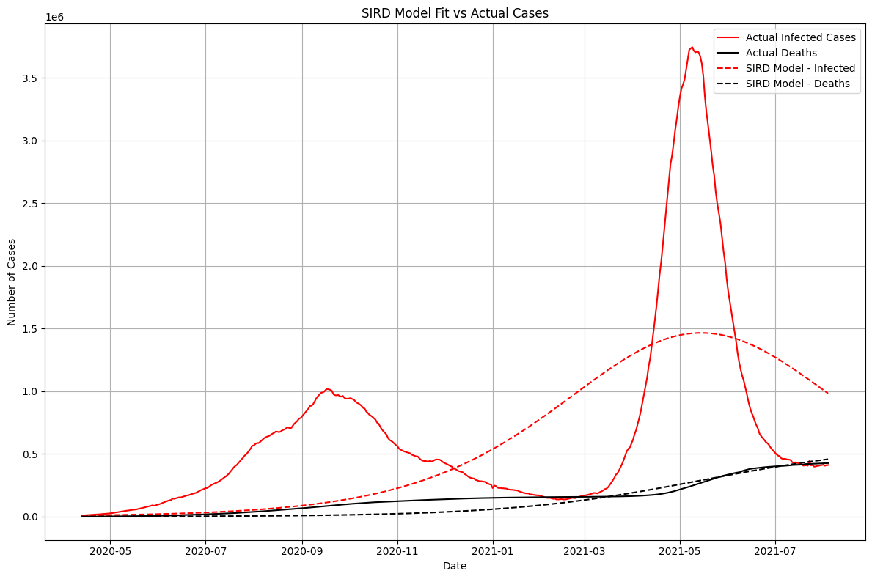

Slide 42
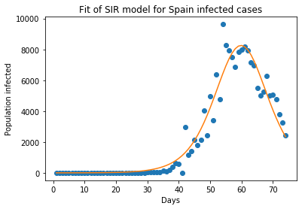

Slide 43
Challenges
Data Issues
Multivariate Dependencies
Stationarity Requirements
BITS, PILANI – K. K. BIRLA GOA CAMPUS
43

Slide 44
THANK YOU
Notes:
44

