Slide 1
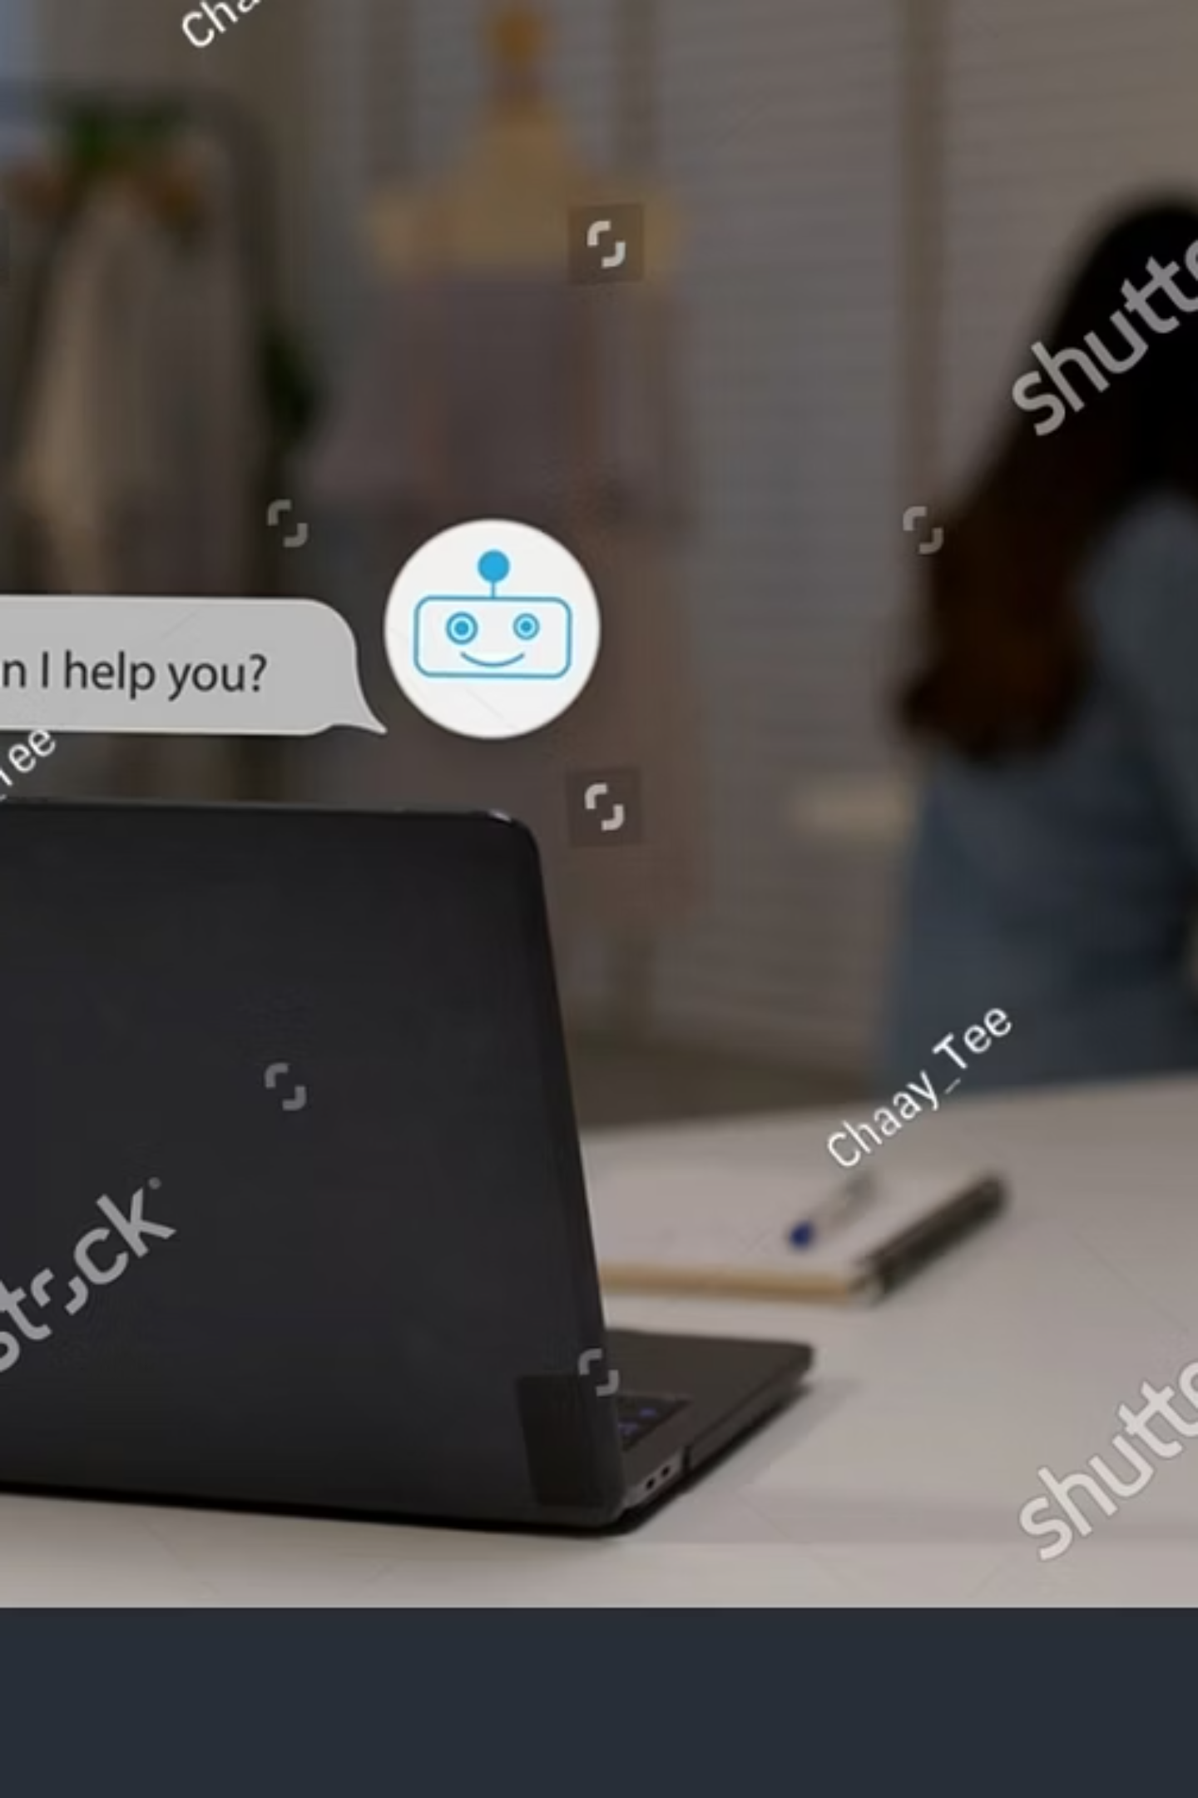
E-commerce FAQ Chatbot with Database Integration
Team Members:
Tanmay Pathak
Shreyas Sj
Utkarsh Aryan
Vansh Gupta
Hackathon Round: Round 1

Slide 2

The Aim
To build an AI chatbot that automates customer support by retrieving real-time order data and product info from a database.

Slide 3
Key Project Objectives
FAQ Logic
1
Define intent matching and response routing for common customer queries
Database Connectivity
2
Establish live connection to a real-time database for dynamic data retrieval
Order History Retrieval
3
Placeholder: Enable users to fetch their past orders through the chat interface
Transit / Status Tracking
4
Provide real-time shipping and order status updates to customers
Real-World Simulation
5
Mimic the behavior of production e-commerce platforms for authentic testing

Slide 4

Core Features
Chat Interface
Database Integration
API Endpoints
Conversational UI for customer queries and bot responses
Real-time operations via
RESTful endpoints for chat processing and order data access]
database

Slide 5

Basic Solution Architecture
Frontend
JS chat UI sends/receives messages in real time
Backend API
Flask handles requests, auth, and business logic
Database
stores chat messages and metadata
[Placeholder: High-level view of how the UI, API, and DB interact to solve the project aim]

Slide 6
Technical Stack
Backend
Frontend
Python — Flask
SQL Lite
HTML
CSS
JS

Slide 7
Preview
Data Schema
API Endpoints
User document structure — UID, name, email, order references
/api/chat — Placeholder: Handles incoming user messages and returns bot responses
[ /api/orders ] — Retrieves order history and status for a given user
/api/products ] — Fetches product information for FAQ responses
Order document structure — order ID, items, status, timestamps

Slide 8



The Demo Journey
Support Query
Order Lookup
Status Tracking
User submits a question about their order or a product
Bot queries Firebase and retrieves matching order records
Bot returns real-time transit and delivery status to the user

Slide 9
Success Metrics
1
2
Deployment Ready
Database Operations
Fully function safe for deployment
Read, Update, Delete operations functioning on order data
3
4
FAQ Responses
Real-Time Data from FAQ
Working FAQ responses returned accurately for common queries
Order and product data fetched live from the database during demo

Slide 10


Conclusion & Q&A
A Real-Time FAQ database based-chatbot
We welcome your feedback and questions. Thank you for your time!

