Slide 1
ASCEND SEASON 4 ?? CASE STUDY RESPONSE
7,452
Where Cipla can win
in the India Cardiac market
packs analysed
108
opportunity spaces scored
The full argument: how the agent works, what it found, and what Cipla should do about it.
14
cited external signals
0
numbers written by the model
AI-enabled prioritisation with integrated trend analytics ?? MAT February 2026

Slide 2
HOW THE AGENT WORKS
The model never calculates a number
Reasoning and arithmetic are separated, and a verifier stands between them.
01
Ingest
02
Construct
03
Score
7,452 packs validated against a fixed schema, normalised into a warehouse with a SHA-256 of the source.
108 opportunity spaces across six levels, including molecule franchises that span the reporting hierarchy.
Four pillars from percentile-ranked metrics, with a right-to-win gate. Deterministic and reproducible.
04
Retrieve
05
Narrate
06
Verify
14 cited external signals linked to spaces, bounded and centred so universal evidence moves nothing.
The model plans, calls eleven tools and writes prose over a finished evidence pack.
Every number in the draft is matched against the evidence. Unmatched figures are rejected and rewritten.
Guardrails: scope control before any tool runs, numeric grounding and citation validation on the draft, injection neutralisation on retrieved text.

Slide 3
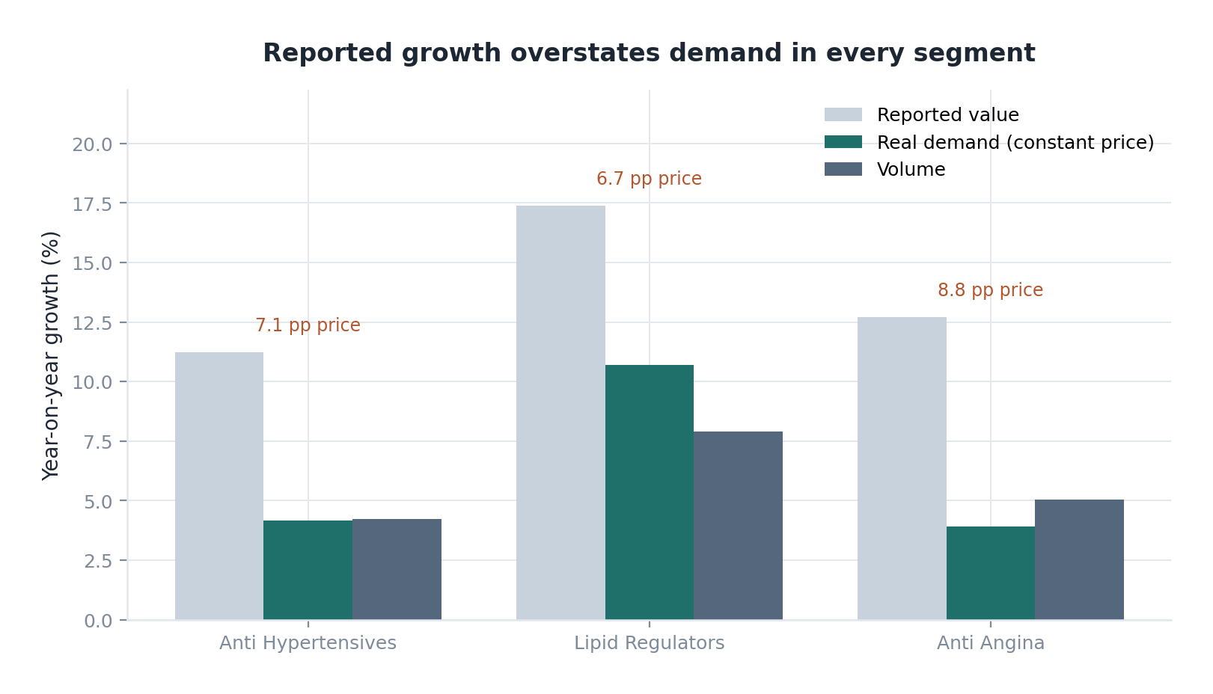
READING THE DATA
Seven of thirteen points of growth are price
The organisers' glossary is explicit: constant-price MAT measures real demand, and quantity confirms it.
Price gains do not compound the way prescription volume does, and a material part of the essential cardiovascular basket sits under administered ceiling prices. A space growing on value but flat on volume is being repriced, not growing.
So reported value growth carries no weight at all in the future-potential pillar. It appears in market attractiveness, where it belongs as a measure of today.
WHAT THIS CHANGES
AHT diuretic combinations reports +7.2% growth. Real demand is -1.0% and volume -0.8%. Ranking on the headline number alone would have made it look defensible.

Slide 4
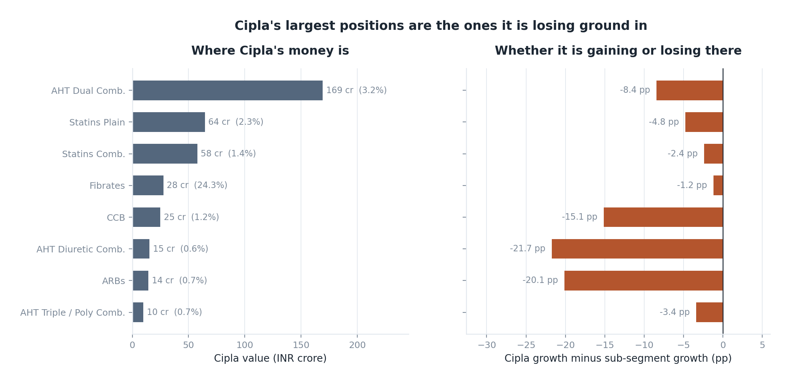
THE STARTING POSITION
Cipla's largest positions are the ones it is losing
Five umbrella franchises carry the cardiac business. One of them grows faster than the market.
FRANCHISES
Brand
Cr
Growth
Amlopres
148
+3.3%
Atorlip
60
+6.2%
Rosulip
54
+18.1%
Cresar
51
-5.4%
Fenolip
28
+14.1%
At 1.68% therapy share and rank 19 of 279, Cipla cannot out-invest the leaders across every sub-segment. Adjacency is the cheapest advantage it has.

Slide 5
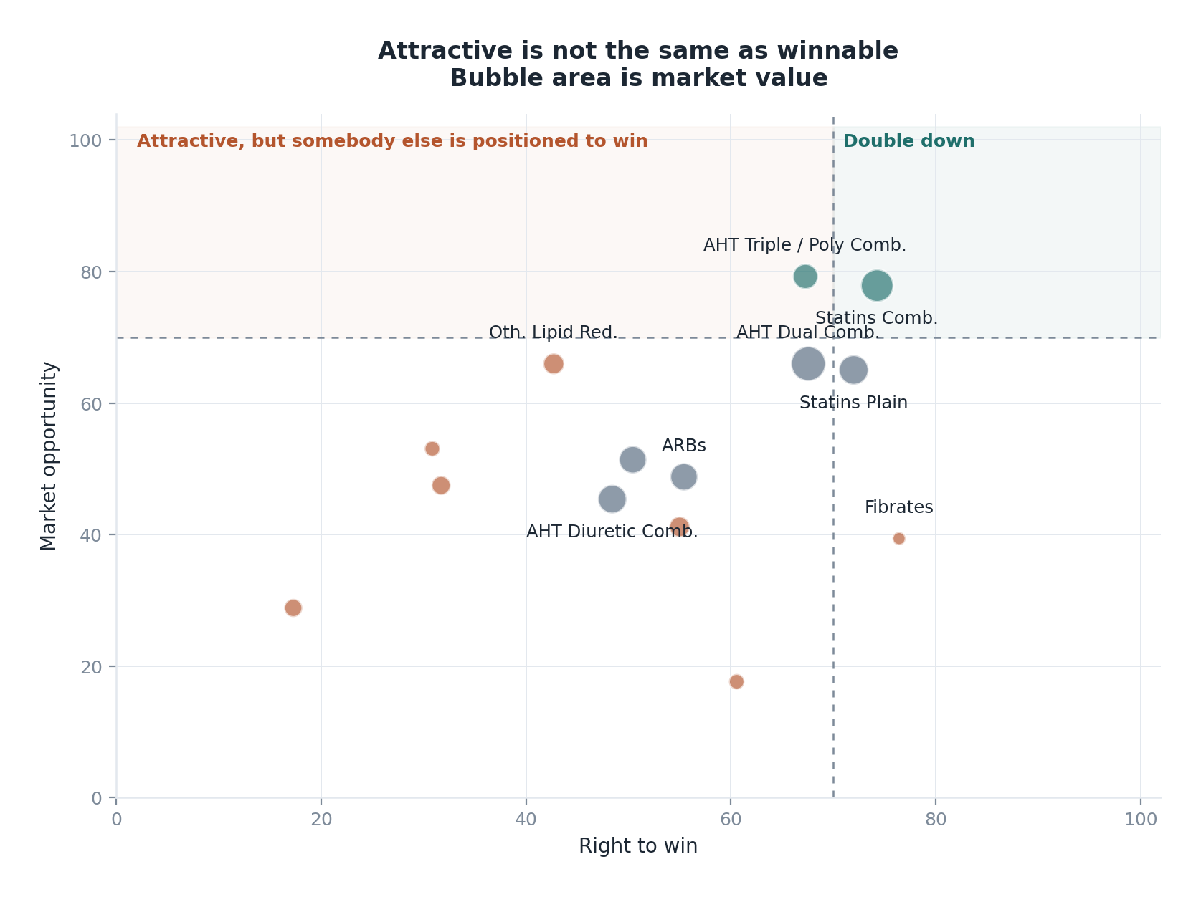
WHAT THE AGENT FOUND
Cipla grows at 4.6% in a market growing 13.3%.
Two configurations inside it are winnable.
Ranked on market opportunity, then gated by right to win. The two scores are kept apart so the trade-off stays visible.
23,244
6.3%
1.68%
INR crore
Cardiac market
real demand growth
of 13.3% reported
Cipla share
rank 19 of 279
HOW IT WORKS
Six levels of opportunity space, from segment down to individual molecule
combinations and cross-hierarchy molecule franchises.
Four pillars: market attractiveness, future potential, competitive headroom,
and a right-to-win gate built from Cipla's actual estate.
Every figure is computed deterministically. The language model narrates and
is rejected if it states a number the evidence does not contain.
Source: Cardiac prescription audit, MAT Feb 2026. Bubble area is market value.

Slide 6
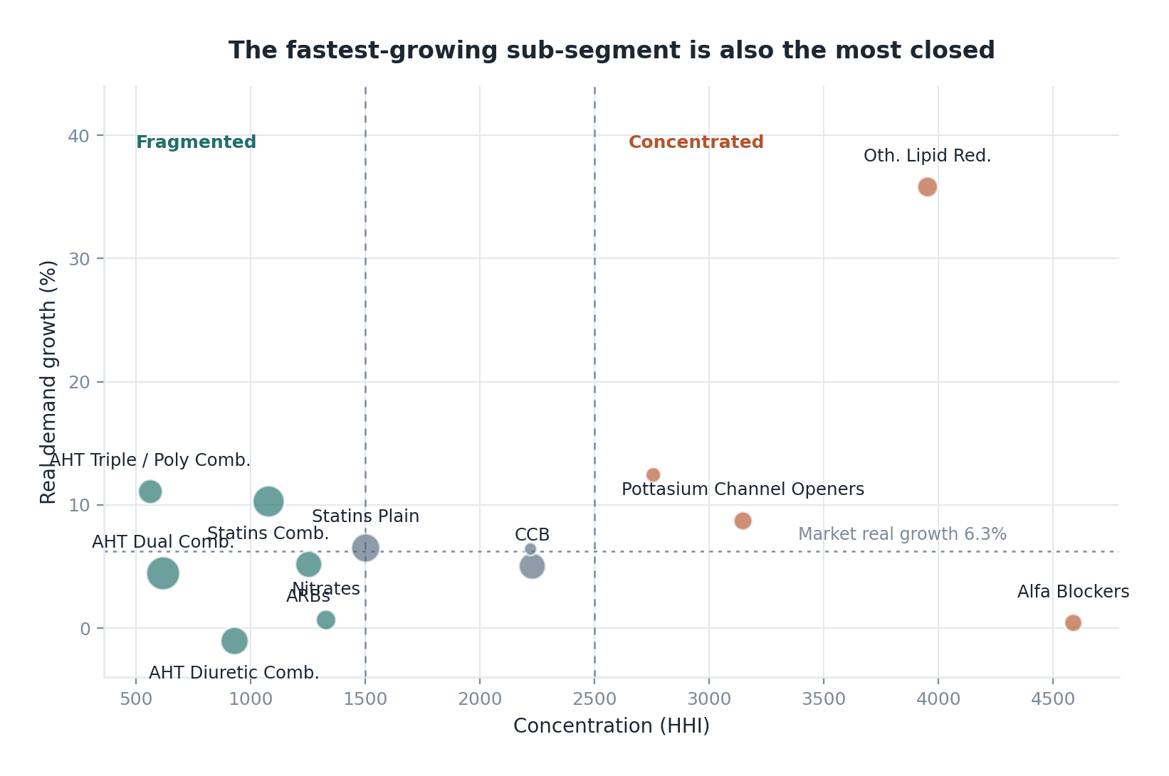
BEYOND THE REPORTING HIERARCHY
Some franchises are visible only across the hierarchy
Summing every pack that contains a molecule, whether plain or combined, exposes clusters no single reporting level shows.
THE CILNIDIPINE CASE
The molecule appears as a plain calcium channel blocker, in three dual combinations and in two triples. Those sit in different sub-segments, so no row of the standard hierarchy shows the size of the franchise.
Layer
Cr
Growth
HHI
Whole franchise
2,519
+21%
1,755
Dual with telmisartan
759
+28%
1,747
The question is not whether to enter cilnidipine. It is which layer of the franchise still has share being allocated rather than defended.

Slide 7
THE RECOMMENDATION
Prioritise the ezetimibe extension of Rosulip,
and the cilnidipine family entered through Cresar
Both are brand extensions rather than standing starts, which is what makes them reachable inside two years.
PRIORITY 1
PRIORITY 2
Statin combinations,
via ezetimibe
Cilnidipine combinations,
via Cresar
Sub-segment
4,154 cr, +17.4%, real +10.3%
Franchise
2,519 cr across plain and combination packs, +21.5%
Structure
HHI 1,080, 143 players, leader 25%
Cipla today
0.19% share, 4.8 cr, growing 40%
Cipla today
57.9 cr, 1.39%, +15.1%
Where to enter
Not the plain molecule. The dual sits at HHI 1,747; the triples are more open
The target
Rosuvastatin + ezetimibe: 183 cr, +88%
The target
Cilnidipine + telmisartan: 759 cr, +28%, real +20%
Right to win
Rosulip is the fastest-growing Cipla franchise; Rosulip EZ is launched
Right to win
Cresar carries telmisartan; Cresar LN already sells in this space
TRADE-OFFS RESOLVED
Size against growth. AHT dual combinations is larger at 5,280 cr, but only 4.5 of its 12.6 points of growth is real. Chose real growth.
Growth against competition. Other lipid reducers grows 46% and is 60% held by one company. Chose accessibility.
Attractiveness against right to win. Cilnidipine is larger and scores higher; ezetimibe is winnable sooner. Resolved by sequencing, not by choosing.

Slide 8
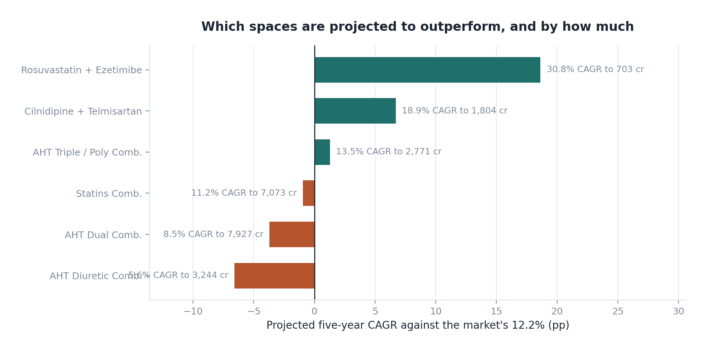
THE THREE-TO-FIVE YEAR VIEW
Which spaces should outperform, and by how much
Growth mean-reverts towards the therapy-area rate. Nothing is projected to sustain its current rate for five years.
METHOD
The base rate blends constant-price growth, volume growth, two-year CAGR and three-month momentum, weighted towards demand.
Excess growth over the market decays 28 per cent a year, the rate is capped, and bull and bear cases shift it by four points.
These are structured extrapolations from two years of history, not plans, and every projection returns its assumptions alongside the number.
Market baseline: 12.2% two-year CAGR. Anything above the line gains share of the therapy area.

Slide 9
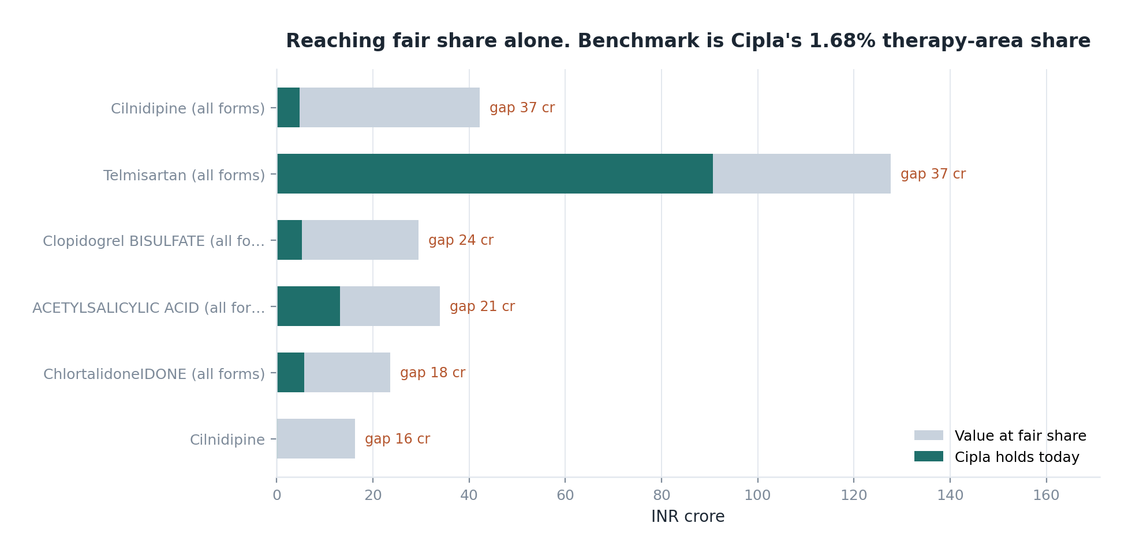
WHERE ELSE, AND WHERE TO STOP
Five franchises are underpenetrated and reachable.
Four positions should be harvested, not defended.
Penetration index is Cipla's share of a space against its 1.68% share of the therapy area.
STOP FUNDING
AHT Diuretic Comb.
real -1.0%
Reported growth is positive, real demand and volume are both negative. Cipla is declining inside it.
ACEi
real -5.5%
Real growth is negative. Structural decline, not a cycle.
Oth. Lipid Red.
real +35.8%
Every one has a Cipla molecule or brand behind it, which is what separates a target from a wish. Reaching fair share across the five is worth roughly 137 crore.
Fastest growth in the market and the most closed. In-license or leave it.
The portfolio is optimised for a market that has already moved. Concentrating on two configurations beats defending nine.

Slide 10
EXECUTION
What happens, and in what order
Sequenced so the shorter-cycle move funds attention for the longer one.
MONTHS 0-12
MONTHS 12-24
CONTINUOUS
Scale the ezetimibe extension
Build the cilnidipine combination line
Release the funding
Rosulip EZ is launched. The constraint is share of voice, not development.
File and launch a cilnidipine plus telmisartan pack under Cresar.
Defend Amlopres and Amlopres-AT efficiently, without expansion.
The space grew 88 per cent last year and twelve companies entered it.
Follow with a chlortalidone triple, where no player holds above a quarter.
Harvest Cresar-H and Ramipres rather than defending them with new spend.
Share allocated in the next eighteen months will be hard to take back.
Formulation risk is low; every component is already manufactured.
Redeploy field-force time from declining diuretic combinations.
Two things would have to be checked before committing: freedom to operate on each combination, and whether the field-force economics support a share build against sub-segments carrying more than a hundred competing companies.

Slide 11
THE IMPLICATION
Cipla cannot win this market by covering it.
It can win two configurations inside it,
both next to brands it already owns.
And it should stop funding the legacy positions that make the portfolio look broader than its right to win actually is.

Slide 12
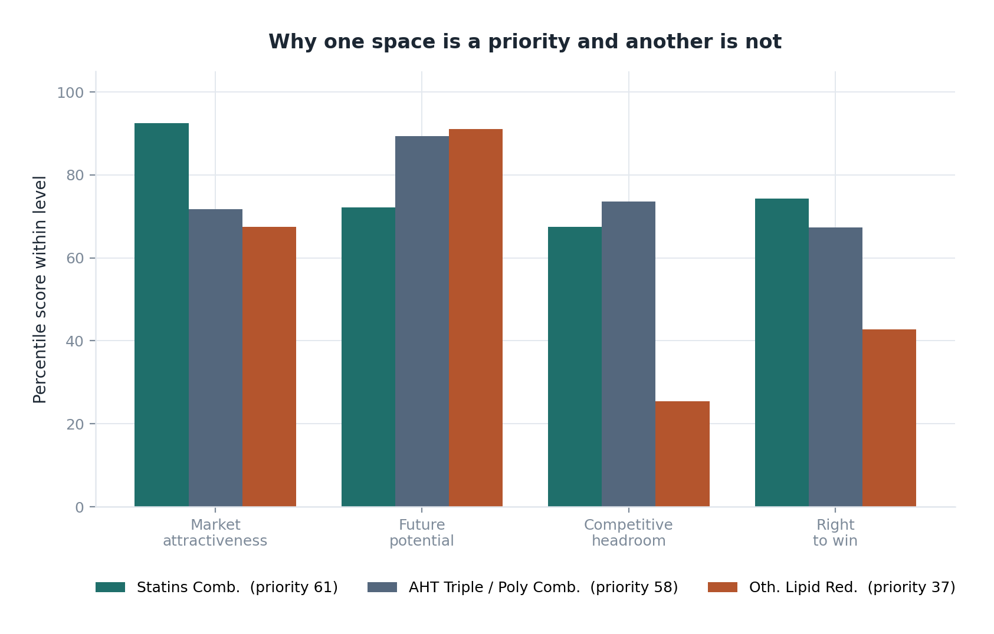
APPENDIX A1
The prioritisation framework
Every weight lives in a configuration file, so a challenge is answered by editing one number and re-running.
Pillar
Weight
Market attractiveness
34%
Size, value added, two-year CAGR
Future potential
40%
Constant-price and volume growth, momentum, signals
Competitive headroom
26%
HHI, leader share, crowding, price erosion
Right to win
gate
Share, momentum, molecule and brand adjacency
THE GATE
Cipla Priority Score = Market Opportunity Index x gate(right to win), where the gate runs from 0.35 to 1.00 on a curve that punishes weak right to win harder than linearly. A multiplier cannot let an inaccessible space outrank a winnable one.

Slide 13
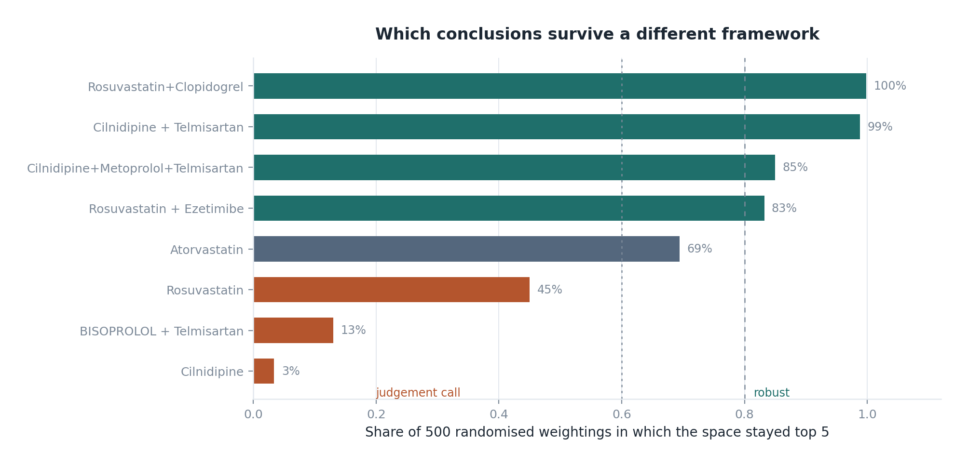
APPENDIX A2
How much survives a different framework
Every weight block redrawn from a Dirichlet distribution and the market re-scored 500 times.
Sub-segment
In top 3
Mean rank
Statins Comb.
100%
1.11
AHT Triple / Poly Comb.
99%
1.91
Statins Plain
68%
3.31
AHT Dual Comb.
32%
3.70
Oth. Lipid Red.
0%
5.23
Above 80 per cent the recommendation survives almost any reasonable weighting. Below 60 per cent it is a judgement call, and is presented as one. The two priorities on slide two sit at the top of this table; the fourth and fifth entries of the wider shortlist do not, and are named as candidates rather than conclusions.

Slide 14
APPENDIX A3
Sources for external data
14 signals, each with a publisher and an access date. Four are analysis of the supplied dataset and are labelled as such.
Signal
Publisher
S-01
Roughly one in four Indian adults is hypertensive, and
National Family Health Survey-5 (NFHS-
S-02
The "75/25" initiative is putting tens of millions of
Ministry of Health and Family Welfare,
S-03
Indian lipid guidelines put ezetimibe combinations in
Lipid Association of India, Journal of
S-04
Air pollution is a first-order cardiovascular risk fac
The Lancet Planetary Health; Harvard T
S-05
Inclisiran has entered India at premium pricing throug
Novartis; reported by ChemXpert and In
S-06
Saroglitazar is an originator-controlled Indian NCE, n
Zydus Lifesciences; New Drug Approvals
S-07
Price control caps the value upside on essential cardi
Ministry of Health and Family Welfare;
S-08
Indian hypertension guidance favours early combination
Indian Society of Hypertension (InSH);
S-09
Cardiovascular disease carries a disproportionate shar
Peer-reviewed literature on India's NC
S-10
Bempedoic acid is the next non-statin LDL step and is
Korean Society of Lipid and Atheroscle
Signal influence is bounded. Confidence discounts magnitude, agreement within a category is damped, and the resulting tilt is centred within each level, so a signal that applies to everything moves nothing. The multiplier is clipped to 0.80 to 1.25 on one metric inside one pillar.

Slide 15
APPENDIX A4
What this analysis cannot tell you
Two years of history
Two annual observations support a direction, not a cycle. Five-year projections are structured extrapolation with an explicit mean-reversion assumption.
No patent or regulatory status
The framework can see that a space is originator-dominated. It cannot say whether entry is legally possible. Any entry decision needs a freedom-to-operate review.
No cost or margin data
Every conclusion is about revenue opportunity. Whether a space is profitable to enter is not answerable here.
Retail audit only
Institutional and government-tender channels are absent, which matters given the scale of public screening programmes.
Curated external signals
Fourteen documents chosen for relevance, not a systematic review. Their influence is bounded by design for exactly that reason.
Stated here rather than buried, because the recommendations should be read against it.

