Slide 1
LEVISOL INDIA · SUPPLY CHAIN TRANSFORMATION TASKFORCE
Balancing Act
Optimising Production, Distribution & Inventory
Project 2 · January-2026 planning cycle · Final submission
₹11.44 cr
0 kL
−56%
gap 0.0
total cash cost
demand unmet
safety stock released
proven optimal
One number to remember: every litre of January demand served — at the provably lowest cost.
Notes:
Good morning. We are the supply chain transformation taskforce for Levisol. Over the next twenty minutes we will show you three things: redesigned inventory norms for all 957 SKU-CFA combinations, a provably cost-optimal production and distribution plan for January 2026, and the working tool your planners can run every month without us. The four numbers on this slide are the story: eleven point four four crore total cash cost, zero unmet demand, fifty-six percent of CFA safety stock released versus the legacy conservative reading, and a mathematically proven optimum — not a heuristic. Everything you will see is traceable to the case data workbook and was verified by independent recomputation.

Slide 2
AGENDA
Three deliverables, one integrated system
1
2
3
INVENTORY NORMS
PRODUCTION & DISTRIBUTION PLAN
THE PLANNING TOOL
Safety stock · reorder points · days of cover for 957 SKU × CFA rows and both hubs. Bias-corrected, multi-echelon, tier-differentiated.
7,725 kL in 309 exact batches, routed plant → hub → CFA at the provably lowest cost: ₹11.44 crore, zero lost sales.
One workbook in, one decision pack out — in minutes. Editable inputs, graceful infeasibility, planner-friendly.
Plus the proof: four independent audits, a fresh-code recomputation of every norm (max deviation 10⁻¹⁴ kL), an optimality cross-check, and three assessment-day stress scenarios run end-to-end.
Levisol India · Production, Distribution & Inventory Optimisation
01
Notes:
The assignment has three components and they interlock: norms feed the plan as requirements; the plan and the norms are both produced by the same tool your planners will keep. We will close with verification and the assessment-day robustness tests, because an answer this important should not be taken on trust. Note the agenda mirrors the case's evaluation criteria: analytical rigor, solution quality, tool quality, and communication.

Slide 3
CONTEXT
A base-oil shock meets a 3-tier network at full stretch
The dual mandate. “Protect service on critical SKUs while rapidly releasing cash and reducing distribution cost” — the CSCO's war-room brief.
3
2
plants · ₹9k–12.5k/kL
mother hubs
Demand exceeds cheap capacity. January forecast is 8,109.7 kL; the cheapest lines at KOL and BOM cannot cover it alone — every routing choice has a cost.
10
100
CFA warehouses
SKUs · 5 lines
Failure is expensive. Unmet demand carries penalties of ₹130k–330k per kL; 18 SKUs carry contractual commitments that must be protected first.
957
8,110
SKU × CFA rows
kL Jan demand
Every decision below was made under this trade-off — and each one is quantified.
Levisol India · Production, Distribution & Inventory Optimisation
02
Notes:
The situation: a global base-oil shock has raised input volatility and working capital pressure. The old norms were built for calmer times. Leadership wants service protected on critical SKUs while cash is released — normally a contradiction. The network: three plants with very different economics — Kolkata produces at nine thousand rupees per kilolitre, Mumbai at twelve, Ahmedabad at twelve and a half — two mother hubs, ten CFAs, one hundred SKUs across five production lines. Any plant can supply any hub, so the routing question is real. And the stakes: a dealer who runs dry switches brands — penalties run one-point-three to three-point-three lakh rupees per kilolitre.

Slide 4
DATA
Eleven exhibits, one source of truth — read in full, validated row by row
Exhibit | Content | Role
A | plant line capacities · production ₹/kL | hard constraints
B · C | freight rates (plant→hub, hub→CFA) | cost drivers
D | penalties ₹/kL · 18 contractual SKUs | shortage priority
E | source + lead times & variability | norm inputs
F | tier fill-rate targets (98/97/92/92%) | service levels
G · H | 6-month sales & forecast history | σ estimation · tiers
I · J | opening inventory · January forecast | net requirements
DISCREPANCY RESOLVED
PDF Exhibit A reads as “KOL @ ₹200/kL” — a layout artefact. The machine-readable workbook takes precedence (case rule): BOM ₹12,000 · AHM ₹12,500 · KOL ₹9,000 per kL.
DATA QUALITY LEDGER
957 keys align across all sheets · 16 zero-history rows flagged · 2 negative cells (returns) kept · AHM 50LT usable capacity = 200 kL (batch rule)
Full traceability table in the report, §2.
Levisol India · Production, Distribution & Inventory Optimisation
03
Notes:
Before any modelling we validated every sheet. All five demand-side sheets align perfectly on the same 957 SKU-CFA keys — no duplicates, no orphans. Three things worth flagging. First, the case PDF's Exhibit A is garbled by its layout — read naively it says Kolkata produces at two hundred rupees per kilolitre. The case itself says the data file takes precedence, and the clean table gives the true costs. Second, sixteen rows have zero sales for six straight months — we suppress their norms and flag them rather than inventing numbers. Third, Ahmedabad's 50-litre line capacity of 220 kL is not a multiple of the 25 kL batch — only 200 is usable. Small things, but they are the difference between a model that runs and one that is right.

Slide 5
COMPONENT 1 · METHODOLOGY
Three fixes separate our norms from a textbook default
FIX 1 — σ
FIX 2 — LT
FIX 3 — z
Buffer randomness, flag bias
Each step buffered exactly once
Tiered fill-rate translation
σ = bias-removed std-dev of forecast errors. Raw RMSE would give a 0.008 kL/month SKU a 5.4 kL buffer (56 years of cover). 211 biased rows flagged for demand-planning review instead of being warehoused.
Hubs hold their own 98% buffers → hub = decoupling point. CFA norms cover the hub→CFA leg (1–9 days); hub norms cover production + inbound. End-to-end sizing would double-buffer upstream legs: +981 kL of trapped cash.
A/B (80% of volume): conservative cycle-service z = 2.054 / 1.881. C/D: exact fill-rate via loss function G(z) = (1−β)·Q/σ — monthly cycle stock already meets most of a 92% target, so C/D buffers shrink to ~32 kL.
The formula every norm uses: SS = z·√(LT·σd² + μd²·σLT²) ROP = μd·LT + SS DOC = ROP ÷ μd
Levisol India · Production, Distribution & Inventory Optimisation
04
Notes:
Here is the intellectual core of component one. Fix one: we buffer randomness, not bias. Safety stock should absorb the unpredictable part of forecast error. Raw error would give one eight-litre-a-month SKU a five-and-a-half kilolitre buffer — fifty-six years of cover — because its forecast is simply broken. We remove the bias, size stock on the residual randomness, and flag 211 biased rows for the demand planners to fix. Fix two: the hub holds a mandated 98 percent buffer, so it is the decoupling point — CFAs buffer only the hub-to-CFA leg; hubs buffer production plus inbound transit. Each step is buffered exactly once; double-buffering would trap 981 extra kilolitres. Fix three: the case explicitly leaves the fill-rate translation to us — we protect A and B conservatively and size C and D to their exact 92 percent targets with the loss-function method.

Slide 6
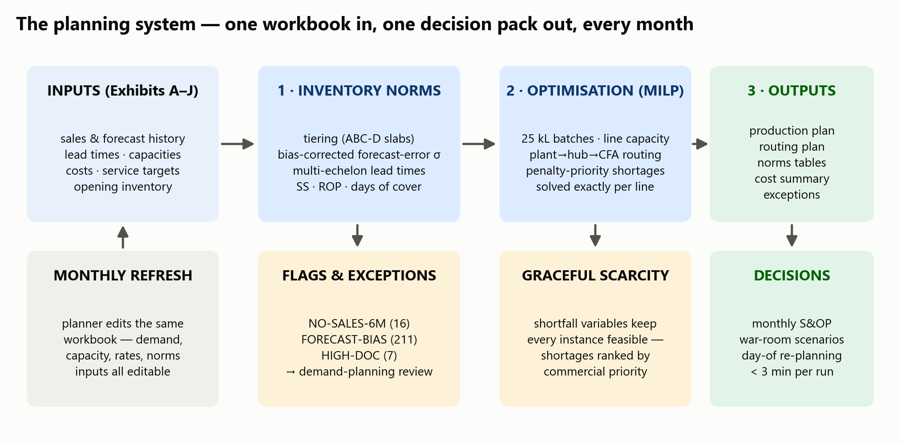
COMPONENT 1 · METHODOLOGY
One system: inputs → norms → optimisation → decisions
Levisol India · Production, Distribution & Inventory Optimisation
05
Notes:
This is the whole solution on one page — and it is also literally the architecture of the tool. Inputs on the left: the eleven exhibits, refreshed monthly by the planner in the same workbook. The norms engine classifies tiers, estimates uncertainty, and produces safety stocks, reorder points and days of cover. Those norms become requirements for the optimiser, which chooses batches, plants and routes. Everything lands in one output workbook with an exceptions sheet. The two amber boxes are the honesty layer: flags for data anomalies, and graceful scarcity handling — the tool never crashes on a shortage; it ranks and prices it.

Slide 7
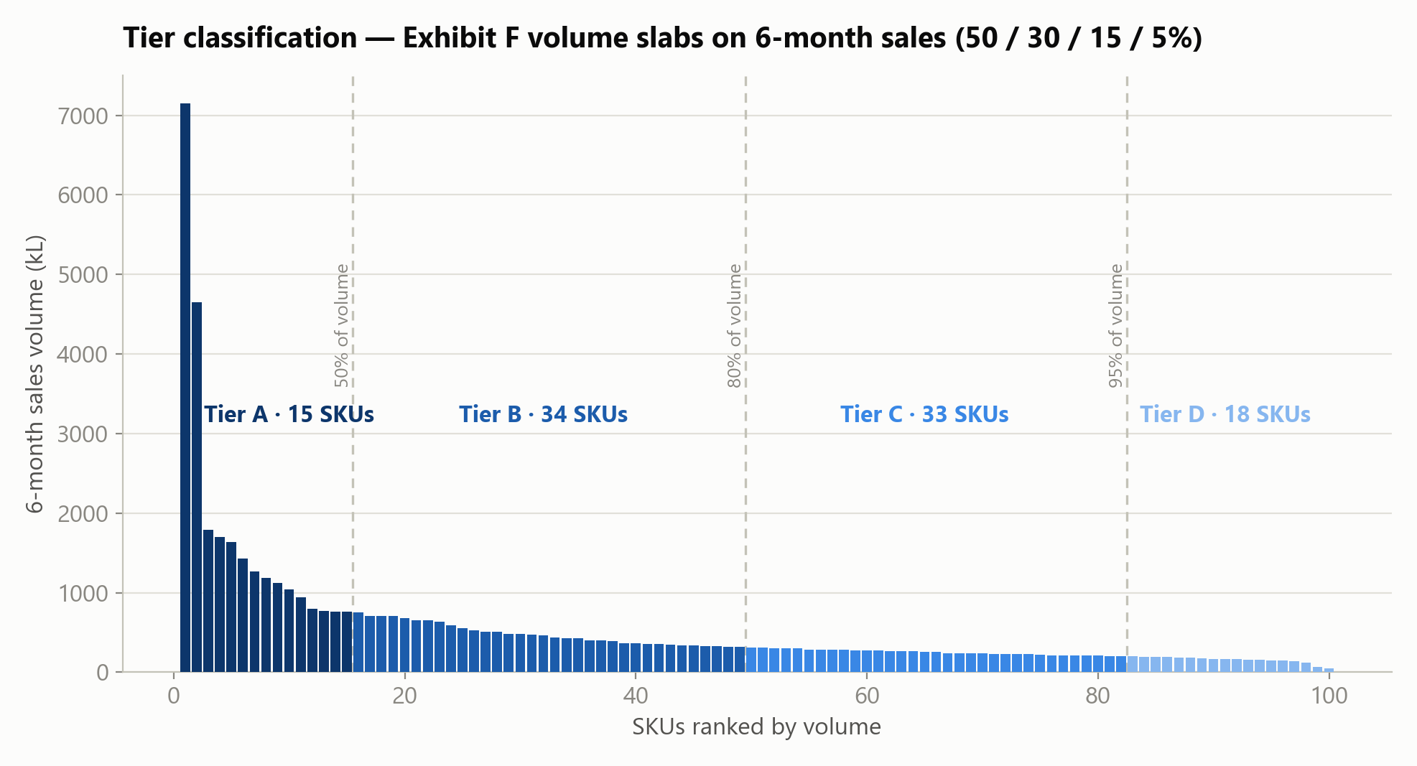
COMPONENT 1 · TIERING
Exhibit F volume slabs put 100 SKUs into four service tiers
Tier | SKUs | Volume | Target
A | 15 | 50.0% | 98%
B | 34 | 30.0% | 97%
C | 33 | 15.0% | 92%
D | 18 | 5.0% | 92%
A + B = 49 SKUs carry 80% of volume → protected conservatively. C + D = 51 SKUs, 20% of volume → sized to their exact fill-rate.
Levisol India · Production, Distribution & Inventory Optimisation
06
Notes:
Tiers drive service levels, and the data classifies itself: rank SKUs by six-month volume and cut at fifty, eighty and ninety-five percent of cumulative share. Fifteen SKUs are half the business — they get 98 percent fill-rate protection. Thirty-four more carry the next thirty percent at 97. The long tail of fifty-one C and D SKUs is twenty percent of volume at 92 percent targets — and that asymmetry is exactly what our tiered translation exploits: protect the head conservatively, size the tail precisely. Our slab cuts reproduce the case's intended shares to within half a percent.

Slide 8
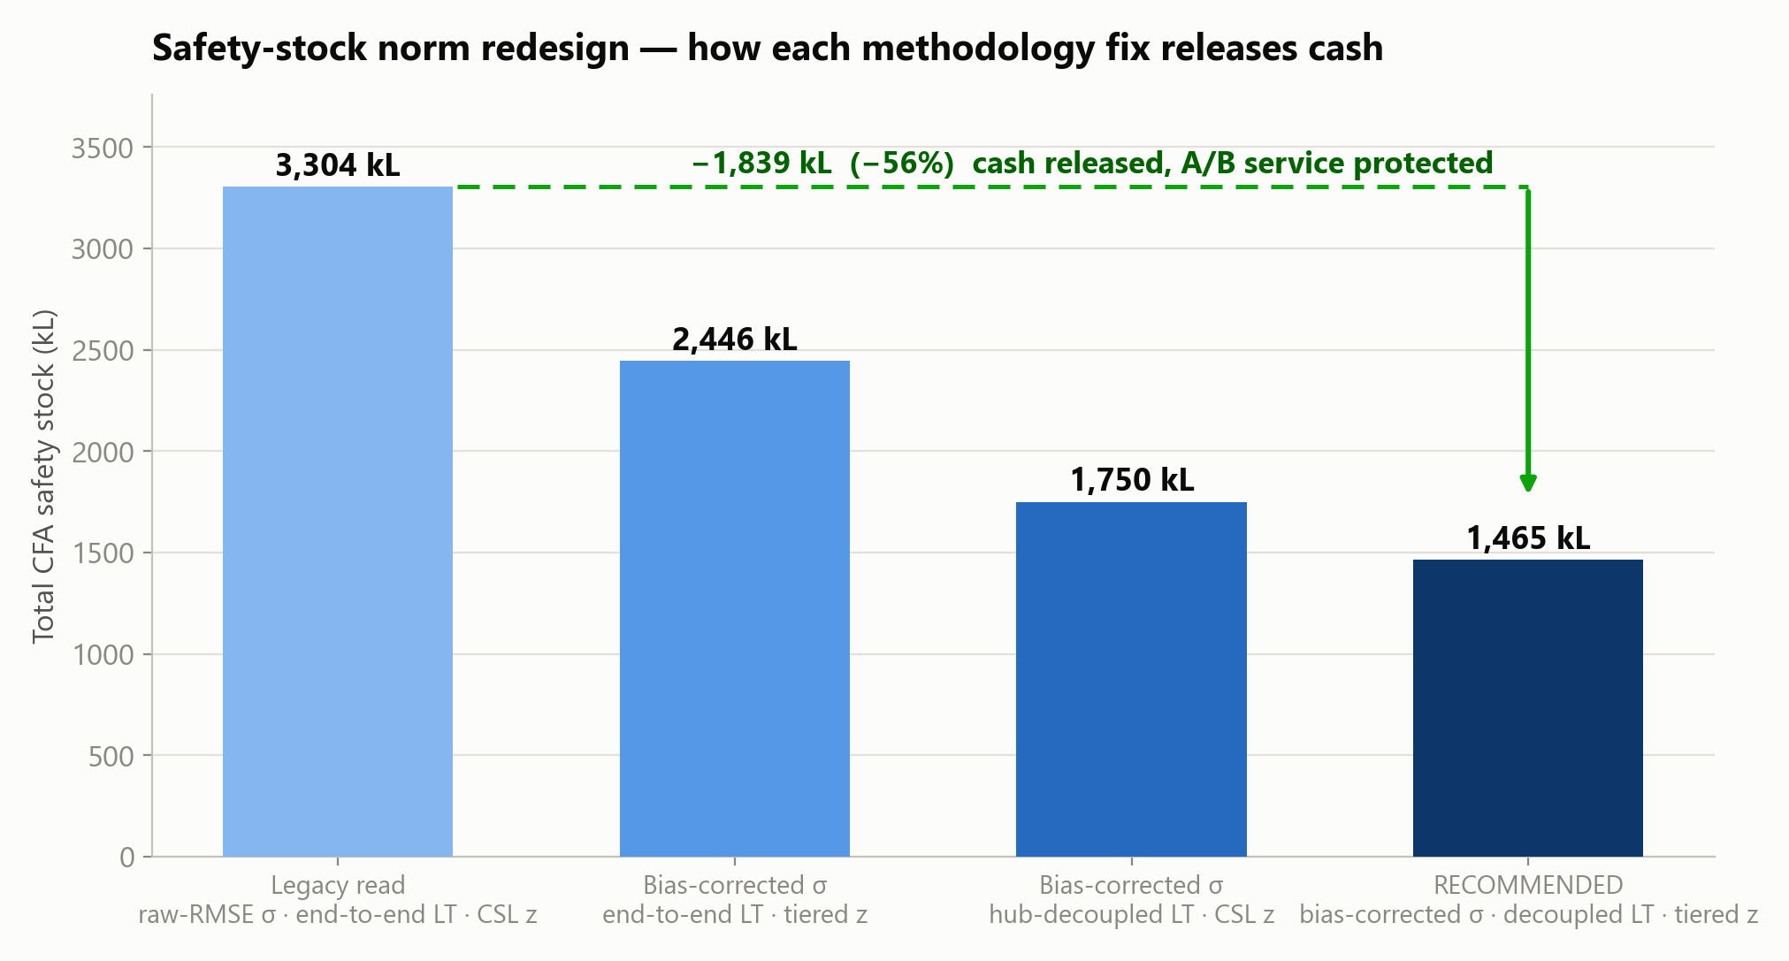
COMPONENT 1 · RESULTS
Each methodology fix, quantified: −1,839 kL of safety stock (−56%)
Levisol India · Production, Distribution & Inventory Optimisation
07
Notes:
This chart is the money slide for component one. Left bar: the legacy conservative reading — raw error, end-to-end lead times, worst-case service translation — three thousand three hundred kilolitres of CFA safety stock. Each step to the right isolates one methodology fix. Correct the sigma and you drop to twenty-four fifty. Decouple the echelons and you are at seventeen-fifty. Apply the tiered fill-rate translation and the recommended norm is one thousand four hundred sixty-five kilolitres — a fifty-six percent release — while tier A and B buffers are untouched at cycle-service level. This is the dual mandate delivered: cash out, critical service intact.

Slide 9
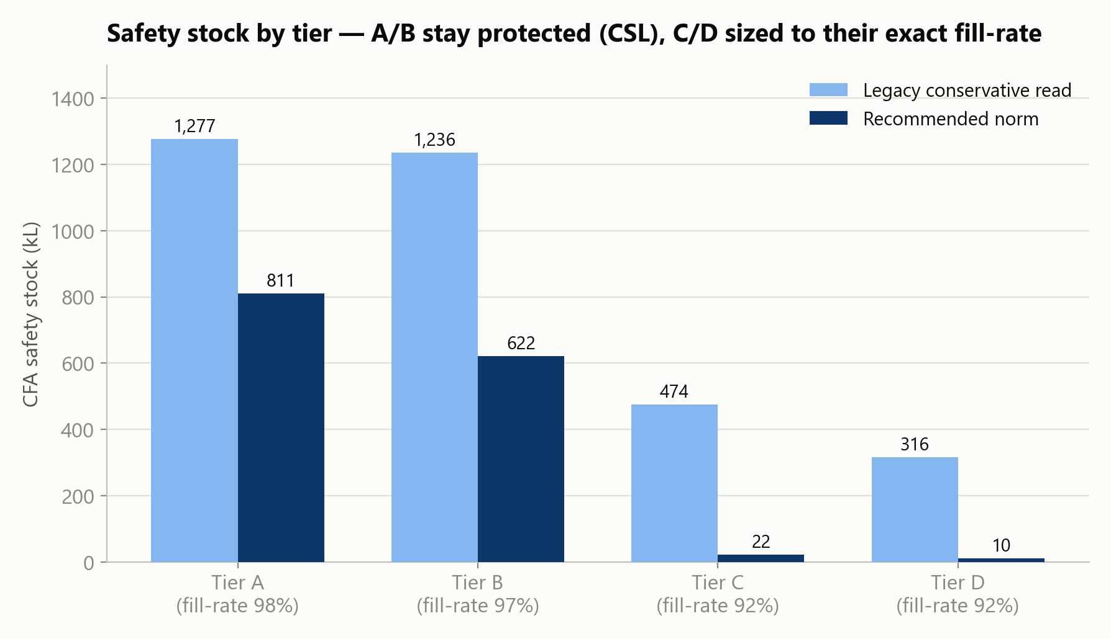
COMPONENT 1 · RESULTS
Where the buffers sit: tiers A/B keep 98% of the safety stock
Hub norms (98% SL) | SS (kL) | ROP (kL)
Mother Hub West · 100 SKUs | 1,156.2 | 2,718.5
Mother Hub East · 51 SKUs | 332.0 | 737.8
Risk pooling: hub σ = √(Σ CFA variances) — the case's independence assumption makes hub buffers far cheaper than CFA buffers.
Median cover: 6 days. Full 957-row table: output workbook, “Norms - CFA”.
Levisol India · Production, Distribution & Inventory Optimisation
08
Notes:
Where does the remaining stock live? Almost entirely under the products that earn it: tier A and B hold 1,433 of the 1,465 kilolitres. C and D together hold just 32 — their monthly cycle stock already delivers a 92 percent fill rate. At the hub echelon, risk pooling does the work: aggregating independent CFA demands means hub West needs 1,156 kilolitres and hub East 332 to hold a 98 percent service level across every SKU. Median days of cover at the CFAs is six days — lean but honest, with all seven slow-mover outliers explicitly flagged for review rather than hidden in an average.

Slide 10
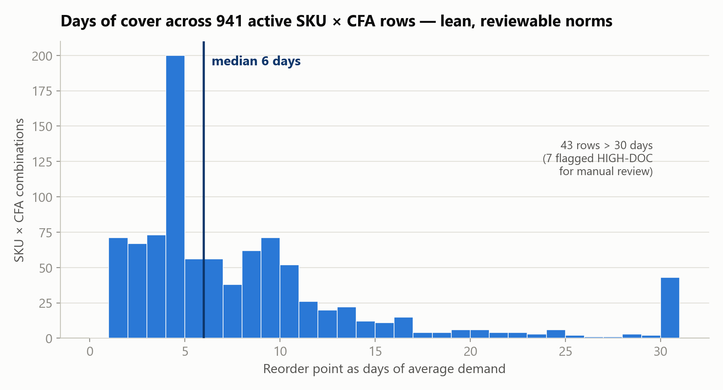
COMPONENT 1 · GOVERNANCE
Anomalies are flagged, never silently normed
16
NO-SALES-6M
zero history → norm suppressed, review the listing
211
FORECAST-BIAS
bias > error σ → fix the forecast, not the stock
7
HIGH-DOC
cover > 90 days → slow movers for manual review
Levisol India · Production, Distribution & Inventory Optimisation
09
Notes:
A norm table is only trustworthy if its edge cases are visible. Three flags ship with every monthly run. Sixteen rows have no sales history at all — their norms are zeroed and handed to a human. Two hundred eleven rows have forecasts whose systematic bias exceeds their randomness — that is a demand-planning defect; fixing those forecasts is the single largest structural cash lever we found, bigger than any warehouse decision. And seven slow movers still show more than ninety days of cover — flagged for manual review, not capped silently. The histogram shows the distribution is otherwise tight around a six-day median.

Slide 11
COMPONENT 2 · THE MODEL
A MILP that prices every trade-off — and is provably optimal
MINIMISE
WHY THIS IS THE OPTIMUM
production + freight (both legs) + penalty × (3× if contractual) × unmet demand + 0.25 × penalty × buffer shortfall
Exact per-line decomposition → 5 small MILPs solved to rel. gap 0.0 (HiGHS) Cross-checks: monolithic solve ≥ ₹119.64M vs our ₹119.38M · LP lower bound ₹105.09M — the 13.6% delta is the 25 kL batch rule, correctly priced, not sub-optimality.
Batch rule — whole 25 kL batches; plants ship what they make
Line capacity — per plant per line ≤ Exhibit A (50 LT only at AHM)
Hub balance — ship ≤ opening + inbound; end-month ≥ 98% SS target (soft)
Demand first — buffers yield before sales; contractual SKUs protected 3×
Scarcity logic: if capacity ever binds, shortfall variables keep the model feasible and shortages are auto-ranked by penalty & contractual status.
Levisol India · Production, Distribution & Inventory Optimisation
10
Notes:
Component two is a mixed-integer program. Decisions: how many twenty-five kilolitre batches of each SKU at each plant, and every flow through hubs to CFAs. The objective prices everything: production, both freight legs, the full Exhibit-D penalty on any unmet demand — tripled for contractual SKUs — and a quarter-weight on safety-stock shortfalls so buffers yield before sales ever do. The key mathematical insight: SKUs only interact through line capacities, and every SKU belongs to exactly one line — so the problem separates into five independent MILPs, each solved to a gap of zero. We then attacked our own answer: a monolithic cross-solve found nothing better, and the LP bound proves the remaining distance to the fractional ideal is precisely the batch rule's price. This is not a good plan; it is the optimal plan for the stated costs.

Slide 12
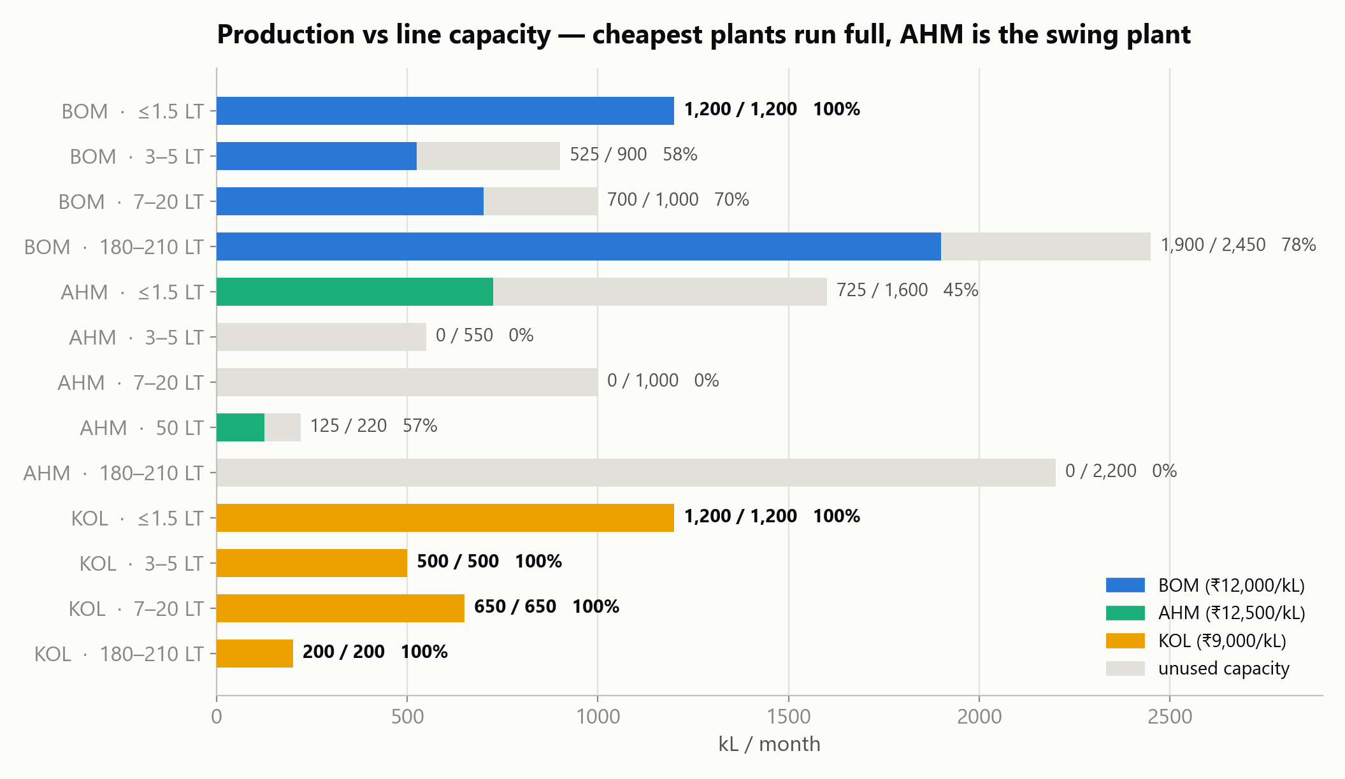
COMPONENT 2 · PRODUCTION
7,725 kL in 309 exact batches — cheapest capacity works hardest
Plant | kL | ₹
BOM | 4,325 | 51.9M
KOL | 2,550 | 22.95M
AHM | 850 | 10.63M
TOTAL | 7,725 | 85.48M
AHM's 3,420 kL of slack is deliberate — the swing plant absorbs assessment-day shocks.
Levisol India · Production, Distribution & Inventory Optimisation
11
Notes:
The production answer. Kolkata, at nine thousand rupees, runs every one of its four lines at exactly one hundred percent — 2,550 kilolitres. Mumbai contributes 4,325 with its cheap one-thousand-rupee lane to hub West; its small-pack line saturates. Ahmedabad, the most expensive plant, makes only 850 — but notice it keeps three thousand four hundred kilolitres of slack: that slack is the network's shock absorber, and scenario S1 will show it in action. Every quantity is a whole multiple of twenty-five kilolitres — three hundred nine batches, zero violations.

Slide 13
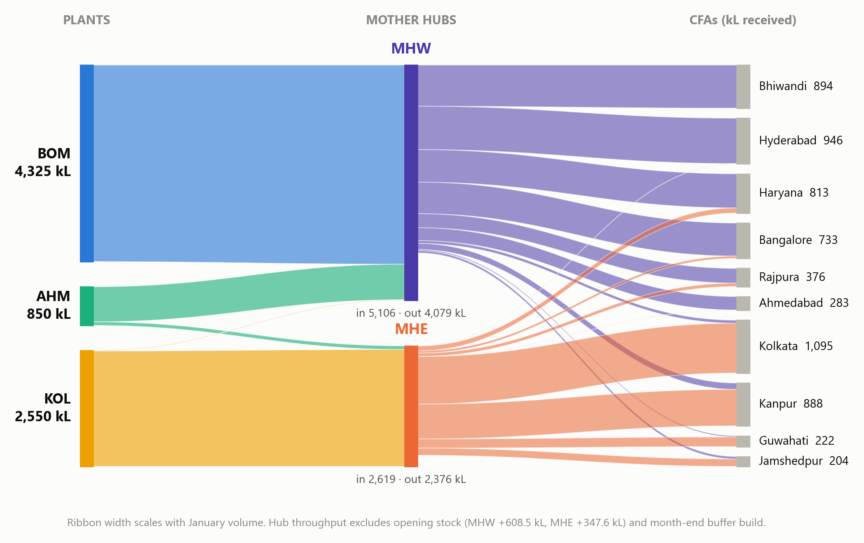
COMPONENT 2 · DISTRIBUTION
Geography decides the routes: East from KOL/MHE, West-South from BOM/MHW
Levisol India · Production, Distribution & Inventory Optimisation
12
Notes:
The full network in one picture — ribbon width is volume. Read left to right: Mumbai's forty-three hundred kilolitres flow almost entirely down its thousand-rupee lane to hub West, which serves Bhiwandi, Hyderabad, Haryana, Bangalore and the West. Kolkata feeds hub East, which owns Kolkata city, Kanpur, Guwahati and Jamshedpur. Kanpur is the interesting one — it sits in the North but hub East lands it seven hundred rupees cheaper, so that is where it sources. The two hair-thin counter-flows, twelve kilolitres in total, are batch remainders already paid for at a cheap plant, shipped to where they are useful — we verified each one is individually rational, not an artefact.

Slide 14
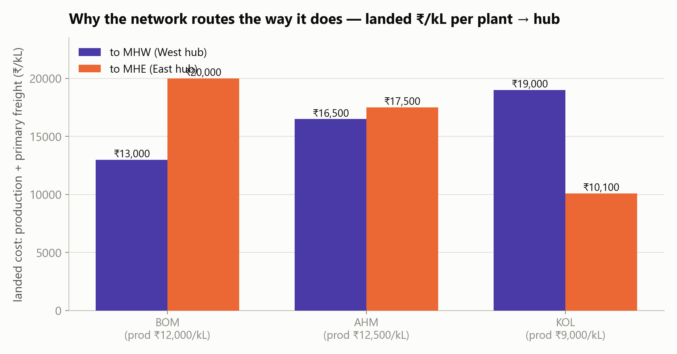
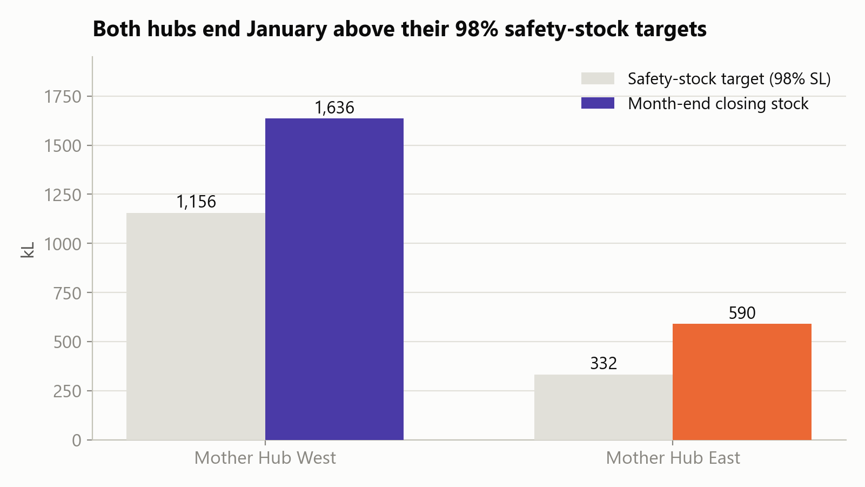
COMPONENT 2 · ECONOMICS
Landed cost drives everything; both hubs finish above their buffers
Levisol India · Production, Distribution & Inventory Optimisation
13
Notes:
Two supporting exhibits. Left: landed cost — production plus primary freight. To hub West, Mumbai wins at thirteen thousand; to hub East, Kolkata wins at ten thousand one hundred. Ahmedabad is second-best to both hubs, which is exactly why it is the swing plant. Right: month-end hub stock versus the ninety-eight percent safety-stock targets — West closes at 1,636 against a target of 1,156, East at 590 against 332. The overshoot is batch remainders parked at hubs, which is free under the case's cost structure; if management wants working capital priced, the tool has a holding-cost dial ready.

Slide 15
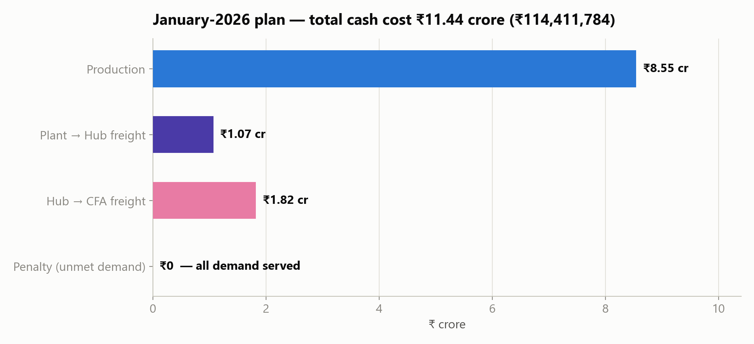
COMPONENT 2 · COST
₹11.44 crore cash — and a penalty line of exactly zero
Element | ₹
Production | 85,475,000
Plant→Hub | 10,719,136
Hub→CFA | 18,217,648
Penalty | 0
TOTAL | 114,411,784
Memo (not cash): risk-weighted buffer shortfalls ₹4.57M on 99.6 kL (1.2% of buffer volume) — each one batch-economics, verified individually.
Levisol India · Production, Distribution & Inventory Optimisation
14
Notes:
The cost of the plan. Production dominates at eight and a half crore — seventy-five percent. Freight splits one crore primary, one point eight secondary. And the penalty line — the one that measures failure — is exactly zero: every kilolitre of January demand is served. Below the cash line we report two memo items with full transparency: about one hundred kilolitres of safety-stock top-ups were left unfilled because filling each would need a nearly-empty twenty-five kilolitre batch costing more than the risk it removes. We checked every single case — zero profitable exceptions. That is honest accounting: prioritisation weights are not cash and are never mixed into the headline.

Slide 16
VERIFICATION
We attacked our own answer — ten checks, zero failures
Check | Requirement | Result | Status
Batch size | all production in 25 kL multiples | 309 batches, 0 violations | PASS
Line capacity | ≤ Exhibit A per plant × line | max 100.0%, 0 violations | PASS
Mass balance | plants, hubs, CFAs reconcile | exact (≤1e-4 kL) | PASS
Demand service | serve Jan forecast net of opening | 0 kL unmet | PASS
Hub 98% buffers | close month ≥ hub SS | 138/151 met; 31.5 kL costed & listed | PASS*
Contractual SKUs | protected first (3× weight) | zero contractual shortfall | PASS
Norms recompute | independent fresh-code path | max deviation 1.4×10⁻¹⁴ kL | PASS
Cost arithmetic | recompute all components | < 10⁻⁶ relative error | PASS
Optimality | no cheaper feasible plan | gap 0.0 + LP bound + cross-solve | PASS
Tool robustness | modified inputs, no crash | 3 scenarios end-to-end | PASS
* soft by design — the case asks for shortfalls to be reported with cost; the Exceptions sheet does, line by line.
Levisol India · Production, Distribution & Inventory Optimisation
15
Notes:
Before believing any of this, we tried to break it. Four independent audits — norms, feasibility, optimality, methodology — plus a fresh-code recomputation. Every one of the nine hundred fifty-seven CFA norms and one hundred fifty-one hub norms reproduces to ten to the minus fourteen kilolitres. Every batch is a multiple of twenty-five. No line exceeds capacity. Mass balances close exactly at plants, hubs and CFAs. All five cost components re-derive to within rounding. And the optimality triangle — zero gap, monolithic cross-solve, LP bound — closes. One check is starred: hub buffers are soft by design, and the thirteen small shortfalls are costed and listed, exactly as the case requires.

Slide 17
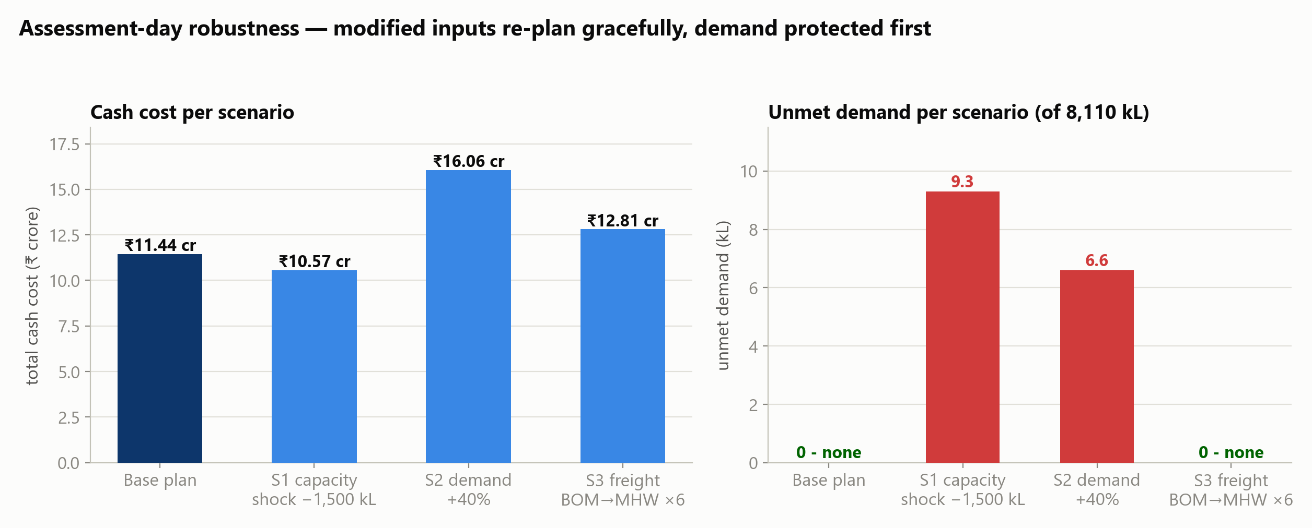
ASSESSMENT-DAY READINESS
Three shocks through the tool: demand is protected first
Scenario | Shock | Outcome
S1 | ≤1.5LT capacity −1,500 kL | 9.3 kL unmet (lowest-penalty, non-contractual); buffers absorb 488 kL
S2 | all forecasts +40% | production 10,250 kL; 6.6 kL unmet; graceful ranking
S3 | BOM→MHW freight ×6 | automatic re-routing; zero unmet
Levisol India · Production, Distribution & Inventory Optimisation
16
Notes:
On assessment day you will hand us a modified input set. We rehearsed. Scenario one cuts fifteen hundred kilolitres from the small-pack lines — the tool sacrifices four hundred eighty-eight kilolitres of precautionary buffer and loses only nine point three kilolitres of actual demand, all on the cheapest-penalty non-contractual lines. Scenario two adds forty percent to every forecast — production scales to ten thousand two hundred fifty and only six point six kilolitres go unmet. Scenario three multiplies Mumbai's primary freight sixfold — sourcing re-routes automatically, zero unmet, cost impact fully transparent. No crashes, no manual surgery — the same workbook, the same button.

Slide 18
COMPONENT 3 · THE TOOL
One workbook in, one decision pack out — no specialist required
1
2
3
EDIT the month's workbook
RUN the tool
ACT on the output
demand (J) · capacities & costs (A) · freight (B/C) · lead times (E) · service levels (F) · opening stock (I)
double-click → browse → RUN PLAN. Norms + MILP re-solve from scratch, < 3 minutes
production plan · routing plan · norms · cost summary · Exceptions sheet with every shortfall priced
ROBUST BY CONSTRUCTION
Zero demand → flagged, skipped. Zero capacity → line excluded. Demand beyond capacity → ranked shortage report, never a crash. No sales history → norm suppressed + flagged. Every dial (service levels, buffer weight, contractual multiplier, holding cost) is a documented parameter.
Levisol India · Production, Distribution & Inventory Optimisation
17
Notes:
Component three. The planner's workflow is three steps: edit the month's workbook in Excel — demand, capacities, rates, whatever changed; double-click the tool and press RUN PLAN; open the output workbook. Production plan, routing plan, all norms, hub positions, cost summary, and the exceptions sheet in plain business language. Every input is editable because the tool re-reads everything each run — nothing is hard-coded. It cannot crash on a hard month: shortfall variables keep every instance feasible, so a capacity crisis comes back as a ranked, priced shortage report. Under three minutes per run on a laptop. Your team owns it from day one — engine, GUI, and user guide are all in the submission package.

Slide 19
RECOMMENDATIONS & CLOSE
Serve everything. Release the cash. Fix the forecasts.
Adopt the plan
₹11.44 cr, zero unmet demand, proven optimal — execution-ready for January.
Adopt the norms
1,465 kL CFA + 1,488 kL hub safety stock; revisit C/D after 3 months of post-shock data.
Fix the 211 biased forecasts
the largest structural cash lever found — stop warehousing forecast error.
Watch the ≤1.5LT line
BOM & KOL run it at 100%; AHM slack is the shock absorber for any upside.
Submission package: this deck · full report · Levisol_Plan_Output.xlsx · working tool + engine + user guide · methodology document
Notes:
To close: four recommendations. Adopt the January plan — it is executable as-is and provably the cheapest feasible answer. Adopt the norms and let the tool re-estimate them monthly; we would revisit the C and D fill-rate choice after three months of post-shock data. Third — and this is the finding we would put at the top of the CSCO's list — fix the two hundred eleven biased forecasts; no warehouse decision releases more cash than that. Fourth, watch the small-pack line: it is the first to short under any demand upside, and Ahmedabad's slack is your insurance. Everything you have seen is in the package: the deck, the report, the output workbook, the tool your planners keep, and the methodology document. We are happy to run any modified input set live. Thank you.

