Slide 1

Warehouse Planning Agent
An AI agent that plans a footwear warehouse's day, every morning.
Levels 3-4 hold reserve. Levels 1-2 are within reach.
Developed by Shreyas Thakur
Notes:
This is an AI agent that plans a footwear warehouse's day. Every morning it works out how much will ship, which SKUs are in demand, which boxes to bring down from levels 3-4 to levels 1-2, and how many workers each day needs. It shows every step on a live dashboard.

Slide 2
The job
Four answers before picking starts
Demand
SKUs
Replenishment
Workers
How much will ship?
Which SKUs are in demand?
What comes down from levels 3-4?
How many workers each day?
Pairs, order lines and orders for the next 5 working days.
The 15 expected to sell most, and where their stock sits.
Every box to bring within reach for the next 2 working days.
Hours of work turned into workers, and the number if the day runs high.
Levels 1-2 are within a picker's reach. Levels 3-4 hold reserve.
A SKU that sells needs boxes on levels 1-2 before the day starts. The agent says which ones come down, from where and to where, and how many people the day needs.
Warehouse Planning Agent
2
Notes:
These are the four questions the warehouse asked for. The third one matters most on the floor: reserve stock sits on levels 3-4, out of reach, so the boxes that will sell have to come down to levels 1-2 before picking starts.

Slide 3
The records
Real records from one warehouse
178
228,195
Pairs shipped each working day, March to October 2023
6,000
working days of orders
pairs shipped
208
41,256
4,000
SKUs, in many sizes
boxes in the racks
2,000
Where the boxes sit
30,456 on levels 1-2
10,800 on 3-4
0
On 20 of 178 working days, the warehouse shipped at least ten times the day before, or a tenth of it.
Warehouse Planning Agent
3
Notes:
The records come from a footwear manufacturer's warehouse in Sherbrooke, Canada, published openly in 2025. Look at the chart: volume swings hard from one day to the next. Any forecast here will miss by a lot, so the question is whether the agent beats the simple rules a supervisor would use.

Slide 4
The idea
What makes it an agent
Observe
Decide
Act
Check
Report
Read the orders and grade the last plan.
Choose the forecast method that missed least, and how to staff.
Forecast, find the SKUs in demand, plan the boxes and the workers.
Test the plan against the roster and the racks.
Write the brief and raise what a person must decide.
Every morning, with no one at the keyboard.
A goal
Tools
Judgement
A plan for the day that a supervisor can act on.
8 small tools do every sum. It chooses which to call, and when.
It picks the forecast method, how to staff, and what to raise with a person.
Warehouse Planning Agent
4
Notes:
An ordinary program runs the same steps every time. An agent is given a goal and tools, decides which tool to use next, reads the answer and decides what to do with it. This one also checks its own plan, and hands anything it should not settle alone to the supervisor.

Slide 5
The idea
8 tools, and one rule
Tool
What it returns
The language model never calculates a number
read_orders
How much history there is, and the last working day's volume
check_yesterday
The last plan's forecast against what shipped
A brief that states a number no tool produced is rejected, and rewritten from the tools' answers.
compare_forecast_methods
Each method's miss over the last 30 working days
forecast_demand
Pairs, lines and orders for the next 5 working days, with a range
find_skus_in_demand
The 15 SKUs expected to sell most, with trend and stock
plan_replenishment
Every box to bring down from levels 3-4 to 1-2
Two brains
plan_workers
Hours of work and workers for each forecast day
Built-in rules with no key, or Claude with one. Same tools, same check.
check_plan
What a person should know or decide
Warehouse Planning Agent
5
Notes:
The tools are plain code: they read the orders, forecast, split demand across SKUs, plan boxes and workers, and check the plan. Claude can run the loop instead of the built-in rules, but it never does arithmetic. That rule is enforced in code, and the same check runs over this project's own documents.

Slide 6
A real plan
The next working day: about 832 pairs
Pairs shipped
Forecast
Likely range
832
6,000
pairs expected, likely 54 to 2,085
4,000
471
order lines, in about 110 orders
2,000
Method chosen this morning
Average of the last six same weekdays: it missed by 70.8% over the last 30 days.
0
Tue 26 Sep
Thu 5 Oct
Fri 13 Oct
Fri
Mon
Tue
Wed
Thu
Warehouse Planning Agent
6
Notes:
The worked example is the first working day after the records end. The agent scored three methods on the last 30 working days and used the one that missed least. The blue band is the likely range, taken from that method's own past misses. A wide band is honest: volume here swings hard.

Slide 7
A real plan
Which SKUs are in demand
Pairs expected over the next 5 working days
50.5%
8N10W9, steady
551
05W6TK, falling
484
of the forecast falls on the top 15 SKUs
I1KDJ0, steady
288
7.5
WRRW1W, steady
251
SMMRK3, steady
223
days the boxes on levels 1-2 last for 8N10W9
PY5UPB, falling
222
9FWH2G, falling
160
Rising lately: AKP0A7.
AHR20O, falling
147
Warehouse Planning Agent
7
Notes:
It shares the forecast out across SKUs by their sales over the last 40 working days. For each SKU it shows the trend over the last 10 days and how long the boxes within reach will last. That last figure is what drives the move list on the next slide.

Slide 8
A real plan
Bring 62 boxes down from levels 3-4
62
32
7
23 Oct
boxes to bring down
SKU sizes
new pick faces
covered until, Monday
SKU size
Boxes
From
To
Why
AX7BJ8 size 9
1
M-24-30 L3
M-22-13 L1
New pick face
EUMBM7 size 9
1
Q-21-30 L3
Q-21-12 L1
New pick face
5MNTT7 size 11
1
E-14-30 L3
E-14-11 L1
New pick face
9FWH2G size 9
7
A-22-30 L3 and 6 more
F-21-13 L1
4 on L1-2, 13 needed
DSQXYR size 8
5
F-13-30 L3 and 4 more
A-20-23 L2
4 on L1-2, 9 needed
It also flags what it cannot fix: 6 SKU sizes will run short by about 24 pairs.
Warehouse Planning Agent
8
Notes:
This is the work list for the morning: which boxes move from levels 3-4 to levels 1-2, from where, to where, and why. The ones about to run out come first. A new pick face needs a free slot, so the agent sends 7 idle boxes up to make room.

Slide 9
A real plan
How many workers each day
3 (6)
Day
Hours
Workers
6
2 (5)
Fri 20 Oct
5.9
1
Mon 23 Oct
13.6
3
4
Tue 24 Oct
8.0
2
1 (3)
2 (3)
1 (3)
Wed 25 Oct
5.4
1
Thu 26 Oct
11.8
2
2
10 s a stop, 6 s a pair, 60 s a box moved, plus 15%. A worker gives 6.8 hours.
0
Fri 20 Oct
Mon 23 Oct
Tue 24 Oct
Wed 25 Oct
Thu 26 Oct
Workers planned, and in brackets if the day runs high. Dashed: the 3 on the roster.
Warehouse Planning Agent
9
Notes:
The hours come from a time standard: stops, pairs, trolley runs and the boxes to move. It staffs to the expected volume unless 4 of the last 5 days ran above forecast, when it staffs to the top of the range. A day that needs more than the roster goes to the supervisor.

Slide 10
Results
How well it planned 134 real days
Each day planned from the orders before it only, then checked against what happened
64.9%
79.9%
27.9%
forecast miss, against 75.9% for the same weekday last week
of days with enough workers, 94.8% when staffed for a high day
of boxes brought down were needed within 2 days
76.1% of days inside the range. Bias +2.3%.
2.04 planned against 1.84 needed, on average.
3,514 of 12,610 boxes. The weak part.
It beats the simplest rule on the forecast, and leans slightly over on workers rather than short.
Warehouse Planning Agent
10
Notes:
The miss is large because the volume swings, but it beats the rule a supervisor would reach for first. Workers lean slightly over, which suits a warehouse where an idle hour costs less than a late order. Boxes are the weak part, and the next slide says why.

Slide 11
Honesty
What did not work, and why
SKU-size demand is too lumpy to place
A longer history barely helps
Even with the next 5 days' total known exactly, sharing it by recent sales misses by 92.9% by SKU size.
10 days of sales: 97.2% by SKU size. 90 days: 92.6%. The agent uses 40.
Boxes moved early, few needed
Some days still ran short
It caught 21.6% of the 16,261 boxes that truly had to come down.
27 of 134 days needed more workers than planned. 54 had more than needed.
These results sit in the repository beside the ones that worked.
Warehouse Planning Agent
11
Notes:
Publishing what failed is part of the method. A box is cheap to move, so the agent still brings down what the forecast points to, and the dashboard shows how few were needed. A supervisor should treat the move list as a starting point.

Slide 12
Control
People stay in charge
What its own check raised over the 134 days
It plans, people act
Check
Days
Mark
It does not run the warehouse. A person carries out the plan.
More workers needed than the roster holds
32
ASK
Demand the racks cannot cover
8
ASK
A SKU selling at 3 times its usual rate
76
CHECK
Two kinds wait
ASK items need a decision before the plan is settled.
Weekly: SKU sizes with no box in the racks
33
CHECK
Weekly: idle boxes on levels 1-2
33
CHECK
Every step shown
The dashboard lists each one.
Warehouse Planning Agent
12
Notes:
Each threshold was set so that it fires on a minority of days. The two weekly reviews run on the first plan day of each week, so a standing issue is not repeated daily. Nothing here is connected to a live warehouse system.

Slide 13
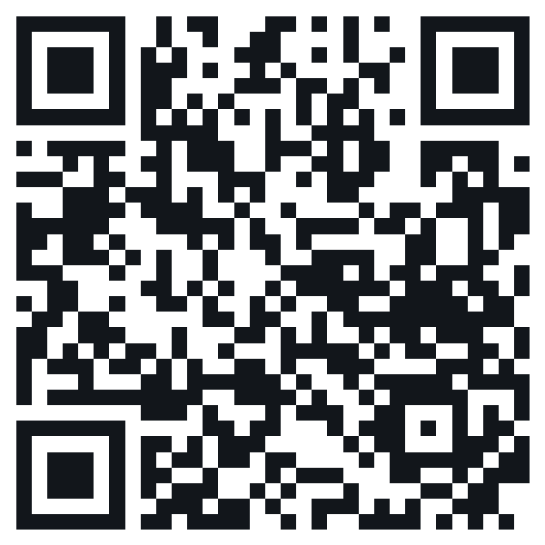
See it plan today
A live dashboard that shows a new plan each day, with nothing to install.
Today: the brief, every step and the four answers
Track record: every plan against what happened
How it works: every number the agent uses
shreyasthakur11.github.io/warehouse-planning-agent
Developed by Shreyas Thakur
Data: de Assis, de Paula Ferreira and Ouhimmou (2025), CC BY 4.0
Notes:
Open the dashboard on a phone or laptop. It opens on today's plan: the brief, every step the agent took, and the four answers. Pick any day to see how its plan compared with what happened. Nothing is installed and no key is needed.

