Slide 1
S1-26_SSZG628T · Dissertation Midterm Viva
Demand Forecasting In Inventory Management
A predictive spare-parts demand forecasting pipeline for a high-priority aircraft landing-gear component
Dimpal Shetty · 2024MT13052 · M.Tech Software Systems
Airbus India Pvt Ltd, Bangalore · Supervisor: Saurabh Mahajan
Notes:
Good morning/afternoon. Thank you for the opportunity to present my midterm progress on demand forecasting for aircraft spare parts, carried out at Airbus India under the supervision of Saurabh Mahajan.

Slide 2
OVERVIEW
What I'll cover
01
Introduction & Objectives
02
Literature Review
03
Research Methodology
04
Data Collection & Progress to Date
05
Business Case & Feedback Incorporated
06
Next Steps
1
Notes:
Six parts, mapped directly to what the committee asked to see: introduction, literature review, methodology, data collection and progress, and where I've incorporated feedback since the abstract.

Slide 3
1 · INTRODUCTION
Static schedules can't see how an aircraft is actually operated
Under-stock
Over-stock
Missing part → Aircraft-On-Ground (AOG) → costly, disruptive downtime
Excess spares → capital tied up in parts that may never be needed
Today's reorder logic is a fixed flight-hour schedule — it cannot account for how differently individual aircraft actually wear out.
2
Notes:
Every maintenance department faces this trade-off. Understock and you get an AOG event; overstock and you tie up capital. Right now the industry solves this with a flat flight-hour schedule, which is blind to how an aircraft is actually flown.

Slide 4
1 · INTRODUCTION
Four objectives
1
Classify spare parts by value and demand predictability to identify which part justifies a machine-learning forecast
2
Build and test a model predicting demand for that part, using landing-cycle history and landing-severity conditions
3
Mine historical maintenance records to find which spare parts are usually flagged together, for supplier bundling
4
Quantify the stock-vs-stockout cost trade-off, turning the forecast into a reorder recommendation
3
Notes:
These four objectives chain into each other: classification picks the part, the model forecasts it, Apriori bundles companion parts, and the cost layer turns all of it into a rupee decision.

Slide 5
2 · LITERATURE REVIEW
Grounding the approach in prior work
Author (Year) | Focus | Relevance here
Bacchetti & Saccani (2012) | Gap between academic classification models and real MRO practice | Motivates testing assumptions on real data, not idealised data
Lagoda & Klumpp (2024) | Modified ABC-XYZ integrating forecasting into classification | Same integration this project performs
Olmo & Domingo (2026) | Fleet usage-data for aerospace rotable-parts demand | Same core argument — tested empirically here
Stanton et al. (2025) | ML model comparison for landing-gear maintenance | Precedent for the model-benchmarking approach
Agrawal & Srikant (1994) | Apriori algorithm for market-basket analysis | Used directly for companion-part mining
Ke et al. (2017) | LightGBM gradient boosting | Selected forecasting model
4
Notes:
Two threads: classification-and-forecasting-integration literature, and the specific algorithms (Apriori, LightGBM) used. The project's own contribution is testing its starting premise empirically rather than assuming it, which none of these six do for this specific domain.

Slide 6
3 · RESEARCH METHODOLOGY
Current practice vs. the gap we found
Today
The real gap
• Fixed flight-hour / cycle reorder schedule
• Parts ranked only by cost, not predictability
• Static safety-stock buffer, rarely revisited
• Companion parts bundled by engineer experience, not data
Landing severity — load and braking force on touchdown — predicts failure far better than flight cycles alone. Weather turned out to matter far less than our original abstract assumed.
5
Notes:
This is the central empirical finding so far: the industry convention assumes weather drives wear, but the real data shows landing severity does instead. We tested this rather than taking it as given, and it changed a core assumption from the original abstract.

Slide 7
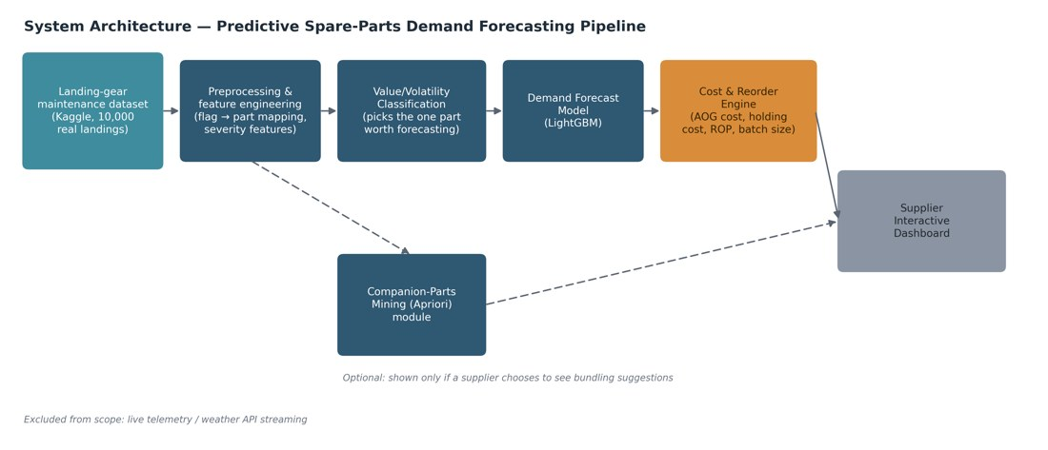
3 · RESEARCH METHODOLOGY
System architecture
6
Notes:
One mandatory path, left to right: classification picks the part, the model forecasts it, the cost engine turns that into a reorder recommendation on the dashboard. Companion-part mining is a separate, dashed, optional module — not every supplier wants bundling suggestions, so it never sits on the critical path. This revision came directly from my mentor's feedback that the first version made bundling look co-equal with the cost logic.

Slide 8
3 · RESEARCH METHODOLOGY
Why LightGBM, and how it was tested
Model choice
Validation design
Baseline
Gradient-boosted trees (LightGBM) outperform deep learning on tabular, non-sequential data (Grinsztajn et al., 2022). There is no per-aircraft time sequence in this dataset, which rules out LSTM/Transformer approaches.
No dates or aircraft IDs exist in the data, so records are grouped into 50 artificial batches of 200 landings each, used as the unit for the baseline comparison and cross-validation — not real calendar time.
A constant-average predictor across the 50 batches scores MAE = 5.52 units/batch — the number any real model must beat to justify the added complexity.
7
Notes:
I want to be upfront about a limitation here: the dataset has no dates or aircraft IDs, so I cannot do a true time-series validation. I used batches of 200 landings as a proxy period, which is defensible but not the same as calendar time. I chose LightGBM over LSTM or Transformer models specifically because there is no real sequence to exploit, and literature backs tree models for this kind of tabular data.

Slide 9
4 · DATA COLLECTION & PROGRESS
From placeholder data to a real dataset
The dataset
What changed when real data arrived
10,000 rows, landing-gear maintenance records (Kaggle). 12 columns: 8 operating-condition variables and 4 binary failure/wear flags.
• Brake Assembly replaced the placeholder "most critical part" assumption
• Weather dropped out as a driver; landing severity took its place
• No dates/aircraft IDs → batches of 200 landings used as a proxy period
The 4 flags were mapped to 4 physical parts: Brake Assembly, Landing Gear Actuator, Wheel Unit, Hydraulic Line.
Unit costs and the fleet-utilisation figure (2,000 landings/year) are stated, flagged assumptions — not yet sourced from Airbus data.
8
Notes:
I want to flag this myself before it comes up: this is real failure data, but the cost figures and the fleet-utilisation number are still assumptions I've stated explicitly, not Airbus-sourced numbers. I switched from placeholder to real data mid-project once I got access to this Kaggle set, and let the real data overturn some of my original assumptions rather than forcing the data to fit the abstract.

Slide 10
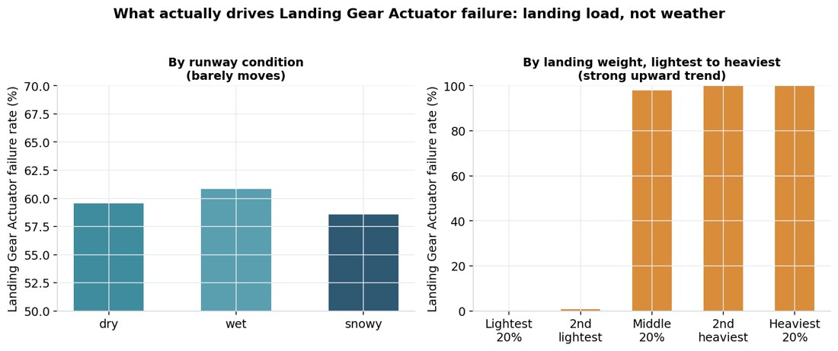
4 · DATA COLLECTION & PROGRESS
The key finding: severity beats weather
The original abstract assumed weather conditions would be the dominant predictor of part wear.
The real data shows landing-severity variables — load and braking force on touchdown — are the stronger signal.
This revised the forecasting model's feature priorities.
9
Notes:
This is the finding I'm most confident about because it came directly from testing the data rather than assuming it. It also means I had to revise what I told the committee in the abstract — I'm flagging that change here rather than waiting for it to be noticed.

Slide 11
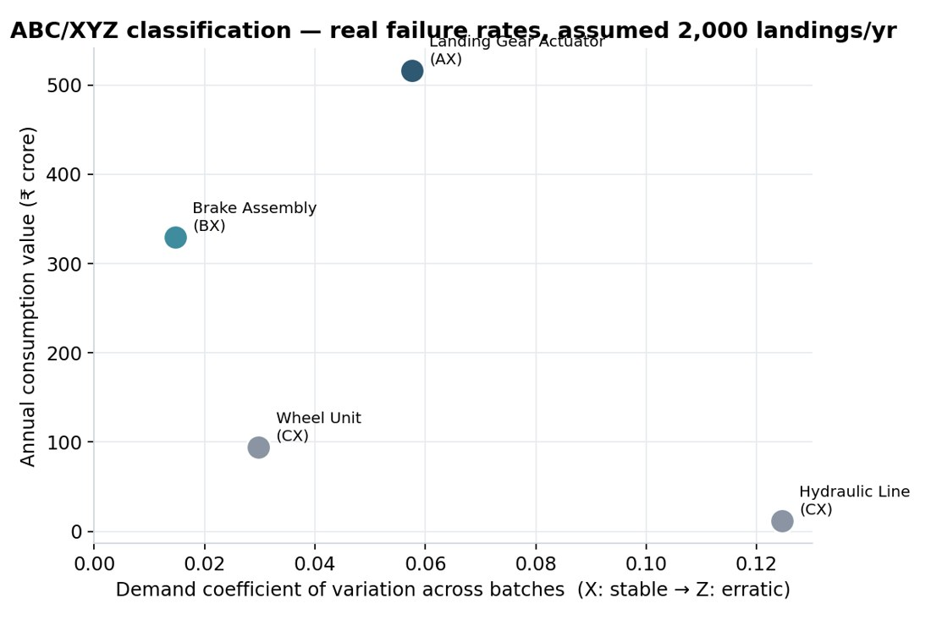
4 · DATA COLLECTION & PROGRESS
Value / Volatility classification
Landing Gear Actuator — Class A·X, ₹516.0cr value, 59.7% failure rate
Brake Assembly — Class B·X, ₹329.3cr value, 95.3% failure rate
Wheel Unit — Class C·X, ₹94.1cr value, 81.7% failure rate
Hydraulic Line — Class C·X, ₹11.8cr value, 24.5% failure rate
10
Notes:
I call this Value/Volatility classification in the workflow rather than ABC/XYZ, since that's jargon not everyone on the committee will know by name — same underlying method. The Landing Gear Actuator is Class A, the highest-value part, which is why it's the one the forecasting model targets.

Slide 12
4 · DATA COLLECTION & PROGRESS
Companion-parts mining (optional module)
Rule | Support | Confidence | Lift
Hydraulic Line → Landing Gear Actuator | 0.18 | 0.72 | 1.20
Landing Gear Actuator → Wheel Unit | 0.57 | 0.95 | 1.17
Hydraulic Line → Wheel Unit | 0.21 | 0.87 | 1.07
Apriori (min support 0.15, min lift 1.05) finds which parts are usually flagged together, for suppliers who want bundled-order suggestions. This module sits off the mandatory forecast-to-reorder path, by design.
11
Notes:
Lift above 1.0 means these pairs co-occur more than chance would predict. This directly serves Objective 3 and remains an optional, dashed branch on the architecture, exactly as my mentor asked.

Slide 13
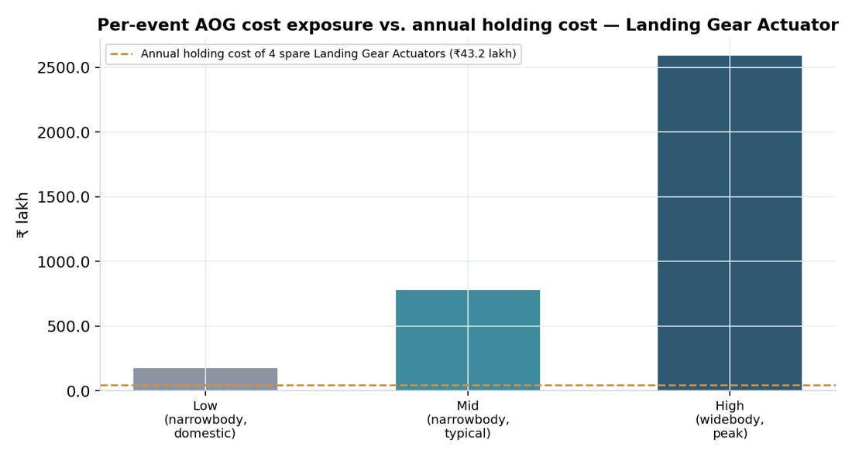
5 · BUSINESS CASE & FEEDBACK INCORPORATED
The cost of getting this wrong
Low scenario: ₹9.6L/hr → ₹1.73cr per AOG event
Mid scenario: ₹43.2L/hr → ₹7.78cr per AOG event
High scenario: ₹1.44cr/hr → ₹25.92cr per AOG event
vs. holding cost of just ₹43.2L/year for 4 spare units
12
Notes:
18-hour AOG duration assumed. Even at the low end, one stockout event costs roughly 4x the entire year's holding cost for 4 spare units — that asymmetry is the economic case for forecasting over static schedules. The 2,000-landings/year fleet-utilisation figure behind this is a stated assumption, not yet Airbus-sourced data.

Slide 14
5 · BUSINESS CASE & FEEDBACK INCORPORATED
Changes made since the abstract
Feedback / trigger | What changed
Need technical rationale for model choice | Added literature-backed justification for LightGBM over deep-learning sequence models
Need business analysis in INR | Full cost-benefit analysis redone in rupees, with three AOG severity scenarios
Architecture diagram was confusing | Redrawn so cost & reorder is the mandatory path; companion-parts mining is a clearly optional, dashed module
Real dataset became available | Entire pipeline rebuilt on real Kaggle data; some original assumptions (weather as driver) were revised, not forced to fit
Current-solution & gap analysis requested | Added explicit comparison of today's fixed-schedule practice against the data-driven approach
13
Notes:
Every one of these came from specific feedback — from the committee on the abstract, or from my mentor on the workflow diagram. I'd rather show this table than have it inferred that the report just changed on its own.

Slide 15
6 · NEXT STEPS
What's left before the final report
Done
Phases 1–4: data pipeline, classification, EDA, midterm report
Pending
Phase 5: formal LightGBM model training & tuning (preliminary test run only, not yet in the report)
Pending
Phase 6: reorder-point engine and validation against the AOG cost model
Pending
Phase 7: supplier dashboard and final dissertation writeup
Also open: exact Kaggle dataset citation, and a real fleet-utilisation figure to replace the assumed 2,000 landings/year.
14
Notes:
I'm deliberately showing Phases 5 through 7 as not yet done — that's the honest state of the work at the midterm point, not a gap I'm hiding. The two open items at the bottom are things I need from Airbus or a dataset source, not things I've forgotten.

Slide 16
THANK YOU
Questions & discussion
Demand Forecasting In Inventory Management · Dimpal Shetty · 2024MT13052
Airbus India Pvt Ltd, Bangalore
Supervisor: Saurabh Mahajan
Notes:
Thank you for your time. I'm happy to take questions, and I welcome any feedback on the three pending phases and the two open items I flagged on the previous slide.

