Slide 1
S U D A R S H A N · S P P N S P A C E R E S E A R C H T E A M
ASTRA-MINE
Autonomous AI-Driven Extraterrestrial Resource Prospecting & ISRU Demonstrator
“Mine the resource. Optimize the mission. Build the future.”
AI
ROBOTICS
EMBEDDED SYSTEMS
SPACE TECHNOLOGY
RESEARCH
Mini-Project Presentation · 2026
github.com/Shreyasderaje/ASTRA-MINE

Slide 2
WHAT WE SET OUT TO DO
Objectives
01
Build an autonomous rover
02
Map buried resources with AI
4-wheel prototype with AI 'brain' (Raspberry Pi 5) and real-time 'reflexes' (ESP32) on a 3 m lunar-analogue testbed
Camera-proxy perception fused into a live resource-probability map of unknown terrain
03
Decide where to mine
04
Close the autonomous loop
Resource-energy-risk target selection - the rover computes the best site per unit of energy
Survey → decide → navigate → mine → return → deliver, with self re-planning
05
Benchmark the decision making
06
Command it like a mission
Four strategies compared on identical terrain: resource yield per watt-hour (g/Wh)
Live Mission Control digital twin streaming pose, battery, decisions and yields
ASTRA-MINE · SUDARSHAN — SPPN Space Research Team
02

Slide 3
WHY THIS PROJECT EXISTS
The Purpose
Every kilogram launched from Earth costs thousands of dollars — and a lunar base needs water, oxygen and building material forever.
THE EARTH-SUPPLY PROBLEM
THE ISRU CHAIN — WHAT ASTRA-MINE DEMONSTRATES
✕
Launch everything from Earth
✓
Find the resource (prospecting)
✕
Pay per kilogram, every mission
✓
Decide if it is worth the trip
✕
No resupply independence
✓
Extract and carry it
✕
Not scalable for a lunar economy
✓
Process → estimate usable yield
In-Situ Resource Utilization (ISRU) is NASA & ESA's active answer — use what is already there.
Water near the lunar poles can even become rocket propellant — energy in space buys more missions.
Our purpose: build and measure the decision intelligence such a mining system would need — at student scale, with real hardware.
ASTRA-MINE · SUDARSHAN — SPPN Space Research Team
03

Slide 4
WHERE THIS TECHNOLOGY LANDS
Uses & Applications
1
2
3
Planetary & surface robotics
Autonomous mining
Disaster response
Lunar/Mars prospecting rovers; the same loop flies on future ISRU missions
Self-directed haul & dig decisions that optimize yield per litre of fuel
Robots that map rubble, find victims' zones and ration battery autonomy
4
5
6
Unknown-terrain exploration
Hazardous-site inspection
Precision agriculture
Caves, tunnels, poles, ocean floors — anywhere GPS and maps do not exist
Nuclear, chemical and deep-industrial sites where humans should not walk
Soil-sensing scouts that decide where sampling pays off per unit energy
One architecture — sense → believe → decide → act — transfers to every one of these domains.
ASTRA-MINE · SUDARSHAN — SPPN Space Research Team
04

Slide 5
HONEST ENGINEERING
Limitations & Environmental Impact
HONEST LIMITATIONS
ENVIRONMENTAL RESPONSIBILITY
Terrestrial analogue
No real chemistry
we demonstrate the intelligence on proxy markers — not real lunar ice
water → propellant is a modelled pathway; we never produce or store H₂/O₂
Proxy sensing
No planetary contamination
colour-marked simulant stands in for spectral detection (future work: NIR)
everything happens in an indoor sand testbed — the Moon stays untouched
Odometry-only localization
Reusable standard parts
encoders + IMU drift a few %; no SLAM yet
COTS electronics chosen for re-use across semesters → minimal e-waste
Small, self-made dataset
Battery stewardship
vision model is trained on our own synthetic + testbed data
sealed Li-ion pack with BMS; retired cells routed to e-waste recycling
Prototype-scale energy model
Tiny energy footprint
calibrated to ≈15% on the testbed, not flight-grade
≈40 Wh per mission — less than a laptop hour
We say these out loud — scope honesty is part of the engineering.
ASTRA-MINE · SUDARSHAN — SPPN Space Research Team
05

Slide 6
THE BRAIN — IDENTICAL IN SIMULATION & ON THE ROVER
Software Architecture
CAMERA + TOF
PERCEPTION
BELIEF MAP
MISSION OPTIMIZER
A* PLANNER
MISSION FSM
sensing
OpenCV proxy
probability
score sites
energy + risk
state machine
◀ closed loop: every delivery re-scores every remaining target ◀
HARDWARE ABSTRACTION LAYER (HAL)
MISSION CONTROL — DIGITAL TWIN
One interface, two worlds: SIMULATOR (physics + noisy sensors)
and REAL ROVER (ESP32 over serial) — zero brain changes.
FastAPI + WebSocket dashboard: live map, pose, battery,
AI decisions, energy and yield — in the browser.
Python
OpenCV
NumPy
FastAPI
21 automated tests
100% run in CI-style suite
GitHub: Shreyasderaje/ASTRA-MINE — full source, docs and experiments.
ASTRA-MINE · SUDARSHAN — SPPN Space Research Team
06

Slide 7
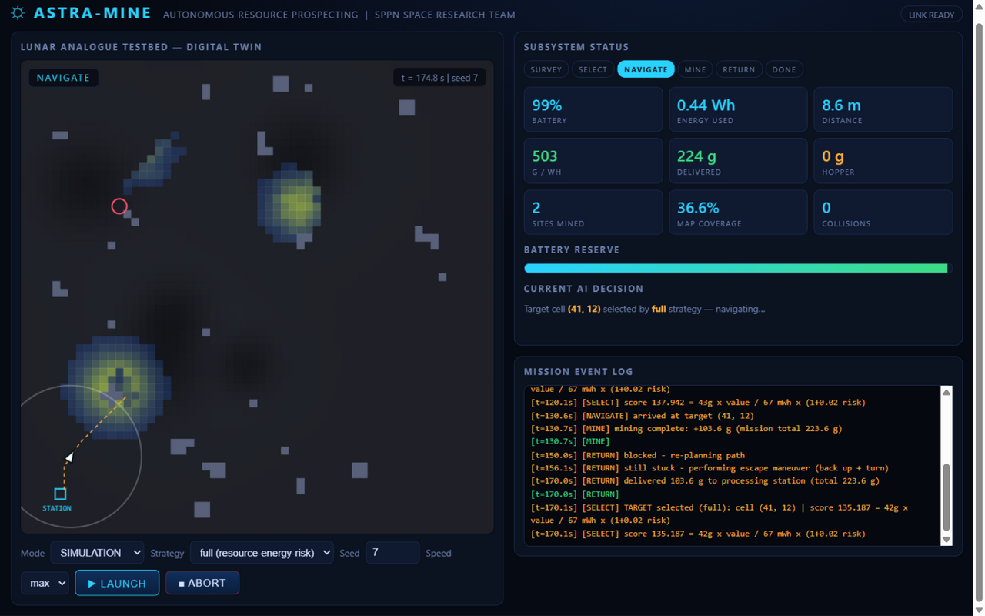
MISSION CONTROL, LIVE
The Digital Twin — See It Working
Live telemetry, 2× / second
pose, heading, battery, energy, AI decision, planned path, yield
Map starts unknown
rocks appear as the ToF finds them; resource zones from camera + operator cues
Same code, two worlds
SIMULATION mode today — REAL ROVER mode drives the physical rover
Measured, not claimed
energy integrated by the INA219 chip; grams weighed by the station load cell
Live run shown: 241 g delivered · 200 g/Wh · 0 collisions
ASTRA-MINE · SUDARSHAN — SPPN Space Research Team
07

Slide 8
WHAT WE PHYSICALLY BUILD
Hardware Architecture
RASPBERRY PI 5 — “BRAIN”
USB
ESP32 — “REFLEXES” (50 Hz)
AI vision · planning · mission logic · digital twin server · Wi-Fi dashboard
real-time motor loop, odometry, gyro fusion, failsafes — things Linux cannot do
ONBOARD SENSORS & ACTUATORS
TB6612 → 4× DC motors
wheel encoders
MPU-6050 IMU
INA219 power
VL53L0X ToF
scoop servo
POWER
PROCESSING STATION — 2nd ESP32 + HX711 load cell
3S Li-ion 11.1 V (40 Wh) + BMS · inline fuse · buck converter 5 V rail · common ground bus
Weighs every delivery and streams the measured grams — the honest number behind g/Wh. Failsafes: 600 ms command watchdog · tilt cut-off · manual override.
Max speed
Battery
Sensors
Testbed
Budget
Team
0.12 m/s
40 Wh
6 onboard + camera
3 m × 3 m
₹35k–50k
4 × 16 weeks
ASTRA-MINE · SUDARSHAN — SPPN Space Research Team
08

Slide 9
OUR RESEARCH CONTRIBUTION
The Rover Doesn't Follow a Path — It Decides
Mission Score = P(resource) × expected yield
÷ ( E_travel + E_mine + E_return ) × ( 1 + w·risk )
Every reachable target re-scored after each delivery — a closed-loop autonomous prospector.
NEAREST
SHORTEST PATH
RESOURCE-GREEDY
FULL (OURS)
always the closest zone
cheapest route wins
richest zone, cost ignored
value ÷ energy ÷ risk — all three traded off
BASELINE
BASELINE
BASELINE
OUR CONTRIBUTION
Why it matters: a rover that spends 1 Wh to fetch 1 g is useless — the optimizer maximizes grams per watt-hour, the currency of deep-space robotics.
ASTRA-MINE · SUDARSHAN — SPPN Space Research Team
09

Slide 10
15 TERRAINS × 4 STRATEGIES · IDENTICAL ENERGY BUDGET
Results: Decisions Beat Default
WHAT THE DATA SAYS
+14.9%
resource yield per watt-hour vs the nearest-target baseline (best strategy)
+12.1%
our full optimizer vs baseline — same mission, 9% less energy and 14% less travel than resource-greedy
Honest note: at 3 m scale travel is cheap, so resource-greedy ties. The scale study (3 m → 5 m) tests where the optimizer's edge grows.
Source: our own experiment — software/results/experiments.csv, 15 seeded terrains, 1.2 Wh budget, 0 collisions across 60 runs.
ASTRA-MINE · SUDARSHAN — SPPN Space Research Team
10

Slide 11
OUR PIECE OF THE MOON
Lunar Analogue Testbed & ISRU Pathway
3 m × 3 m TESTBED — TOP VIEW
1
SCOOP
rover collects marked simulant
2
DELIVER
returns to the processing station
3
WEIGH
load cell measures the true grams
4
YIELD MODEL
recoverable fraction → resource estimate
STATION
5
PROPELLANT MODEL
rocks ○ resource zones ○○ rover ▲ station ■
electrolysis → theoretical H₂ + O₂ (modelled only)
Craters, slopes and rocks are rebuilt to match the simulator — the sim is a 1:1 model of this floor.
Demonstrates the full ISRU chain — without ever producing a dangerous chemical.
ASTRA-MINE · SUDARSHAN — SPPN Space Research Team
11

Slide 12
16 WEEKS, 4 MEMBERS
Execution Plan
WEEKS 1–4
WEEKS 5–7
WEEKS 8–9
WEEKS 10–12
WEEKS 13–16
DESIGN + SIMULATION
ROVER BUILD
PERCEPTION
AUTONOMY
PROVE IT
architecture · world simulator · vision dataset · strategy experiments
chassis · power · firmware · bring-up checks B1–B10
camera on Pi · HSV/YOLO tuning · live detector
calibration · ToF rocks · closed-loop missions on testbed
experiments · report · PPT · filmed demo day
SOFTWARE: DONE
build phase
integration
the real thing
delivery
Risk doctrine: manual override always wired · MVP first · modular mining mechanism · no hazardous chemistry · integration rehearsed weekly, not at the end.
ASTRA-MINE · SUDARSHAN — SPPN Space Research Team
12

Slide 13
WHAT IT TAKES
Budget & Team Roles
BUDGET (REALISTIC, STUDENT-SCALE)
Shreyas Deraje
₹35k – ₹50k
TEAM LEAD · AI & SYSTEM ARCHITECTURE
mission optimizer, perception, integration, research lead
Pruthviraj Anchan
recommended build · ₹20k–30k minimum viable
ROBOTICS & MECHANISMS
chassis, drivetrain, scoop design, testbed construction
Mobility (chassis, motors, wheels, driver)
Power (3S pack, BMS, buck)
Puneeth
EMBEDDED & POWER
Brain (Pi 5 kit + camera)
ESP32 firmware, wiring, battery system, sensor bring-up
Sensors (IMU, INA219, ToF, encoders)
Naveen M
Station node + scoop + testbed
SOFTWARE & DIGITAL TWIN
No LiDAR, no lab-grade simulant — scope discipline is the budget strategy.
dashboard, telemetry, data logging, experiments
ASTRA-MINE · SUDARSHAN — SPPN Space Research Team
13

Slide 14
WHERE ASTRA-MINE GOES NEXT
Future Scope
01
Multi-rover cooperative mining
rover teams that split prospecting, mapping and hauling — the direction NASA's CADRE mission is flying
02
Reinforcement learning on the twin
the simulator is a safe gym: train smarter target policies, deploy the winner on the rover
03
Spectral proxy sensing
near-infrared reflectance instead of colour markers — a step toward real volatiles detection
04
SLAM + field trials
replace odometry drift with proper mapping; take the rover outdoors on rough terrain
05
Open dataset release
publish the ASTRA-MINE Lunar Analogue Dataset for other student teams to benchmark on
The architecture is the product — every upgrade plugs into the same closed loop.
ASTRA-MINE · SUDARSHAN — SPPN Space Research Team
14

Slide 15
Thank You
ASTRA-MINE — Autonomous AI-Driven Extraterrestrial Resource Prospecting & ISRU Demonstrator
Questions · live demo · github.com/Shreyasderaje/ASTRA-MINE
T E A M S U D A R S H A N · S P P N S P A C E R E S E A R C H T E A M
Shreyas Deraje
Pruthviraj Anchan
Puneeth
Naveen M
4VP24AI043
4VP24AI031
4VP25AI403
4VP25AI401

