Slide 1

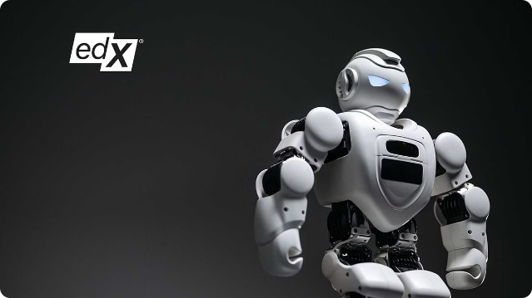
Personal Learning Assistant
Introducing a groundbreaking learning tool designed to personalize and enhance the educational experience. Leveraging the power of AI, this assistant provides interactive features that cater to individual learning styles and needs.

Slide 2



Introduction
1
Personalized Learning
Tailored learning paths adapt to individual strengths and weaknesses, providing personalized feedback and guidance.
2
AI-Powered Assessment
AI-driven quizzes and question generation offer dynamic assessment tools, providing immediate feedback and identifying areas for improvement.
3
Efficient Learning
Streamlined learning experience with smart features that help students learn more effectively and efficiently.
4
Enhanced Engagement
Interactive features and engaging learning content increase student engagement and motivation.

Slide 3
Technologies Used
LangChain
Vertex AI
PDFMiner
Streamlit
A framework for building applications powered by large language models (LLMs).
A fully managed AI platform for building and deploying AI models.
A Python library for extracting text and metadata from PDF documents.
An open-source Python library for building web applications.

Slide 4
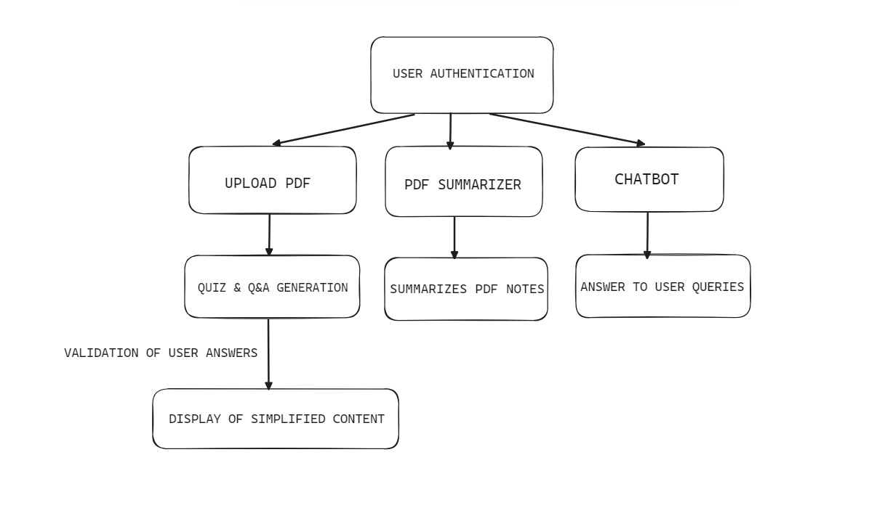
Project Architecture

Slide 5
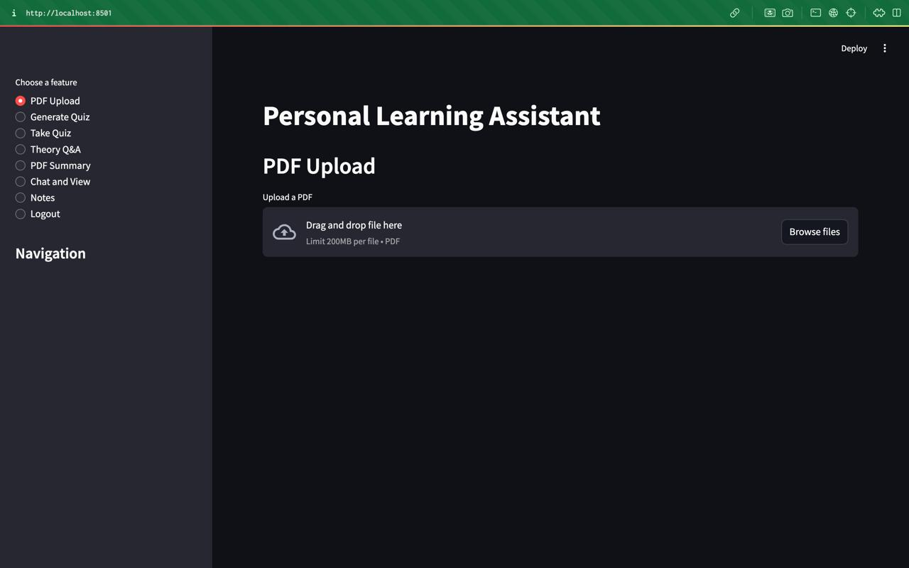
PDF Upload and Text Extraction
1
Upload PDF
Users can upload PDF documents to the platform.
2
Text Extraction
PDFMiner extracts text content from the uploaded PDF file.
3
Text Processing
The extracted text is stored and prepared for further processing by AI models.

Slide 6
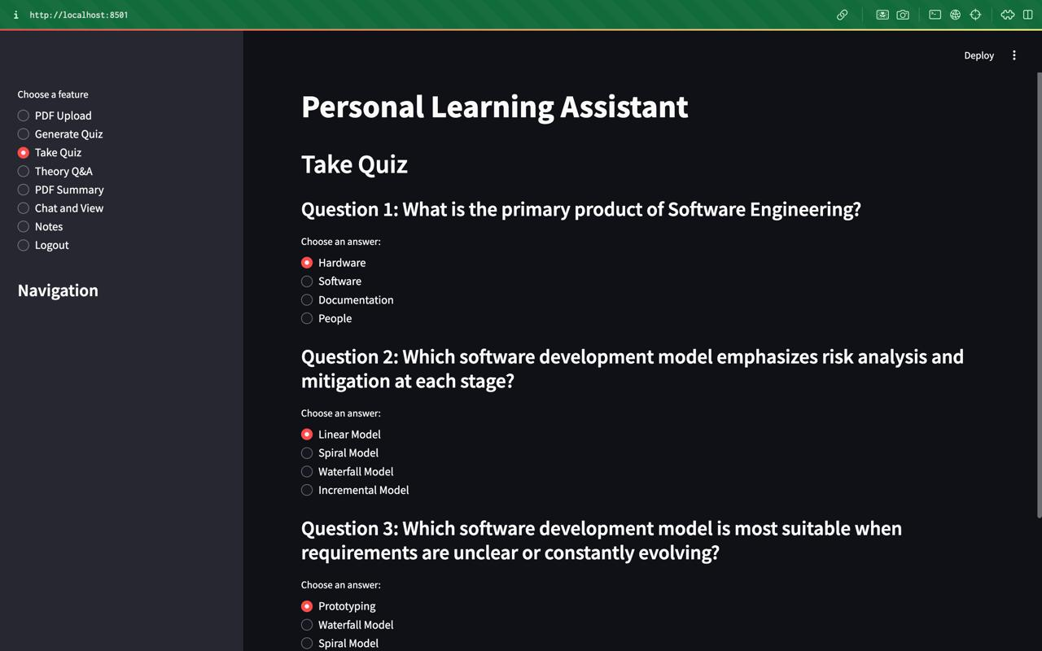
Quiz Generation
Question Generation
AI models generate multiple-choice questions based on the extracted PDF text.
Vertex AI Integration
Vertex AI is used for question generation and content analysis.
Streamlit Interface
The generated quizzes are displayed and answered through the Streamlit interface.

Slide 7
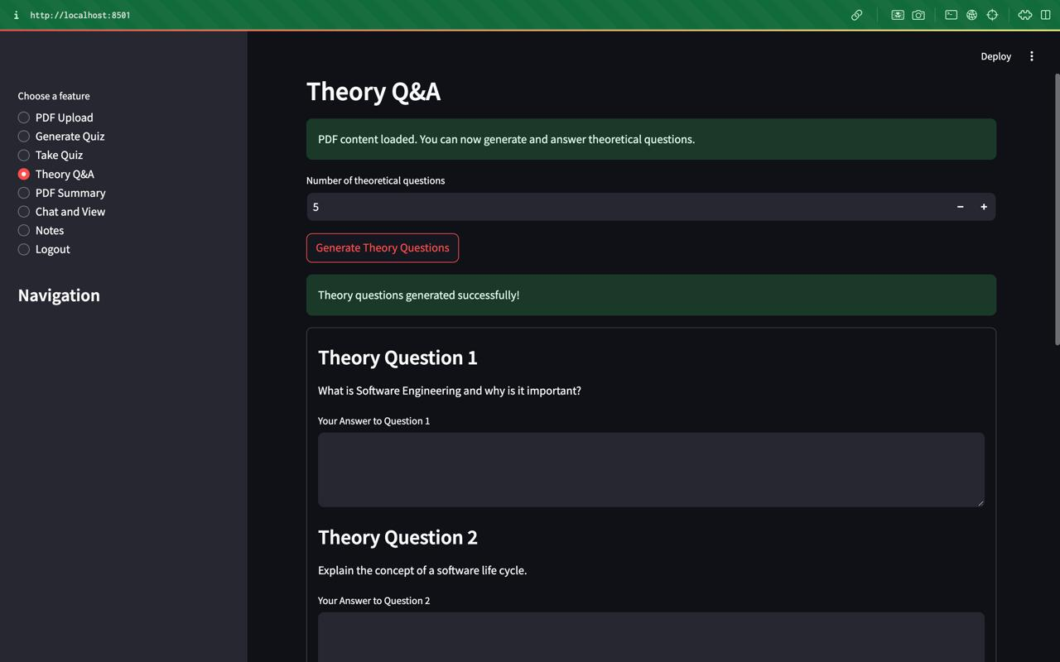
Theory Q&A
Step
Description
1
Question Generation
2
User Answer Input
3
Answer Evaluation
4
Feedback Provided

Slide 8

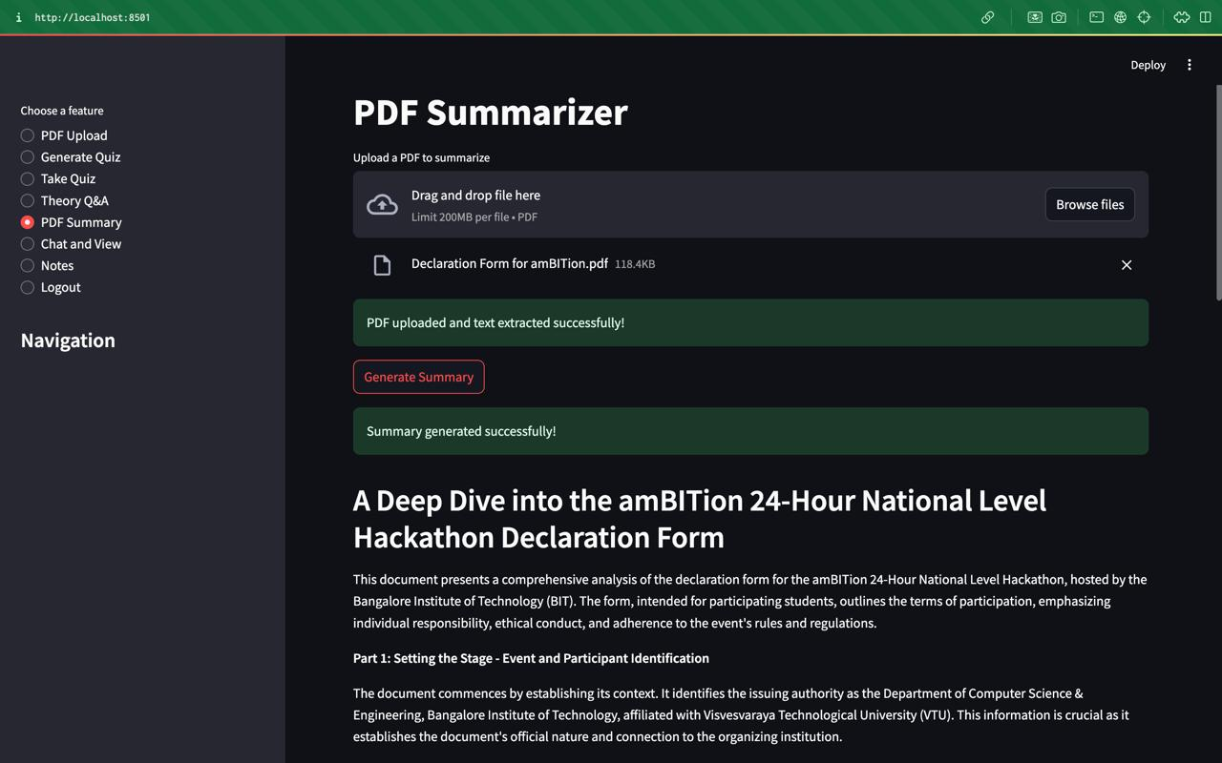



PDF Summarization
PDF Upload
Users can upload PDF documents to the platform.
Text Extraction
PDFMiner extracts text content from the uploaded PDF file.
AI Summarization
AI models generate a concise summary of the PDF content.
Summary Display
The generated summary is displayed in the Streamlit interface.

Slide 9
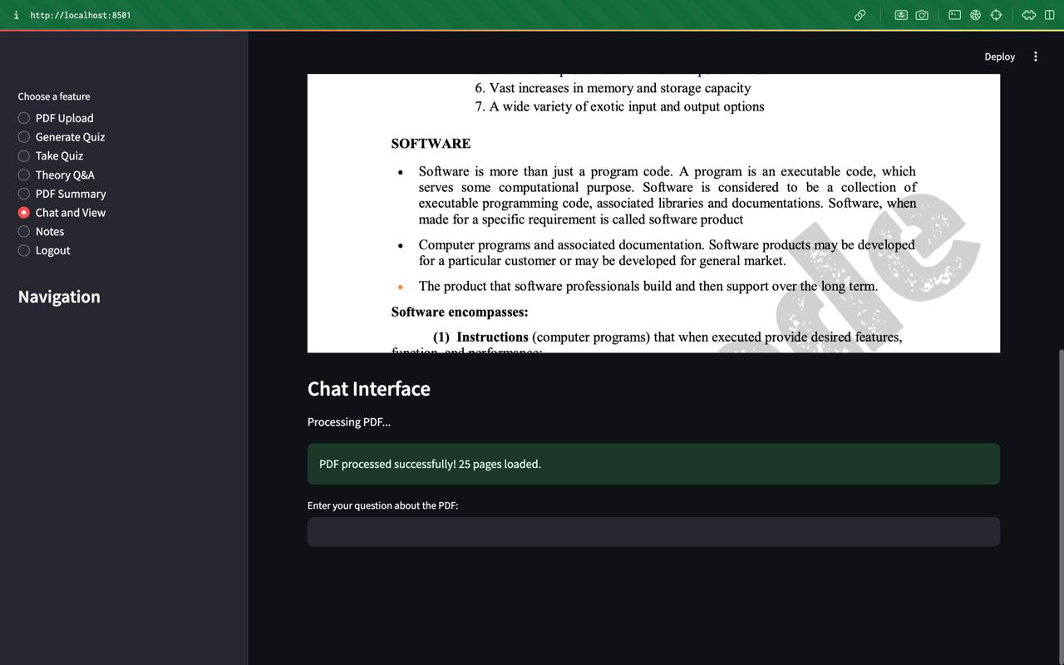
Chat Interface
AI Retrieval
PDF Upload
Chroma db, RAG, and LangChain are used for document retrieval and answer generation.
Users can upload PDF documents for interactive learning.
1
2
3
Chat Interaction
Users can ask questions about the PDF content through a chat interface.

Slide 10
Leveling Up
1
AI-Powered Q&A
2
Personalized Summaries
Advanced language models will generate dynamic quizzes and theory questions to test your knowledge.
Text-to-speech technology will provide tailored audio summaries of key concepts.
3
Adaptive Learning
4
Sleek New UI
The app will track your progress and recommend content based on your strengths and weaknesses.
A modern, React-powered interface will make the app a joy to use.

Slide 11
Conclusion
Our personalized learning assistant integrates cutting-edge technologies from OpenAI and Google's Vertex AI to significantly enhance the learning experience. Users can seamlessly upload PDFs to extract text, generate quizzes, and receive comprehensive evaluations with detailed feedback. The system excels in generating theoretical questions, summarizing extensive PDFs into concise formats, and facilitating interactive chats for AI-driven answers. Moreover, it offers text-to-speech conversion to enhance accessibility across different learning preferences. Our overarching objective is to create an adaptive and engaging learning environment that meets the unique needs of each user by delivering targeted content and personalized feedback. This project exemplifies the powerful synergy between AI advancements and educational tools, providing a robust platform tailored to individual learning journeys.

Slide 12
Thank You
Presented By-
BM Somashekar
Shreyas H S
Hritik P Gowda
Sri Vathsa

