Slide 1
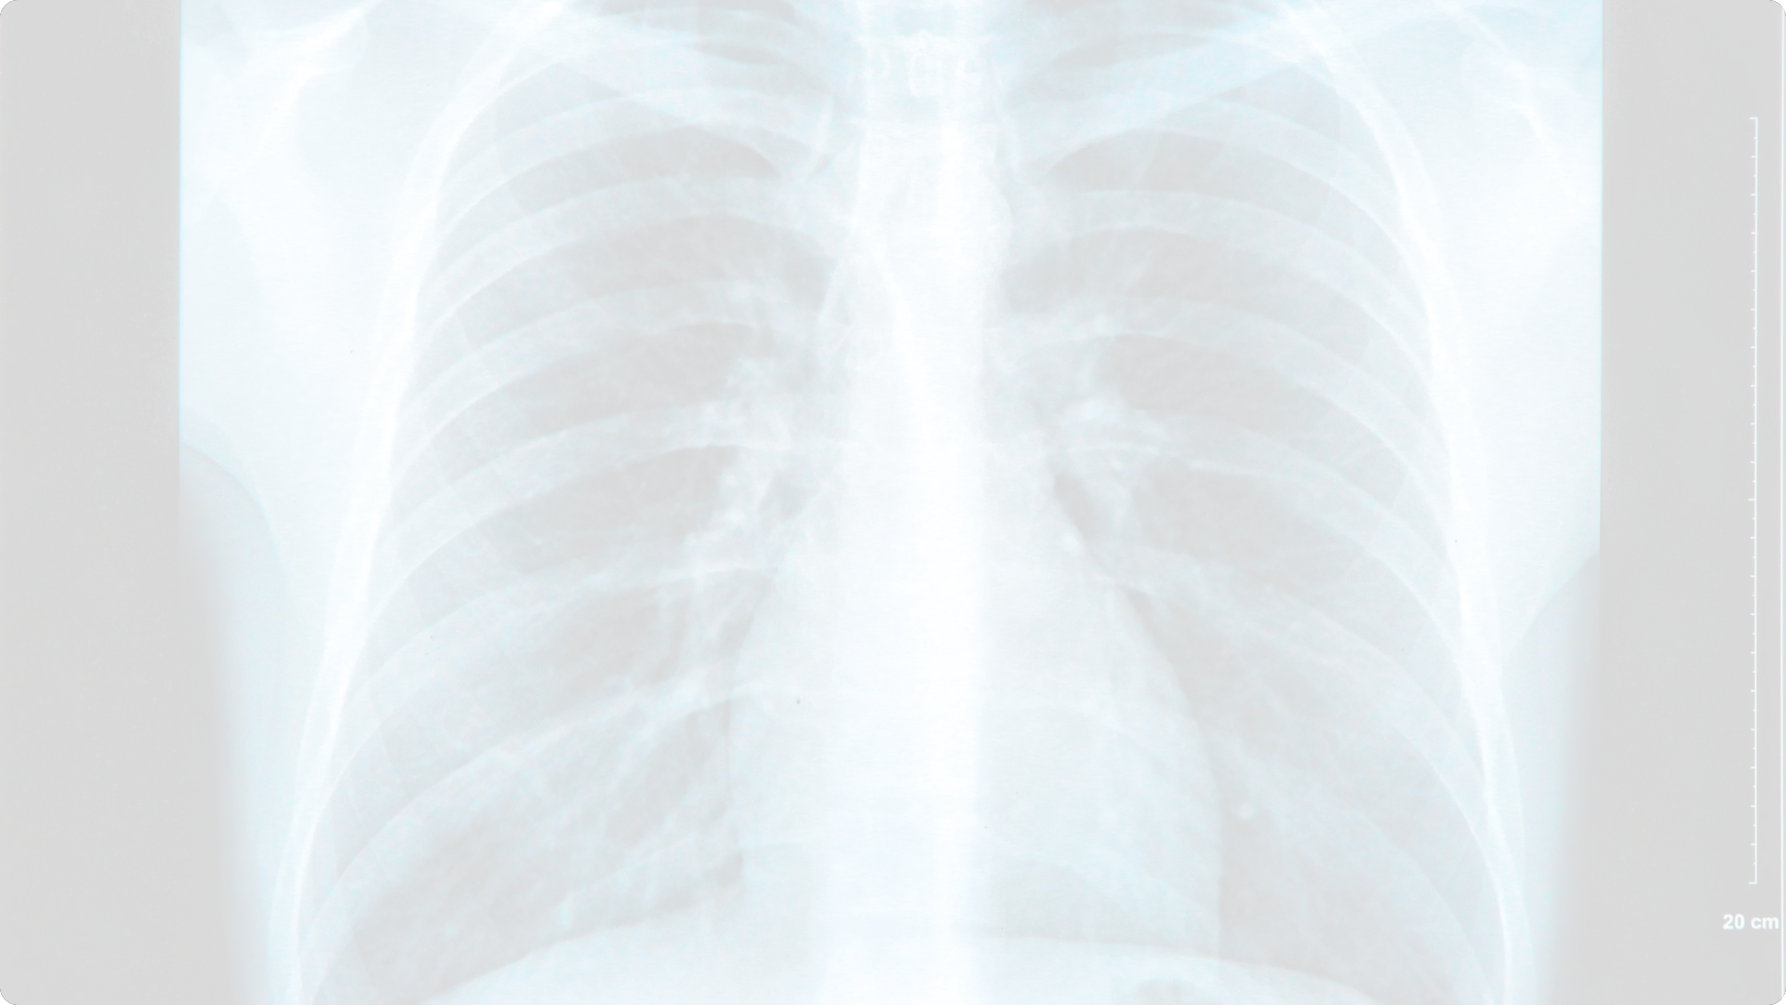
Image Captioning Using Deep Learning
Infosys Springboard Internship
Elevate medical diagnostics and streamline report generation through the power of deep learning-driven image captioning. This innovative project explores the development and deployment of advanced models to bring enhanced efficiency and precision to the healthcare industry.
Intern Name : Shreyas H S
Mentor Name : Sudheer Kumar Y

Slide 2
Project Overview and Objectives
1
Project Overview
2
Objective
Development and deployment of an image captioning system for radiology images using deep learning models.
Enhance medical diagnostics and report generation through automated image captioning.

Slide 3
Deep Learning Models Employed
Vision Encoder-Decoder Model
BLIP Model
CNN-RNN Model
Conditional image captioning model developed by Salesforce.
Combines CNNs for feature extraction with RNNs for sequential caption generation.
Integrates Google's ViT with GPT-2 for end-to-end image captioning.

Slide 4
Data Science Process
1
2
3
Data Acquisition
Data Preprocessing
Model Training
Collecting and organizing the ROCO dataset of radiology images and text captions.
Optimizing hyperparameters, leveraging transfer learning, and fine-tuning models.
Cleaning, resizing, and normalizing images; tokenizing and cleaning text captions.

Slide 5
Data Acquisition and Preprocessing
Dataset
Image Preprocessing
Text Preprocessing
ROCO (Radiology Objects in Context) dataset, containing radiology images and associated text captions.
Loading, resizing, and normalizing images to fit model requirements.
Tokenization, cleaning, and removal of special characters from the text captions.

Slide 6
Training Process and Optimization
Hyperparameter Tuning
1
Optimizing batch size, learning rate, and number of epochs for best performance.
2
Optimization Techniques
Employing Adam optimizer, early stopping, and model checkpointing to prevent overfitting.
Transfer Learning
3
Leveraging pre-trained models to accelerate training and improve accuracy.

Slide 7
Evaluation and Results
1
Evaluation Metrics
2
Model Performance
3
Analysis
Transformer-based models demonstrate superior accuracy and caption coherence over CNN-based approaches.
ROUGE and BLEU scores to assess the quality and coherence of generated captions.
Comparison of CNN-LSTM and VisionEncoderDecoderModel (BLIP) on validation and test sets.

Slide 8
Use Cases and Applications
Diagnostic Assistance
Medical Education
Clinical Documentation
Telemedicine
Medical Research
Quality Assurance
Patient Communication
Regulatory Compliance

Slide 9
THANK YOU
Thank you Infosys Springboard for the wonderful opportunity to show case our work!

