Slide 1
Cloud based Conditioning Monitoring System
Preseneted by:
Shreyash Sabde (119M0025)
Guided by:
Prof. G. D. Korwar

Slide 2
Introduction
90% of machine failures occurs due to vibration that leads to fatigue.
Vibration analysis is an important aspect when comes to failure of machine.
If we can able to predict the failure of machine well before, then probable damage can be avoided.
But Machine vibrations measured by accelerometers contains lot of noise so they need to be processed and necessary parameters should be extracted.
This can be done by a micro-computer like raspberry pi and with the help of cloud server, real time condition monitoring can be possible from anywhere in the world.
Condition monitoring is the process of monitoring a parameter of condition in machinery (vibration, temperature etc.), in order to identify a significant change which is indicative of a developing fault or presence of imbalance.
Placing sensors on industrial equipment to monitor performance, identifying changes in different parameters, and determining if these changes signal a need for equipment maintenance.

Slide 3
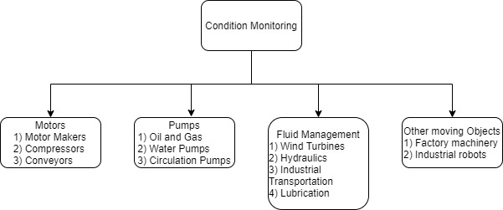
Condition Monitoring
Key Sensor Technologies for condition monitoring technologies
1) Vibration
2) Fluid Property
3) Pressure
4) Temperature
5) Humidity
6) Speed
7) Position
Applications of Condition Monitoring system

Slide 4
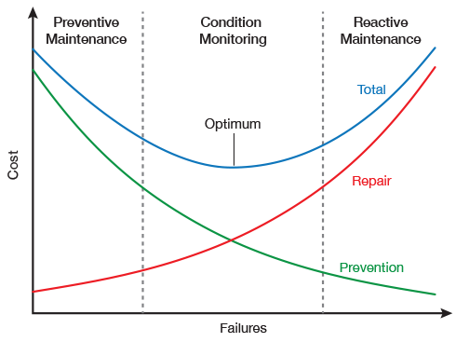
Advantages of Condition Monitoring
Increased uptime and machine productivity
Reduction of breakdowns / unplanned downtime, production losses and collateral damages
Lower maintenance and spares inventory costs
Enhanced human and environment safety
Prioritizing Maintenance Tasks
Increasing Lifespan of Machinery
Ability to detect, locate and distinguish faults, in a non-destructive way by acquiring data during normal machinery operation as the Vibration Signature contains most information that can be applied to inaccessible components and used for on-line condition monitoring.
Cost to failure analysis of Maintenance types

Slide 5
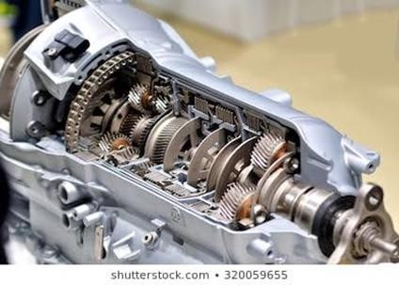
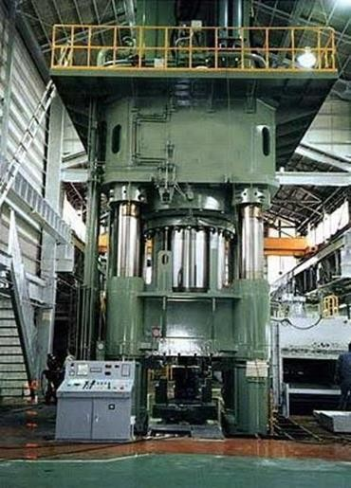
Problem Statement
To develop a cloud/ server based system which can be used to monitor health of the machines (viz. forging press, milling machine, gear box, etc) with the help of vibration analysis in order to predict failure so that the probable damage can be avoided.
Gearbox
Forging Press

Slide 6
Objectives
Measure time domain data of machine vibrations with an accelerometer and Raspberry pi Hardware
Preconditioning of the time domain data to make it suitable for FFT/Wavelet analysis
Qualitative analysis of the time domain data (FFT/Wavelet) and extraction of frequency and magnitude parameters
Transmission of the parameters to remote server/cloud at regular intervals
Detection of change in vibration data so as to warn machine operator.
Monitoring of vibration data with minimum human intervention.

Slide 7
Highlights of Project
Real time analysis of the machine
Localised analysis of sensor data
Routine study of the machine data for a specific duration of time
Predict failure of the machine by identification of change in sensor data
Monitor current state of machine from anywhere by enabling wireless transmission
Motivation of the project
We have already one system LabVIEW to detect the fault in machine through FFT analysis of vibration. But the issue with the system is that system is costly an requires attention from supervisor.
System we are trying to build requires raspberry, accelerometer and wired connections. Which is portable, very cheap compared LabVIEW setup and we are trying to make system robust, accurate, reliable.

Slide 8
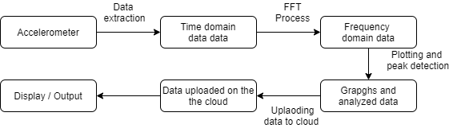
Methodology
General Procedure 1) Generating time domain sensor data 2) Qualitative analysis of data (FFT) 3) Finding peaks of the acceleration and FFT data 4) Plotting the FFT graphs 5) Extracting and uploading important parameters to the cloud server
Then, analyse the plots with plot taken when machine is under is new or under ideal condition.
Flowchart of Methodology

Slide 9
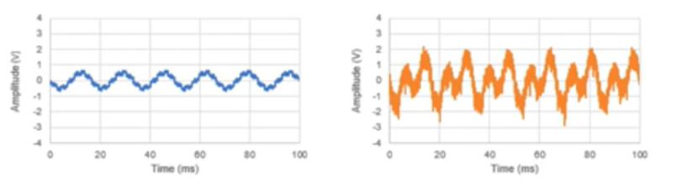
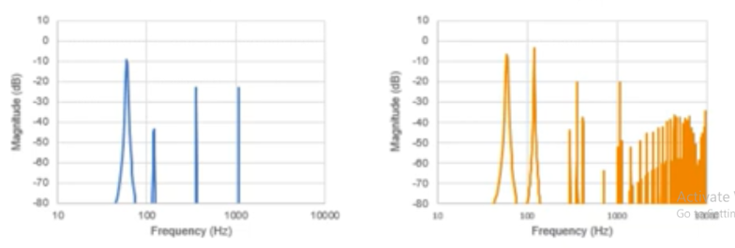
Industrial Condition Monitoring Sensors (methodology)
When Machine running OK
When Machine not running OK

Slide 10
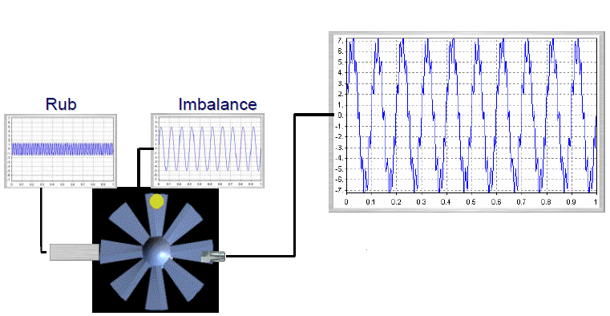
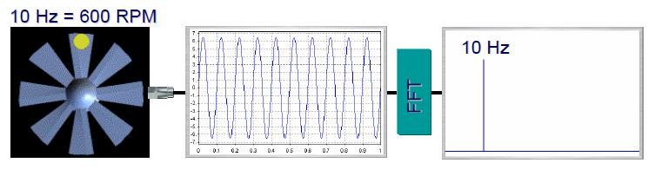
Effect of presence of Imbalance on vibration
Under normal condition
Under presence of imbalance

Slide 11
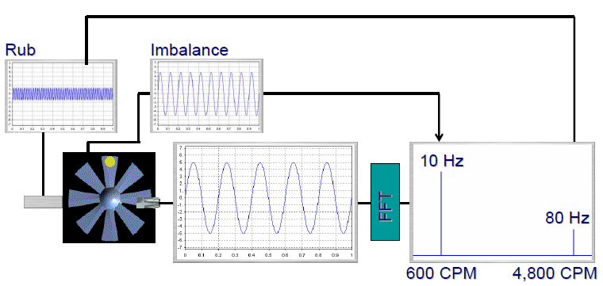
Effect of presence of Imbalance on vibration
Frequency Spectrum under presence of imbalance
The presence of imbalance in the machine lead to the rise in the amplitude at frequency other than natural frequency.
This distinguishing factor we will be using
Frequency Spectrum of Machine under presence of imbalance

Slide 12
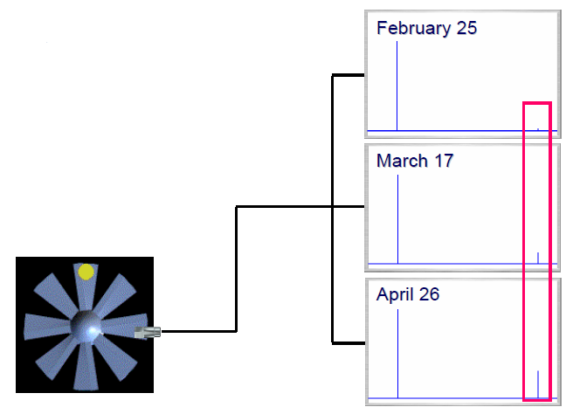
Condition Monitoring
In practice, we watch how the patterns and levels change over time.
We relate the changes to what we know about the machine.
The sensor converts the vibration into an electronic signal.
The most common sensor is an accelerometer.
The sensor is commonly attached using a magnet.
Proper mounting is very important.
“Repeatability” is essential.
Condition Monitoring over regular interval

Slide 13
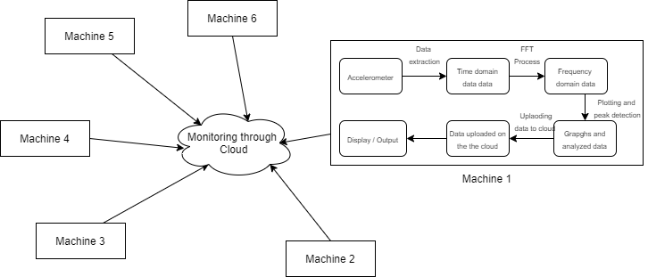
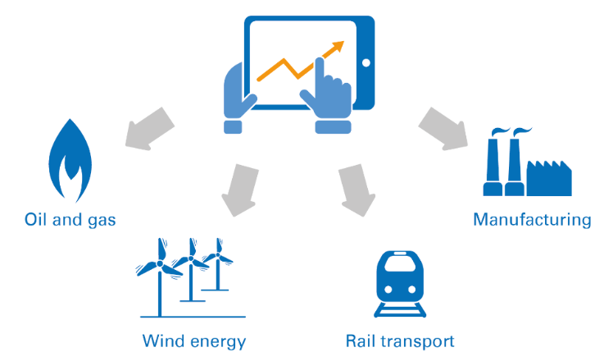
Centralized Condition Monitoring System
Centralized Condition Monitoring System for different applications

Slide 14
Hardware Required for setup
Raspberry Pi 3B+
Broadcom BCM2837B0, Cortex-A53 (ARMv8) 64-bit SoC @ 1.4GHz.
1GB LPDDR2 SDRAM.
2.4GHz and 5GHz IEEE 802.11.b/g/n/ac wireless LAN, Bluetooth 4.2, BLE.
Gigabit Ethernet over USB 2.0 (maximum throughput 300 Mbps)
Extended 40-pin GPIO header.
Full-size HDMI.
4 USB 2.0 ports.
ADXL 345 accelerometer
The ADXL345 is a small, thin, low power, 3-axis accelerometer with high resolution (13-bit) measurement at up to ±16g.
Ultralow power: as low as 23 μA in measurement mode and 0.1 μA in standby mode at V_{S} = 2.5 V

Slide 15
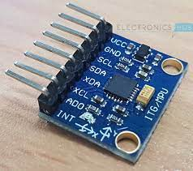
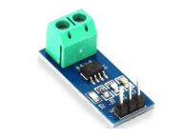
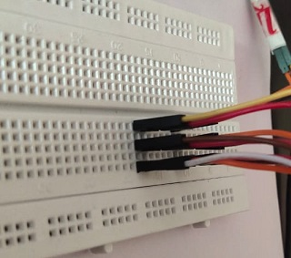
Other Hardware Equipments required
Gyroscope Sensor MPU6050
Current Sensor ACS712
Breadboard
Other than that
HDMI cable to connect monitor to raspberry pi card
Jumper wires connects accelerometer to the raspberry pi card
Charging adapter for power supply to raspberry pi card
Monitor screen displays output of a program
Keyboard, mouse is to give inputs

Slide 16
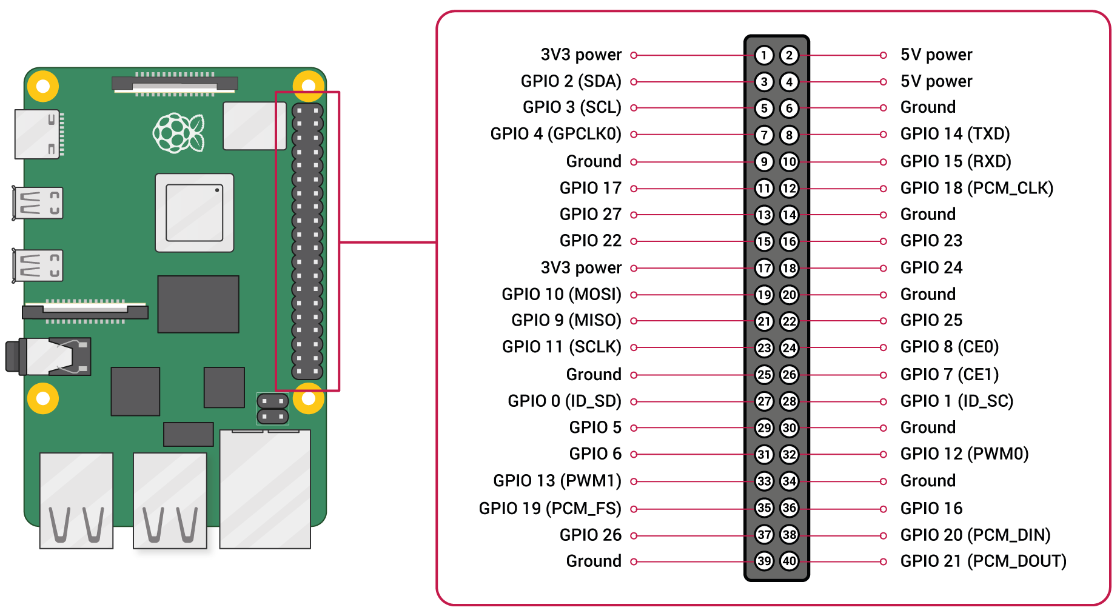
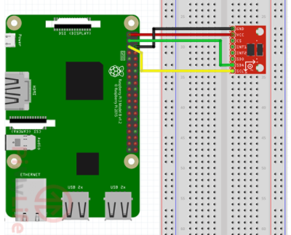
Connections
Raspberry Pi GPIO Nomenclature
Raspberry Pi to Accelerometer ADXL345 sensor

Slide 17
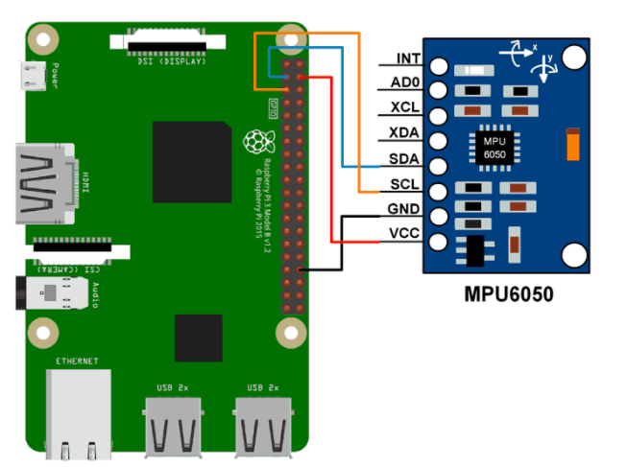
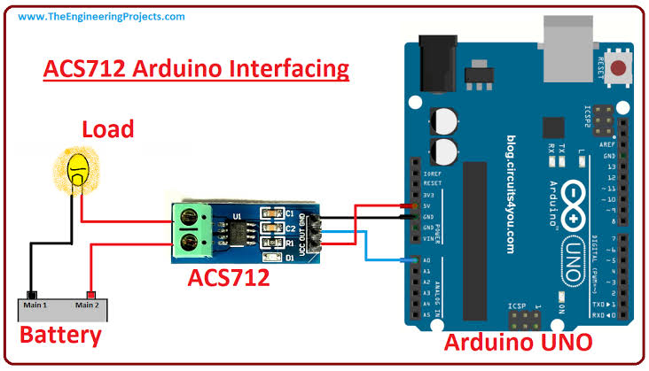
Connections contd.
Raspberry Pi to Gyroscope MPU605 sensor
Connection of Current Sensor ACS712

Slide 18
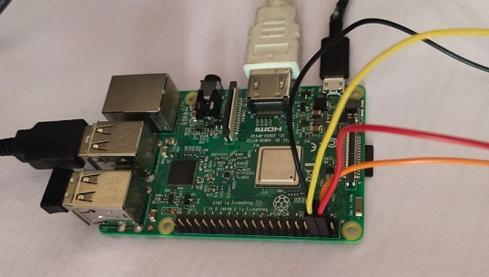
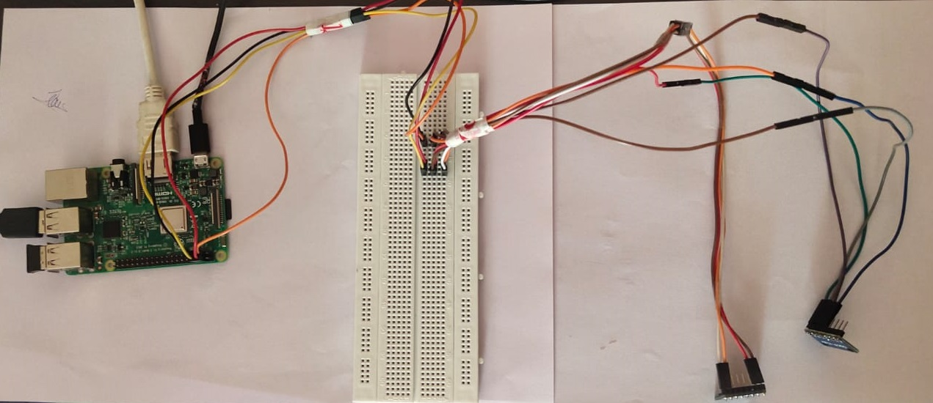
Connections contd.
Full connections with raspberry Pi

Slide 19
Programming required for setup
Software required for setup
Programming flow chart
Installation of software
Python 3.7
Python IDE, Visual studio code
Python Libraries: Numpy, Scipy, Matplotlib,adxl345
Flowchart of Programming flow

Slide 20
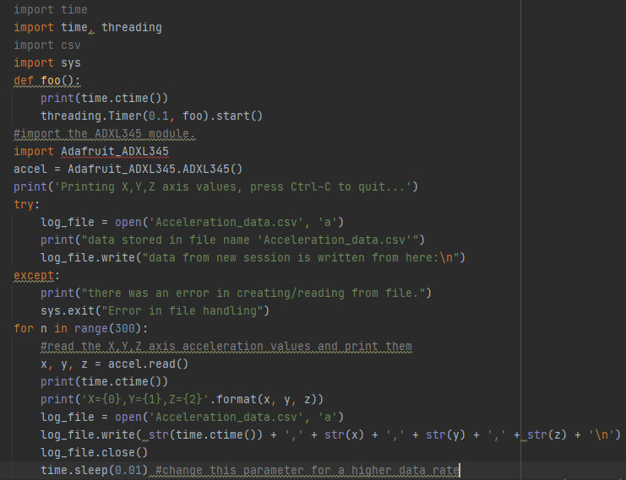
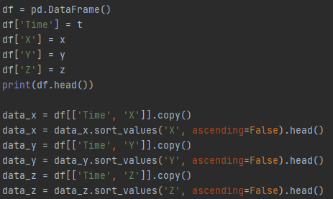
Coding Part and Output
Code for extracting sensor data
Code for finding peaks in acceleration data

Slide 21
Coding Part and Output
data from new session is written from here:
Wed Dec 2 19:39:20 2020 | X | Y | Z
Wed Dec 2 19:39:20 2020 | 18 | -30 | 241
Wed Dec 2 19:39:20 2020 | 20 | -31 | 242
Wed Dec 2 19:39:20 2020 | 16 | -30 | 241
Wed Dec 2 19:39:20 2020 | 17 | -30 | 243
Wed Dec 2 19:39:20 2020 | 18 | -29 | 242
Wed Dec 2 19:39:20 2020 | 16 | -26 | 245
Wed Dec 2 19:39:20 2020 | 15 | -29 | 242
Wed Dec 2 19:39:20 2020 | 24 | -23 | 242
Wed Dec 2 19:39:21 2020 | 22 | -25 | 243
Wed Dec 2 19:39:21 2020 | 22 | -21 | 243
Wed Dec 2 19:39:21 2020 | 25 | -26 | 242
Wed Dec 2 19:39:21 2020 | 27 | -24 | 247
Wed Dec 2 19:39:21 2020 | 24 | -23 | 240
Wed Dec 2 19:39:21 2020 | 27 | -25 | 241
Wed Dec 2 19:39:21 2020 | 24 | -22 | 247
Wed Dec 2 19:39:21 2020 | 25 | -23 | 243
Wed Dec 2 19:39:21 2020 | 26 | -24 | 243
 | Time | X | Time | Y | Time | Z
0 | Tue Jun 8 17:27:09 2021 | 470 | Tue Jun 8 17:27:09 2021 | 177 | Tue Jun 8 17:27:09 2021 | 511
1 | Tue Jun 8 17:27:09 2021 | 470 | Tue Jun 8 17:27:09 2021 | 177 | Tue Jun 8 17:27:10 2021 | 511
2 | Tue Jun 8 17:27:09 2021 | 226 | Tue Jun 8 17:27:10 2021 | 157 | Tue Jun 8 17:27:10 2021 | 511
3 | Tue Jun 8 17:27:09 2021 | 200 | Tue Jun 8 17:27:09 2021 | 149 | Tue Jun 8 17:27:10 2021 | 511
4 | Tue Jun 8 17:27:09 2021 | 200 | Tue Jun 8 17:27:09 2021 | 149 | Tue Jun 8 17:27:10 2021 | 511
Output of code of finding peaks of acceleration data
Output of code of Extraction of sensor data

Slide 22
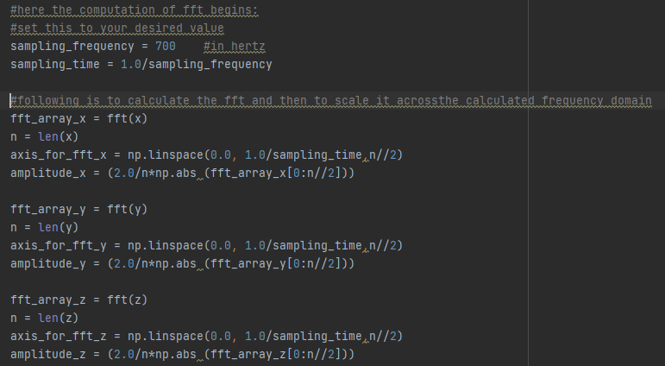
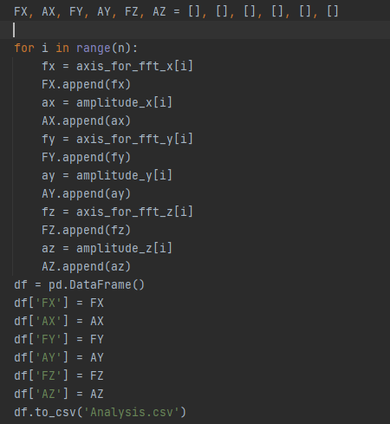
Coding Part and Output contd.
Code for Fast Fourier Transformation
Code for extracting FFT values

Slide 23
Coding Part and Output contd.
frequency of X | Amplitude of X | frequency of Y | Amplitude of Y | frequency of Z | Amplitude of Z
0.00 | 53.03 | 0.00 | 47.50 | 0.00 | 476.37
0.34 | 3.07 | 0.34 | 2.04 | 0.34 | 7.24
0.69 | 6.62 | 0.69 | 0.76 | 0.69 | 8.76
1.03 | 4.48 | 1.03 | 1.23 | 1.03 | 7.43
1.38 | 3.55 | 1.38 | 0.89 | 1.38 | 9.82
1.72 | 2.42 | 1.72 | 2.40 | 1.72 | 10.37
2.07 | 1.26 | 2.07 | 1.63 | 2.07 | 7.61
2.41 | 1.52 | 2.41 | 0.27 | 2.41 | 7.27
2.76 | 2.13 | 2.76 | 0.72 | 2.76 | 5.36
3.10 | 2.05 | 3.10 | 2.03 | 3.10 | 10.13
3.45 | 3.05 | 3.45 | 1.05 | 3.45 | 7.96
3.79 | 0.76 | 3.79 | 2.87 | 3.79 | 13.76
Output of code of FFT conversion of time domain data

Slide 24
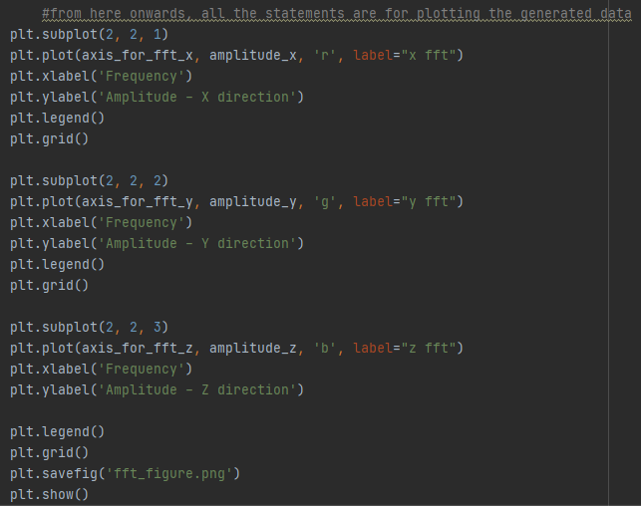
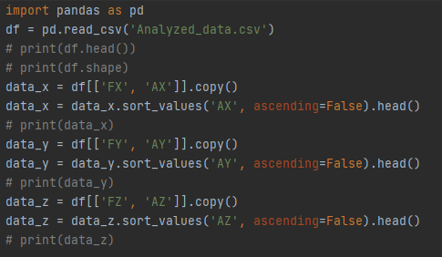
Coding Part and Output contd.
Code for plotting FFT plots
Code for finding the peaks in vibration amplitude

Slide 25
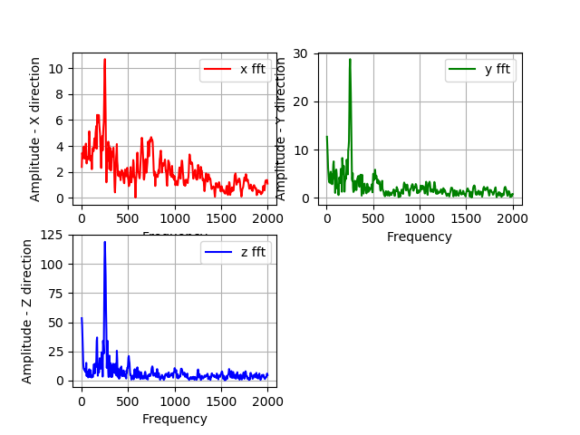
Coding Part and Output contd.
 | FX | AX | FY | AY | FZ | AZ
0 | 3.355705 | 47.55197 | 0 | 490.78 | 0 | 148.4267
1 | 127.5168 | 39.7611 | 127.5168 | 49.58895 | 127.5168 | 15.70128
2 | 130.8725 | 28.16092 | 130.8725 | 31.06386 | 3.355705 | 8.313788
3 | 6.711409 | 25.66657 | 124.1611 | 21.2913 | 130.8725 | 6.308352
4 | 124.1611 | 17.25682 | 120.8054 | 19.27833 | 120.8054 | 5.491521
Output of code of plotting the FFT data
Output of code of finding peaks of FFT data

Slide 26
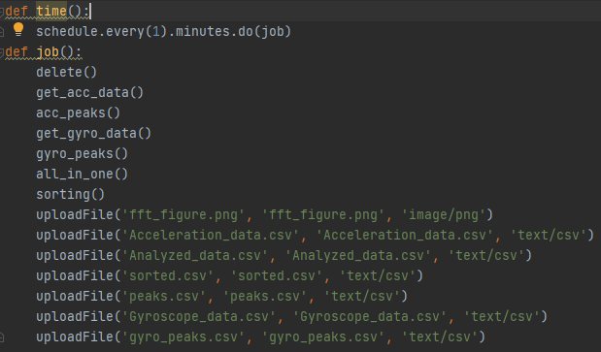
Coding Part and Output contd.
As one of the objective is to monitor the vibration data with minimum human intervention. So, operator doesn’t have to run the python program separately and after interval.
First, we call all the programs in one program sequentially. So that on running on one master program all the sub programs like extracting accelerometer, FFT analysis, Uploading csv and png file run in the sequence we call them.
Then we add schedule function in our program to run the program after regular interval.
Now, it is ready to take run on machine to record vibration data after regular interval.
Example, in our program we have given start time 7:00, so the first program will run at 7 am. Then after that it will run after regular interval of 60 minutes.

Slide 27
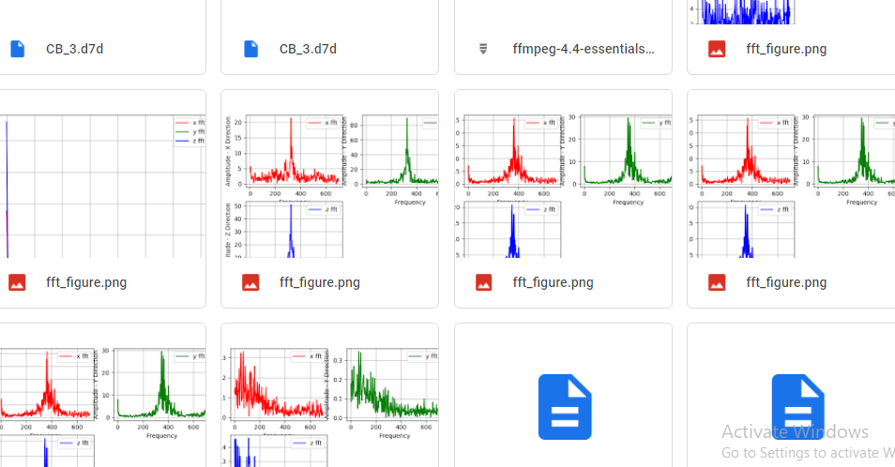
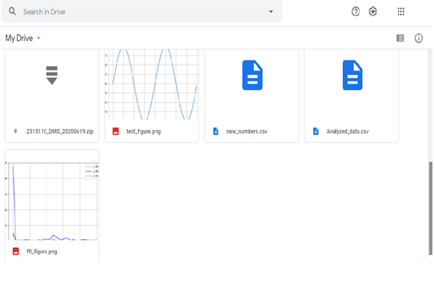
Coding Part and Output contd.
Output of code of data uploading to drive
Output of code of data uploading to drive

Slide 28
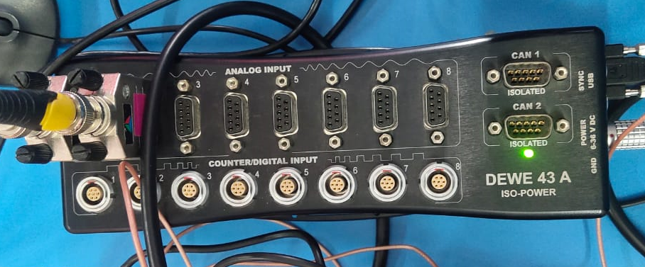
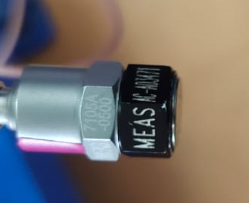
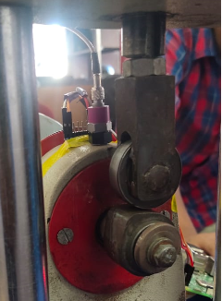
Testing and Validation
Setup
Data acquisition system
Accelerometer
Acceleration sensors mounting

Slide 29
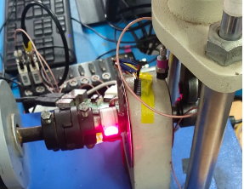
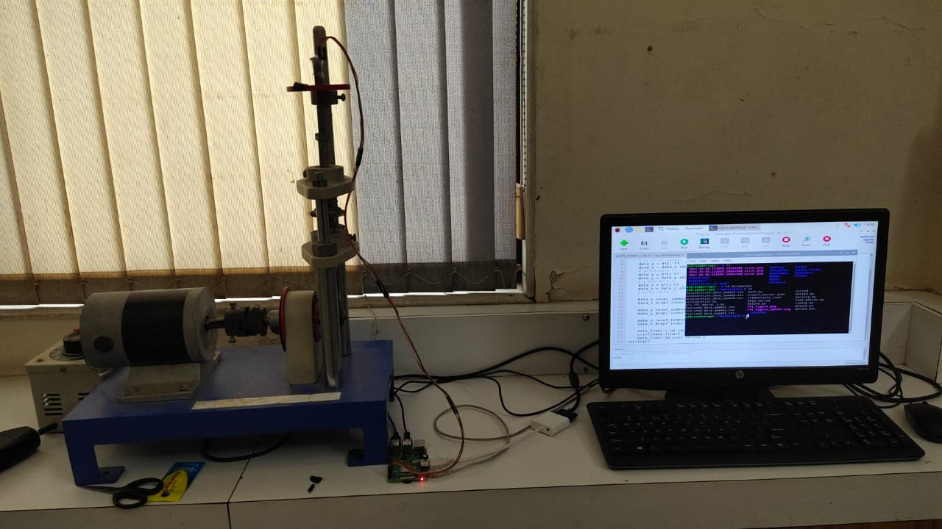
Cam Follower setup against Raspberry Pi setup
Sensor Mounting on bearing casing
Cam Follower setup
Raspberry Pi
Setup on cam follower using DAQ, accelerometer
Setup on cam follower using raspberry pi and ADXL accelerometer

Slide 30
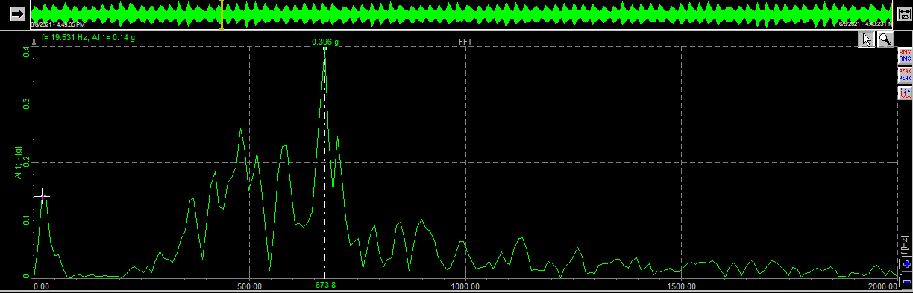
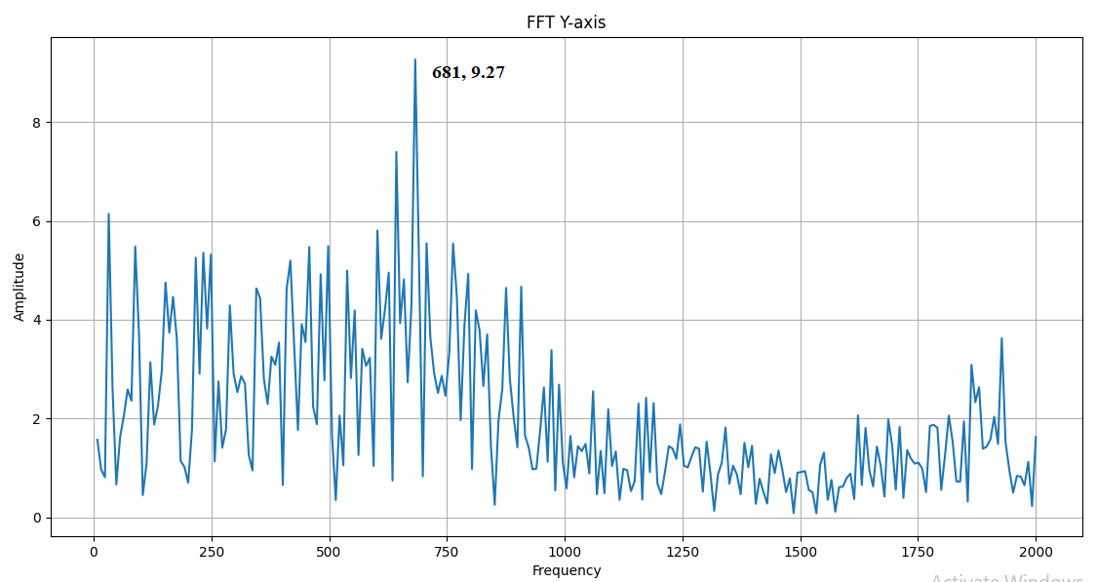
Test1
Result and Discussion
Dewsoft software FFT readings
Corresponding FFT plot on raspberry pi
Sr. No. | Reading | Dewesoft reading | Pi setup reading
1 | Frequency | 673.8 | 681
2 | Amplitude | 0.396g = 3.88 m/s² | 9.27 m/s²

Slide 31
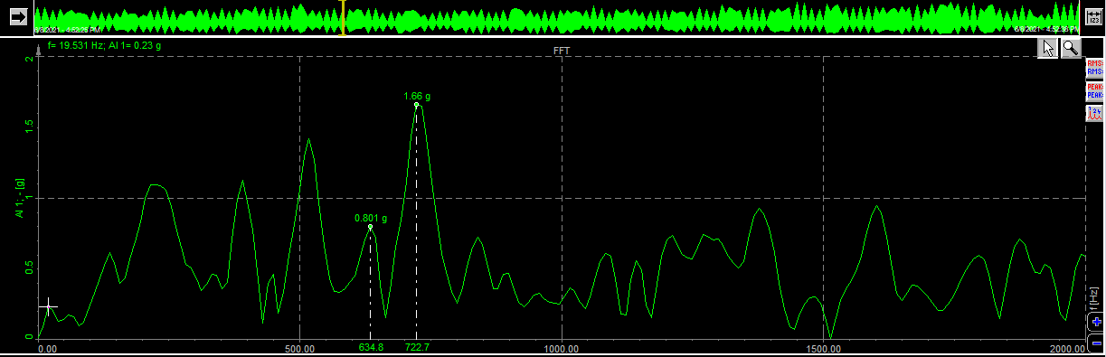
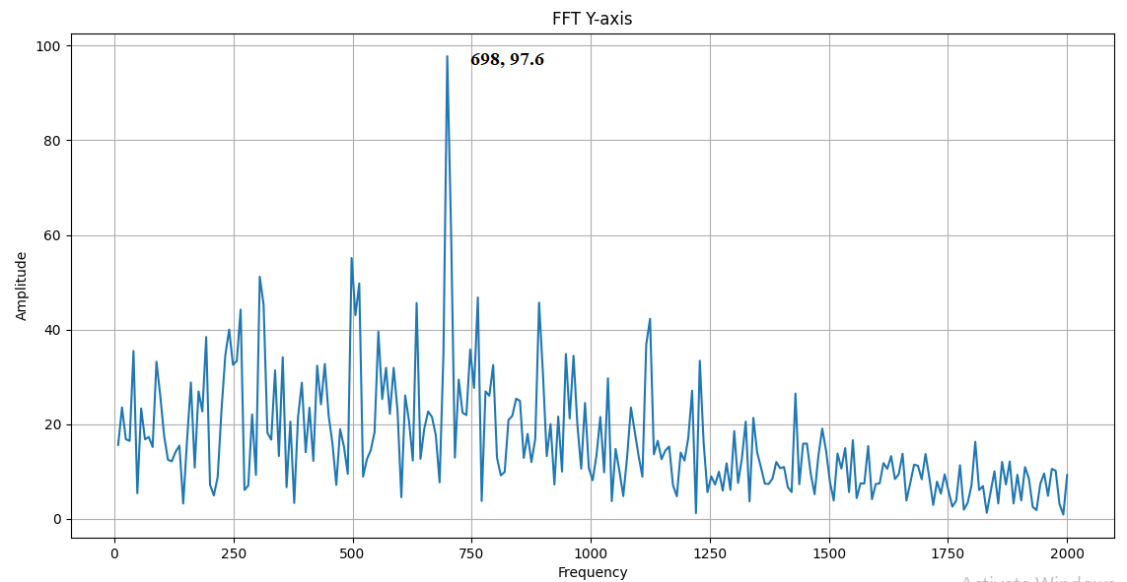
Test 2
Result and Discussion
Dewsoft software FFT readings
Corresponding FFT plot on raspberry pi
Sr. No. | Reading | Dewesoft reading | Pi setup reading
1 | Frequency | 722 | 698
2 | Amplitude | 1.66g = 16.28 m/s² | 97.2 m/s²

Slide 32
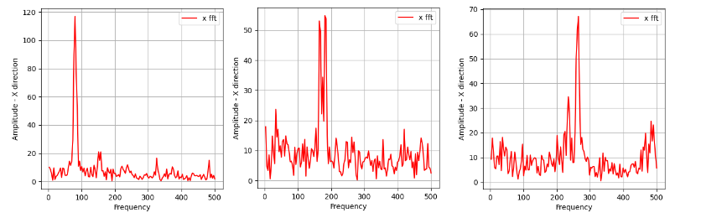
Testing variation of peaks with change in speed
FFT plot at Speed 1
FFT plot at Speed 2
FFT plot at Speed 3
Sr. No | Speed | Frequency at peak
1 | Speed 1 | 80 Hz
2 | Speed 2 | 181 Hz
3 | Speed 3 | 265 Hz

Slide 33
Conclusion
Python codes developed are working. Right from Acceleration data acquisition to uploading FFT values and plots are working well.
We are able to get graphs of FFT in all three axis. By this we can detect the vibration nature in all three axis. It will be easy to diagnose the vibration problem.
We are able to get the FFT values of machine at regular intervals and operator can check the values from google drive without actually being present at the machine. This helps us in taking periodic checking of vibration analysis. Based on regular analysis we can compare the graph when we have ideal condition of machine.
Based on the basis of rise in amplitude at other than natural frequency we can detect the presence any fault or imbalance in the machine.
Also the multiple sensor integration is achieved, through which we are able use multiple sensor like accelerometer, gyroscope, current sensor on same raspberry pi system so that we can achieve monitoring of many parameters of machine or we can monitor many machines at a time.

Slide 34
Thank You

