Slide 1
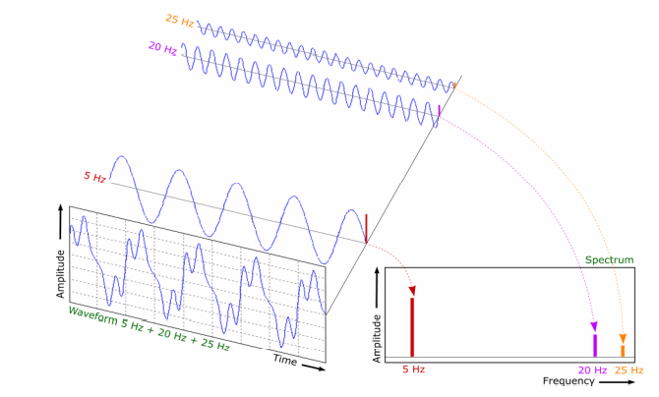
Spectrum
Converting time domain data into frequency domain, it will tell us the different vibrating frequency in the system.

Slide 2
Lines of resolution
The FFT always has a defined number of lines of resolution.
100, 200, 400, 800, 1600, and 3200 lines are common choices.
This spectrum has 800 lines, or the X scale is broken down into 800 points.
The sampling rate, The sampling rate, number of samples and the length of time record determine resolution and Fmax.

