Slide 1
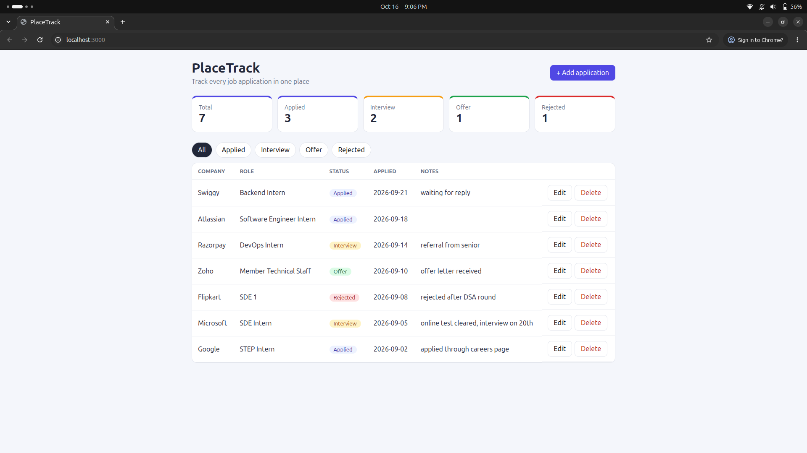
DEVOPS FINAL PROJECT
ApplyLog
Job application tracker, built, shipped and monitored with DevOps tools
Shreyash Kawde
24BCS10253
github.com/Shreyash-Beyond-Journeys-End/Devops_Final_Project

Slide 2
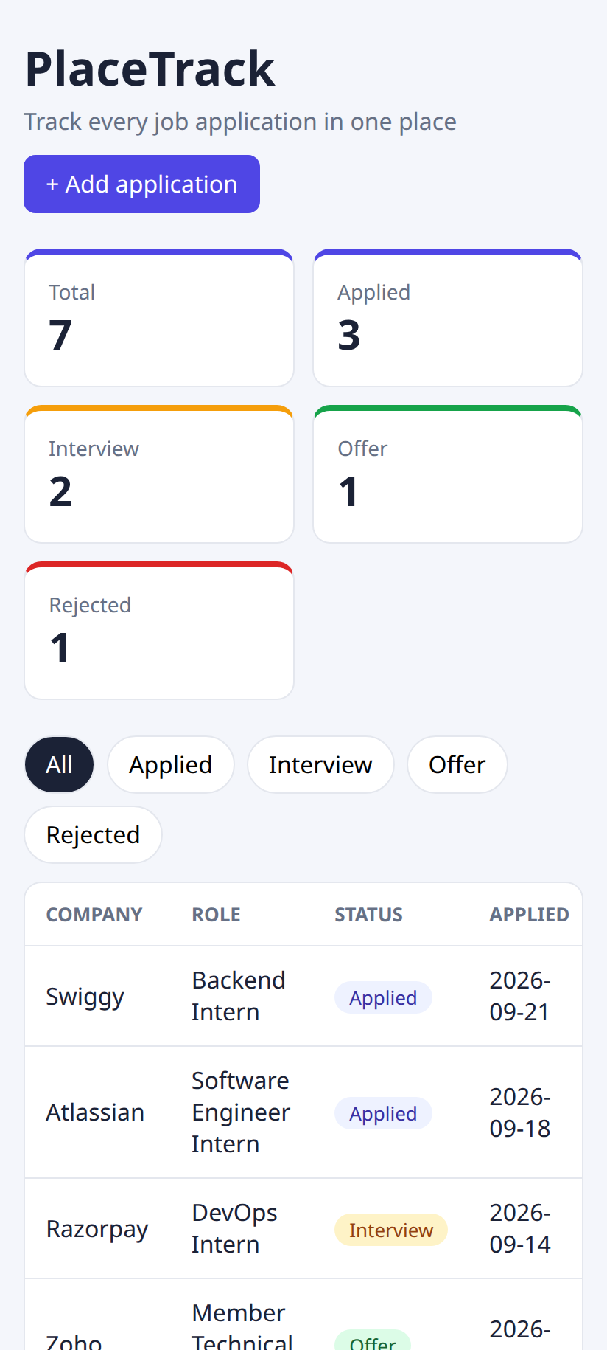
What I will show
1
Build and test
App, pytest, Git, Docker
2
CI/CD and security
GitHub Actions, GHCR, Trivy
3
Cloud and Kubernetes
Terraform on AWS, Helm, HPA
4
Run it
Monitoring, troubleshooting, live demo
02

Slide 3
The idea
In placement season I was applying everywhere and my Excel sheet became a mess. So I made a small app where every application has a status and I can see everything in one place.
Tools I used
- React + nginx
- FastAPI + PostgreSQL
- pytest
- Docker, Compose
- GitHub Actions, GHCR
- Trivy
- Terraform, AWS EKS
- minikube, Helm
- Prometheus, Grafana
applied
interview
offer
rejected
- The app is small on purpose
- Most of the work is around it: tests, containers, pipeline, security scan, cloud, Kubernetes and monitoring
03

Slide 4
How it all connects
1
I push code to main
Safety checks
2
Tests and frontend build run
- A failing test stops everything
- A fixable HIGH / CRITICAL CVE stops the push
3
Docker images are built
4
Trivy scans the images
Separate from the pipeline
5
Images go to GHCR (tag = commit SHA)
- Terraform makes the VPC + EKS on AWS
- I ran it once and destroyed it to save money
6
Self-hosted runner does helm upgrade
7
Prometheus + Grafana watch the app
04

Slide 5
PART 1
Build and test
The app, the tests, Git and Docker

Slide 6
Application
Part 1 | M1
What it has
- FastAPI with GET, POST, PUT, DELETE on /api/jobs
- Extra: /stats, /health, /ready, /metrics
- Postgres table from an Alembic migration
- Wrong input gives 422
- React page uses fetch to call the API
Running at localhost:3000
06

Slide 7
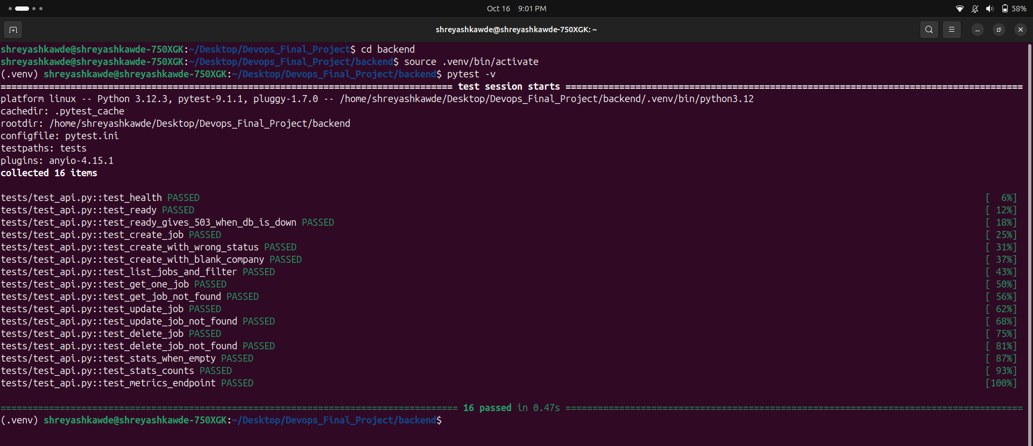
Tests
Part 1 | M2
How I tested
- 16 tests in test_api.py
- All endpoints + 404 and 422 cases
- In-memory SQLite, never the real DB
- conftest.py overrides get_db
- Pipeline runs these first
pytest -v -> 16 passed
07

Slide 8
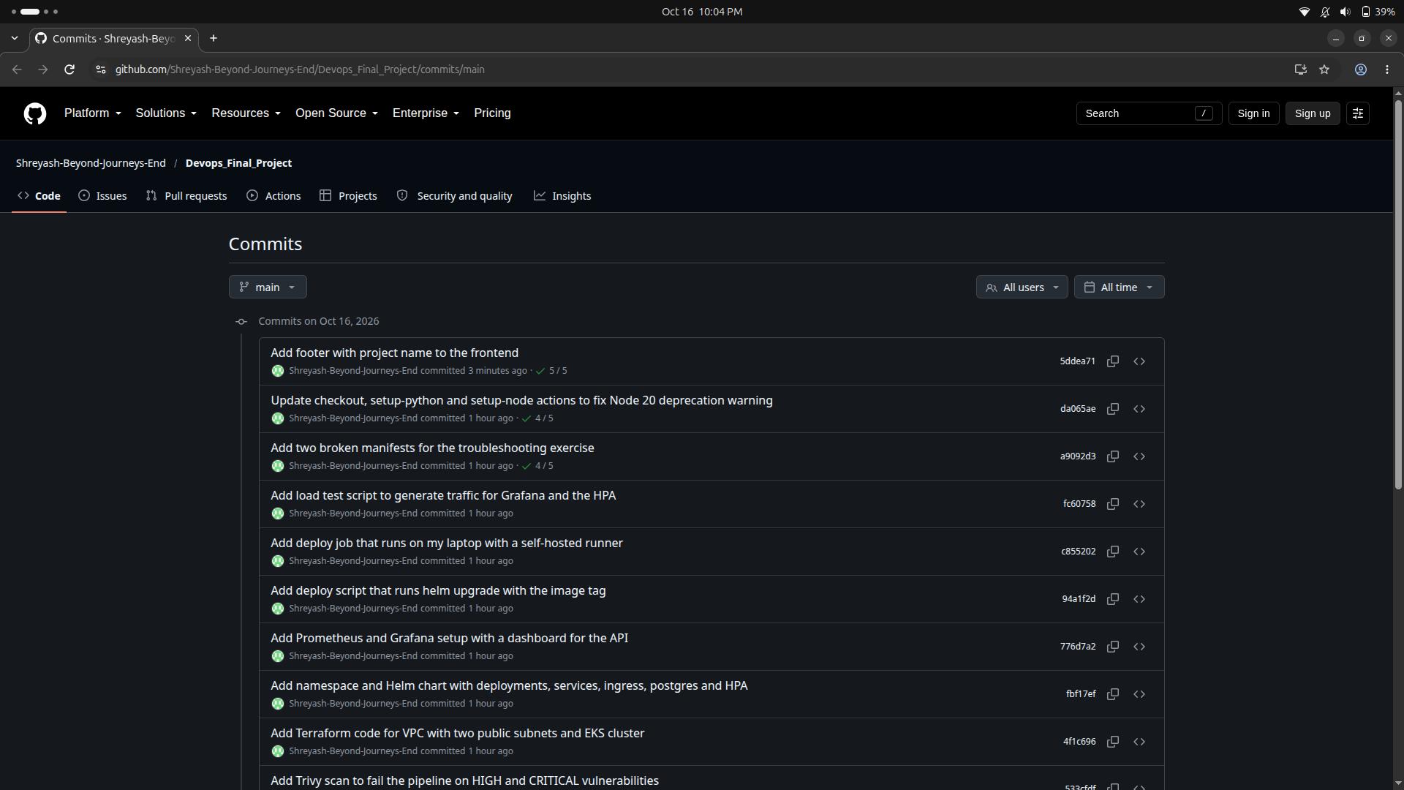
Git and GitHub
Part 1 | M3
How I used Git
- Public repo
- Small commits, clear messages
- .gitignore covers .env, .venv, __pycache__, node_modules, tfstate, tfvars
- No passwords or AWS keys committed
Commit history on GitHub
08

Slide 9
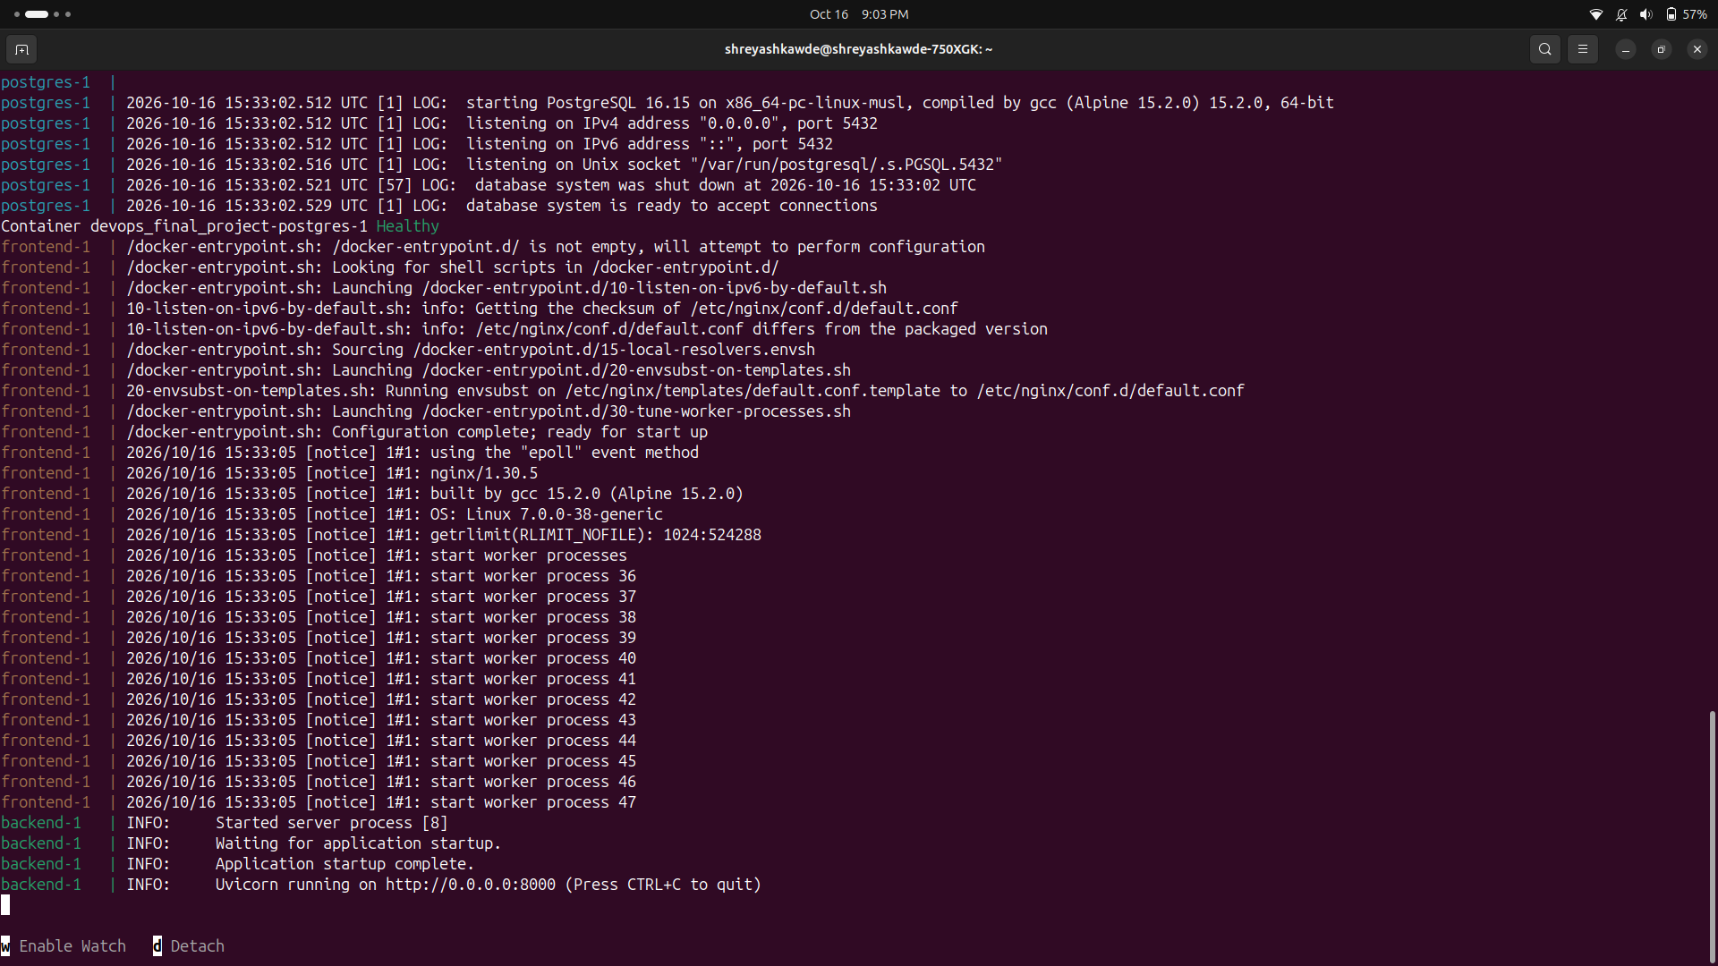
Docker
Part 1 | M4
Images
- Backend: python:3.12-slim, runs as appuser
- Frontend: 2 stages, node builds, nginx-unprivileged serves
- Nothing runs as root
- Compose: postgres, backend, frontend
- Backend waits for postgres, then migrates
docker compose up --build
09

Slide 10
PART 2
CI/CD and security
GitHub Actions, GHCR and Trivy

Slide 11
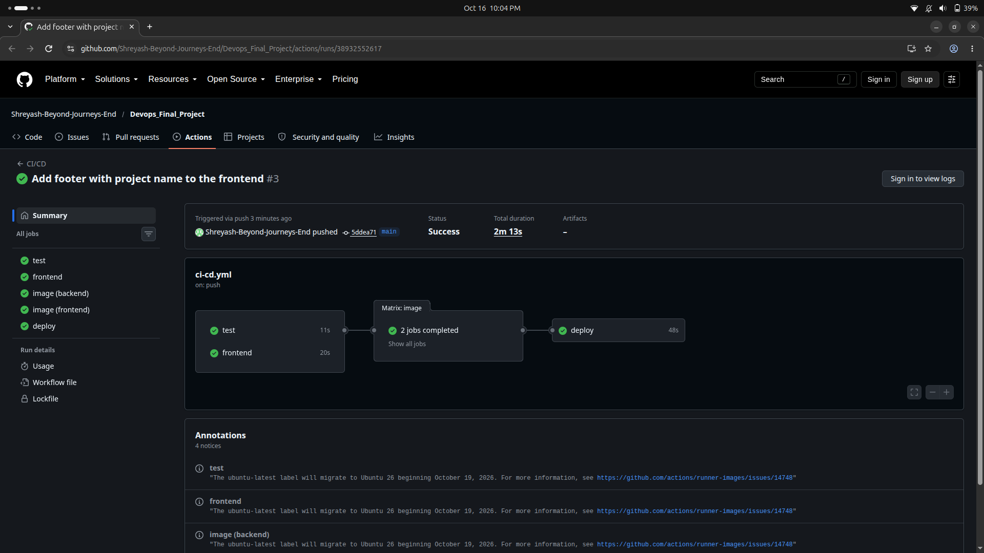
Pipeline
Part 2 | M5
Run #3: test, frontend, image x2 and deploy all passed
runs on every push to main | pytest gate | frontend build | images tagged with commit SHA | deploy on my laptop runner
11

Slide 12
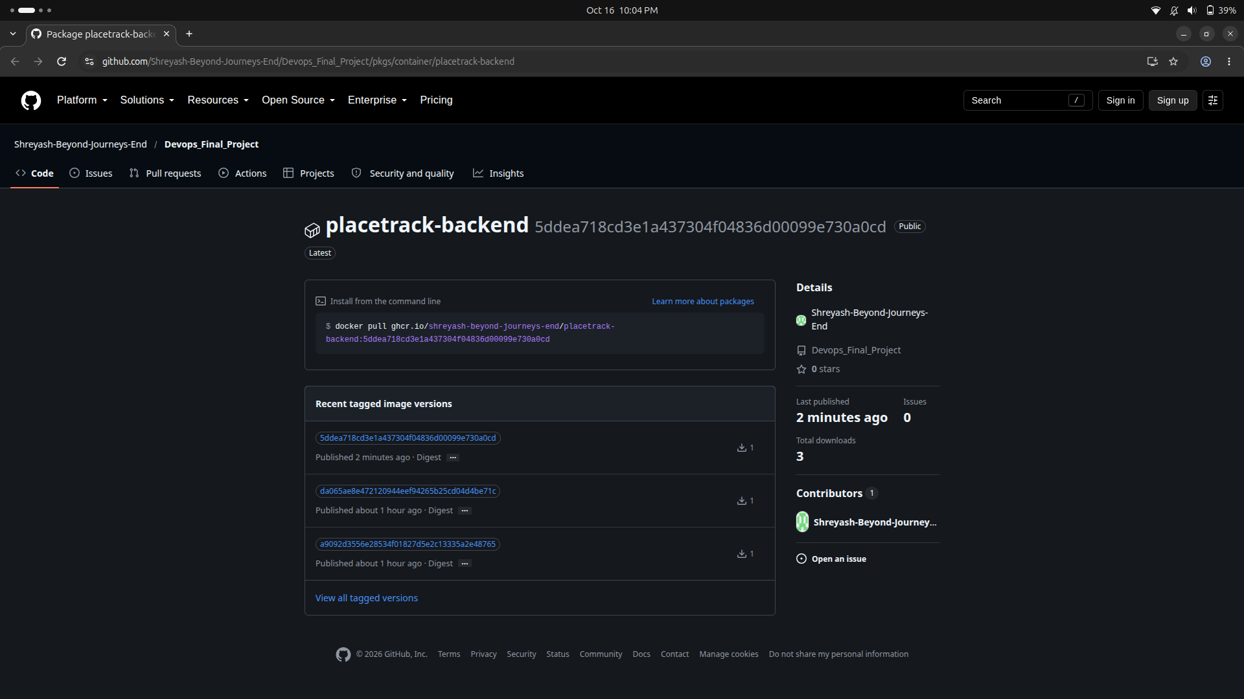
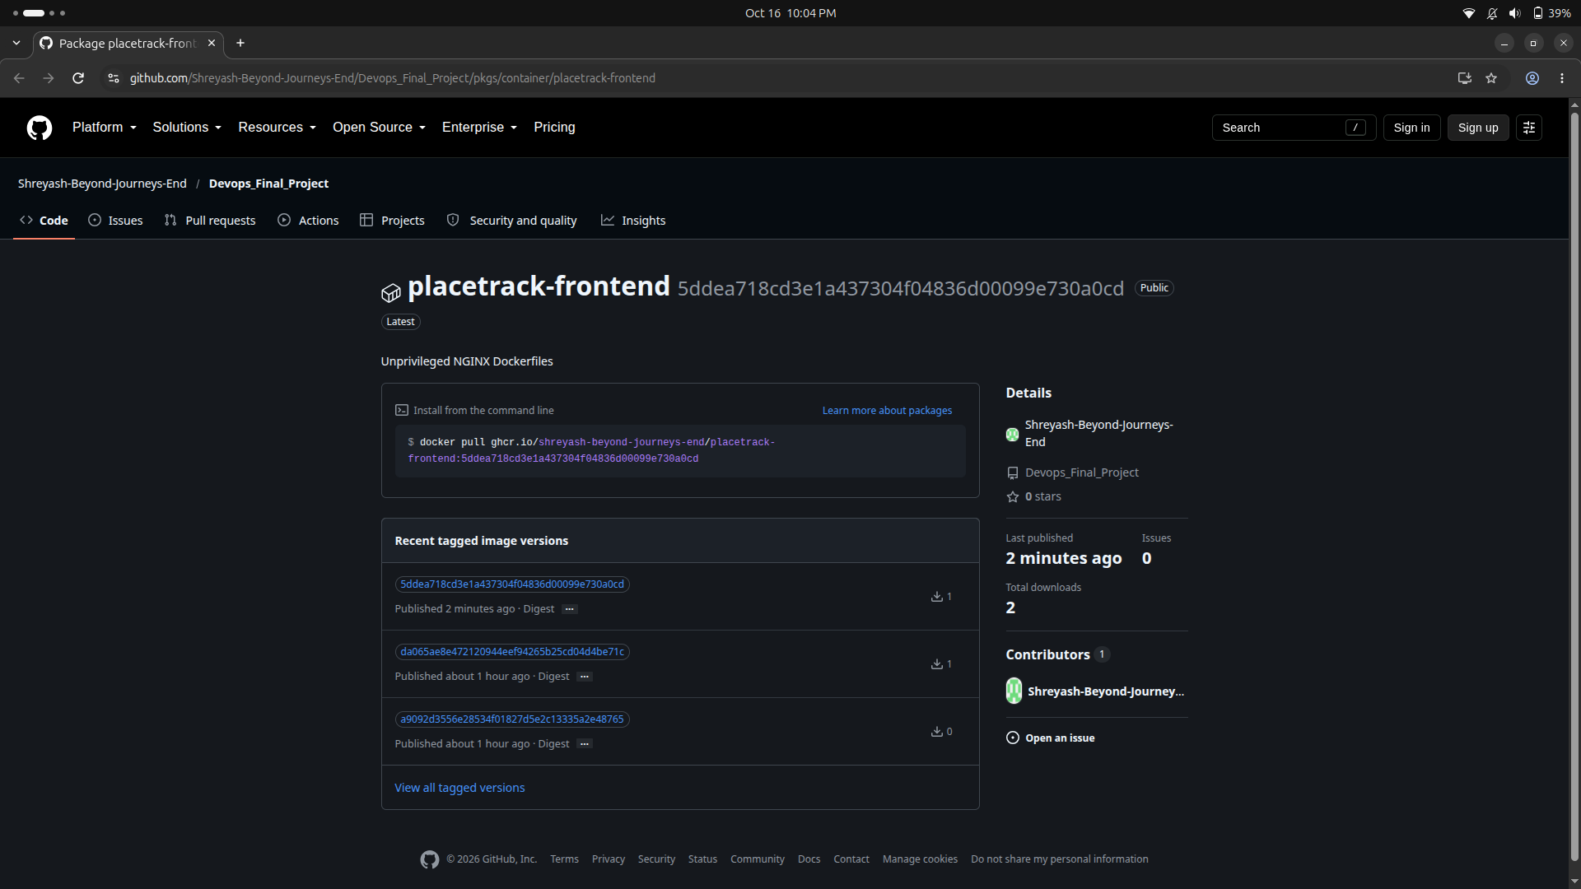
Images in GHCR
Part 2 | M5
Both packages are public. Every version is named by its commit SHA, never latest.
backend package
frontend package
12

Slide 13
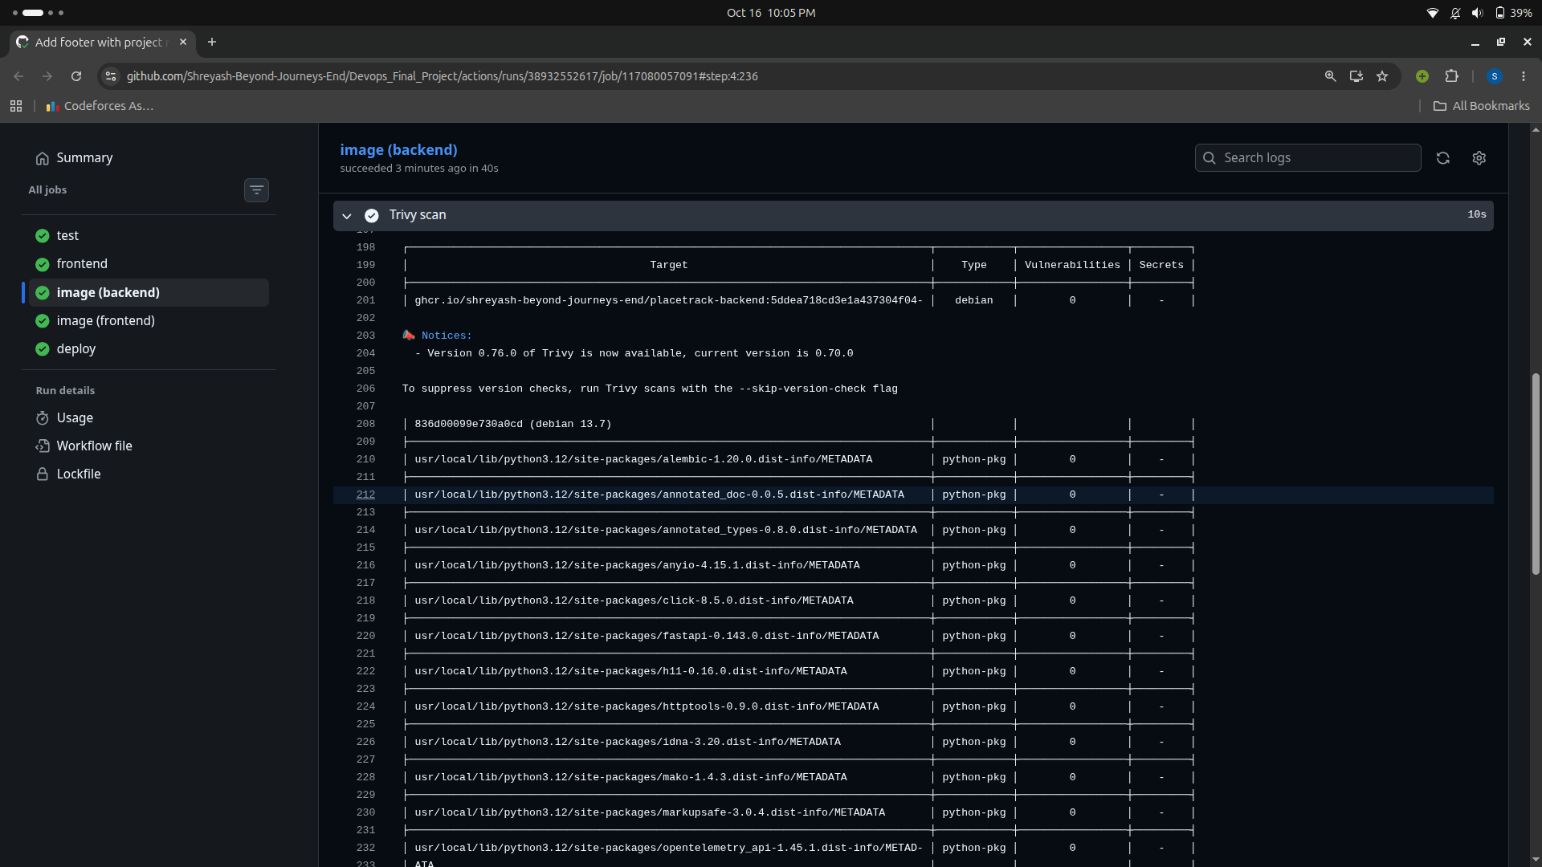
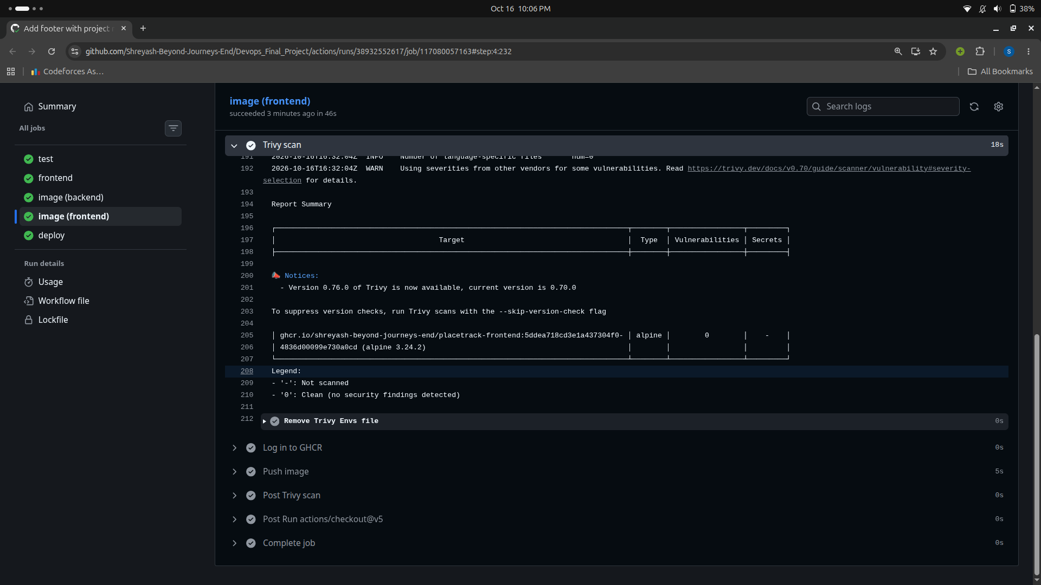
Trivy scan
Part 2 | M6
Runs after build, before push. HIGH/CRITICAL with a fix = pipeline fails. My result: 0 in both images.
backend: Debian 13.7 + Python packages
frontend: Alpine 3.24.2
13

Slide 14
PART 3
Cloud and Kubernetes
Terraform on AWS, then Helm on minikube

Slide 15
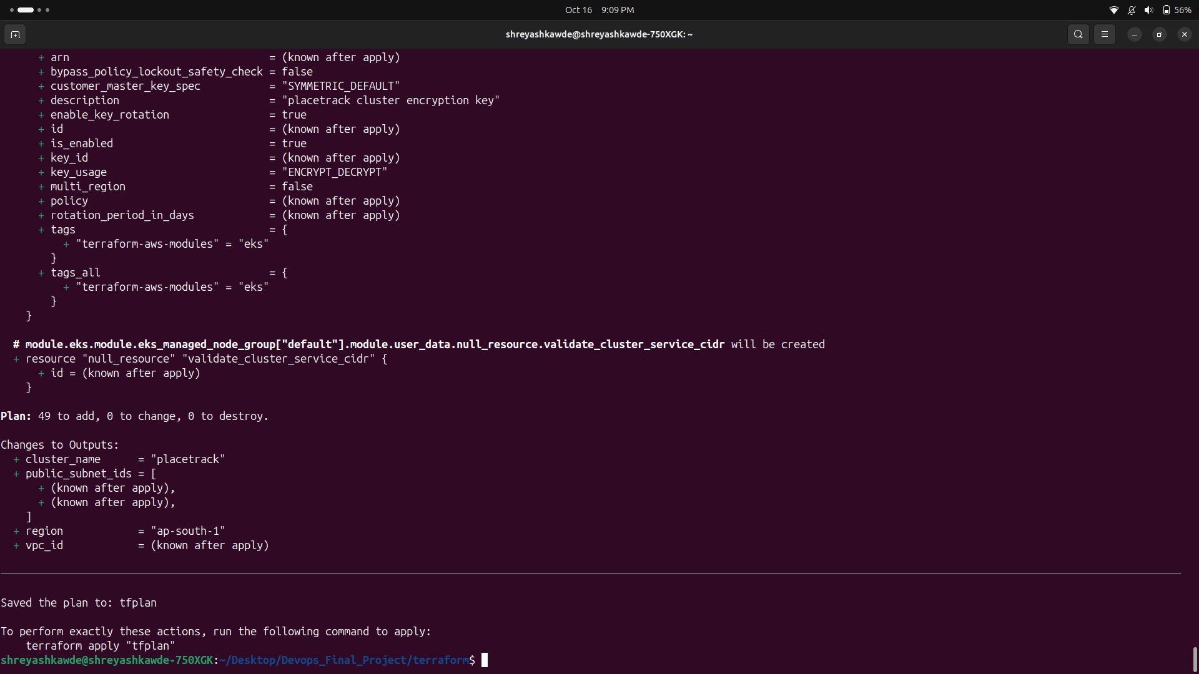
Terraform
Part 3 | M7
What it creates
- ap-south-1 (Mumbai)
- VPC with 2 public subnets
- EKS 1.35, 2 x t3.small nodes
- No NAT gateway, cheaper
- API only open to my IP
- Only tfvars.example is in git
terraform plan: 49 to add
15

Slide 16
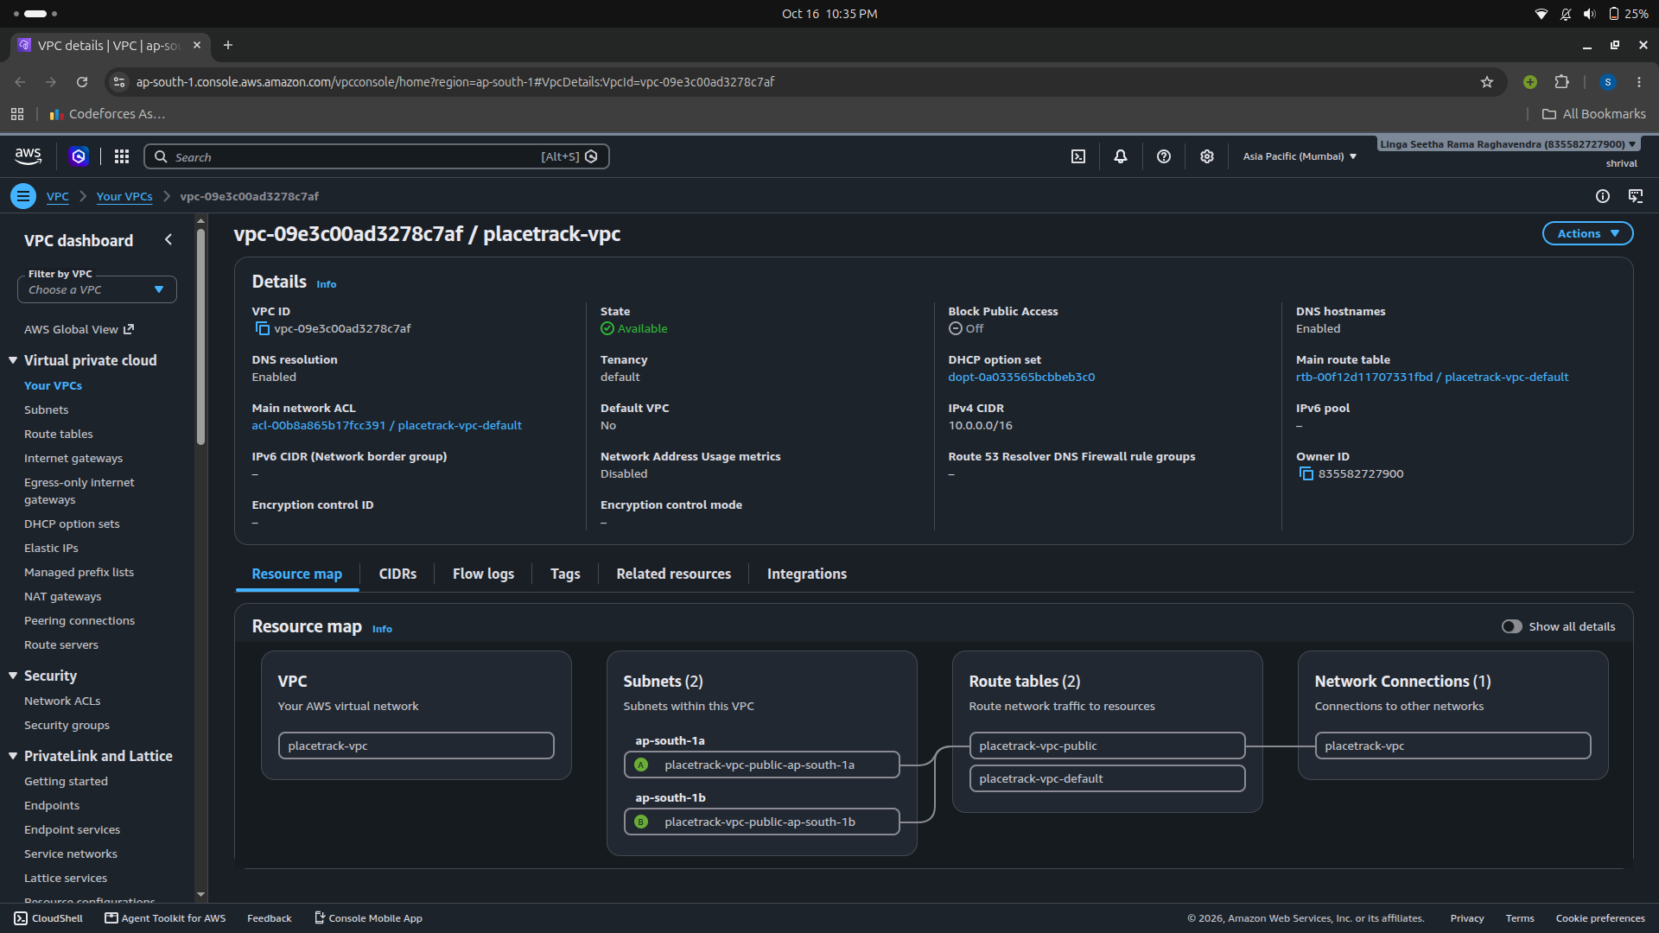
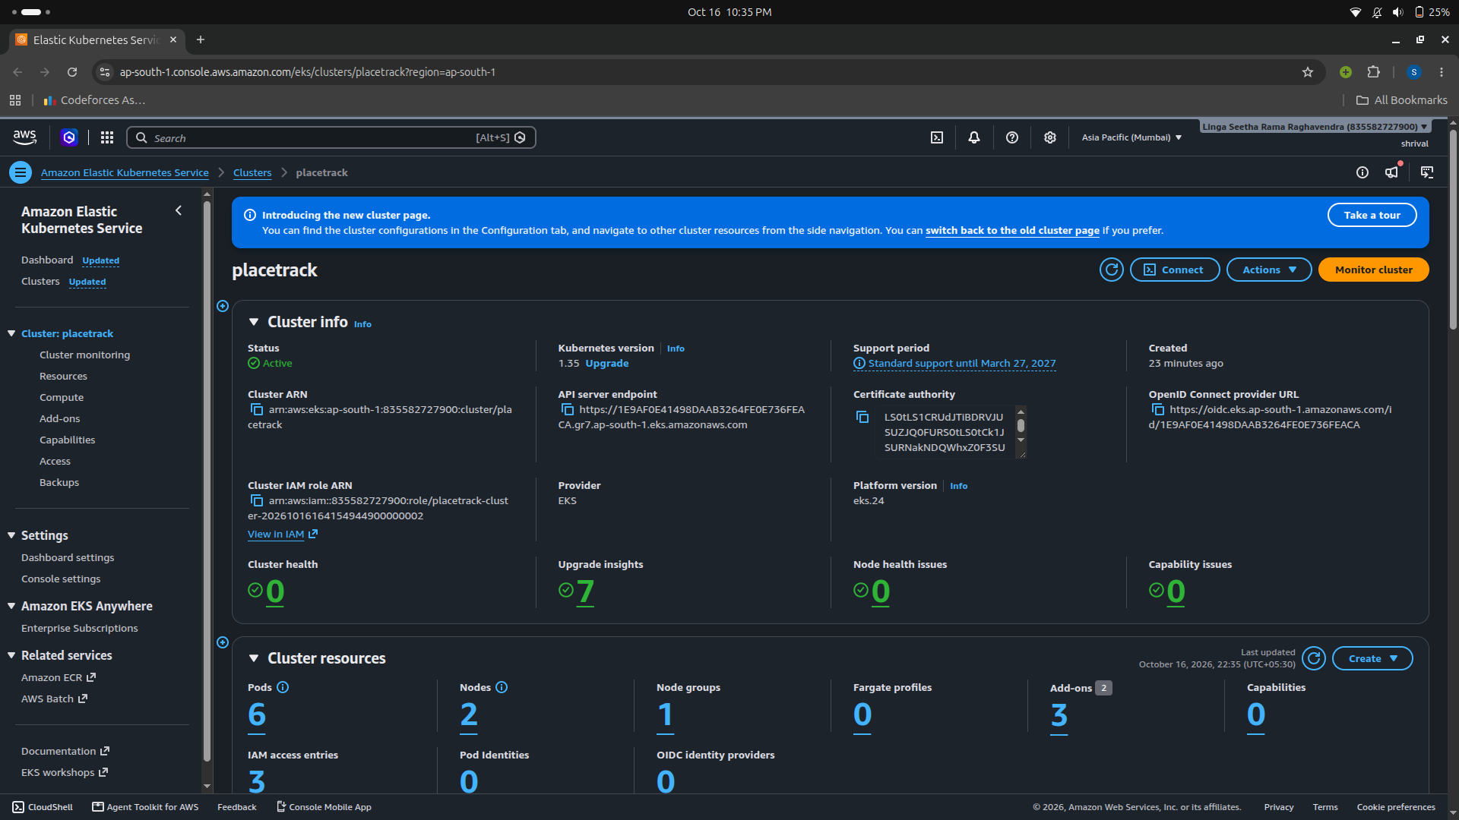
Checked in the AWS console
Part 3 | M7
After terraform apply:
VPC with its 2 public subnets
EKS cluster Active
16

Slide 17
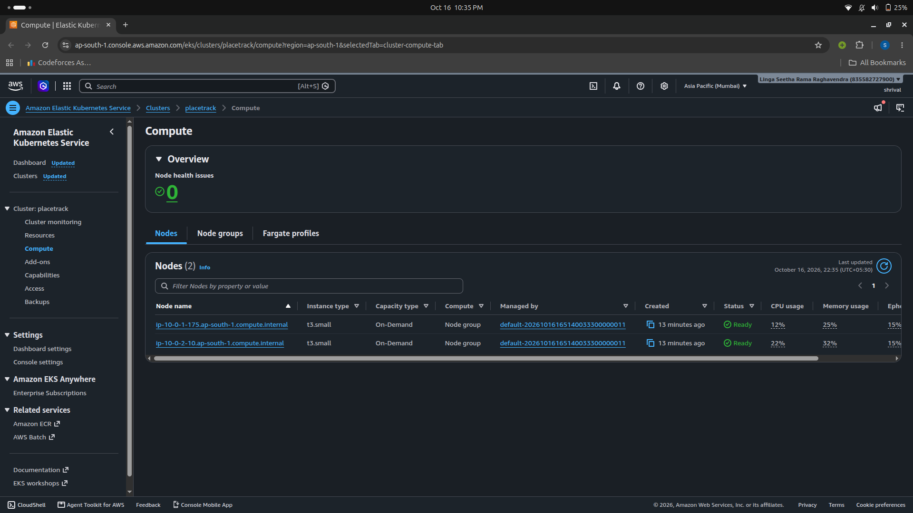
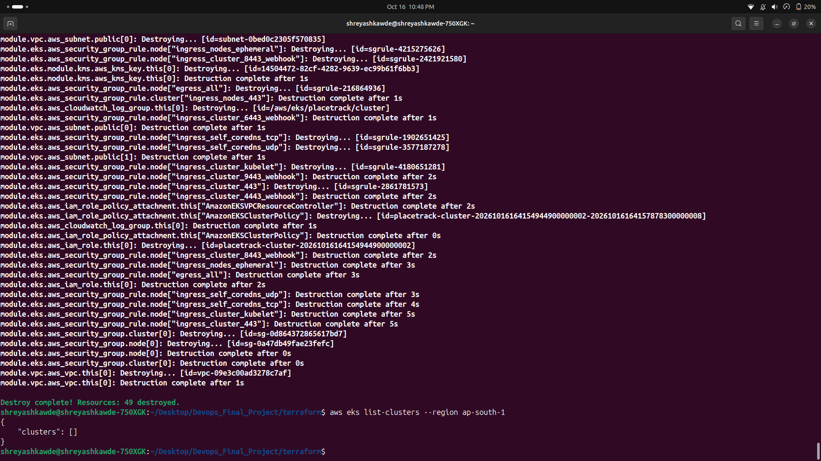
Nodes, then destroy
Part 3 | M7
EKS is paid per hour, so I destroyed it right after checking.
2 nodes Ready
Destroy complete: 49 destroyed
17

Slide 18
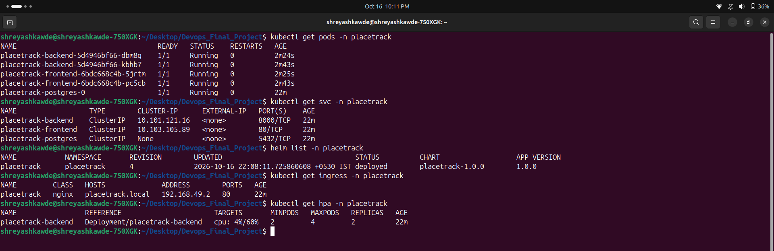
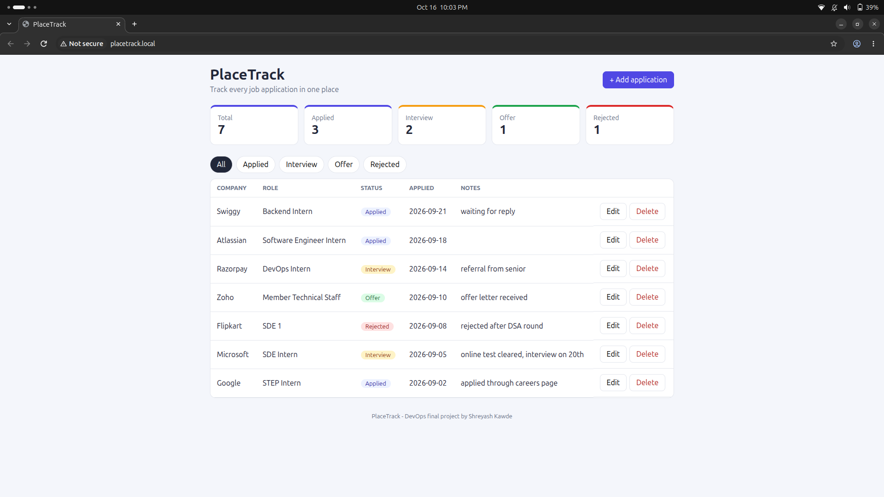
Helm on minikube
Part 3 | M8
Chart: backend + frontend (2 replicas), Postgres, secret, migrate job, ingress (/ and /api), HPA
pods, services, helm list
app at placetrack.local
18

Slide 19
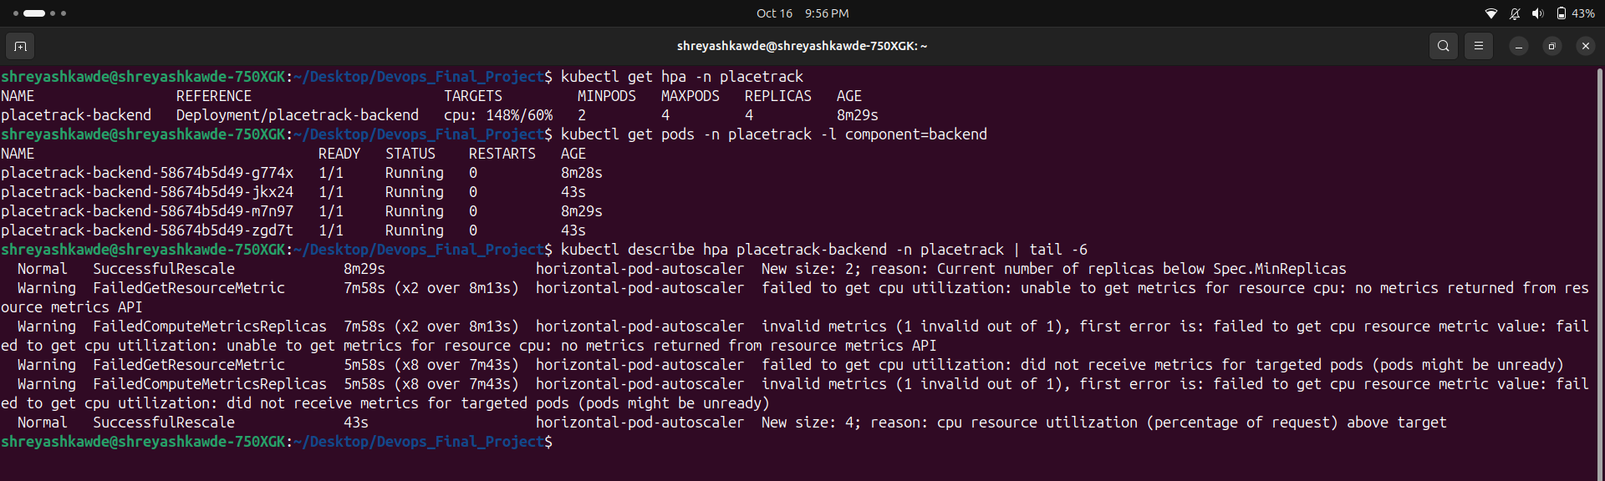
Autoscaling
Part 3 | M8
Load test
- HPA: 2 to 4 pods at 60% CPU
- Ran load-test.sh a few times together
- CPU went to 148%
- Backend went from 2 to 4 pods
HPA event: New size: 4
19

Slide 20
PART 4
Run it
Monitoring, fixing problems and the demo

Slide 21
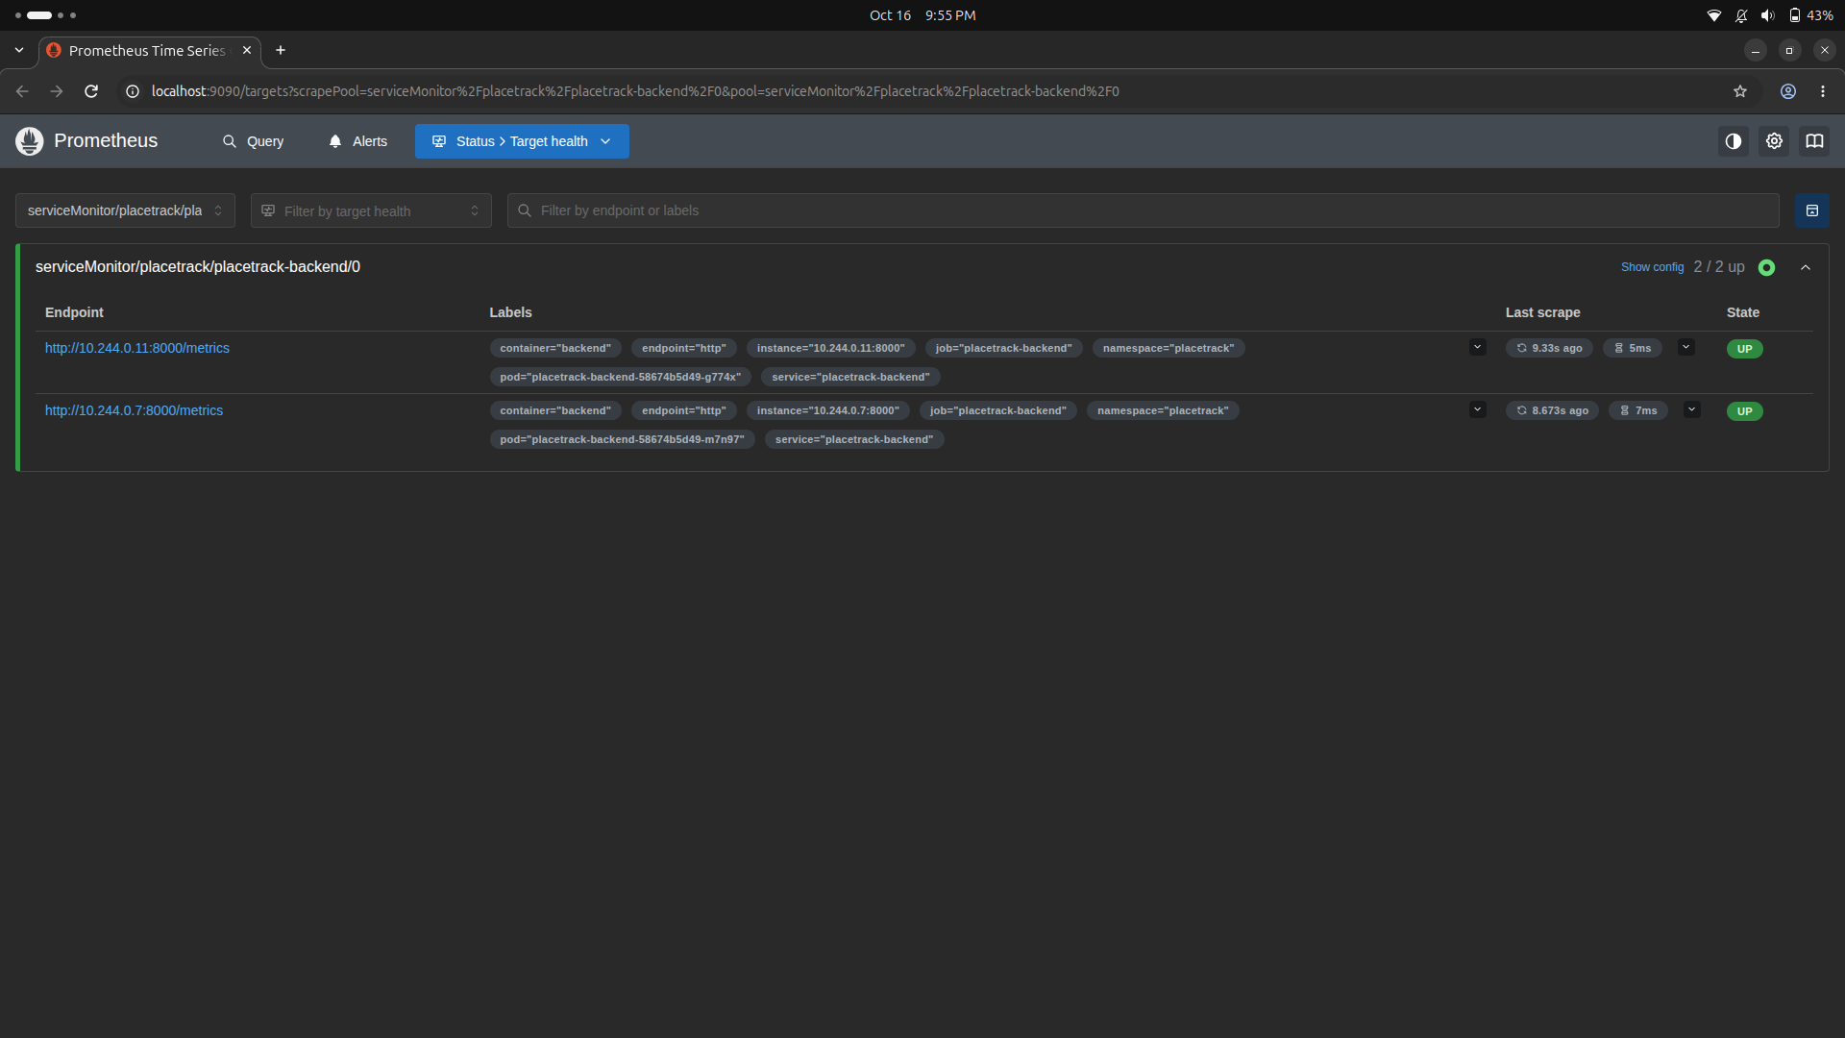
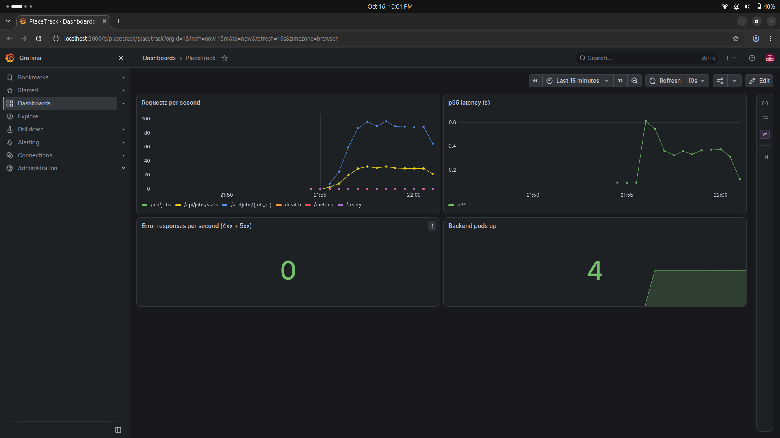
Monitoring
Part 4 | M9
FastAPI /metrics -> ServiceMonitor -> Prometheus -> Grafana dashboard
Prometheus: both backend pods UP
Grafana during the load test
21

Slide 22
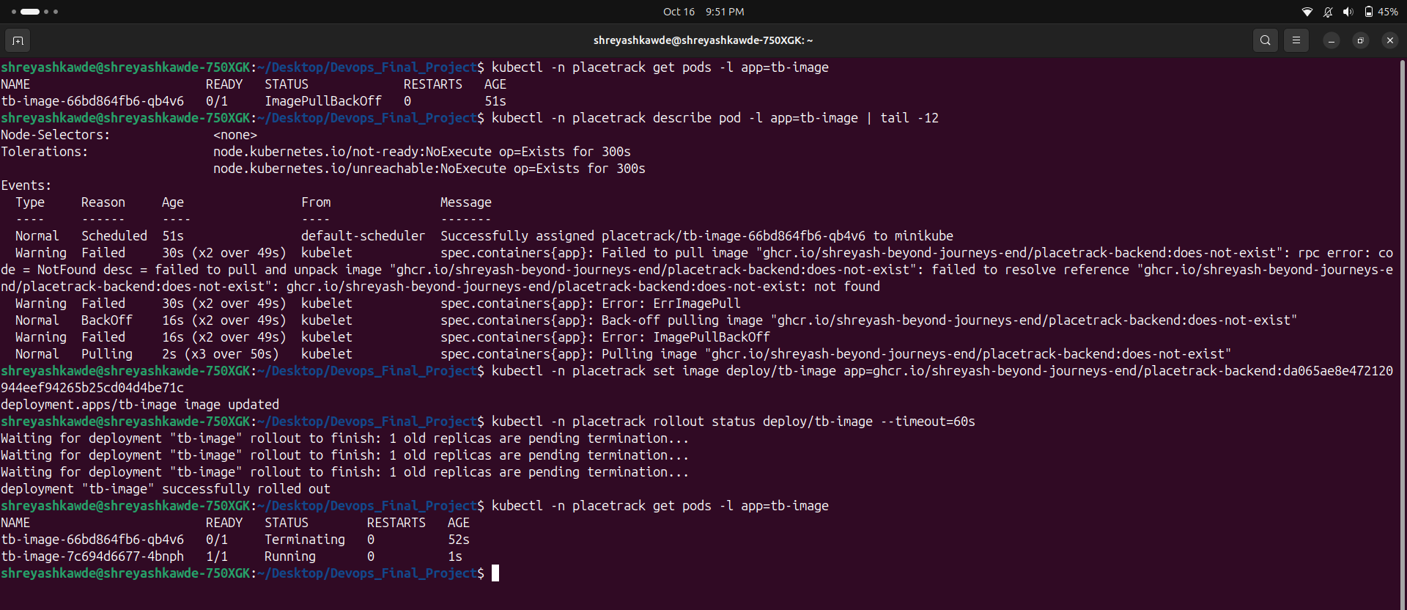
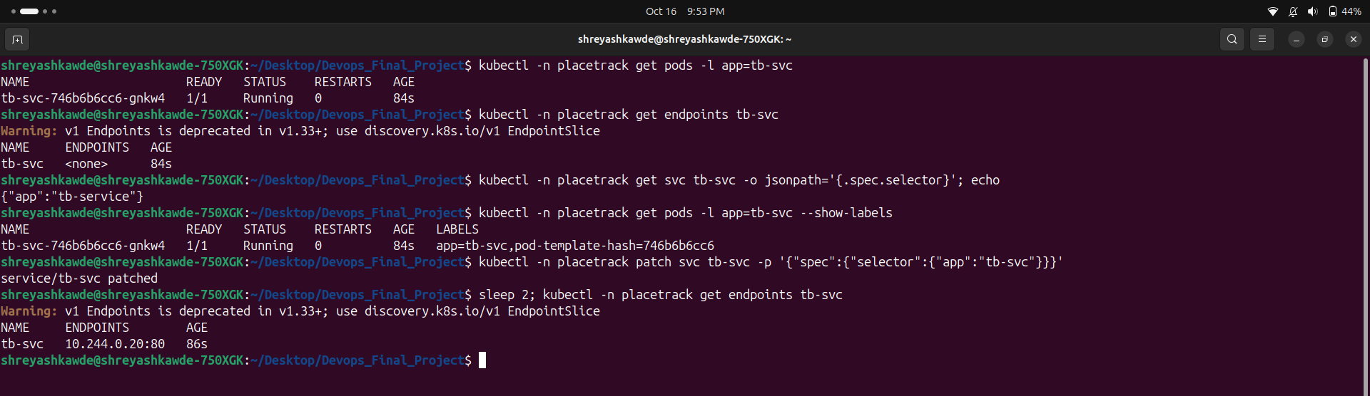
Troubleshooting
Part 4
Broke 2 things on purpose and fixed them with kubectl get / describe / set image / patch
Wrong image tag -> ImagePullBackOff
Wrong selector -> no endpoints
22

Slide 23
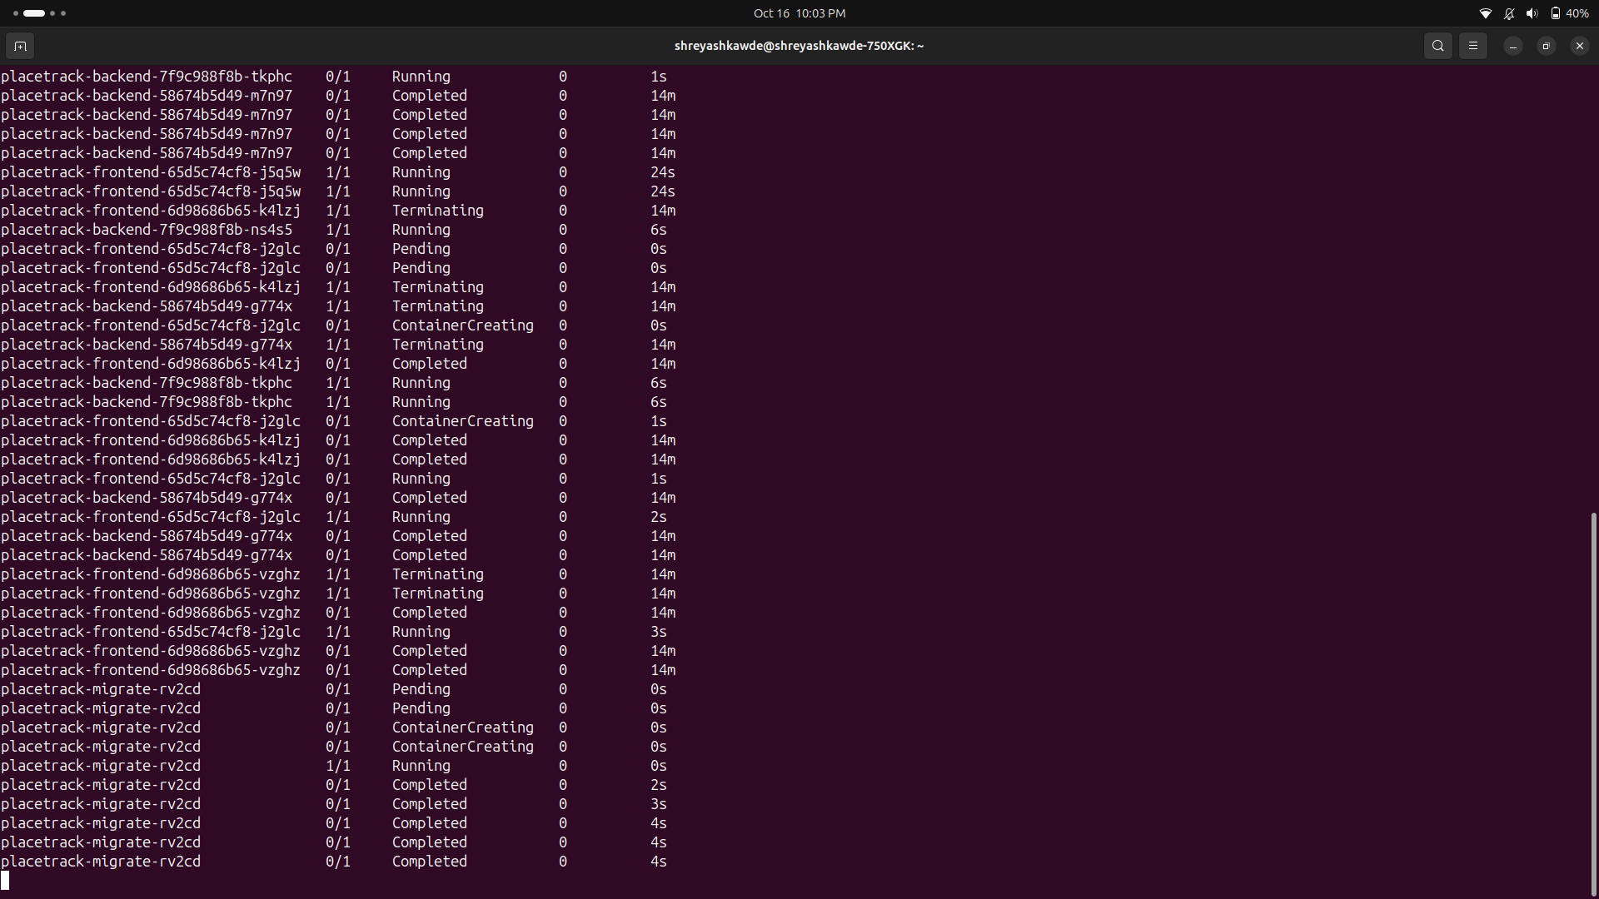
Live demo
Part 4 | M10
1
Change text in App.jsx
2
git commit + git push
3
Actions: test, build, Trivy, push
4
Deploy job: helm upgrade with new SHA
5
kubectl get pods -w
6
Refresh browser
Practice run: new pods start, old pods stop
23

Slide 24
What I learned
Problems I hit
Takeaways
- nginx 502 until I used the full service DNS name
- Pods Running but not Ready until Postgres was up
- DB password secret has to survive helm uninstall
- Old GitHub actions gave a Node 20 warning
- One load test was not enough for the HPA
- Working build is not the same as secure build
- SHA tags tell me exactly what is running
- Readiness and liveness are different
- Helm makes redeploy one command
- Always destroy cloud resources after use
24

Slide 25
Thank you
Questions?
Shreyash Kawde | github.com/Shreyash-Beyond-Journeys-End/Devops_Final_Project

