Slide 1
INTRODUCTION
CropScope
Selected-area weather, Sentinel-2 vegetation data and evidence-backed field checks
Shreyash Shukla
Parth Parekh
23BCP089
23BCP083
Minor project demo | 30 October 2026
Notes:
Introduce CropScope as a decision-support prototype. Weather, NDVI and rule-based checks were exercised live; the Gemini live call is pending a local API key.

Slide 2
PROBLEM & MOTIVATION
02
The decision gap for farmers
Current challenge
Project response
Weather forecasts describe conditions around a farm, but they do not show whether vegetation in a particular plot is changing.
Combine a recent vegetation observation with upcoming weather and the user’s crop information.
Satellite images can reveal vegetation patterns, but an image alone does not tell a farmer what to check next.
Turn those inputs into concise recommendations that show the supporting evidence and its date.
Goal: useful decision support for one selected plot, without requiring IoT hardware.
Notes:
The project does not claim to replace farmer judgment or provide verified diagnosis. Scope excludes IoT sensors.

Slide 3
DESIGN & METHODOLOGY
03
From plot information to advice
User input
Weather data
Satellite data
Analysis
AI advice
Plot location
Crop and stage
→
Rain forecast
Temperature
ET₀
→
Sentinel-2 scene
Red + NIR bands
→
Cloud filter
NDVI summary
→
Ranked actions
Reasons + caution
What the user sees
A dated weather summary, a vegetation indicator, and recommended next steps linked to those inputs.
Notes:
A user can draw or enter a rectangle anywhere within the supported analysis size. Weather and satellite observations are independent inputs. Code proposes checks; Gemini can rank them when configured.
Source: https://open-meteo.com/en/docs
Source: https://github.com/Element84/earth-search

Slide 4
DESIGN & METHODOLOGY
04
How the input data are processed
Weather
Satellite imagery
Open-Meteo supplies a seven-day forecast for the plot coordinates.
Earth Search locates a recent, low-cloud Sentinel-2 scene for the same area.
The app extracts daily rainfall, maximum temperature and reference evapotranspiration (ET₀).
The app crops the selected area, removes cloudy pixels and computes NDVI from red and near-infrared bands.
NDVI = (NIR − Red) / (NIR + Red)
NDVI is a vegetation indicator, not a disease diagnosis.
Notes:
Use Sentinel-2 Level-2A red band B04 and near-infrared band B08. Show acquisition dates and the share of usable pixels. ET₀ is reference evapotranspiration, not measured soil moisture.
Source: https://open-meteo.com/en/docs
Source: https://earth-search.aws.element84.com/v1/api.html

Slide 5
DESIGN & METHODOLOGY
05
How recommendations are selected
Code prepares candidates
Ranking and validation
Crop and growth stage
Dated weather observations
NDVI and usable-pixel share
Safe field checks with evidence IDs
Gemini selects action and evidence IDs
Code rejects unsupported selections
A rule-based fallback works offline
Displayed wording comes from code
Example decision
When rain is scarce and reference ET₀ is high, the app suggests checking soil moisture on site.
The live Gemini call awaits a local API key. No exact water or fertilizer dose is proposed.
Notes:
The current live demo uses the rule-based fallback. Gemini ranking is implemented and unit-tested, but a successful live call awaits a locally configured API key. The model may only select action and evidence IDs; displayed advice is code-controlled.
Source: https://ai.google.dev/api/generate-content

Slide 6
IMPLEMENTATION & TECHNICAL DETAILS
06
A small Python application
Component
Tool
Responsibility
Interface
Streamlit
Plot inputs and results page
Weather
Open-Meteo API
Forecast request and validation
Imagery
Earth Search + rasterio
Scene search, plot crop and NDVI
AI
Gemini API
Validated ranking when configured
Reliability
Local dated cache
Repeatable classroom demonstration
The API key will be kept in a local environment variable, outside the project code.
Notes:
The Python app uses app.py, weather.py, satellite.py, recommendations.py, ai.py, analysis.py and cache.py. The key is never stored in source code.
Source: https://open-meteo.com/en/docs
Source: https://github.com/Element84/earth-search
Source: https://ai.google.dev/api/generate-content

Slide 7
IMPLEMENTATION & TECHNICAL DETAILS
07
Implemented checks and remaining gate
Complete
Draw or enter a rectangle; fetch its seven-day forecast
Complete
Search Sentinel-2 by rectangle and show scene provenance
Complete
Mask clouds and calculate NDVI for usable pixels
Complete
Show evidence-backed checks and test failure paths
Pending
Complete one live Gemini call with a local API key
Completion check
Three distinct regions returned live weather and satellite results. The fallback needs no key.
Notes:
Live checks on 30 October 2026 covered India, France and Australia. Weather-only, satellite-only, neither-source and same-area cache paths also have automated tests.

Slide 8
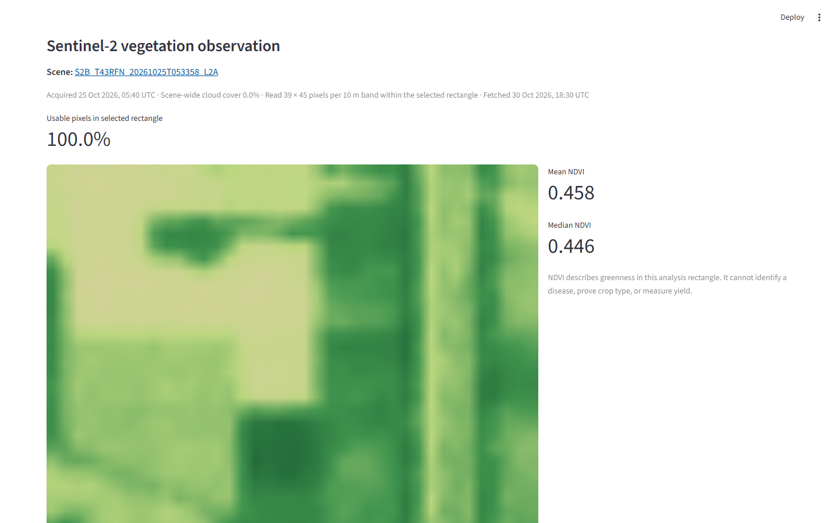
RESULTS / DEMO
08
Karnal live vegetation result
Karnal, India
Mean NDVI 0.458
Usable pixels 100%
Scene acquired
25 Oct 2026
Live fetch
30 Oct 2026
Three regions checked live: India, France and Australia.
Notes:
Screenshot from a live CropScope analysis of the exact Karnal example rectangle on 30 October 2026. Mean NDVI 0.458498; 100% usable pixels; Sentinel-2 scene S2B_T43RFN_20261025T053358_L2A. Weather forecast dates 30 October through 5 November. The recommendation view used the labeled rule-based fallback because no Gemini key was configured. Sources: Open-Meteo, Element 84 Earth Search, Copernicus Sentinel-2.
Source: https://earth-search.aws.element84.com/v1/collections/sentinel-2-c1-l2a/items/S2B_T43RFN_20261025T053358_L2A
Source: https://open-meteo.com/en/docs

Slide 9
CONCLUSION
09
What CropScope does now
A focused decision-support prototype
It combines a seven-day forecast with a dated satellite vegetation observation for a user-selected rectangle.
It shows evidence-linked checks, with a rule-based fallback when Gemini is unavailable.
The live Gemini acceptance check remains after a local API key is configured.
Notes:
The prototype remains decision support. The model ranking is implemented and tested with mocked responses, but has not yet been exercised live.

Slide 10
Q&A
Questions?
Discussion topics
Data sources and freshness
NDVI interpretation and cloud limits
How AI uses the observations
Shreyash Shukla · 23BCP089
Parth Parekh · 23BCP083
Notes:
Invite questions. The live weather and satellite paths ran for three areas on 30 October 2026. The Gemini live call awaits a local key.

