Slide 1

Game Recommendation System
Submitted by:
Amogh Sharma(230343025004)
Akshay Anandkar(230343025006)
Guided by: Anushman Purohit(230343025007)
Prof. Anay Tamhankar Shreyash Patil(230343025038)
Prof. Prasad Deshmukh Sourabh Sarnobat(230343025041)

Slide 2
Overview:
1. Introduction
2. About Steam Platform
3. Problem Statement
3. Technologies used
5. About Data
6. Data Pre-processing and ETL
7. Methodology and workflow
8.Using visualization to visualize our dataset
9. Future Scope
10. Conclusion

Slide 3
Introduction
1.The main goal of this project is to recommend games to user by analysis and studying datasets so gaming industry can increase there business profits
2. We collected data from require from Kaggle. To achieve this aim of project, we will first explore data, preprocessing and ETL, recommendation and data visualization.
3. This project can useful for further studies inside advanced research
in machine learning ,deep learning and for real time recommendation.

Slide 4

2. About Steam Platform
What is steam platform ?
Why we need steam platform?
Who is founder of this steam platform?

Slide 5
Problem Statement
Gaming is multibillion markets that are heavily influenced by customer interest. Our Recommendation System will suggest games based on the interest on users. Spark is used to process user data for games retrieved from stream platform. Data visualization and EDA (Expository data analysis) are performed using Power Bi/Tableau.

Slide 6



Technologies used

Slide 7
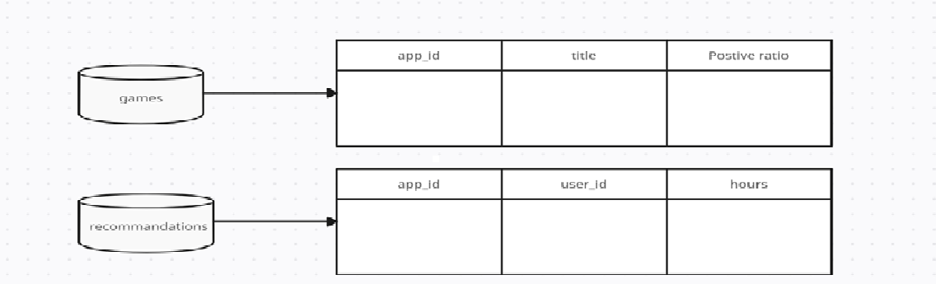
Data
We have about 2 dataset for recommendation:
1. games.csv :- This csv consists of data especially related to games present on Steam. Api. The Data set consists of app_id, title, Release Date, win , mac , Linux , ratings , positive ratio, user reviews, price final, price original and steam deck
2. recommendation.csv :- This data establish a connection games data and users information using both primary key of games data(app_id) and recommendation data(user_id).This Data Consists of app_id, helpful, funny, Date, is_Recommended, hours, user_id and review_id.

Slide 8
Data preprocessing and ETL
Data source :
Dataset downloaded from Kaggle
Data understanding :
Available variables
Relationships
Data Preparation :
Missing values
Redundant variables

Slide 9
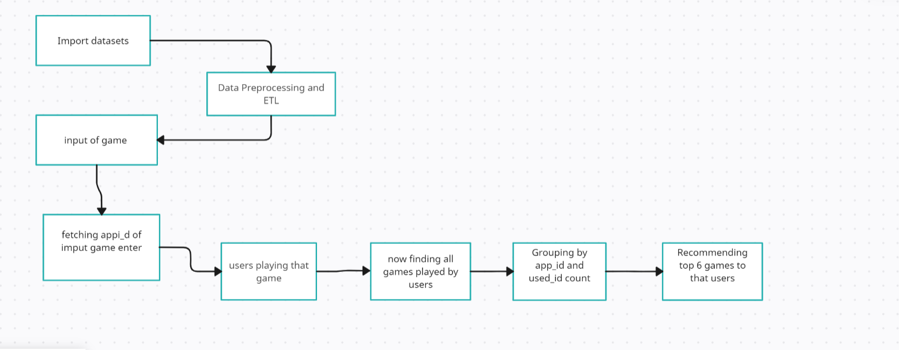
Methodology and workflow

Slide 10
Data Visualization
Why we need visualization?
Communication and Understanding
Data Quality and Anomalies
Market and Competitive Analysis

Slide 11
Git hub Link
https://github.com/Shreyash-p/Game_Recommendation_System_CDAC_Project.git

Slide 12
Future Scope
Integration of User Preferences
Real-time Recommendations
Diversity in Recommendations
Benefit to gaming industry

Slide 13
Conclusion
In the this real world where technology and entertainment intersect, the gaming industry stands as a vibrant playground for innovation and creativity. The journey of this project has illuminated the transformative potential of data science and recommendation systems within this dynamic landscape. By diving into the depths of gaming data, we've ventured beyond the surface to uncover patterns, preferences, and insights that have the power to shape user experiences and redefine engagement

Slide 14
Thank You

